Slide 1
47-4
This work is licensed under a Creative Commons Attribution-ShareAlike 4.0 International License.
Please add this statement to all the videos you create.
English Bible quotes are from the World English Bible US, which is in the public domain.
Notes:
c47 Peter and John Heal Lame Man
1. Peter and John heal lame man - Acts 3:1-26 (Left Top)
2. Peter and John warned - Acts 4:1-31 (Right Top)
3. Believers living in unity/ Ananias and Sapphira - Acts 4:32 – 5:11 (Right
Center)
4. Many Healings – Acts 5:12-16 (Bottom)
5. Apostles arrested – Acts 5:17-42 (Left and Center)

Slide 2
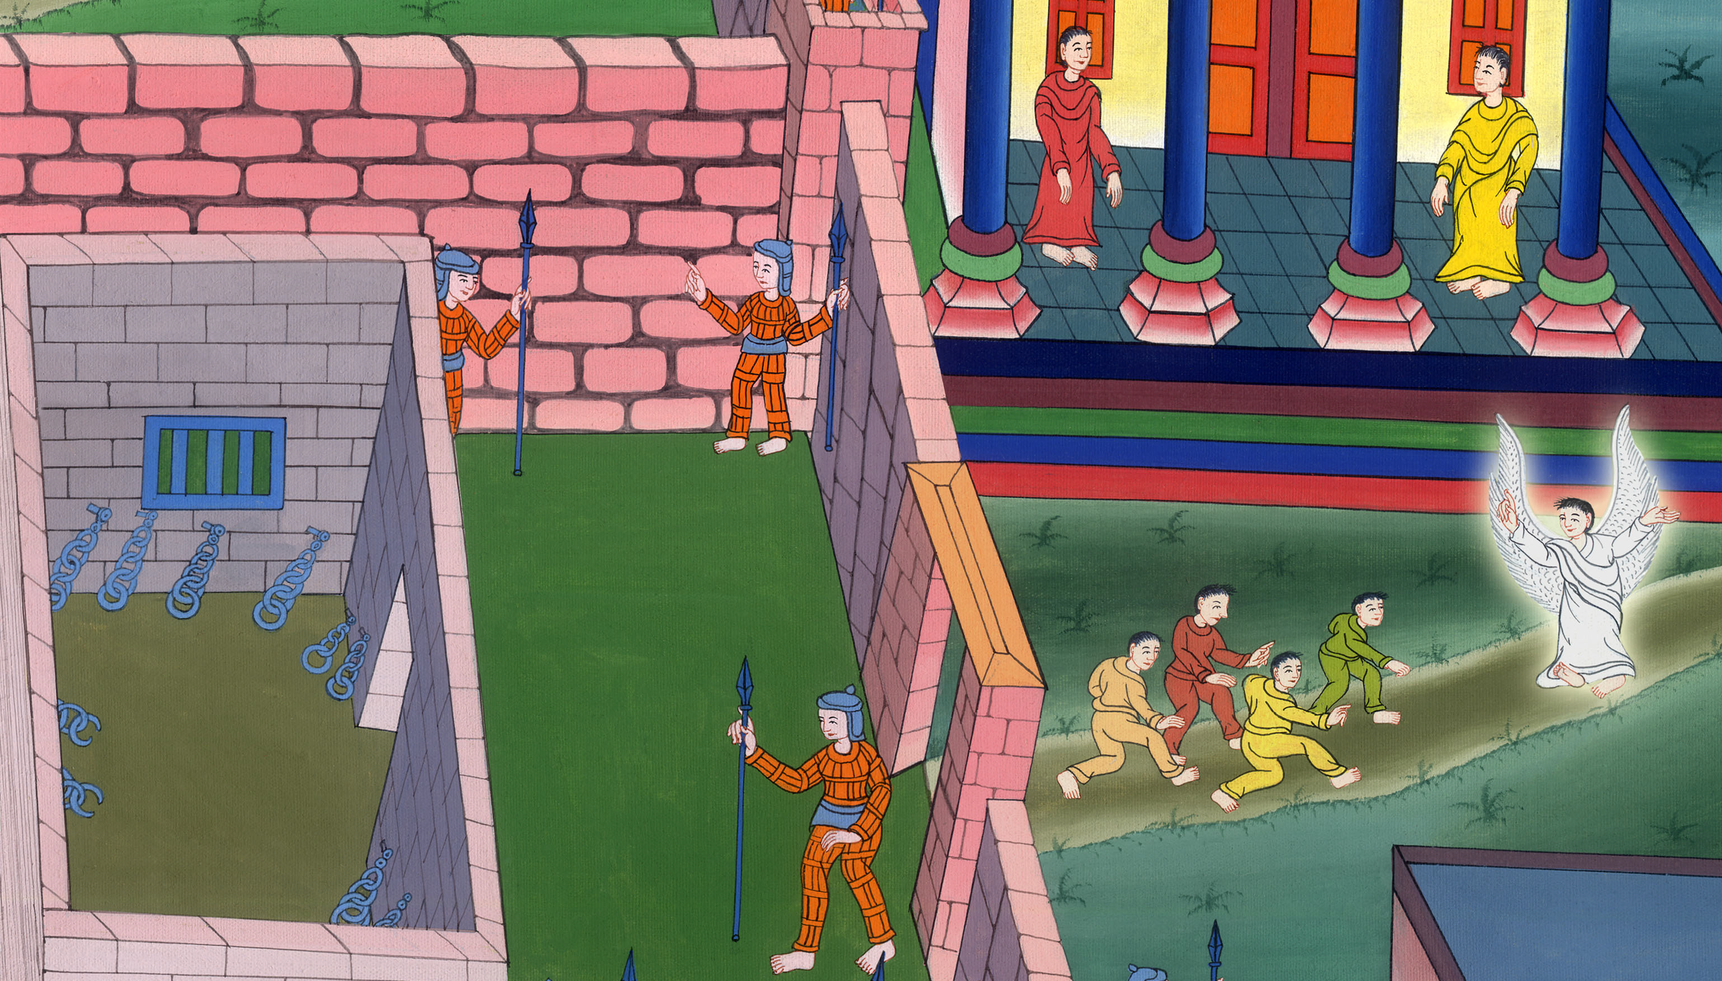
Apostles arrested –
Acts 5:12-42

Slide 3
Apostles arrested – Acts 5:12-42

Slide 4
Apostles arrested –
Acts 5:12-42

Slide 5
12By the hands of the apostles many signs and wonders were done among the people. They were all with one accord in Solomon’s porch. 14More believers were added to the Lord, multitudes of both men and women.

Slide 6
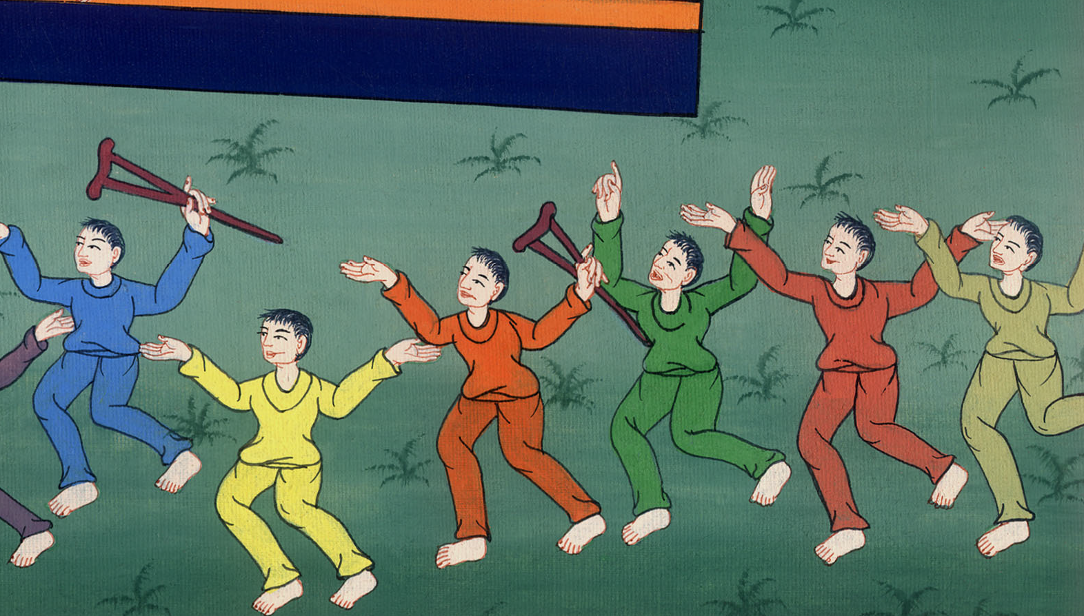
Acts 5:12,14

Slide 7
15They even carried out the sick into the streets and laid them on cots and mattresses, so that as Peter came by, at least his shadow might overshadow some of them.

Slide 8
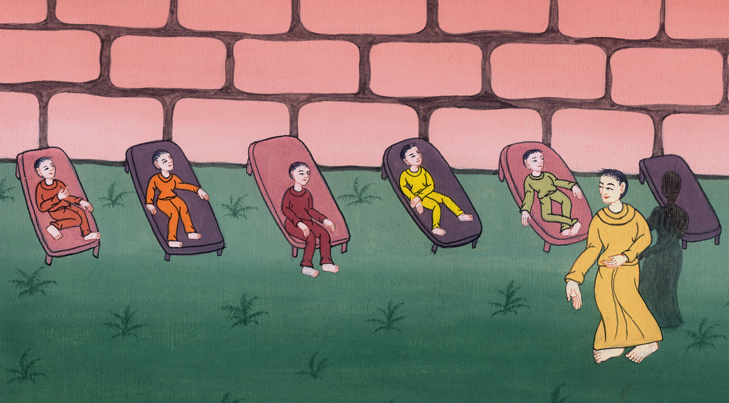
Acts 5:15

Slide 9
16The multitude also came together from the cities around Jerusalem, bringing sick people and those who were tormented by unclean spirits; and they were all healed.

Slide 10
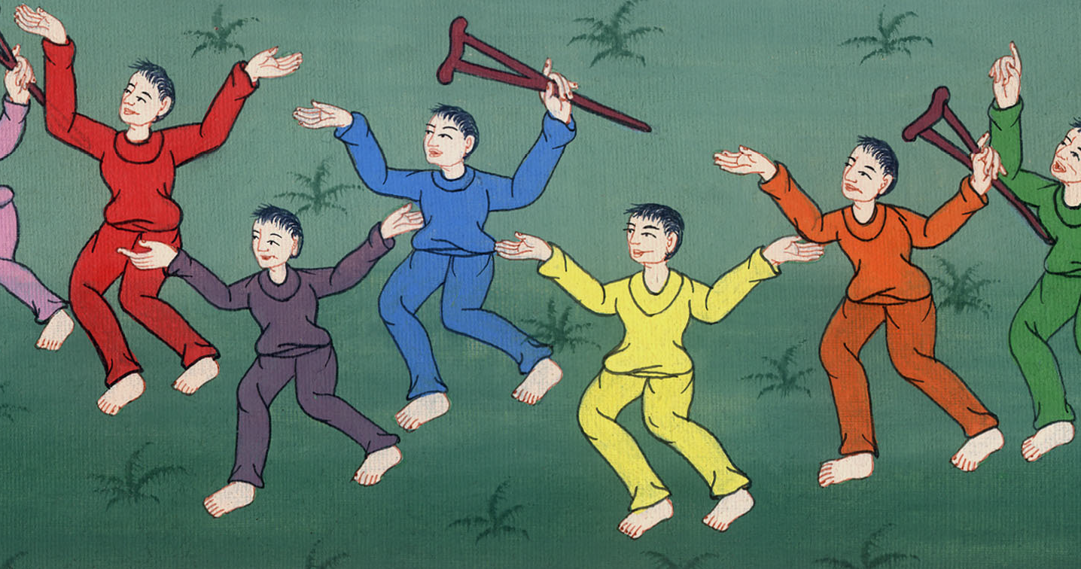
Acts 5:16

Slide 11
17But the high priest rose up, and all those who were with him (which is the sect of the Sadducees), and they were filled with jealousy 18and laid hands on the apostles, then put them in public custody.

Slide 12
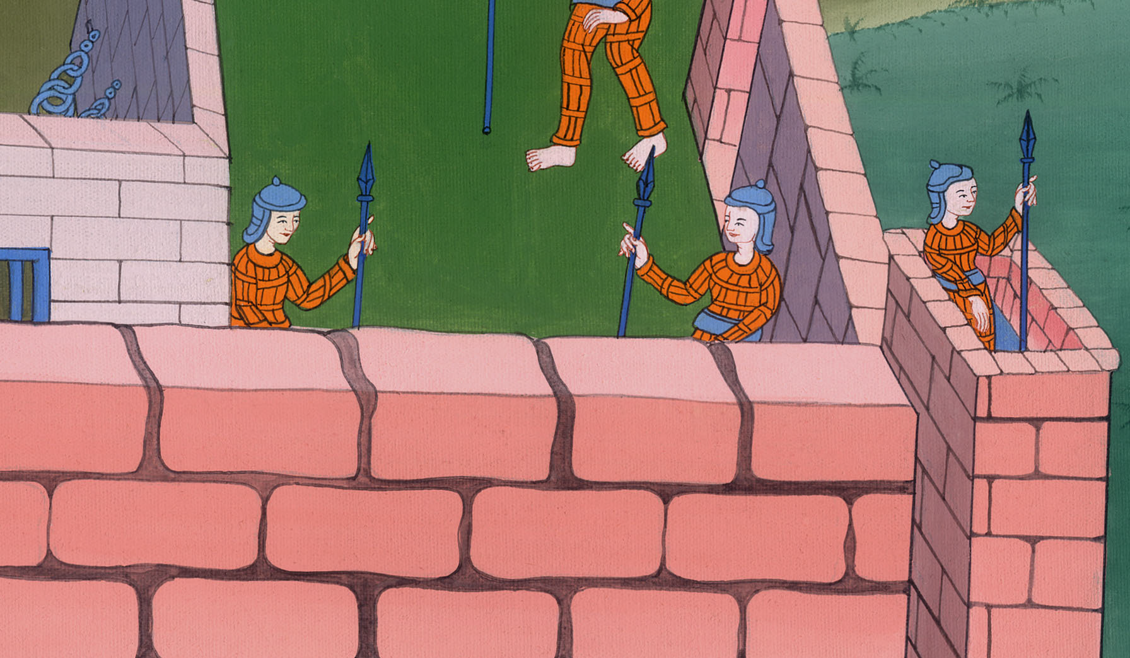
Acts 5:17,18

Slide 13
19But an angel of the Lord opened the prison doors by night, and brought them out and said, 20“Go stand and speak in the temple to the people all the words of this life.”

Slide 14
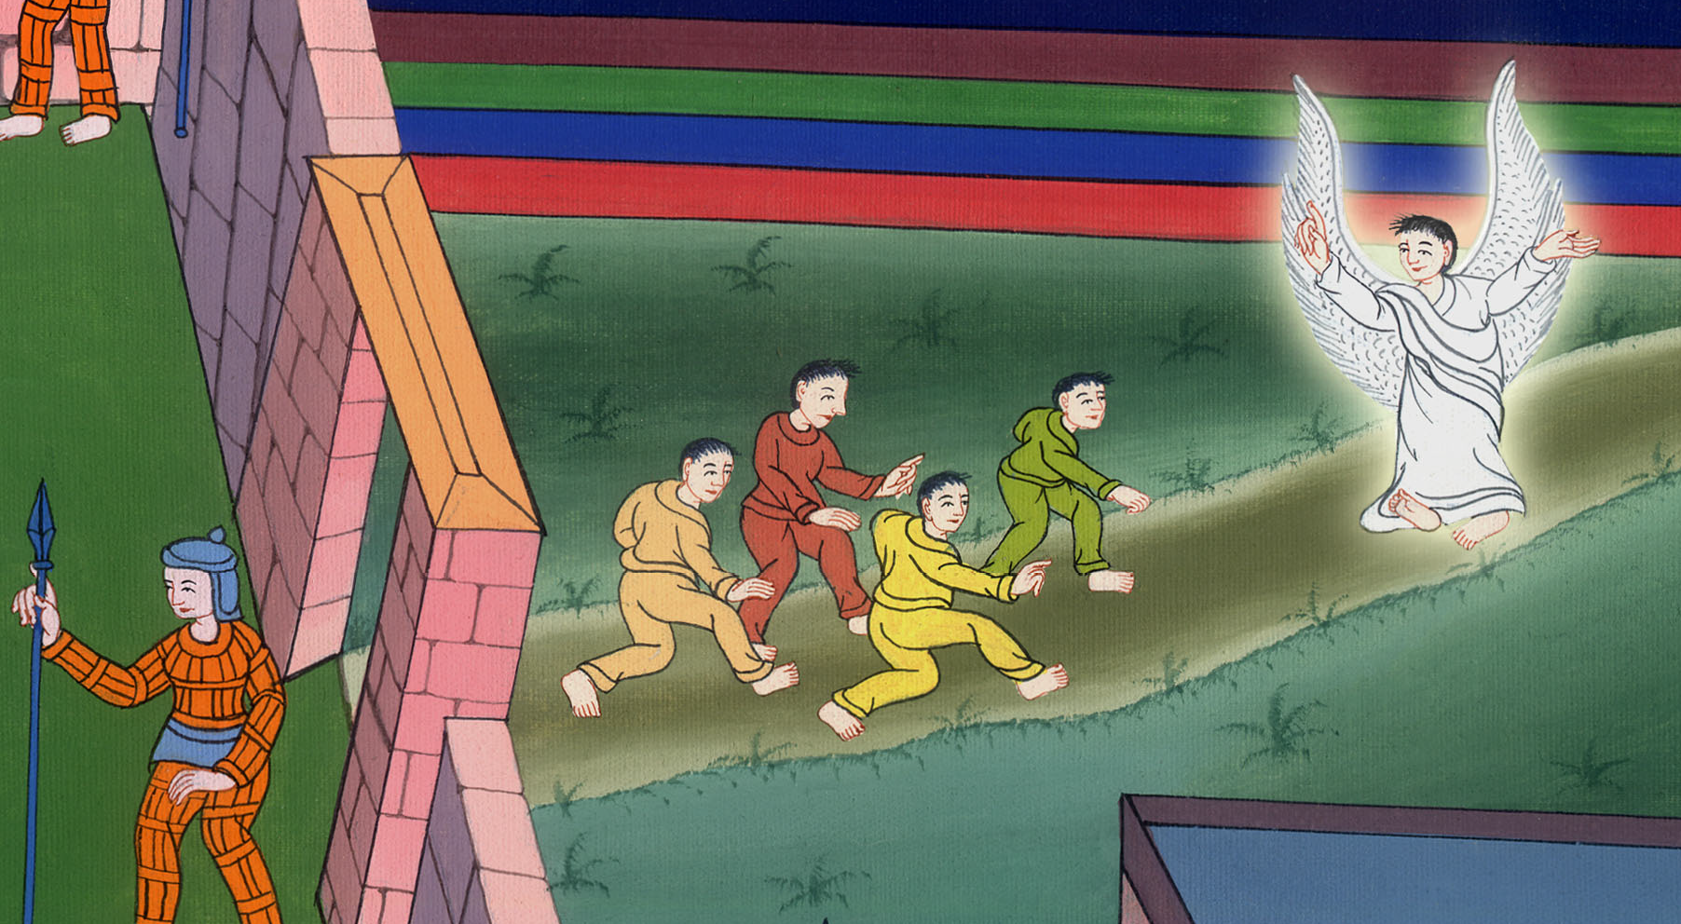
Acts 5:19,20

Slide 15
21When they heard this, they entered into the temple about daybreak and taught.

Slide 16
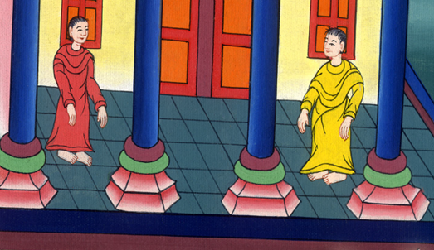
Acts 5:21

Slide 17
But the high priest and those who were with him came and called the council together, with all the senate of the children of Israel, and sent to the prison to have them brought.

Slide 18
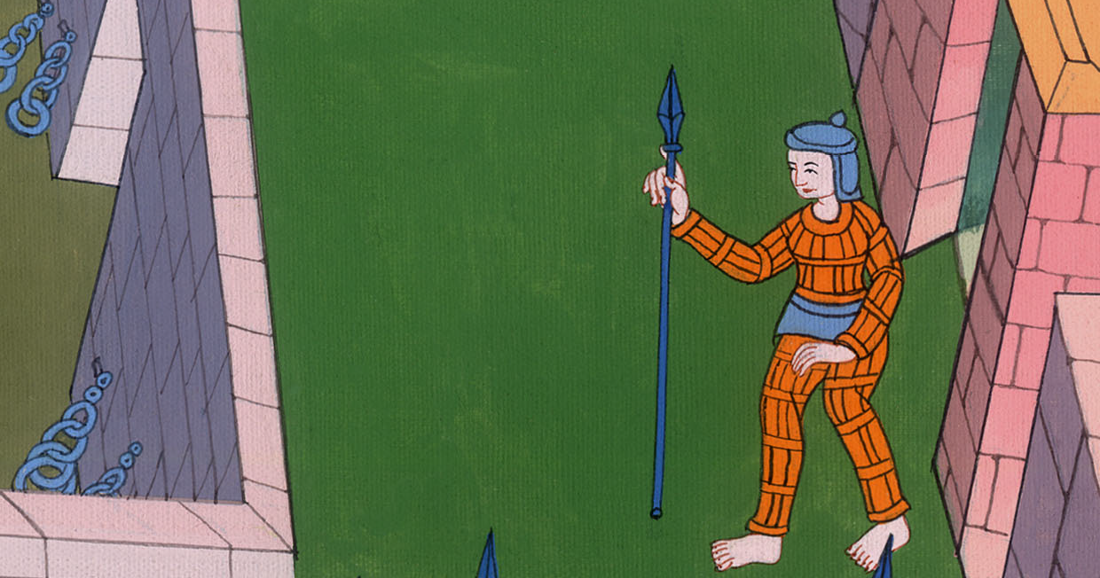
Acts 5:21

Slide 19
22But the officers who came didn’t find them in the prison. They returned and reported,

Slide 20
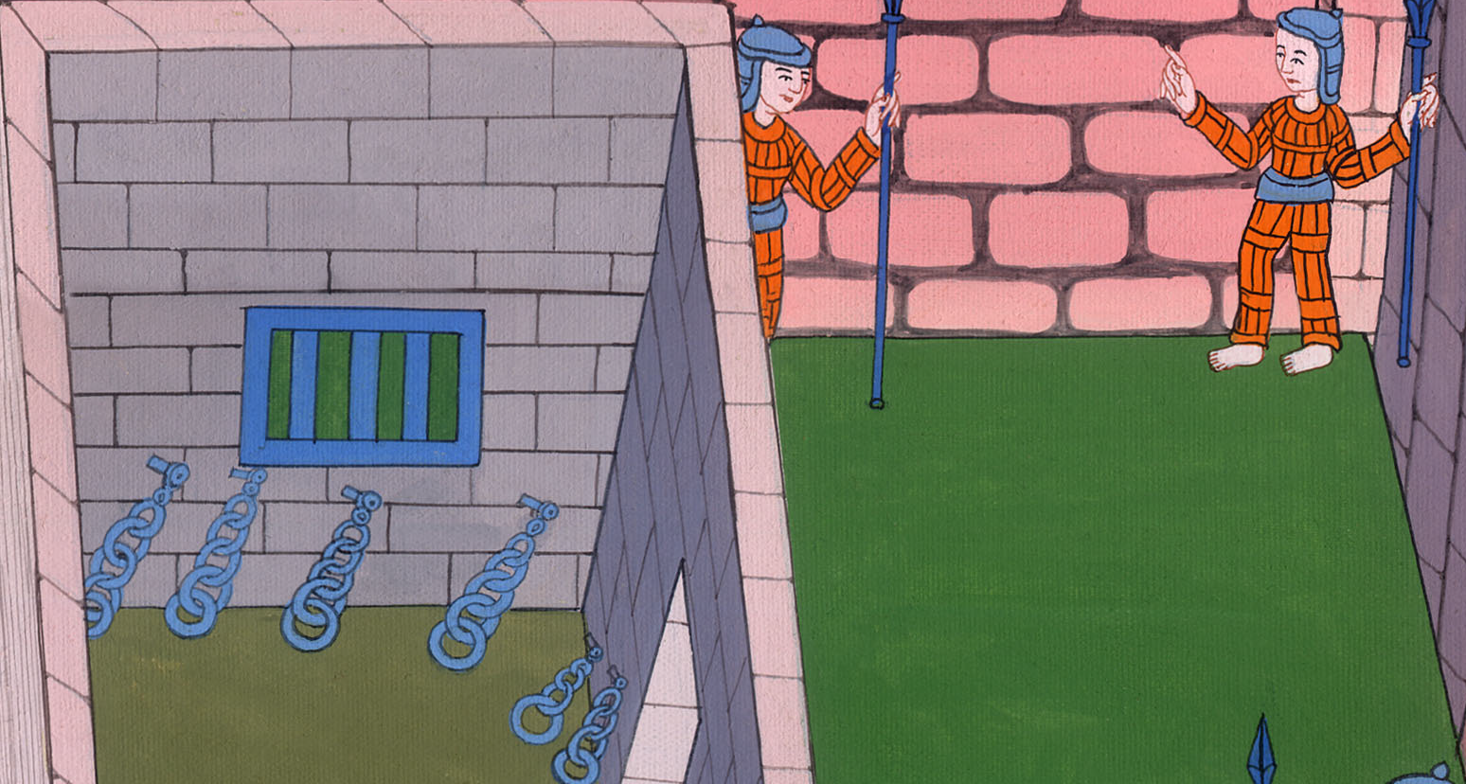
Acts 5:22

Slide 21
23“We found the prison shut and locked, and the guards standing before the doors, but when we opened them, we found no one inside!”

Slide 22
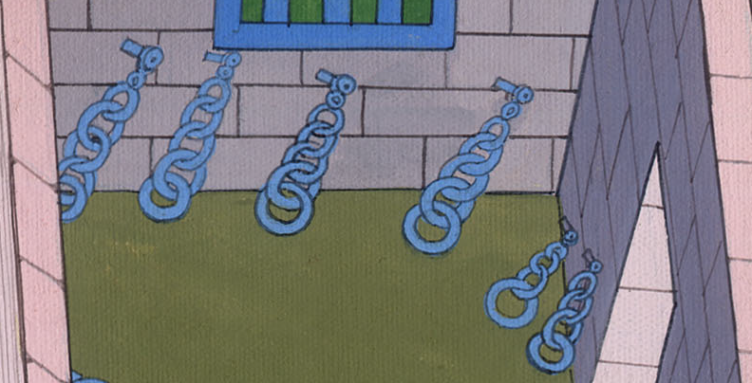
Acts 5:23

Slide 23
24Now when the high priest, the captain of the temple, and the chief priests heard these words, they were very perplexed about them and what might become of this.

Slide 24
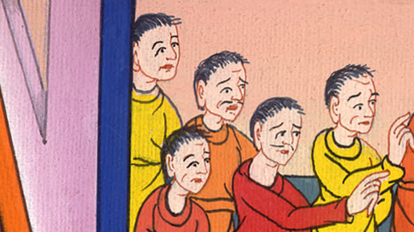
Acts 5:24

Slide 25
25One came and told them, “Behold, the men whom you put in prison are in the temple, standing and teaching the people.”

Slide 26
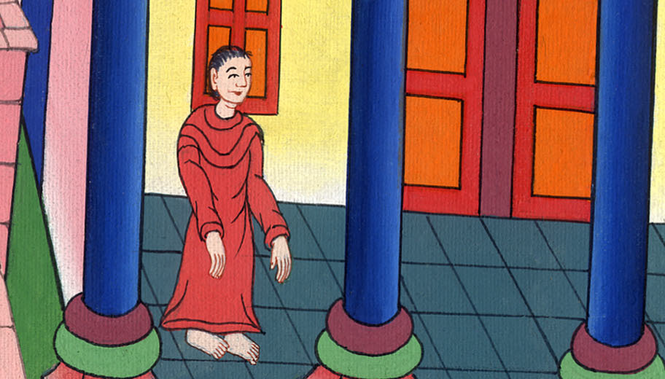
Acts 5:25

Slide 27
26Then the captain went with the officers, and brought them without violence, for they were afraid that the people might stone them.

Slide 28
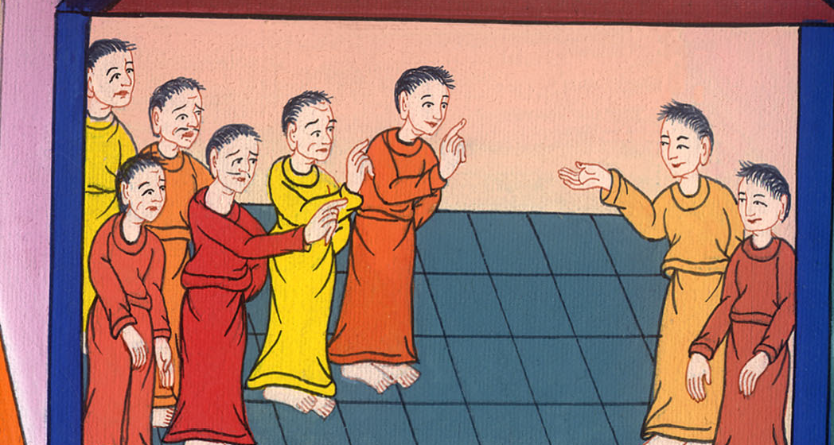
Acts 5:26

Slide 29
27When they had brought them, they set them before the council. The high priest questioned them, 28saying, “Didn’t we strictly command you not to teach in this name? Behold, you have filled Jerusalem with your teaching, and intend to bring this man’s blood on us.”

Slide 30
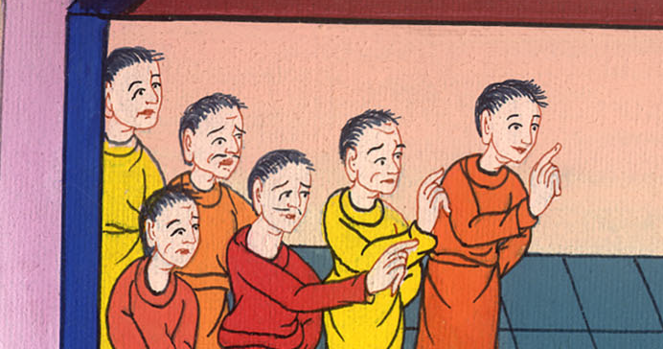
Acts 5:27,28

Slide 31
29But Peter and the apostles answered, “We must obey God rather than men. 30The God of our fathers raised up Jesus, whom you killed, hanging him on a tree.

Slide 32
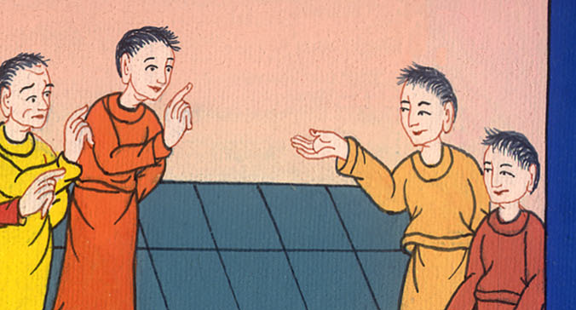
Acts 5:29,30

Slide 33
31God exalted him with his right hand to be a Prince and a Savior, to give repentance to Israel, and remission of sins.

Slide 34
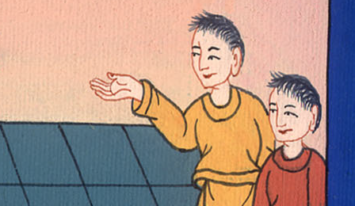
Acts 5:31

Slide 35
32We are his witnesses of these things; and so also is the Holy Spirit, whom God has given to those who obey him.”
33But they, when they heard this, were cut to the heart, and were determined to kill them.

Slide 36
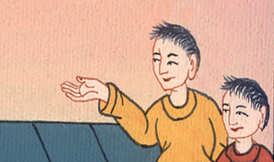
Acts 5:32,33

Slide 37
34But one stood up in the council, a Pharisee named Gamaliel, a teacher of the law, honored by all the people, and commanded to put the apostles out for a little while.

Slide 38
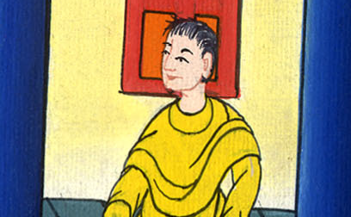
Acts 5:34

Slide 39
35He said to them, “You men of Israel, be careful concerning these men, what you are about to do.

Slide 40
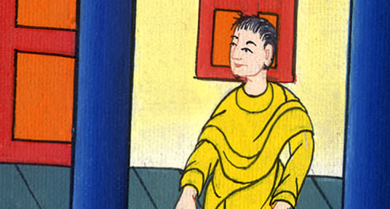
Acts 5:35

Slide 41
36For before these days Theudas rose up, making himself out to be somebody; to whom a number of men, about four hundred, joined themselves. He was slain; and all, as many as obeyed him, were dispersed and came to nothing.

Slide 42
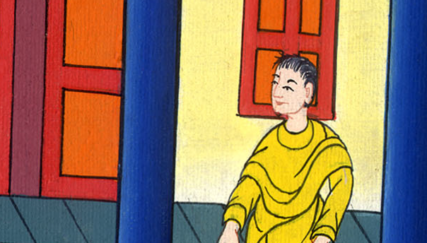
Acts 5:36

Slide 43
37After this man, Judas of Galilee rose up in the days of the enrollment, and drew away some people after him. He also perished, and all, as many as obeyed him, were scattered abroad

Slide 44
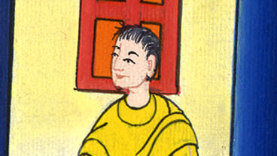
Acts 5:37

Slide 45
38Now I tell you, withdraw from these men and leave them alone. For if this counsel or this work is of men, it will be overthrown.

Slide 46
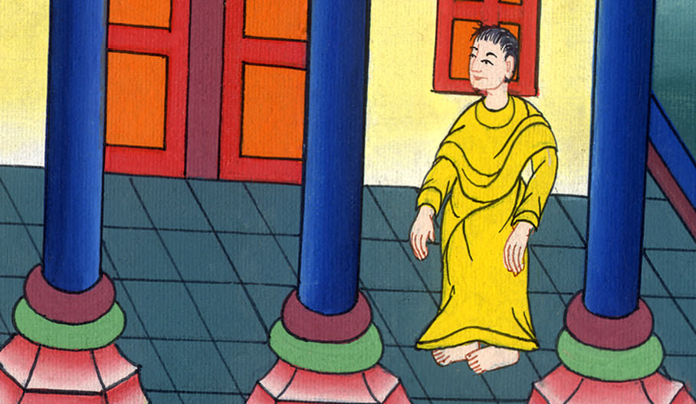
Acts 5:38

Slide 47
39But if it is of God, you will not be able to overthrow it, and you would be found even to be fighting against God!”

Slide 48
Acts 5:39

Slide 49
40They agreed with him. Summoning the apostles, they beat them and commanded them not to speak in the name of Jesus, and let them go.

Slide 50
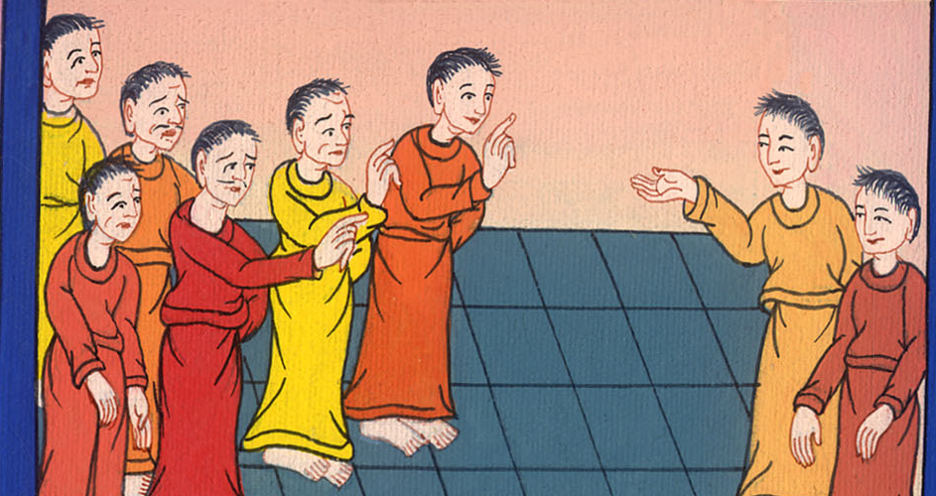
Acts 5:40

Slide 51
41They therefore departed from the presence of the council, rejoicing that they were counted worthy to suffer dishonor for Jesus’ name.

Slide 52
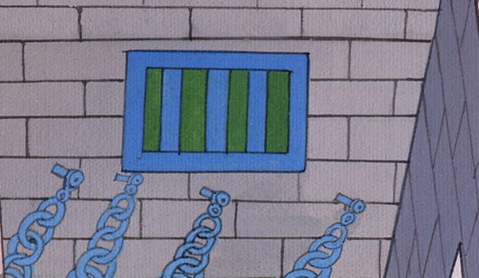
Acts 5:41

Slide 53
42Every day, in the temple and at home, they never stopped teaching and preaching Jesus, the Christ.

Slide 54
Acts 5:42

