Slide 1
48-1
This work is licensed under a Creative Commons Attribution-ShareAlike 4.0 International License.
Please add this statement to all the videos you create.
English Bible quotes are from the World English Bible US, which is in the public domain.
Notes:
Ch
48 Persecution
1. Deacons appointed – Acts 6:1-7 (Left Top)
2. Stephen – Acts 6:8 – 8:4 (Right Top)
3. Philip, Peter and John in Samaria – Acts 8:4-25 (Right Bottom)
4. Philip and the Ethiopian – Acts 8:25-40 (Left Bottom)
5. Saul’s Conversion – Acts 9:1-9 (Left Center)
6. Ananias prays for Saul– Acts 9:10-19a (Center Lower)
7. Saul’s Escape – Acts 9:19b-31 (Center Upper)

Slide 2
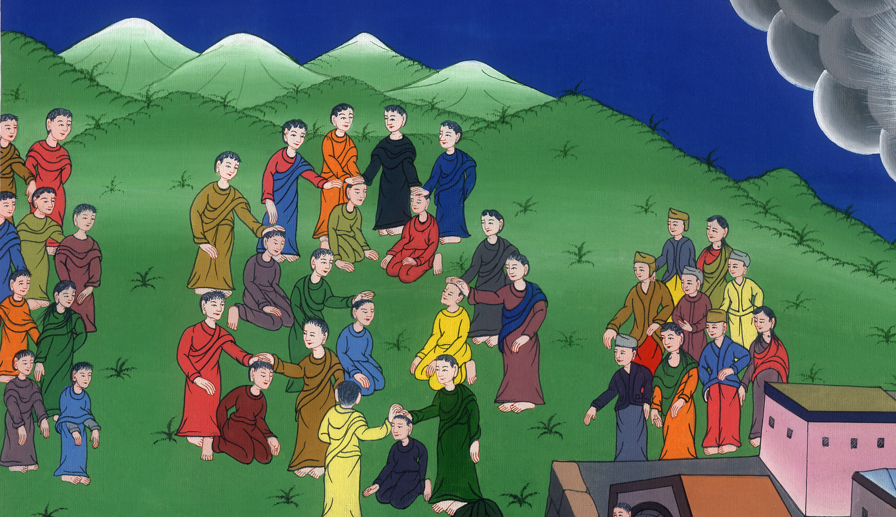
Deacons appointed
– Acts 6:1-15

Slide 3
Deacons appointed
– Acts 6:1-15

Slide 4
Deacons appointed
– Acts 6:1-15

Slide 5
1Now in those days, when the number of the disciples was multiplying, a complaint arose from the Hellenists against the Hebrews,

Slide 6
Acts 6:1

Slide 7
They said that the widows of the Greek Jews were not being taken care of. They weren’t getting their fair share of food each day.

Slide 8
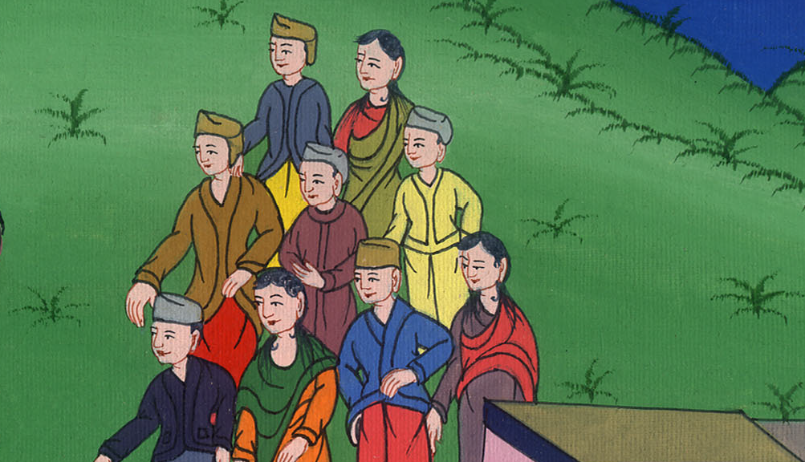
Acts 6:1

Slide 9
2The twelve summoned the multitude of the disciples and said, “It is not appropriate for us to forsake the word of God and serve tables.

Slide 10
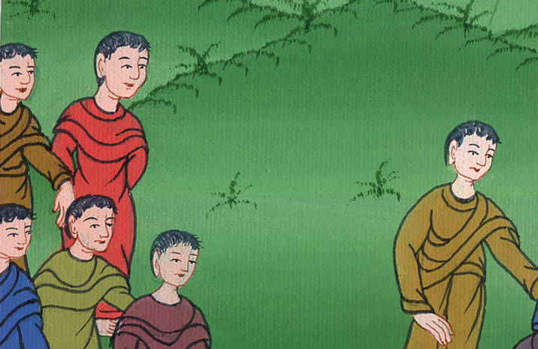
Acts 6:2

Slide 11
3Therefore, select from among you, brothers, seven men of good report, full of the Holy Spirit and of wisdom, whom we may appoint over this business.

Slide 12
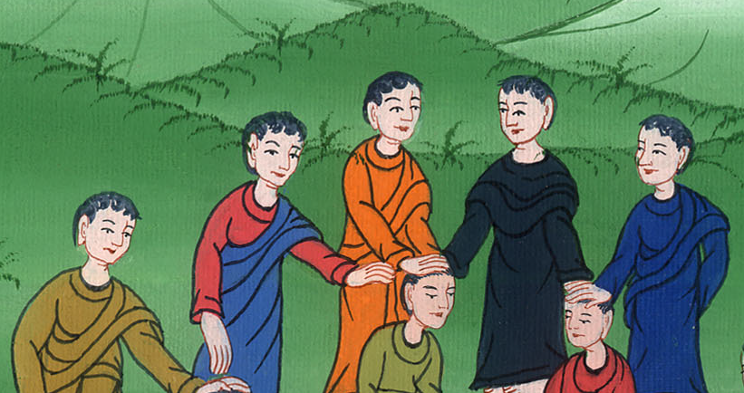
Acts 6:3

Slide 13
4But we will continue steadfastly in prayer and in the ministry of the word.”

Slide 14
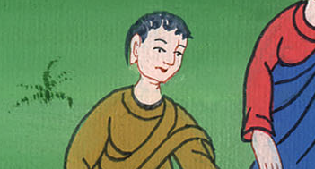
Acts 6:4

Slide 15
5These words pleased the whole multitude. They chose Stephen, a man full of faith and of the Holy Spirit, Philip, Prochorus, Nicanor, Timon, Parmenas, and Nicolaus, a proselyte of Antioch,

Slide 16
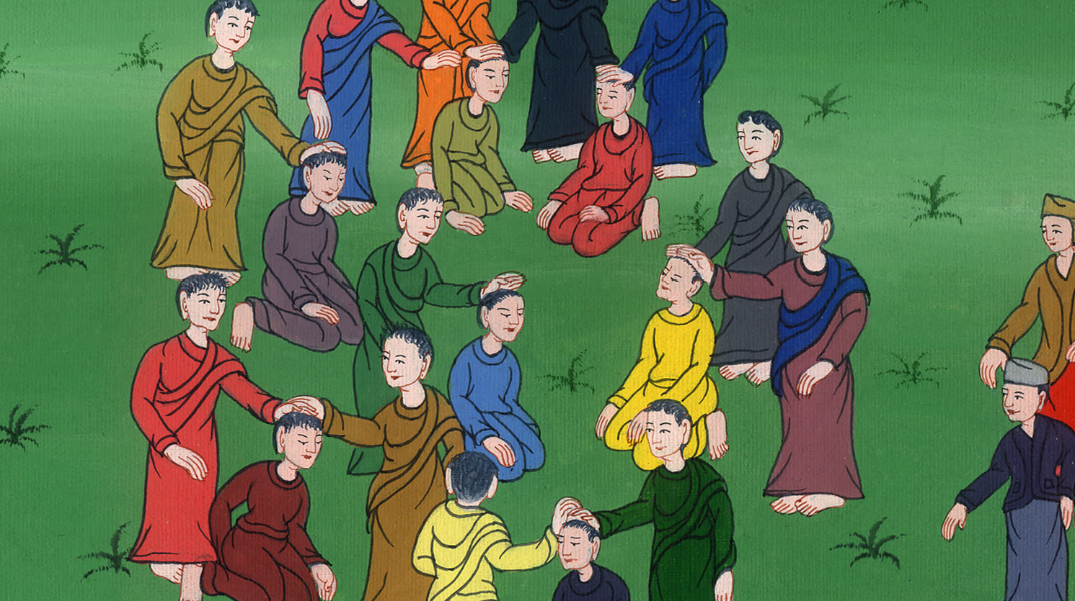
Acts 6:5

Slide 17
6whom they set before the apostles. When they had prayed, they laid their hands on them.

Slide 18
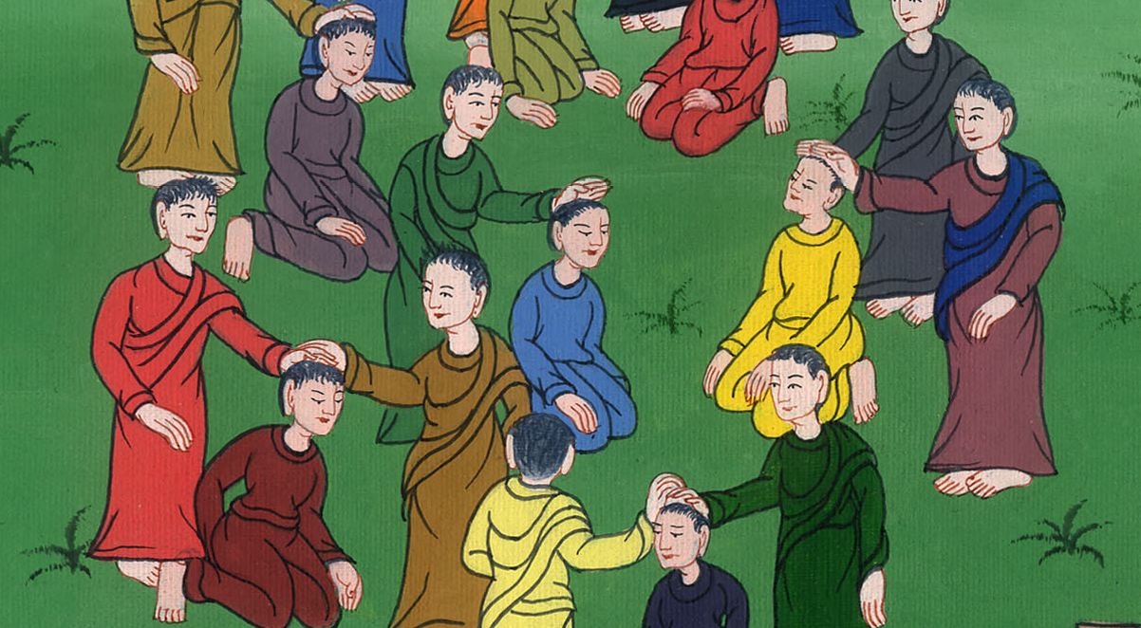
Acts 6:6

Slide 19
7The word of God increased and the number of the disciples greatly multiplied in Jerusalem. A great company of the priests were obedient to the faith.

Slide 20
Acts 6:7

