Slide 1
48-4
This work is licensed under a Creative Commons Attribution-ShareAlike 4.0 International License.
Please add this statement to all the videos you create.
English Bible quotes are from the World English Bible US, which is in the public domain.
Notes:
Ch
48 Persecution
1. Deacons appointed – Acts 6:1-7 (Left Top)
2. Stephen – Acts 6:8 – 8:4 (Right Top)
3. Philip, Peter and John in Samaria – Acts 8:4-25 (Right Bottom)
4. Philip and the Ethiopian – Acts 8:25-40 (Left Bottom)
5. Saul’s Conversion – Acts 9:1-9 (Left Center)
6. Ananias prays for Saul– Acts 9:10-19a (Center Lower)
7. Saul’s Escape – Acts 9:19b-31 (Center Upper)

Slide 2
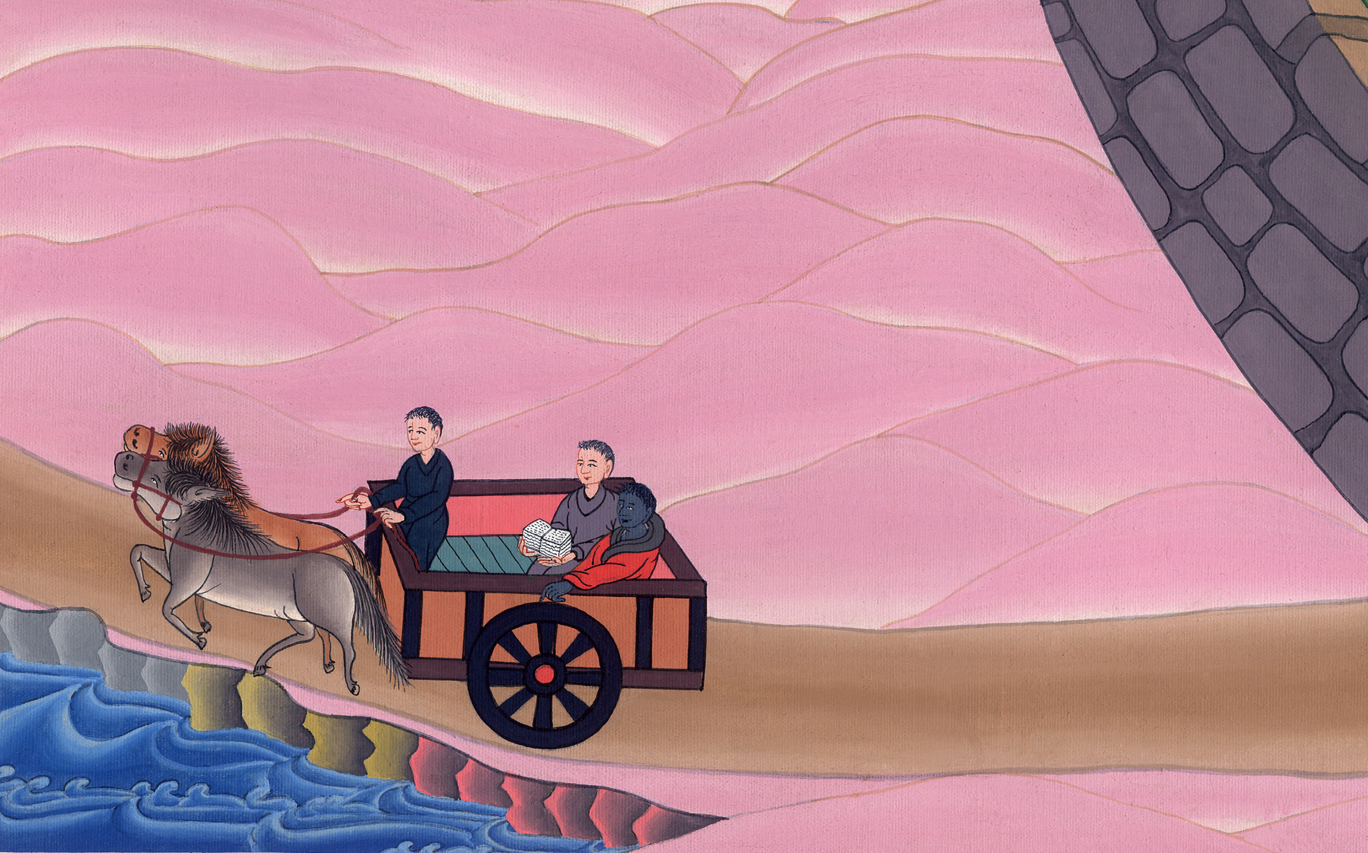
Philip and the Ethiopian – Acts 8:26-40

Slide 3
Philip and the Ethiopian – Acts 8:26-40

Slide 4
Philip and the Ethiopian – Acts 8:26-40

Slide 5
26Then an angel of the Lord spoke to Philip, saying, “Arise, and go toward the south to the way that goes down from Jerusalem to Gaza. This is a desert.”

Slide 6
Acts 8:26

Slide 7
27He arose and went; and behold, there was a man of Ethiopia, a eunuch of great authority under Candace, queen of the Ethiopians, who was over all her treasure, who had come to Jerusalem to worship.

Slide 8
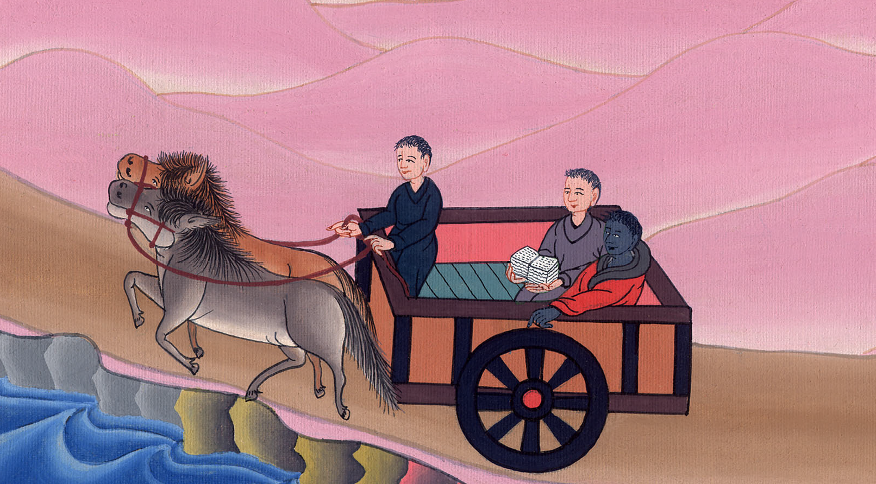
Acts 8:27

Slide 9
28He was returning and sitting in his chariot, and was reading the prophet Isaiah.
29The Spirit said to Philip, “Go near, and join yourself to this chariot.”

Slide 10
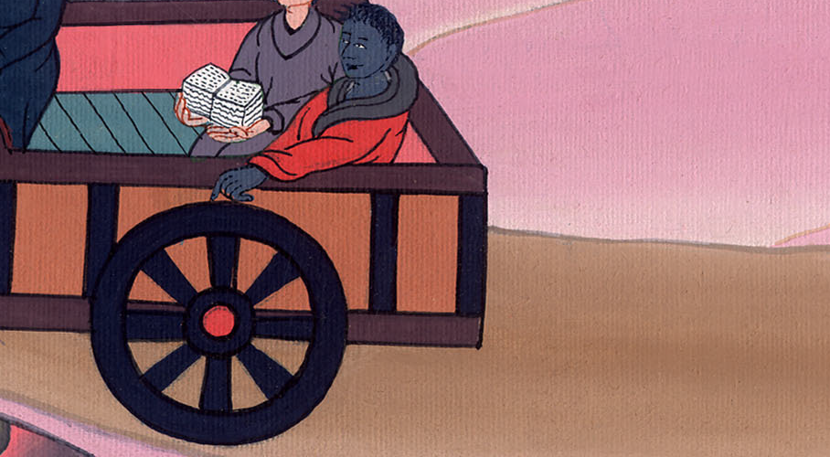
Acts 8:28,29

Slide 11
30Philip ran to him, and heard him reading Isaiah the prophet, and said, “Do you understand what you are reading?”

Slide 12
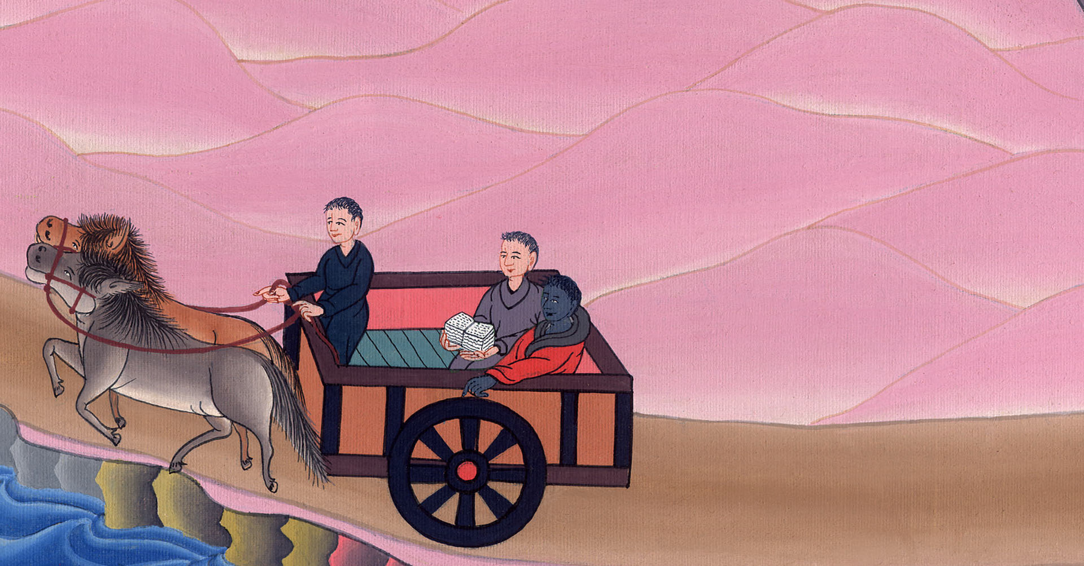
Acts 8:30

Slide 13
31He said, “How can I, unless someone explains it to me?” He begged Philip to come up and sit with him.

Slide 14
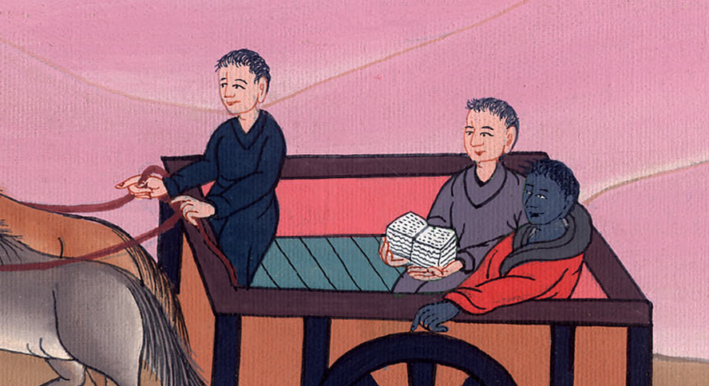
Acts 8:31

Slide 15
32Now the passage of the Scripture which he was reading was this,
“He was led as a sheep to the slaughter.
As a lamb before his shearer is silent,
so he doesn’t open his mouth.

Slide 16
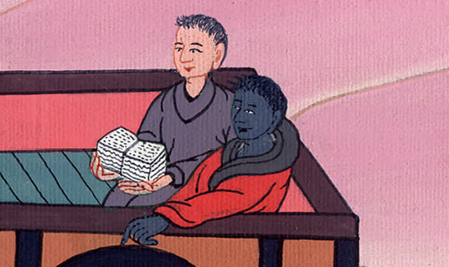
Acts 8:32

Slide 17
33In his humiliation, his judgment was taken away.
Who will declare His generation?
For his life is taken from the earth.”

Slide 18
Acts 8:33

Slide 19
34The eunuch answered Philip, “Who is the prophet talking about? About himself, or about someone else?”
35Philip opened his mouth, and beginning from this Scripture, preached to him about Jesus.

Slide 20
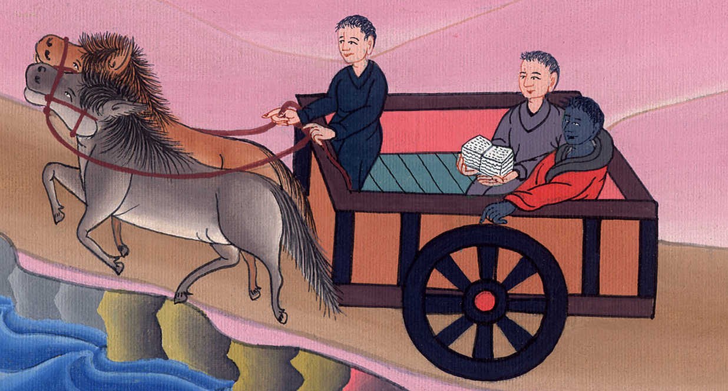
Acts 8:34,35

Slide 21
36As they went on the way, they came to some water; and the eunuch said, “Behold, here is water. What is keeping me from being baptized?”

Slide 22
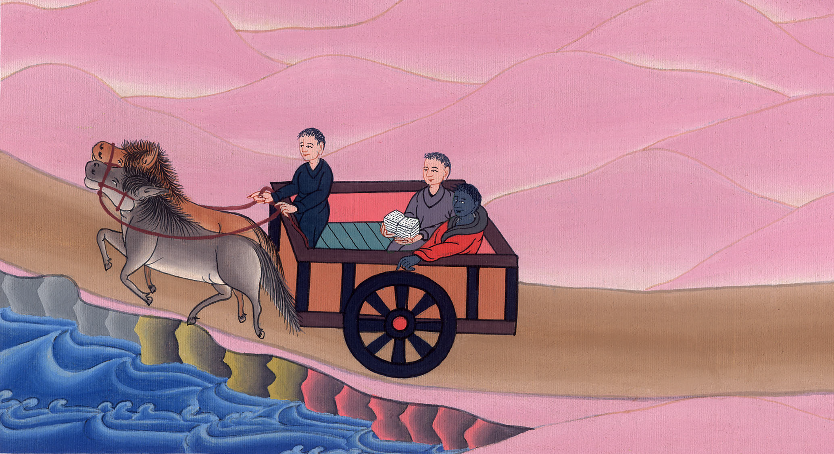
Acts 8:36,37

Slide 23
38He commanded the chariot to stand still, and they both went down into the water, both Philip and the eunuch, and he baptized him.

Slide 24
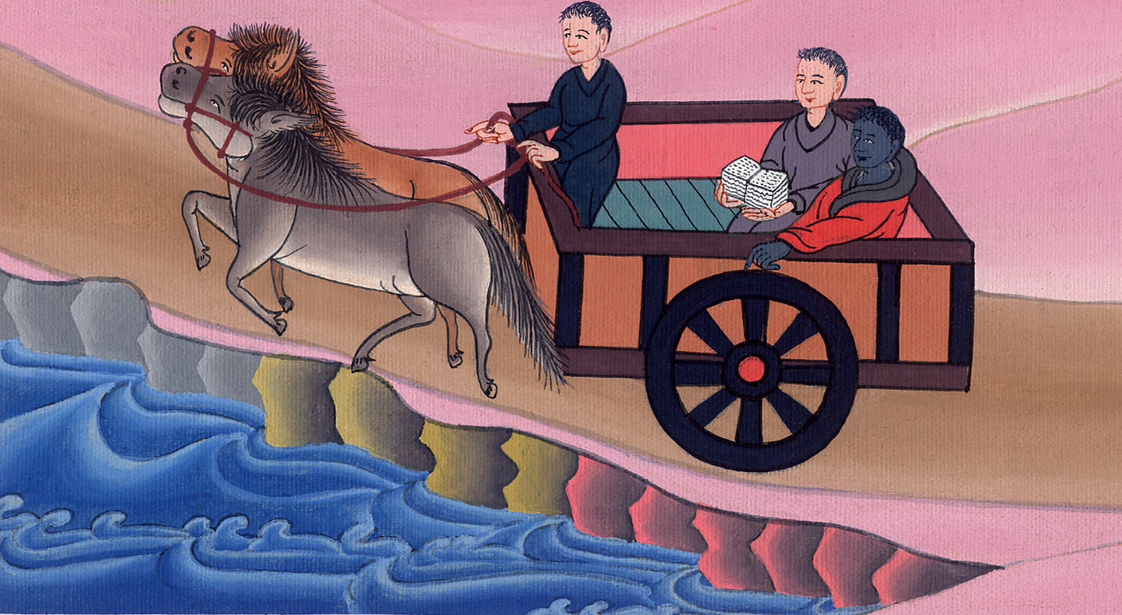
Acts 8:38

Slide 25
39When they came up out of the water, the Spirit of the Lord caught Philip away, and the eunuch didn’t see him any more, for he went on his way rejoicing.

Slide 26
Acts 8:39

Slide 27
40But Philip was found at Azotus. Passing through, he preached the Good News to all the cities until he came to Caesarea.

Slide 28
Acts 8:40

