Slide 1
48-5
This work is licensed under a Creative Commons Attribution-ShareAlike 4.0 International License.
Please add this statement to all the videos you create.
English Bible quotes are from the World English Bible US, which is in the public domain.
Notes:
48 Persecution
1. Deacons appointed – Acts 6:1-7 (Left Top)
2. Stephen – Acts 6:8 – 8:4 (Right Top)
3. Philip, Peter and John in Samaria – Acts 8:4-25 (Right Bottom)
4. Philip and the Ethiopian – Acts 8:25-40 (Left Bottom)
5. Saul’s Conversion – Acts 9:1-9 (Left Center)
6. Ananias prays for Saul– Acts 9:10-19a (Center Lower)
7. Saul’s Escape – Acts 9:19b-31 (Center Upper)

Slide 2
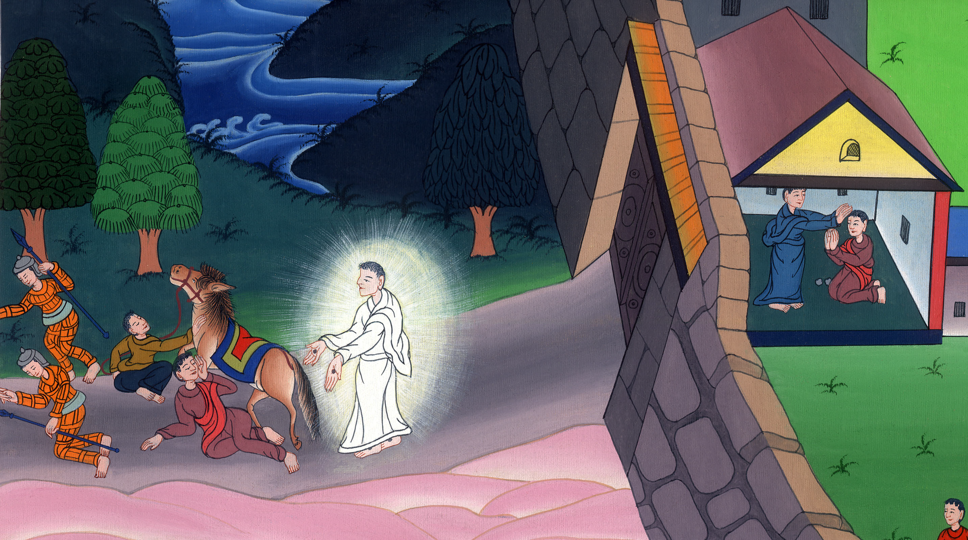
Saul’s Conversion –
Acts 9:1-19

Slide 3
Saul’s Conversion – Acts 9:1-19

Slide 4
Saul’s Conversion –
Acts 9:1-19

Slide 5
1But Saul, still breathing threats and slaughter against the disciples of the Lord, went to the high priest

Slide 6
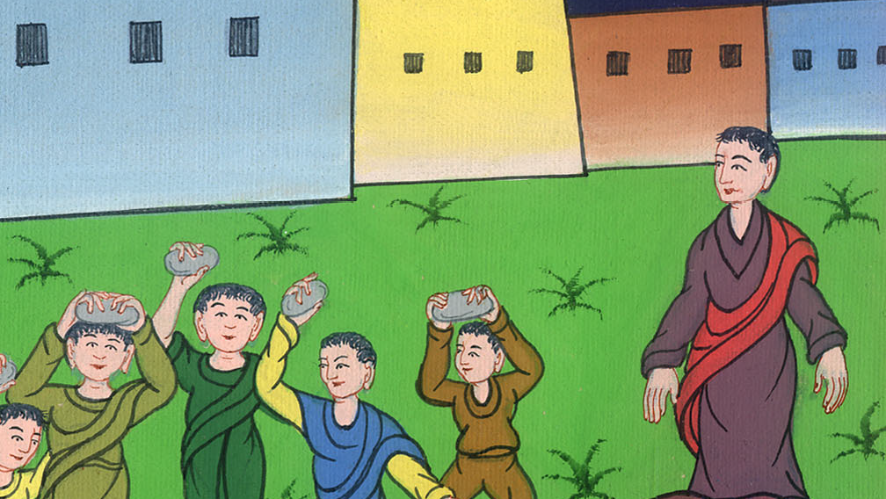
Acts 9:1

Slide 7
2and asked for letters from him to the synagogues of Damascus, that if he found any who were of the Way, whether men or women, he might bring them bound to Jerusalem.

Slide 8
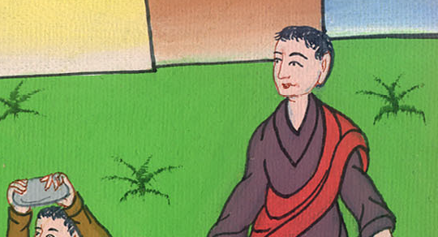
Acts 9:2

Slide 9
2and asked for letters from him to the synagogues of Damascus, that if he found any who were of the Way, whether men or women, he might bring them bound to Jerusalem.

Slide 10
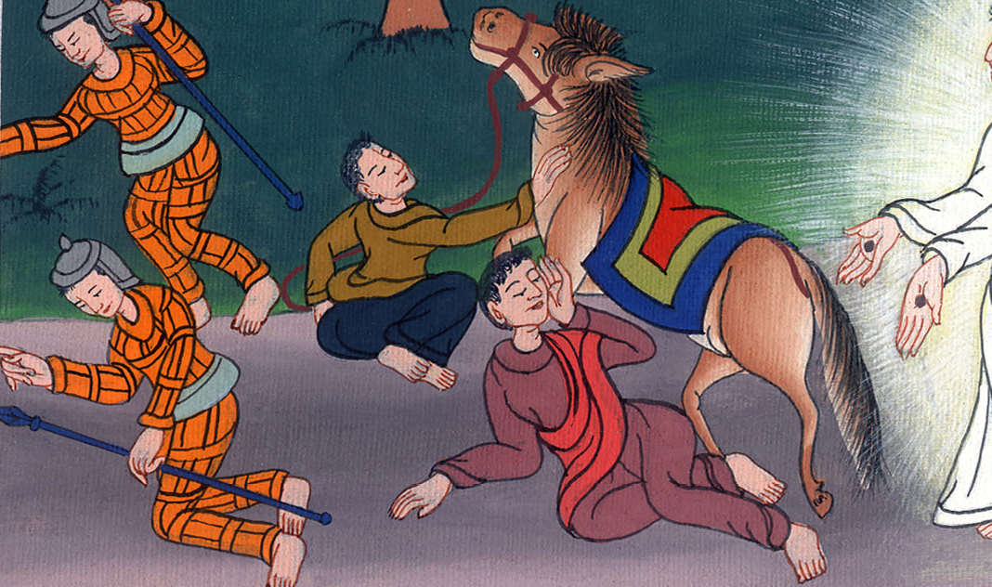
Acts 9:3,4

Slide 11
5He said, “Who are you, Lord?”
The Lord said, “I am Jesus, whom you are persecuting. 6But rise up and enter into the city, then you will be told what you must do.”

Slide 12
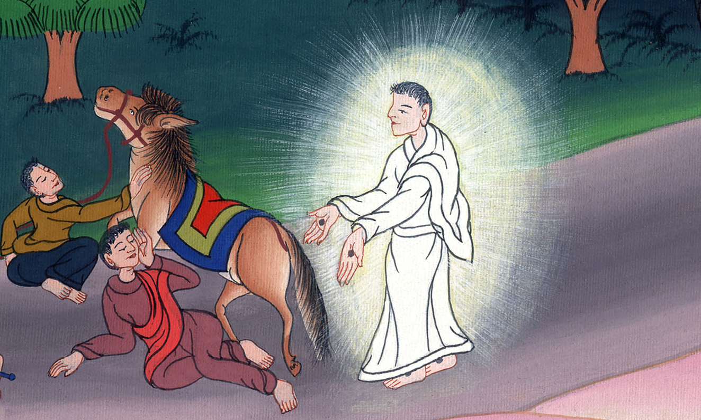
Acts 9:5,6

Slide 13
7The men who traveled with him stood speechless, hearing the sound, but seeing no one.

Slide 14
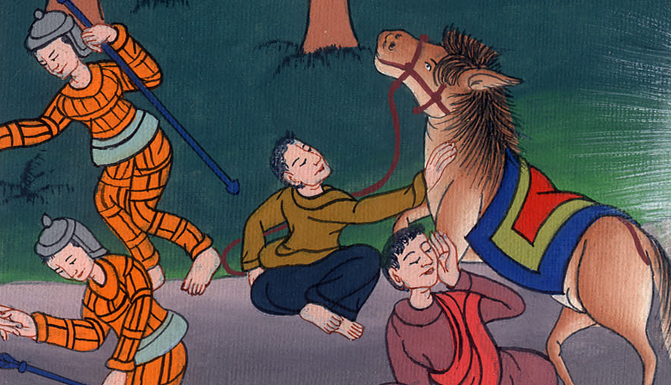
Acts 9:7

Slide 15
8Saul arose from the ground, and when his eyes were opened, he saw no one. They led him by the hand and brought him into Damascus. 9He was without sight for three days, and neither ate nor drank.

Slide 16
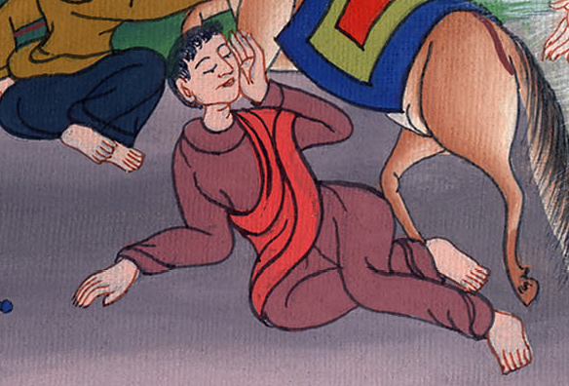
Acts 9:8,9

Slide 17
10Now there was a certain disciple at Damascus named Ananias. The Lord said to him in a vision, “Ananias!”
He said, “Behold, it’s me, Lord.”

Slide 18
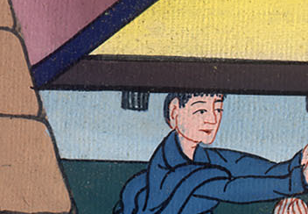
Acts 9:10

Slide 19
11The Lord said to him, “Arise and go to the street which is called Straight, and inquire in the house of Judah for one named Saul, a man of Tarsus. For behold, he is praying,

Slide 20
Acts 9:11

Slide 21
12and in a vision he has seen a man named Ananias coming in and laying his hands on him, that he might receive his sight.”

Slide 22
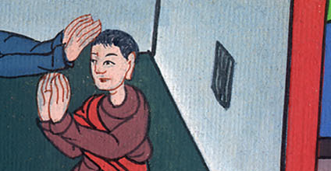
Acts 9:12

Slide 23
13But Ananias answered, “Lord, I have heard from many about this man, how much evil he did to your saints at Jerusalem. 14Here he has authority from the chief priests to bind all who call on your name.”

Slide 24
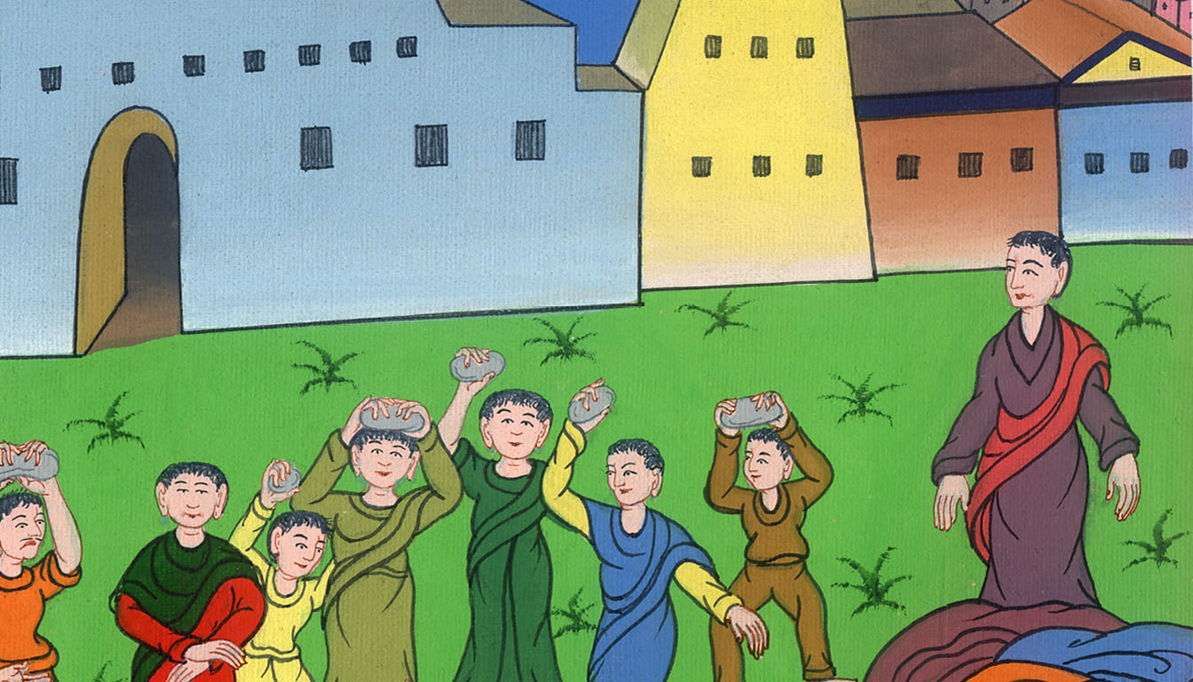
Acts 9:13,14

Slide 25
15But the Lord said to him, “Go your way, for he is my chosen vessel to bear my name before the nations and kings, and the children of Israel.

Slide 26
Acts 9:15

Slide 27
16For I will show him how many things he must suffer for my name’s sake.”

Slide 28
Acts 9:16

Slide 29
17Ananias departed and entered into the house. Laying his hands on him, he said, “Brother Saul, the Lord, who appeared to you on the road by which you came, has sent me that you may receive your sight and be filled with the Holy Spirit.”

Slide 30
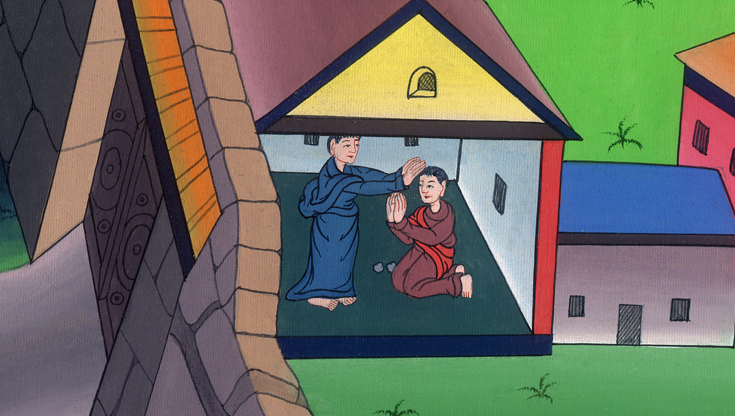
Acts 9:17

Slide 31
18Immediately something like scales fell from his eyes, and he received his sight. He arose and was baptized. 19He took food and was strengthened.

Slide 32
Acts 9:18,19

