Slide 1
48-6
This work is licensed under a Creative Commons Attribution-ShareAlike 4.0 International License.
Please add this statement to all the videos you create.
English Bible quotes are from the World English Bible US, which is in the public domain.
Notes:
48 Persecution
1. Deacons appointed – Acts 6:1-7 (Left Top)
2. Stephen – Acts 6:8 – 8:4 (Right Top)
3. Philip, Peter and John in Samaria – Acts 8:4-25 (Right Bottom)
4. Philip and the Ethiopian – Acts 8:25-40 (Left Bottom)
5. Saul’s Conversion – Acts 9:1-9 (Left Center)
6. Ananias prays for Saul– Acts 9:10-19a (Center Lower)
7. Saul’s Escape – Acts 9:19b-31 (Center Upper)

Slide 2
Saul Preaches and Escapes –
Acts 9:19-31

Slide 3
Saul Preaches and Escapes – Acts 9:19-31

Slide 4
Saul Preaches and Escapes –
Acts 9:19-31

Slide 5
Saul stayed several days with the disciples who were at Damascus. 20Immediately in the synagogues he proclaimed the Christ, that he is the Son of God.

Slide 6
Acts 9:19,20

Slide 7
21All who heard him were amazed, and said, “Isn’t this he who in Jerusalem made havoc of those who called on this name? And he had come here intending to bring them bound before the chief priests!”

Slide 8
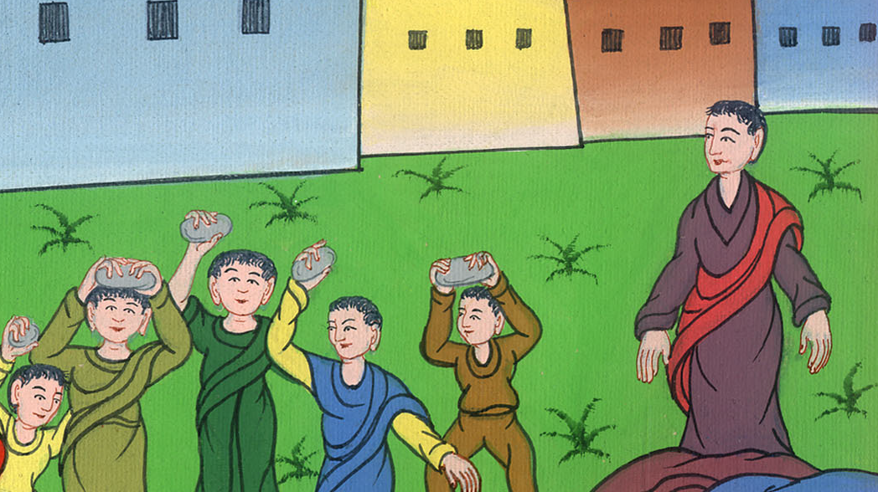
Acts 9:21

Slide 9
22But Saul increased more in strength, and confounded the Jews who lived at Damascus, proving that this is the Christ.

Slide 10
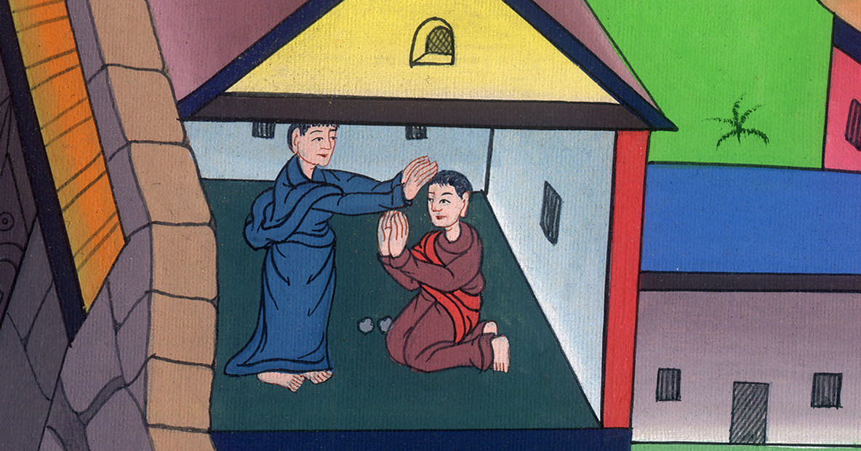
Acts 9:22

Slide 11
23When many days were fulfilled, the Jews conspired together to kill him, 24but their plot became known to Saul. They watched the gates both day and night that they might kill him,

Slide 12
Acts 9:23,24

Slide 13
25but his disciples took him by night and let him down through the wall, lowering him in a basket.

Slide 14
Acts 9:25

Slide 15
26When Saul had come to Jerusalem, he tried to join himself to the disciples; but they were all afraid of him, not believing that he was a disciple.

Slide 16
Acts 9:26

Slide 17
27But Barnabas took him and brought him to the apostles, and declared to them how he had seen the Lord on the way, and that he had spoken to him, and how at Damascus he had preached boldly in the name of Jesus.

Slide 18
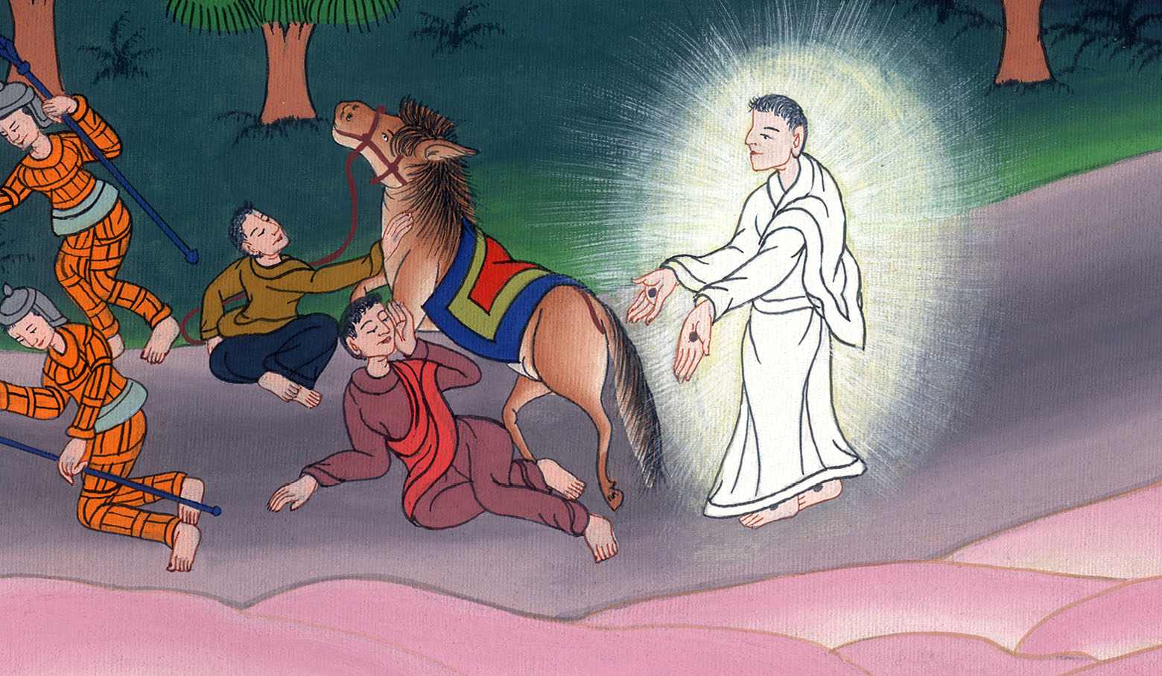
Acts 9:27

Slide 19
28He was with them entering into Jerusalem,

Slide 20
Acts 9:28

Slide 21
29He talked and argued with the Greek Jews. But they tried to kill him.

Slide 22
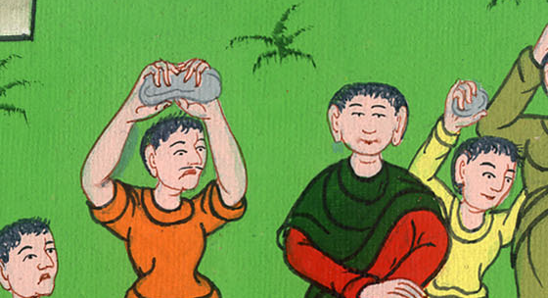
Acts 9:29

Slide 23
30When the brothers knew it, they brought him down to Caesarea and sent him off to Tarsus.

Slide 24
Acts 9:30

