Slide 1
49-1
This work is licensed under a Creative Commons Attribution-ShareAlike 4.0 International License.
Please add this statement to all the videos you create.
English Bible quotes are from the World English Bible US, which is in the public domain.
Notes:
Ch
49 Cornelius
1. Peter Heals Aeneas – Acts 9:32-35 (Left Top)
2. Tabitha raised – Acts 9:36-43 (Right Top)
3. Cornelius has a vision – Acts 10:1-8 (Right Bottom)
4. Peter’s vision – Acts 10:9-23 (Left Bottom and Center)
5. Cornelius Believes– Acts 10:24 – 11:18 (Left Center)

Slide 2
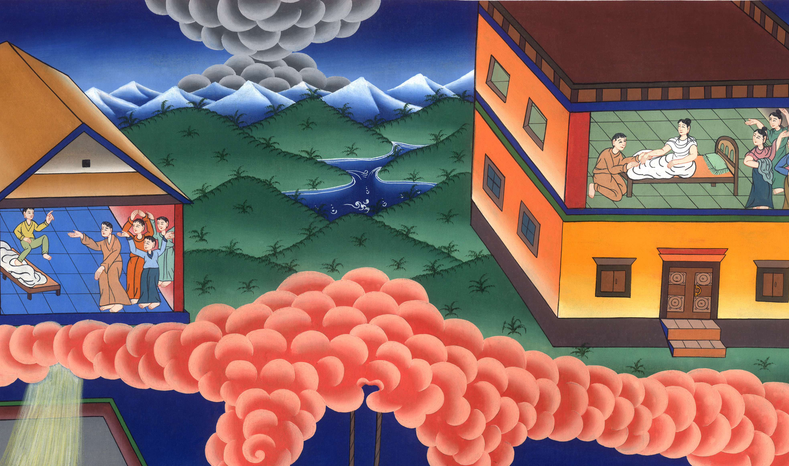
Tabitha raised from the dead– Acts 9:32-43

Slide 3
Tabitha raised from the dead– Acts 9:32-43

Slide 4
Tabitha raised from the dead– Acts 9:32-43

Slide 5
32As Peter went throughout all those parts, he came down also to the saints who lived at Lydda.

Slide 6
Acts 9:32

Slide 7
33There he found a certain man named Aeneas, who had been bedridden for eight years because he was paralyzed.

Slide 8
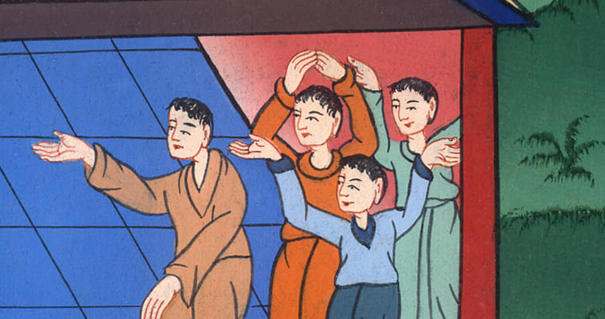
Acts 9:33

Slide 9
34Peter said to him, “Aeneas, Jesus Christ heals you. Get up and make your bed!” Immediately he arose. 35All who lived at Lydda and in Sharon saw him, and they turned to the Lord.

Slide 10
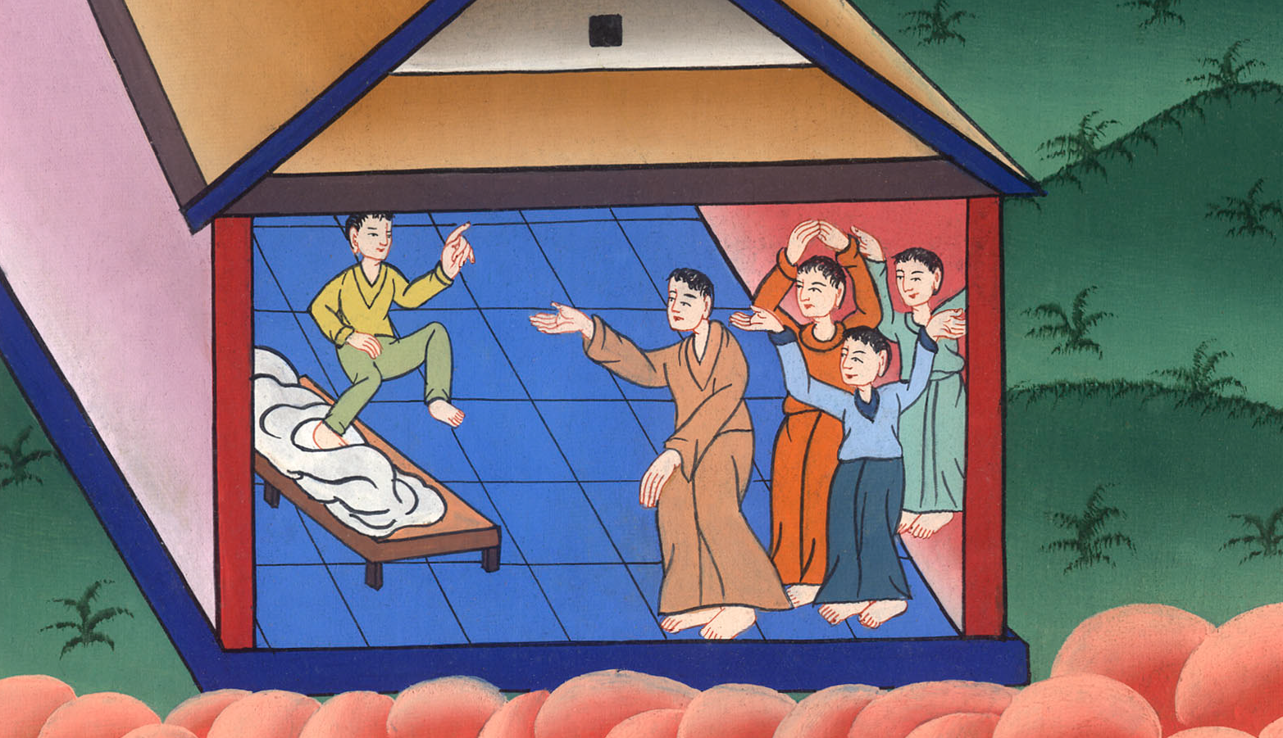
Acts 9:34,35

Slide 11
36Now there was at Joppa a certain disciple named Tabitha, which when translated means Dorcas. This woman was full of good works and acts of mercy which she did.

Slide 12
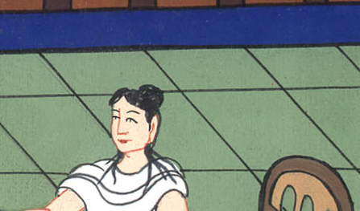
Acts 9:36

Slide 13
37In those days, she became sick and died. When they had washed her, they laid her in an upper room.

Slide 14
Acts 9:37

Slide 15
38As Lydda was near Joppa, the disciples, hearing that Peter was there, sent two men to him, imploring him not to delay in coming to them.

Slide 16
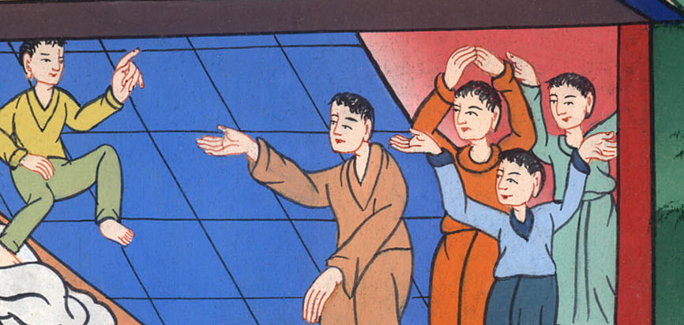
Acts 9:38

Slide 17
39Peter got up and went with them. When he had come, they brought him into the upper room. All the widows stood by him weeping, and showing the tunics and other garments which Dorcas had made while she was with them.

Slide 18
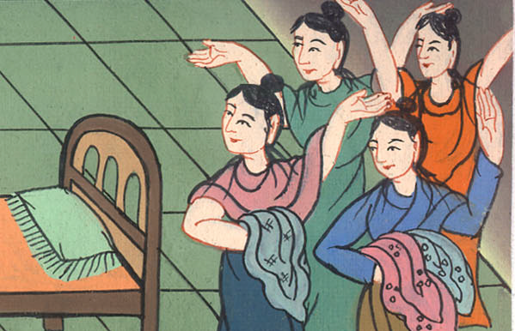
Acts 9:39

Slide 19
40Peter sent them all out, and knelt down and prayed. Turning to the body, he said, “Tabitha, get up!” She opened her eyes, and when she saw Peter, she sat up.

Slide 20
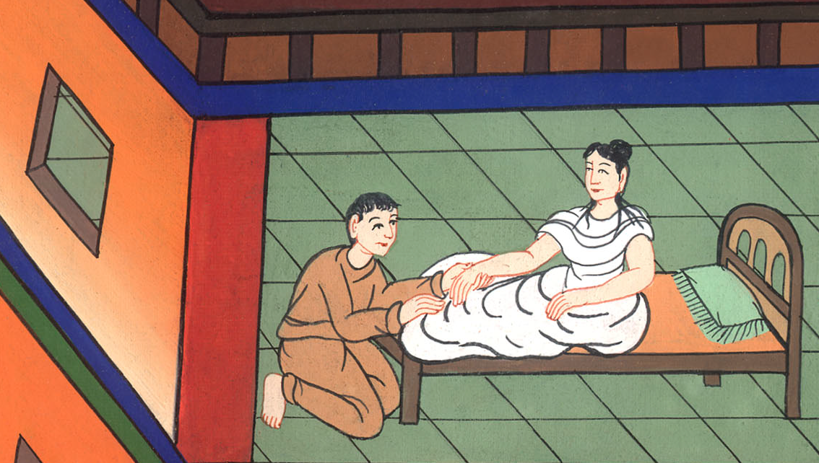
Acts 9:40

Slide 21
41He gave her his hand and raised her up. Calling the saints and widows, he presented her alive.

Slide 22
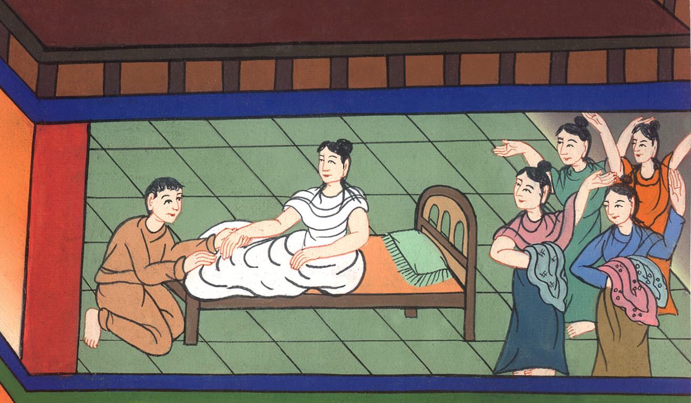
Acts 9:41

Slide 23
42This became known throughout all Joppa, and many believed in the Lord. 43He stayed many days in Joppa with a tanner named Simon.

Slide 24
Acts 9:42,43

