Slide 1
49-2
This work is licensed under a Creative Commons Attribution-ShareAlike 4.0 International License.
Please add this statement to all the videos you create.
English Bible quotes are from the World English Bible US, which is in the public domain.
Notes:
Ch
49 Cornelius
1. Peter Heals Aeneas – Acts 9:32-35 (Left Top)
2. Tabitha raised – Acts 9:36-43 (Right Top)
3. Cornelius has a vision – Acts 10:1-8 (Right Bottom)
4. Peter’s vision – Acts 10:9-23 (Left Bottom and Center)
5. Cornelius Believes– Acts 10:24 – 11:18 (Left Center)

Slide 2
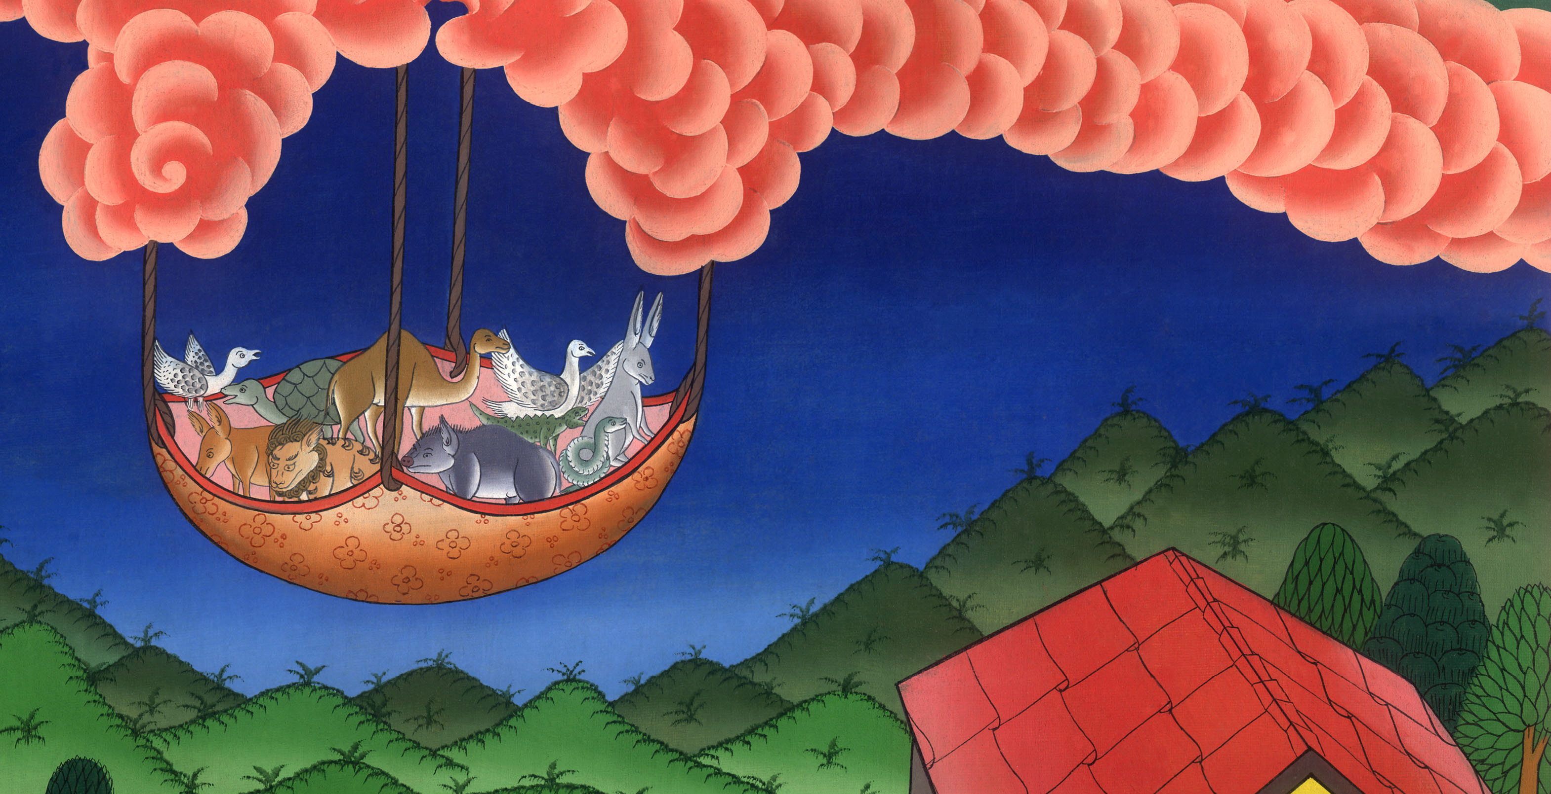
Cornelius and Peter’s visions – Acts 10:1-23

Slide 3
Cornelius and Peter’s visions – Acts 10:1-23

Slide 4
Cornelius and Peter’s visions – Acts 10:1-23

Slide 5
1Now there was a certain man in Caesarea, Cornelius by name, a centurion of what was called the Italian Regiment

Slide 6
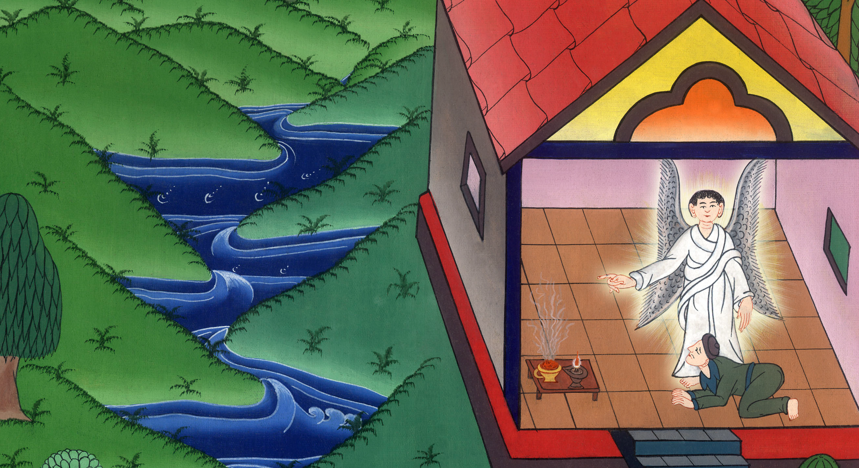
Acts 10:1

Slide 7
2a devout man, and one who feared God with all his house, who gave gifts for the needy generously to the people, and always prayed to God.

Slide 8
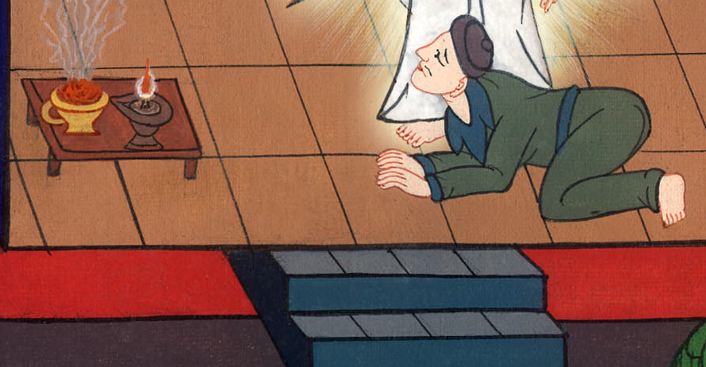
Acts 10:2

Slide 9
3At about the ninth hour of the day, he clearly saw in a vision an angel of God coming to him and saying to him, “Cornelius!”

Slide 10
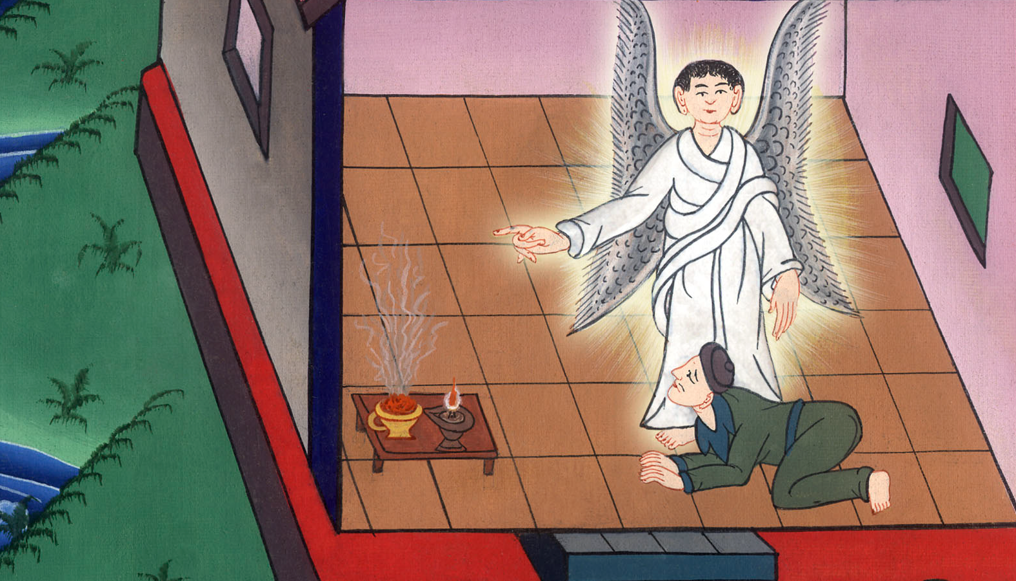
Acts 10:3

Slide 11
4He, fastening his eyes on him and being frightened, said, “What is it, Lord?”
He said to him, “Your prayers and your gifts to the needy have gone up for a memorial before God.

Slide 12
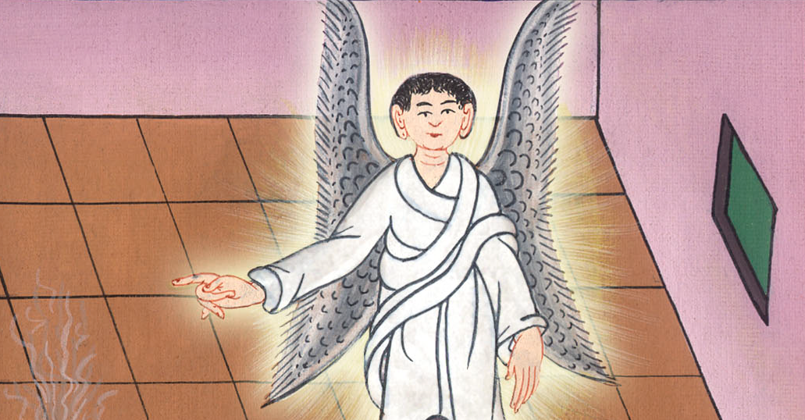
Acts 10:4

Slide 13
5Now send men to Joppa, and get Simon, who is also called Peter. 6He is staying with a tanner named Simon, whose house is by the seaside.

Slide 14
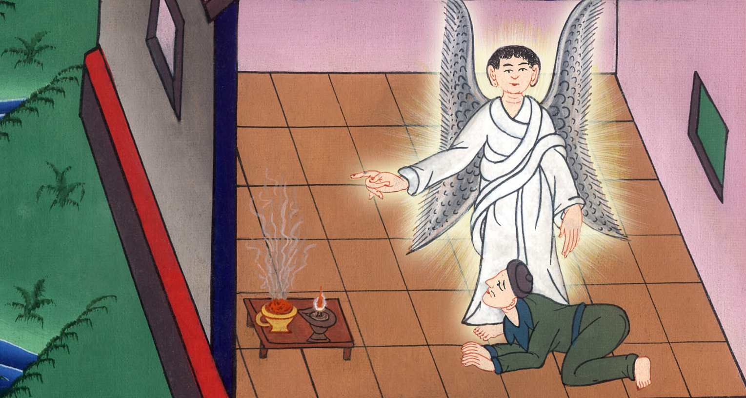
Acts 10:5,6

Slide 15
7When the angel who spoke to him had departed, Cornelius called two of his household servants and a devout soldier of those who waited on him continually. 8Having explained everything to them, he sent them to Joppa.

Slide 16
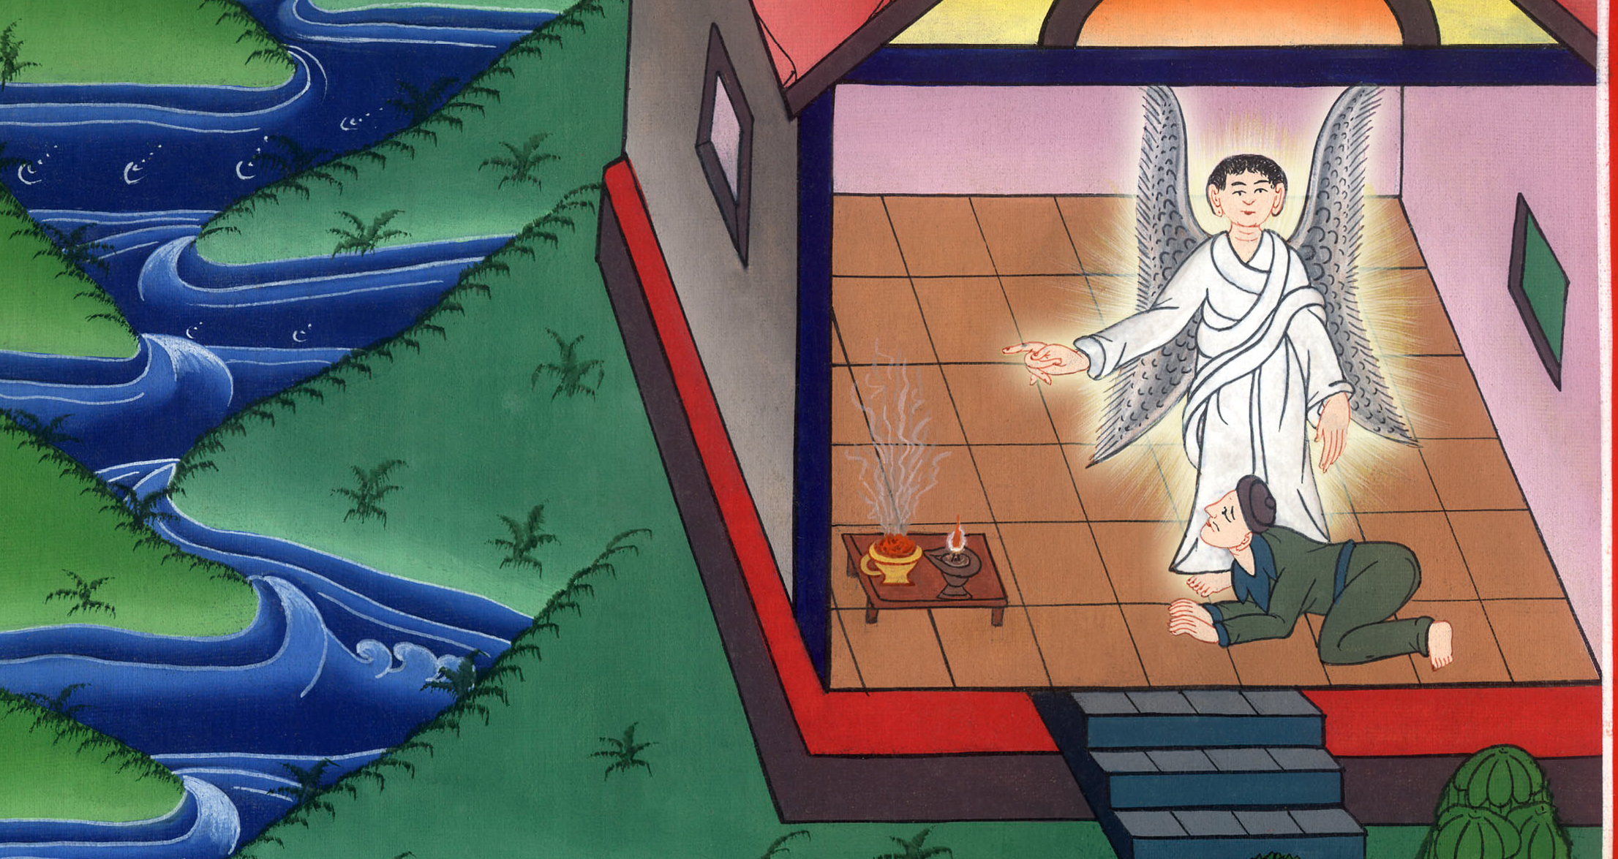
Acts 10:7,8

Slide 17
9Now on the next day as they were on their journey and got close to the city, Peter went up on the housetop to pray at about noon.

Slide 18
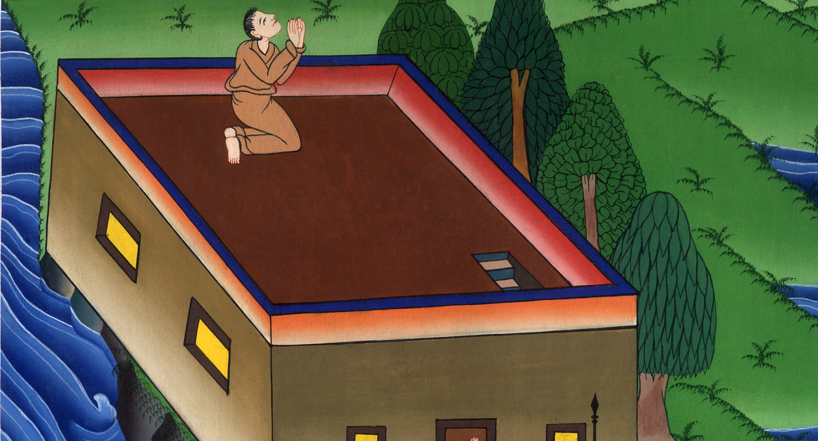
Acts 10:9

Slide 19
10He became hungry and desired to eat, but while they were preparing, he fell into a trance.

Slide 20
Acts 10:10

Slide 21
11He saw heaven opened and a certain container descending to him, like a great sheet let down by four corners on the earth,

Slide 22
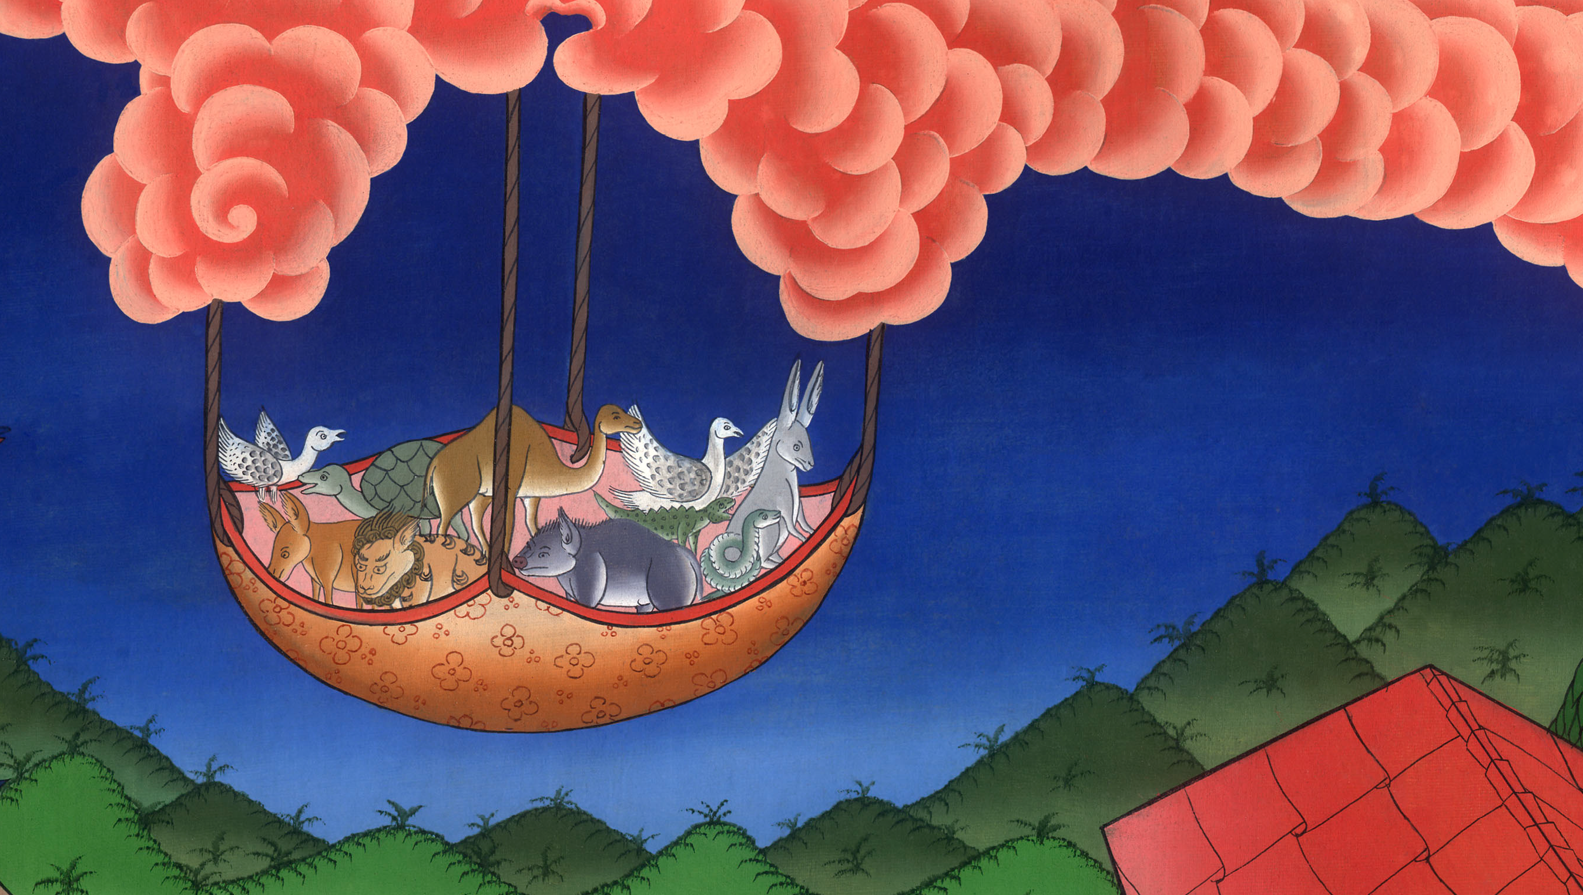
Acts 10:11

Slide 23
12in which were all kinds of four-footed animals of the earth, wild animals, reptiles, and birds of the sky. 13A voice came to him, “Rise, Peter, kill and eat!”

Slide 24
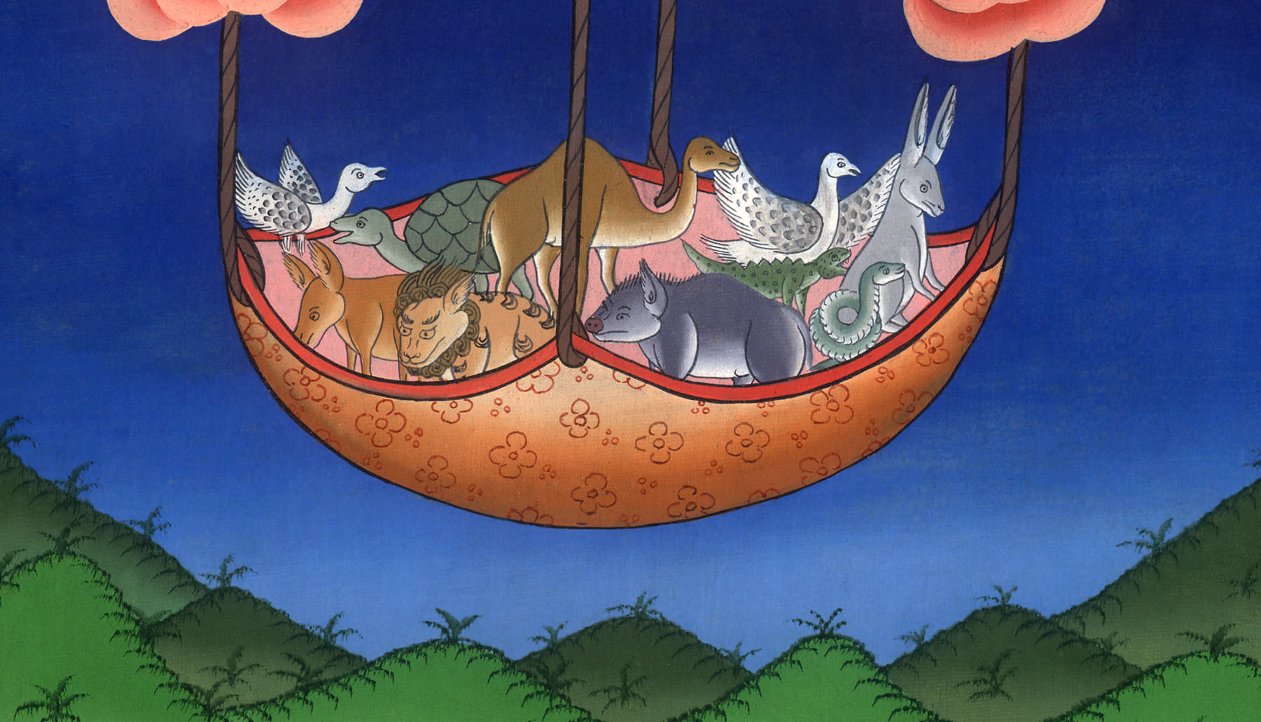
Acts 10:12,13

Slide 25
14But Peter said, “Not so, Lord; for I have never eaten anything that is common or unclean.”
15A voice came to him again the second time, “What God has cleansed, you must not call unclean.”

Slide 26
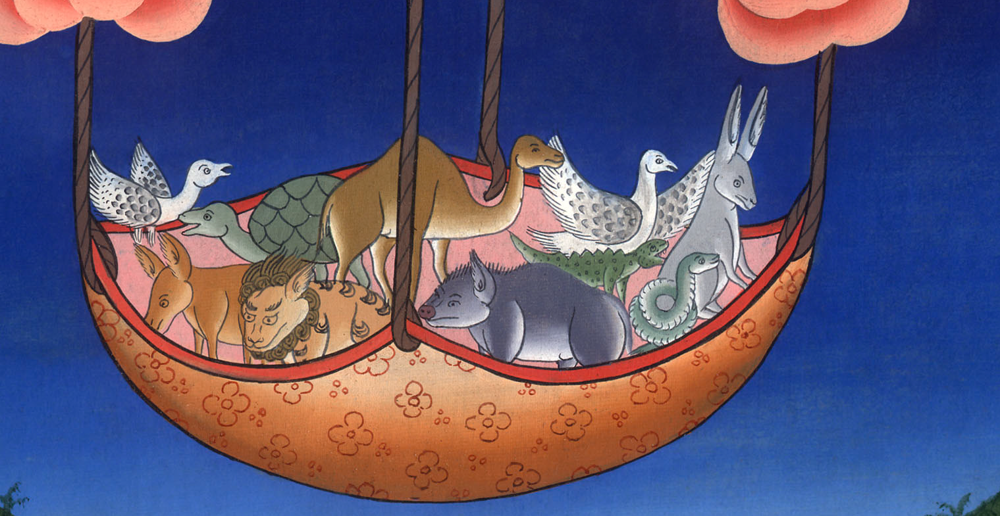
Acts 10:14,15

Slide 27
16This was done three times, and immediately the thing was received up into heaven.

Slide 28
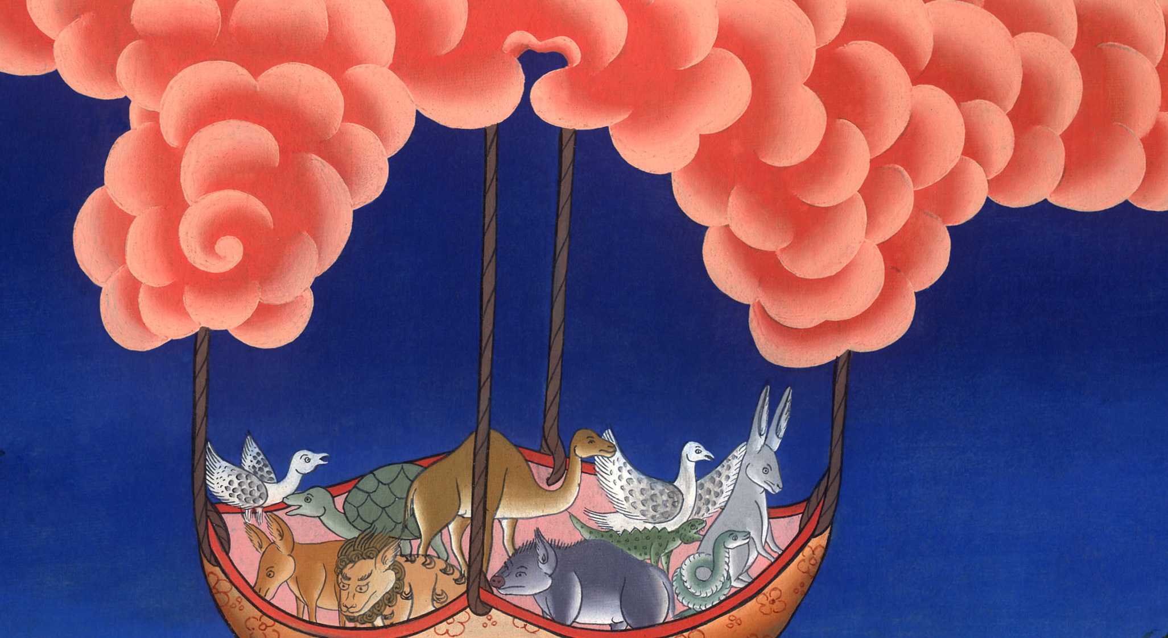
Acts 10:16

Slide 29
17Now while Peter was very perplexed in himself what the vision which he had seen might mean, behold, the men who were sent by Cornelius, having made inquiry for Simon’s house, stood before the gate, 18and called and asked whether Simon, who was also called Peter, was lodging there.

Slide 30
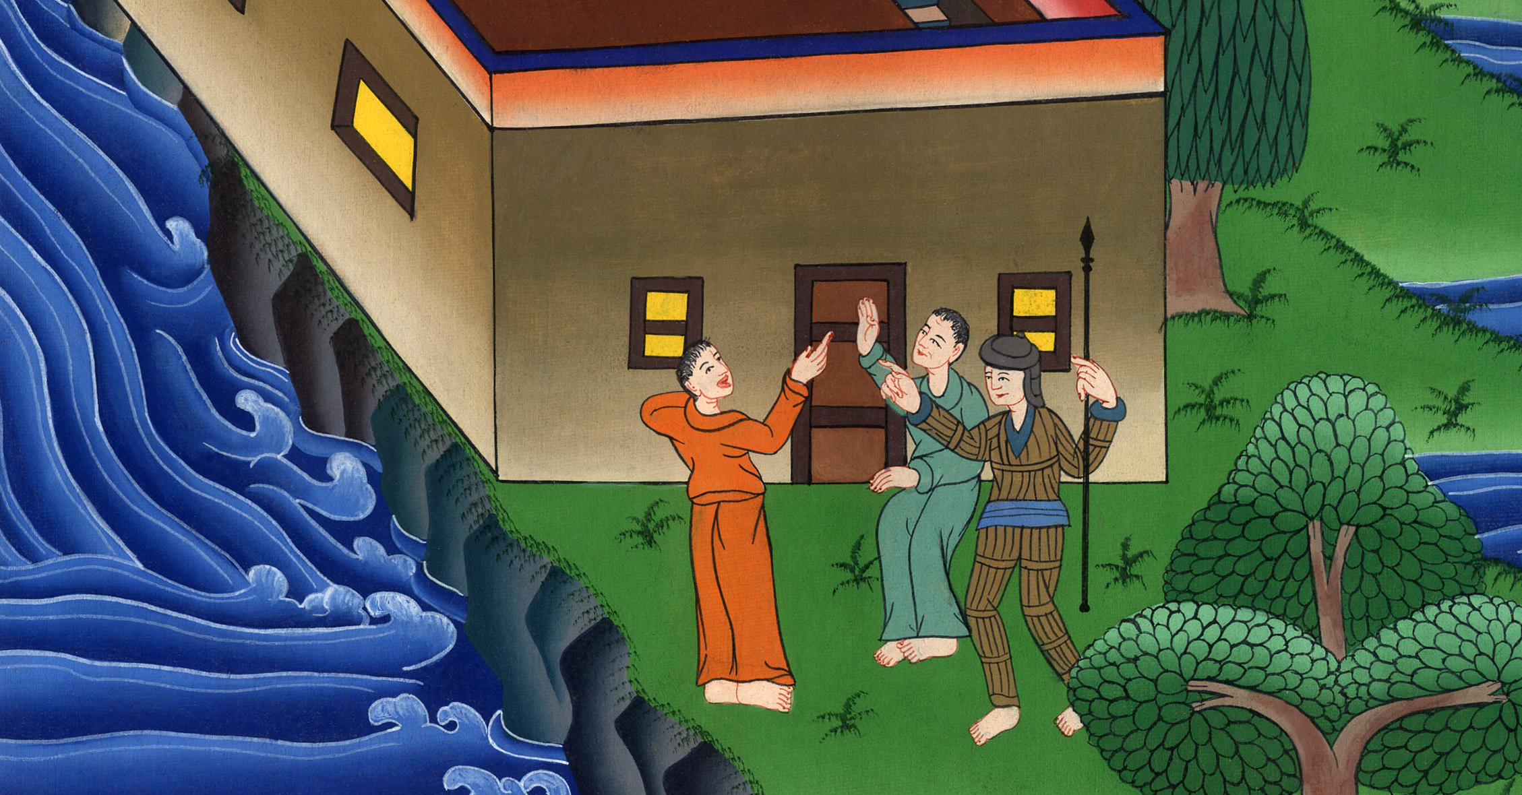
Acts 10:17,18

Slide 31
19While Peter was pondering the vision, the Spirit said to him, “Behold, three men seek you. 20But arise, get down, and go with them, doubting nothing; for I have sent them.”

Slide 32
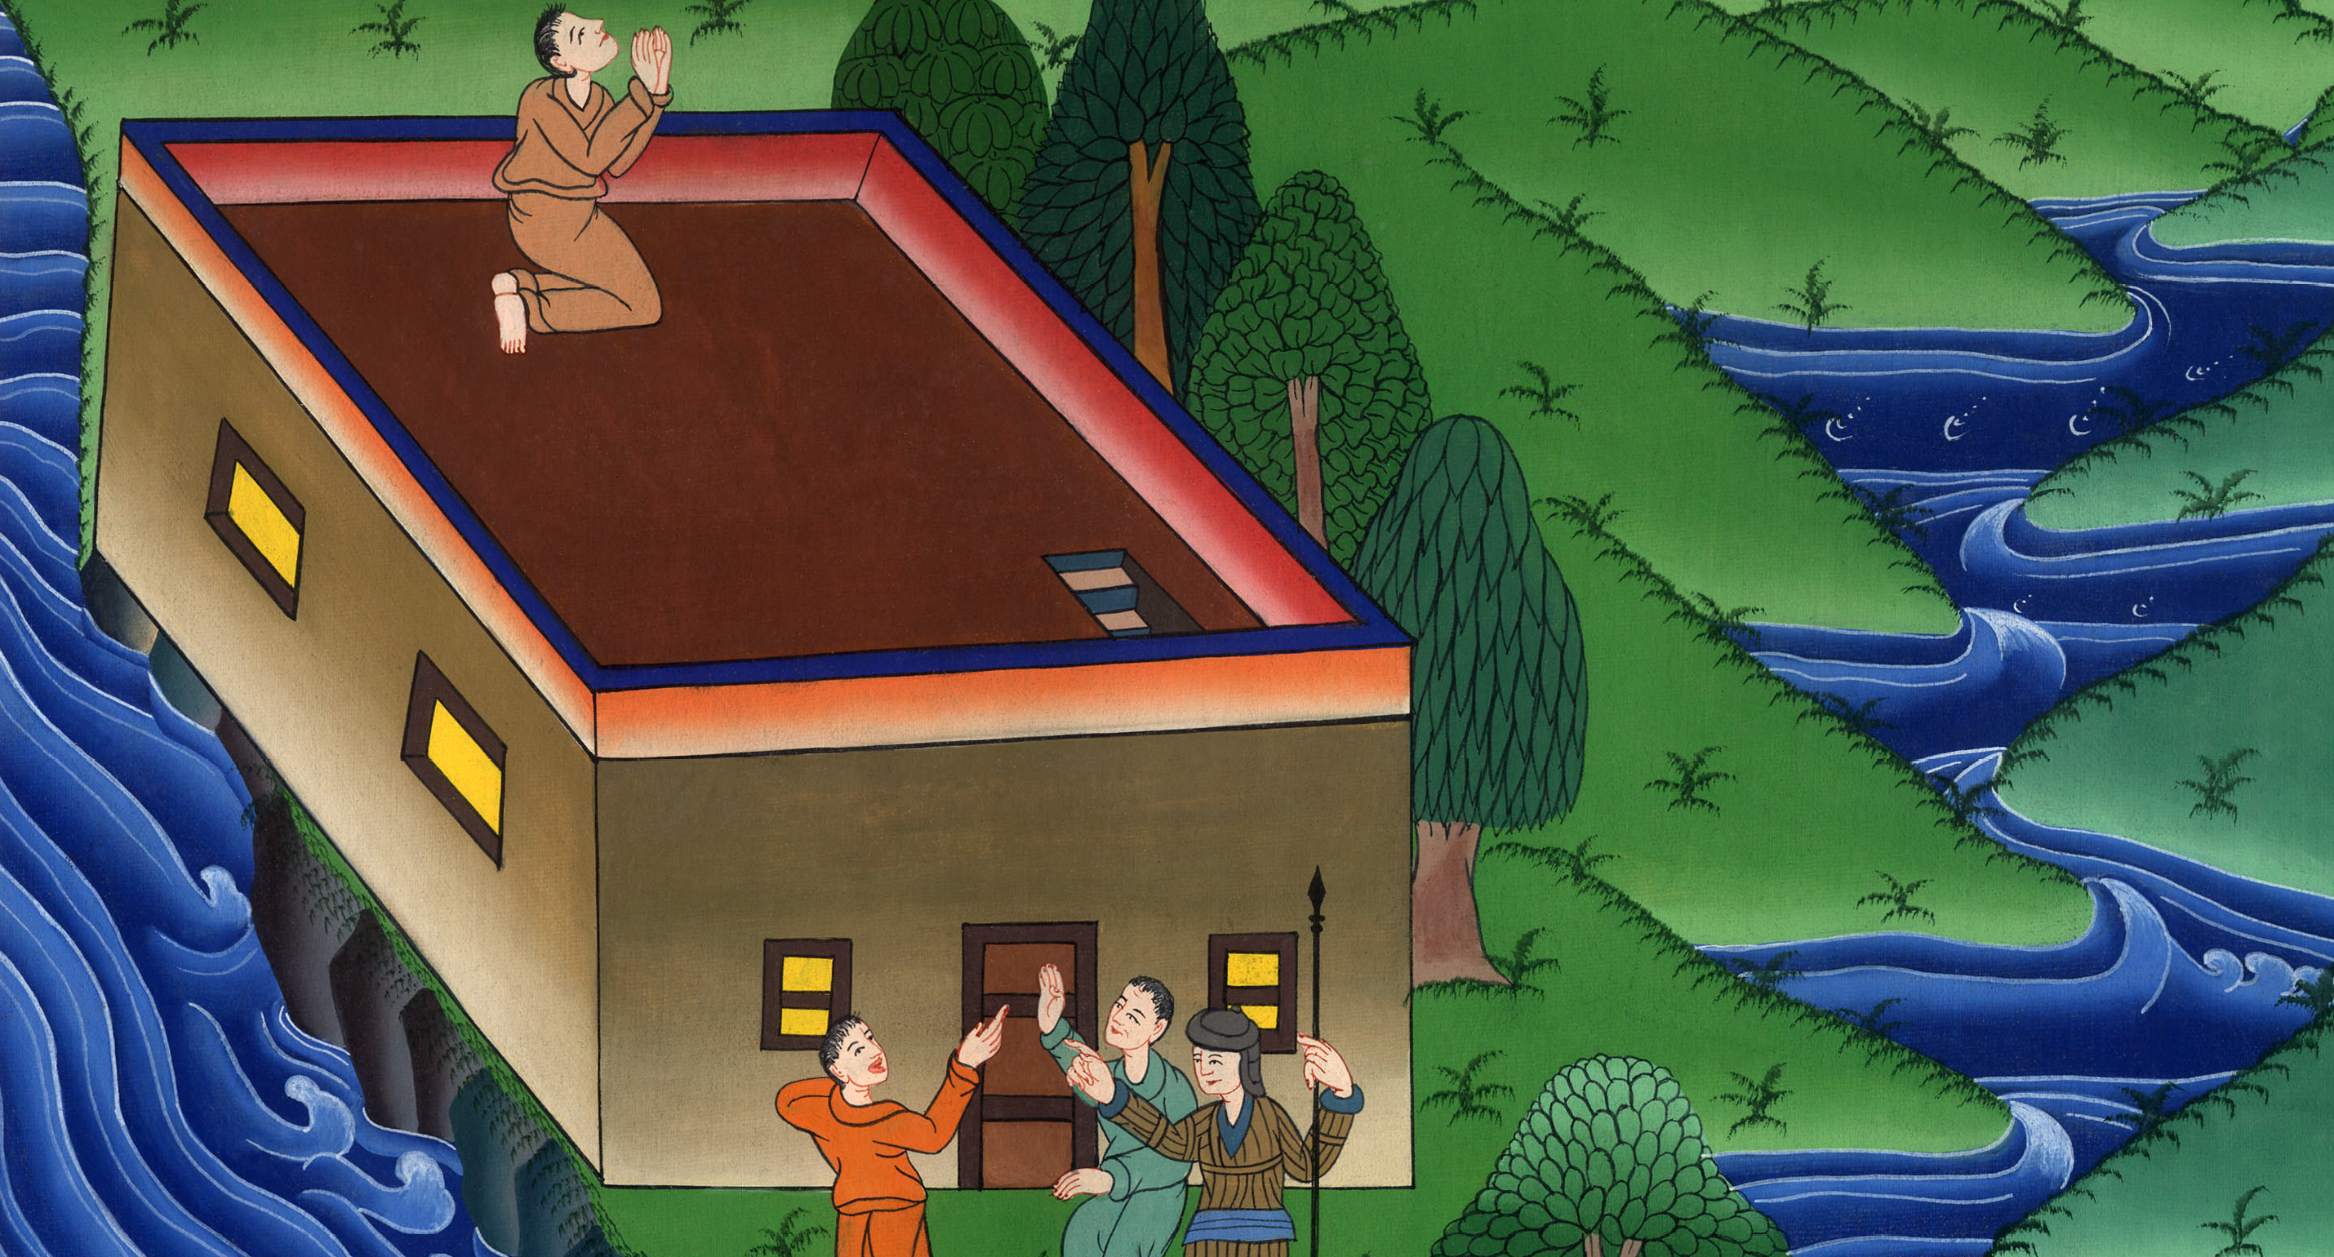
Acts 10:19,20

Slide 33
21Peter went down to the men, and said, “Behold, I am he whom you seek. Why have you come?”

Slide 34
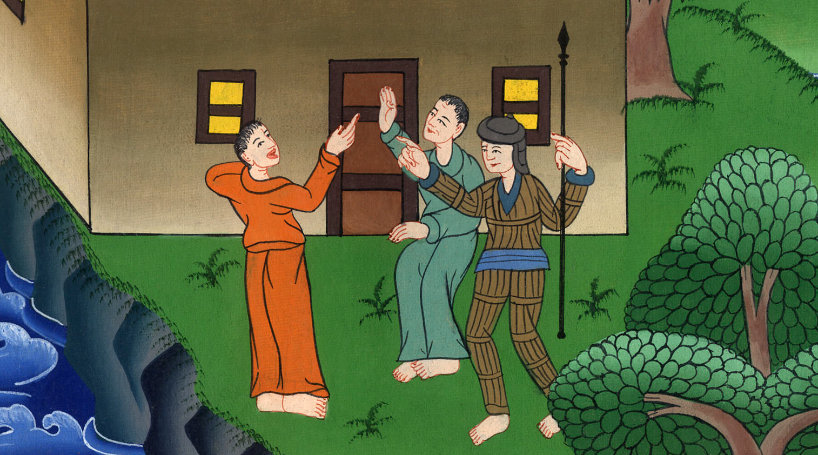
Acts 10:21

Slide 35
22They said, “Cornelius, a centurion, a righteous man and one who fears God, and well spoken of by all the nation of the Jews, was directed by a holy angel to invite you to his house, and to listen to what you say.”

Slide 36
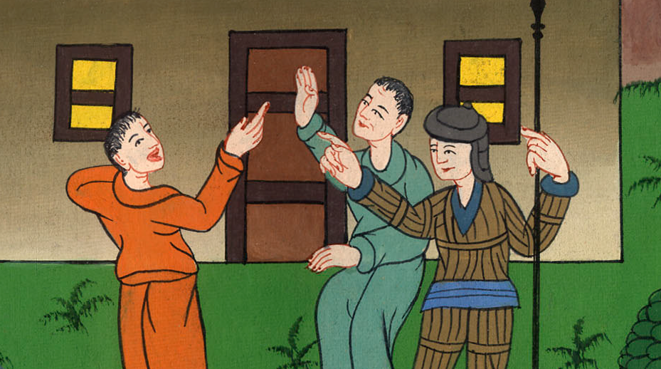
Acts 10:22

Slide 37
23So he called them in and provided a place to stay.

Slide 38
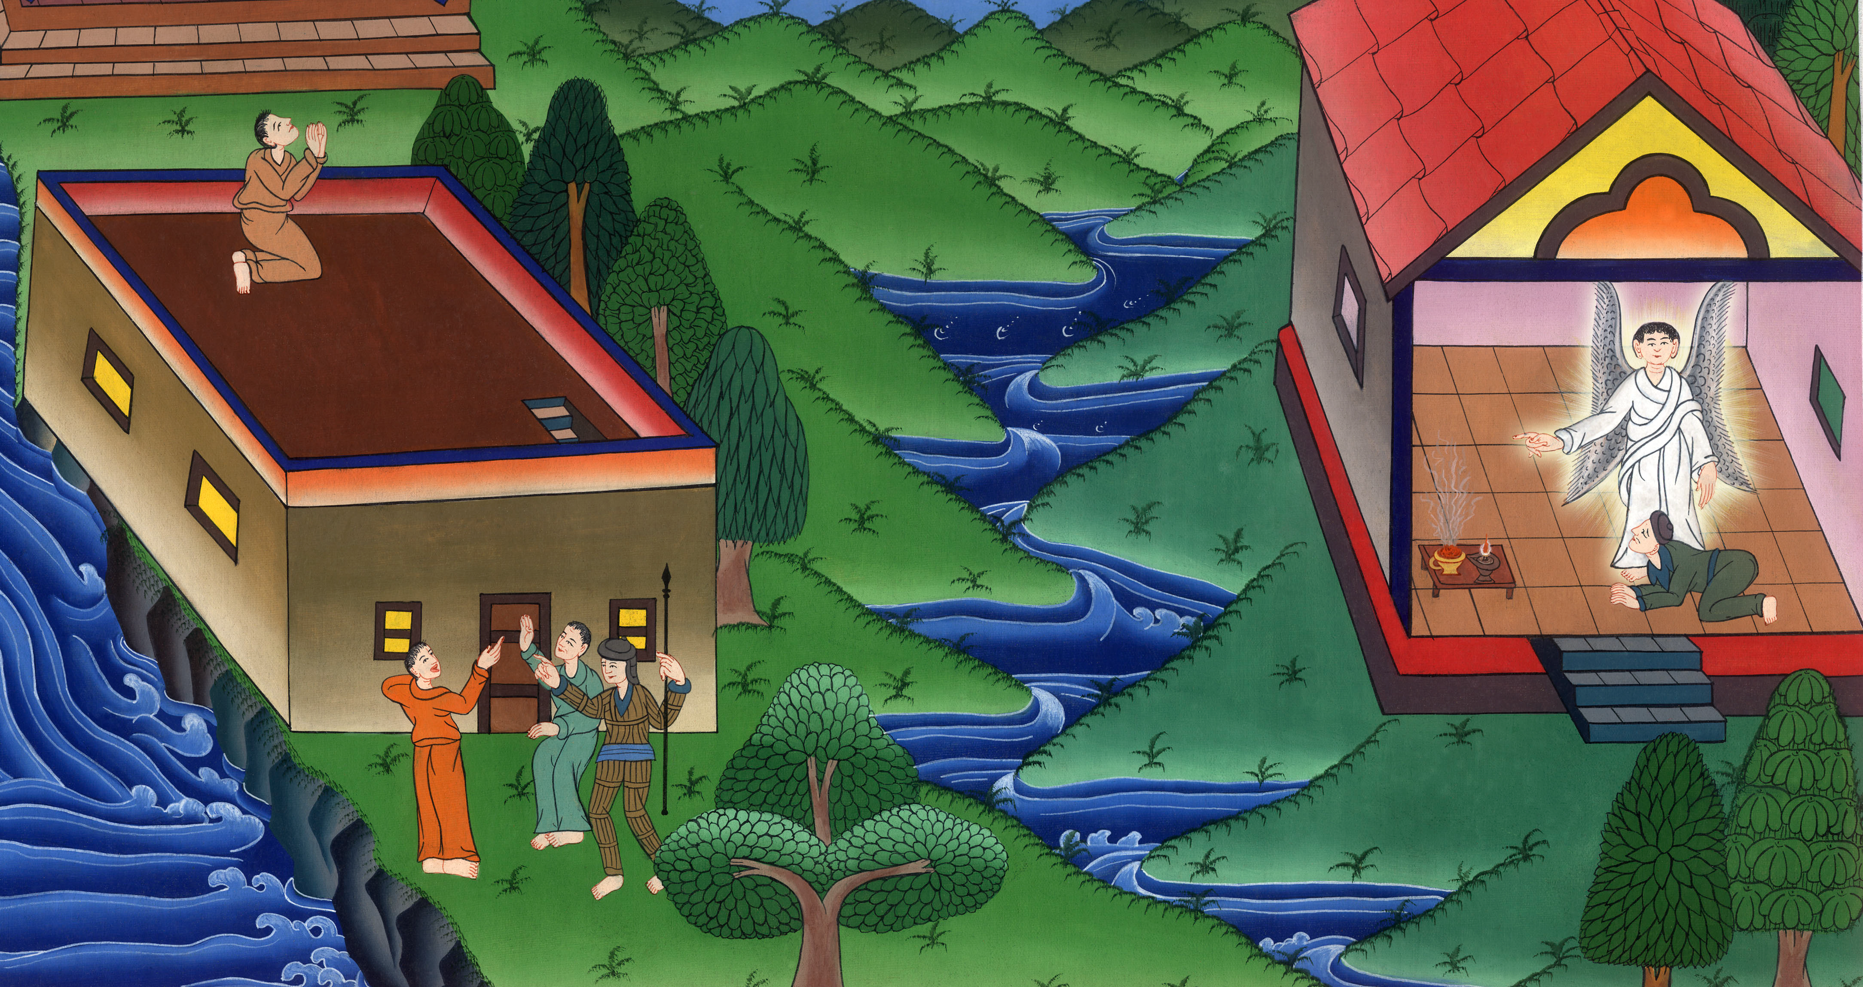
Acts 10:23

