Slide 1
49-3
This work is licensed under a Creative Commons Attribution-ShareAlike 4.0 International License.
Please add this statement to all the videos you create.
English Bible quotes are from the World English Bible US, which is in the public domain.
Notes:
Ch
49 Cornelius
1. Peter Heals Aeneas – Acts 9:32-35 (Left Top)
2. Tabitha raised – Acts 9:36-43 (Right Top)
3. Cornelius has a vision – Acts 10:1-8 (Right Bottom)
4. Peter’s vision – Acts 10:9-23 (Left Bottom and Center)
5. Cornelius Believes– Acts 10:24 – 11:18 (Left Center)

Slide 2
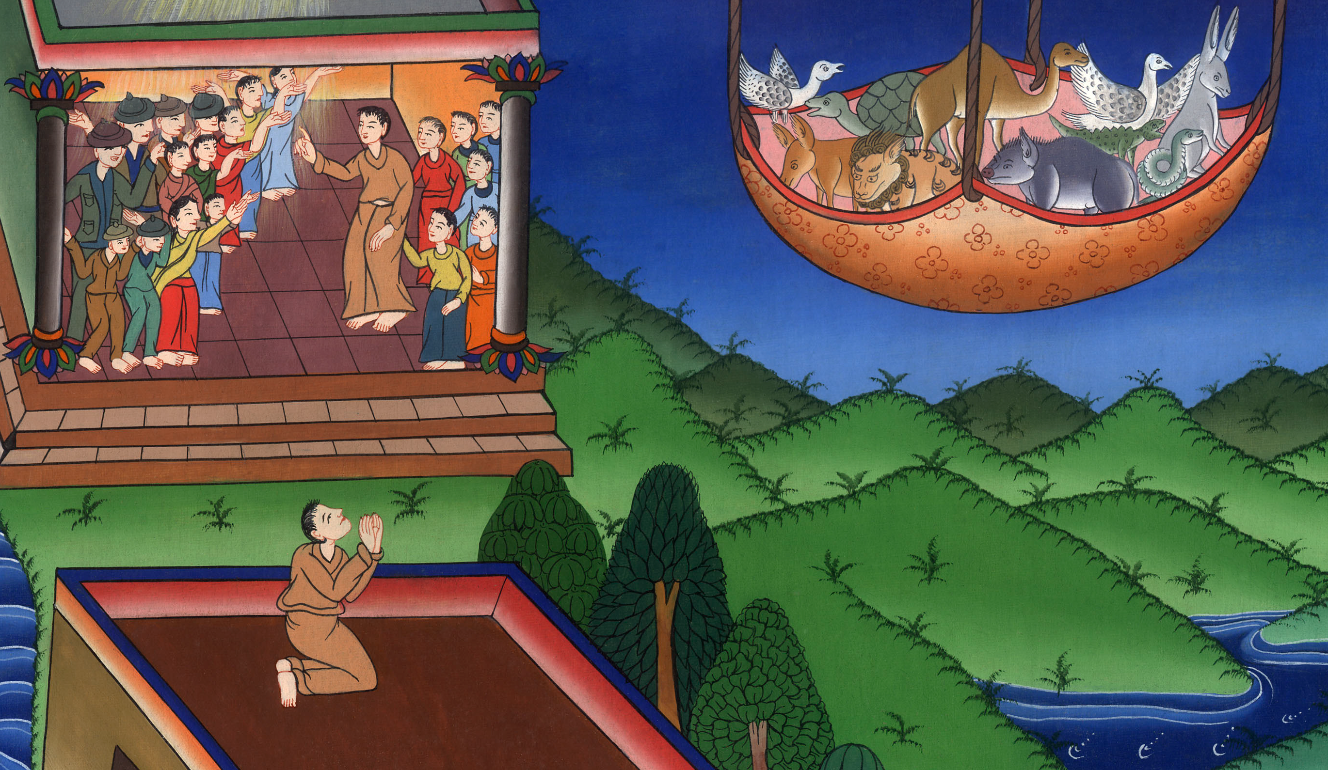
Cornelius Believes – Acts 10:24 – 11:18

Slide 3
Cornelius Believes – Acts 10:24 – 11:18

Slide 4
Cornelius Believes – Acts 10:24 – 11:18

Slide 5
23…On the next day Peter arose and went out with them, and some of the brothers from Joppa accompanied him.

Slide 6
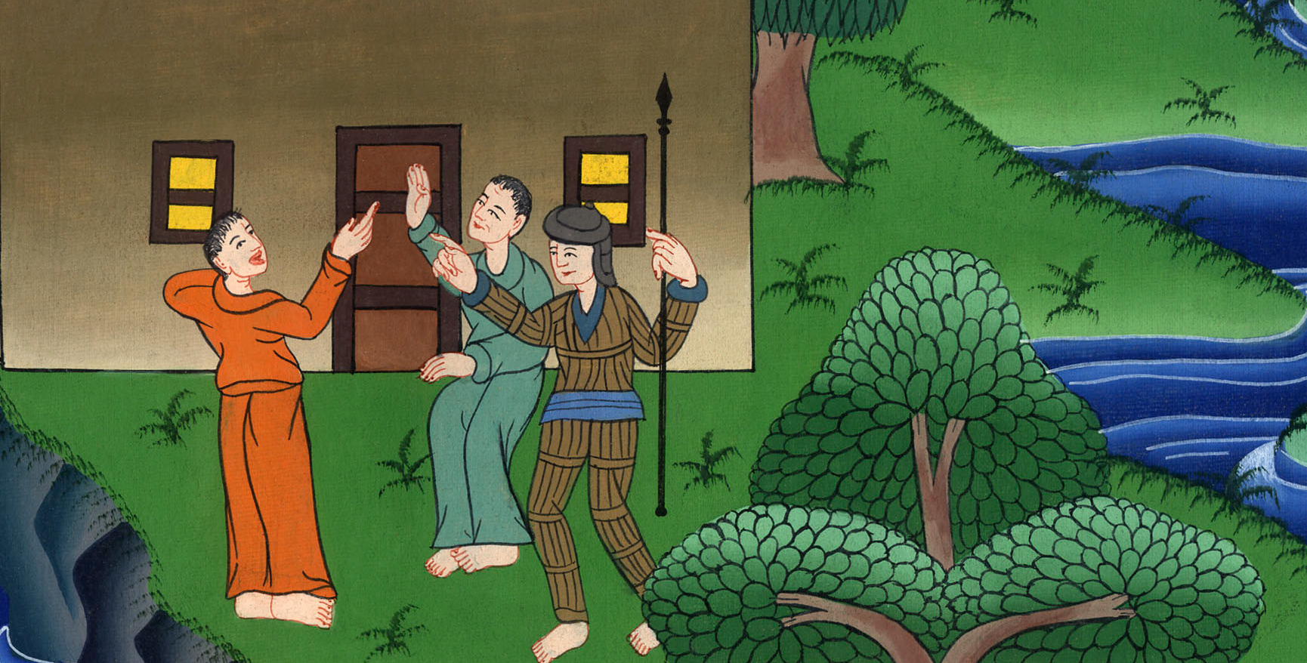
Acts 10:23

Slide 7
24On the next day they entered into Caesarea. Cornelius was waiting for them, having called together his relatives and his near friends.

Slide 8
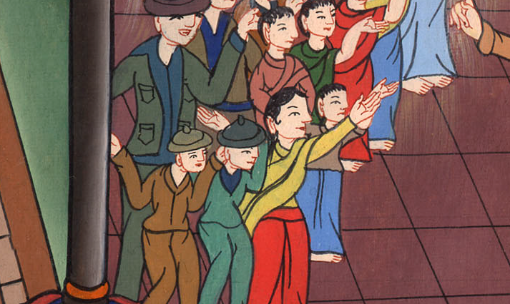
Acts 10:24

Slide 9
25When Peter entered, Cornelius met him, fell down at his feet, and worshiped him. 26But Peter raised him up, saying, “Stand up! I myself am also a man.”

Slide 10
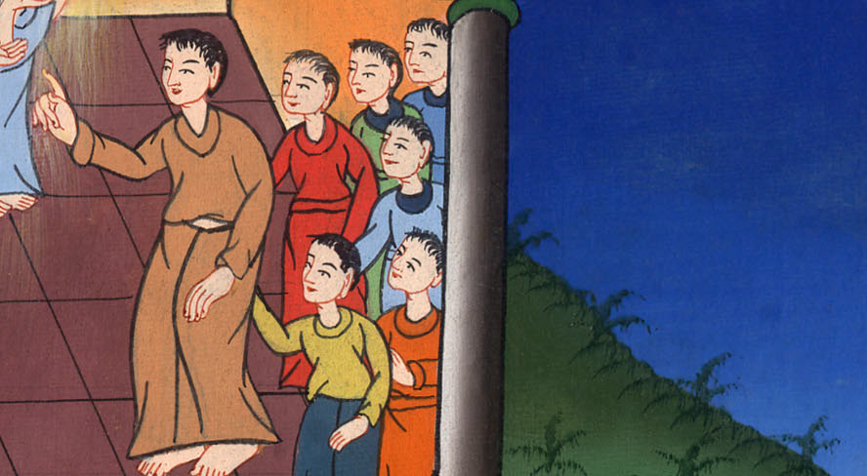
Acts 10:25,26

Slide 11
27As he talked with him, he went in and found many gathered together.

Slide 12
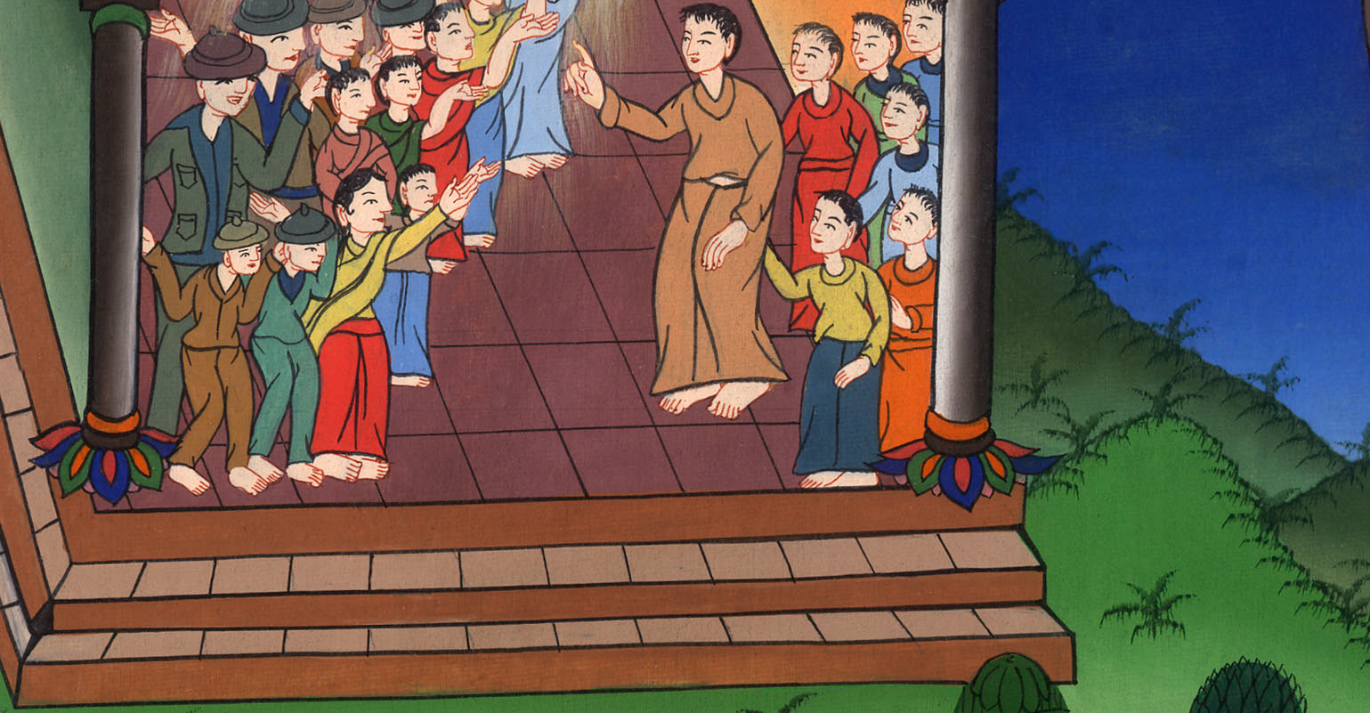
Acts 10:27

Slide 13
28He said to them, “You yourselves know how it is an unlawful thing for a man who is a Jew to join himself or come to one of another nation, but God has shown me that I shouldn’t call any man unholy or unclean.

Slide 14
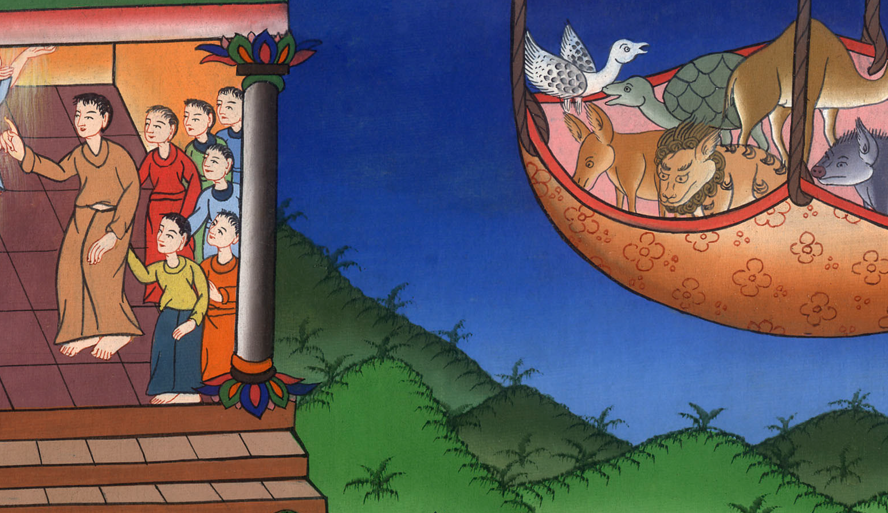
Acts 10:28

Slide 15
29Therefore I also came without complaint when I was sent for. I ask therefore, why did you send for me?”

Slide 16
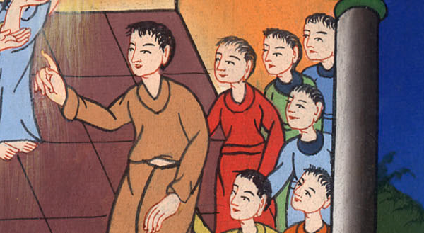
Acts 10:29

Slide 17
30Cornelius said, “Four days ago, I was fasting until this hour; and at the ninth hour, I prayed in my house, and behold, a man stood before me in bright clothing

Slide 18
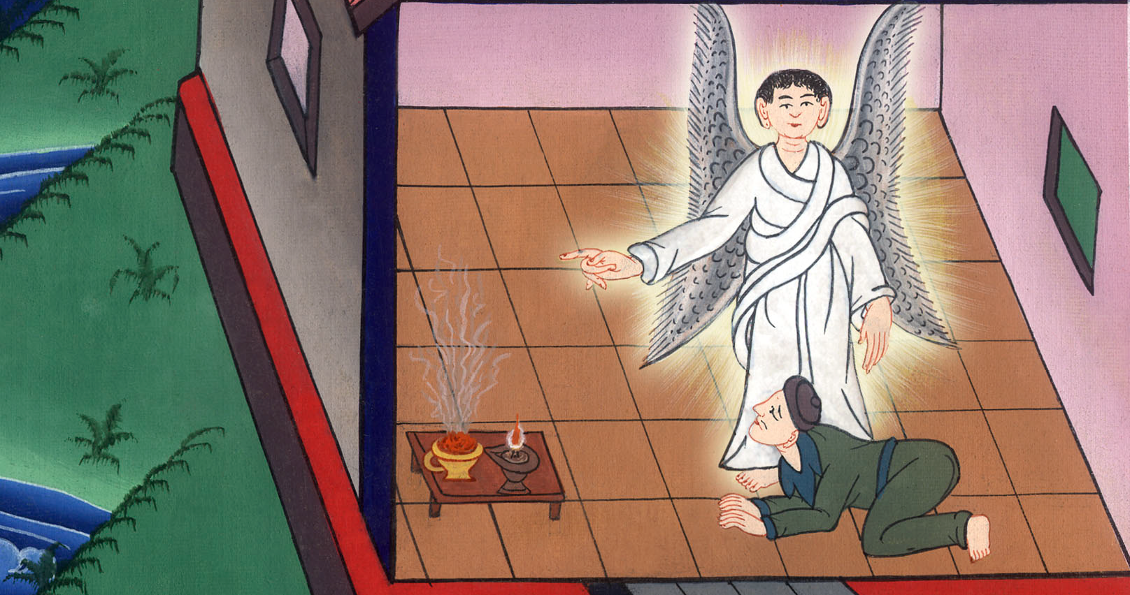
Acts 10:30

Slide 19
31and said, ‘Cornelius, your prayer is heard, and your gifts to the needy are remembered in the sight of God.

Slide 20
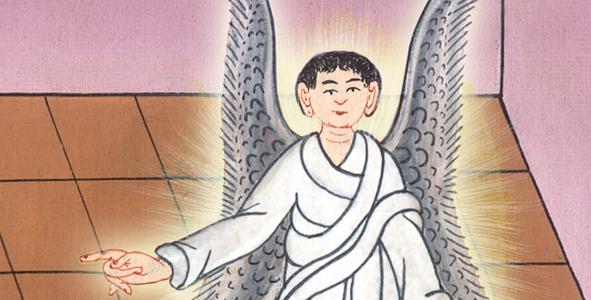
Acts 10:31

Slide 21
32Send therefore to Joppa and summon Simon, who is also called Peter. He is staying in the house of a tanner named Simon, by the seaside. When he comes, he will speak to you.’

Slide 22
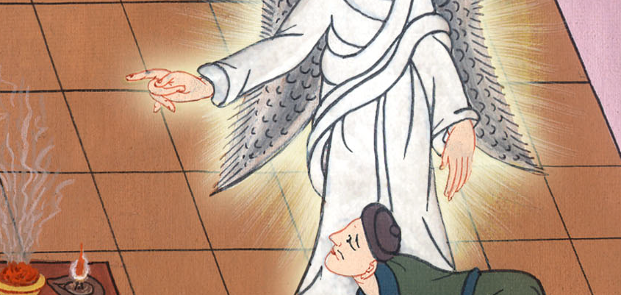
Acts 10:32

Slide 23
33Therefore I sent to you at once, and it was good of you to come. Now therefore we are all here present in the sight of God to hear all things that have been commanded you by God.”

Slide 24
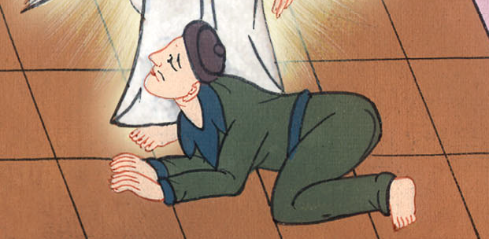
Acts 10:33

Slide 25
34Peter opened his mouth and said, “Truly I perceive that God doesn’t show favoritism; 35but in every nation he who fears him and works righteousness is acceptable to him.

Slide 26
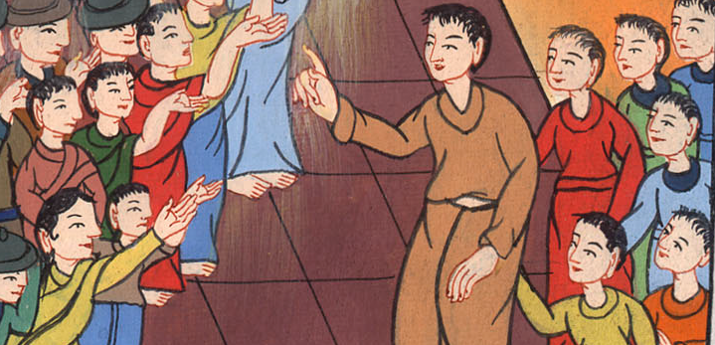
Acts 10:34,35

Slide 27
36The word which he sent to the children of Israel, preaching good news of peace by Jesus Christ—he is Lord of all—

Slide 28
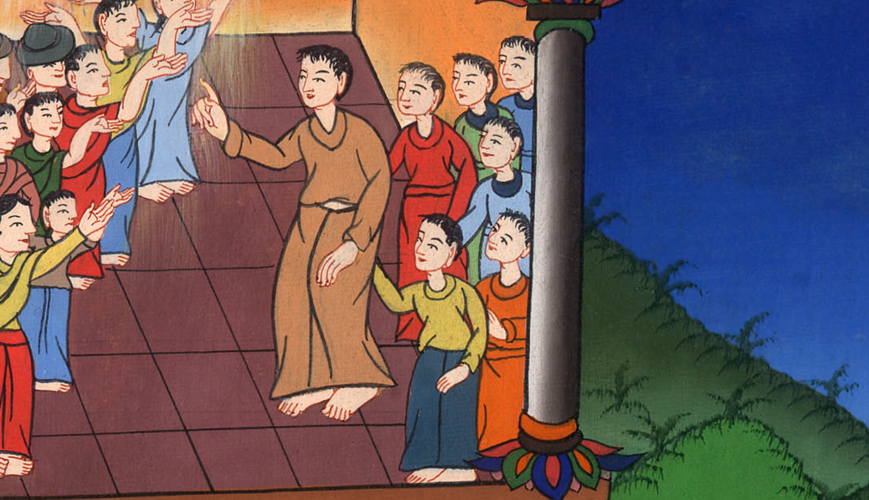
Acts 10:36

Slide 29
38how God anointed Jesus of Nazareth with the Holy Spirit and with power, who went about doing good and healing all who were oppressed by the devil, for God was with him.

Slide 30
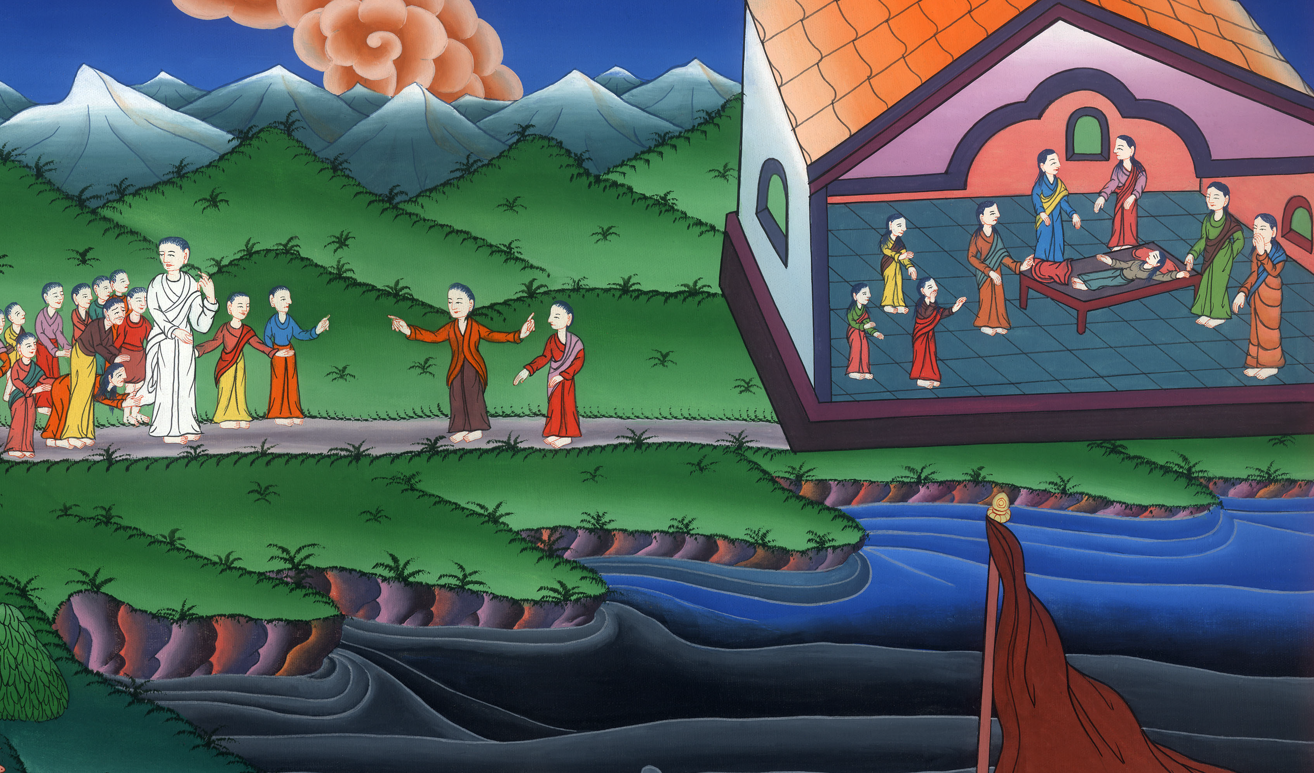
Acts 10:38

Slide 31
39We are witnesses of everything he did both in the country of the Jews and in Jerusalem; whom they also killed, hanging him on a tree. 40God raised him up the third day

Slide 32
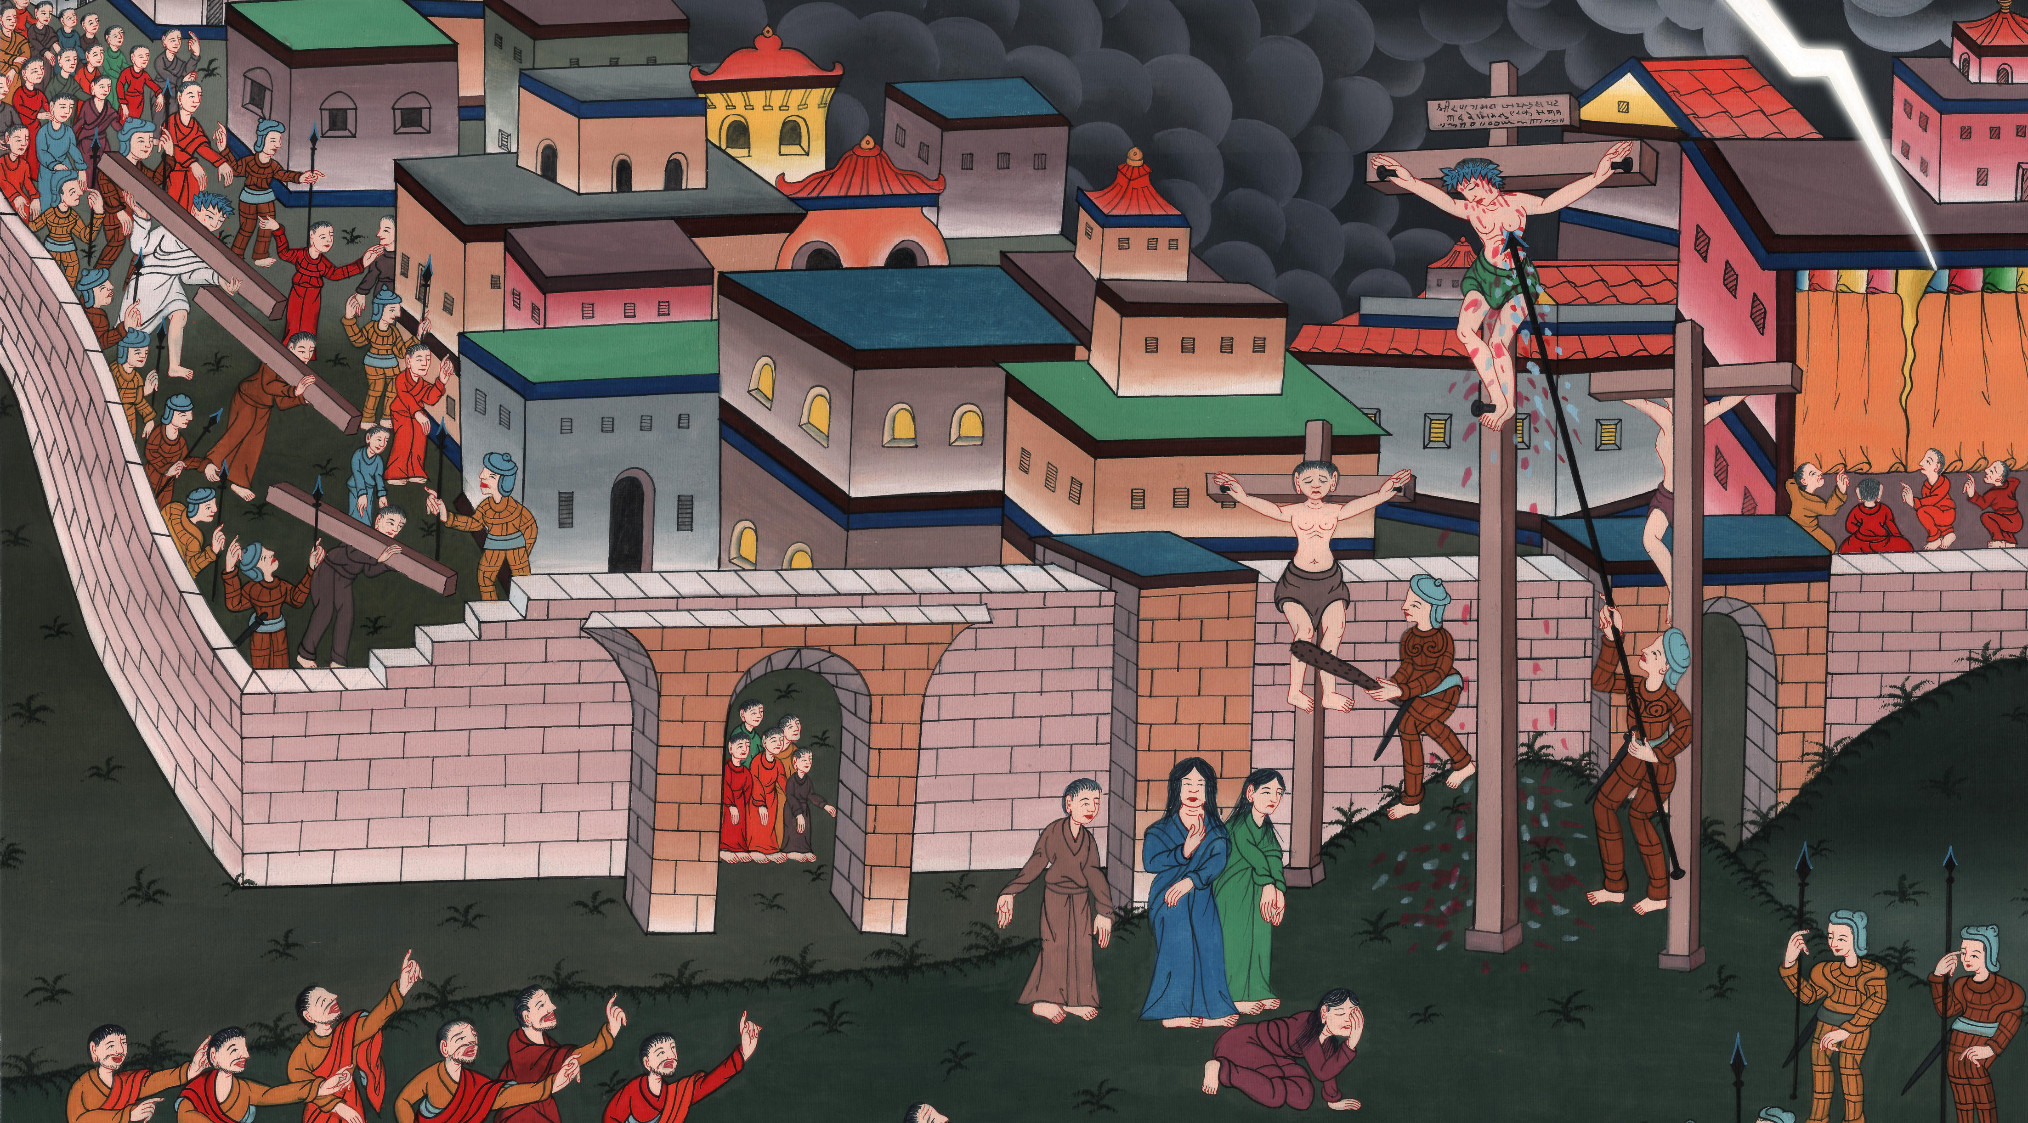
Acts 10:39,40

Slide 33
God allowed Jesus to be seen. 41But he wasn’t seen by all the people. He was seen only by us. We are witnesses whom God had already chosen. We ate and drank with him after he rose from the dead.

Slide 34
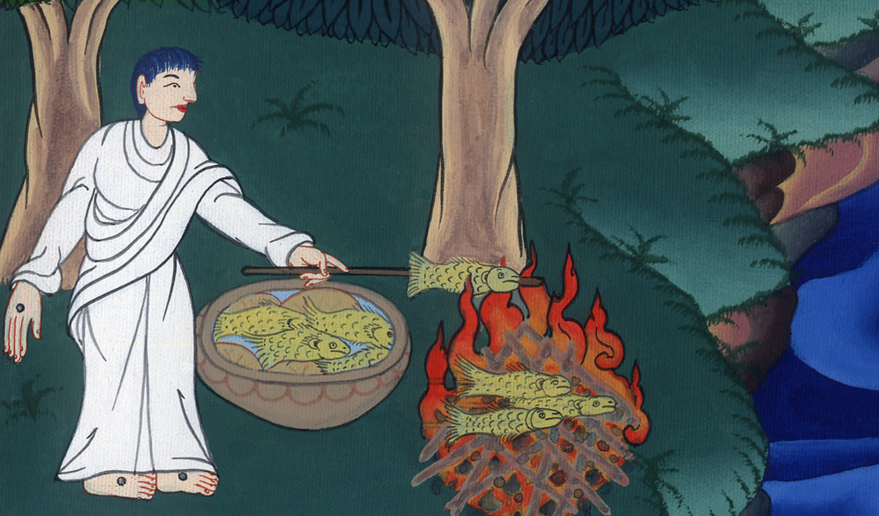
མཛད་པ། 10:41
Acts

Slide 35
42He commanded us to preach to the people and to testify that this is he who is appointed by God as the Judge of the living and the dead.

Slide 36
Acts 10:42

Slide 37
43All the prophets testify about him, that through his name everyone who believes in him will receive remission of sins.”

Slide 38
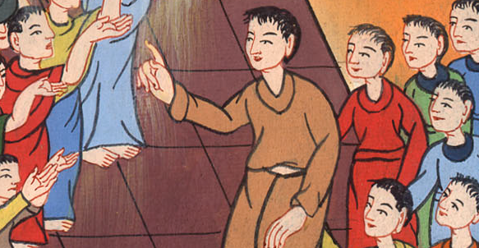
Acts 10:43

Slide 39
44While Peter was still speaking, the Holy Spirit came on all who heard the message.

Slide 40
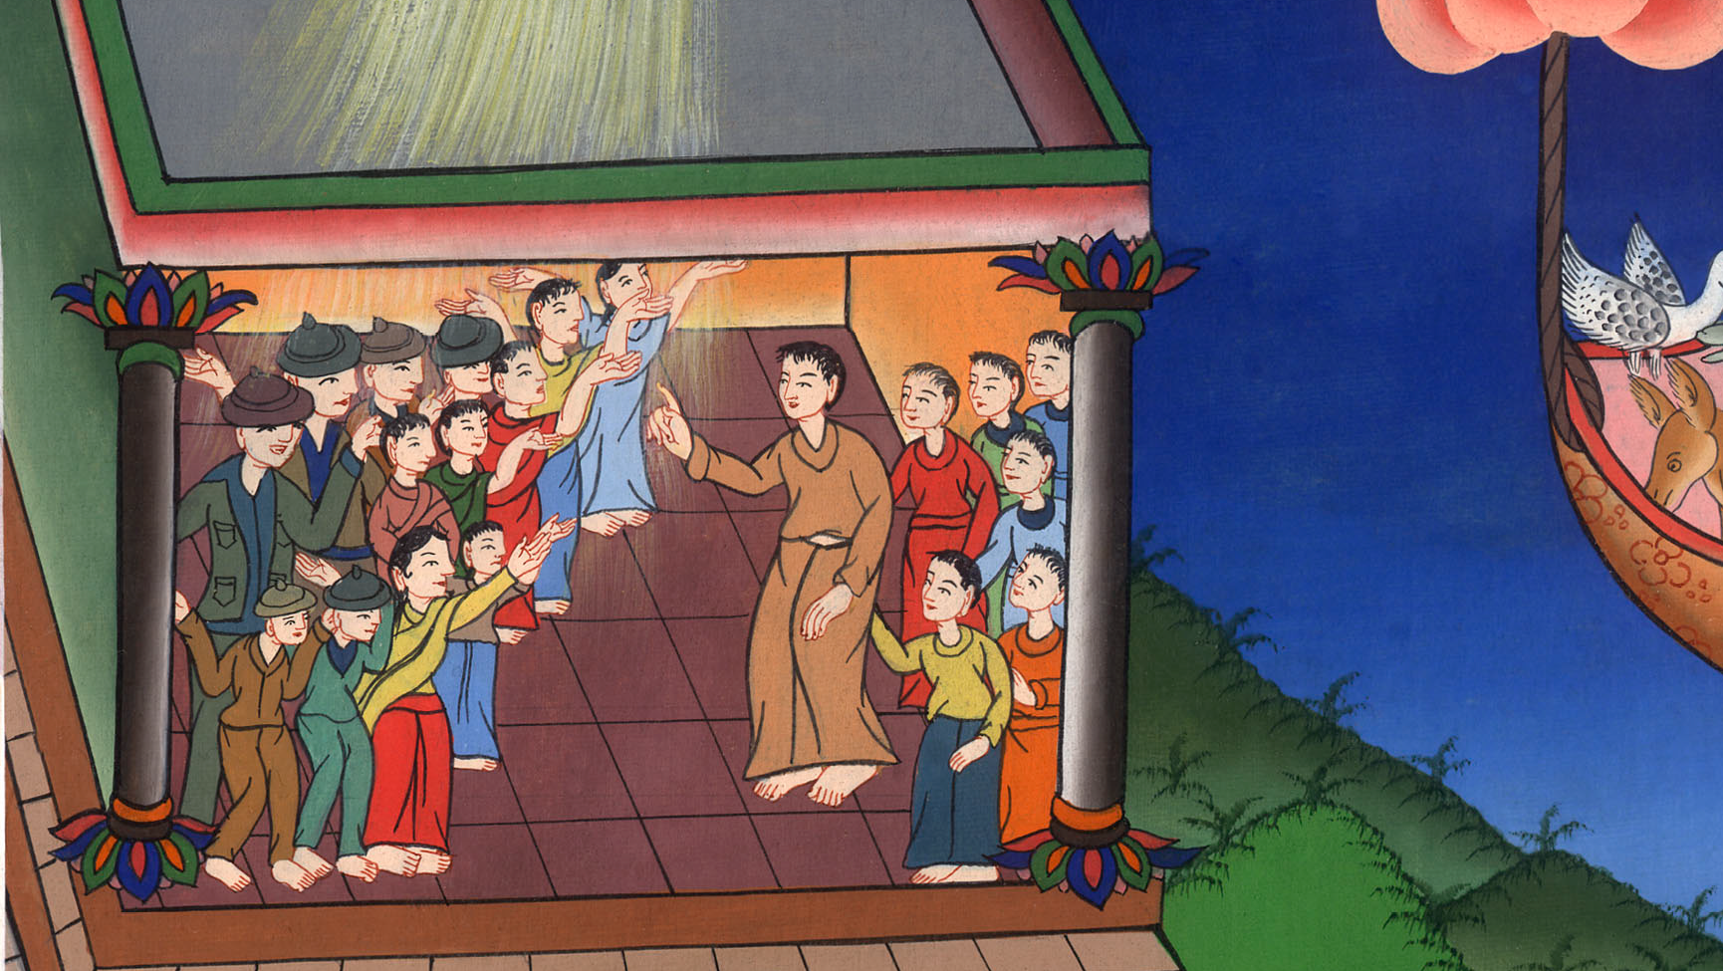
Acts 10:44

Slide 41
45They of the circumcision who believed were amazed, as many as came with Peter, because the gift of the Holy Spirit was also poured out on the Gentiles.

Slide 42
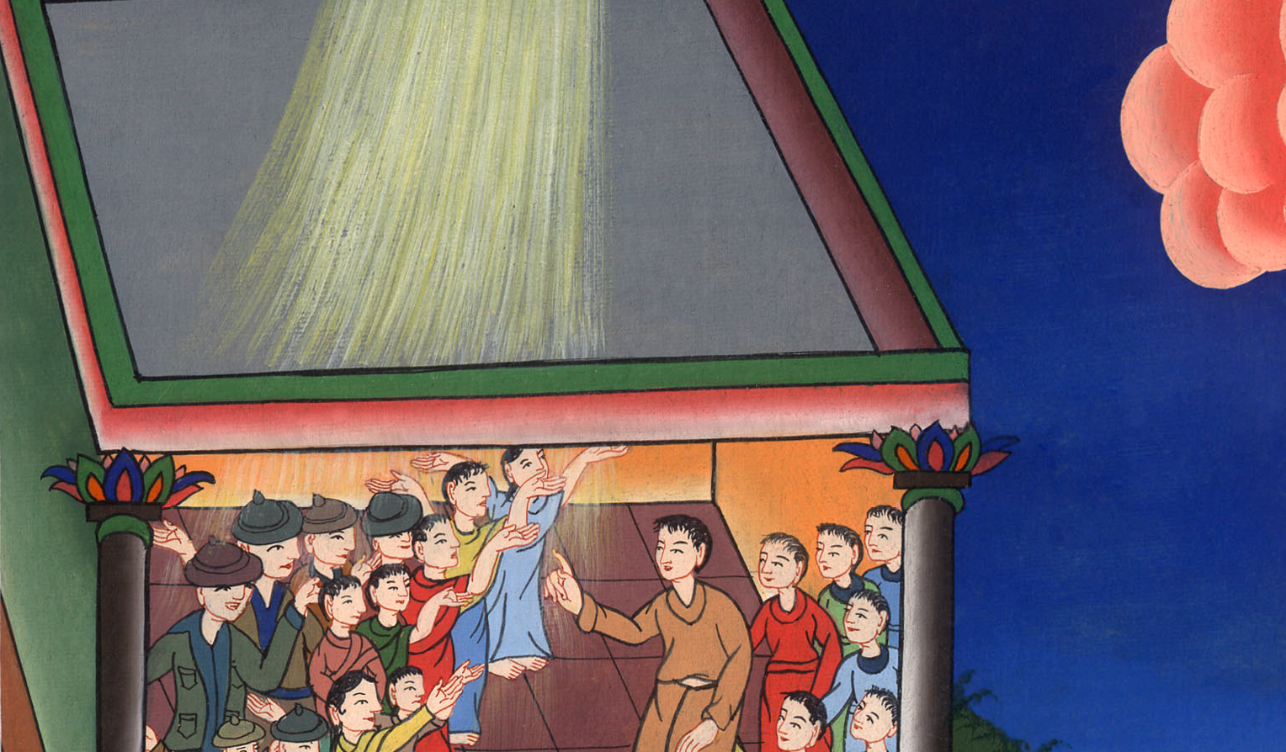
Acts 10:45

Slide 43
46For they heard them speaking in other languages and magnifying God.

Slide 44
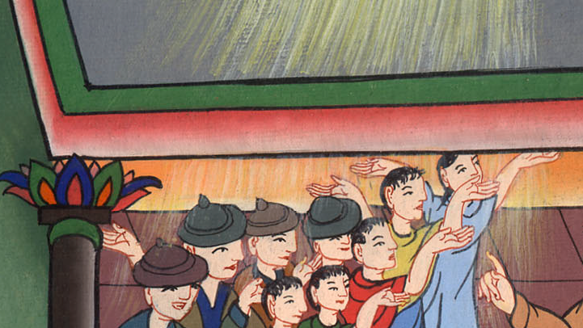
Acts 10:46

Slide 45
Then Peter answered, 47“Can anyone forbid these people from being baptized with water? They have received the Holy Spirit just like us.”

Slide 46
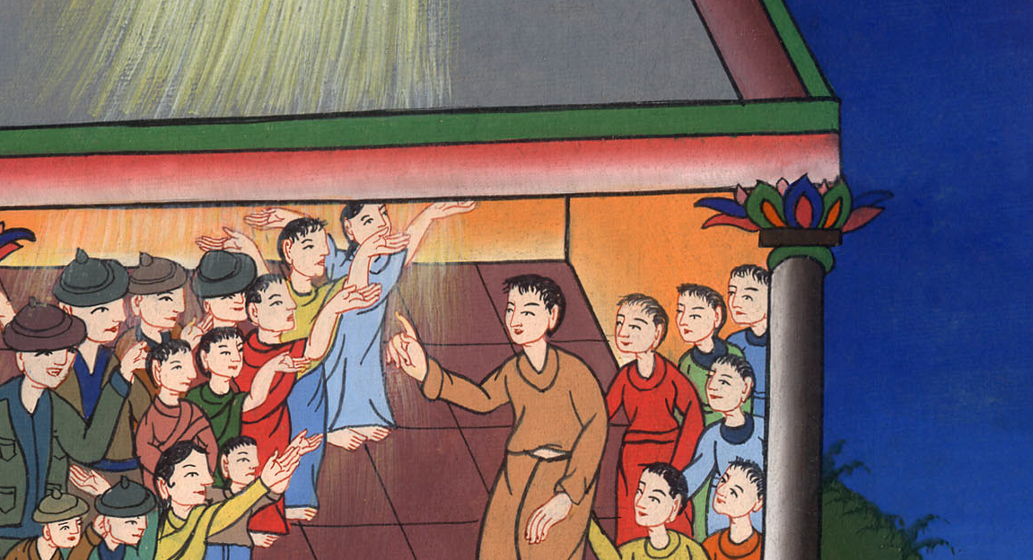
Acts 10:47

Slide 47
48He commanded them to be baptized in the name of Jesus Christ. Then they asked him to stay some days.

Slide 48
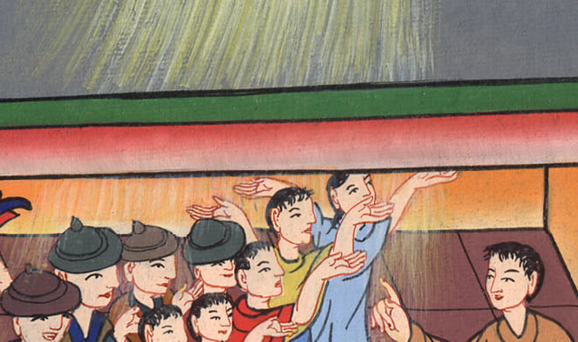
Acts 10:48

Slide 49
(When peter returned to Jerusalem, The Jews there were unhappy about Peter preaching to Gentiles.)He finally told them:
15“As I began to speak, the Holy Spirit came on them. He came just as he had come on us at the beginning.

Slide 50
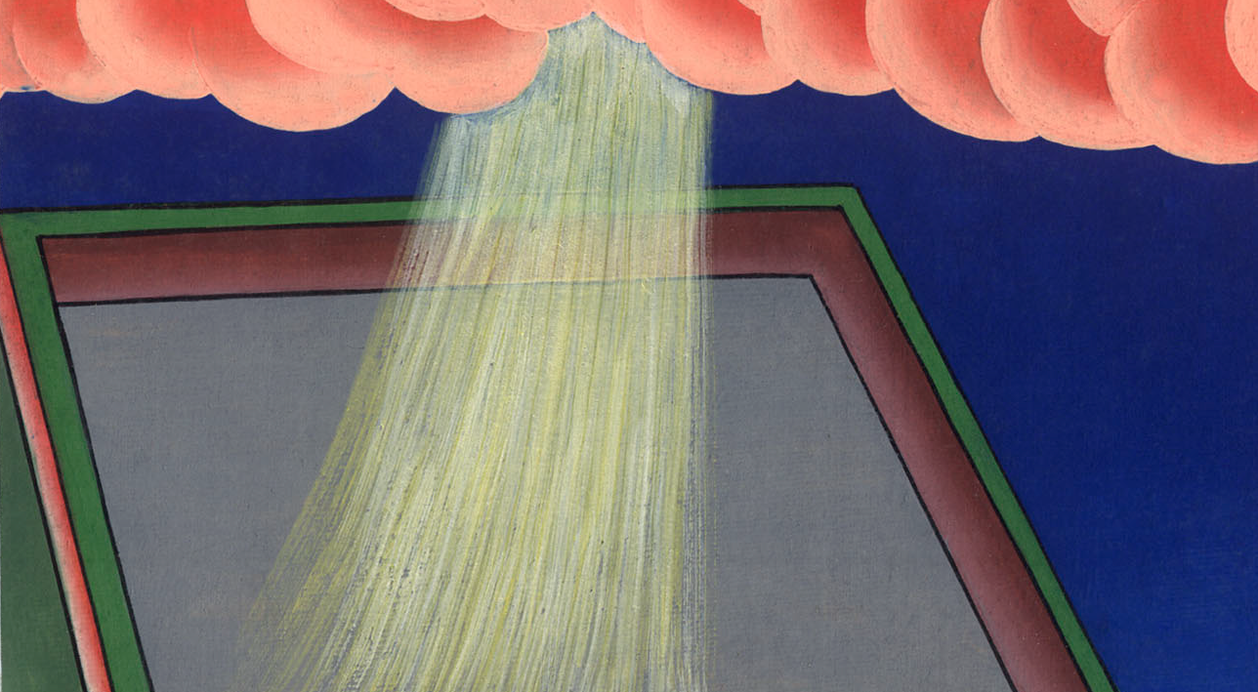
Acts 11:15

Slide 51
17God gave them the same gift he gave those of us who believed in the Lord Jesus Christ. So who was I to think that I could stand in God’s way?”

Slide 52
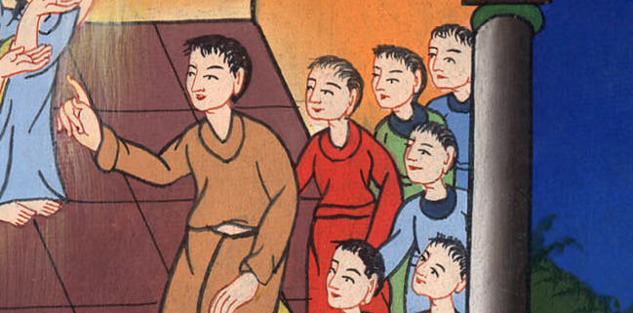
Acts 11:17

Slide 53
18When they heard this, they didn’t object anymore. They praised God. They said, “So then, God has allowed even Gentiles to turn away from their sins. He did this so that they could live.”

Slide 54
Acts 11:18

