Slide 1
50-1
This work is licensed under a Creative Commons Attribution-ShareAlike 4.0 International License.
Please add this statement to all the videos you create.
English Bible quotes are from the World English Bible US, which is in the public domain.
Notes:
Ch
50 Peter Arrested
1. James killed –Acts 12:1-2 (Left Top)
2. Peter arrested – Acts 12:3-11 (Right Top)
3. Peter goes to Mary’s House – Acts 12:12-17 (Right Bottom)
4. Herod kills guards – Acts 12:18-19 (Left Bottom)
5. Herod dies – Acts 12:20-25 (Left Center)

Slide 2
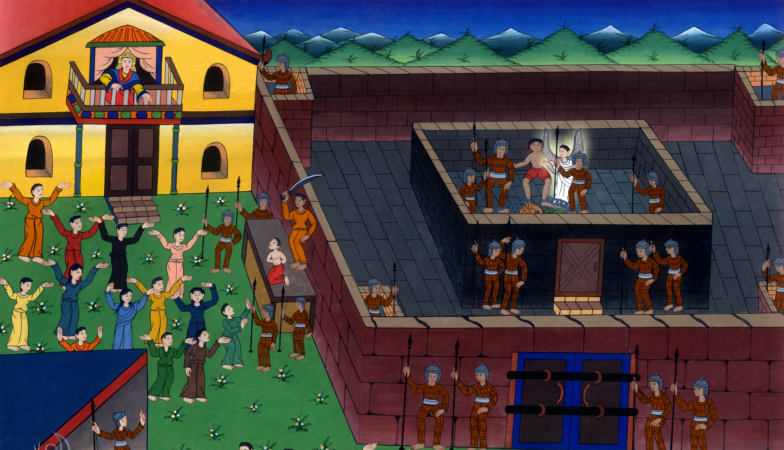
Peter Arrested –Acts 12:1-11

Slide 3
Peter Arrested –Acts 12:1-11

Slide 4
Peter Arrested –Acts 12:1-11

Slide 5
1Now about that time, King Herod stretched out his hands to oppress some of the assembly.

Slide 6
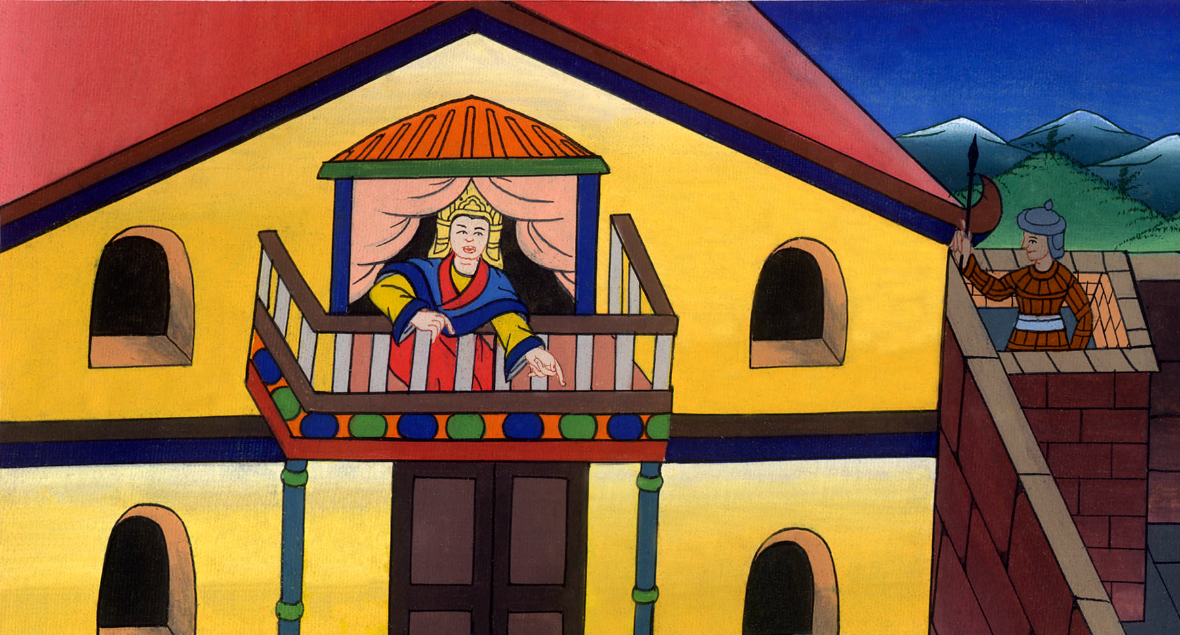
Acts 12:1

Slide 7
2He killed James, the brother of John, with the sword.

Slide 8
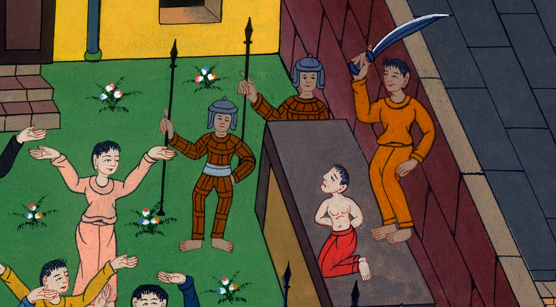
Acts 12:2

Slide 9
3When he saw that it pleased the Jews, he proceeded to seize Peter also. This was during the days of unleavened bread.

Slide 10
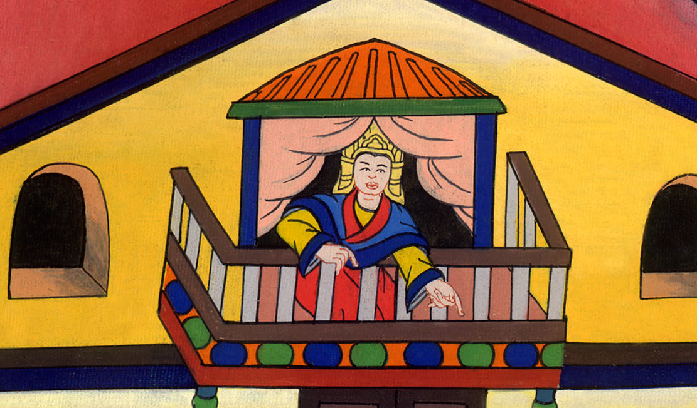
Acts 12:3

Slide 11
4When he had arrested him, he put him in prison and delivered him to four squads of four soldiers each to guard him, intending to bring him out to the people after the Passover.

Slide 12
Acts 12:4

Slide 13
5Peter therefore was kept in the prison, but constant prayer was made by the assembly to God for him.

Slide 14
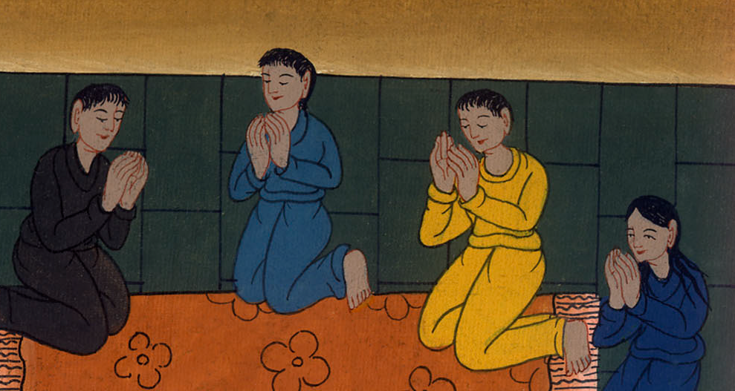
མཛད་པ། 12:5
Acts 12:5

Slide 15
6The same night when Herod was about to bring him out, Peter was sleeping between two soldiers, bound with two chains. Guards in front of the door kept the prison.

Slide 16
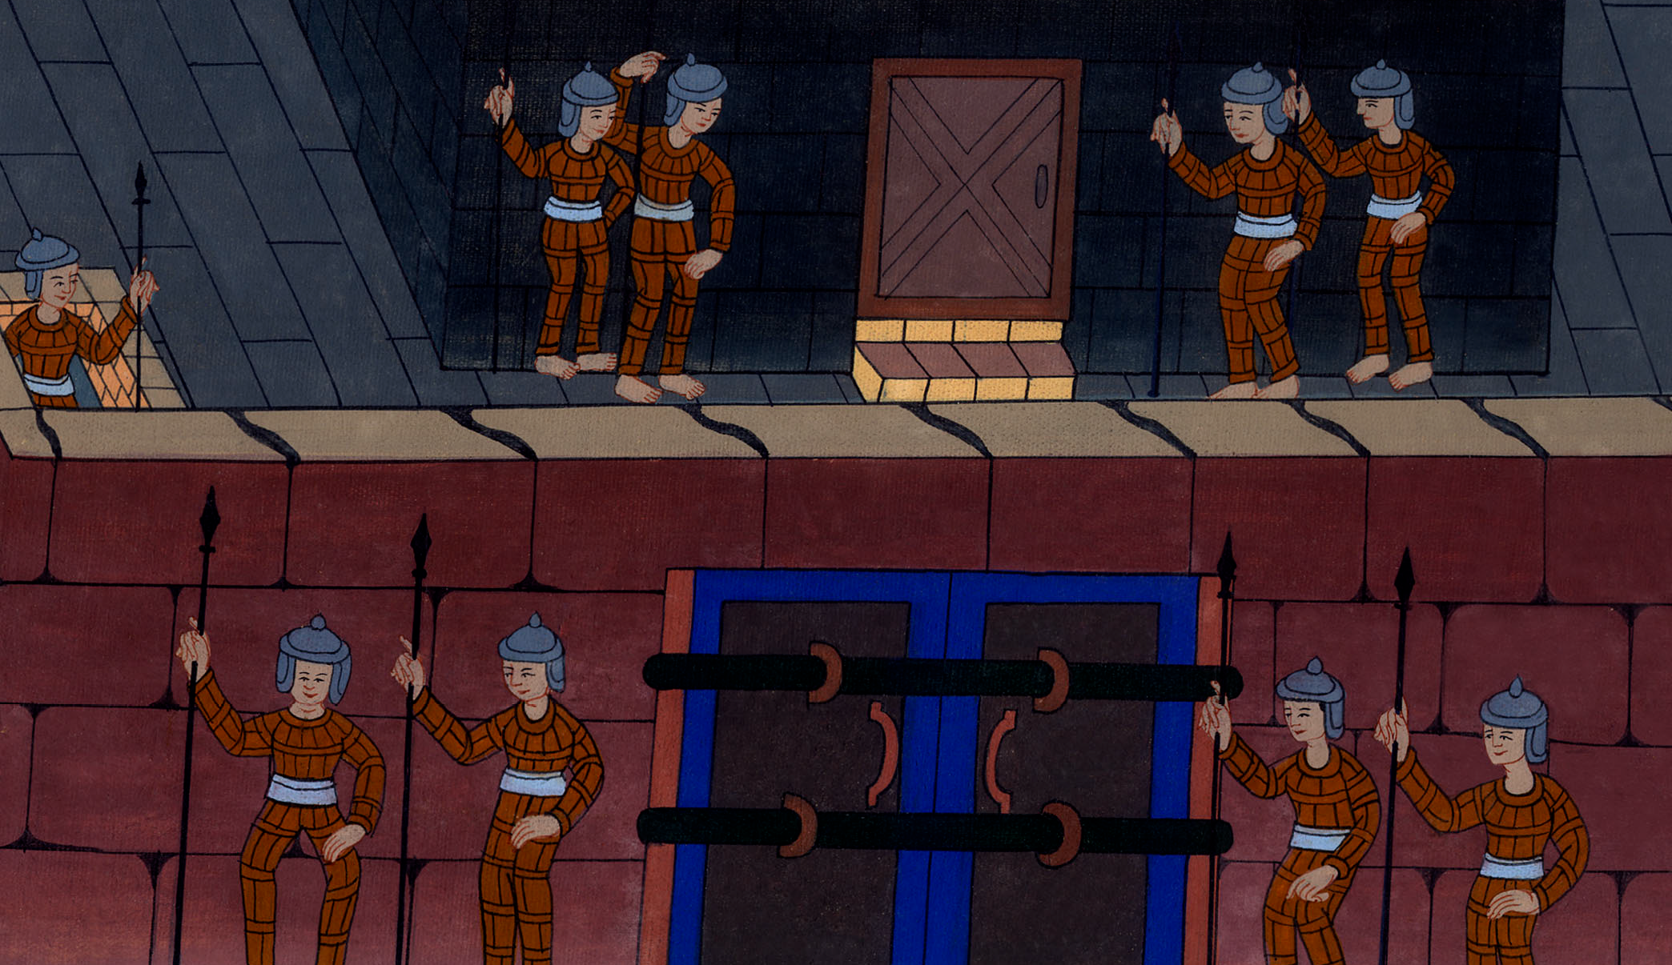
Acts 12:6

Slide 17
7And behold, an angel of the Lord stood by him, and a light shone in the cell. He struck Peter on the side and woke him up, saying, “Stand up quickly!” His chains fell off his hands.

Slide 18
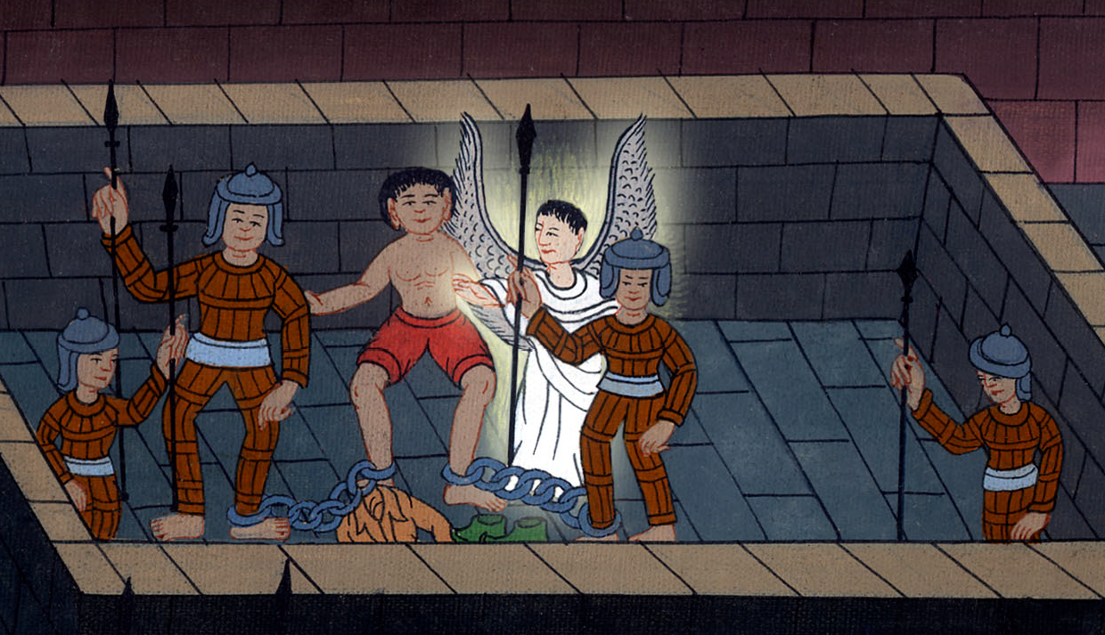
Acts 12:7

Slide 19
8The angel said to him, “Get dressed and put on your sandals.” He did so. He said to him, “Put on your cloak and follow me.”

Slide 20
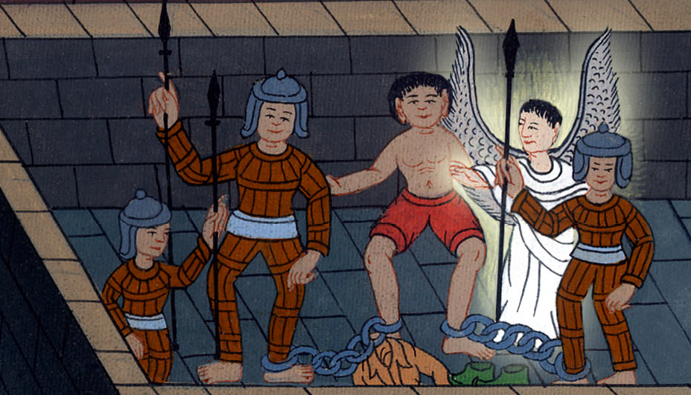
Acts 12:8

Slide 21
9And he went out and followed him. He didn’t know that what was being done by the angel was real, but thought he saw a vision.

Slide 22
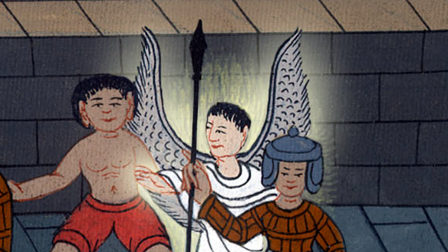
Acts 12:9

Slide 23
10When they were past the first and the second guard, they came to the iron gate that leads into the city, which opened to them by itself. They went out and went down one street, and immediately the angel departed from him.

Slide 24
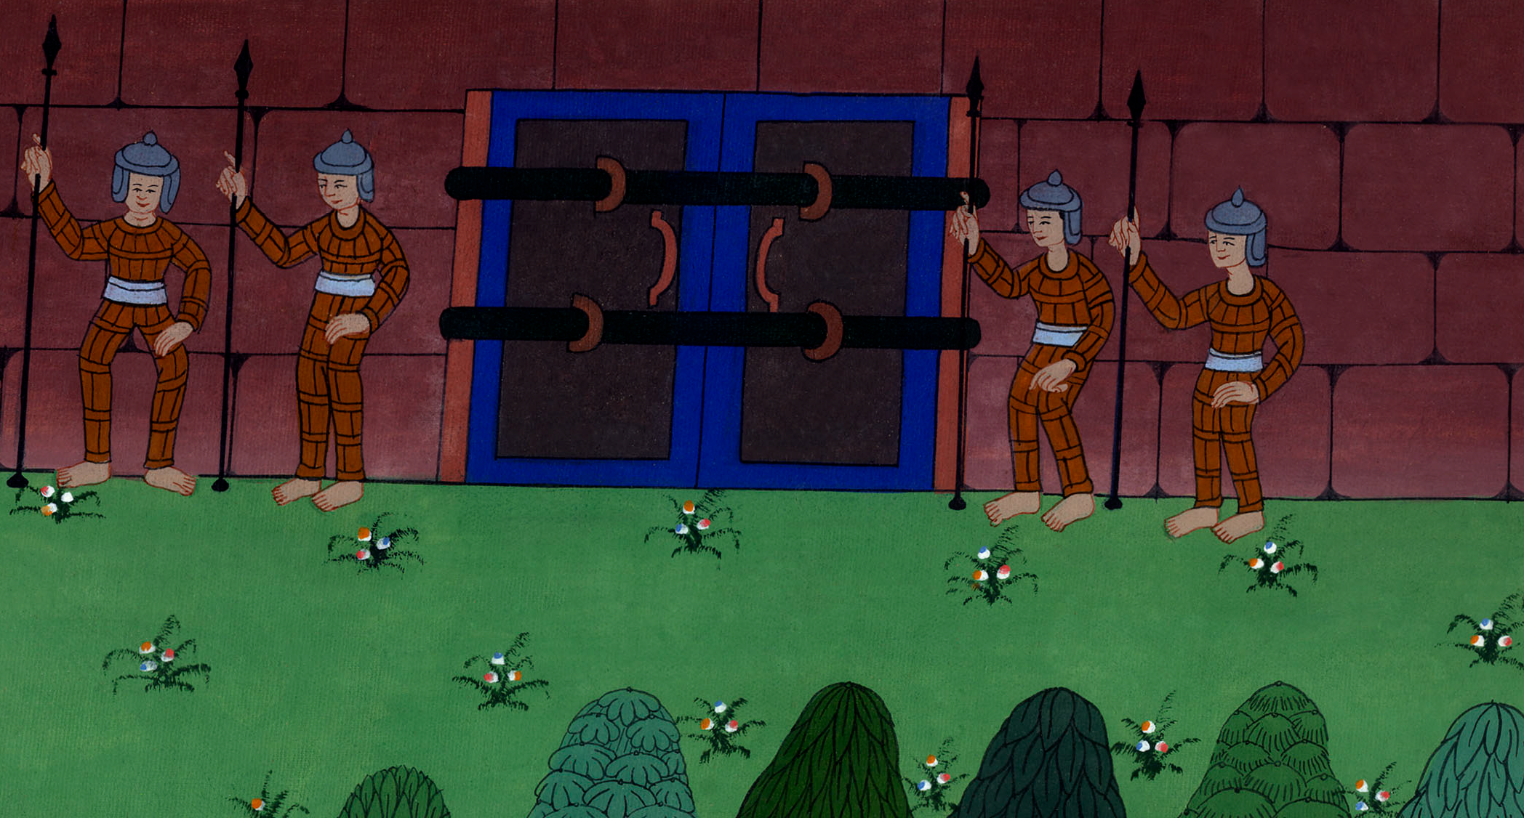
Acts 12:10

Slide 25
11When Peter had come to himself, he said, “Now I truly know that the Lord has sent out his angel and delivered me out of the hand of Herod, and from everything the Jewish people were expecting.”

Slide 26
Acts 12:11

