Slide 1
50-2
This work is licensed under a Creative Commons Attribution-ShareAlike 4.0 International License.
Please add this statement to all the videos you create.
English Bible quotes are from the World English Bible US, which is in the public domain.
Notes:
Ch
50 Peter Arrested
1. James killed –Acts 12:1-2 (Left Top)
2. Peter arrested – Acts 12:3-11 (Right Top)
3. Peter goes to Mary’s House – Acts 12:12-17 (Right Bottom)
4. Herod kills guards – Acts 12:18-19 (Left Bottom)
5. Herod dies – Acts 12:20-25 (Left Center)

Slide 2
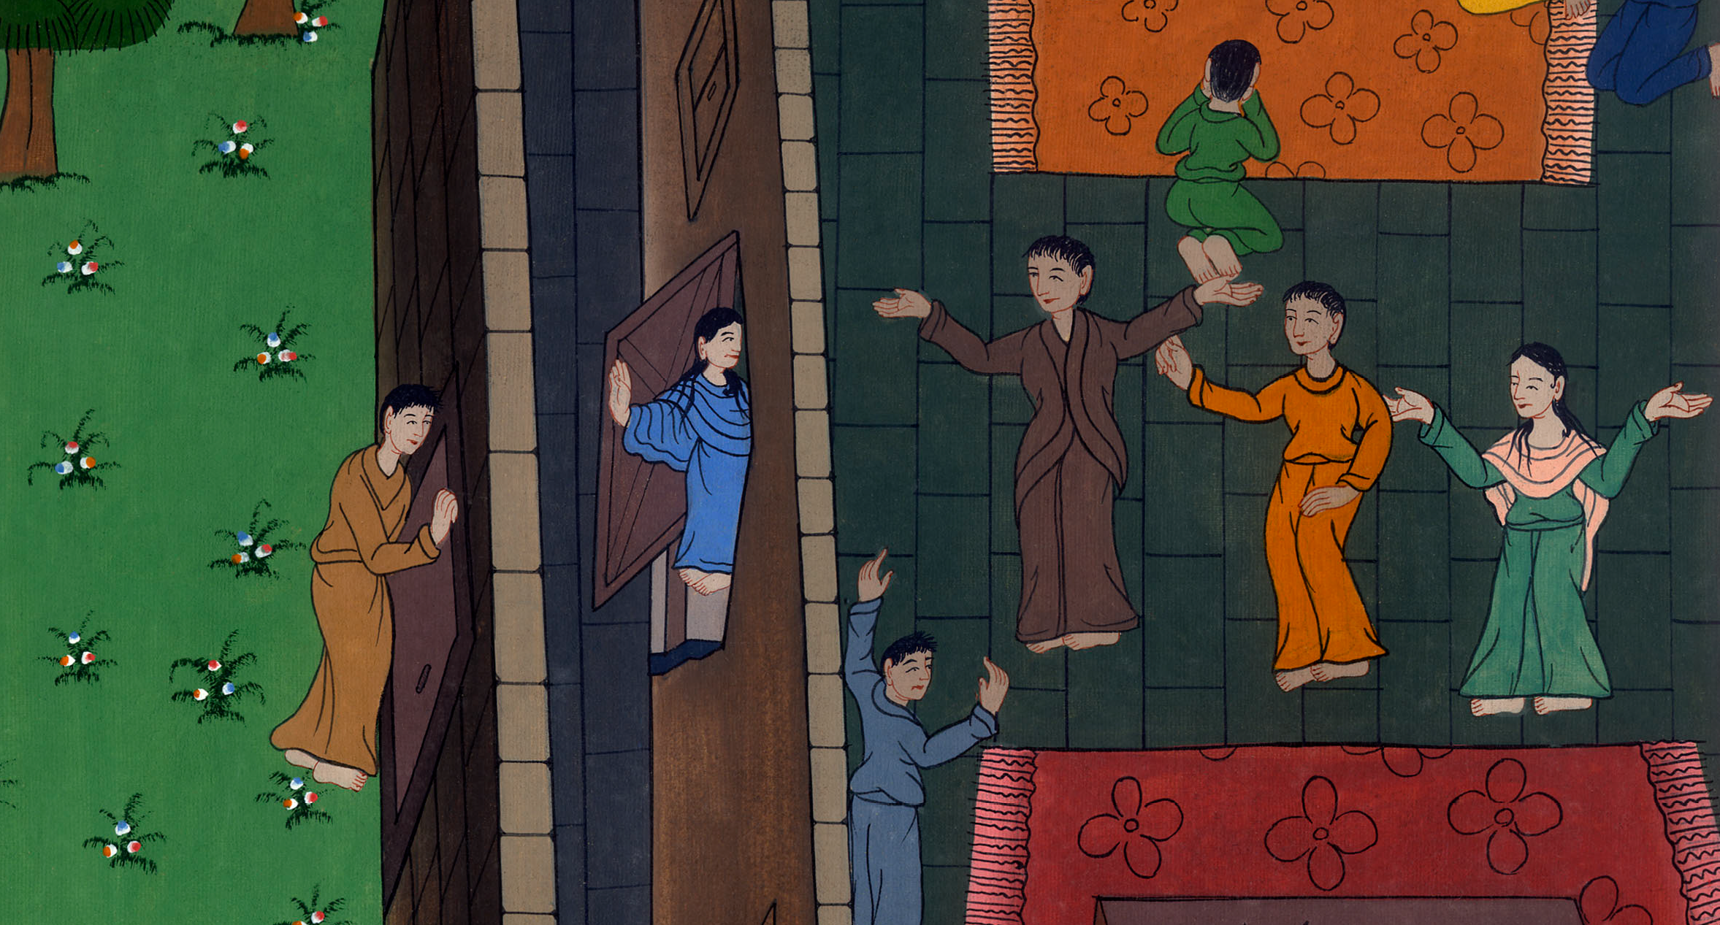
Peter goes to Mary’s House – Acts 12:12-17

Slide 3
Peter goes to Mary’s House – Acts 12:12-17

Slide 4
Peter goes to Mary’s House – Acts 12:12-17

Slide 5
12Thinking about that, he came to the house of Mary, the mother of John who was called Mark, where many were gathered together and were praying.

Slide 6
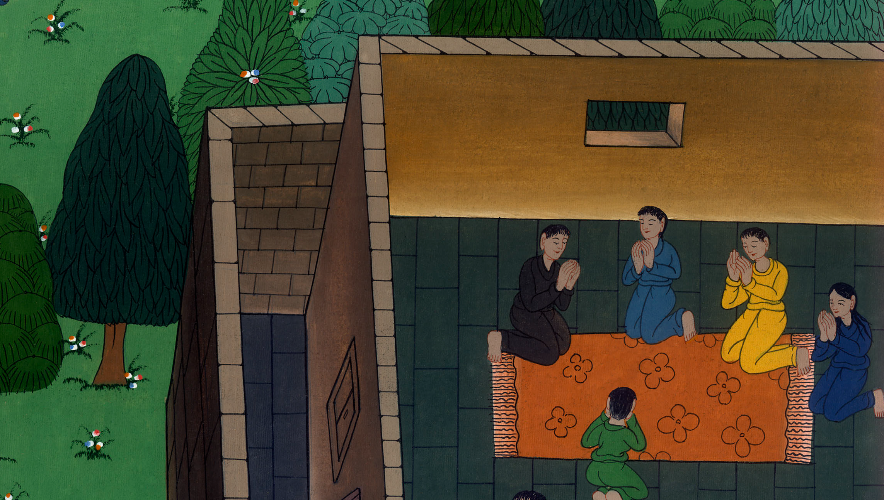
Acts 12:12

Slide 7
13When Peter knocked at the door of the gate, a servant girl named Rhoda came to answer.

Slide 8
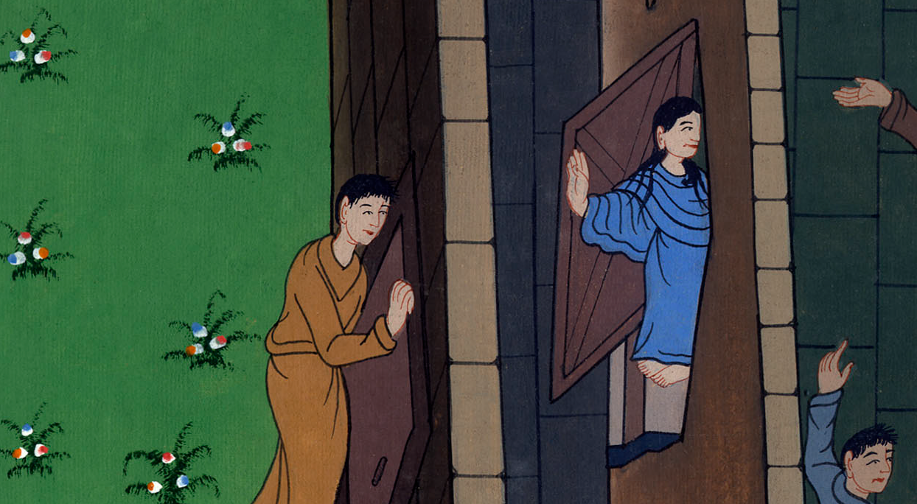
Acts 12:13

Slide 9
14When she recognized Peter’s voice, she didn’t open the gate for joy, but ran in and reported that Peter was standing in front of the gate.

Slide 10
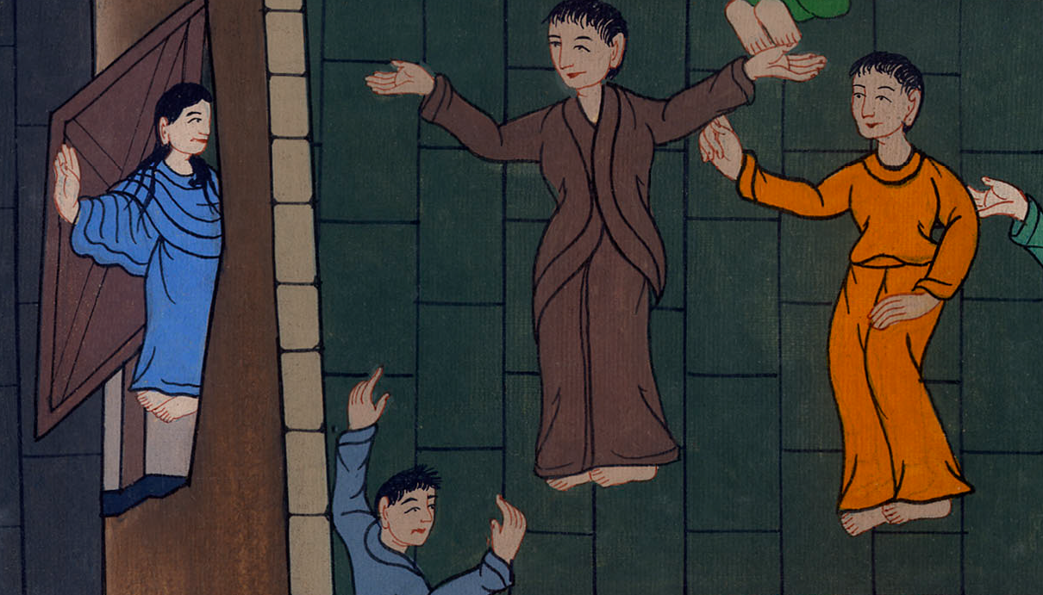
Acts 12:14

Slide 11
15They said to her, “You are crazy!” But she insisted that it was so. They said, “It is his angel.”

Slide 12
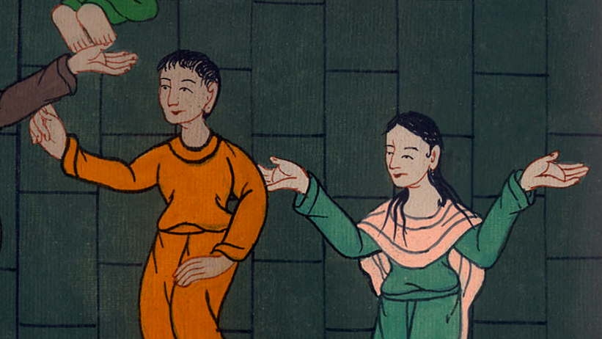
Acts 12:15

Slide 13
16But Peter continued knocking. When they had opened, they saw him and were amazed.

Slide 14
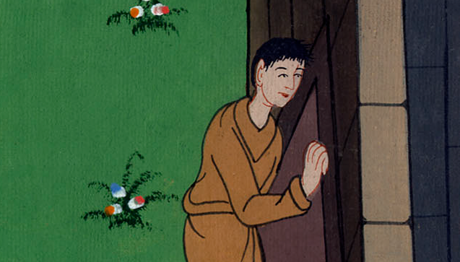
Acts 12:16

Slide 15
17But he, beckoning to them with his hand to be silent, declared to them how the Lord had brought him out of the prison.

Slide 16
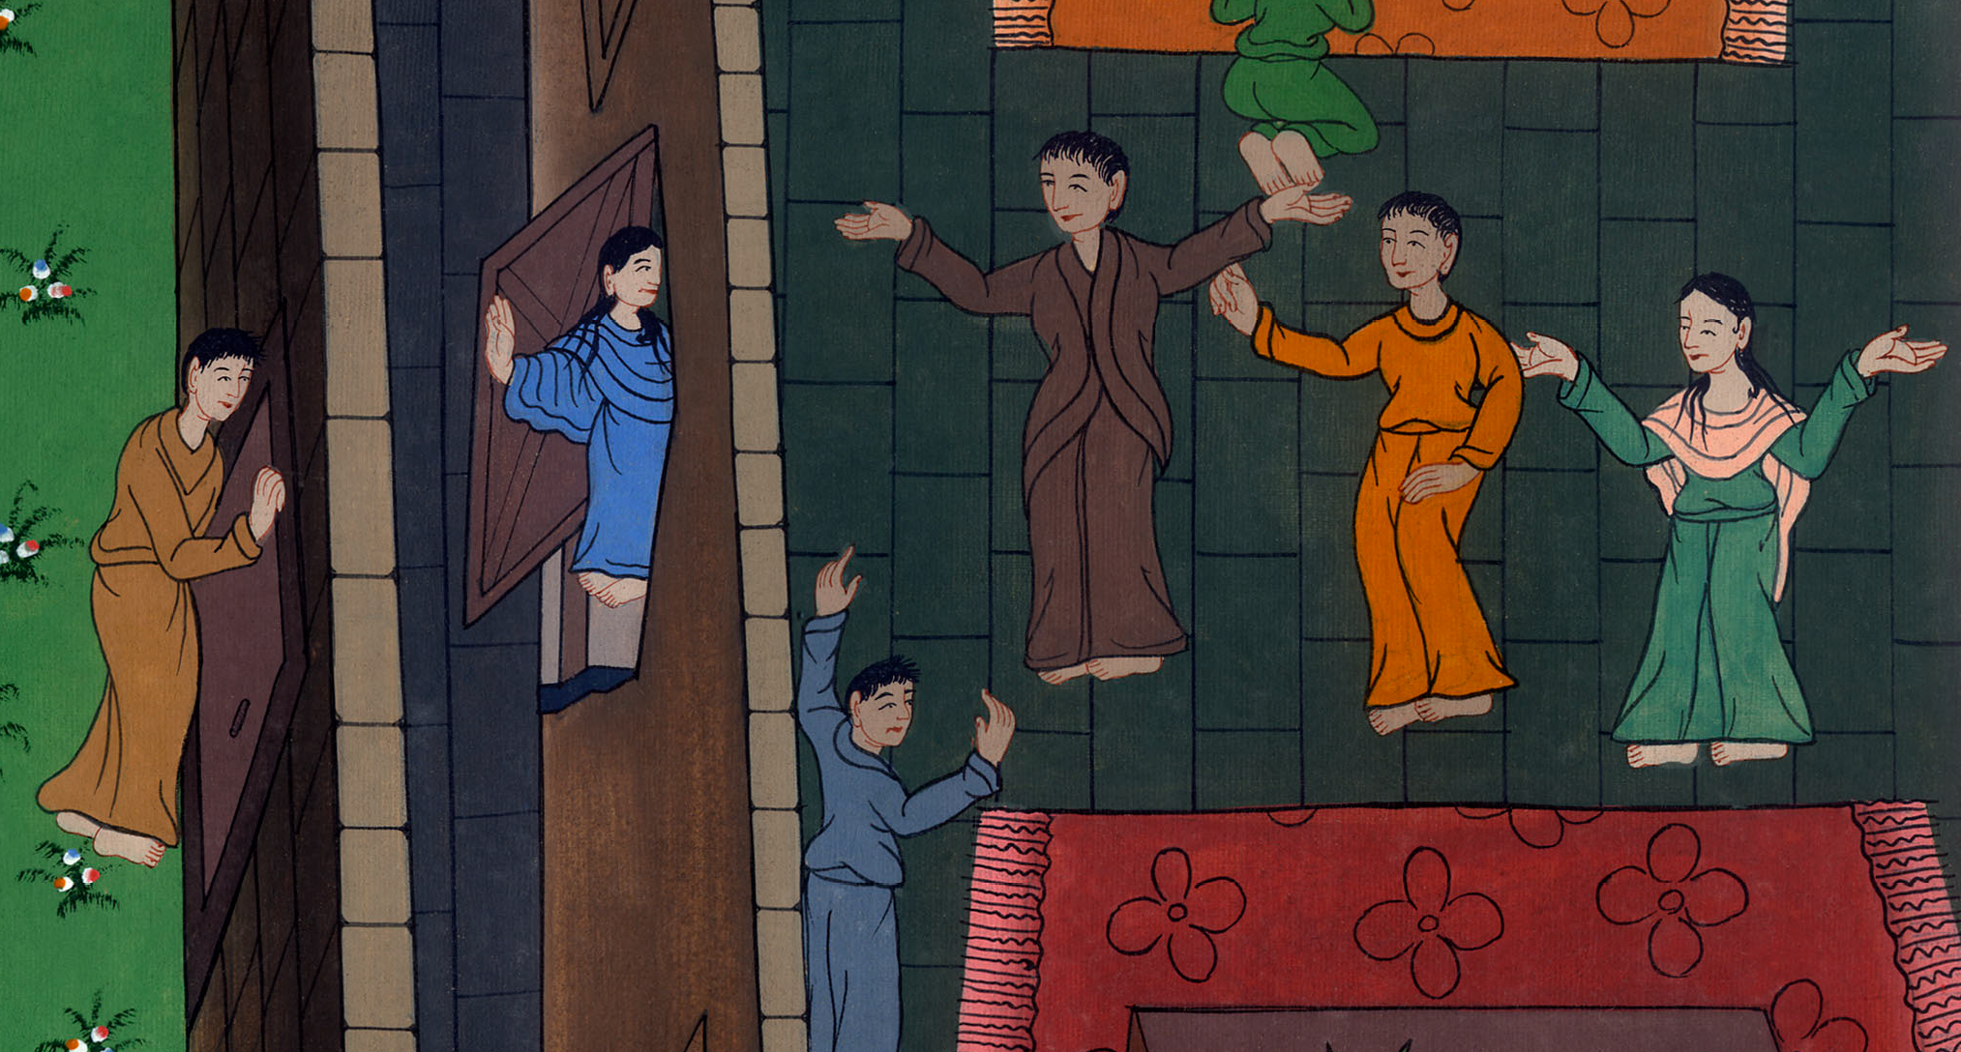
Acts 12:17

Slide 17
He said, “Tell these things to James and to the brothers.” Then he departed and went to another place.

Slide 18
Acts 12:17

