Slide 1
51-1
This work is licensed under a Creative Commons Attribution-ShareAlike 4.0 International License.
Please add this statement to all the videos you create.
English Bible quotes are from the World English Bible US, which is in the public domain.
Notes:
Ch
51 Paul’s 1st Journey
1. Barnabas, Saul and Agabus in Antioch – Acts 11:19-30 (Left Top)
2. Saul, Barnabas and John Mark sent out – Acts 13:1-5 (Center Top)
3. Sergius Paulus and Elymas – Acts 13:6-12 (Right Top)
4. John Mark leaves them and returns to Jerusalem – Acts 13:13 (Right Center)
5. Rejected by Jews in Pisidian Antioch – Acts 13:14-52 (Right Bottom)
6. Chased from Iconium – Acts 14:1-6 (Center Bottom)
7. Healing of lame man in Lystra – Acts 14:7-20 (Left Bottom)
8. On the way back to Antioch – Acts 14:21-28 (Left Center)
9. The Council at Jerusalem – Acts 15:1-35 (Center)

Slide 2
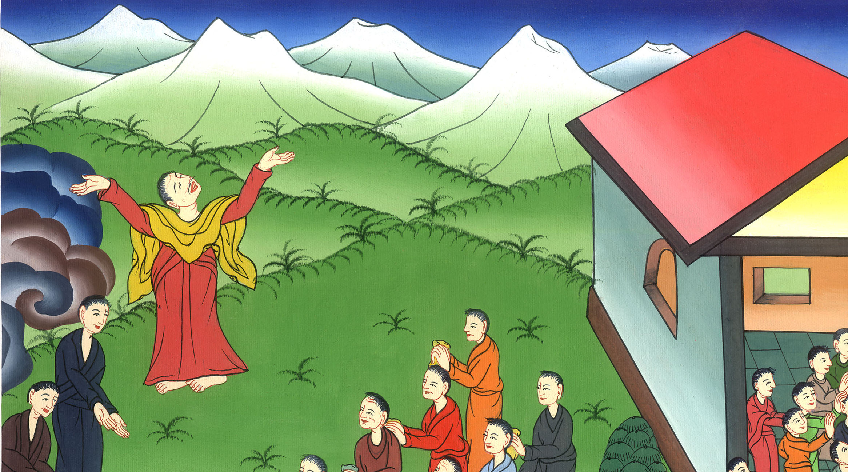
Teaching in Antioch -
Acts 11:19-30

Slide 3
Saul’s 1st Journey
Teaching in Antioch – Acts 11:19-30

Slide 4
Teaching in Antioch -
Acts 11:19-30

Slide 5
19They therefore who were scattered abroad by the oppression that arose about Stephen traveled as far as Phoenicia, Cyprus, and Antioch, speaking the word to no one except to Jews only.

Slide 6
Acts 11:19

Slide 7
20 But there were some of them, men of Cyprus and Cyrene, who, when they had come to Antioch, spoke to the Hellenists, preaching the Lord Jesus.

Slide 8
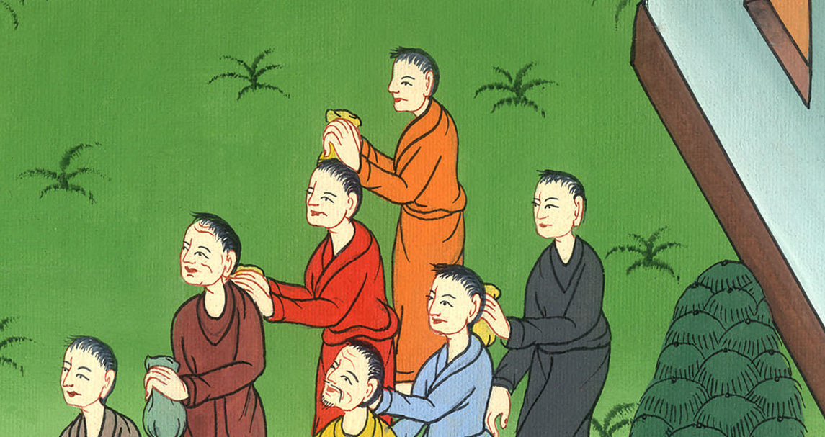
Acts 11:20

Slide 9
21 The hand of the Lord was with them, and a great number believed and turned to the Lord.

Slide 10
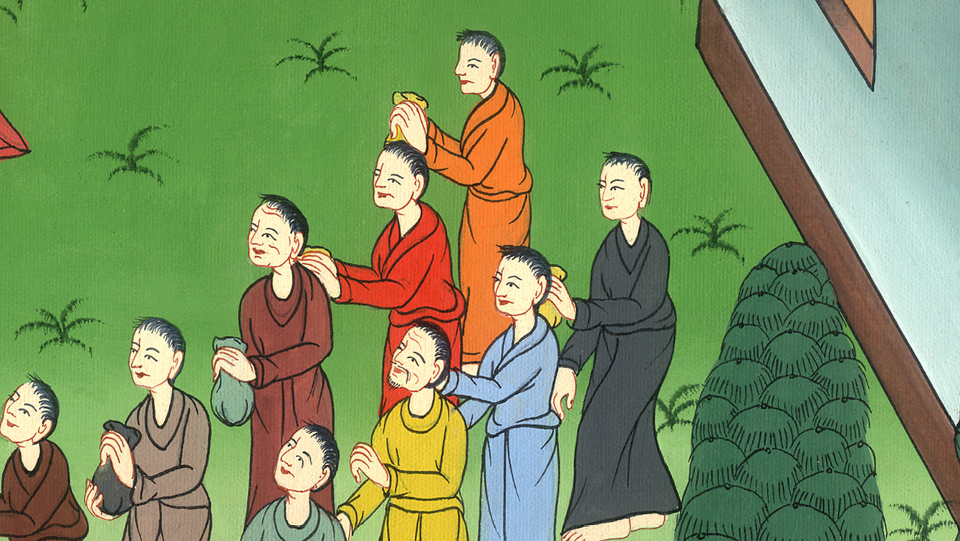
Acts 11:21

Slide 11
22 The report concerning them came to the ears of the assembly which was in Jerusalem. They sent out Barnabas to go as far as Antioch,

Slide 12
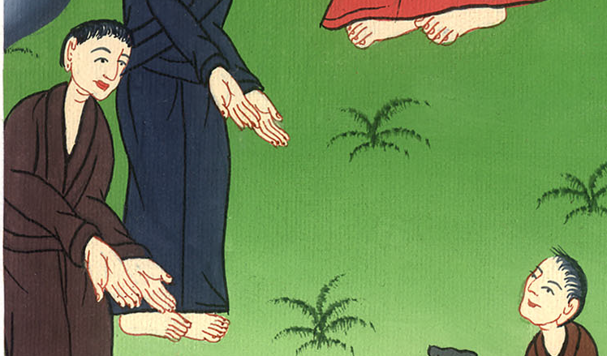
Acts 11:22

Slide 13
23when Barnabas had come, and had seen the grace of God, he was glad. He exhorted them all, that with purpose of heart they should remain near to the Lord.

Slide 14
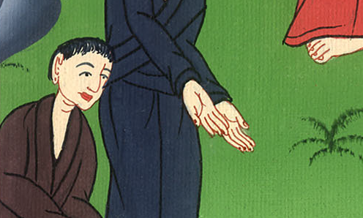
Acts 11:23

Slide 15
24 For he was a good man, and full of the Holy Spirit and of faith, and many people were added to the Lord.

Slide 16
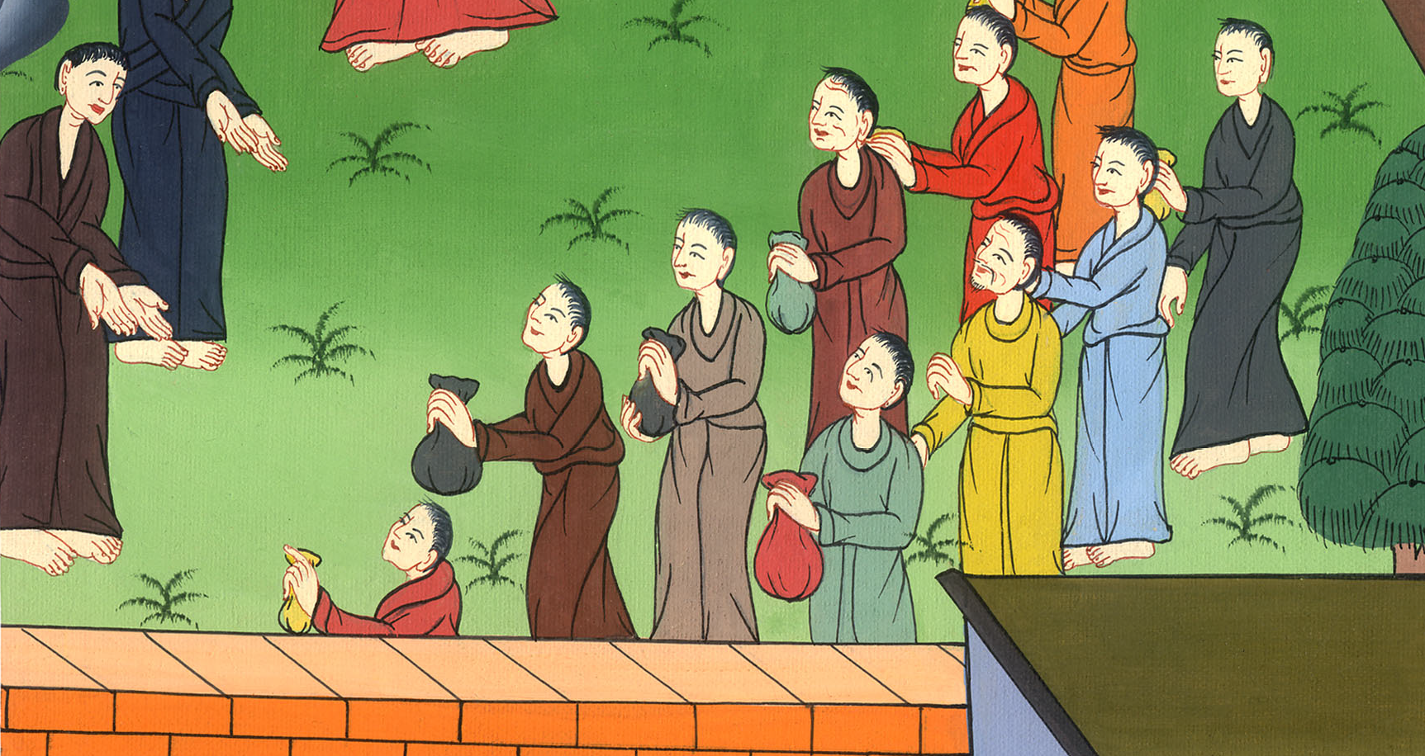
Acts 11:24

Slide 17
25 Barnabas went out to Tarsus to look for Saul. 26When he had found him, he brought him to Antioch.

Slide 18
Acts 11:25

Slide 19
For a whole year they were gathered together with the assembly, and taught many people. The disciples were first called Christians in Antioch.

Slide 20
Acts 11:26

Slide 21
27 Now in these days, prophets came down from Jerusalem to Antioch.

Slide 22
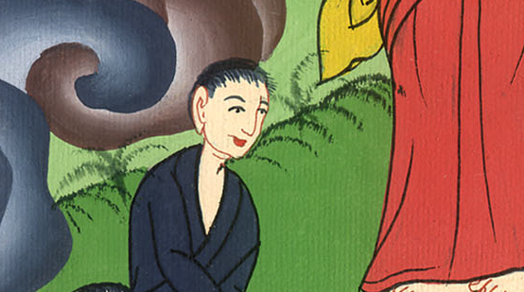
Acts 11:27

Slide 23
28 One of them named Agabus stood up and indicated by the Spirit that there should be a great famine all over the world, which also happened in the days of Claudius.

Slide 24
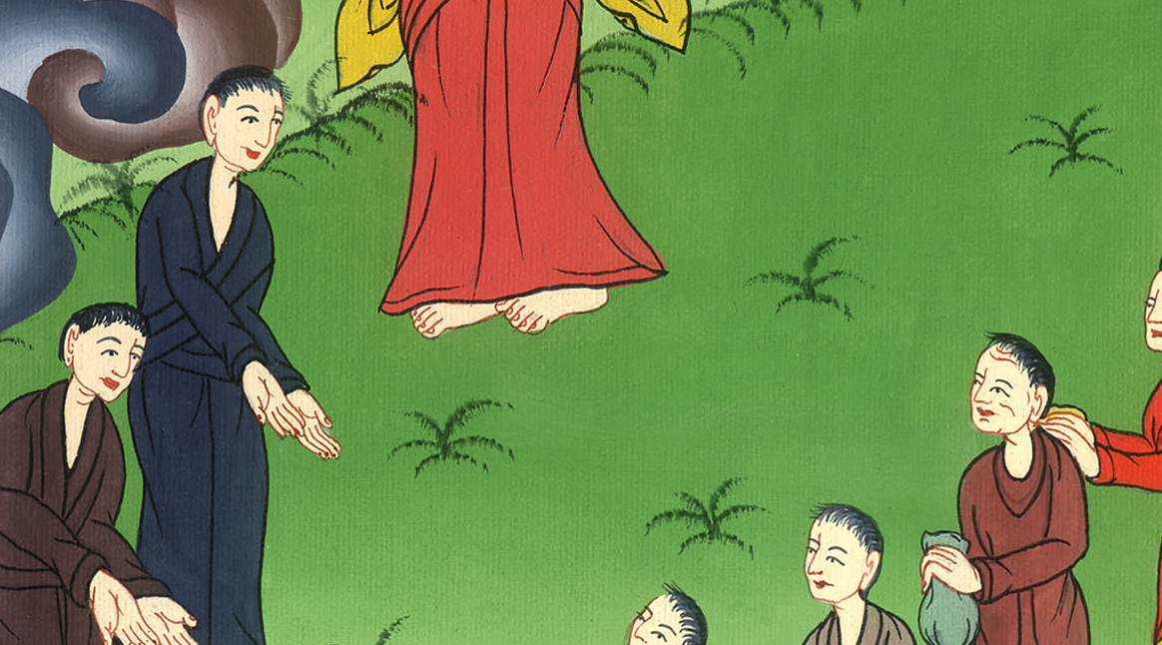
Acts 11:28

Slide 25
29As any of the disciples had plenty, each determined to send relief to the brothers who lived in Judea;

Slide 26
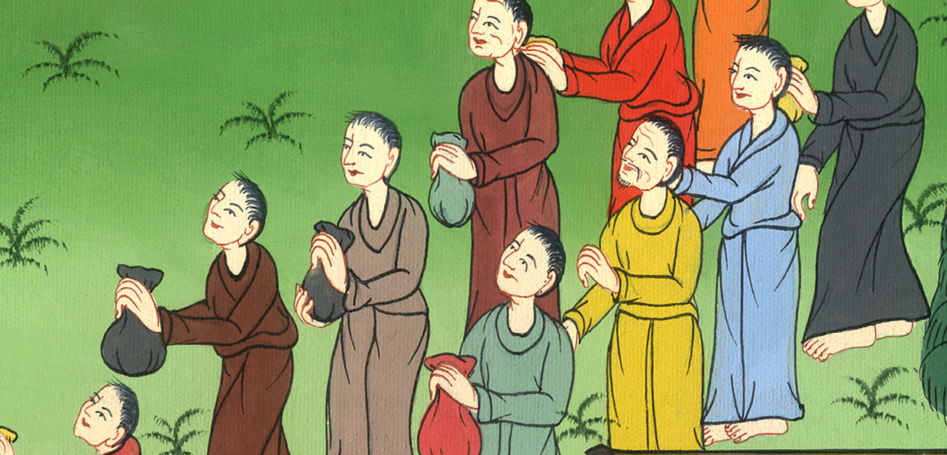
Acts 11:29

Slide 27
30This they also did, sending it to the elders by the hands of Barnabas and Saul.

Slide 28
Acts 11:30

