Slide 1
51-2
This work is licensed under a Creative Commons Attribution-ShareAlike 4.0 International License.
Please add this statement to all the videos you create.
English Bible quotes are from the World English Bible US, which is in the public domain.
Notes:
Ch
51 Paul’s 1st Journey
1. Barnabas, Saul and Agabus in Antioch – Acts 11:19-30 (Left Top)
2. Saul, Barnabas and John Mark sent out – Acts 13:1-5 (Center Top)
3. Sergius Paulus and Elymas – Acts 13:6-12 (Right Top)
4. John Mark leaves them and returns to Jerusalem – Acts 13:13 (Right Center)
5. Rejected by Jews in Pisidian Antioch – Acts 13:14-52 (Right Bottom)
6. Chased from Iconium – Acts 14:1-6 (Center Bottom)
7. Healing of lame man in Lystra – Acts 14:7-20 (Left Bottom)
8. On the way back to Antioch – Acts 14:21-28 (Left Center)
9. The Council at Jerusalem – Acts 15:1-35 (Center)

Slide 2
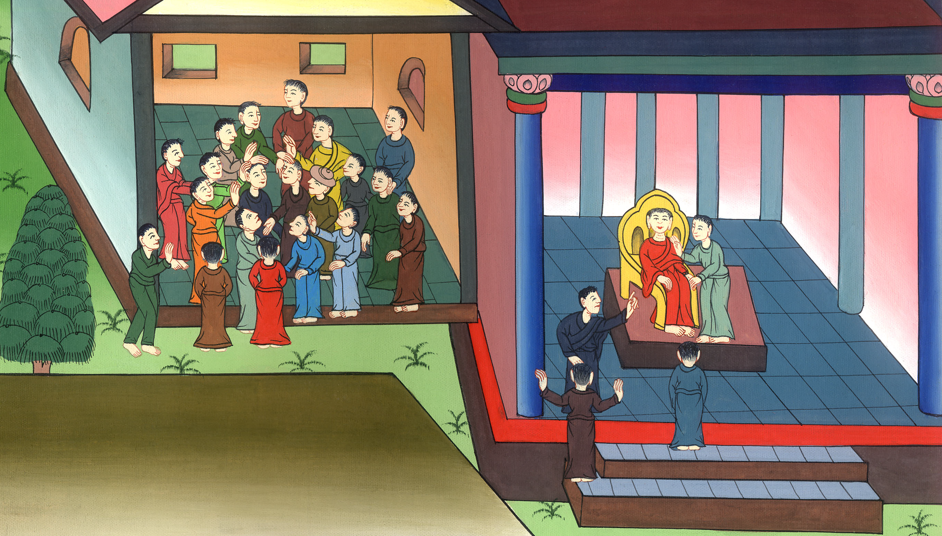
Saul and Barnabas sent out – Acts 13:1-13

Slide 3
Saul and Barnabas sent out – Acts 13:1-13

Slide 4
Saul and Barnabas sent out – Acts 13:1-13

Slide 5
1Now in the assembly that was at Antioch there were some prophets and teachers: Barnabas, Simeon who was called Niger, Lucius of Cyrene, Manaen the foster brother of Herod the tetrarch, and Saul.

Slide 6
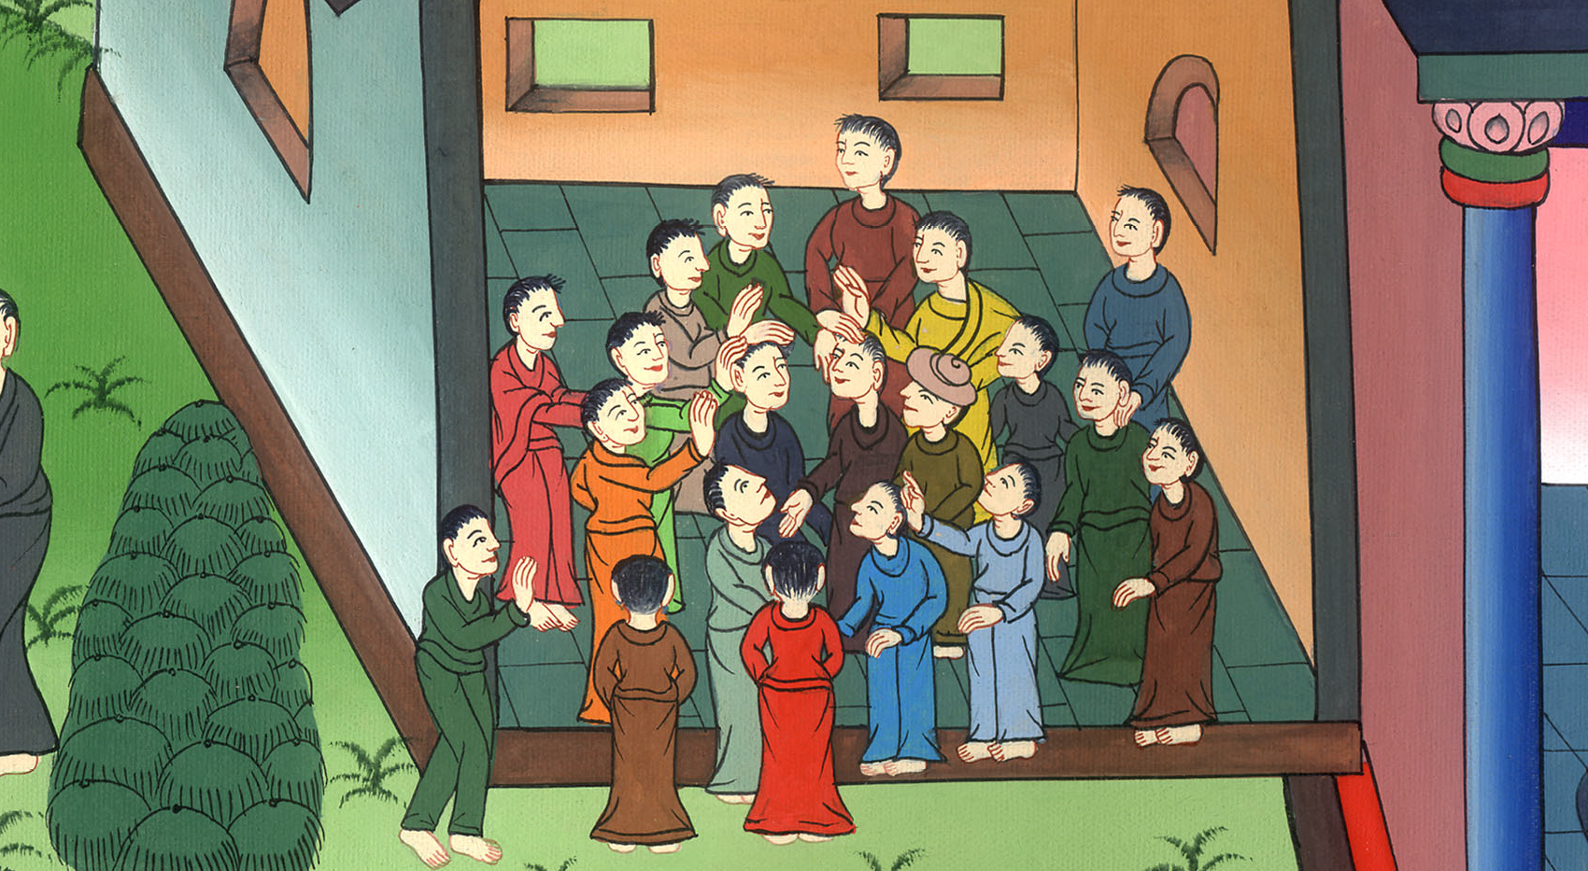
Acts 13:1

Slide 7
2As they served the Lord and fasted, the Holy Spirit said, “Separate Barnabas and Saul for me, for the work to which I have called them.”

Slide 8
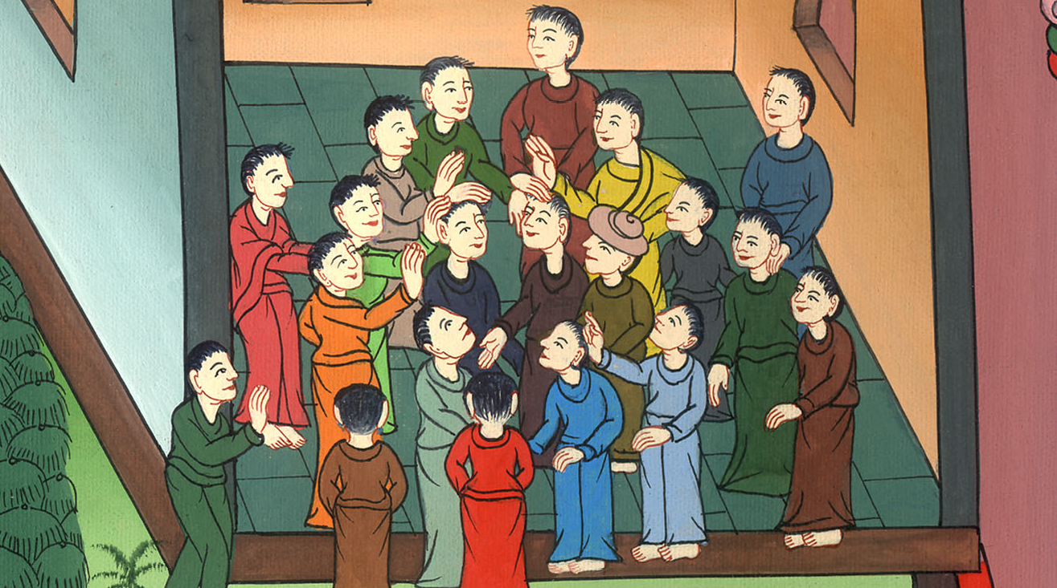
Acts 13:2

Slide 9
3Then, when they had fasted and prayed and laid their hands on them, they sent them away.

Slide 10
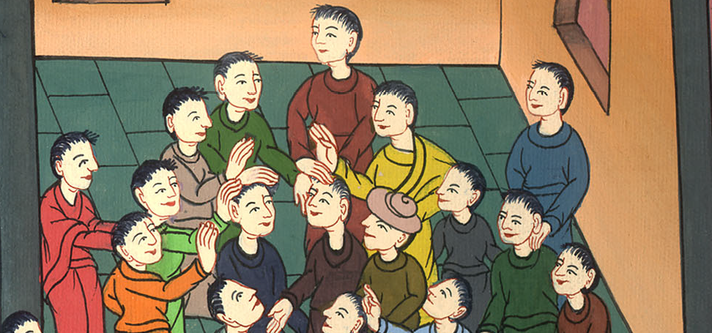
Acts 13:3

Slide 11
4So, being sent out by the Holy Spirit, they went down to Seleucia. From there they sailed to Cyprus.

Slide 12
Acts 13:4

Slide 13
5When they were at Salamis, they proclaimed God’s word in the Jewish synagogues. They also had John as their attendant.

Slide 14
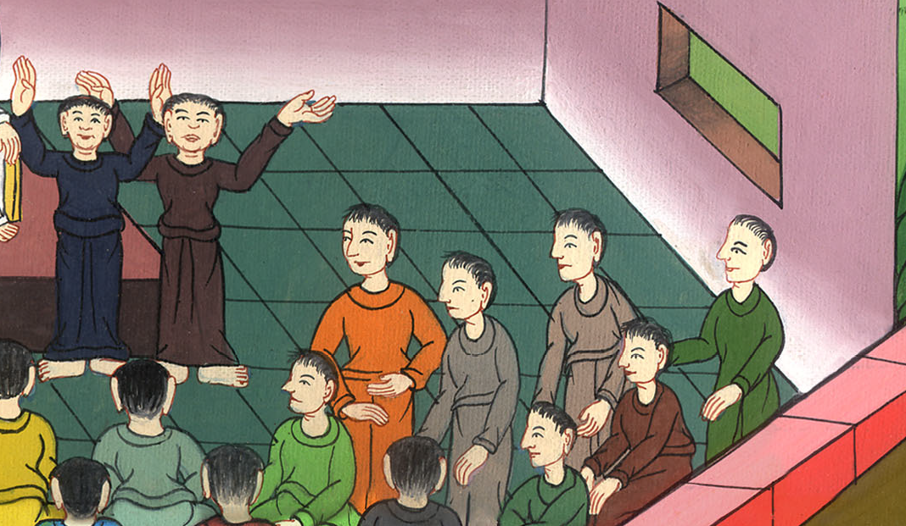
Acts 13:5

Slide 15
6When they had gone through the island to Paphos, they found a certain sorcerer, a false prophet, a Jew whose name was Bar Jesus,

Slide 16
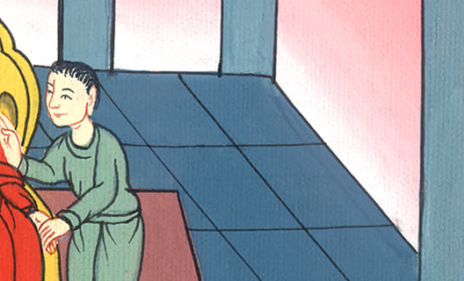
Acts 13:6

Slide 17
7Bar Jesus was with the proconsul, Sergius Paulus, a man of understanding. This man summoned Barnabas and Saul, and sought to hear the word of God

Slide 18
Acts 13:7

Slide 19
8But Elymas the sorcerer (for so is his name by interpretation) withstood them, seeking to turn the proconsul away from the faith

Slide 20
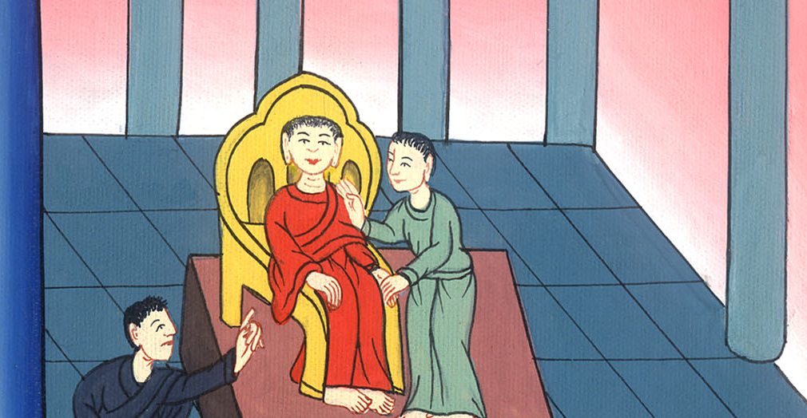
Acts 13:8

Slide 21
9But Saul, who is also called Paul, filled with the Holy Spirit, fastened his eyes on him

Slide 22
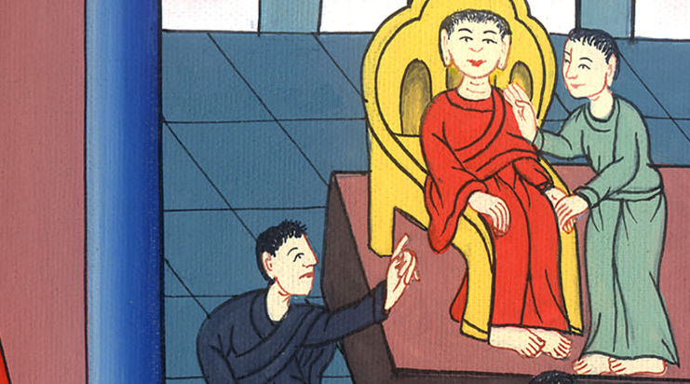
Acts 13:9

Slide 23
10He said, “You son of the devil, full of all deceit and all cunning, you enemy of all righteousness, will you not cease to pervert the right ways of the Lord?

Slide 24
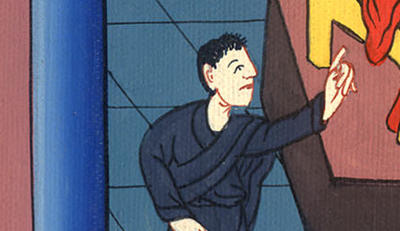
Acts 13:10

Slide 25
11Now, behold, the hand of the Lord is on you, and you will be blind, not seeing the sun for a season!”

Slide 26
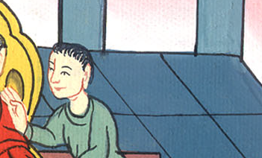
Acts 13:11

Slide 27
Immediately a mist and darkness fell on him. He went around seeking someone to lead him by the hand.

Slide 28
Acts 13:11

Slide 29
12Then the proconsul, when he saw what was done, believed, being astonished at the teaching of the Lord.

Slide 30
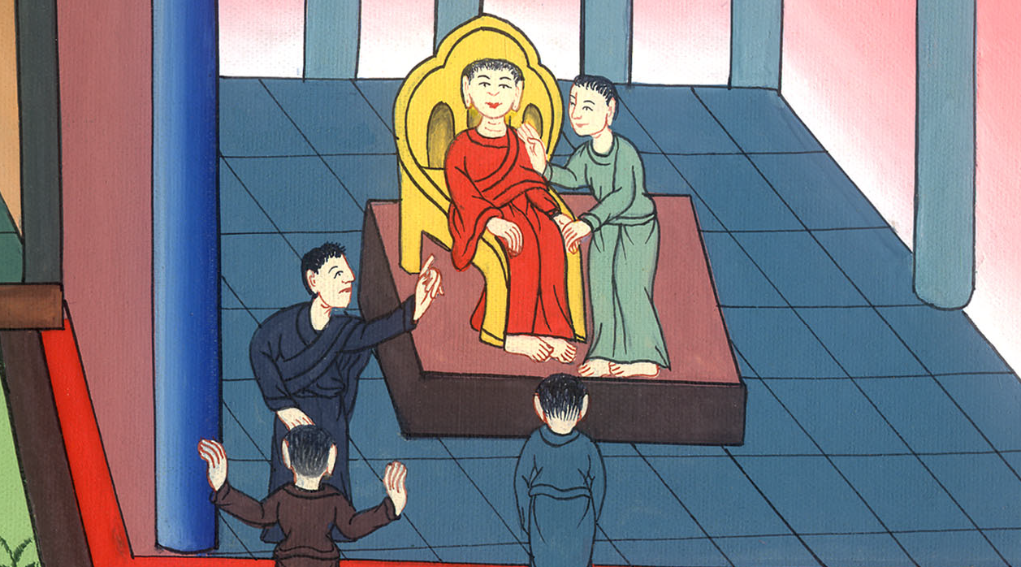
Acts 13:12

Slide 31
13Now Paul and his company set sail from Paphos and came to Perga in Pamphylia. John departed from them and returned to Jerusalem.

Slide 32
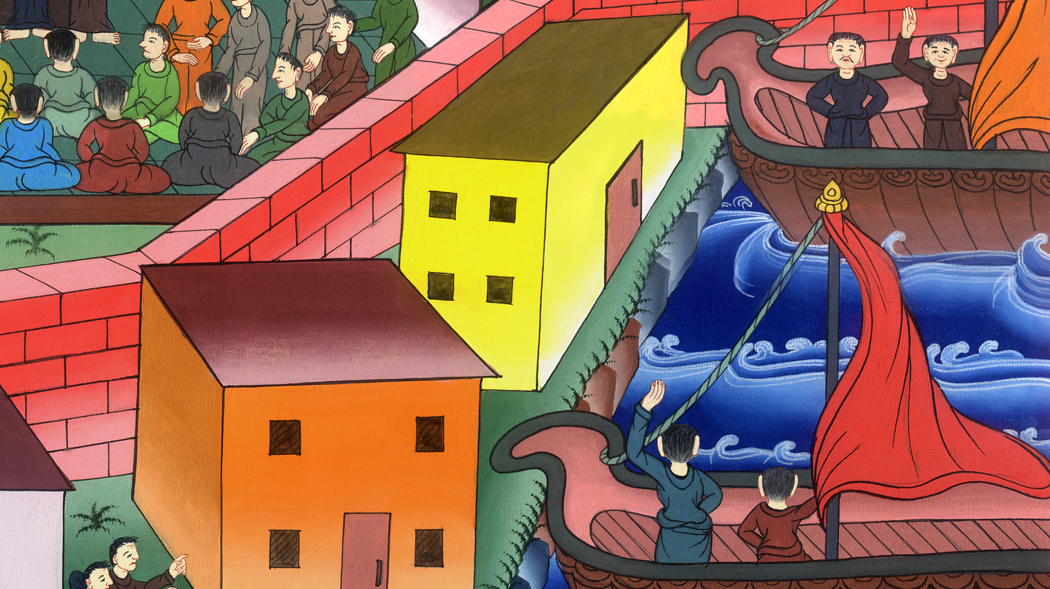
Acts 13:13

