Slide 1
51-4
This work is licensed under a Creative Commons Attribution-ShareAlike 4.0 International License.
Please add this statement to all the videos you create.
English Bible quotes are from the World English Bible US, which is in the public domain.
Notes:
Ch
51 Paul’s 1st Journey
1. Barnabas, Saul and Agabus in Antioch – Acts 11:19-30 (Left Top)
2. Saul, Barnabas and John Mark sent out – Acts 13:1-5 (Center Top)
3. Sergius Paulus and Elymas – Acts 13:6-12 (Right Top)
4. John Mark leaves them and returns to Jerusalem – Acts 13:13 (Right Center)
5. Rejected by Jews in Pisidian Antioch – Acts 13:14-52 (Right Bottom)
6. Chased from Iconium – Acts 14:1-6 (Center Bottom)
7. Healing of lame man in Lystra – Acts 14:7-20 (Left Bottom)
8. On the way back to Antioch – Acts 14:21-28 (Left Center)
9. The Council at Jerusalem – Acts 15:1-35 (Center)

Slide 2
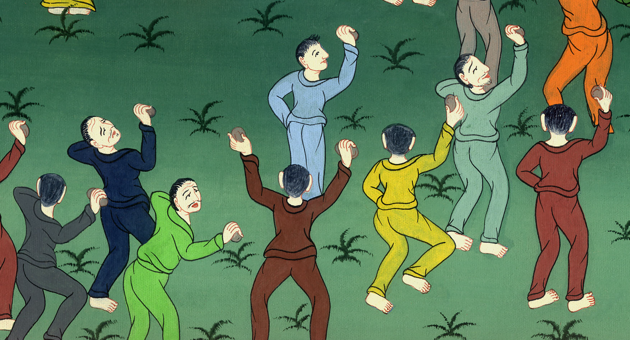
Chased from Iconium – Acts 14:1-7

Slide 3
Chased from Iconium – Acts 14:1-7

Slide 4
Chased from Iconium – Acts 14:1-7

Slide 5
1In Iconium, they entered together into the synagogue of the Jews, and so spoke that a great multitude both of Jews and of Greeks believed.

Slide 6
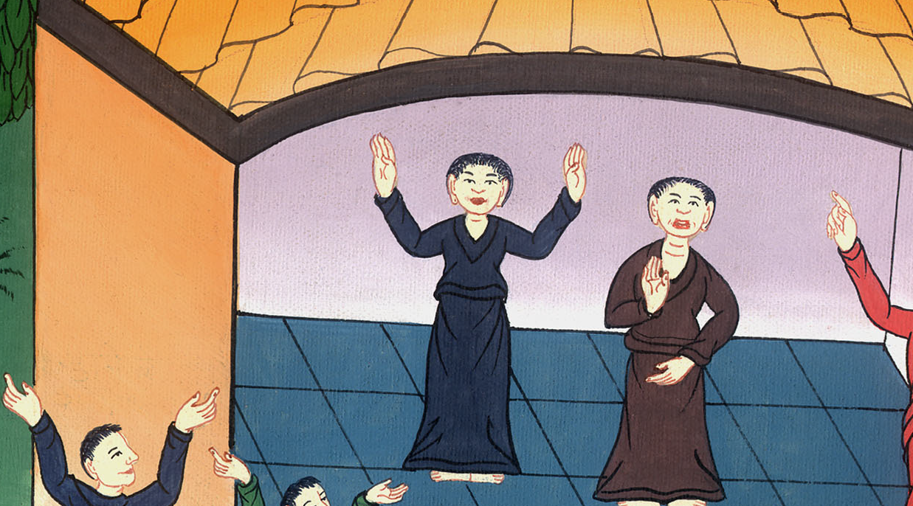
Acts 14:1

Slide 7
2But the disbelieving Jews stirred up and embittered the souls of the Gentiles against the brothers.

Slide 8
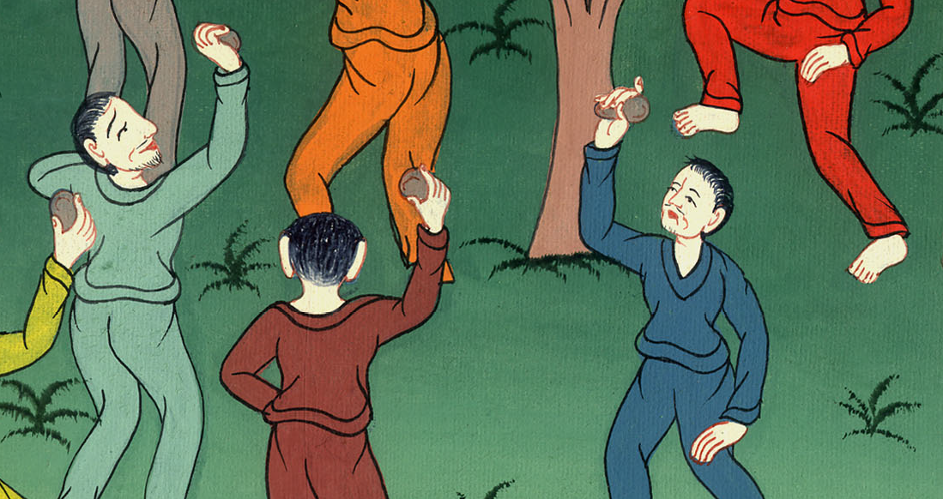
Acts 14:2

Slide 9
3Therefore they stayed there a long time, speaking boldly in the Lord, who testified to the word of his grace, granting signs and wonders to be done by their hands

Slide 10
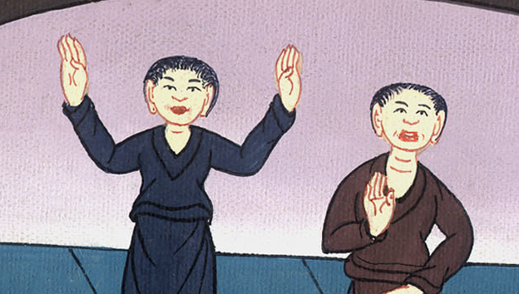
Acts 14:3

Slide 11
4But the multitude of the city was divided. Part sided with the Jews and part with the apostles.

Slide 12
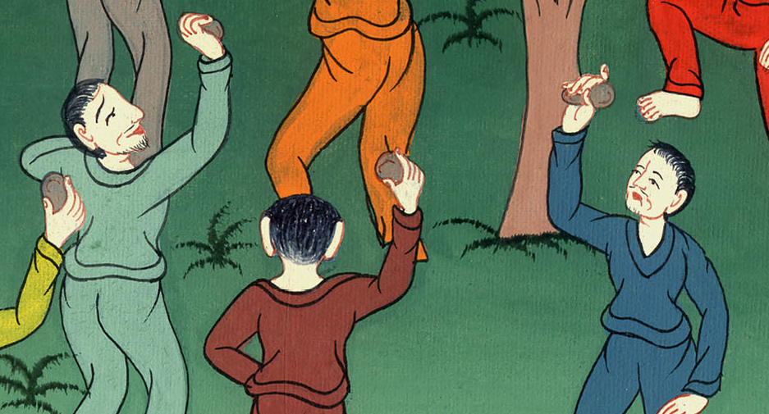
Acts 14:4

Slide 13
5Then some of both the Gentiles and the Jews, with their rulers, made a violent attempt to mistreat and stone them.

Slide 14
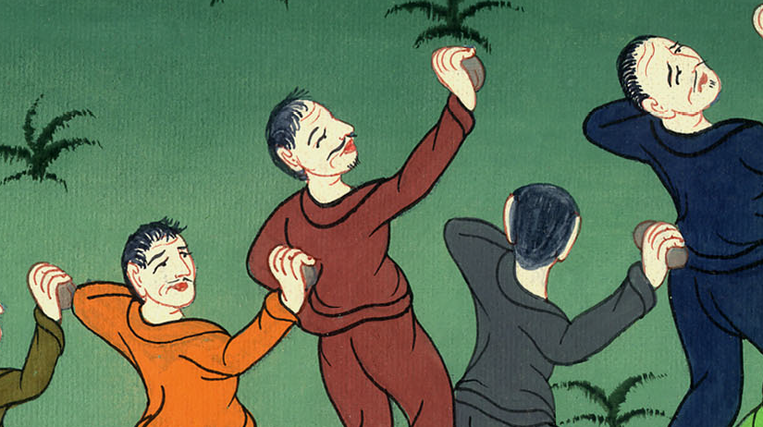
Acts 14:5

Slide 15
6They became aware of it and fled to the cities of Lycaonia, Lystra, Derbe, and the surrounding region.

Slide 16
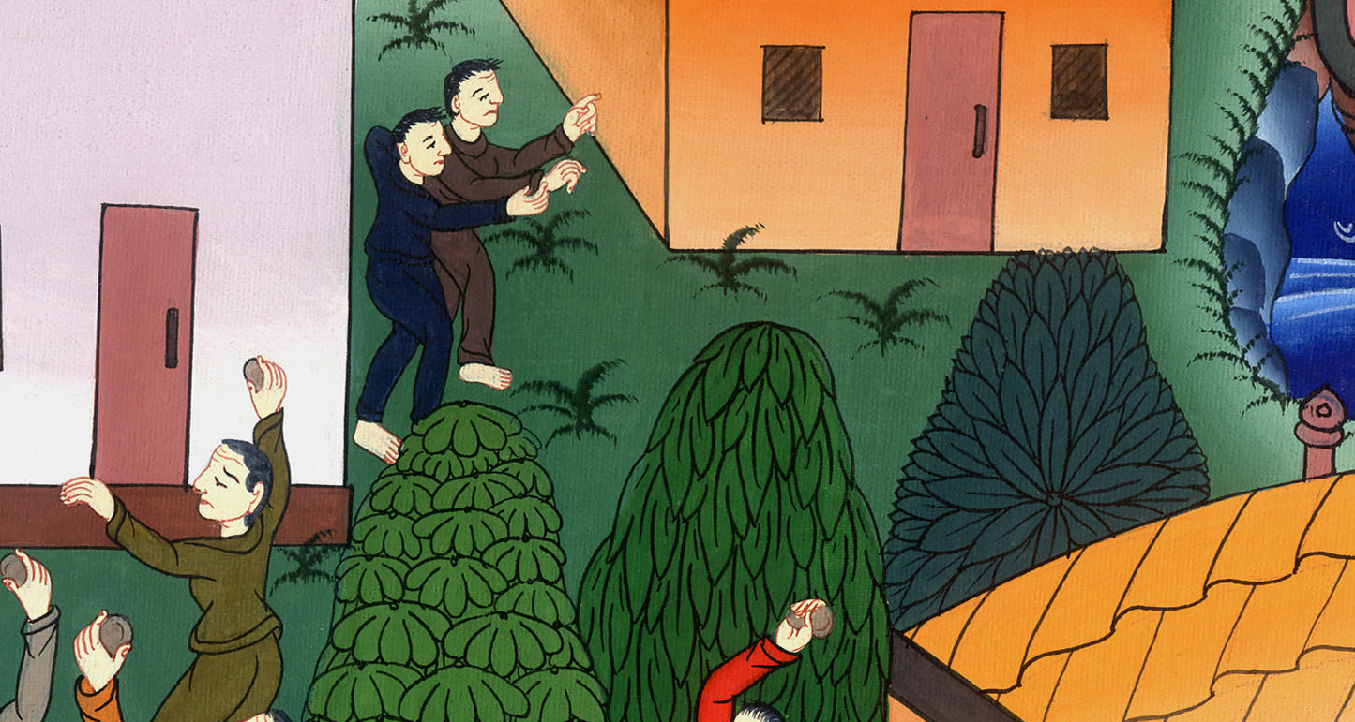
Acts 14:6

Slide 17
7There they preached the Good News.

Slide 18
Acts 14:7

