Slide 1
51-5
This work is licensed under a Creative Commons Attribution-ShareAlike 4.0 International License.
Please add this statement to all the videos you create.
English Bible quotes are from the World English Bible US, which is in the public domain.
Notes:
Ch
51 Paul’s 1st Journey
1. Barnabas, Saul and Agabus in Antioch – Acts 11:19-30 (Left Top)
2. Saul, Barnabas and John Mark sent out – Acts 13:1-5 (Center Top)
3. Sergius Paulus and Elymas – Acts 13:6-12 (Right Top)
4. John Mark leaves them and returns to Jerusalem – Acts 13:13 (Right Center)
5. Rejected by Jews in Pisidian Antioch – Acts 13:14-52 (Right Bottom)
6. Chased from Iconium – Acts 14:1-6 (Center Bottom)
7. Healing of lame man in Lystra – Acts 14:7-20 (Left Bottom)
8. On the way back to Antioch – Acts 14:21-28 (Left Center)
9. The Council at Jerusalem – Acts 15:1-35 (Center)

Slide 2
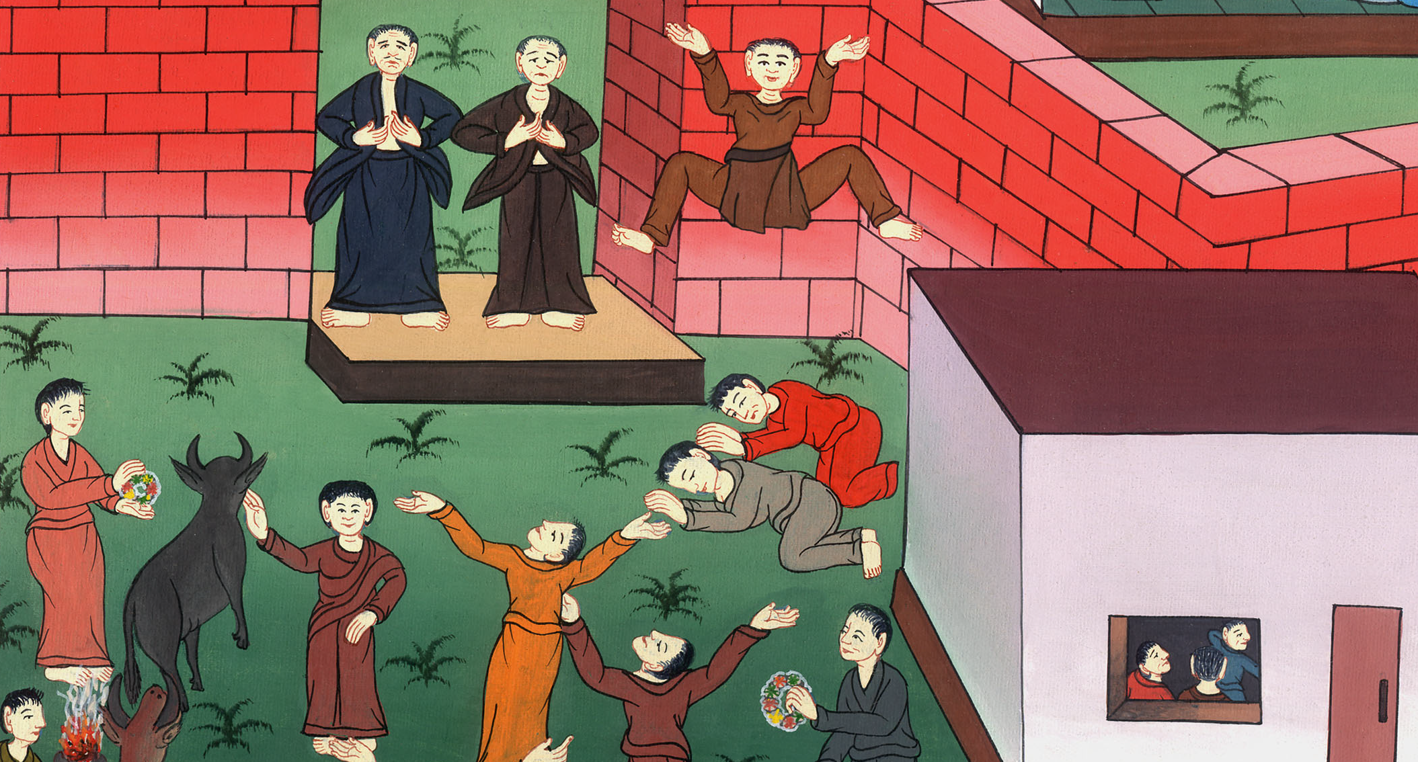
Healing of lame man in Lystra – Acts 14:7-20

Slide 3
Healing of lame man in Lystra – Acts 14:7-20

Slide 4
Healing of lame man in Lystra – Acts 14:7-20

Slide 5
7Paul and Barnabas escaped to Lystra.
8At Lystra a certain man sat, impotent in his feet, a cripple from his mother’s womb, who never had walked.

Slide 6
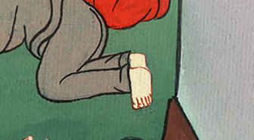
Acts 14:7,8

Slide 7
9He was listening to Paul speaking, who fastened his eyes on him and saw that he had faith to be made whole.

Slide 8
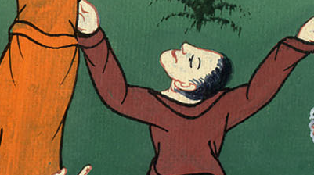
Acts 14:9

Slide 9
10Paul said with a loud voice, “Stand upright on your feet!” He leaped up and walked.

Slide 10
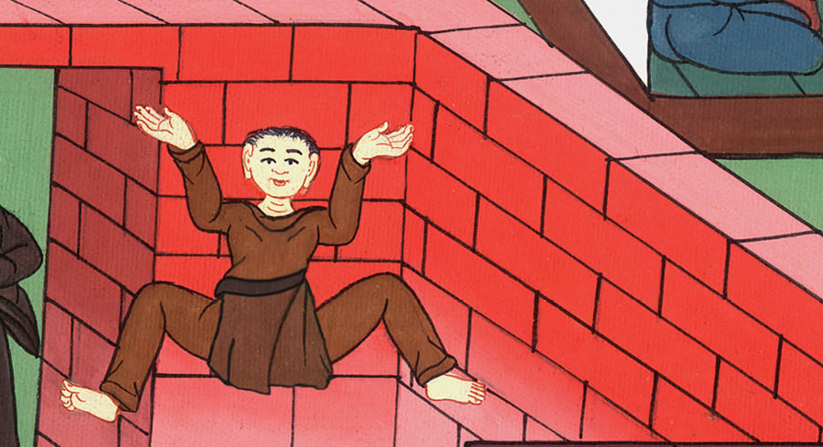
Acts 14:10

Slide 11
11When the multitude saw what Paul had done, they lifted up their voice, saying in the language of Lycaonia, “The gods have come down to us in the likeness of men!”

Slide 12
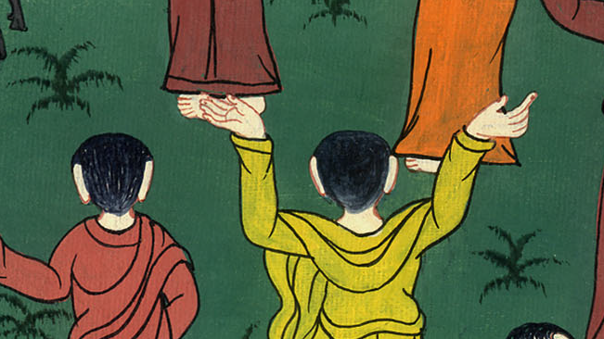
Acts 14:11

Slide 13
12They called Barnabas “Jupiter”, and Paul “Mercury”, because he was the chief speaker.

Slide 14
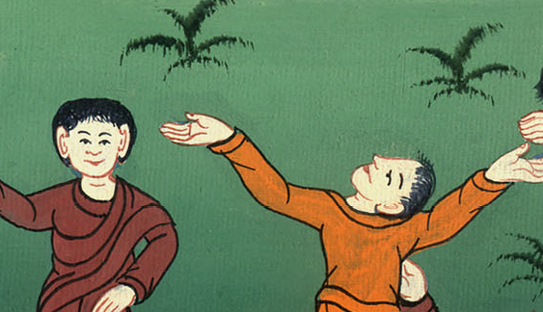
Acts 14:12

Slide 15
13The priest of Jupiter, whose temple was in front of their city, brought oxen and garlands to the gates, and would have made a sacrifice along with the multitudes.

Slide 16
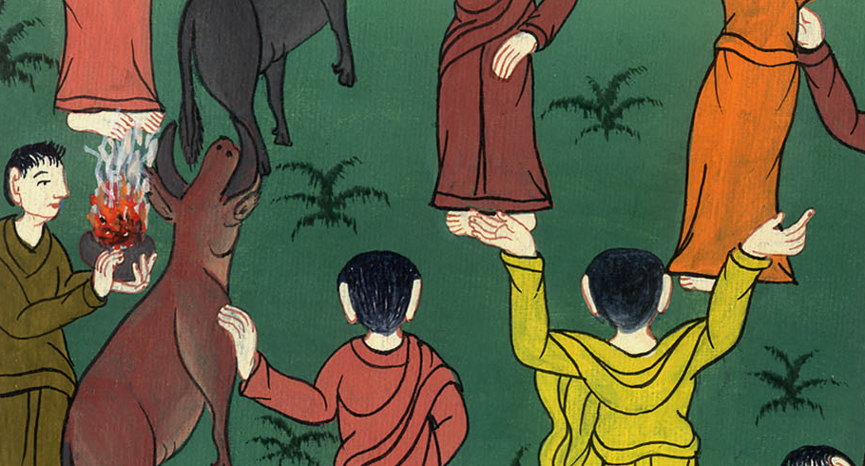
Acts 14:13

Slide 17
14But when the apostles, Barnabas and Paul, heard of it, they tore their clothes and sprang into the multitude, crying out, 15“Men, why are you doing these things?

Slide 18
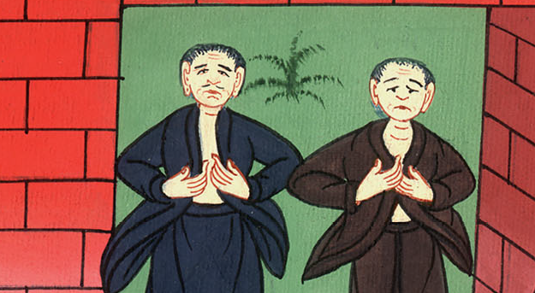
Acts 14:14

Slide 19
We also are men of the same nature as you, and bring you good news, that you should turn from these vain things to the living God, who made the sky, the earth, the sea, and all that is in them;

Slide 20
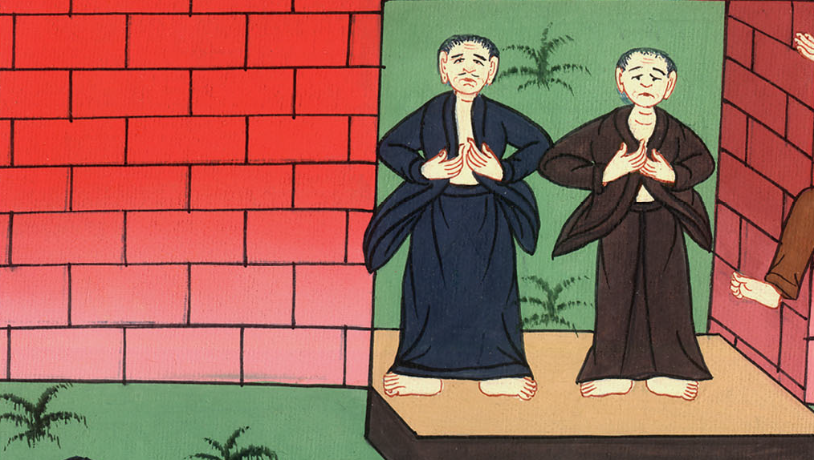
Acts 14:15

Slide 21
16who in the generations gone by allowed all the nations to walk in their own ways.

Slide 22
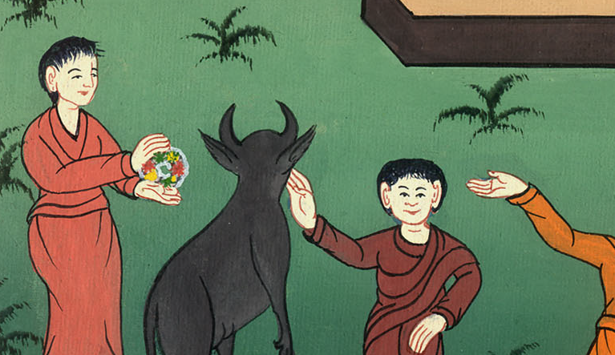
Acts 14:16

Slide 23
17Yet he didn’t leave himself without witness, in that he did good and gave you rains from the sky and fruitful seasons, filling our hearts with food and gladness.”

Slide 24
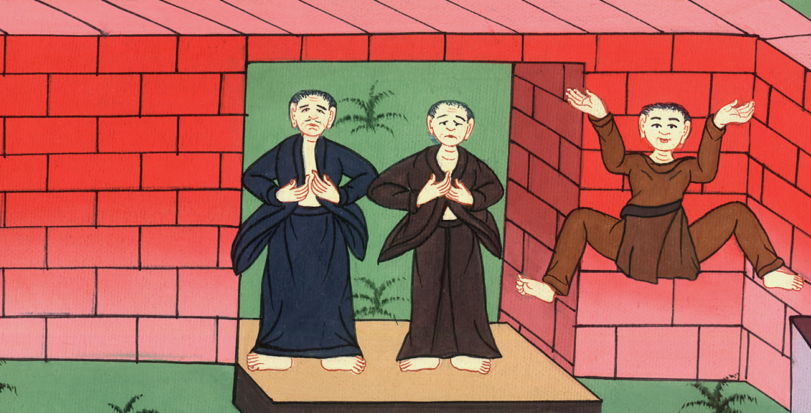
Acts 14:17

Slide 25
18Even saying these things, they hardly stopped the multitudes from making a sacrifice to them.

Slide 26
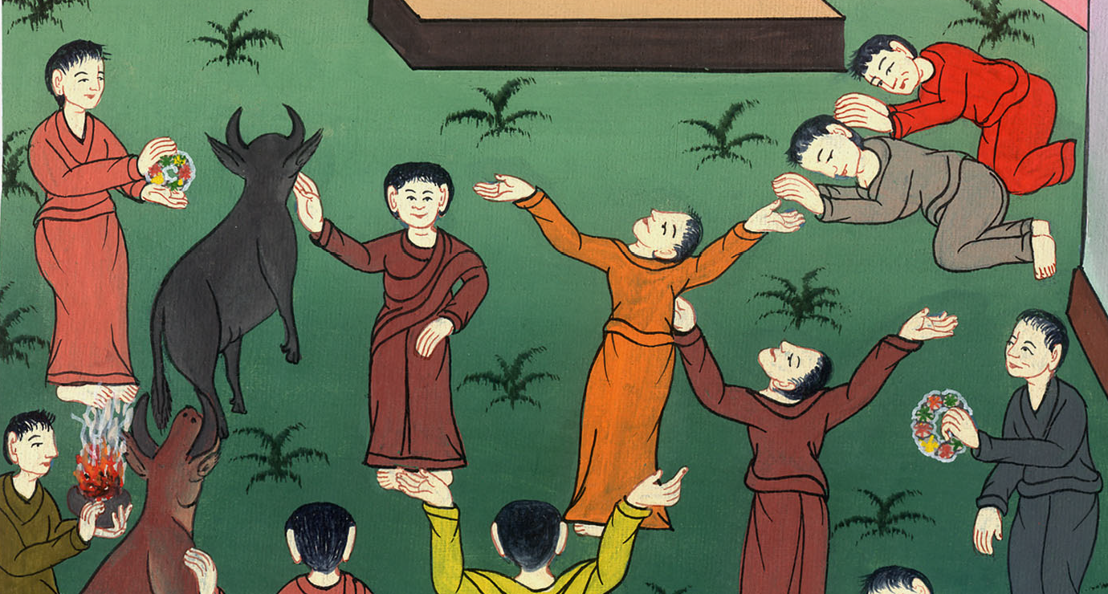
Acts 14:18

Slide 27
19But some Jews from Antioch and Iconium came there, and having persuaded the multitudes, they stoned Paul and dragged him out of the city, supposing that he was dead.

Slide 28
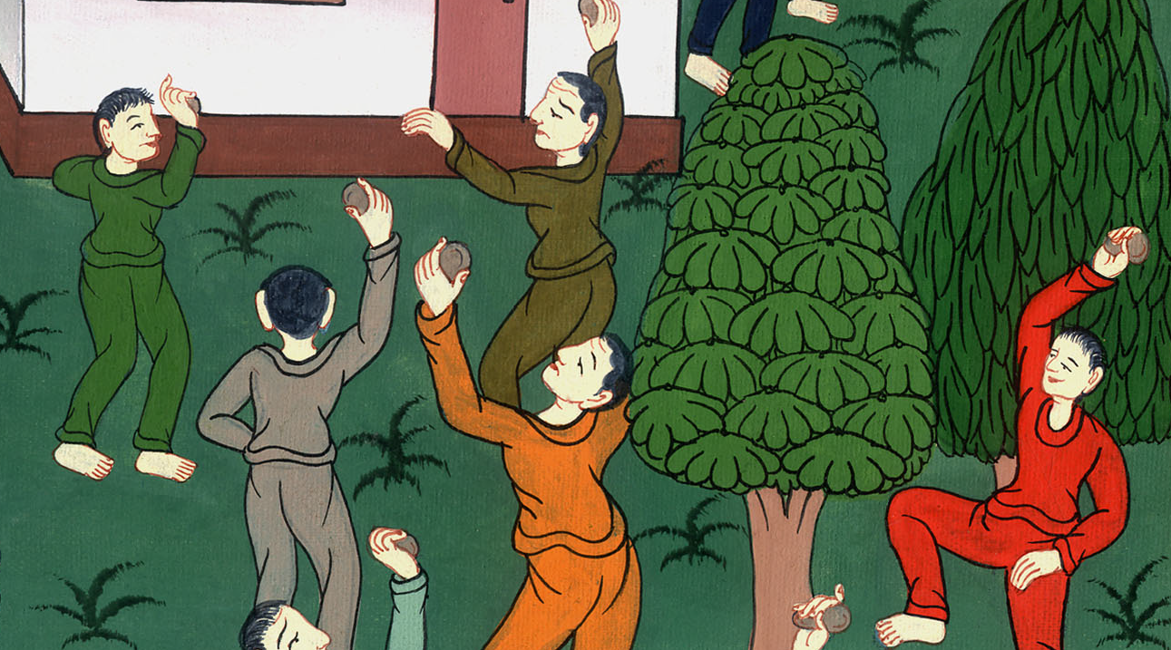
Acts 14:19

Slide 29
20But as the disciples stood around him, he rose up, and entered into the city. On the next day he went out with Barnabas to Derbe.

Slide 30
Acts 14:20

