Slide 1
51-6
This work is licensed under a Creative Commons Attribution-ShareAlike 4.0 International License.
Please add this statement to all the videos you create.
English Bible quotes are from the World English Bible US, which is in the public domain.
Notes:
Ch
51 Paul’s 1st Journey
1. Barnabas, Saul and Agabus in Antioch – Acts 11:19-30 (Left Top)
2. Saul, Barnabas and John Mark sent out – Acts 13:1-5 (Center Top)
3. Sergius Paulus and Elymas – Acts 13:6-12 (Right Top)
4. John Mark leaves them and returns to Jerusalem – Acts 13:13 (Right Center)
5. Rejected by Jews in Pisidian Antioch – Acts 13:14-52 (Right Bottom)
6. Chased from Iconium – Acts 14:1-6 (Center Bottom)
7. Healing of lame man in Lystra – Acts 14:7-20 (Left Bottom)
8. On the way back to Antioch – Acts 14:21-28 (Left Center)
9. The Council at Jerusalem – Acts 15:1-35 (Center)

Slide 2
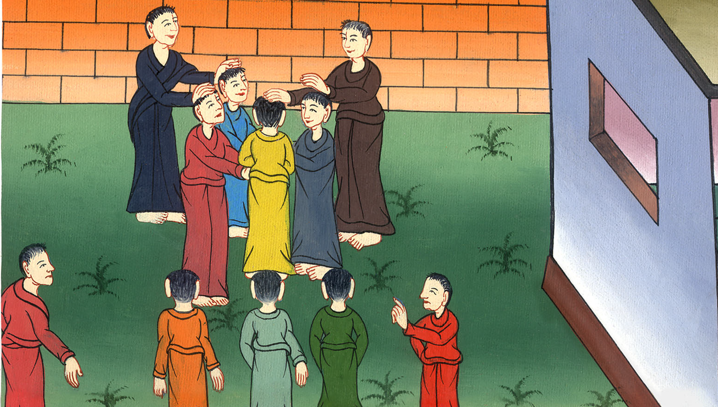
On the way back to Antioch –
Acts 14:21-28

Slide 3
On the way back to Antioch – Acts 14:21-28

Slide 4
On the way back to Antioch –
Acts 14:21-28

Slide 5
21When they had preached the Good News to Derbe and had made many disciples, they returned to Lystra, Iconium, and Antioch,

Slide 6
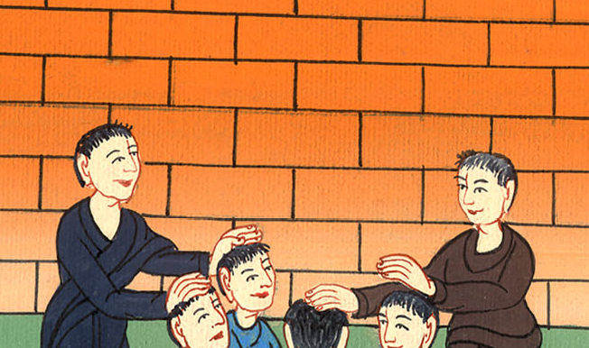
Acts 14:21

Slide 7
22They strengthened the souls of the disciples, exhorting them to continue in the faith, and that through many afflictions we must enter into God’s Kingdom.

Slide 8
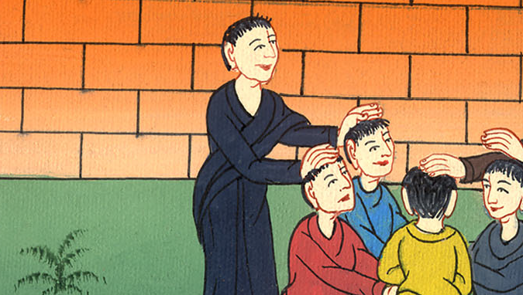
Acts 14:22

Slide 9
23When they had appointed elders for them in every assembly, and had prayed with fasting, they commended them to the Lord on whom they had believed.

Slide 10
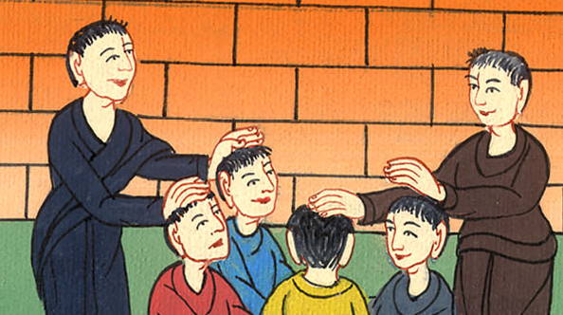
Acts 14:23

Slide 11
24They passed through Pisidia and came to Pamphylia. 25When they had spoken the word in Perga, they went down to Attalia.

Slide 12
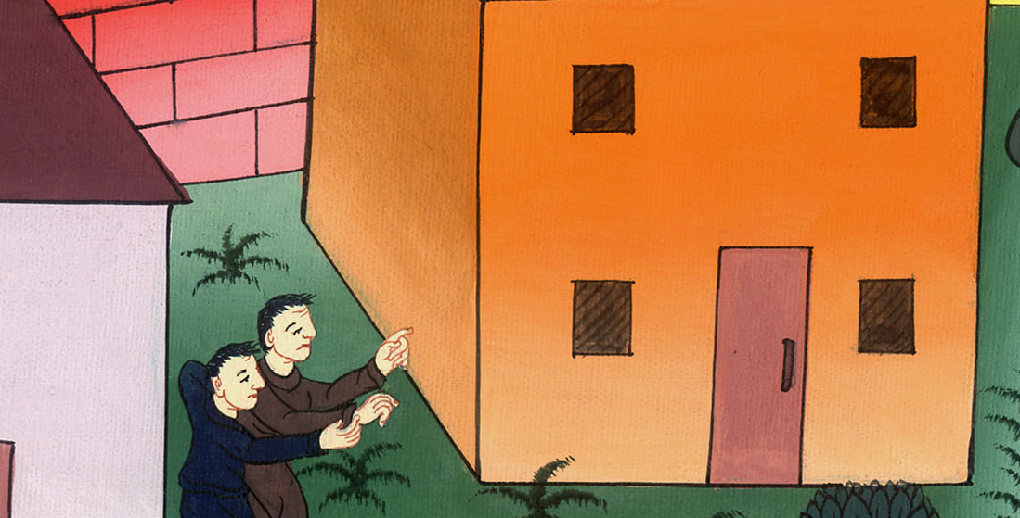
Acts 14:24,25

Slide 13
26From there they sailed to Antioch, from where they had been committed to the grace of God for the work which they had fulfilled.

Slide 14
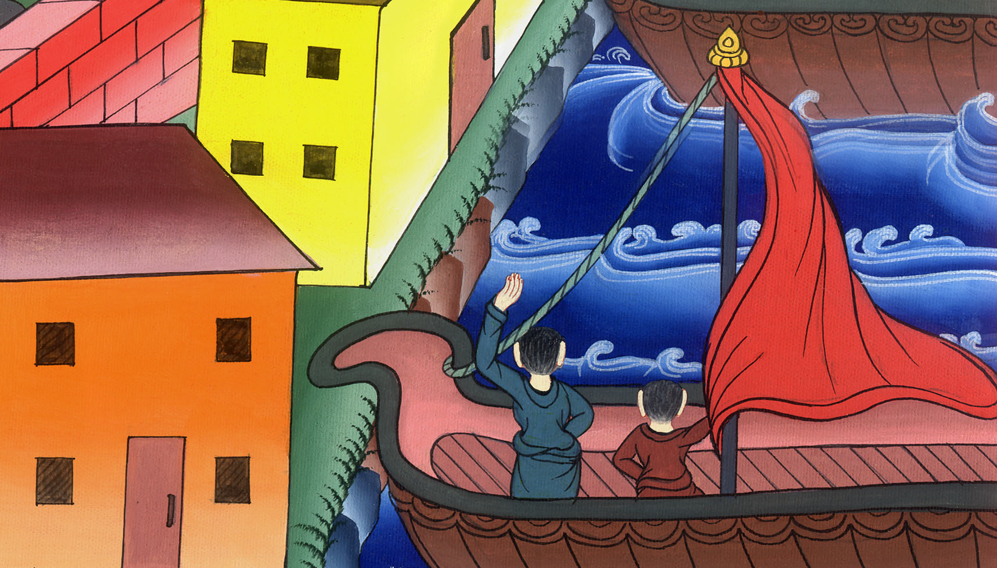
Acts 14:26

Slide 15
27When they had arrived and had gathered the assembly together, they reported all the things that God had done with them, and that he had opened a door of faith to the nations.

Slide 16
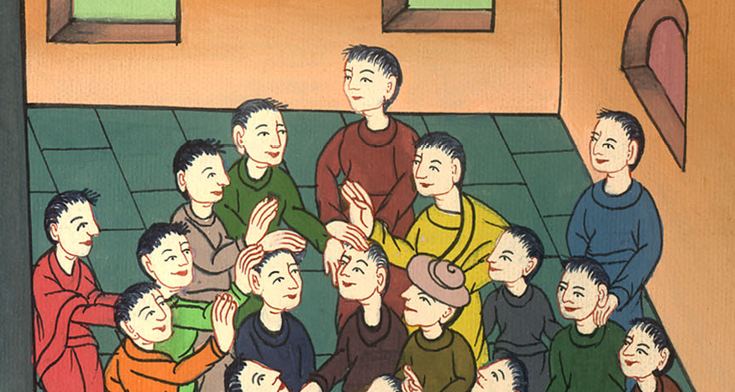
Acts 14:27

Slide 17
28They stayed there with the disciples for a long time.

Slide 18
Acts 14:28

