Slide 1
51-7
This work is licensed under a Creative Commons Attribution-ShareAlike 4.0 International License.
Please add this statement to all the videos you create.
English Bible quotes are from the World English Bible US, which is in the public domain.
Notes:
Ch
51 Paul’s 1st Journey
1. Barnabas, Saul and Agabus in Antioch – Acts 11:19-30 (Left Top)
2. Saul, Barnabas and John Mark sent out – Acts 13:1-5 (Center Top)
3. Sergius Paulus and Elymas – Acts 13:6-12 (Right Top)
4. John Mark leaves them and returns to Jerusalem – Acts 13:13 (Right Center)
5. Rejected by Jews in Pisidian Antioch – Acts 13:14-52 (Right Bottom)
6. Chased from Iconium – Acts 14:1-6 (Center Bottom)
7. Healing of lame man in Lystra – Acts 14:7-20 (Left Bottom)
8. On the way back to Antioch – Acts 14:21-28 (Left Center)
9. The Council at Jerusalem – Acts 15:1-35 (Center)

Slide 2
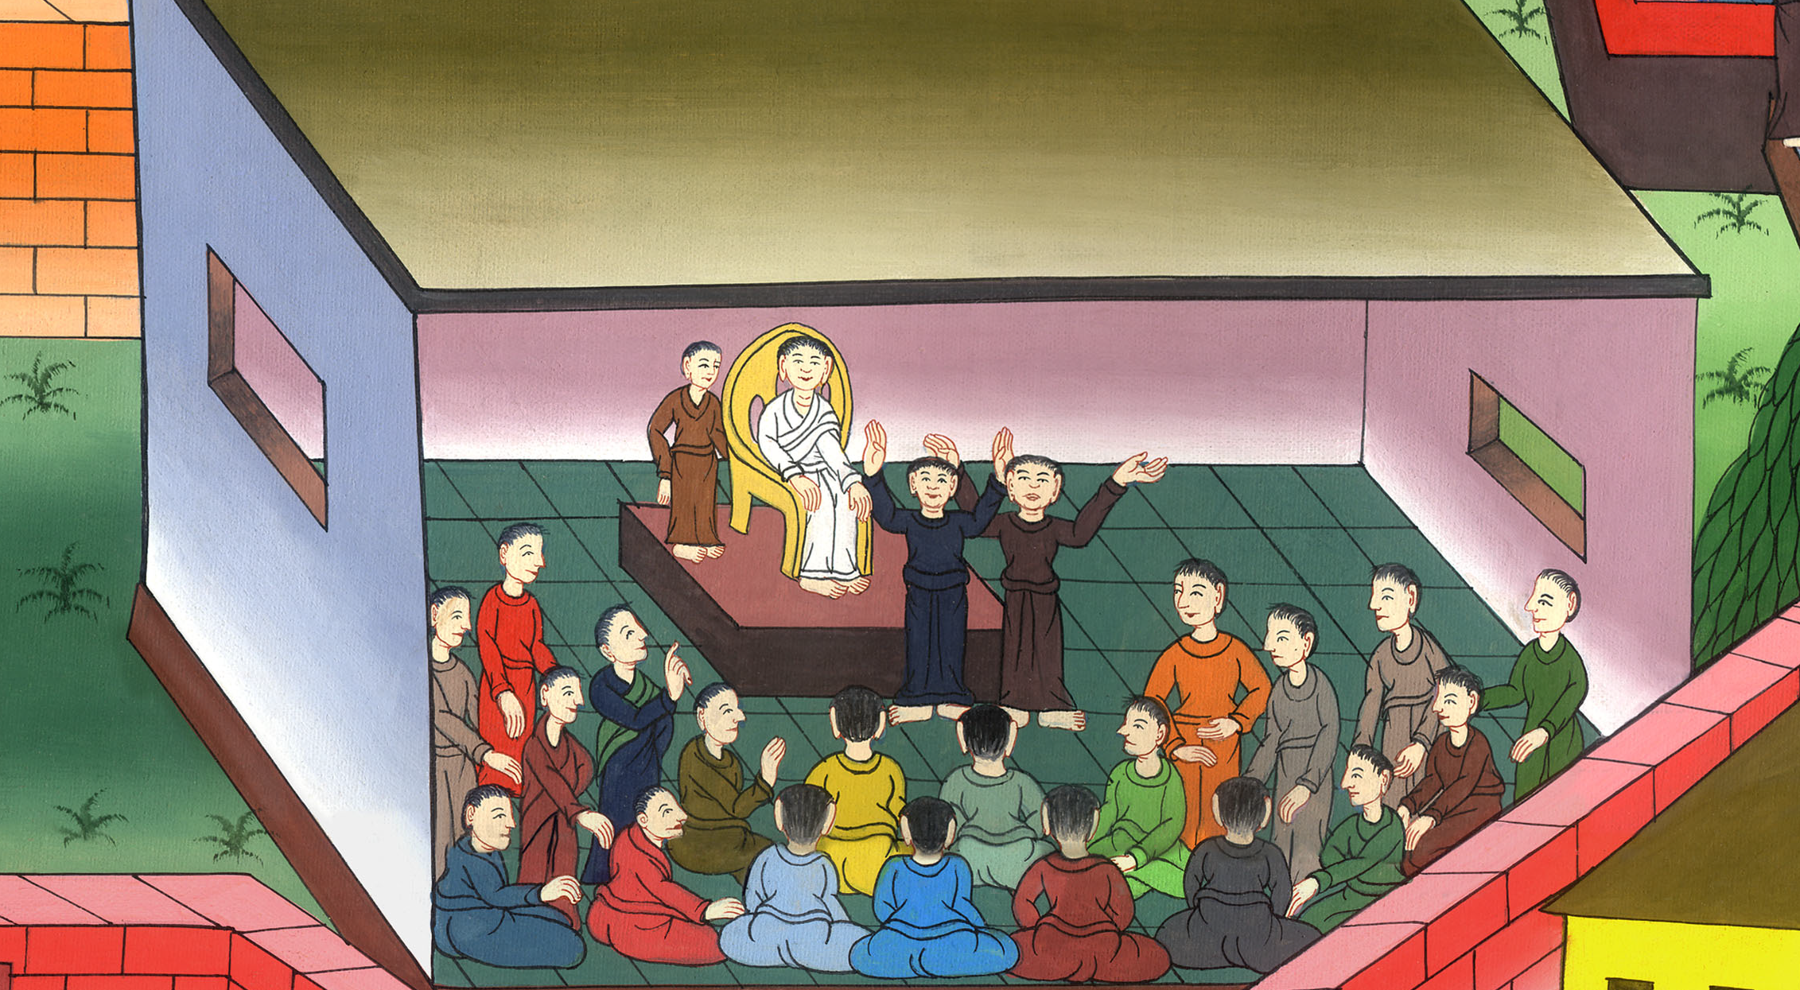
The Council at Jerusalem –
Acts 15:1-35

Slide 3
The Council at Jerusalem – Acts 15:1-35

Slide 4
The Council at Jerusalem –
Acts 15:1-35

Slide 5
1Some men came down from Judea and taught the brothers, “Unless you are circumcised after the custom of Moses, you can’t be saved.”

Slide 6
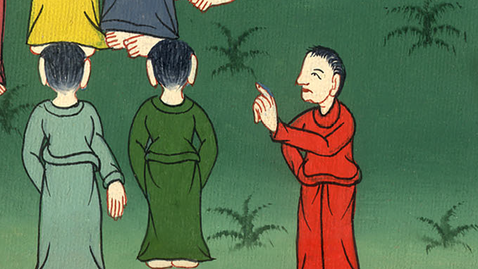
Acts 15:1

Slide 7
2Therefore when Paul and Barnabas had no small discord and discussion with them, they appointed Paul, Barnabas, and some others of them to go up to Jerusalem to the apostles and elders about this question.

Slide 8
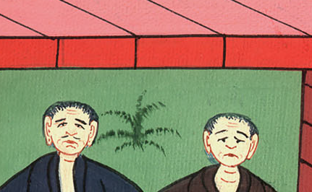
Acts 15:2

Slide 9
4When they had come to Jerusalem, they were received by the assembly and the apostles and the elders, and they reported everything that God had done with them.

Slide 10
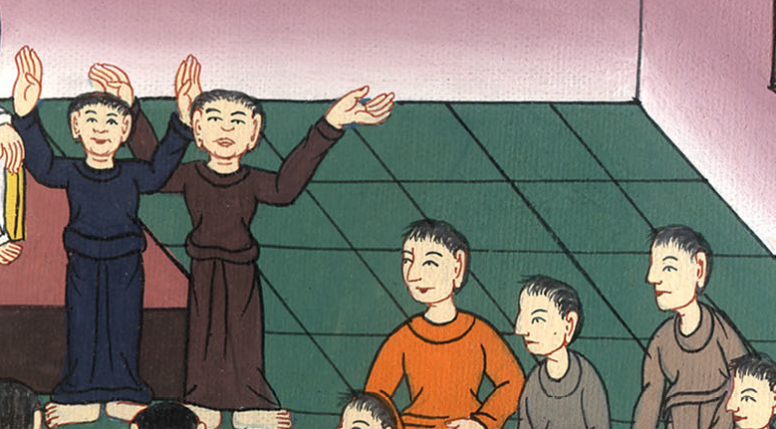
Acts 15:4

Slide 11
5But some of the sect of the Pharisees who believed rose up, saying, “It is necessary to circumcise them, and to command them to keep the law of Moses.”
6The apostles and the elders were gathered together to see about this matter.

Slide 12
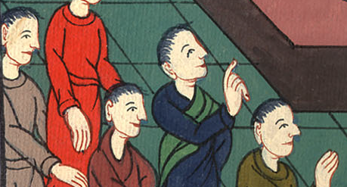
Acts 15:5,6

Slide 13
7When there had been much discussion, Peter rose up and said to them, “Brothers, you know that a good while ago God made a choice among you that by my mouth the nations should hear the word of the Good News and believe.

Slide 14
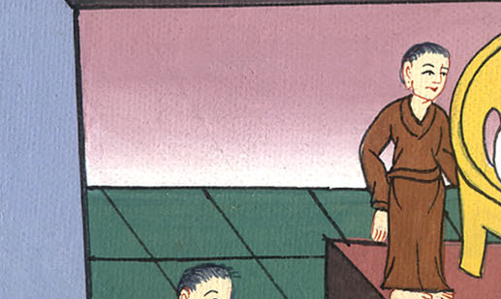
Acts 15:7

Slide 15
8God, who knows the heart, testified about them, giving them the Holy Spirit, just like he did to us.

Slide 16
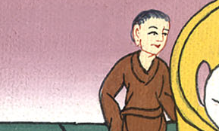
Acts 15:8

Slide 17
9He made no distinction between us and them, cleansing their hearts by faith.

Slide 18
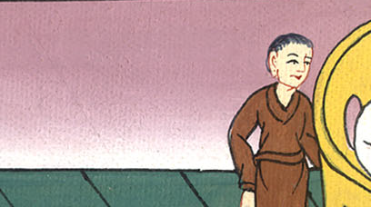
Acts 15:9

Slide 19
10Now therefore why do you tempt God, that you should put a yoke on the neck of the disciples which neither our fathers nor we were able to bear?

Slide 20
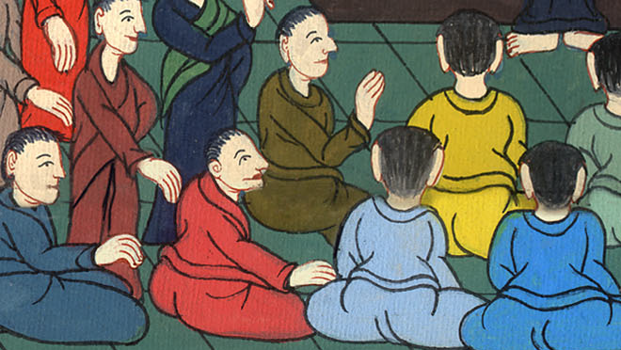
Acts 15:10

Slide 21
11But we believe that we are saved through the grace of the Lord Jesus, just as they are.”

Slide 22
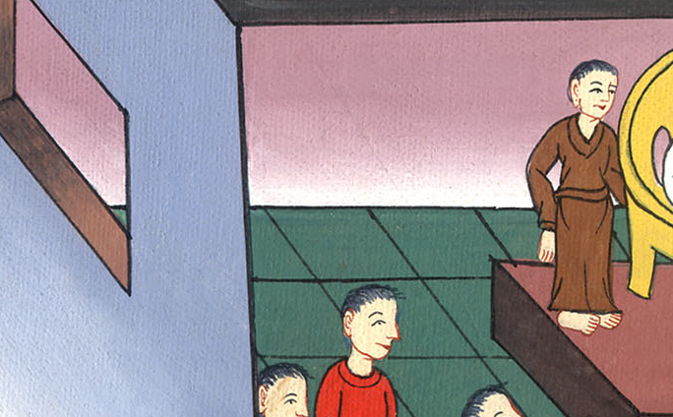
Acts 15:11

Slide 23
12All the multitude kept silence, and they listened to Barnabas and Paul reporting what signs and wonders God had done among the nations through them.

Slide 24
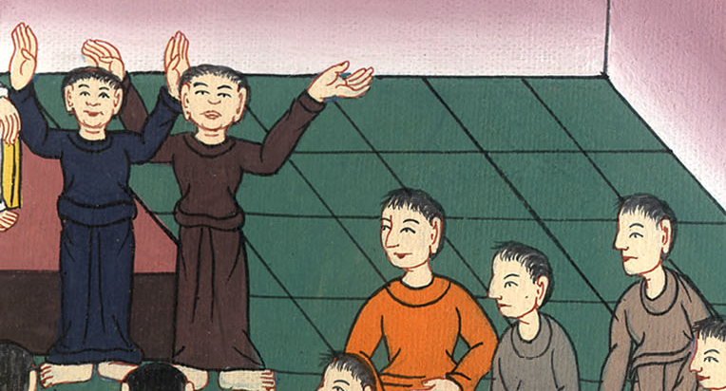
Acts 15:12

Slide 25
13After they were silent, James answered, “Brothers, listen to me. 14Simeon has reported how God first visited the nations to take out of them a people for his name.

Slide 26
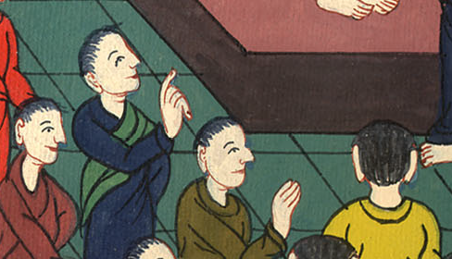
Acts 15:13.14

Slide 27
19Therefore my judgment is that we don’t trouble those from among the Gentiles who turn to God,

Slide 28
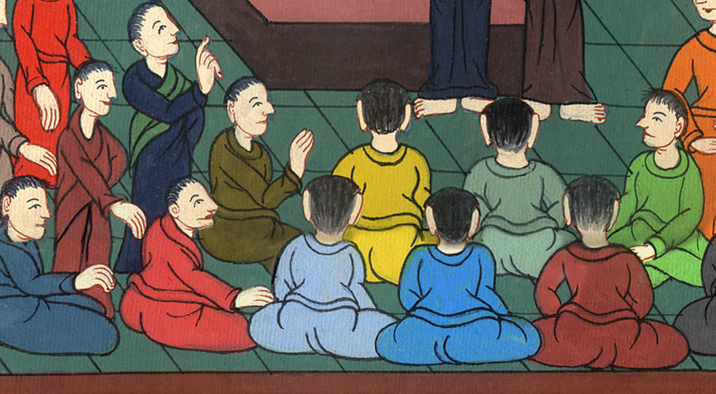
Acts 15:19

Slide 29
20but that we write to them that they abstain from the pollution of idols, from sexual immorality, from what is strangled, and from blood.

Slide 30
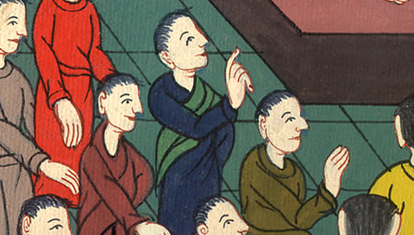
Acts 15:20

Slide 31
21For Moses from generations of old has in every city those who preach him, being read in the synagogues every Sabbath.”

Slide 32
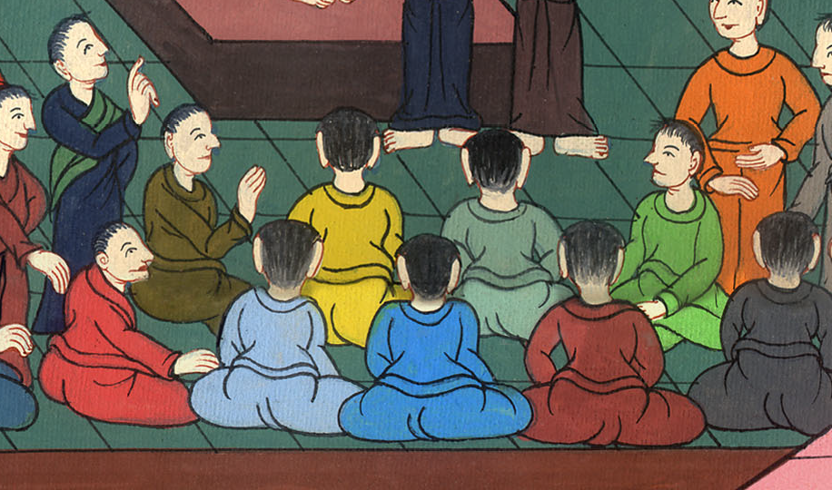
Acts 15:21

Slide 33
22Then it seemed good to the apostles and the elders, with the whole assembly, to choose men out of their company, and send them to Antioch with Paul and Barnabas

Slide 34
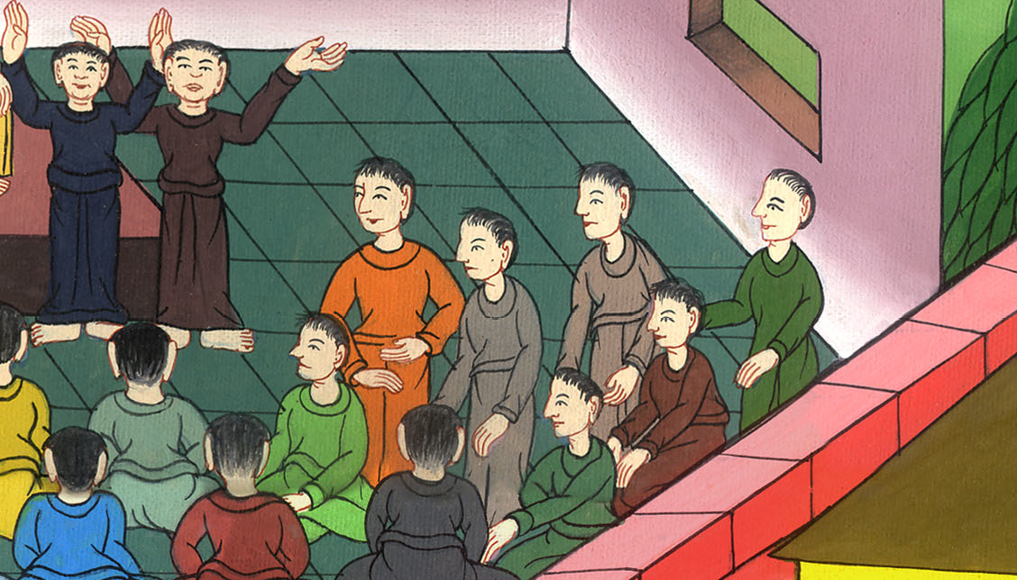
Acts 15:22

Slide 35
They chose Judas called Barsabbas, and Silas, chief men among the brothers.

Slide 36
Acts 15:22

Slide 37
23They wrote these things by their hand:
“The apostles, the elders, and the brothers, to the brothers who are of the Gentiles in Antioch, Syria, and Cilicia: greetings.

Slide 38
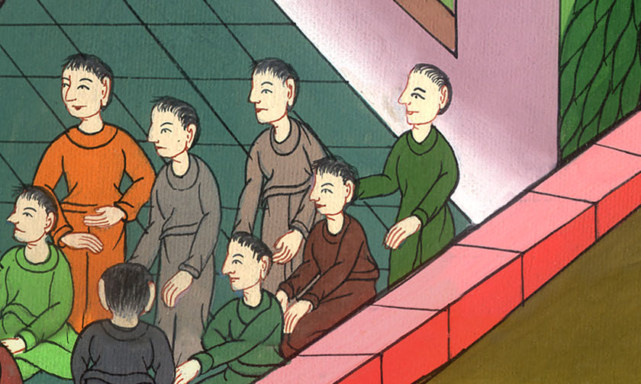
Acts 15:23

Slide 39
28For it seemed good to the Holy Spirit, and to us, to lay no greater burden on you than these necessary things:

Slide 40
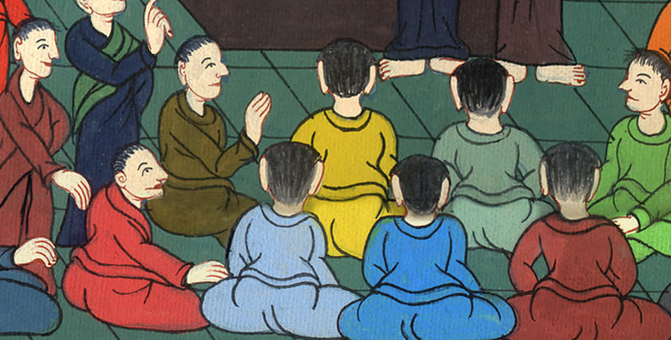
Acts 15:28

Slide 41
29you are to abstain from things sacrificed to idols, from blood, from things strangled, and from sexual immorality, from which if you keep yourselves, it will be well with you. Farewell.”

Slide 42
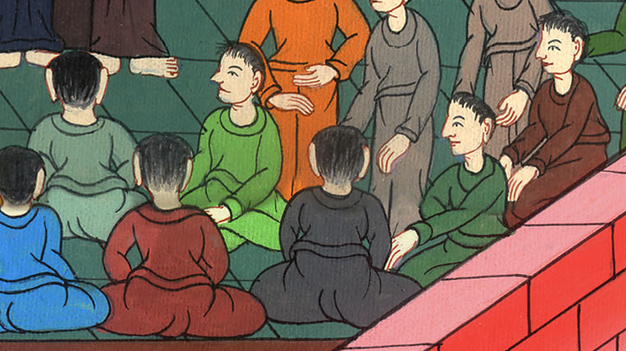
Acts 15:29

Slide 43
30So, when they were sent off, they came to Antioch. Having gathered the multitude together, they delivered the letter. 31When they had read it, they rejoiced over the encouragement.

Slide 44
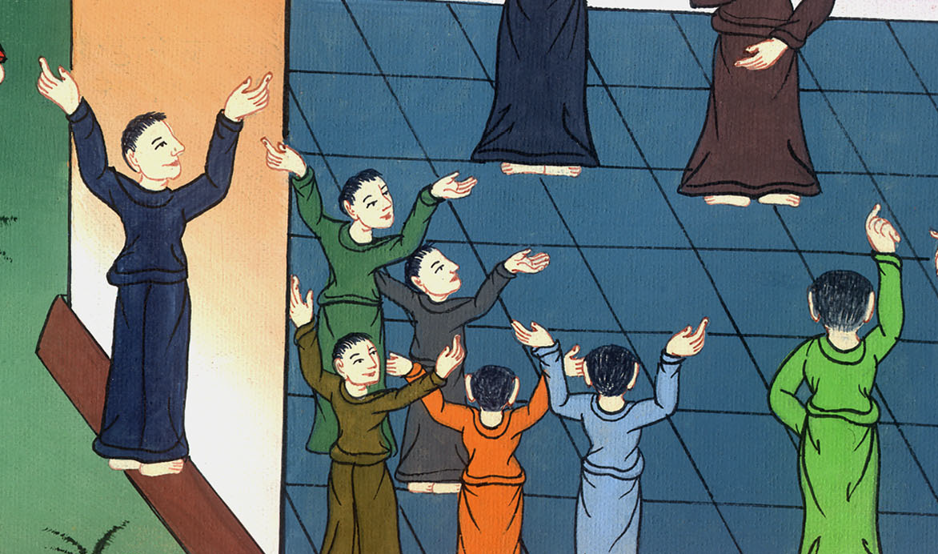
Acts 15:30,31

Slide 45
33-34After they had spent some time there, they were dismissed in peace from the brothers to the apostles.

Slide 46
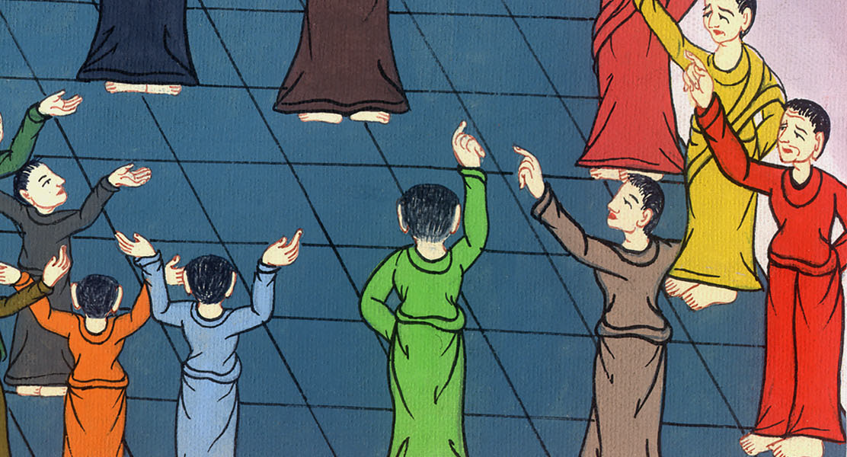
Acts 15:33

Slide 47
35But Paul and Barnabas stayed in Antioch, teaching and preaching the word of the Lord, with many others also.

Slide 48
Acts 15:35

