Slide 1
52-1
This work is licensed under a Creative Commons Attribution-ShareAlike 4.0 International License.
Please add this statement to all the videos you create.
English Bible quotes are from the World English Bible US, which is in the public domain.
Notes:
Ch
52 Paul’s 2nd Journey
1. Paul and Barnabas go separate ways – Acts 15:36-41 (Left Top)
2. Led by the Holy Spirit – Acts 16:1-12 (Center Top)
3. Meeting Lydia in Philippi– Acts 16:13-15 (Right Top)
4. Demonized slave girl – Acts 16:16-19 (Right Center)
5. Paul and Silas beaten and imprisoned – Acts 16:20-24 (Right Bottom)
6. Worship in the Jail – Acts 16:25-27 (Center)
7. The Jailer believes – Acts 16:28-34 (Left Bottom)
8. The chief magistrates beg Paul and Silas to leave – Acts 16:35-40 (Left Center)

Slide 2
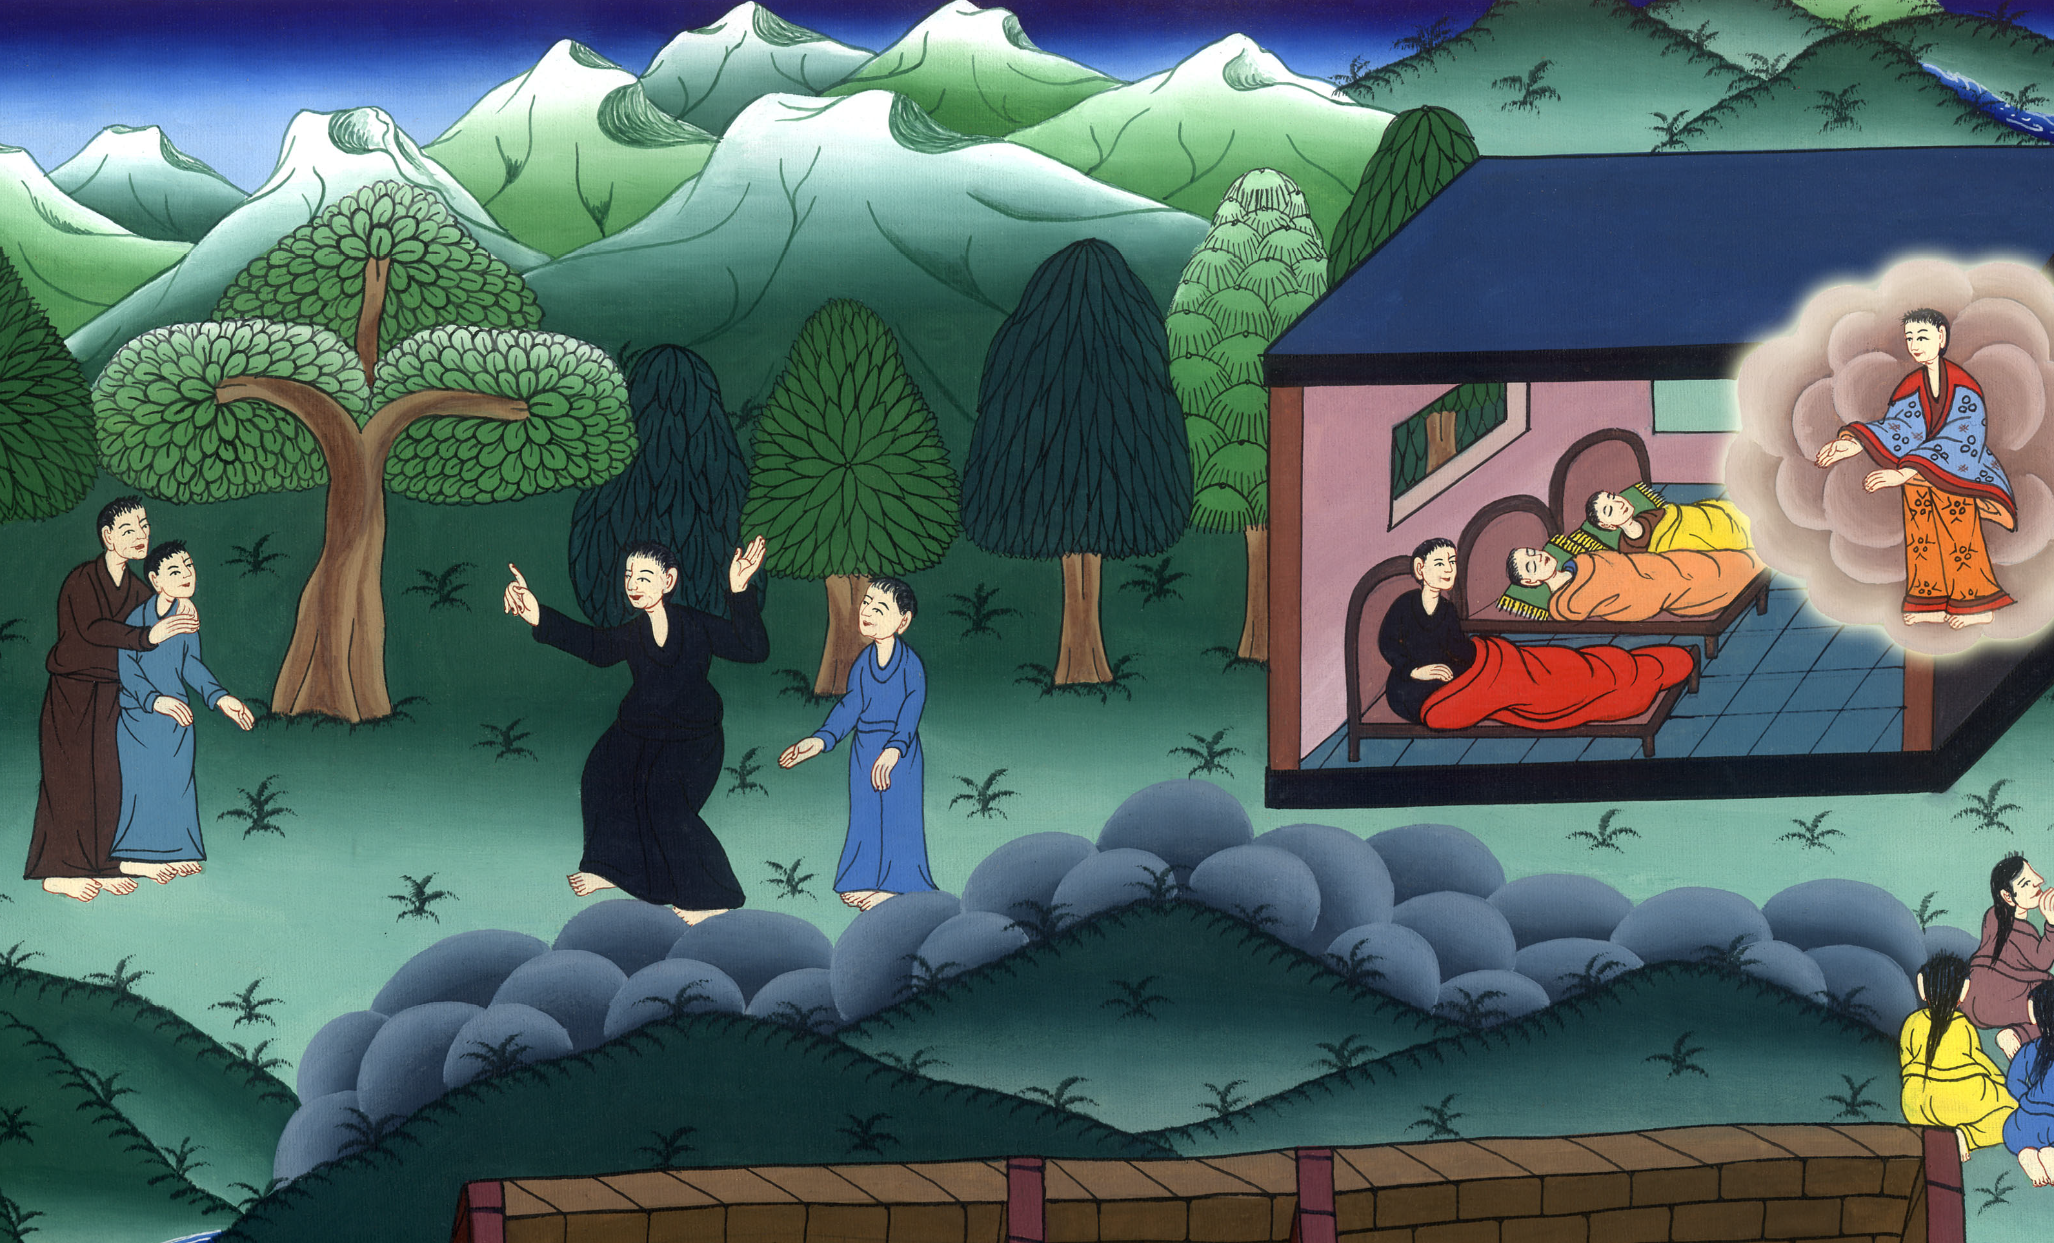
Paul and Barnabas go separate ways –
Acts 15,16

Slide 3
Paul’s 2nd Journey
Paul and Barnabas go separate ways – Acts 15:36-41– Acts 16:1-12

Slide 4
Paul and Barnabas go separate ways –
Acts 15,16

Slide 5
36Some time later Paul said to Barnabas, “Let us go back and visit the believers in all the towns where we preached the word of the Lord and see how they are doing.”

Slide 6
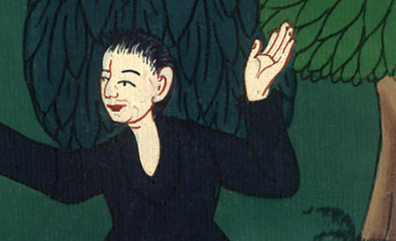
Acts 15:36

Slide 7
37Barnabas wanted to take John, also called Mark, with them, 38but Paul did not think it wise to take him, because he had deserted them in Pamphylia and had not continued with them in the work.

Slide 8
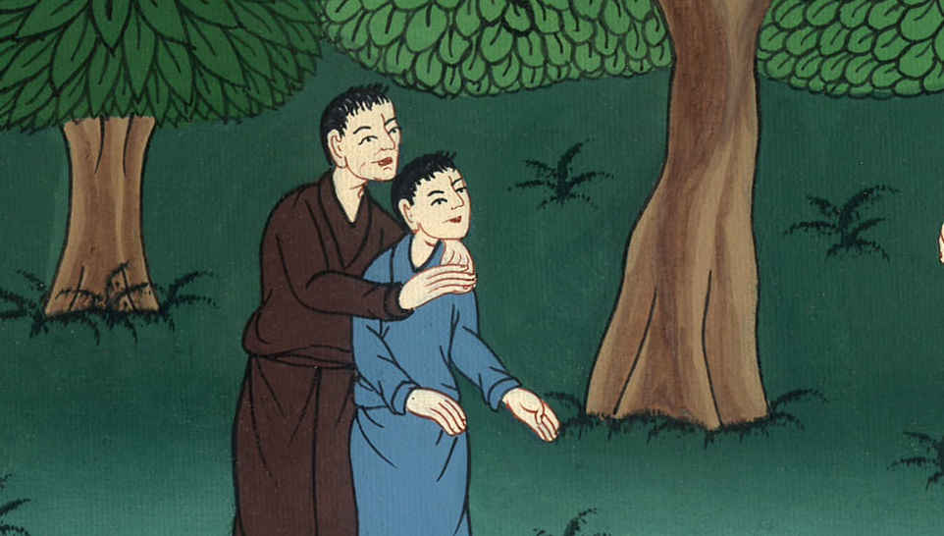
Acts 15:37,38

Slide 9
39They had such a sharp disagreement that they parted company. Barnabas took Mark and sailed for Cyprus,

Slide 10
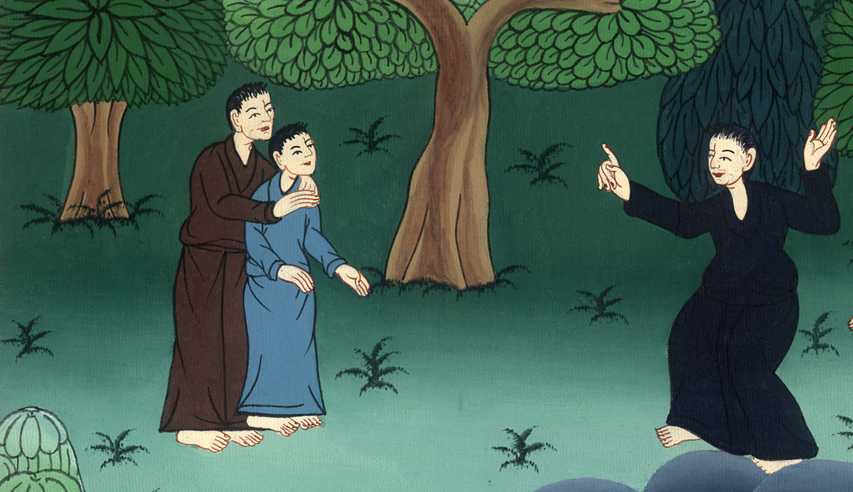
Acts 15:39

Slide 11
40but Paul chose Silas and left, commended by the believers to the grace of the Lord.

Slide 12
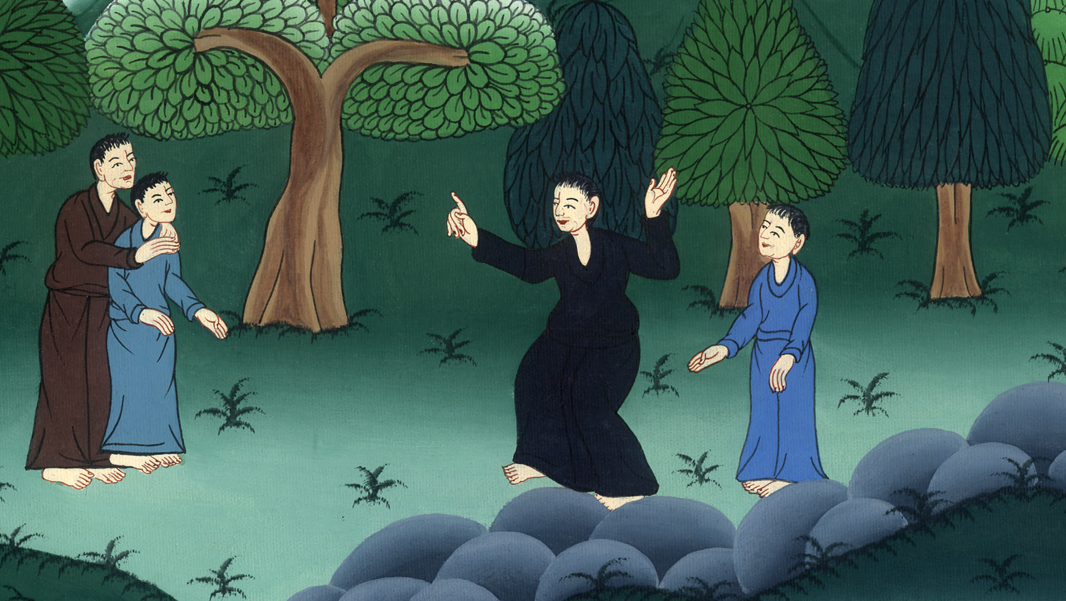
Acts 15:40

Slide 13
41Paul went through Syria and Cilicia, strengthening the churches.

Slide 14
Acts 15:41

Slide 15
16:1Paul came to Derbe and then to Lystra, where a disciple named Timothy lived, whose mother was Jewish and a believer but whose father was a Greek.

Slide 16
Acts 16:1

Slide 17
The believers at Lystra and Iconium spoke well of him. 3Paul wanted to take him along on the journey…

Slide 18
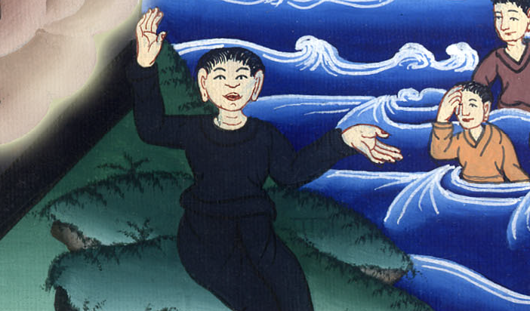
Acts 16:2,3

Slide 19
4As they traveled from town to town, they delivered the decisions reached by the apostles and elders in Jerusalem for the people to obey.

Slide 20
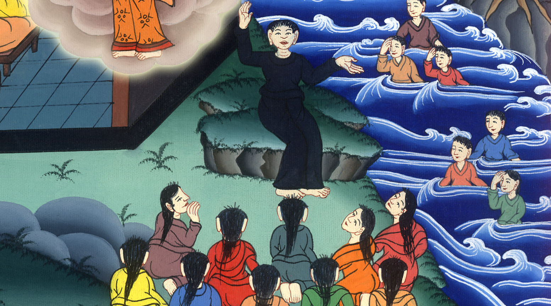
Acts 16:4

Slide 21
5So the churches were strengthened in the faith and grew daily in numbers.

Slide 22
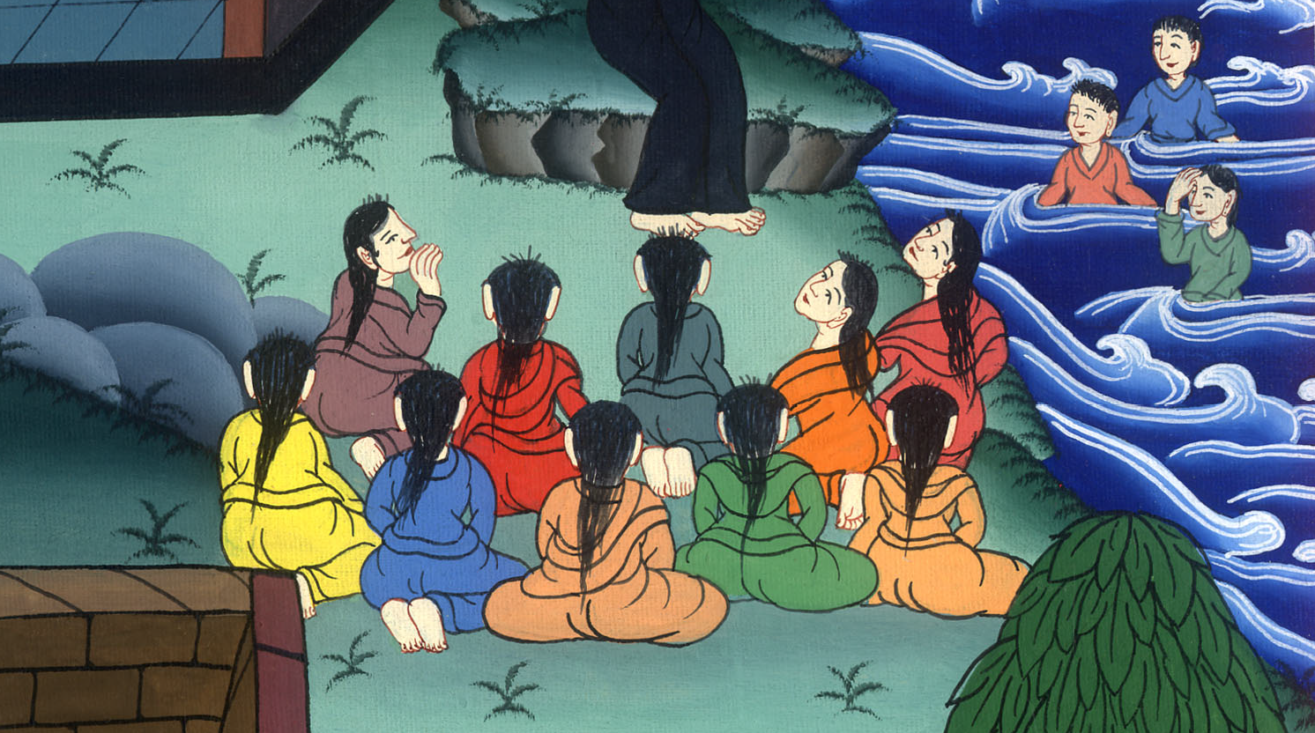
Acts 16:5

Slide 23
6Paul and his companions traveled throughout the region of Phrygia and Galatia, having been kept by the Holy Spirit from preaching the word in the province of Asia.

Slide 24
Acts 16:6

Slide 25
7When they came to the border of Mysia, they tried to enter Bithynia, but the Spirit of Jesus would not allow them to. 8So they passed by Mysia and went down to Troas.

Slide 26
Acts 16:7,8

Slide 27
9During the night Paul had a vision of a man of Macedonia standing and begging him, “Come over to Macedonia and help us.”

Slide 28
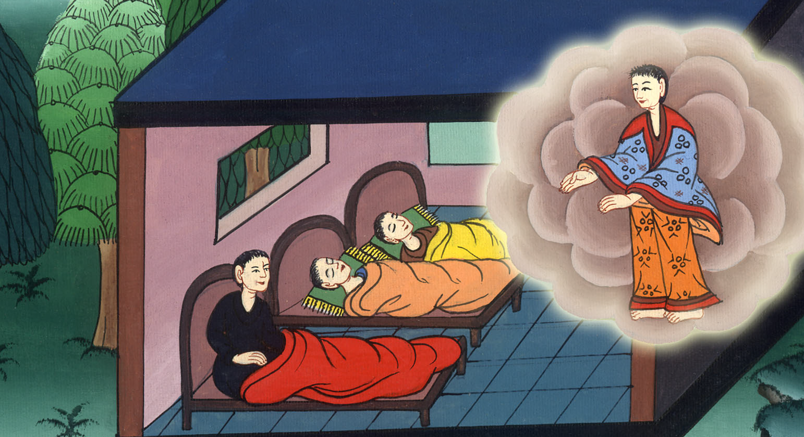
Acts 16:9

Slide 29
10After Paul had seen the vision, we got ready at once to leave for Macedonia, concluding that God had called us to preach the gospel to them.

Slide 30
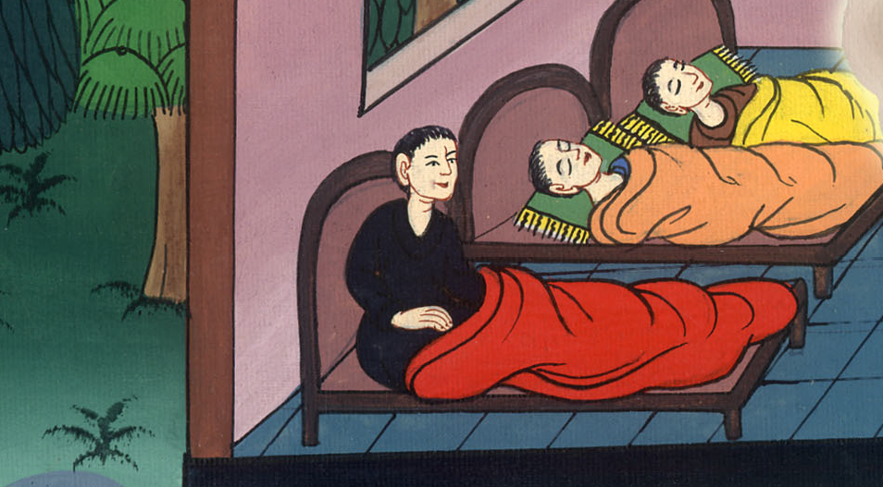
Acts 16:10

Slide 31
11From Troas we put out to sea and sailed straight for Samothrace, and the next day we went on to Neapolis.

Slide 32
Acts 16:11

Slide 33
They sailed to Macedonia12From there we traveled to Philippi, a Roman colony and the leading city of that district of Macedonia. And we stayed there several days.

Slide 34
Acts 16:12

