Slide 1
52-2
This work is licensed under a Creative Commons Attribution-ShareAlike 4.0 International License.
Please add this statement to all the videos you create.
English Bible quotes are from the World English Bible US, which is in the public domain.
Notes:
Ch
52 Paul’s 2nd Journey
1. Paul and Barnabas go separate ways – Acts 15:36-41 (Left Top)
2. Led by the Holy Spirit – Acts 16:1-12 (Center Top)
3. Meeting Lydia in Philippi– Acts 16:13-15 (Right Top)
4. Demonized slave girl – Acts 16:16-19 (Right Center)
5. Paul and Silas beaten and imprisoned – Acts 16:20-24 (Right Bottom)
6. Worship in the Jail – Acts 16:25-27 (Center)
7. The Jailer believes – Acts 16:28-34 (Left Bottom)
8. The chief magistrates beg Paul and Silas to leave – Acts 16:35-40 (Left Center)

Slide 2
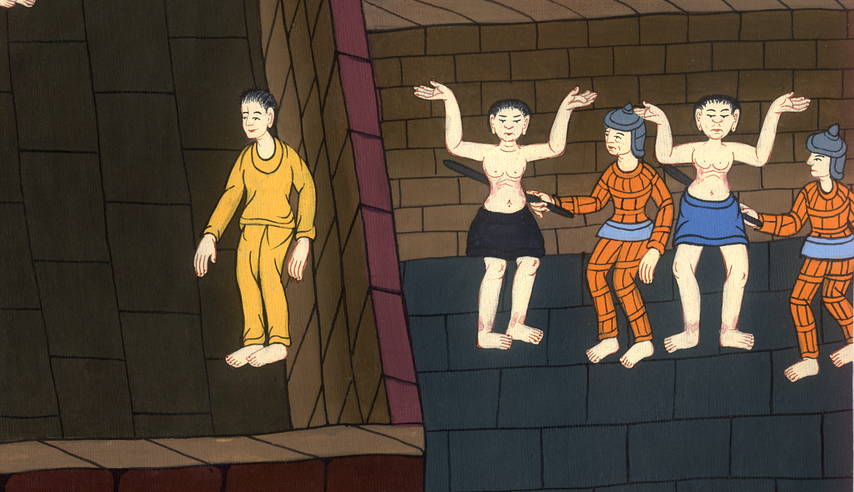
Paul and Silas Put in Prison– Acts 16

Slide 3
Paul and Silas Put in Prison– Acts 16:13-24

Slide 4
Paul and Silas Put in Prison– Acts 16

Slide 5
Paul, Silas and Luke arrived in Philippi, a Roman colony.
Luke says:.

Slide 7
13On the Sabbath day we went outside of the city by a riverside, where we supposed there was a place of prayer, and we sat down and spoke to the women who had come together.

Slide 8
Acts 16:13

Slide 9
14A certain woman named Lydia, a seller of purple, of the city of Thyatira, one who worshiped God, heard us. The Lord opened her heart to listen to the things which were spoken by Paul.

Slide 10
Acts 16:14

Slide 11
15When she and her household were baptized, she begged us, saying, “If you have judged me to be faithful to the Lord, come into my house and stay.” So she persuaded us.

Slide 12
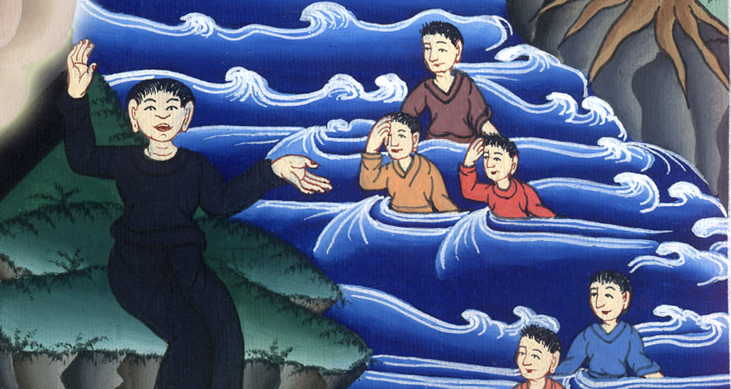
Acts 16:15

Slide 13
16As we were going to prayer, a certain girl having a spirit of divination met us, who brought her masters much gain by fortune telling.

Slide 14
Acts 16:16

Slide 15
17Following Paul and us, she cried out, “These men are servants of the Most High God, who proclaim to us a way of salvation!”

Slide 16
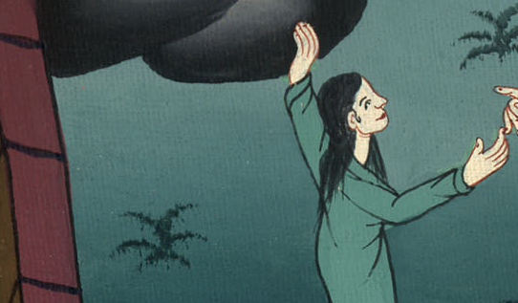
Acts 16:17

Slide 17
18She was doing this for many days.
But Paul, becoming greatly annoyed, turned and said to the spirit, “I command you in the name of Jesus Christ to come out of her!” It came out that very hour.

Slide 18
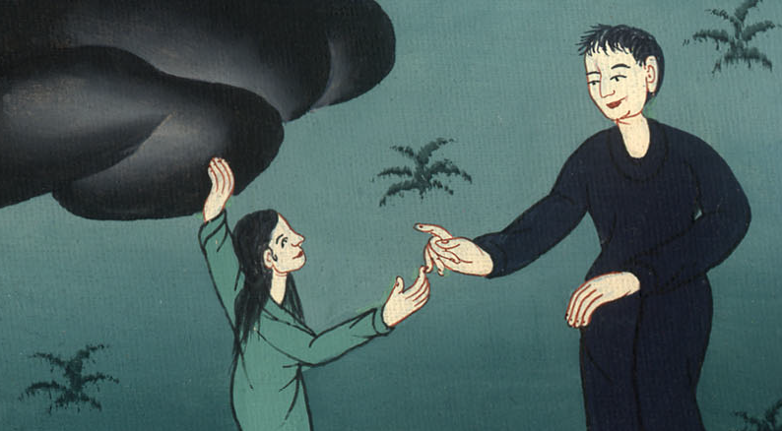
Acts 16:18

Slide 19
19But when her masters saw that the hope of their gain was gone, they seized Paul and Silas and dragged them into the marketplace before the rulers.

Slide 20
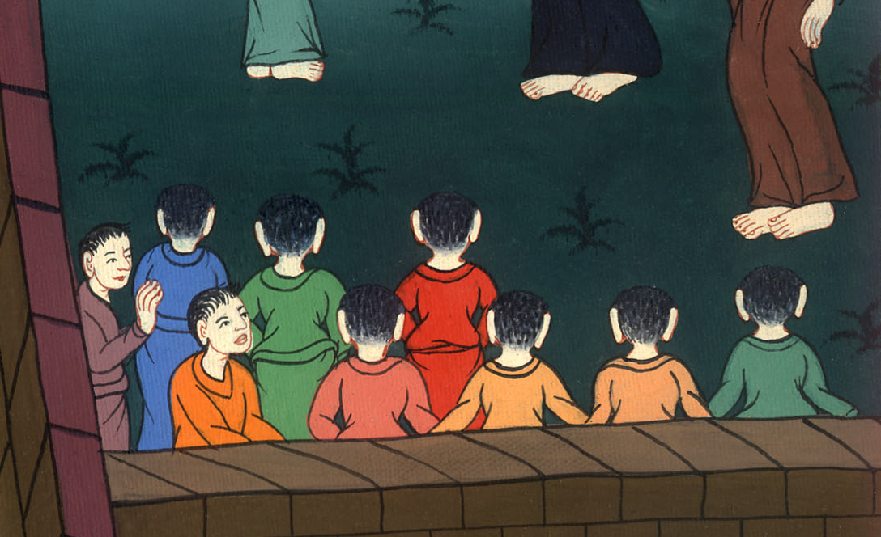
Acts 16:19

Slide 21
20When they had brought them to the magistrates, they said, “These men, being Jews, are agitating our city

Slide 22
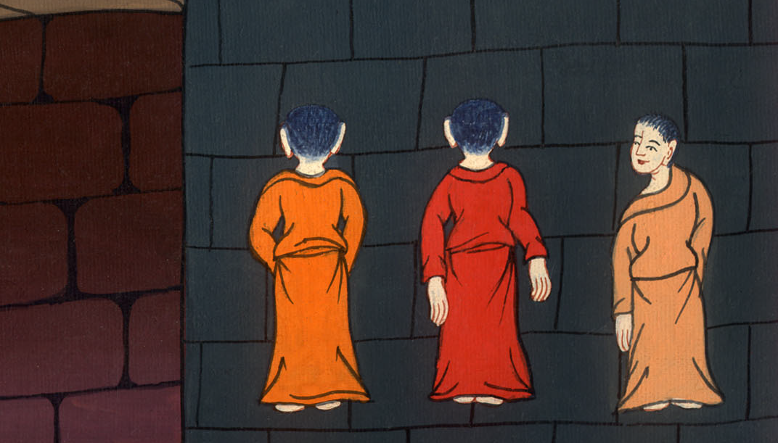
Acts 16:20

Slide 23
21They advocate customs which it is not lawful for us to accept or to observe, being Romans.”

Slide 24
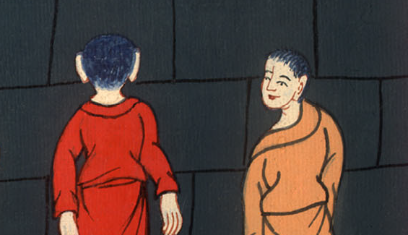
Acts 16:21

Slide 25
22The multitude rose up together against them and the magistrates tore their clothes from them, then commanded them to be beaten with rods.

Slide 26
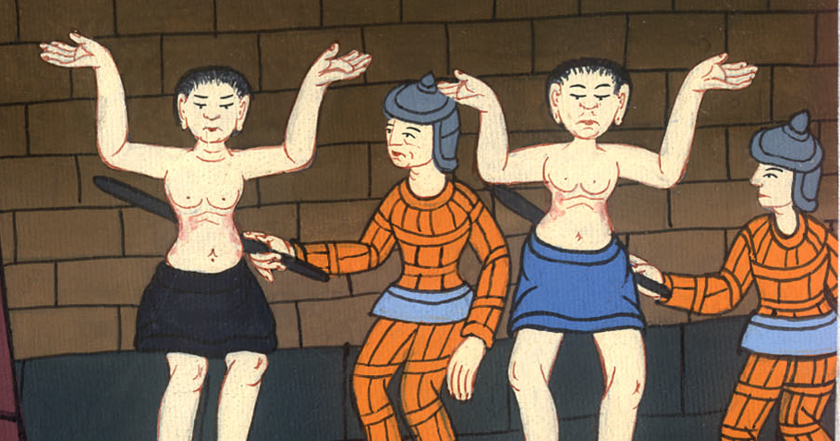
Acts 16:22

Slide 27
23When they had laid many stripes on them, they threw them into prison, charging the jailer to keep them safely.

Slide 28
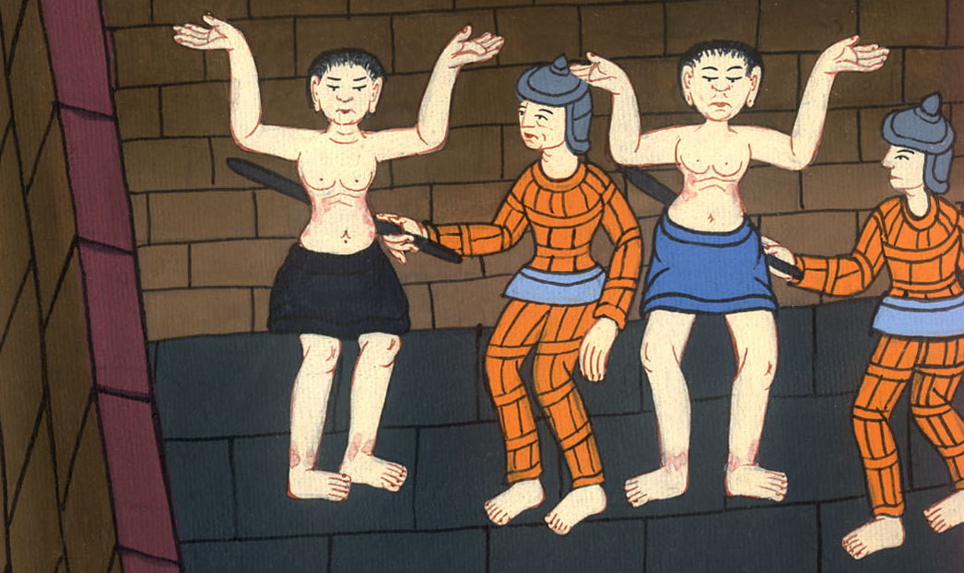
Acts 16:23

Slide 29
24Having received such a command, he threw them into the inner prison and secured their feet in the stocks.

Slide 30
Acts 16:24

