Slide 1
53-1
This work is licensed under a Creative Commons Attribution-ShareAlike 4.0 International License.
Please add this statement to all the videos you create.
English Bible quotes are from the World English Bible US, which is in the public domain.
Notes:
Ch
53 Paul’s 2nd Journey, Part 2
1. Chased out of Thessalonica – Acts 17:1-10 (Left and Center Top)
2. Driven out of Berea – Acts 17:10-14 (Right Top)
3. Paul in Athens – Acts 17:15-34 (Right Center)
4. Paul making tents – Acts 18:1-5 (Right Bottom)
5. Leaving the Jews and going to the Gentiles – Acts 18:6-11 (Center Bottom)
6. The Jews bring Paul to the Judgment seat – Acts 18:12-17 (Left Bottom)
7. Paul In Ephesus – Acts 18:18-22 (left Center)

Slide 2
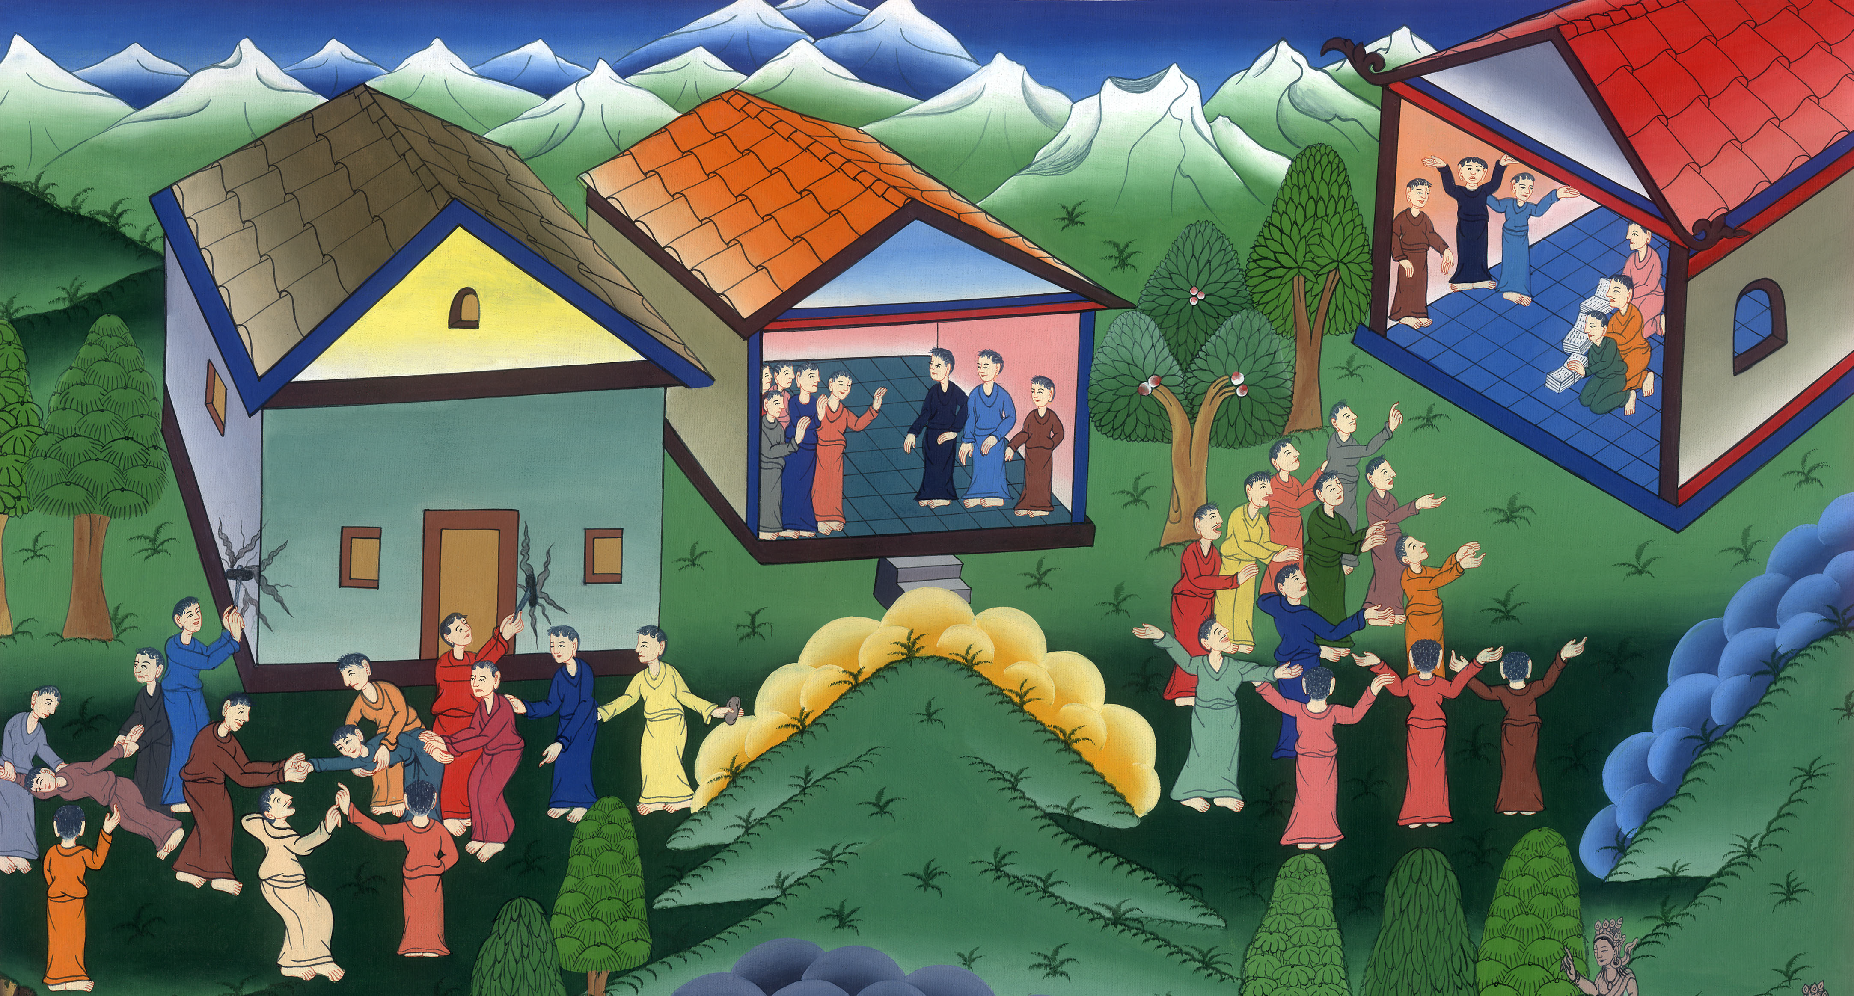
Chased out of Thessalonica and Berea – Acts 17:1-14

Slide 3
Paul’s Second Journey Continues
1. Chased out of Thessalonica and Berea – Acts 17:1-14

Slide 4
Chased out of Thessalonica and Berea – Acts 17:1-14

Slide 5
1Now when they had passed through Amphipolis and Apollonia, they came to Thessalonica, where there was a Jewish synagogue.

Slide 6
Acts 17:1

Slide 7
2Paul, as was his custom, went in to them; and for three Sabbath days reasoned with them from the Scriptures,

Slide 8
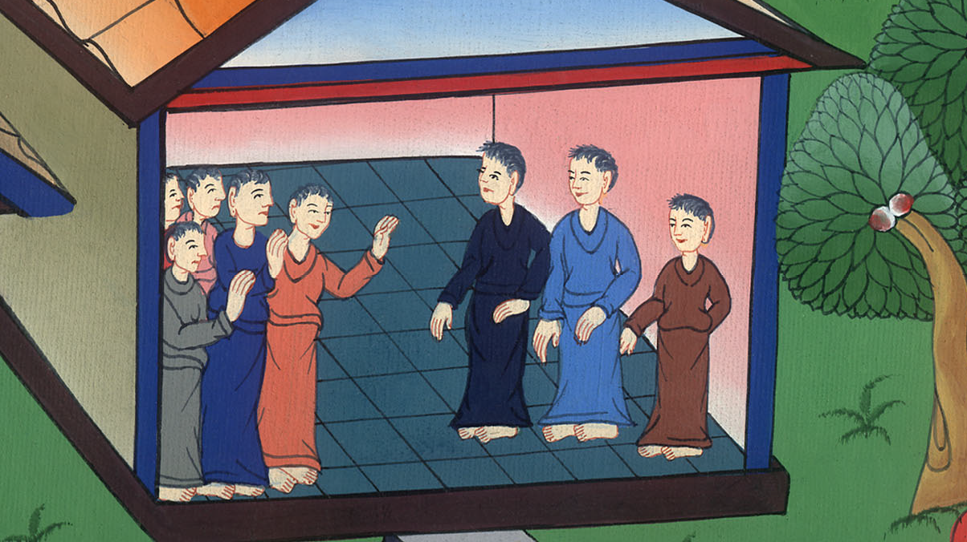
Acts 17:2

Slide 9
3He explained and demonstrated that the Christ had to suffer and rise again from the dead, and saying, “This Jesus, whom I proclaim to you, is the Christ.”

Slide 10
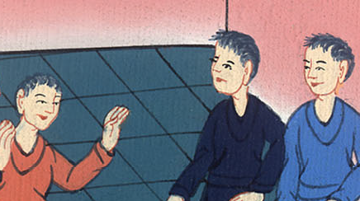
Acts 17:3

Slide 11
4Some of them were persuaded and joined Paul and Silas: of the devout Greeks a great multitude, and not a few of the chief women.

Slide 12
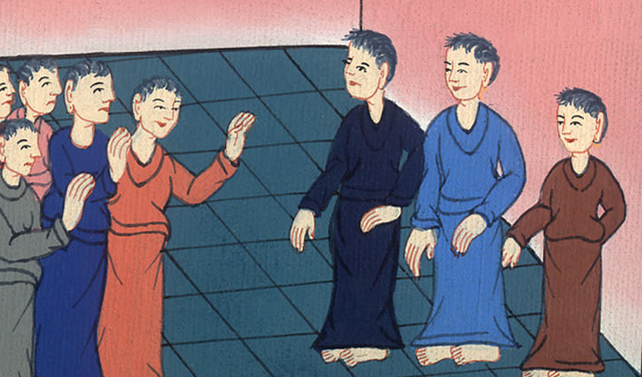
Acts 17:4

Slide 13
5But the unpersuaded Jews took along some wicked men from the marketplace and gathering a crowd, set the city in an uproar.

Slide 14
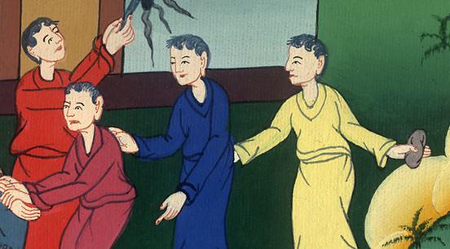
མཛད་པ། 17:6
Acts 17:4

Slide 15
Assaulting the house of Jason, they sought to bring them out to the people.

Slide 16
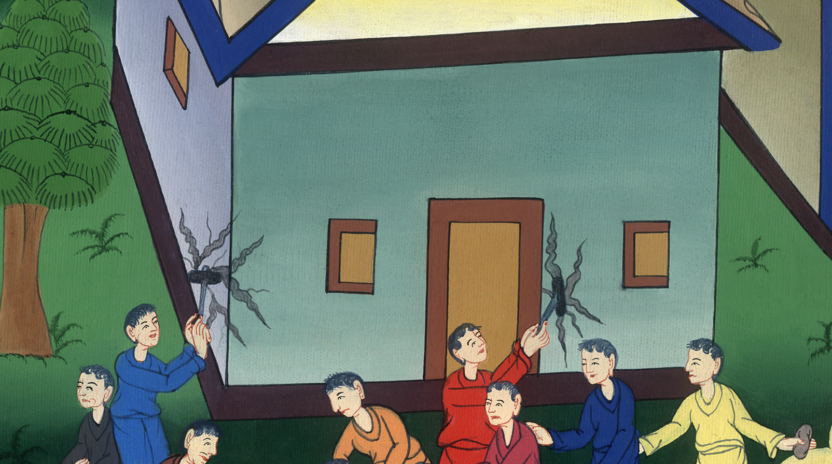
Acts 17:5

Slide 17
6When they didn’t find them, they dragged Jason and certain brothers before the rulers of the city, crying, “These who have turned the world upside down have come here also,

Slide 18
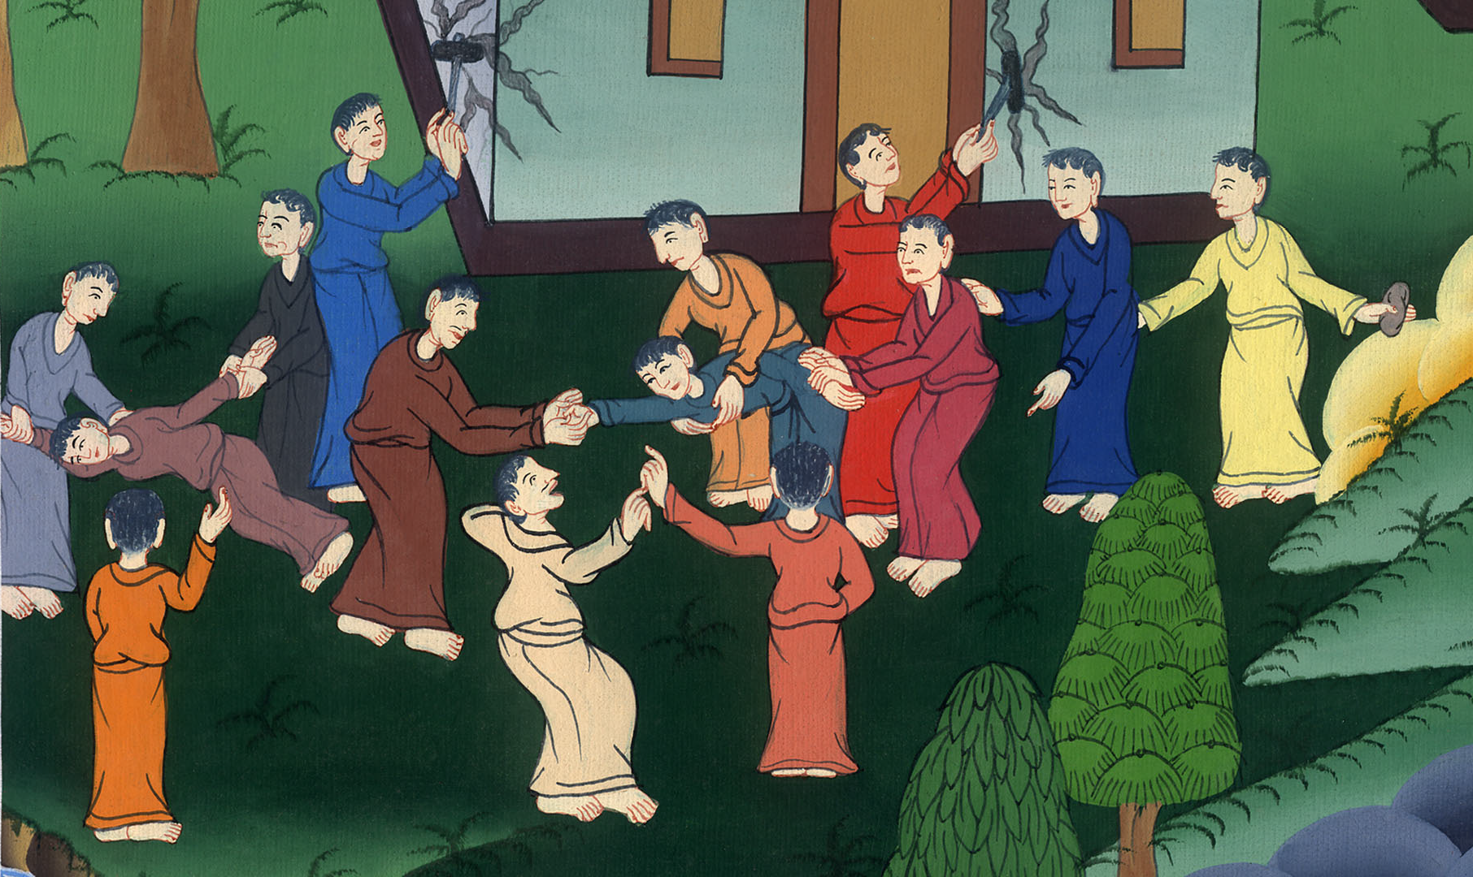
Acts 17:6

Slide 19
7Jason has welcomed them into his house. These all act contrary to the decrees of Caesar, saying that there is another king, Jesus!”

Slide 20
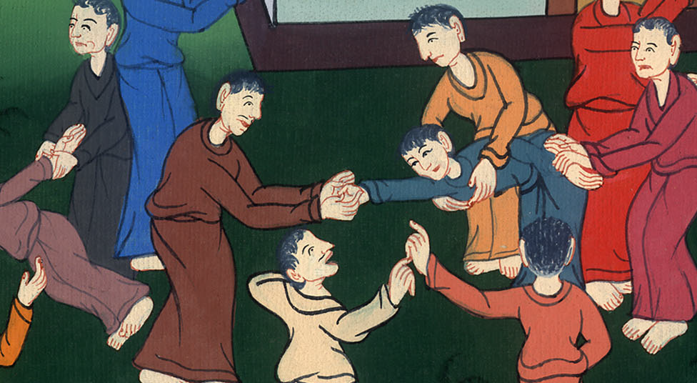
Acts 17:7

Slide 21
8The multitude and the rulers of the city were troubled when they heard these things. 9When they had taken security from Jason and the rest, they let them go.

Slide 22
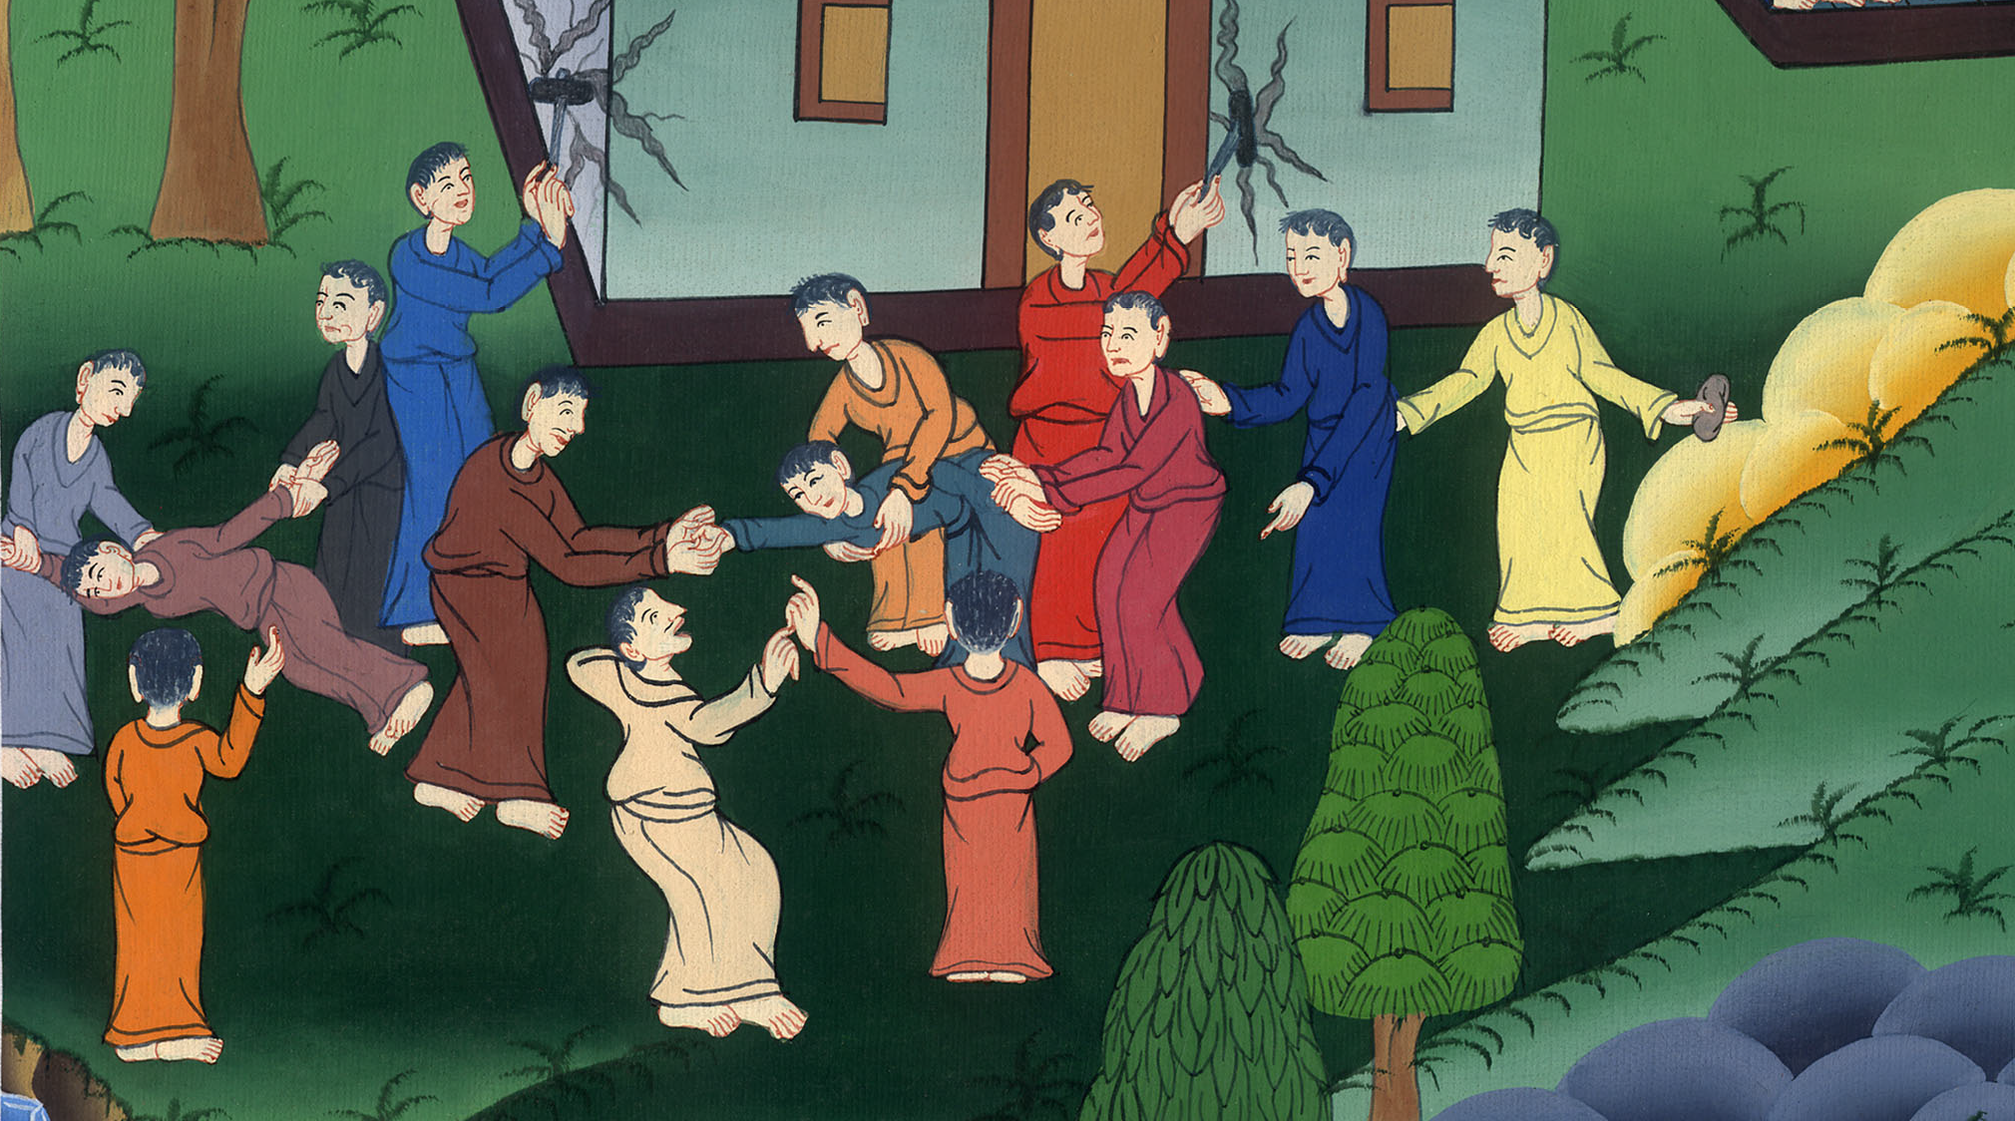
Acts 17:8,9

Slide 23
10The brothers immediately sent Paul and Silas away by night to Beroea. When they arrived, they went into the Jewish synagogue.

Slide 24
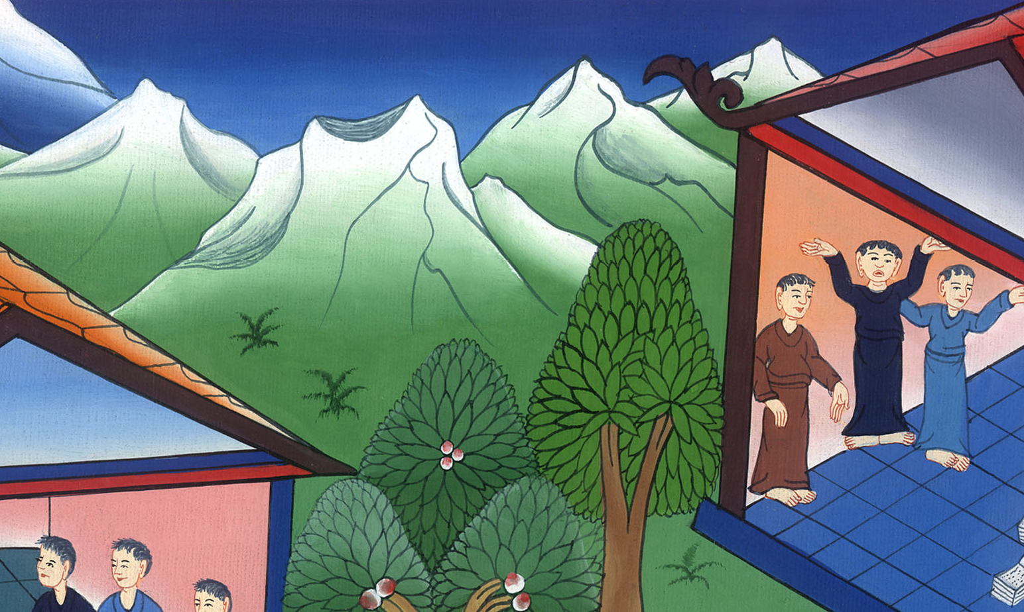
Acts 17:10

Slide 25
11Now these were more noble than those in Thessalonica, in that they received the word with all readiness of mind, examining the Scriptures daily to see whether these things were so.

Slide 26
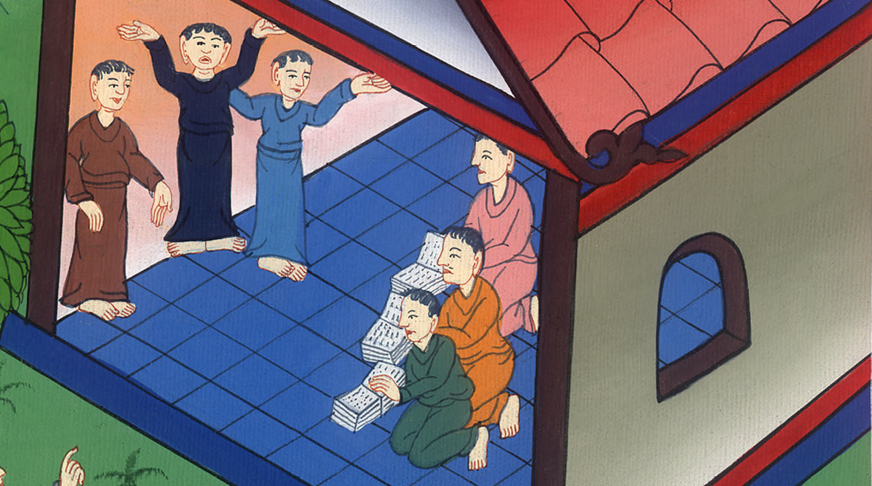
Acts 17:11

Slide 27
12Many of them therefore believed; also of the prominent Greek women, and not a few men.

Slide 28
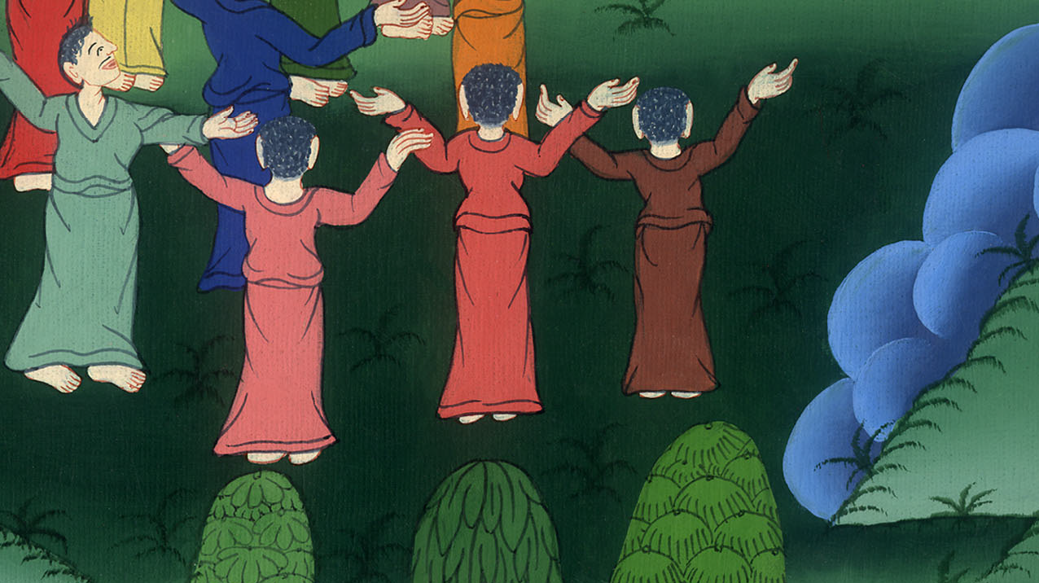
Acts 17:12

Slide 29
13But when the Jews of Thessalonica had knowledge that the word of God was proclaimed by Paul at Beroea also, they came there likewise, agitating the multitudes.

Slide 30
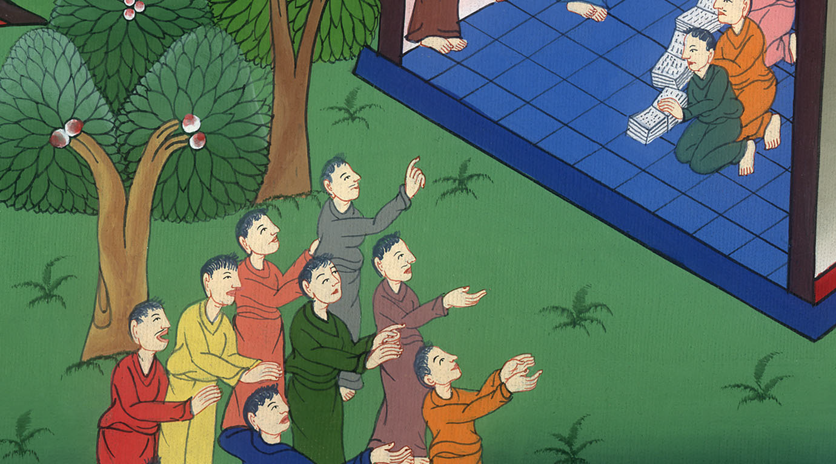
Acts 17:13

Slide 31
14Then the brothers immediately sent out Paul to go as far as to the sea, and Silas and Timothy still stayed there.

Slide 32
Acts 17:14

Slide 33
15But those who escorted Paul brought him as far as Athens. Receiving a commandment to Silas and Timothy that they should come to him very quickly, they departed.

Slide 34
Acts 17:15

