Slide 1
53-2
This work is licensed under a Creative Commons Attribution-ShareAlike 4.0 International License.
Please add this statement to all the videos you create.
English Bible quotes are from the World English Bible US, which is in the public domain.
Notes:
Ch
53 Paul’s 2nd Journey, Part 2
1. Chased out of Thessalonica – Acts 17:1-10 (Left and Center Top)
2. Driven out of Berea – Acts 17:10-14 (Right Top)
3. Paul in Athens – Acts 17:15-34 (Right Center)
4. Paul making tents – Acts 18:1-5 (Right Bottom)
5. Leaving the Jews and going to the Gentiles – Acts 18:6-11 (Center Bottom)
6. The Jews bring Paul to the Judgment seat – Acts 18:12-17 (Left Bottom)
7. Paul In Ephesus – Acts 18:18-22 (left Center)

Slide 2
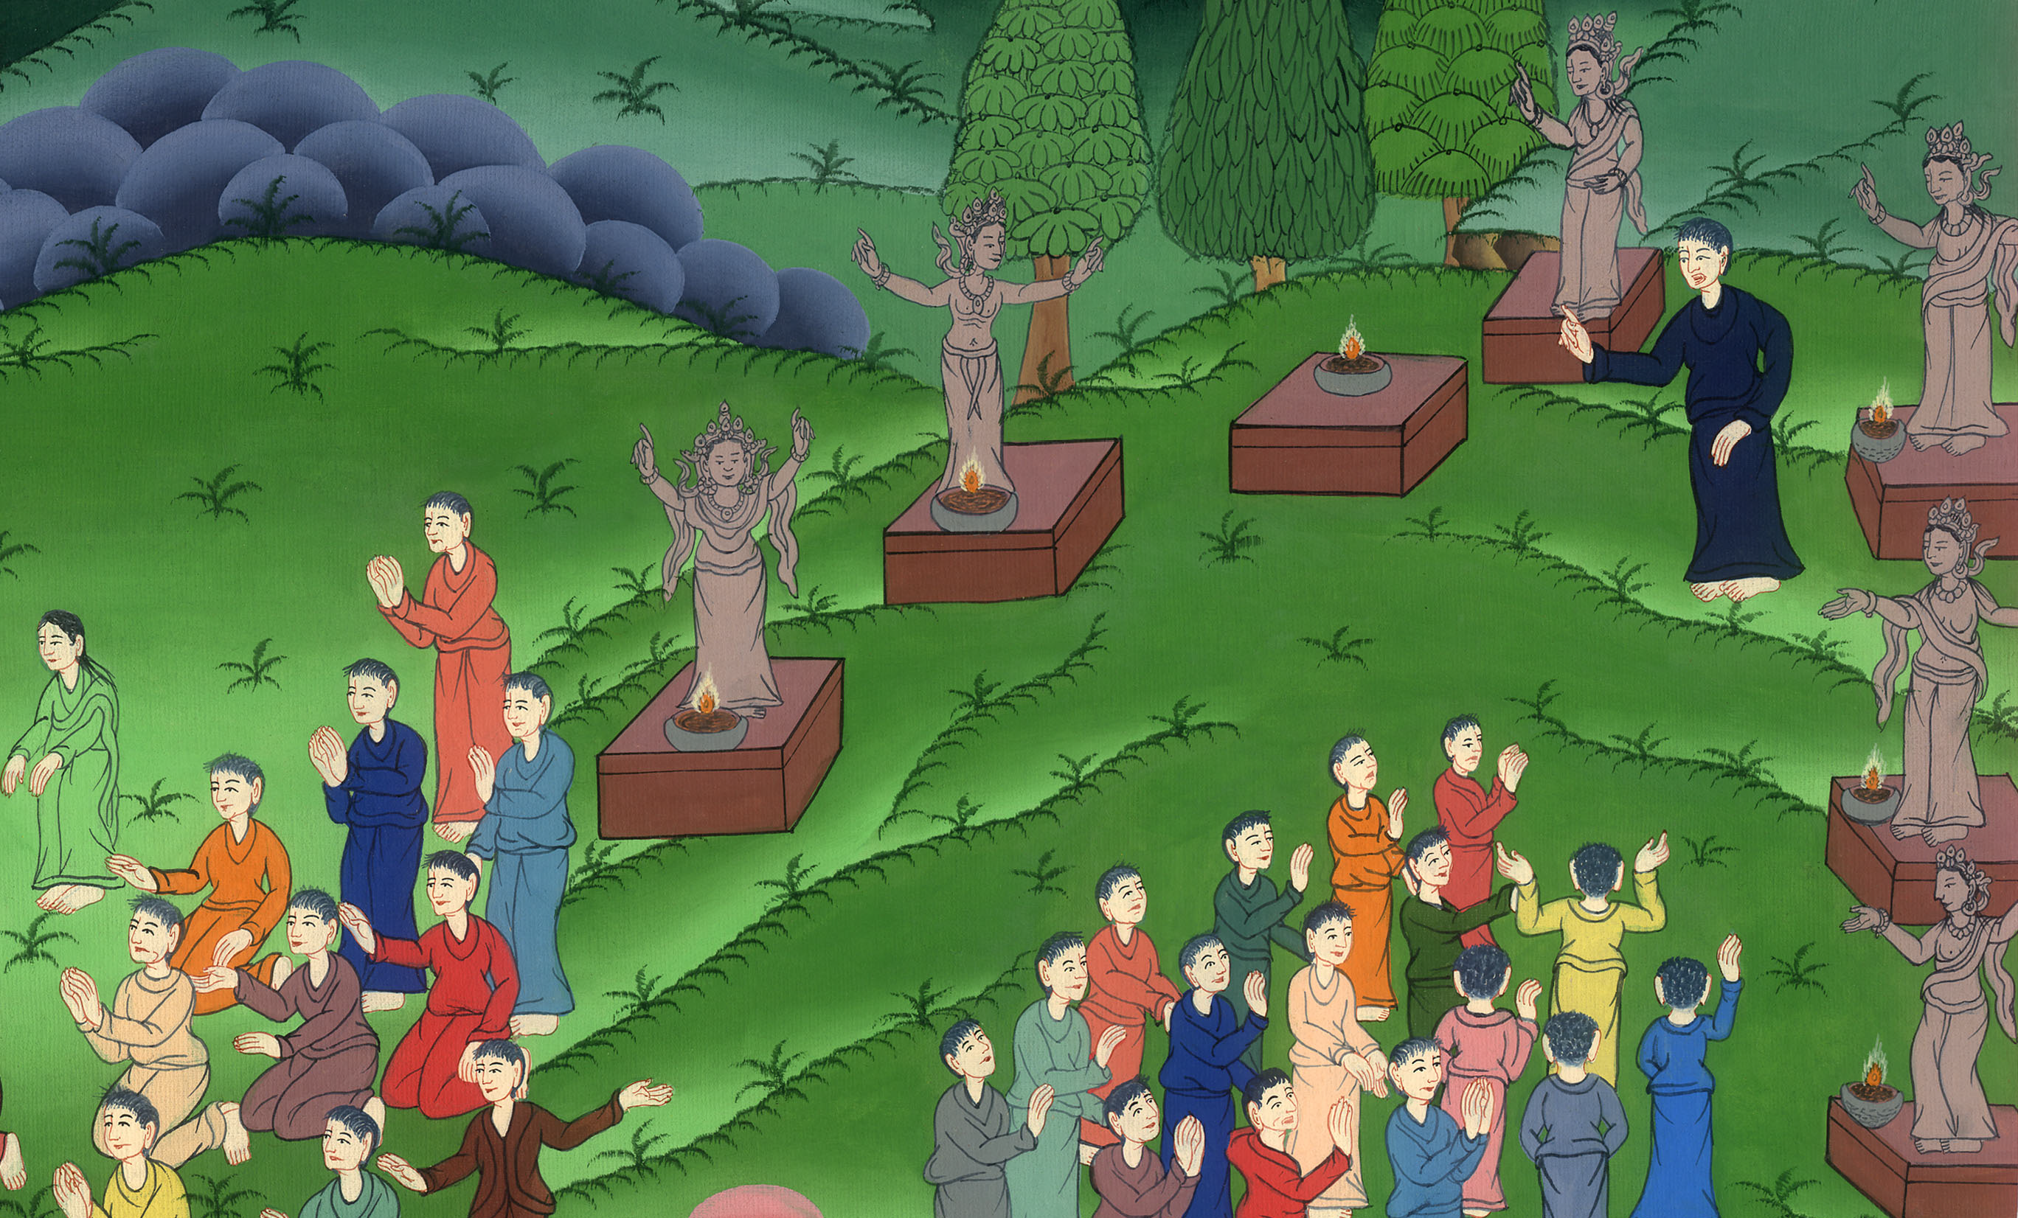
Paul in Athens – Acts 17:15-34

Slide 3
Paul in Athens – Acts 17:15-34

Slide 4
Paul in Athens – Acts 17:15-34

Slide 5
15Those who escorted Paul brought him to Athens and then left with instructions for Silas and Timothy to join him as soon as possible.

Slide 6
15But those who escorted Paul brought him as far as Athens. Receiving a commandment to Silas and Timothy that they should come to him very quickly, they departed.

Slide 7
Acts 17:15

Slide 8
16Now while Paul waited for them at Athens, his spirit was provoked within him as he saw the city full of idols.

Slide 9
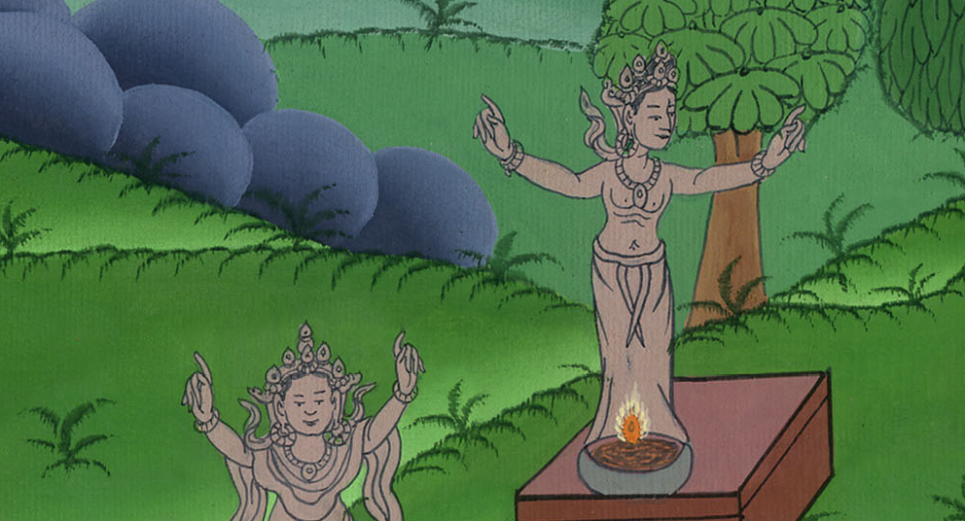
Acts 17:16

Slide 10
17So he reasoned in the synagogue with the Jews and the devout persons, and in the marketplace every day with those who met him.

Slide 11
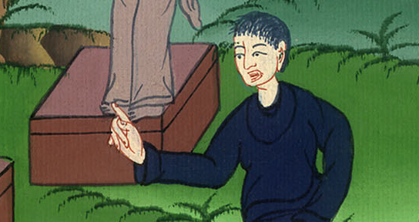
Acts 17:17

Slide 12
18Some of the Epicurean and Stoic philosophers also were conversing with him. Some said, “What does this babbler want to say?”

Slide 13
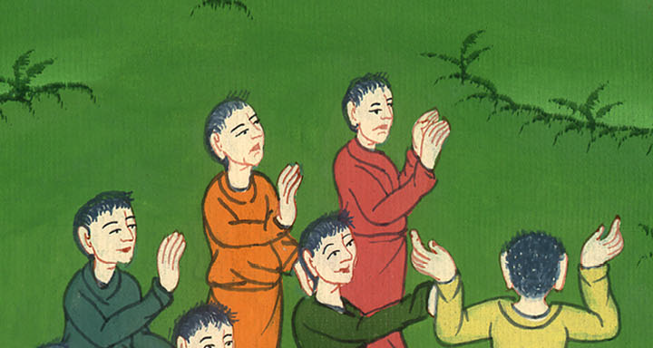
Acts 17:18

Slide 14
Others said, “He seems to be advocating foreign deities,” because he preached Jesus and the resurrection.

Slide 15
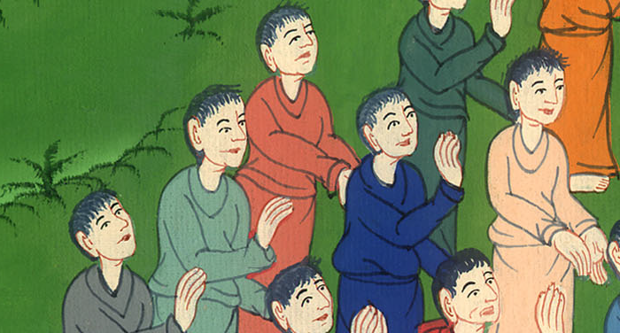
Acts 17:18

Slide 16
19They took hold of him and brought him to the Areopagus, saying, “May we know what this new teaching is, which you are speaking about?

Slide 17
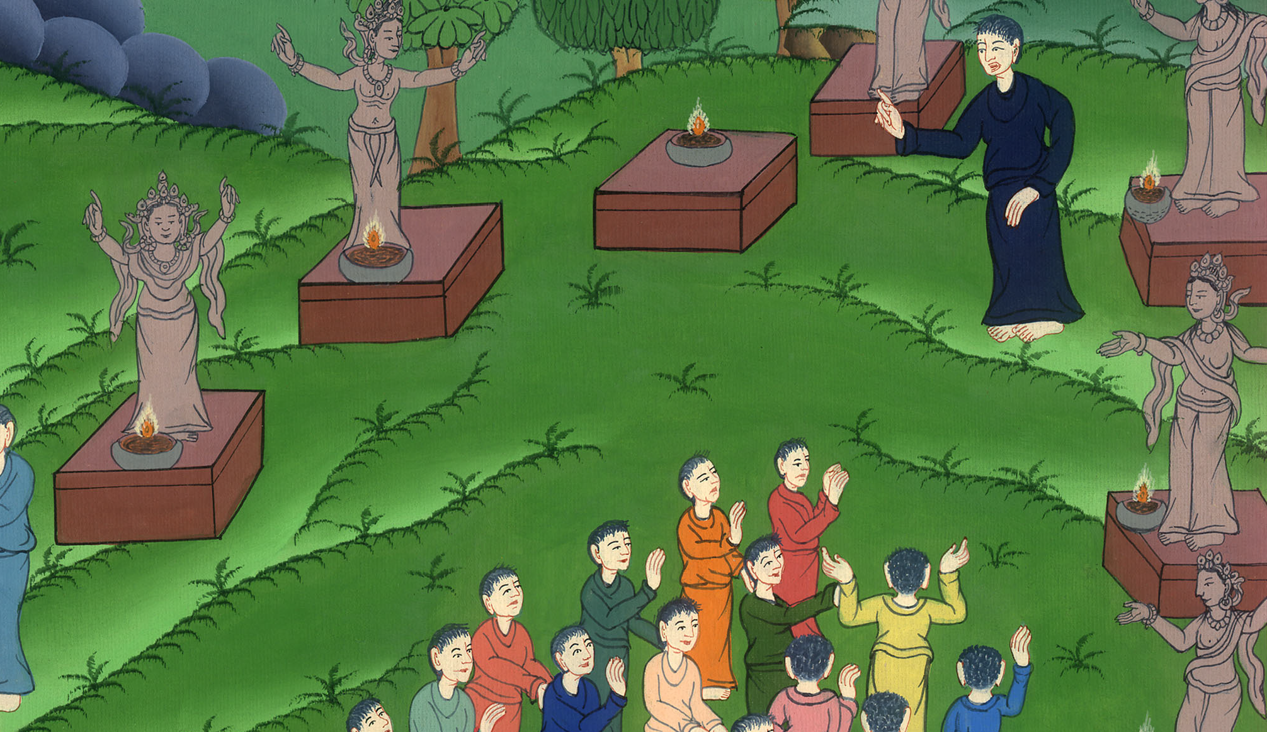
Acts 17:19

Slide 18
20For you bring certain strange things to our ears. We want to know therefore what these things mean.

Slide 19
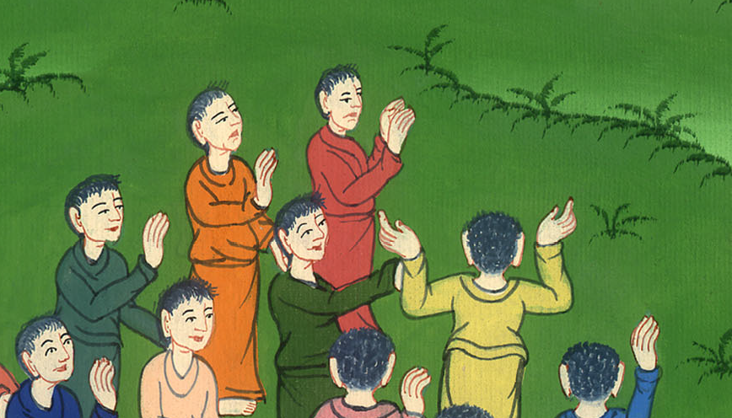
Acts 17:20

Slide 20
21Now all the Athenians and the strangers living there spent their time in nothing else, but either to tell or to hear some new thing.

Slide 21
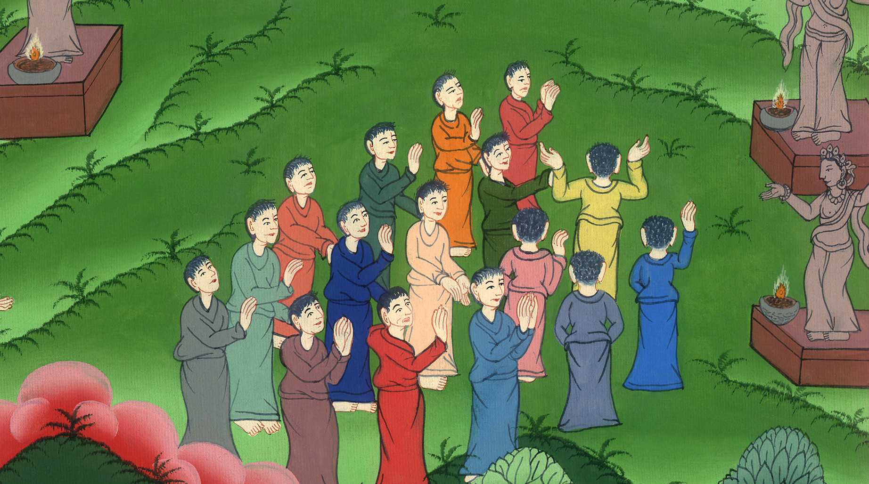
Acts 17:21

Slide 22
22Paul stood in the middle of the Areopagus and said, “You men of Athens, I perceive that you are very religious in all things.

Slide 23
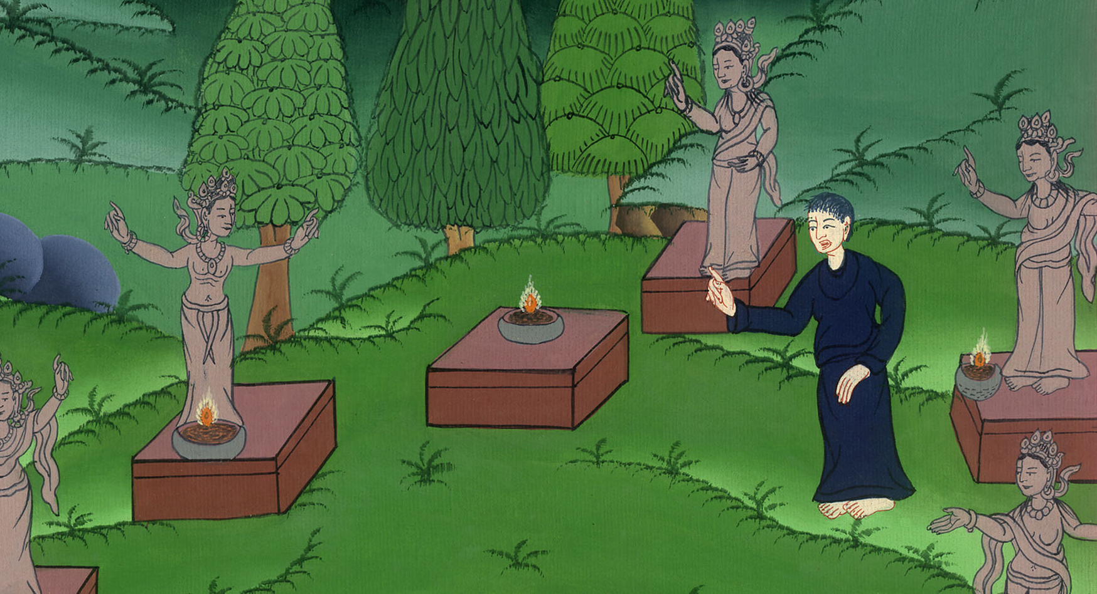
Acts 17:22

Slide 24
23For as I passed along and observed the objects of your worship, I also found an altar with this inscription: ‘TO AN UNKNOWN GOD.’

Slide 25
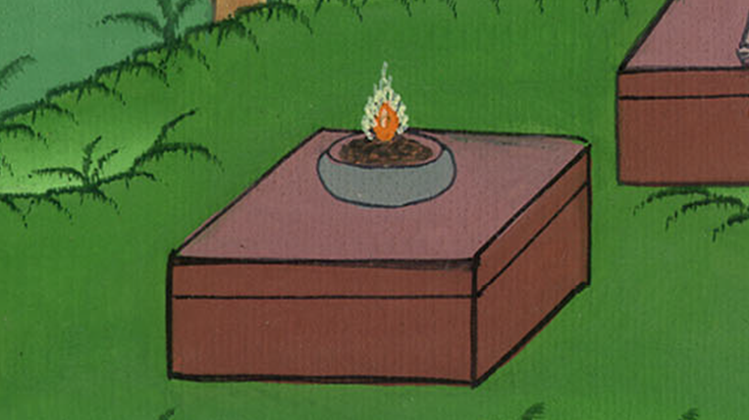
Acts 17:23

Slide 26
What therefore you worship in ignorance, I announce to you.

Slide 27
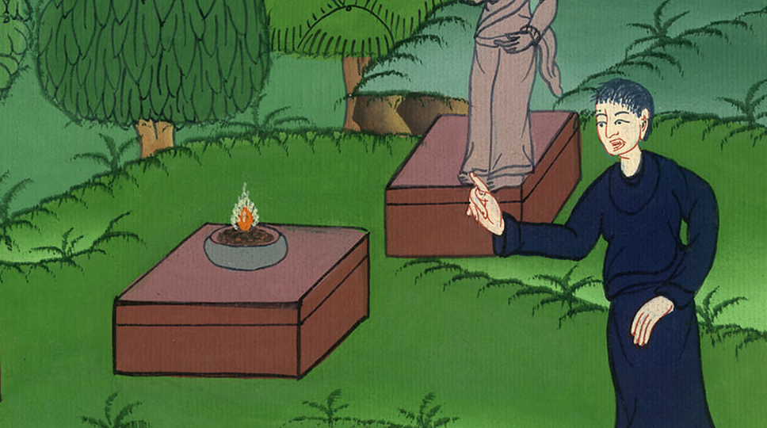
Acts 17:23

Slide 28
24The God who made the world and all things in it, he, being Lord of heaven and earth, doesn’t dwell in temples made with hands.

Slide 29
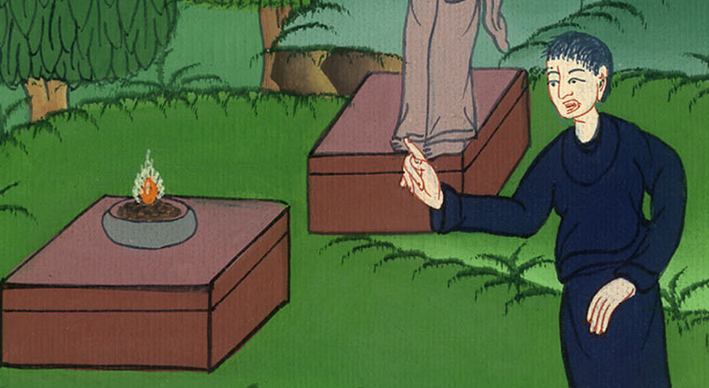
Acts 17:24

Slide 30
25He isn’t served by men’s hands, as though he needed anything, seeing he himself gives to all life and breath and all things.

Slide 31
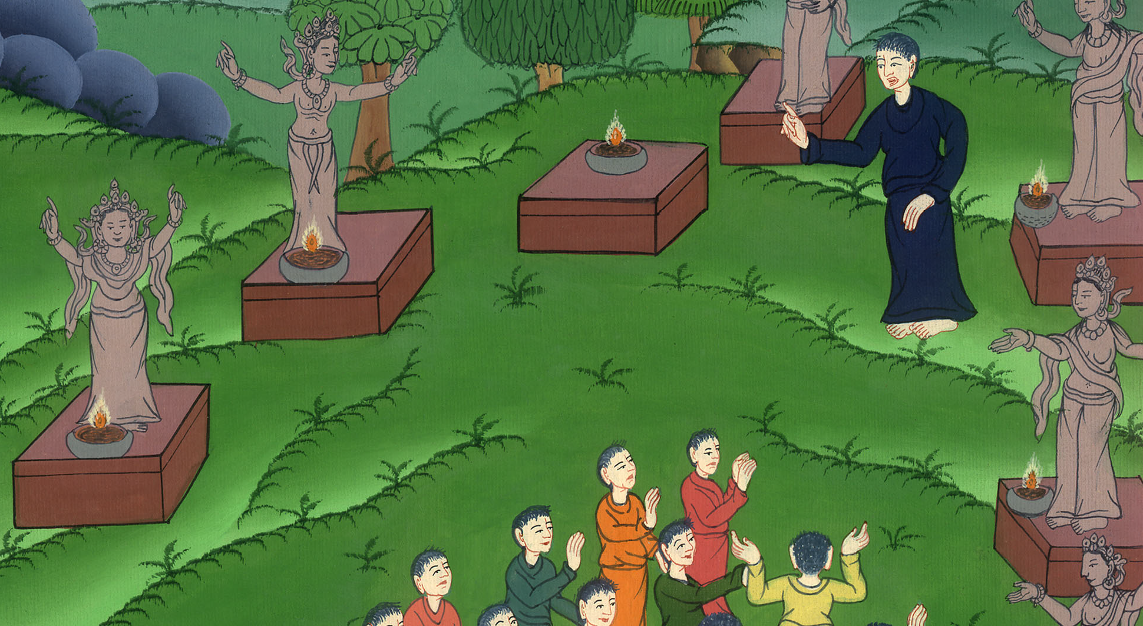
Acts 17:25

Slide 32
26He made from one blood every nation of men to dwell on all the surface of the earth, having determined appointed seasons and the boundaries of their dwellings.

Slide 33
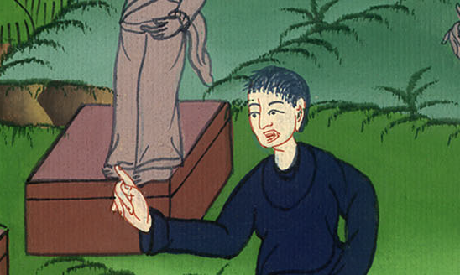
Acts 17:26

Slide 34
27God did this so that they would seek the Lord, if perhaps they might reach out for him and find him, though he is not far from each one of us.

Slide 35
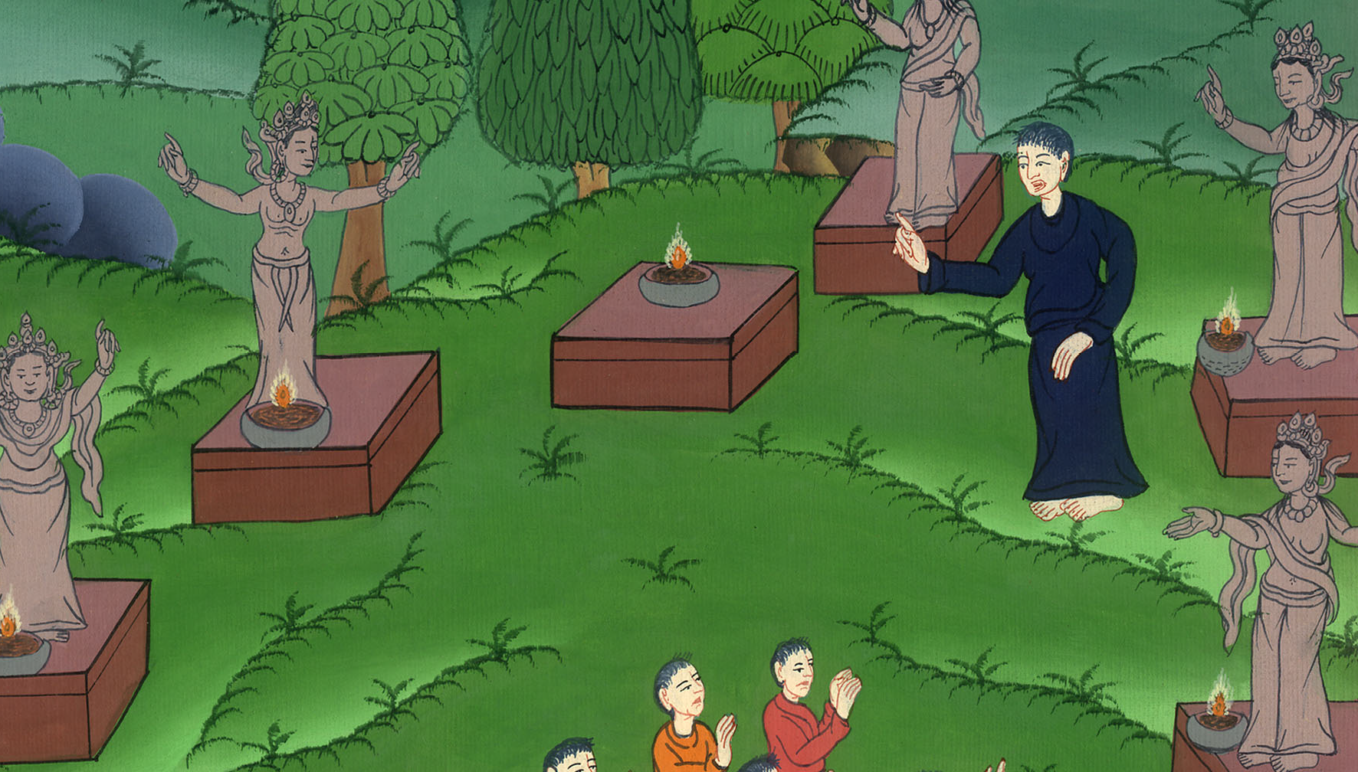
Acts 17:27

Slide 36
28‘For in him we live, move, and have our being.’ As some of your own poets have said, ‘For we are also his offspring.’

Slide 37
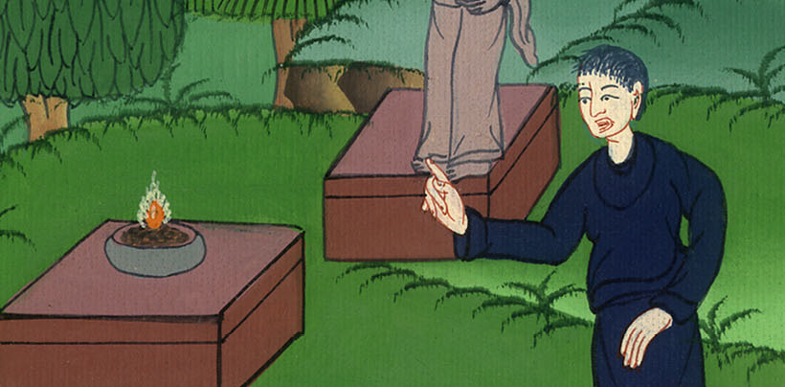
Acts 17:28

Slide 38
29Being then the offspring of God, we ought not to think that the Divine Nature is like gold, or silver, or stone, engraved by art and design of man.

Slide 39
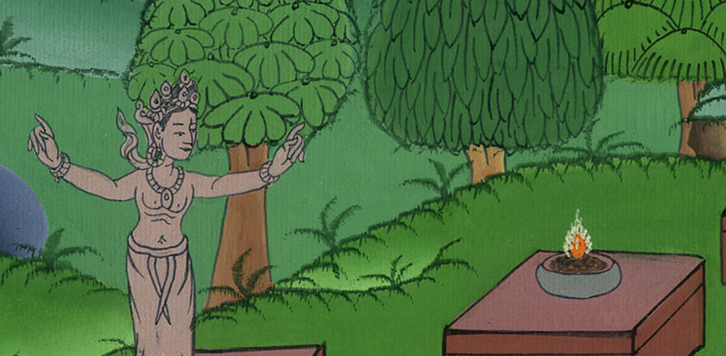
Acts 17:29

Slide 40
30The times of ignorance therefore God overlooked. But now he commands that all people everywhere should repent,

Slide 41
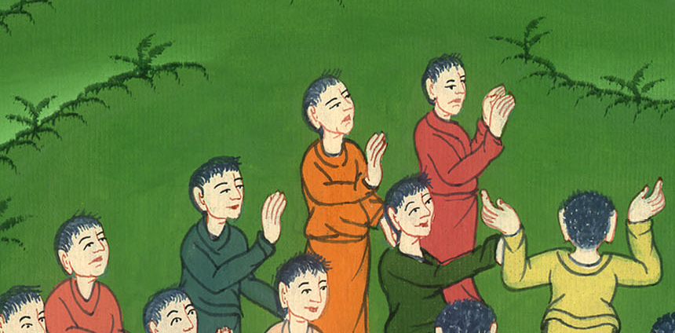
Acts 17:30

Slide 42
31because he has appointed a day in which he will judge the world in righteousness by the man whom he has ordained;

Slide 43
Acts 17:31

Slide 44
of this man he has given assurance to all men, in that he has raised him from the dead.”

Slide 45
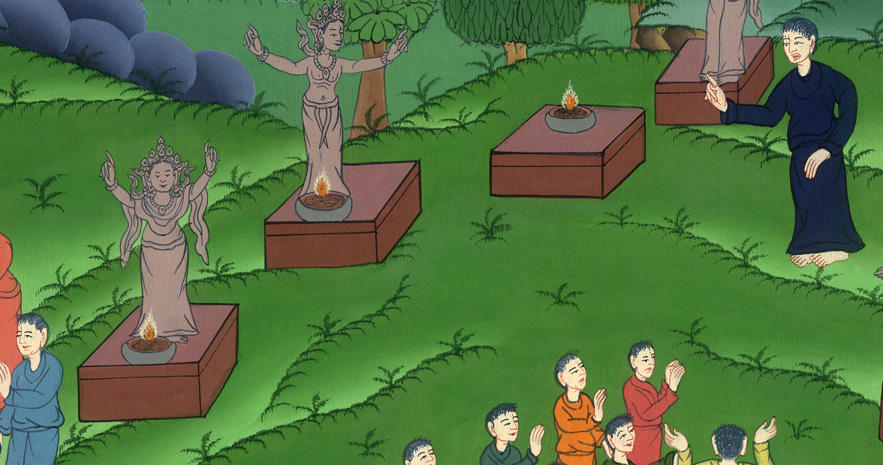
Acts 17:31

Slide 46
32Now when they heard of the resurrection of the dead, some mocked; but others said, “We want to hear you again concerning this.”
33Thus Paul went out from among them.

Slide 47
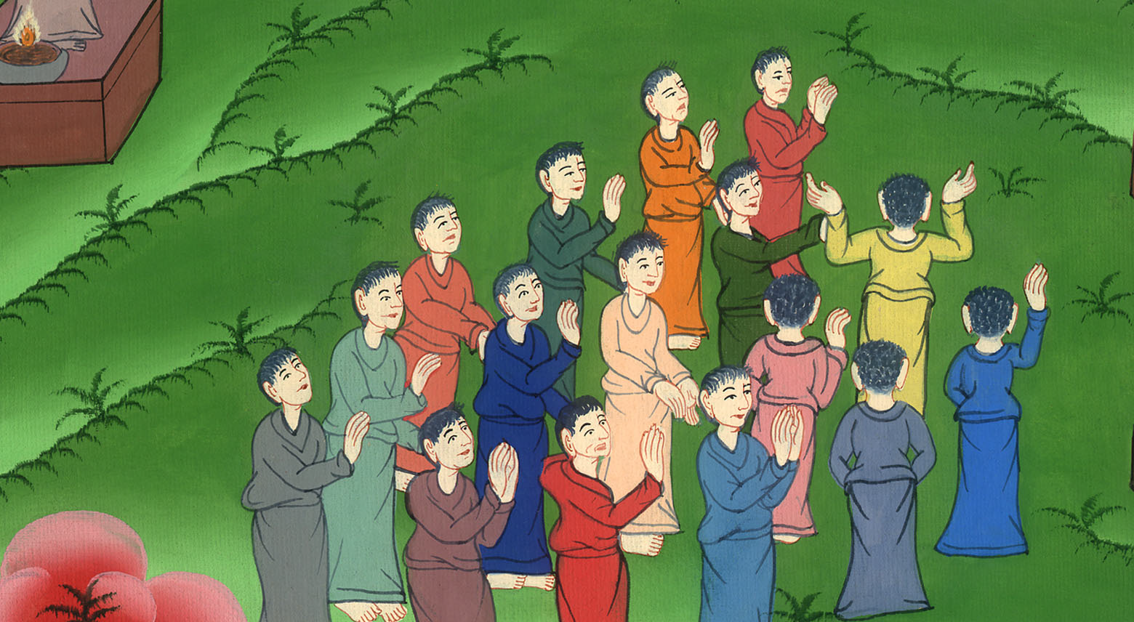
Acts 17:32,33

Slide 48
34But certain men joined with him and believed, including Dionysius the Areopagite, and a woman named Damaris, and others with them.

Slide 49
Acts 17:34

