Slide 1
53-3
This work is licensed under a Creative Commons Attribution-ShareAlike 4.0 International License.
Please add this statement to all the videos you create.
English Bible quotes are from the World English Bible US, which is in the public domain.
Notes:
Ch
53 Paul’s 2nd Journey, Part 2
1. Chased out of Thessalonica – Acts 17:1-10 (Left and Center Top)
2. Driven out of Berea – Acts 17:10-14 (Right Top)
3. Paul in Athens – Acts 17:15-34 (Right Center)
4. Paul making tents – Acts 18:1-5 (Right Bottom)
5. Leaving the Jews and going to the Gentiles – Acts 18:6-11 (Center Bottom)
6. The Jews bring Paul to the Judgment seat – Acts 18:12-17 (Left Bottom)
7. Paul In Ephesus – Acts 18:18-22 (left Center)

Slide 2
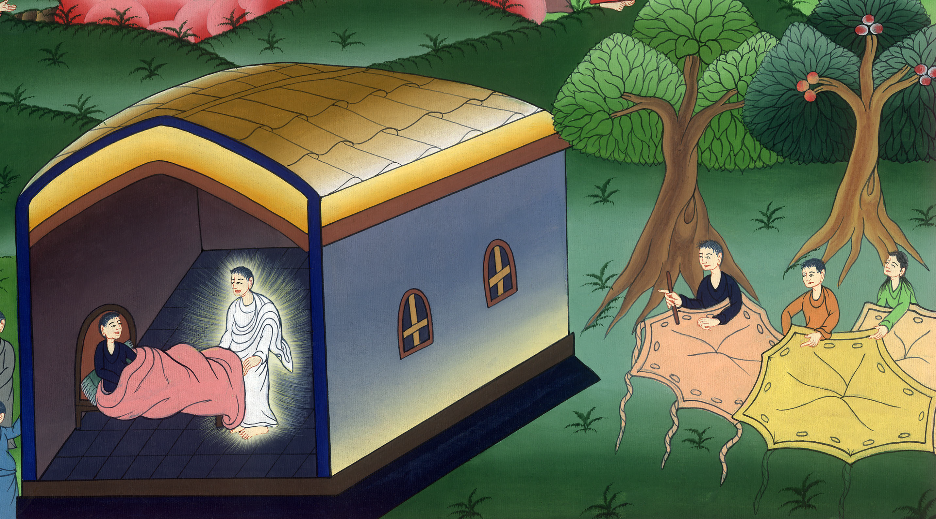
Paul making tents – Acts 18:1-11

Slide 3
Paul making tents – Acts 18:1-11

Slide 4
Paul making tents – Acts 18:1-11

Slide 5
1After these things Paul departed from Athens and came to Corinth.

Slide 6
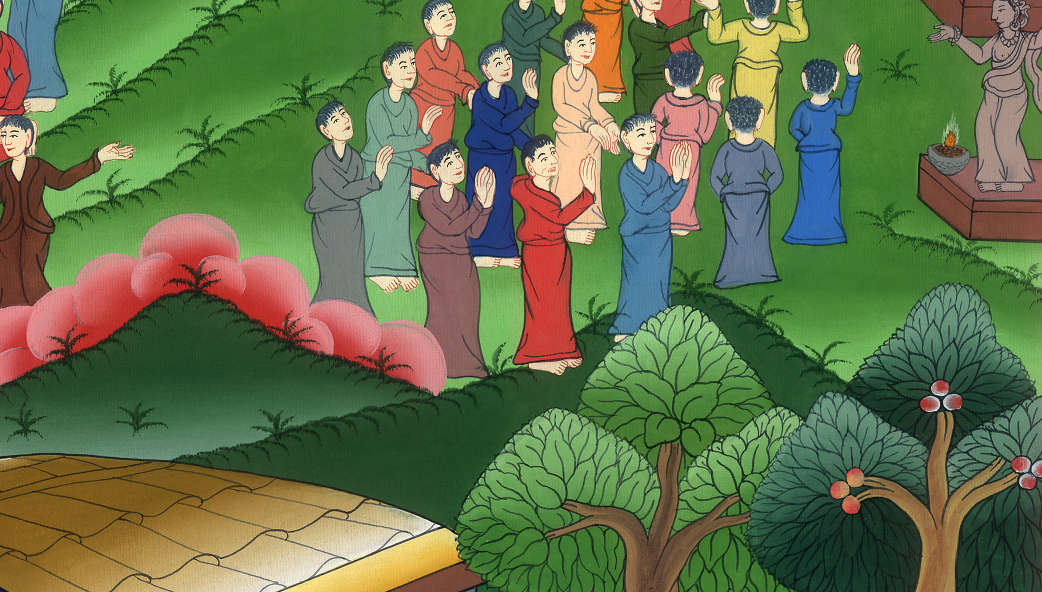
Acts 18:1

Slide 7
2He found a certain Jew named Aquila, a man of Pontus by race, who had recently come from Italy with his wife Priscilla, because Claudius had commanded all the Jews to depart from Rome. He came to them.

Slide 8
Acts 18:2

Slide 9
3Because he practiced the same trade, he lived with them and worked, for by trade they were tent makers.

Slide 10
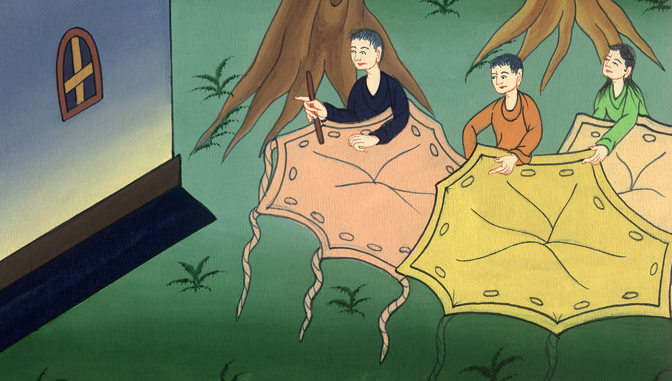
Acts 18:3

Slide 11
4He reasoned in the synagogue every Sabbath and persuaded Jews and Greeks.

Slide 12
Acts 18:4

Slide 13
5When Silas and Timothy came down from Macedonia, Paul was compelled by the Spirit, testifying to the Jews that Jesus was the Christ.

Slide 14
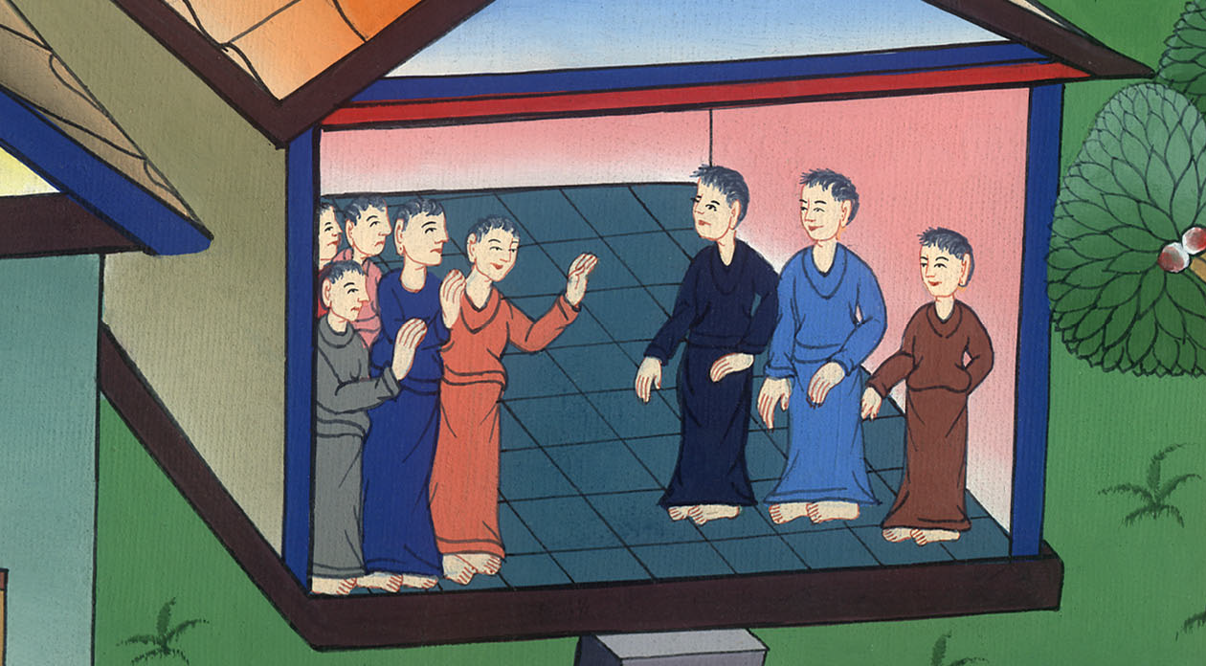
Acts 18:5

Slide 15
6When they opposed him and blasphemed, he shook out his clothing

Slide 16
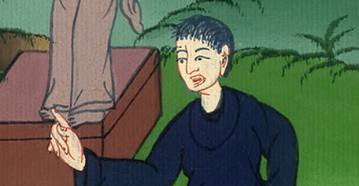
Acts 18:6

Slide 17
Then he said to them, “Your blood be on your own heads! I am clean. From now on, I will go to the Gentiles!”

Slide 18
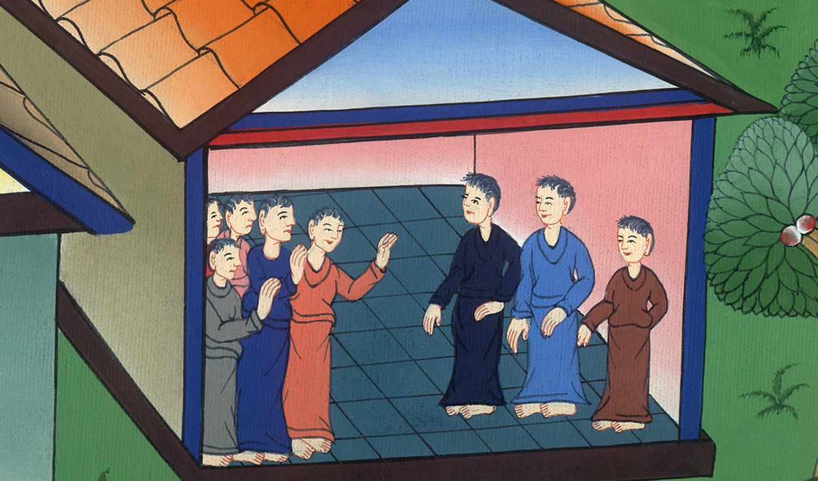
Acts 18:6

Slide 19
7He departed there and went into the house of a certain man named Justus, one who worshiped God, whose house was next door to the synagogue.

Slide 20
Acts 18:7

Slide 21
8Crispus, the ruler of the synagogue, believed in the Lord with all his house. Many of the Corinthians, when they heard, believed and were baptized.

Slide 22
Acts 18:8

Slide 23
9The Lord said to Paul in the night by a vision, “Don’t be afraid, but speak and don’t be silent;

Slide 24
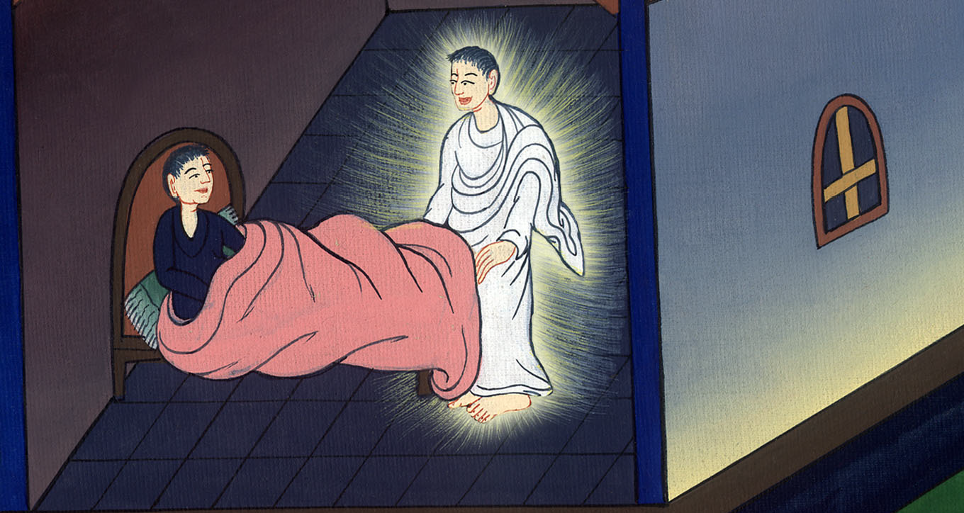
Acts 18:9

Slide 25
10for I am with you, and no one will attack you to harm you, for I have many people in this city.”

Slide 26
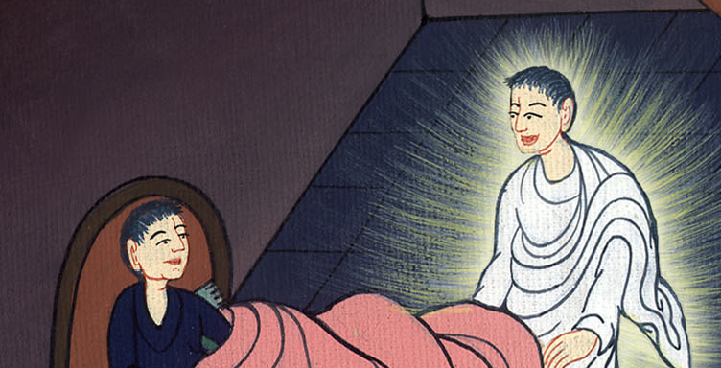
Acts 18:10

Slide 27
11He lived there a year and six months, teaching the word of God among them.

Slide 28
Acts 18:11

