Slide 1
53-4
This work is licensed under a Creative Commons Attribution-ShareAlike 4.0 International License.
Please add this statement to all the videos you create.
English Bible quotes are from the World English Bible US, which is in the public domain.
Notes:
Ch
53 Paul’s 2nd Journey, Part 2
1. Chased out of Thessalonica – Acts 17:1-10 (Left and Center Top)
2. Driven out of Berea – Acts 17:10-14 (Right Top)
3. Paul in Athens – Acts 17:15-34 (Right Center)
4. Paul making tents – Acts 18:1-5 (Right Bottom)
5. Leaving the Jews and going to the Gentiles – Acts 18:6-11 (Center Bottom)
6. The Jews bring Paul to the Judgment seat – Acts 18:12-17 (Left Bottom)
7. Paul In Ephesus – Acts 18:18-22 (left Center)

Slide 2
The Jews bring Paul to the Judgment seat – Acts 18:12-22

Slide 3
The Jews bring Paul to the Judgment seat – Acts 18:12-22

Slide 4
The Jews bring Paul to the Judgment seat – Acts 18:12-22

Slide 5
12But when Gallio was proconsul of Achaia, the Jews with one accord rose up against Paul and brought him before the judgment seat.

Slide 6
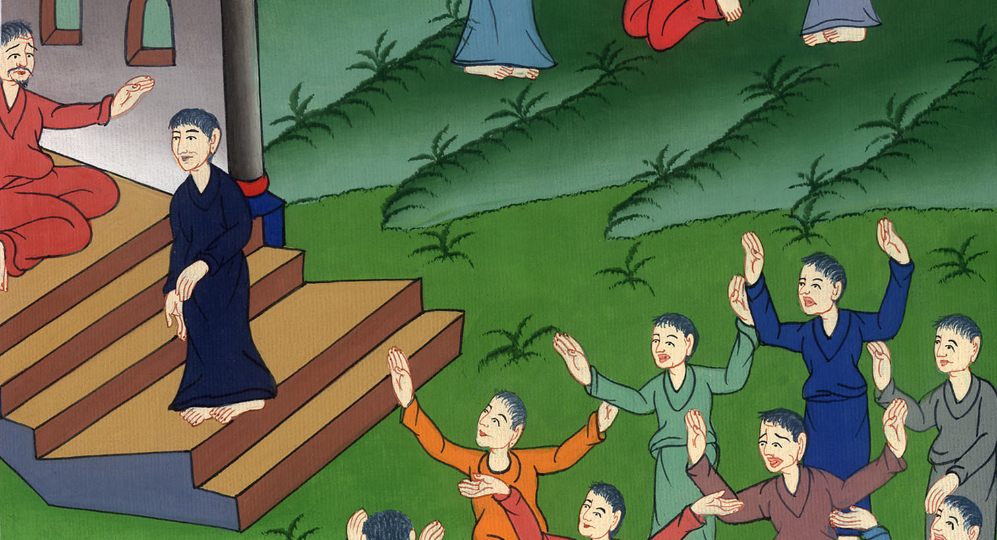
Acts 18:12

Slide 7
13They said, “This man persuades men to worship God contrary to the law.”

Slide 8
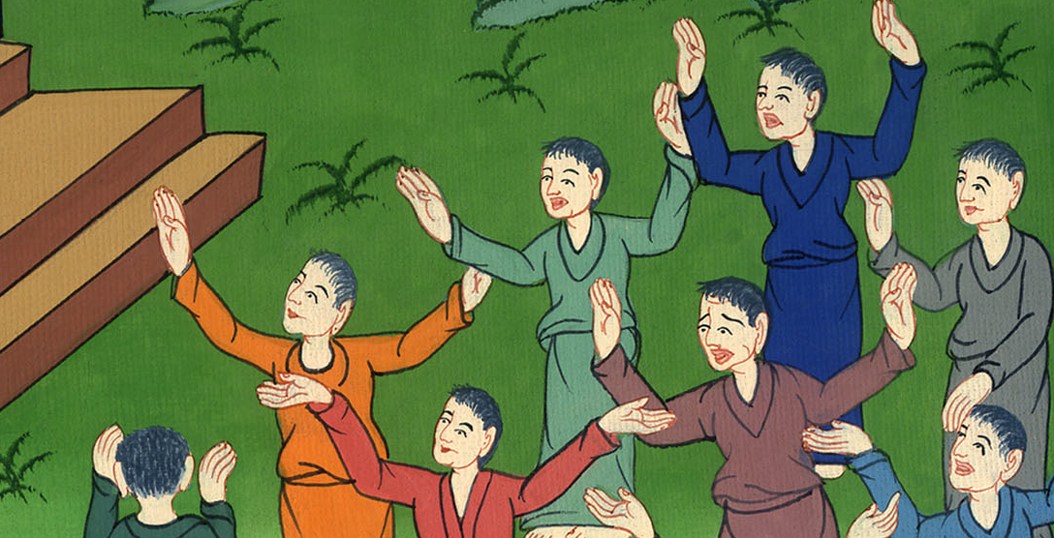
Acts 18:13

Slide 9
14But when Paul was about to open his mouth, Gallio said to the Jews, “If indeed it were a matter of wrong or of wicked crime, you Jews, it would be reasonable that I should bear with you

Slide 10
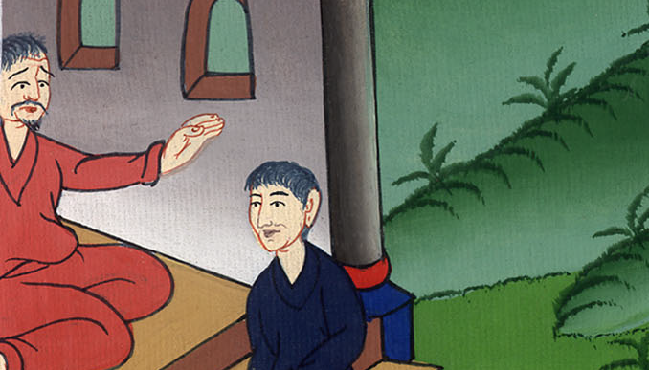
Acts 18:14

Slide 11
15but if they are questions about words and names and your own law, look to it yourselves. For I don’t want to be a judge of these matters.” 16So he drove them from the judgment seat.

Slide 12
Acts 18:15,16

Slide 13
17Then all the Greeks seized Sosthenes, the ruler of the synagogue, and beat him before the judgment seat. Gallio didn’t care about any of these things.

Slide 14
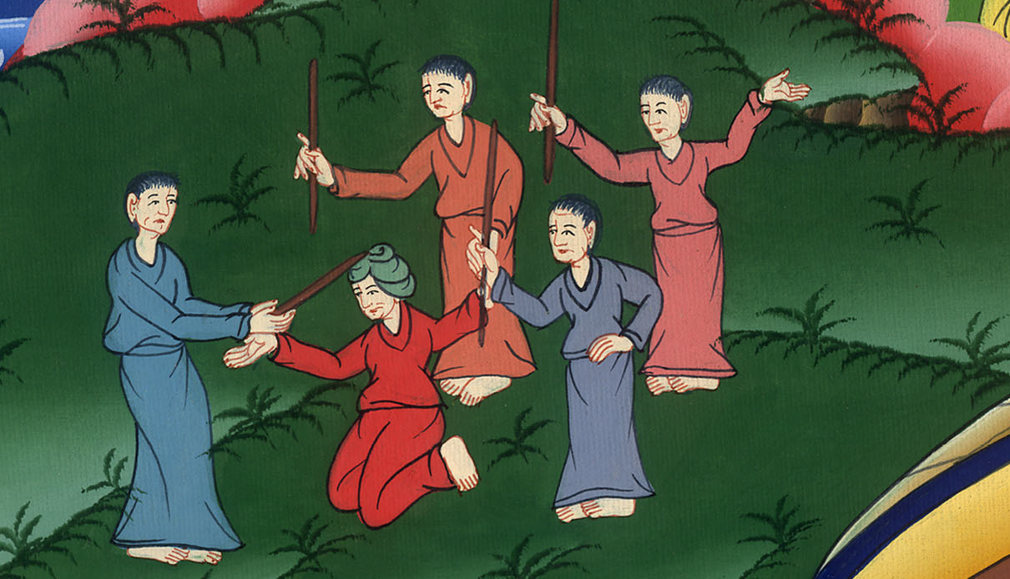
Acts 18:17

Slide 15
18Paul, having stayed after this many more days, took his leave of the brothers, and sailed from there for Syria, together with Priscilla and Aquila.

Slide 16
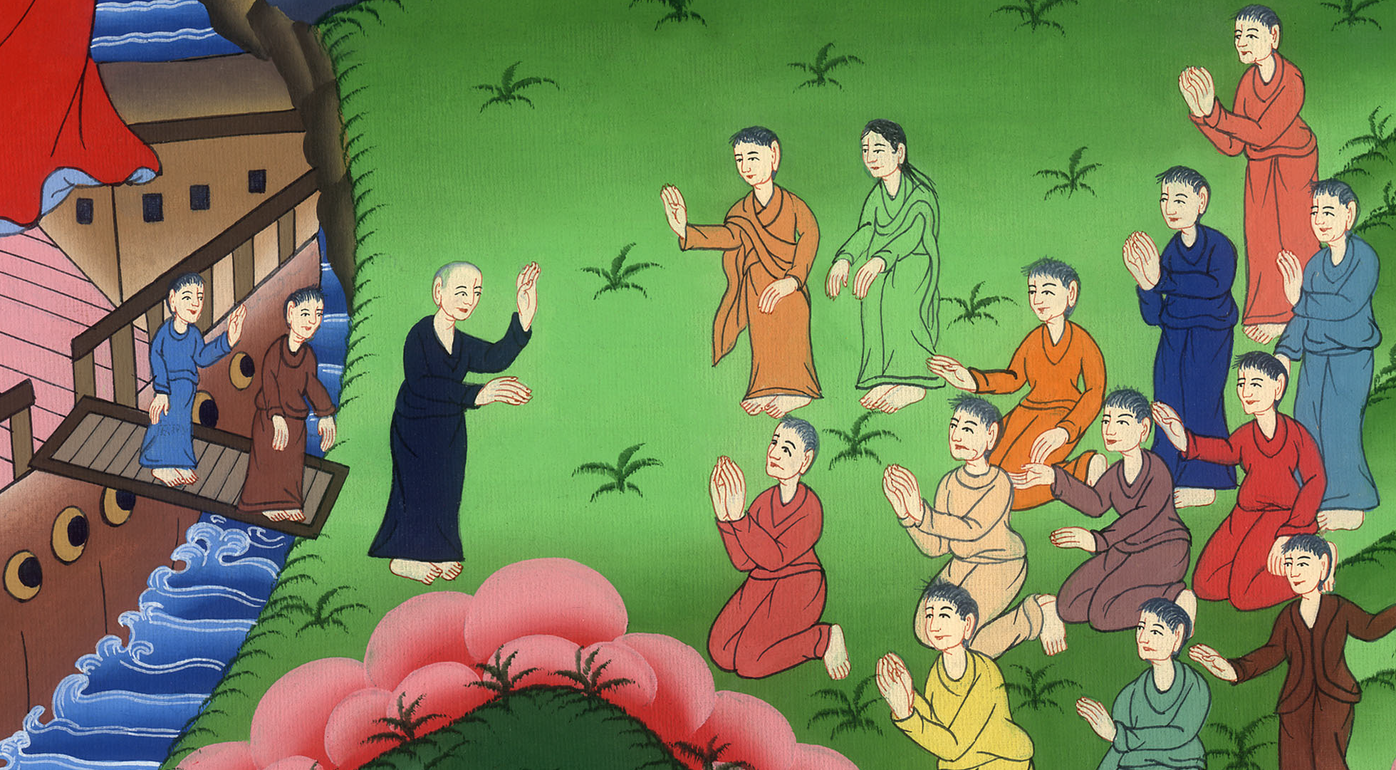
Acts 18:18

Slide 17
He shaved his head in Cenchreae, for he had a vow.

Slide 18
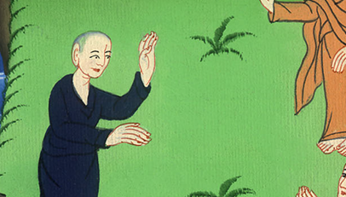
མཛད་པ། 18:18
Acts 18:18

Slide 19
19He came to Ephesus, and he left them there; but he himself entered into the synagogue and reasoned with the Jews.

Slide 20
Acts 18:19

Slide 21
20When they asked him to stay with them a longer time, he declined;

Slide 22
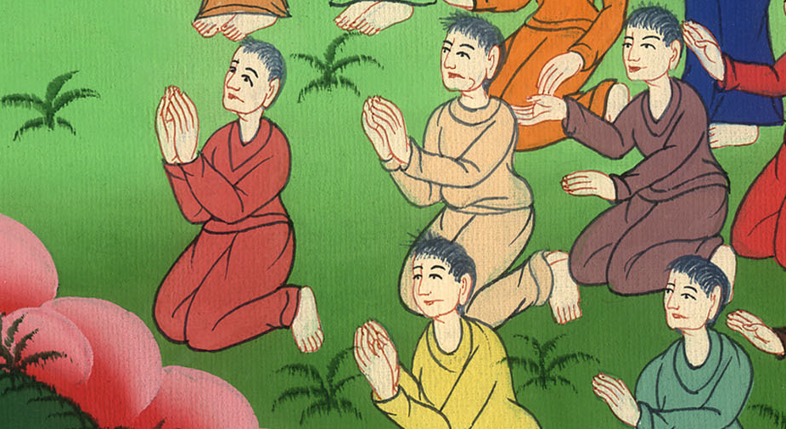
Acts 18:20

Slide 23
21but taking his leave of them, he said, “I must by all means keep this coming feast in Jerusalem, but I will return again to you if God wills.” Then he set sail from Ephesus.

Slide 24
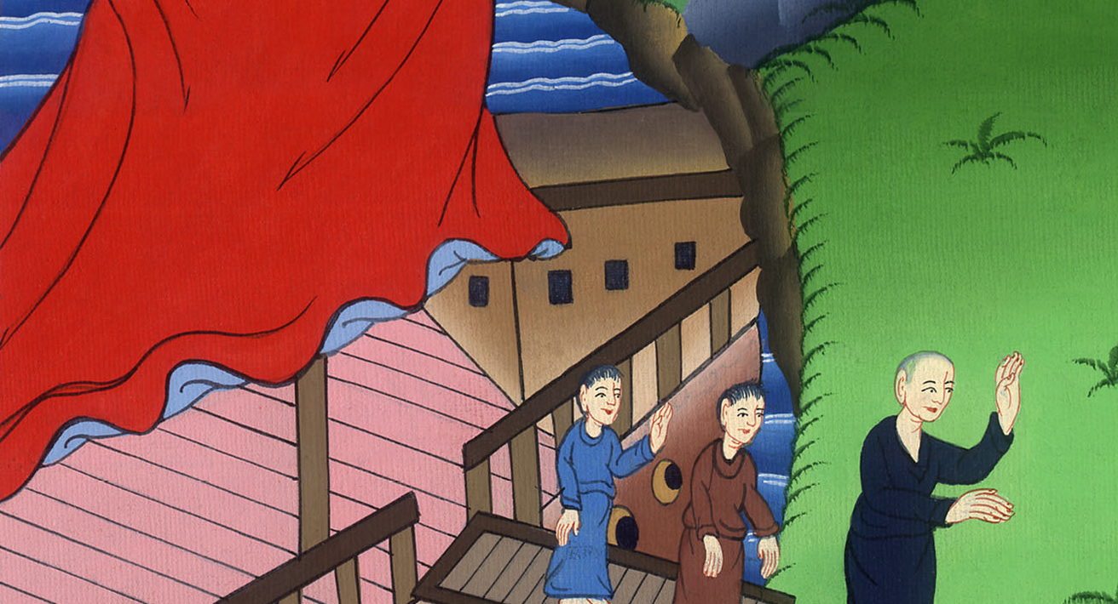
Acts 18:21

Slide 25
22When he had landed at Caesarea, he went up and greeted the assembly, and went down to Antioch.

Slide 26
Acts 18:22

