Slide 1
54-2
This work is licensed under a Creative Commons Attribution-ShareAlike 4.0 International License.
Please add this statement to all the videos you create.
English Bible quotes are from the World English Bible US, which is in the public domain.
Notes:
Ch
54 Paul’s 3rd journey
1. Apollos – Acts 18:24-28 (Left Top)
2. 2 years in Ephesus – Acts 19:1-10 (Center Top)
3. 7 sons of Sceva – Acts 19:11-20 (Right Top)
4. Artemis of the Ephesians – Acts 19:21 – 20:1 (Right Center)
5. Eutychus – Acts 20:6-12 (Right Bottom)
6. Paul visits the Ephesian Elders – Acts 20:16-38 (Center Bottom)
7. Agabus’ prophecy – Acts 21:8-15 (Left Bottom)

Slide 2
Two years in Ephesus – Acts 19:1-10

Slide 3
Two years in Ephesus – Acts 19:1-10

Slide 4
Two years in Ephesus – Acts 19:1-10

Slide 5
1While Apollos was at Corinth, Paul, having passed through the upper country, came to Ephesus and found certain disciples.

Slide 6
Acts 19:1

Slide 7
2He said to them, “Did you receive the Holy Spirit when you believed?”
They said to him, “No, we haven’t even heard that there is a Holy Spirit.”

Slide 8
Acts 19:2

Slide 9
3He said, “Into what then were you baptized?”
They said, “Into John’s baptism.”

Slide 10
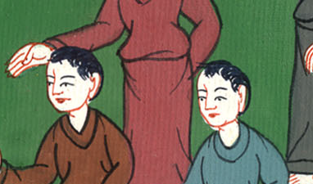
Acts 19:3

Slide 11
4Paul said, “John indeed baptized with the baptism of repentance, saying to the people that they should believe in the one who would come after him, that is, in Christ Jesus.”

Slide 12
Acts 19:4

Slide 13
5When they heard this, they were baptized in the name of the Lord Jesus.

Slide 14
Acts 19:5

Slide 15
6When Paul had laid his hands on them, the Holy Spirit came on them and they spoke with other languages and prophesied. 7They were about twelve men in all.

Slide 16
Acts 19:6,7

Slide 17
8He entered into the synagogue and spoke boldly for a period of three months, reasoning and persuading about the things concerning God’s Kingdom.

Slide 18
Acts 19:8

Slide 19
9But when some were hardened and disobedient, speaking evil of the Way before the multitude, he departed from them and separated the disciples, reasoning daily in the school of Tyrannus.

Slide 20
Acts 19:9

Slide 21
10This continued for two years, so that all those who lived in Asia heard the word of the Lord Jesus, both Jews and Greeks.

Slide 22
Acts 19:10

