Slide 1
54-3
This work is licensed under a Creative Commons Attribution-ShareAlike 4.0 International License.
Please add this statement to all the videos you create.
English Bible quotes are from the World English Bible US, which is in the public domain.
Notes:
Ch
54 Paul’s 3rd journey
1. Apollos – Acts 18:24-28 (Left Top)
2. 2 years in Ephesus – Acts 19:1-10 (Center Top)
3. 7 sons of Sceva – Acts 19:11-20 (Right Top)
4. Artemis of the Ephesians – Acts 19:21 – 20:1 (Right Center)
5. Eutychus – Acts 20:6-12 (Right Bottom)
6. Paul visits the Ephesian Elders – Acts 20:16-38 (Center Bottom)
7. Agabus’ prophecy – Acts 21:8-15 (Left Bottom)

Slide 2
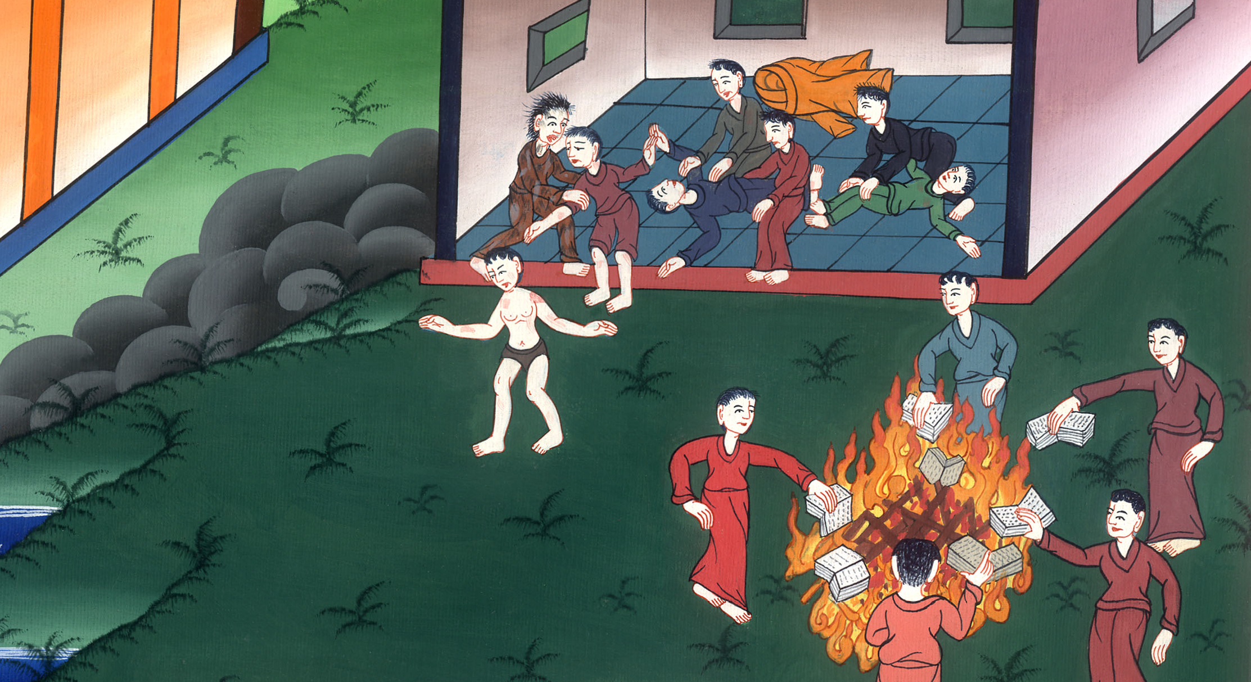
Seven sons of Sceva –
Acts 19:11-20

Slide 3
Seven sons of Sceva – Acts 19:11-20

Slide 4
Seven sons of Sceva –
Acts 19:11-20

Slide 5
11God worked special miracles by the hands of Paul.

Slide 6
Acts 19:11

Slide 7
12Even handkerchiefs or aprons were carried away from his body to the sick, and the diseases departed from them, and the evil spirits went out.

Slide 8
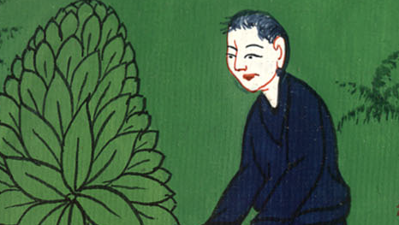
Acts 19:12

Slide 9
13But some of the itinerant Jews, exorcists, took on themselves to invoke over those who had the evil spirits the name of the Lord Jesus, saying, “We adjure you by Jesus whom Paul preaches.”

Slide 10
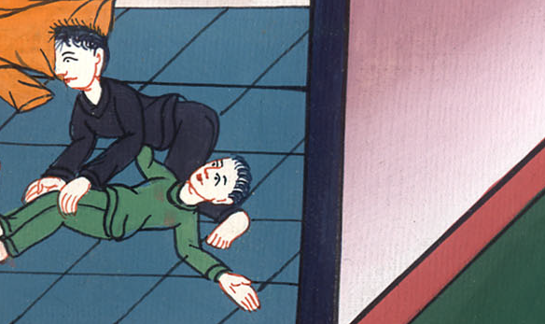
Acts 19:13

Slide 11
14There were seven sons of one Sceva, a Jewish chief priest, who did this.

Slide 12
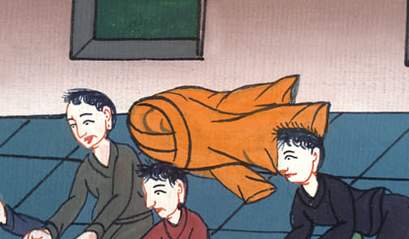
Acts 19:14

Slide 13
15The evil spirit answered, “Jesus I know, and Paul I know, but who are you?”

Slide 14
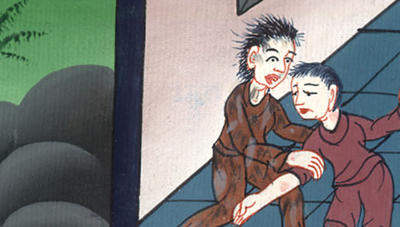
Acts 19:15

Slide 15
16The man in whom the evil spirit was leaped on them, overpowered them, and prevailed against them, so that they fled out of that house naked and wounded.

Slide 16
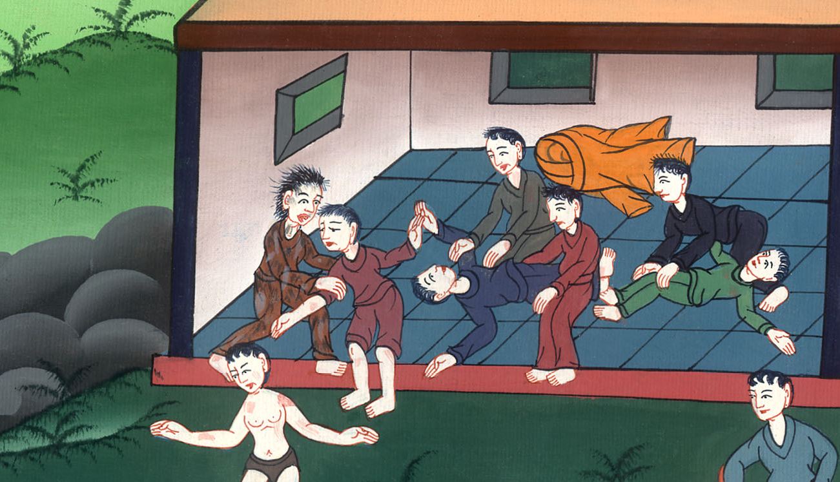
Acts 19:16

Slide 17
17This became known to all, both Jews and Greeks, who lived at Ephesus. Fear fell on them all, and the name of the Lord Jesus was magnified.

Slide 18
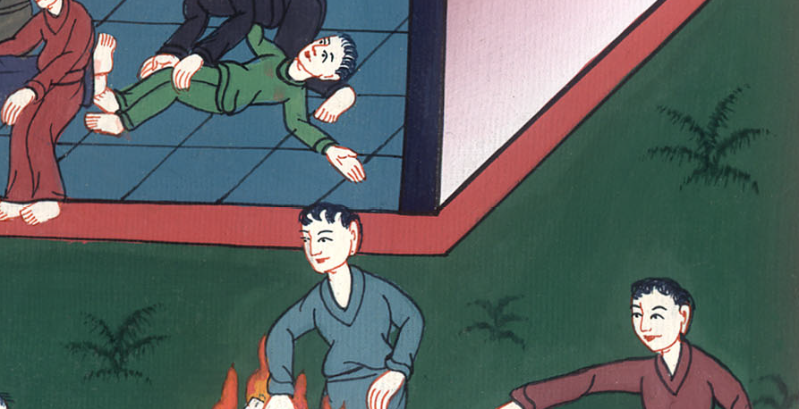
Acts 19:17

Slide 19
18Many also of those who had believed came, confessing and declaring their deeds.

Slide 20
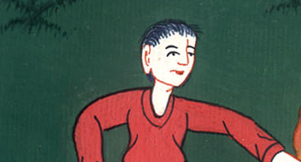
Acts 19:18

Slide 21
19Many of those who practiced magical arts brought their books together and burned them in the sight of all. They counted their price, and found it to be fifty thousand pieces of silver.

Slide 22
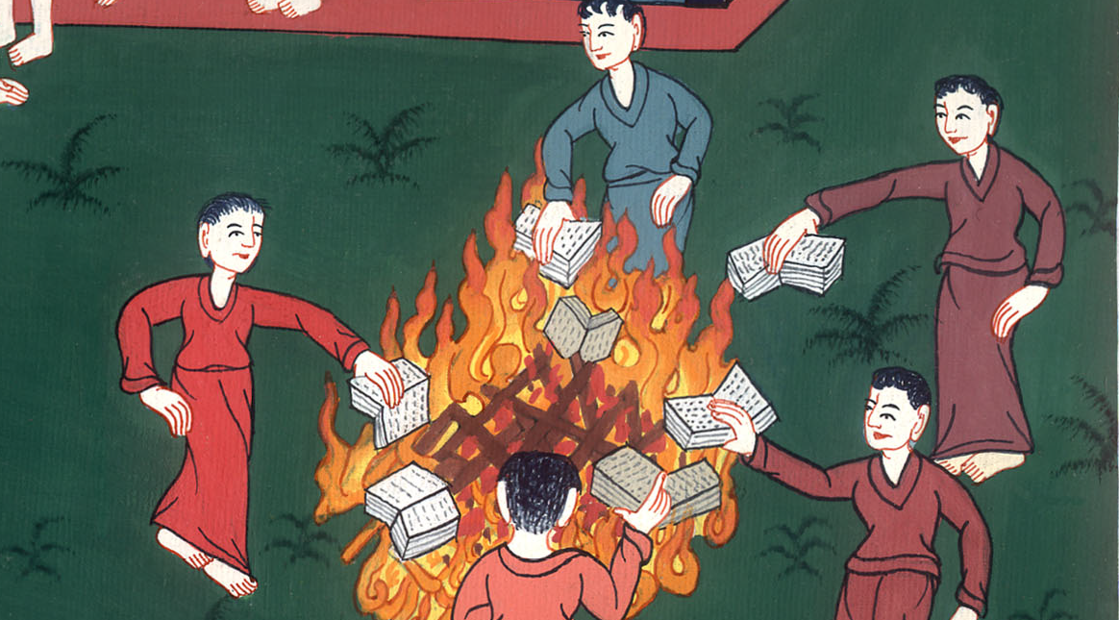
Acts 19:19

Slide 23
20So the word of the Lord was growing and becoming mighty.

Slide 24
Acts 19:20

