Slide 1
54-4
This work is licensed under a Creative Commons Attribution-ShareAlike 4.0 International License.
Please add this statement to all the videos you create.
English Bible quotes are from the World English Bible US, which is in the public domain.
Notes:
Ch
54 Paul’s 3rd journey
1. Apollos – Acts 18:24-28 (Left Top)
2. 2 years in Ephesus – Acts 19:1-10 (Center Top)
3. 7 sons of Sceva – Acts 19:11-20 (Right Top)
4. Artemis of the Ephesians – Acts 19:21 – 20:1 (Right Center)
5. Eutychus – Acts 20:6-12 (Right Bottom)
6. Paul visits the Ephesian Elders – Acts 20:16-38 (Center Bottom)
7. Agabus’ prophecy – Acts 21:8-15 (Left Bottom)

Slide 2
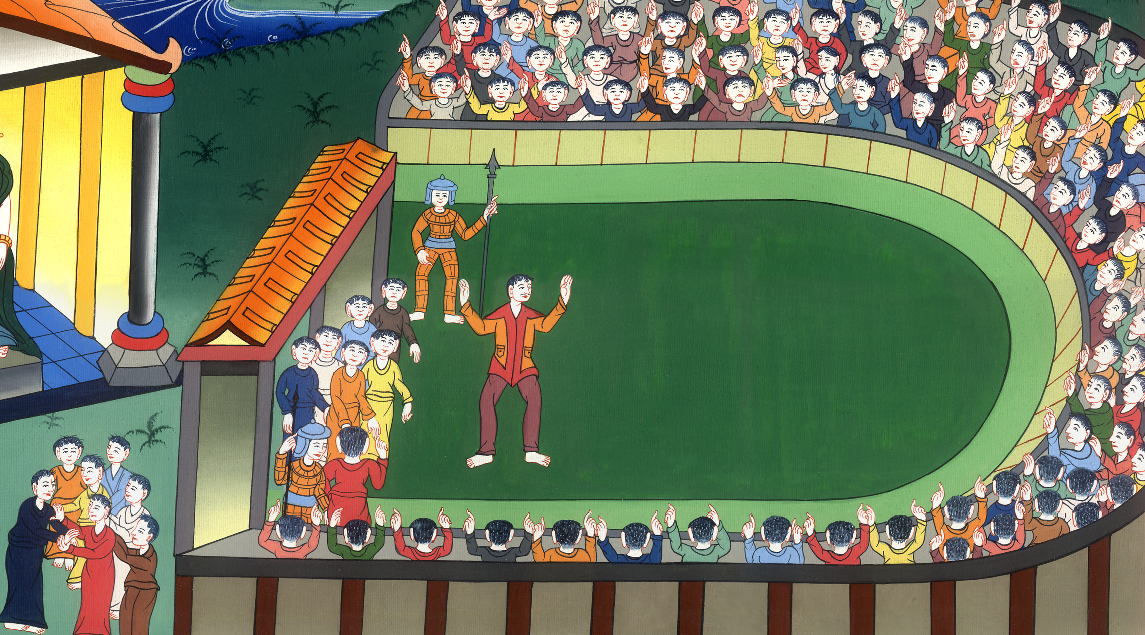
Artemis of the Ephesians –
Acts 19:21 – 20:1

Slide 3
Artemis of the Ephesians – Acts 19:21 – 20:1

Slide 4
Artemis of the Ephesians –
Acts 19:21 – 20:1

Slide 5
21Now after these things had ended, Paul determined in the Spirit to go to Jerusalem, saying, “After I have been there, I must also see Rome.”

Slide 6
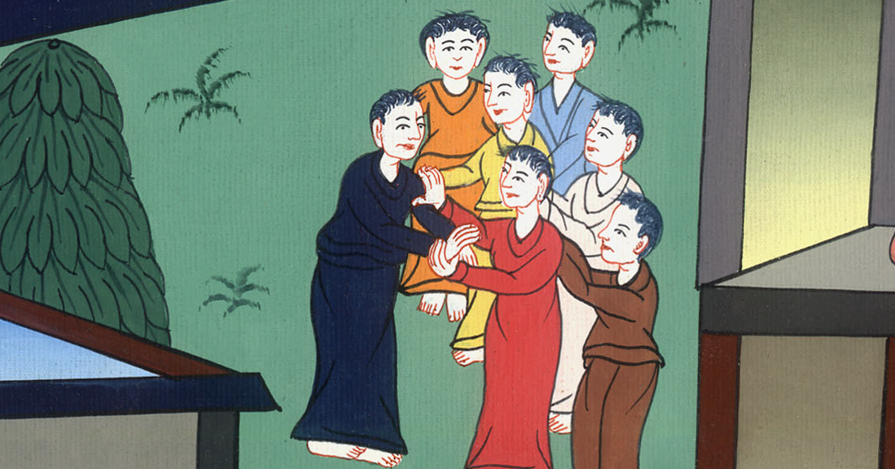
Acts 19:21

Slide 7
22Having sent into Macedonia two of those who served him, Timothy and Erastus, he himself stayed in Asia for a while.

Slide 8
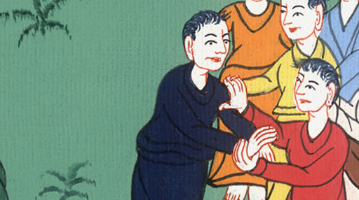
Acts 19:22

Slide 9
23About that time there arose no small disturbance concerning the Way.

Slide 10
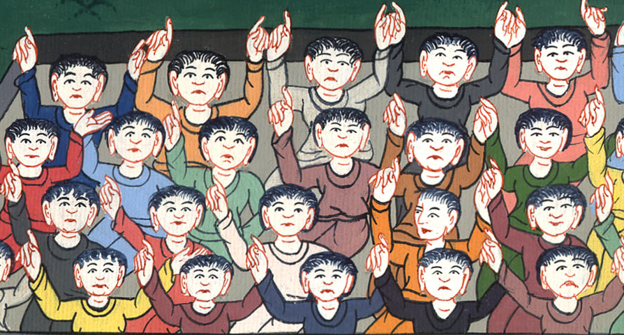
Acts 19:23

Slide 11
24For a certain man named Demetrius, a silversmith who made silver shrines of Artemis, brought no little business to the craftsmen,

Slide 12
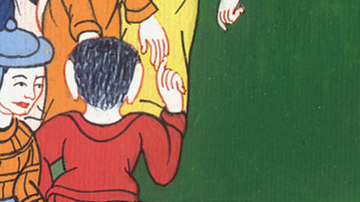
Acts 19:24

Slide 13
25whom he gathered together with the workmen of like occupation, and said, “Sirs, you know that by this business we have our wealth.

Slide 14
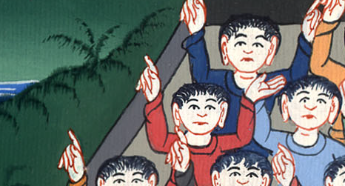
Acts 19:25

Slide 15
26You see and hear that not at Ephesus alone, but almost throughout all Asia, this Paul has persuaded and turned away many people, saying that they are no gods that are made with hands.

Slide 16
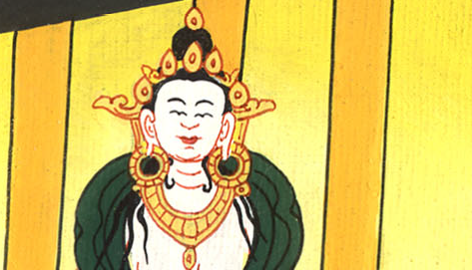
Acts 19:26

Slide 17
27Not only is there danger that this our trade come into disrepute, but also that the temple of the great goddess Artemis will be counted as nothing and her majesty destroyed, whom all Asia and the world worships.”

Slide 18
Acts 19:27

Slide 19
28When they heard this they were filled with anger, and cried out, saying, “Great is Artemis of the Ephesians!”

Slide 20
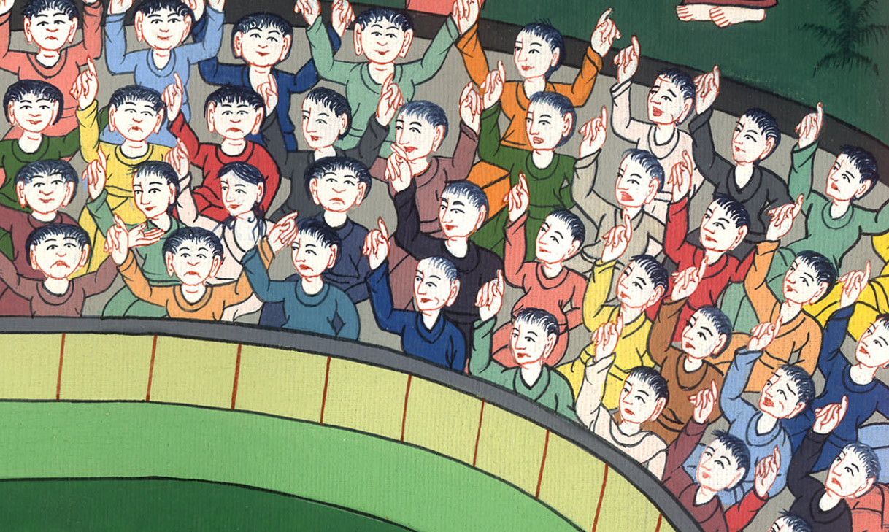
Acts 19:28

Slide 21
29The whole city was filled with confusion, and they rushed with one accord into the theater, having seized Gaius and Aristarchus, men of Macedonia, Paul’s companions in travel.

Slide 22
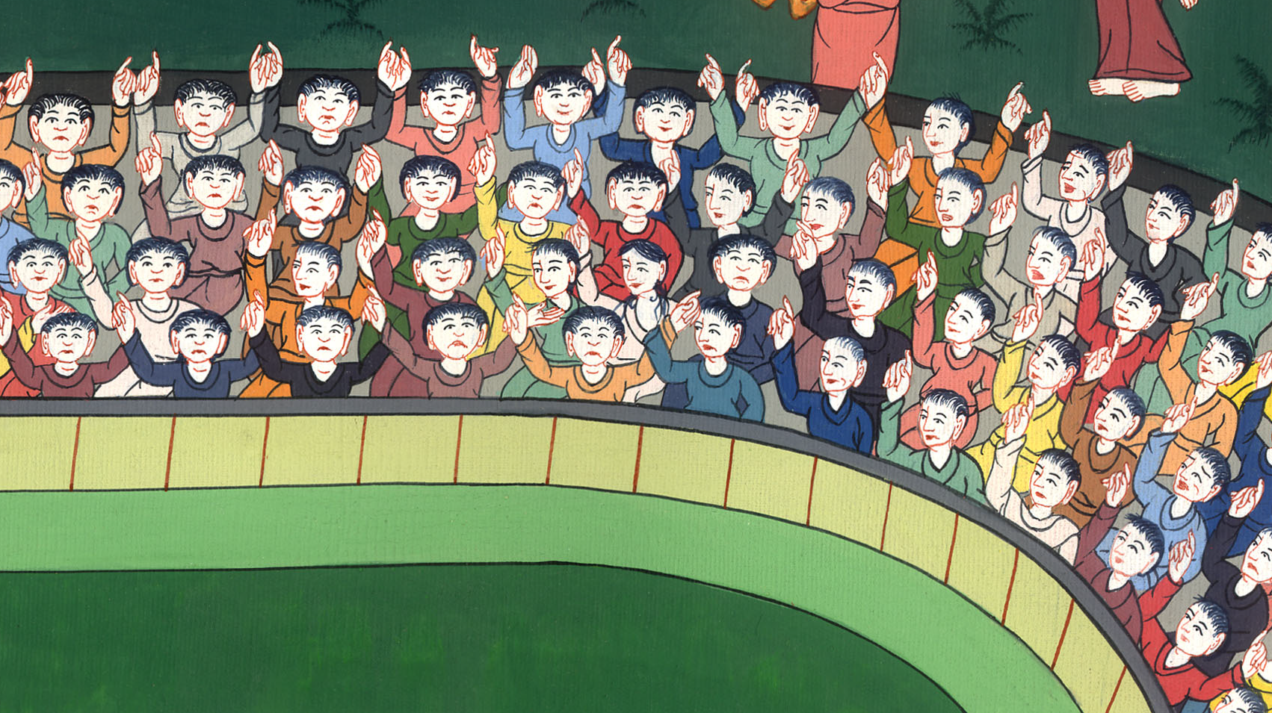
Acts 19:29

Slide 23
32Some therefore cried one thing, and some another, for the assembly was in confusion. Most of them didn’t know why they had come together.

Slide 24
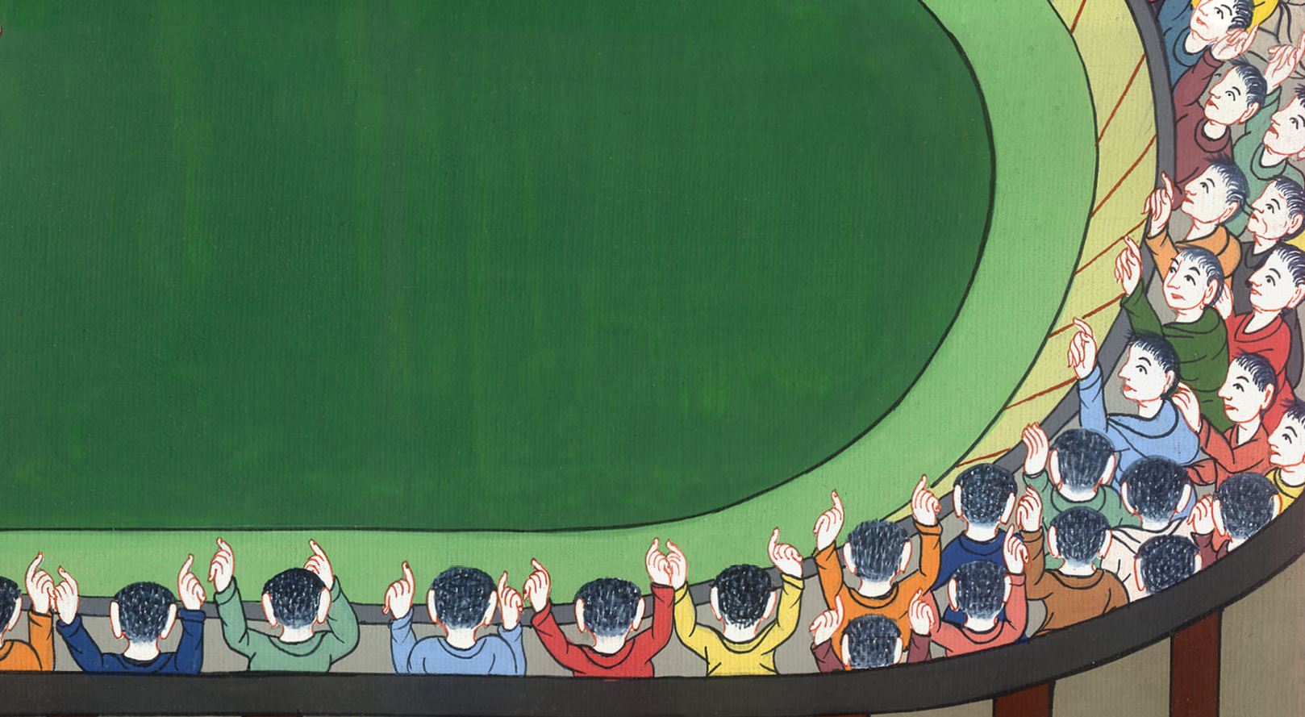
Acts 19:32

Slide 25
33They brought Alexander out of the multitude, the Jews putting him forward.

Slide 26
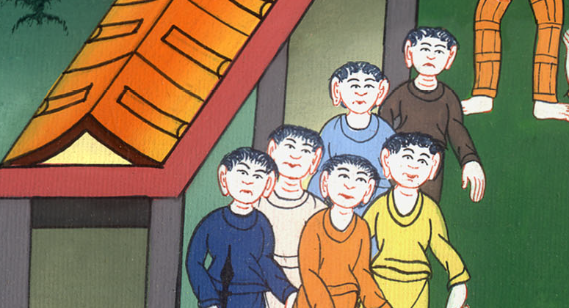
Acts 19:33

Slide 27
34But when they perceived that he was a Jew, all with one voice for a time of about two hours cried out, “Great is Artemis of the Ephesians!”

Slide 28
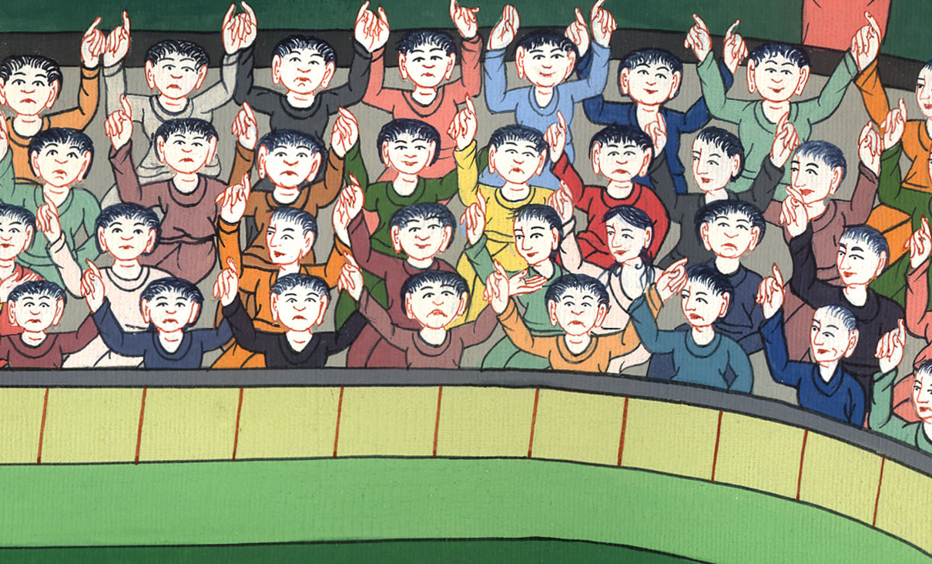
Acts 19:34

Slide 29
35When the town clerk had quieted the multitude, he said, “You men of Ephesus, what man is there who doesn’t know that the city of the Ephesians is temple keeper of the great goddess Artemis, and of the image which fell down from Zeus?

Slide 30
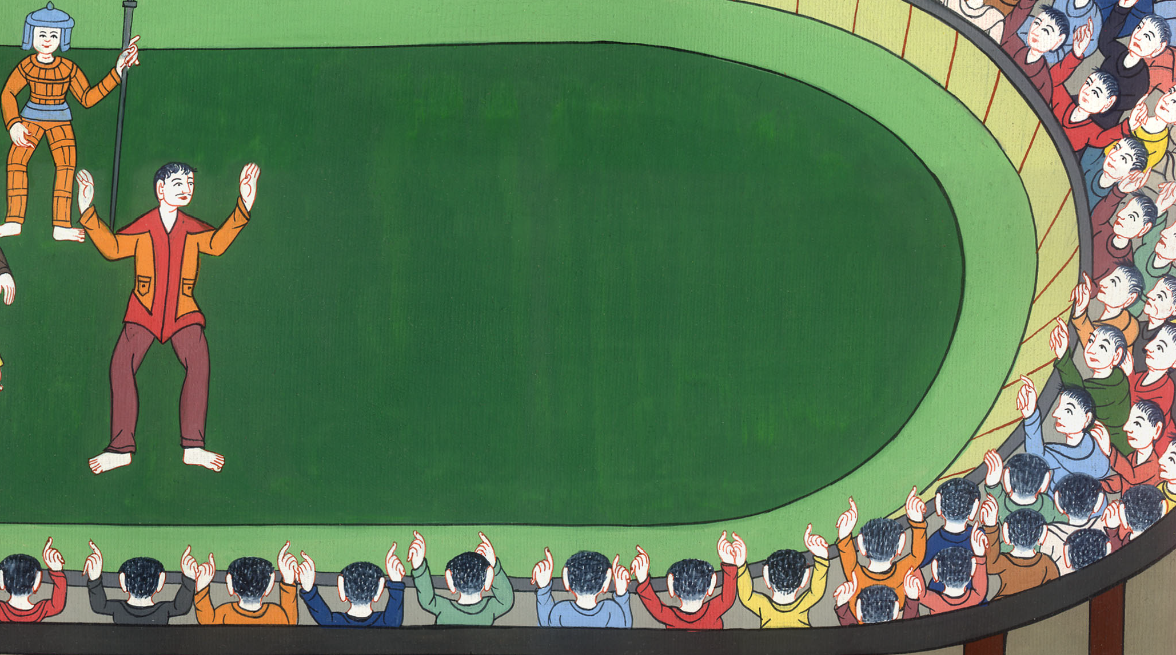
Acts 19:35

Slide 31
36Seeing then that these things can’t be denied, you ought to be quiet and to do nothing rash.

Slide 32
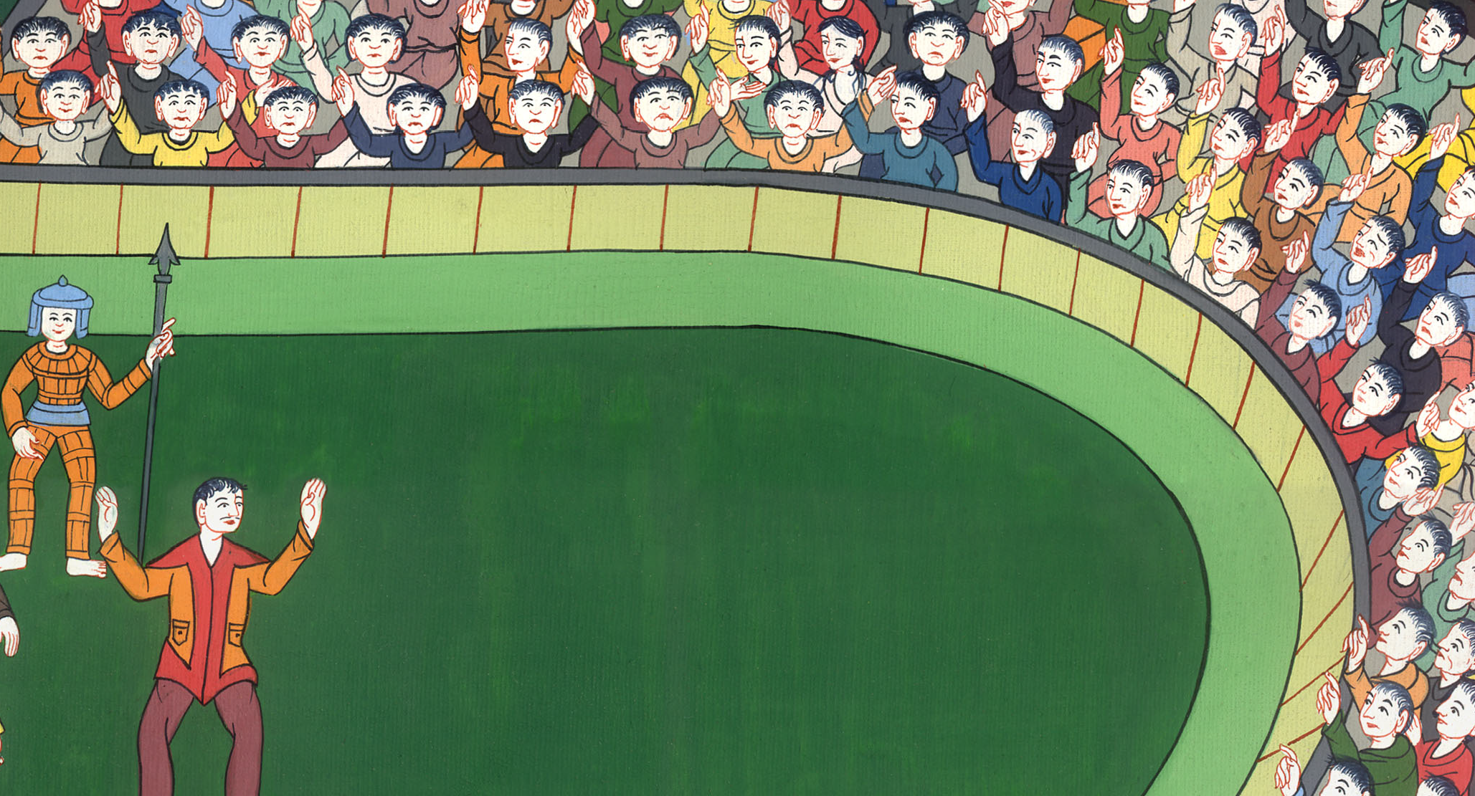
Acts 19:36

Slide 33
37For you have brought these men here, who are neither robbers of temples nor blasphemers of your goddess.

Slide 34
Acts 19:37

Slide 35
38If therefore Demetrius and the craftsmen who are with him have a matter against anyone, the courts are open and there are proconsuls. Let them press charges against one another.

Slide 36
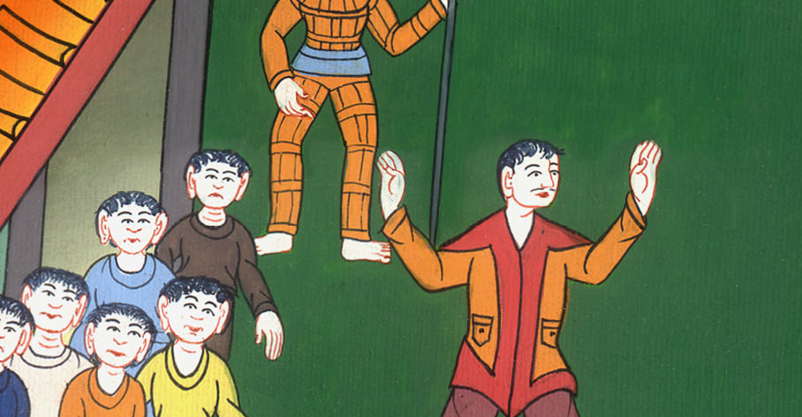
Acts 19:38

Slide 37
For indeed we are in danger of being accused concerning today’s riot, there being no cause. Concerning it, we wouldn’t be able to give an account of this commotion.” 41When he had thus spoken, he dismissed the assembly.

Slide 38
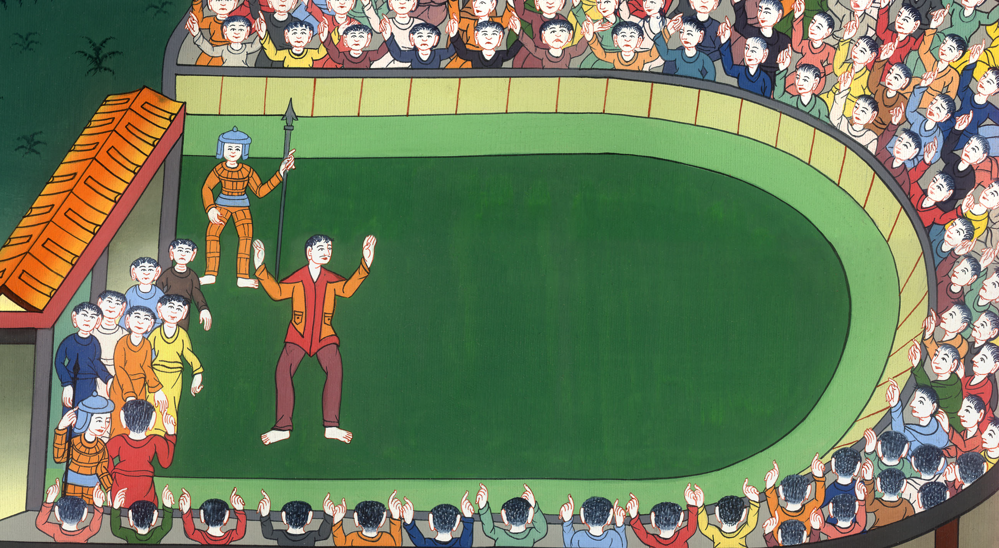
Acts 19:40,41

Slide 39
20:1All the trouble came to an end. Then Paul sent for the believers. After encouraging them, he said goodbye. He then left for Macedonia.

Slide 40
Acts 20:1

