Slide 1
54-5
This work is licensed under a Creative Commons Attribution-ShareAlike 4.0 International License.
Please add this statement to all the videos you create.
English Bible quotes are from the World English Bible US, which is in the public domain.
Notes:
Ch
54 Paul’s 3rd journey
1. Apollos – Acts 18:24-28 (Left Top)
2. 2 years in Ephesus – Acts 19:1-10 (Center Top)
3. 7 sons of Sceva – Acts 19:11-20 (Right Top)
4. Artemis of the Ephesians – Acts 19:21 – 20:1 (Right Center)
5. Eutychus – Acts 20:6-12 (Right Bottom)
6. Paul visits the Ephesian Elders – Acts 20:16-38 (Center Bottom)
7. Agabus’ prophecy – Acts 21:8-15 (Left Bottom)

Slide 2
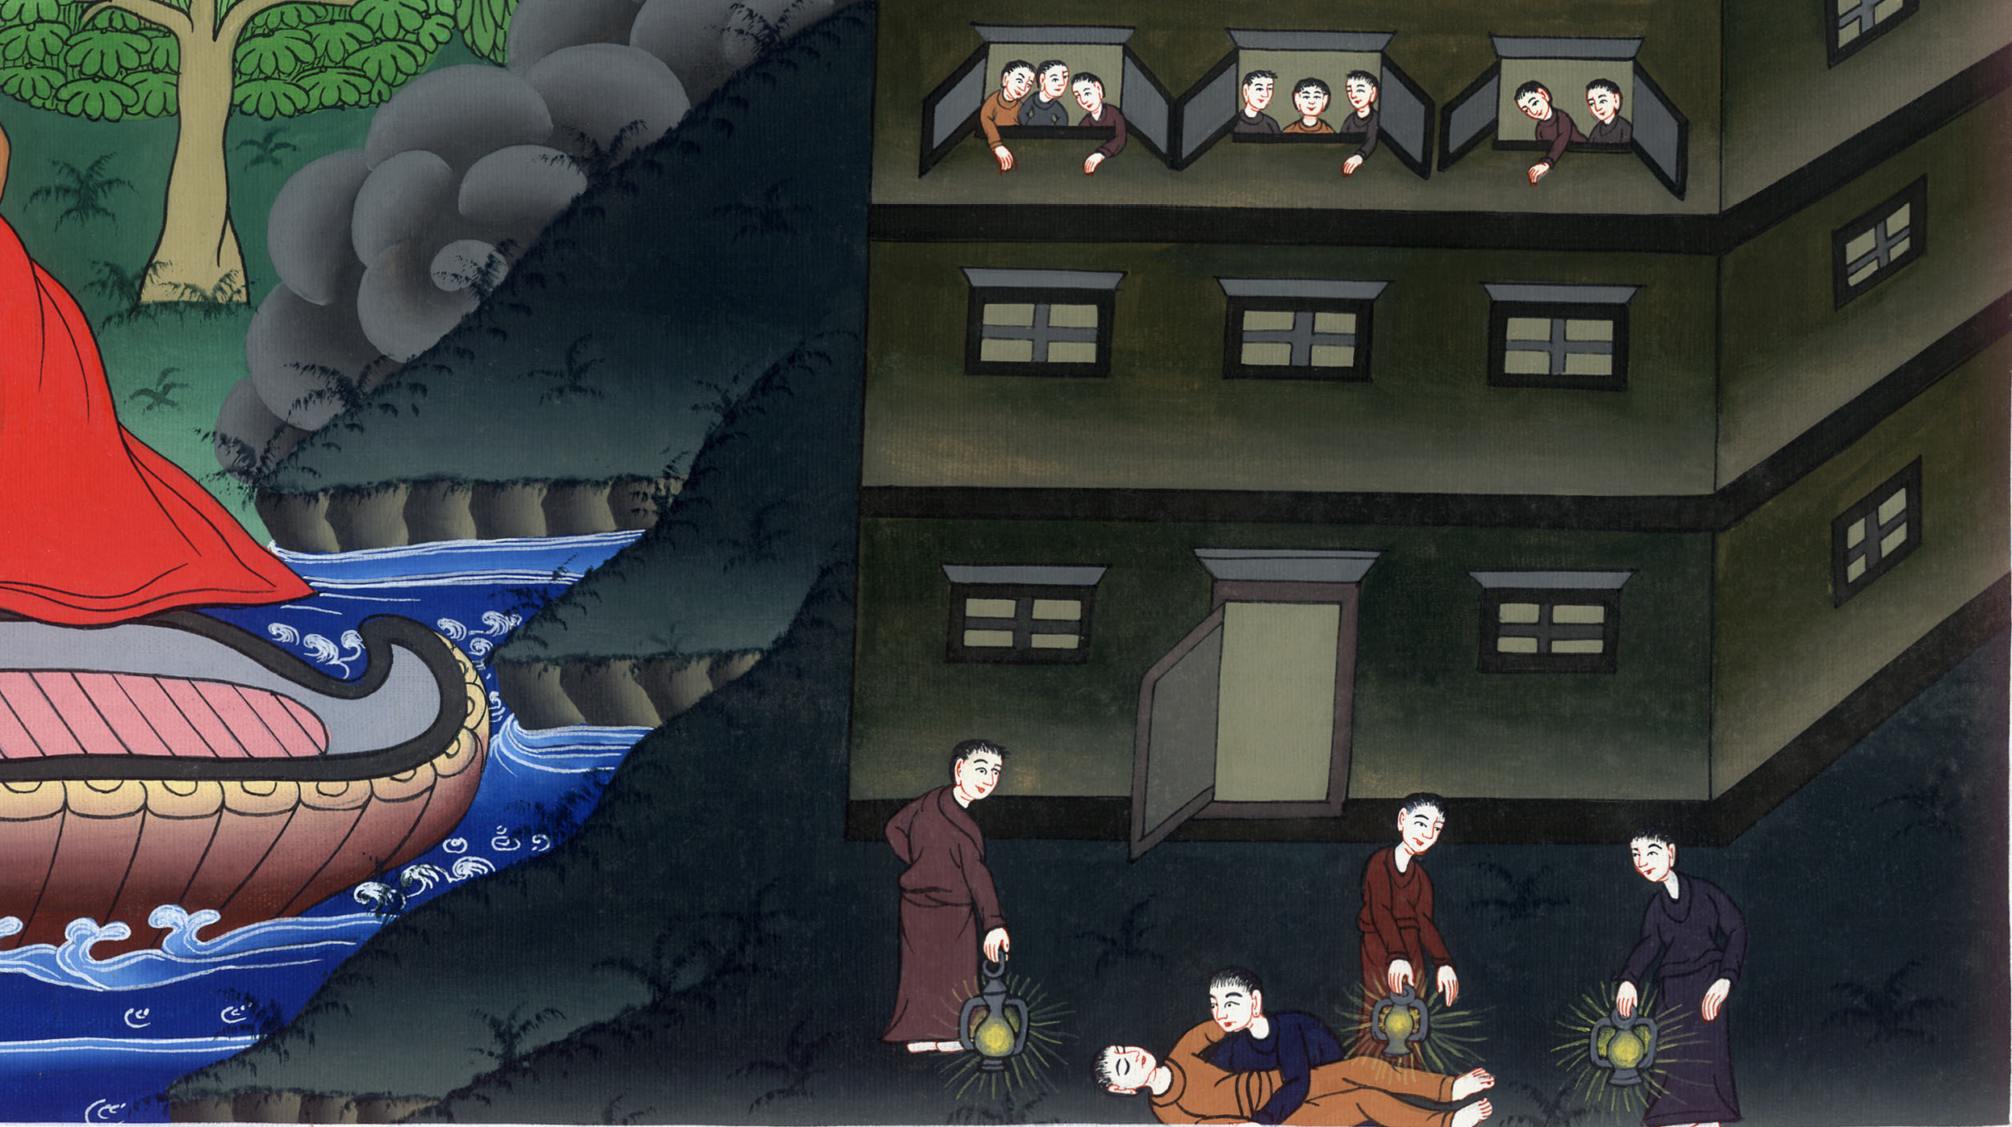
Eutychus – Acts 20:6-12

Slide 3
Eutychus – Acts 20:6-12

Slide 4
Eutychus – Acts 20:6-12

Slide 5
6(Luke says) We sailed away from Philippi after the days of Unleavened Bread, and came to them at Troas in five days, where we stayed seven days.

Slide 6
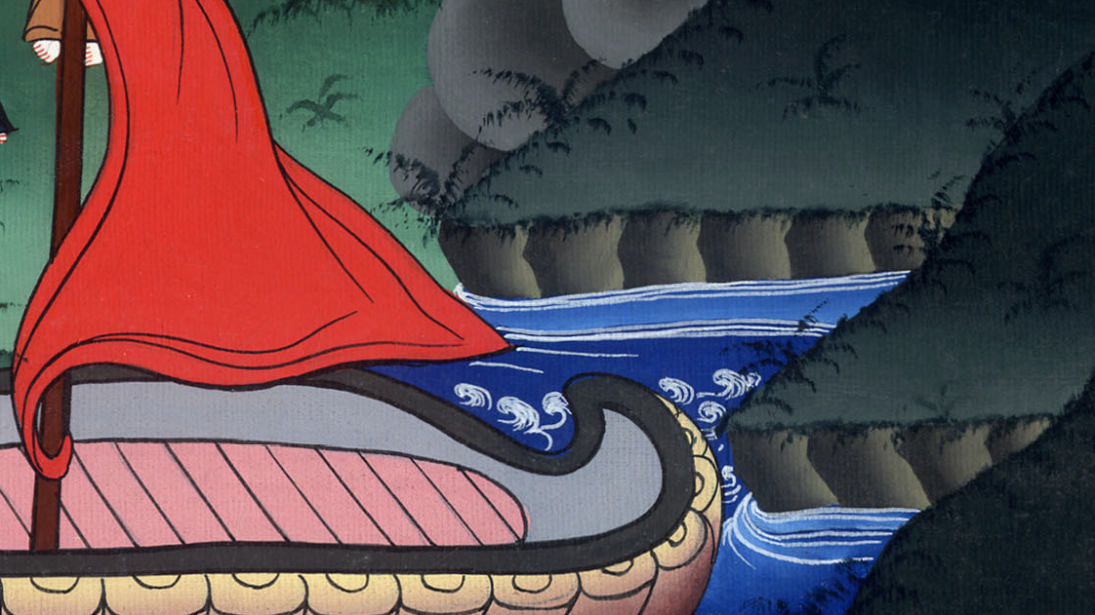
Acts 20:6

Slide 7
7On the first day of the week, when the disciples were gathered together to break bread, Paul talked with them, intending to depart on the next day; and continued his speech until midnight.

Slide 8
Acts 20:7

Slide 9
8There were many lights in the upper room where we were gathered together.

Slide 10
Acts 20:8

Slide 11
9A certain young man named Eutychus sat in the window, weighed down with deep sleep. As Paul spoke still longer, being weighed down by his sleep, he fell down from the third floor and was taken up dead.

Slide 12
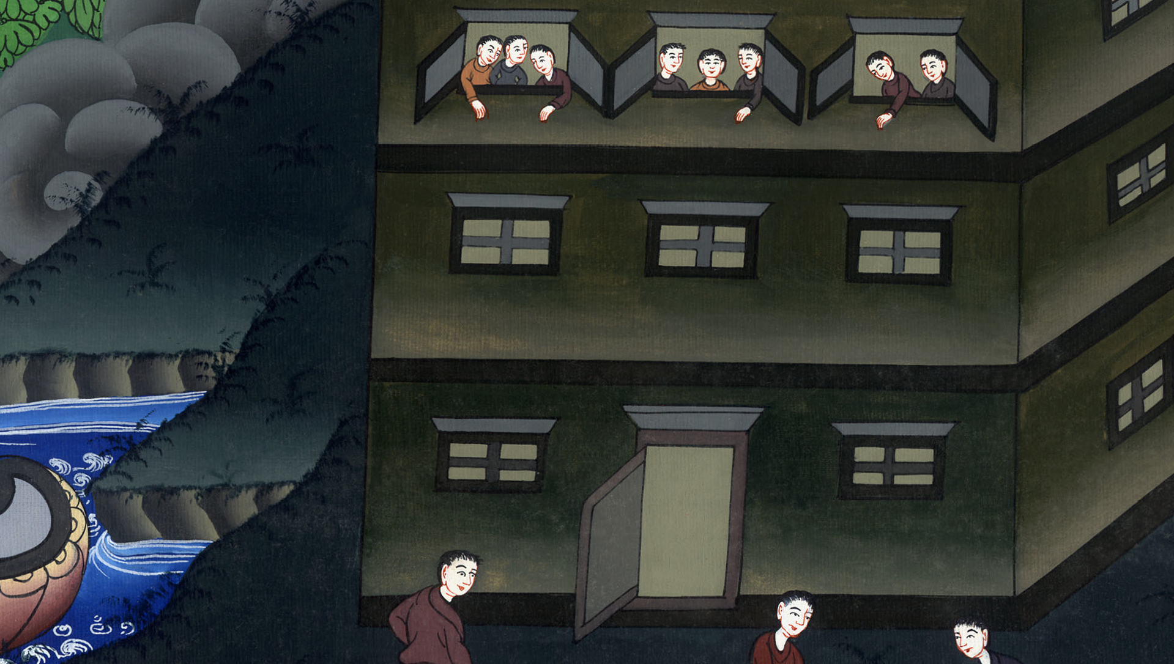
Acts 20:9

Slide 13
10Paul went down and fell upon him, and embracing him said, “Don’t be troubled, for his life is in him.”

Slide 14
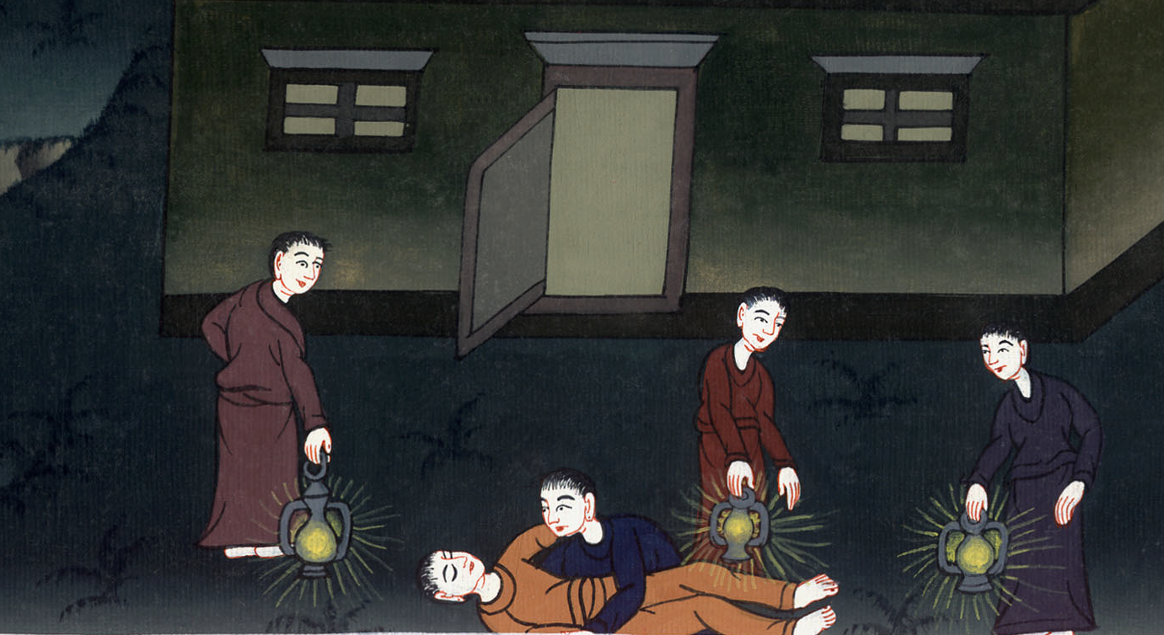
Acts 20:10

Slide 15
11When he had gone up, had broken bread and eaten, and had talked with them a long while, even until break of day, he departed.

Slide 16
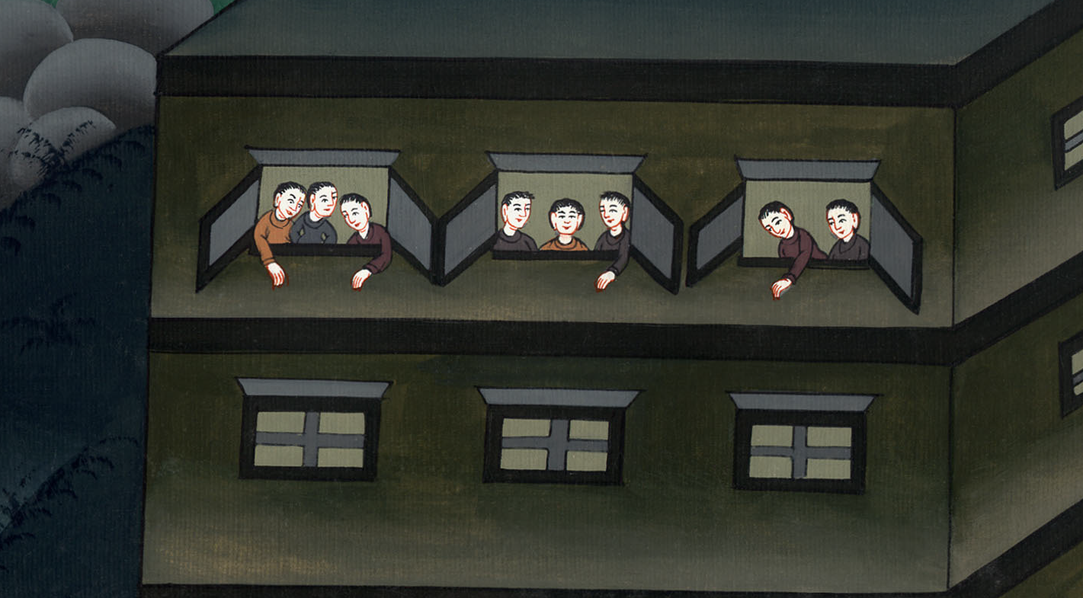
Acts 20:11

Slide 17
12They brought the boy in alive, and were greatly comforted.

Slide 18
Acts 20:12

