Slide 1
54-6
This work is licensed under a Creative Commons Attribution-ShareAlike 4.0 International License.
Please add this statement to all the videos you create.
English Bible quotes are from the World English Bible US, which is in the public domain.
Notes:
Ch
54 Paul’s 3rd journey
1. Apollos – Acts 18:24-28 (Left Top)
2. 2 years in Ephesus – Acts 19:1-10 (Center Top)
3. 7 sons of Sceva – Acts 19:11-20 (Right Top)
4. Artemis of the Ephesians – Acts 19:21 – 20:1 (Right Center)
5. Eutychus – Acts 20:6-12 (Right Bottom)
6. Paul visits the Ephesian Elders – Acts 20:16-38 (Center Bottom)
7. Agabus’ prophecy – Acts 21:8-15 (Left Bottom)

Slide 2
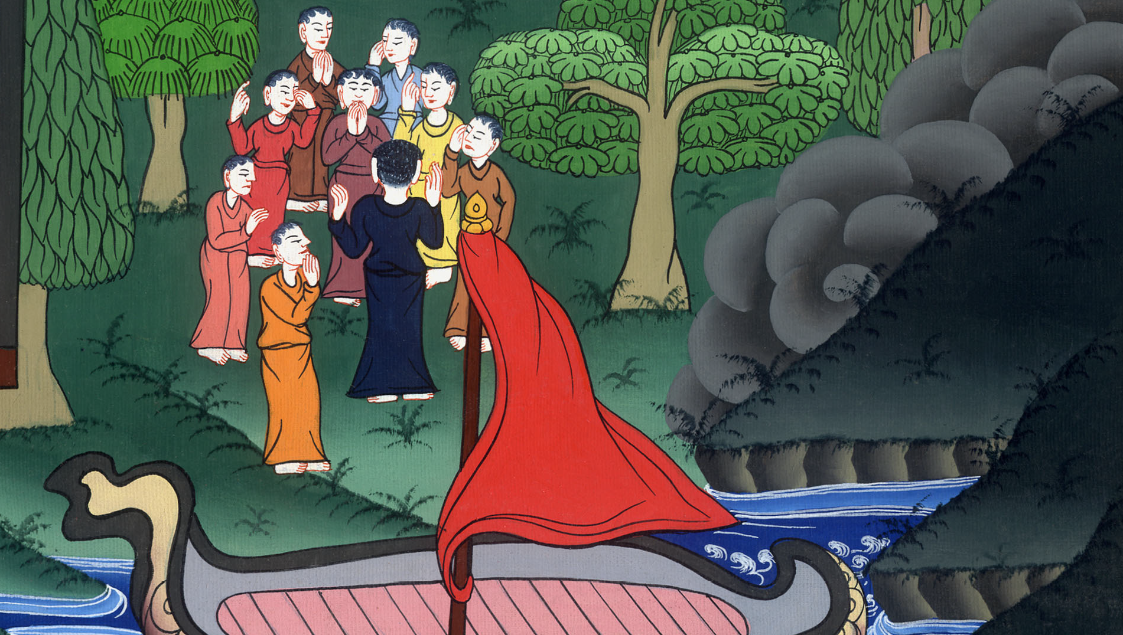
Paul teaches the Ephesian Elders – Acts 20:16-38

Slide 3
Paul teaches the Ephesian Elders – Acts 20:16-38

Slide 4
Paul visits the Ephesian Elders – Acts 20:16-38

Slide 5
16For Paul had determined to sail past Ephesus, that he might not have to spend time in Asia; for he was hastening, if it were possible for him, to be in Jerusalem on the day of Pentecost.

Slide 6
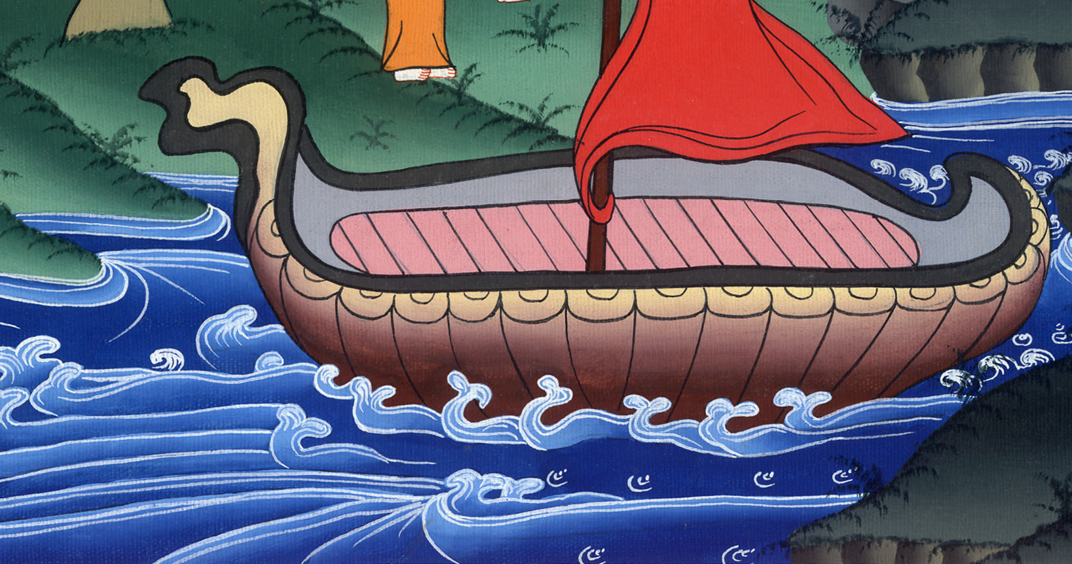
Acts 20:16

Slide 7
17From Miletus he sent to Ephesus and called to himself the elders of the assembly.

Slide 8
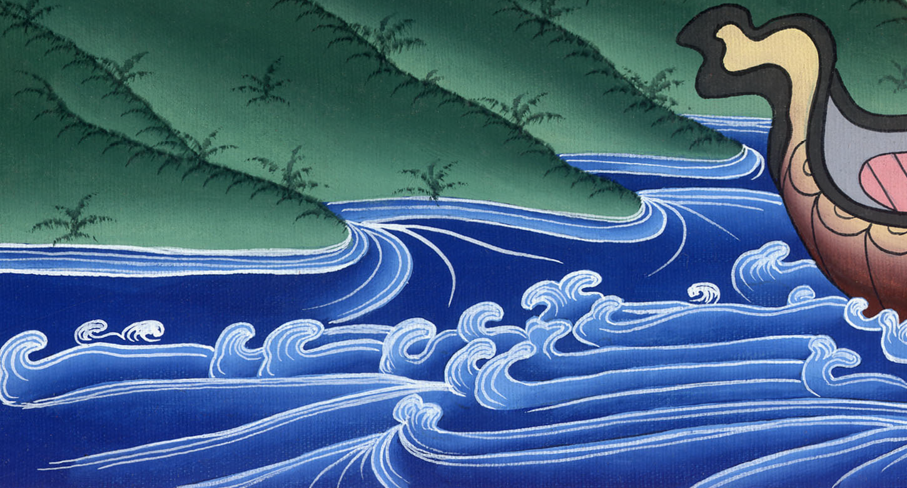
Acts 20:17

Slide 9
18When they had come to him, he said to them, “You yourselves know, from the first day that I set foot in Asia, how I was with you all the time.

Slide 10
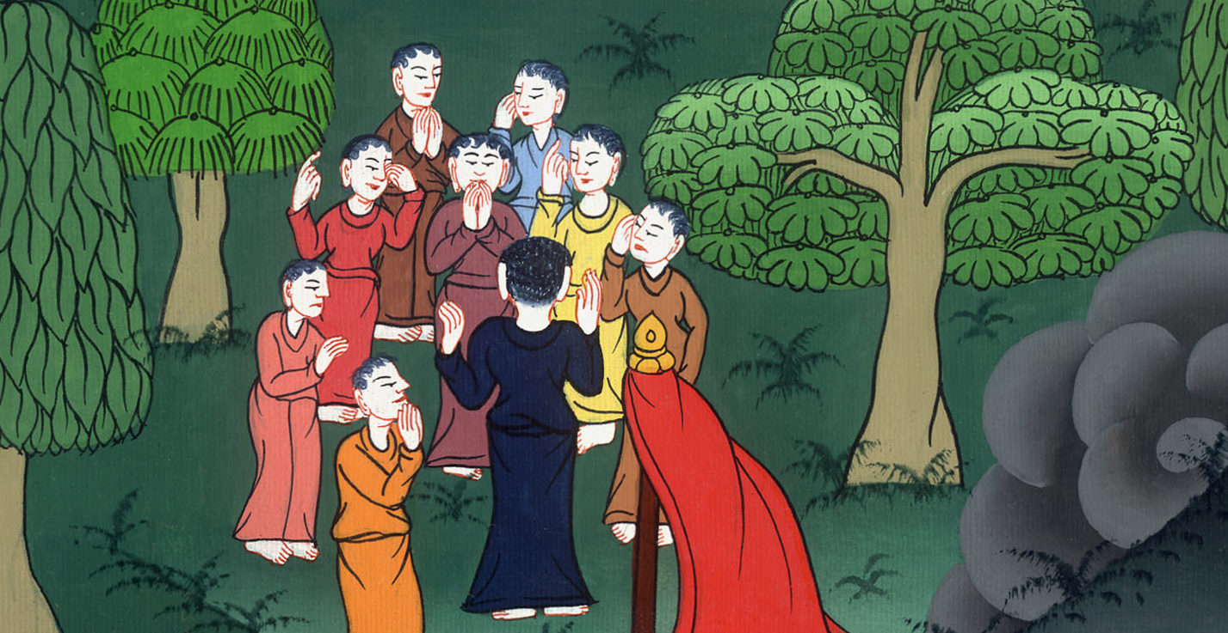
Acts 20:18

Slide 11
19I served the Lord with all humility, with many tears, and with trials which happened to me by the plots of the Jews.

Slide 12
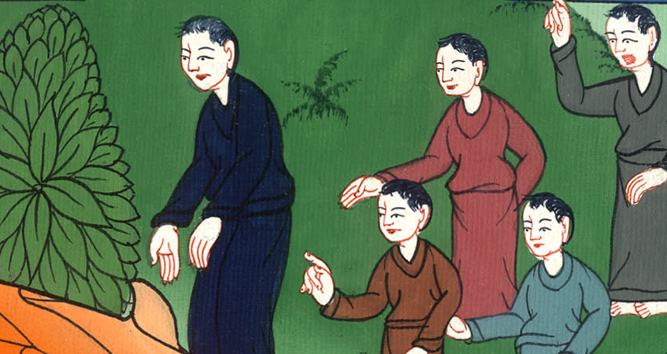
Acts 20:19

Slide 13
20You know how I didn’t shrink from declaring to you anything that was profitable, teaching you publicly and from house to house.

Slide 14
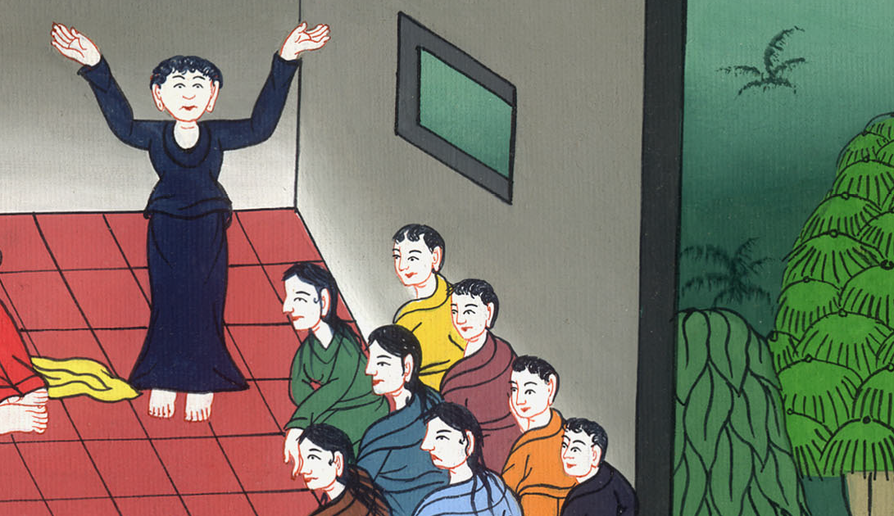
Acts 20:20

Slide 15
21I testified both to Jews and to Greeks repentance toward God and faith toward our Lord Jesus.

Slide 16
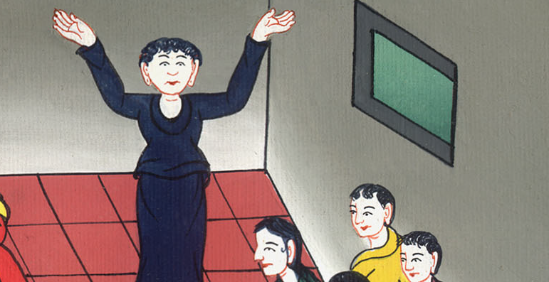
Acts 20:21

Slide 17
22“Now, behold, I go bound by the Spirit to Jerusalem, not knowing what will happen to me there.

Slide 18
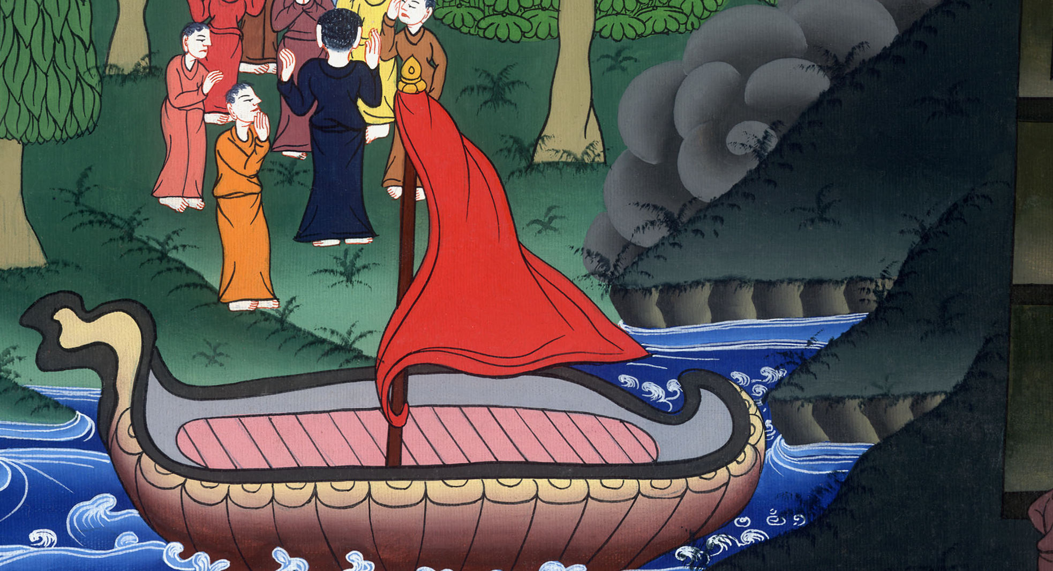
Acts 20:22

Slide 19
23I only know that the Holy Spirit testifies in every city, saying that bonds and afflictions wait for me.

Slide 20
Acts 20:23

Slide 21
24But these things don’t count; nor do I hold my life dear to myself, so that I may finish my race with joy.

Slide 22
Acts 20:24

Slide 23
I want to complete the ministry which I received from the Lord Jesus, to fully testify to the Good News of the grace of God.

Slide 24
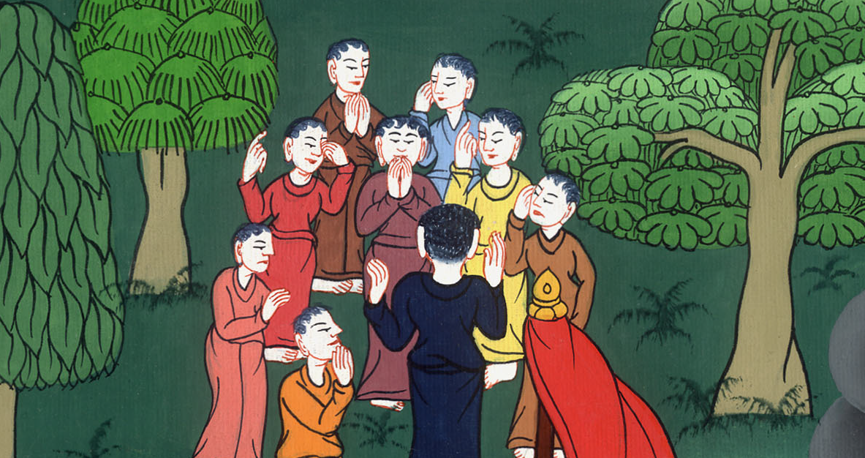
Acts 20:24

Slide 25
25“Now, behold, I know that you all, among whom I went about preaching God’s Kingdom, will see my face no more.

Slide 26
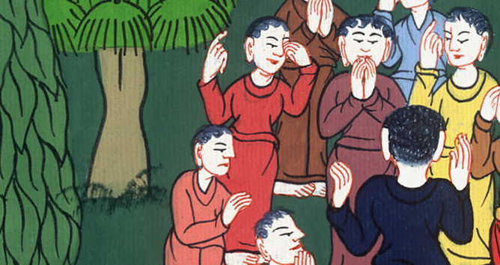
Acts 20:25

Slide 27
26Therefore I testify to you today that I am clean from the blood of all men, 27for I didn’t shrink from declaring to you the whole counsel of God.

Slide 28
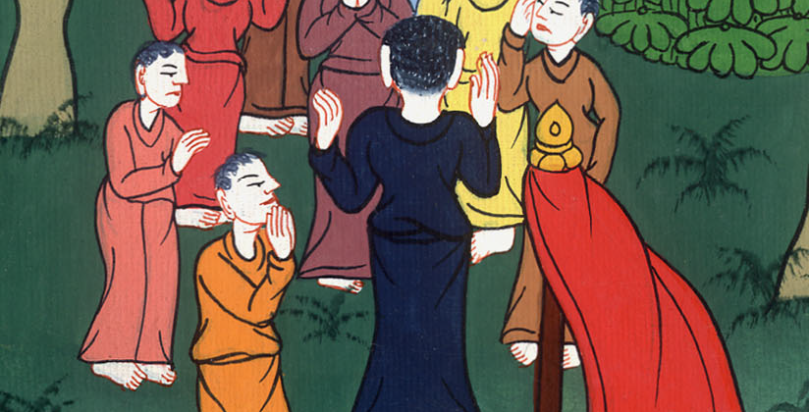
Acts 20:26,27

Slide 29
28Take heed, therefore, to yourselves and to all the flock.

Slide 30
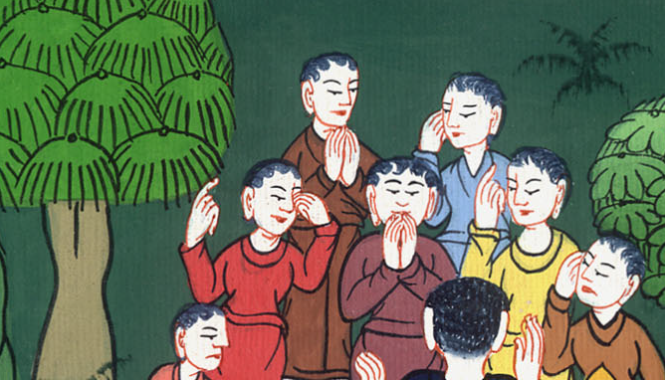
Acts 20:28

Slide 31
The Holy Spirit has made you overseers, to shepherd the assembly of the Lord and God which he purchased with his own blood.

Slide 32
Acts 20:28

Slide 33
29For I know that after my departure, vicious wolves will enter in among you, not sparing the flock.

Slide 34
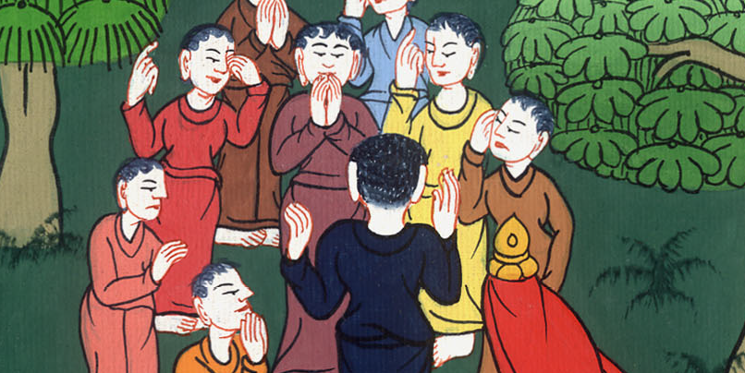
Acts 20:29

Slide 35
30Men will arise from among your own selves, speaking perverse things, to draw away the disciples after them.

Slide 36
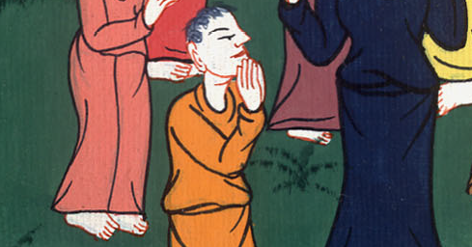
Acts 20:30

Slide 37
31Therefore watch, remembering that for a period of three years I didn’t cease to admonish everyone night and day with tears.

Slide 38
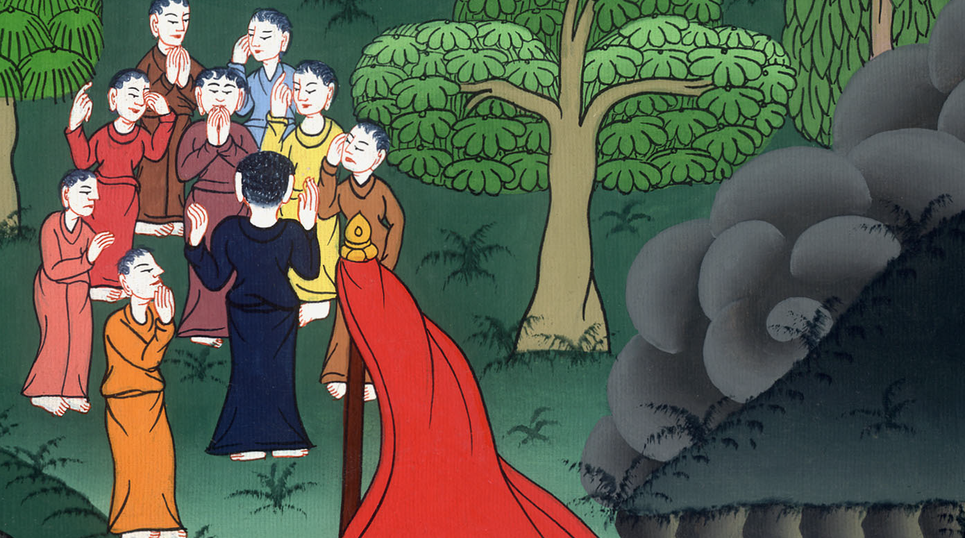
Acts 20:31

Slide 39
32Now, brothers, I entrust you to God and to the word of his grace, which is able to build up and to give you the inheritance among all those who are sanctified.

Slide 40
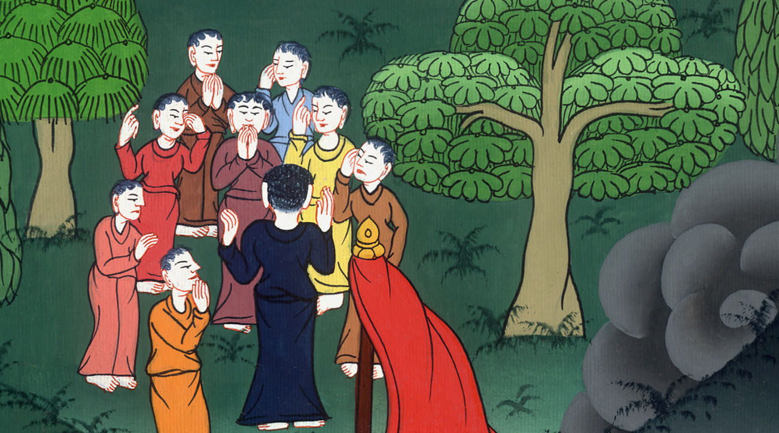
Acts 20:32

Slide 41
33I coveted no one’s silver, gold, or clothing. 34You yourselves know that these hands served my necessities, and those who were with me.

Slide 42
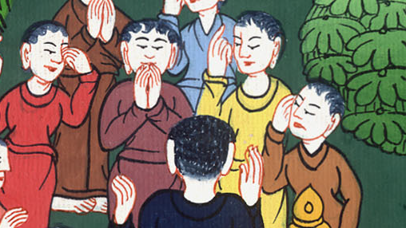
Acts 20:33,34

Slide 43
35In all things I gave you an example, that so laboring you ought to help the weak, and to remember the words of the Lord Jesus, that he himself said, ‘It is more blessed to give than to receive.’ ”

Slide 44
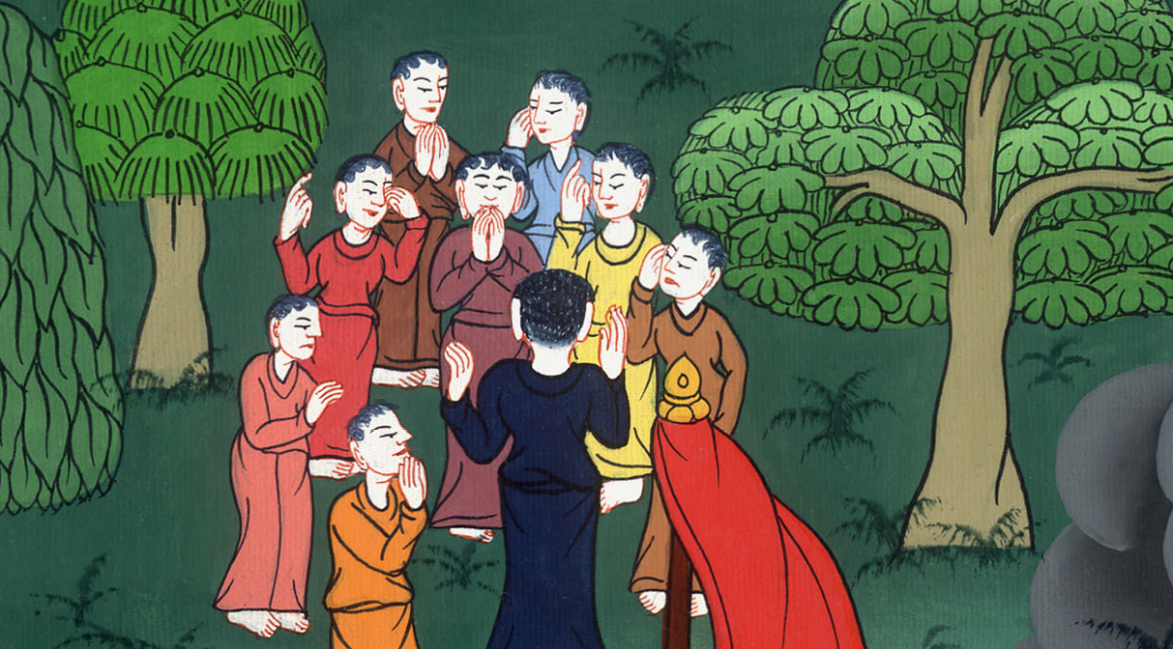
Acts 20:35

Slide 45
When he had spoken these things, he knelt down and prayed with them all. 37They all wept freely, and fell on Paul’s neck and kissed him.

Slide 46
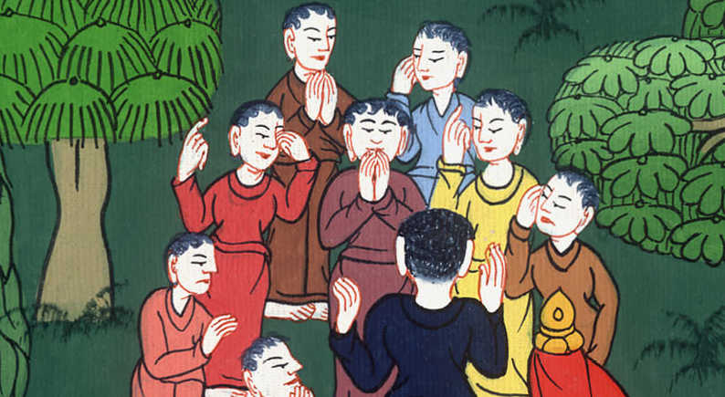
Acts 20:6,37

Slide 47
38They were sorrowing most of all because of the word which he had spoken, that they should see his face no more. Then they accompanied him to the ship.

Slide 48
Acts 20:38

