Slide 1
54-7
This work is licensed under a Creative Commons Attribution-ShareAlike 4.0 International License.
Please add this statement to all the videos you create.
English Bible quotes are from the World English Bible US, which is in the public domain.
Notes:
Ch
54 Paul’s 3rd journey
1. Apollos – Acts 18:24-28 (Left Top)
2. 2 years in Ephesus – Acts 19:1-10 (Center Top)
3. 7 sons of Sceva – Acts 19:11-20 (Right Top)
4. Artemis of the Ephesians – Acts 19:21 – 20:1 (Right Center)
5. Eutychus – Acts 20:6-12 (Right Bottom)
6. Paul visits the Ephesian Elders – Acts 20:16-38 (Center Bottom)
7. Agabus’ prophecy – Acts 21:8-15 (Left Bottom)

Slide 2
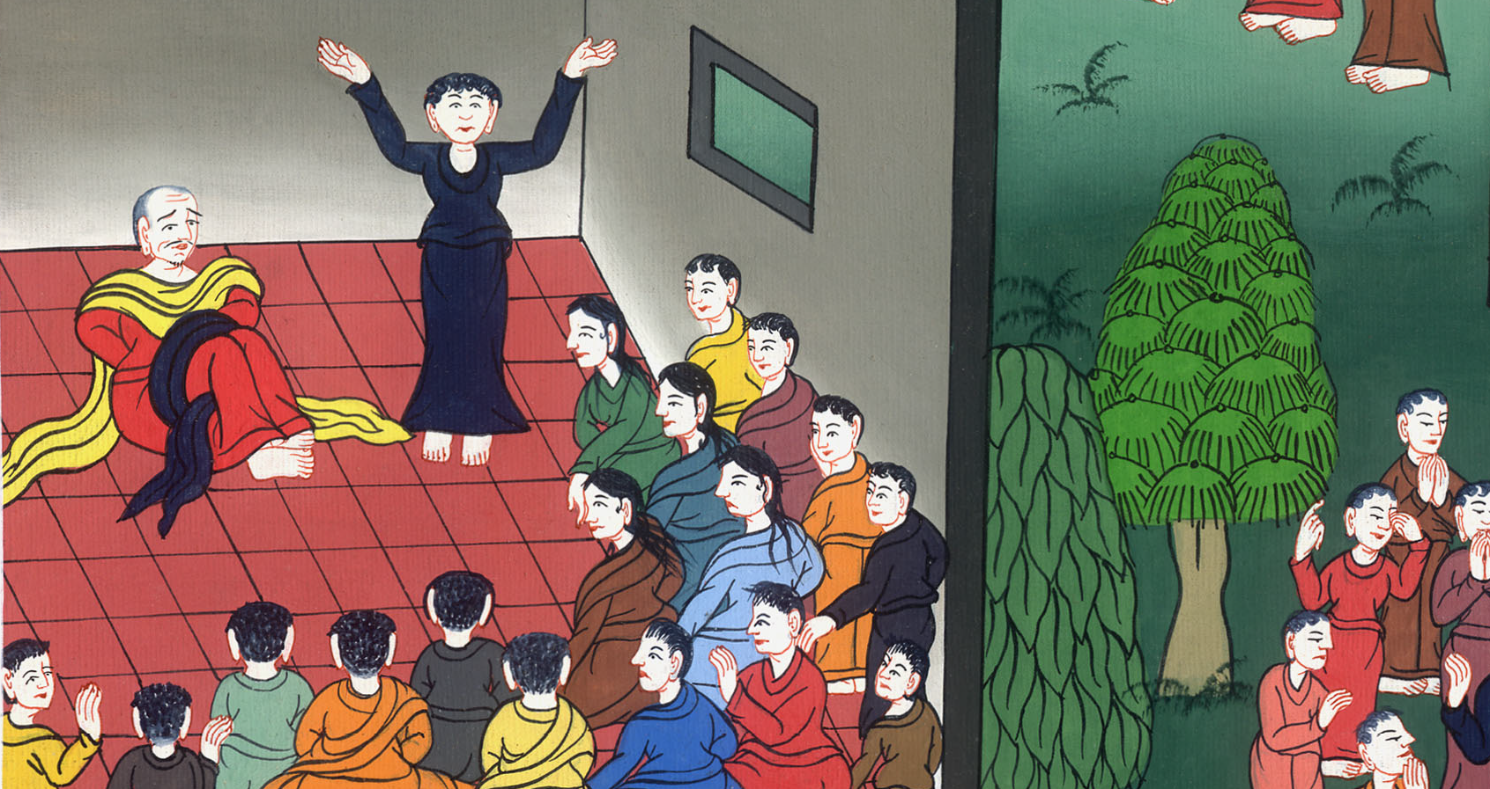
Agabus’s prophecy – Acts 21:8-15

Slide 3
Agabus’s prophecy – Acts 21:8-15

Slide 4
Agabus’s prophecy – Acts 21:8-15

Slide 5
Luke tells about their journey:8On the next day, we who were Paul’s companions departed and came to Caesarea.
We entered into the house of Philip the evangelist, who was one of the seven, and stayed with him.

Slide 6
Acts 21:8

Slide 7
9Now this man had four virgin daughters who prophesied. 10As we stayed there some days, a certain prophet named Agabus came down from Judea.

Slide 8
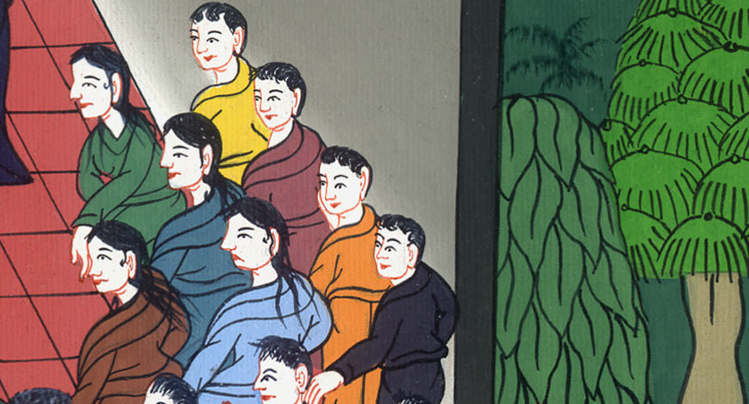
Acts 21:9,10

Slide 9
11Coming to us and taking Paul’s belt, he bound his own feet and hands,

Slide 10
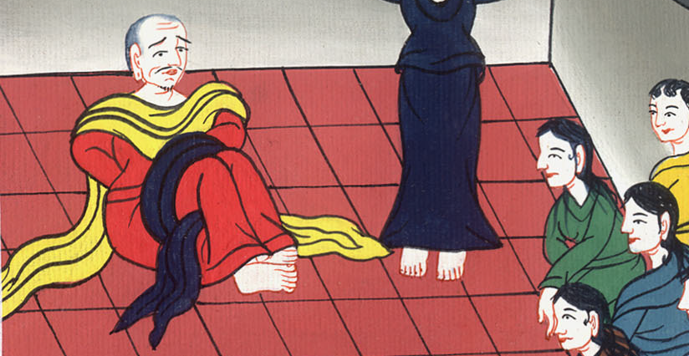
Acts 21:11

Slide 11
He said, “The Holy Spirit says: ‘So the Jews at Jerusalem will bind the man who owns this belt, and will deliver him into the hands of the Gentiles.’”

Slide 12
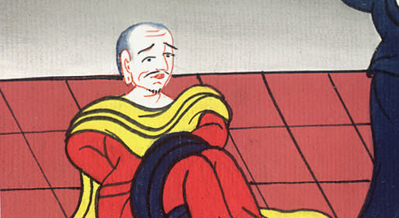
Acts 21:11

Slide 13
12When we heard these things, both we and the people of that place begged him not to go up to Jerusalem.

Slide 14
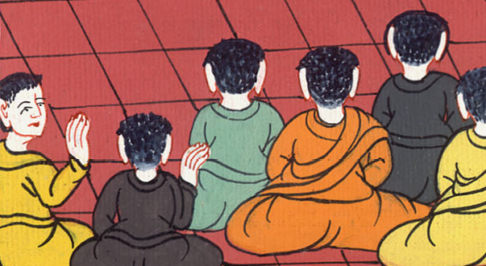
Acts 21:12

Slide 15
13Then Paul answered, “What are you doing, weeping and breaking my heart? For I am ready not only to be bound, but also to die at Jerusalem for the name of the Lord Jesus.”

Slide 16
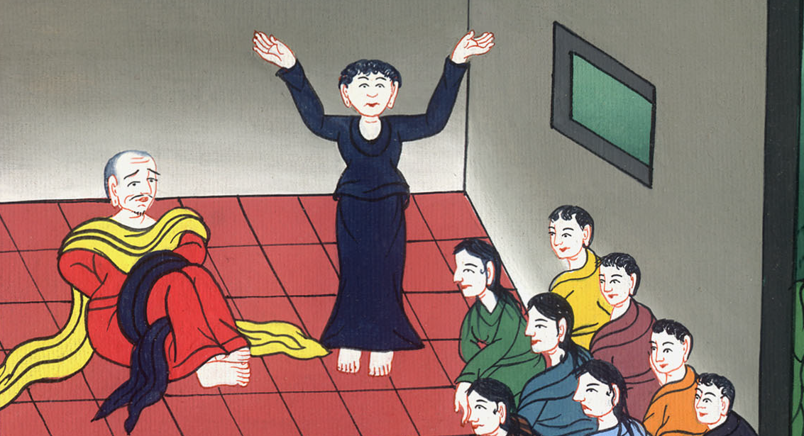
Acts 21:13

Slide 17
14When he would not be persuaded, we ceased, saying, “The Lord’s will be done.”

Slide 18
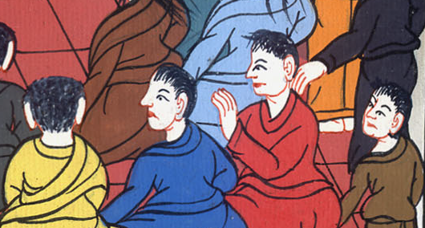
Acts 21:14

Slide 19
15After these days we took up our baggage and went up to Jerusalem.

Slide 20
Acts 21:15

