Slide 1
55-1
This work is licensed under a Creative Commons Attribution-ShareAlike 4.0 International License.
Please add this statement to all the videos you create.
English Bible quotes are from the World English Bible US, which is in the public domain.

Slide 2
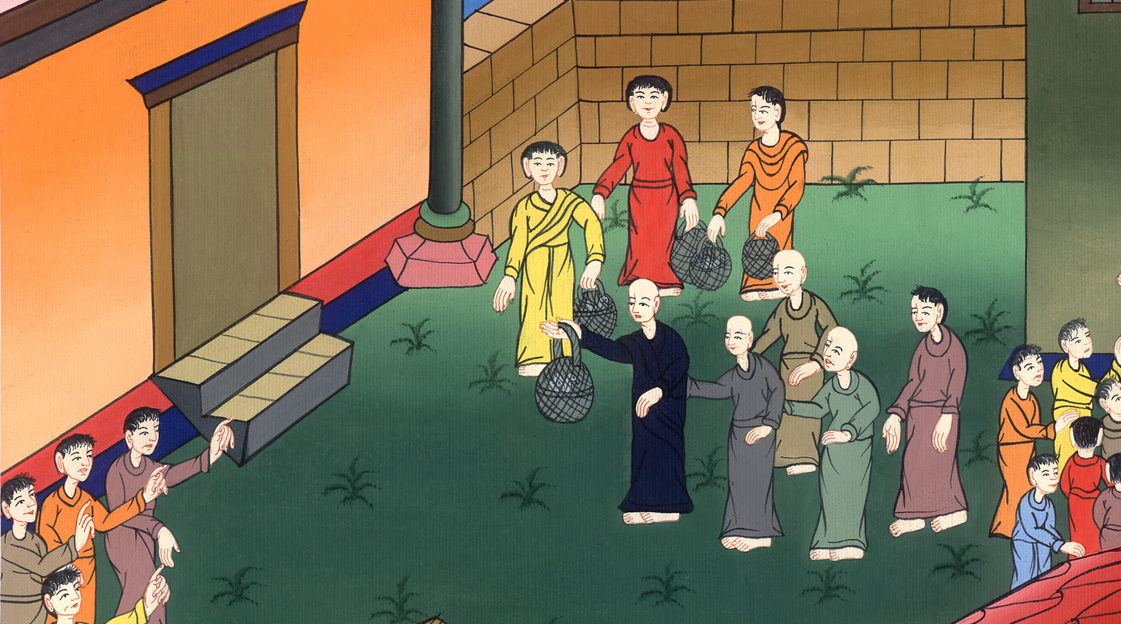
Paul purifies himself –
Acts 21:17-30

Slide 3
55 Paul’s Arrest and Trials
Paul purifies himself – Acts 21:17-30

Slide 4
Paul purifies himself –
Acts 21:17-30

Slide 5
17When we had come to Jerusalem, the brothers received us gladly.

Slide 6
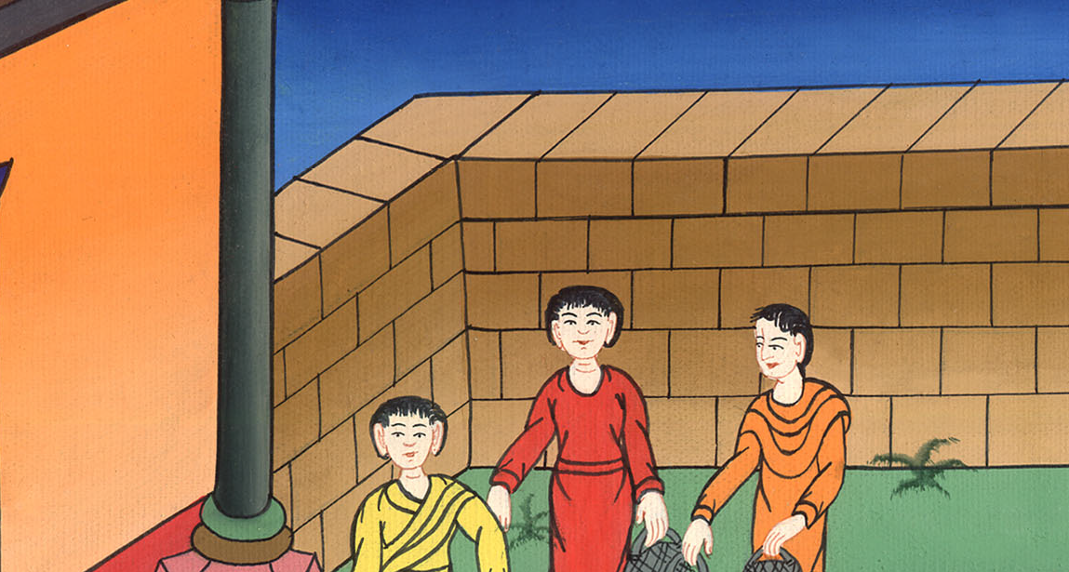
Acts 21:17

Slide 7
The next day we met with the elders19When he had greeted them, he reported one by one the things which God had worked among the Gentiles through his ministry.

Slide 8
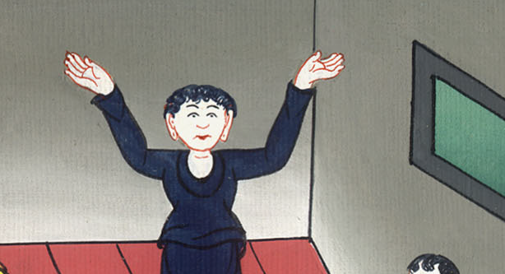
Acts 21:19

Slide 9
20They, when they heard it, glorified God. They said to him, “You see, brother, how many thousands there are among the Jews of those who have believed, and they are all zealous for the law.

Slide 10
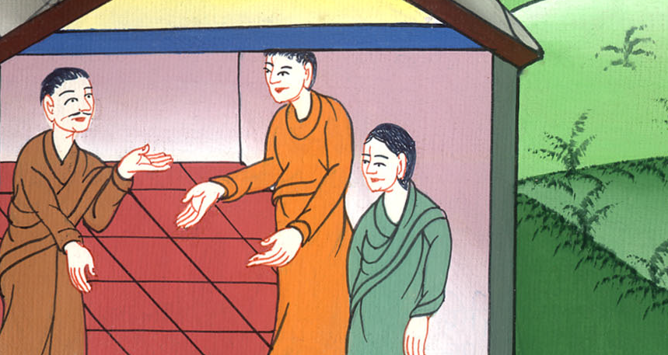
Acts 21:20

Slide 11
21They have been informed about you, that you teach all the Jews who are among the Gentiles to forsake Moses,

Slide 12
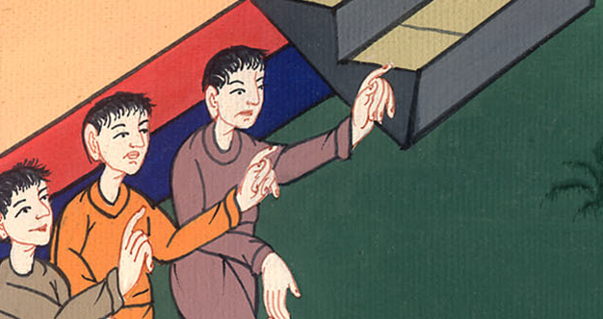
Acts 21:21

Slide 13
They think that you tell them not to circumcise their children and not to walk after the customs.

Slide 14
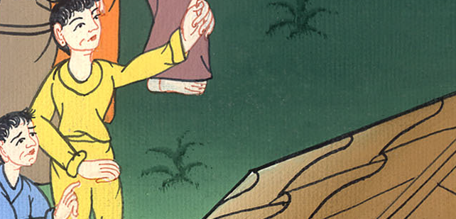
Acts 21:21

Slide 15
22What then? The assembly must certainly meet, for they will hear that you have come. 23Therefore do what we tell you. We have four men who have taken a vow.

Slide 16
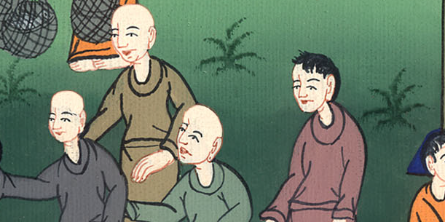
Acts 21:22,23

Slide 17
24Take them and purify yourself with them, and pay their expenses for them, that they may shave their heads.

Slide 18
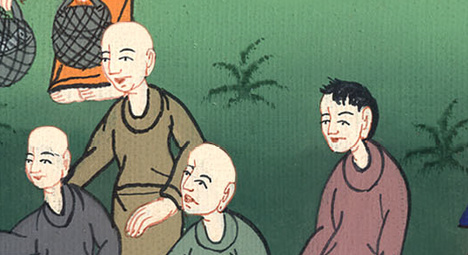
Acts 21:24

Slide 19
Then all will know that there is no truth in the things that they have been informed about you, but that you yourself also walk keeping the law.

Slide 20
Acts 21:24

Slide 21
26Then Paul took the men, and the next day purified himself and went with them into the temple, declaring the fulfillment of the days of purification, until the offering was offered for every one of them.

Slide 22
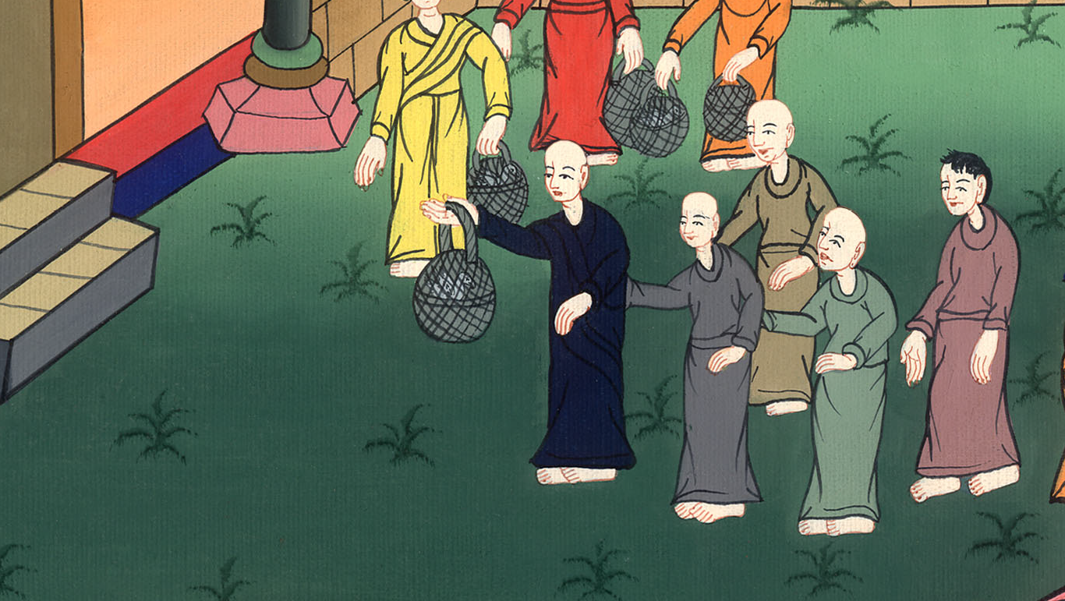
Acts 21:26

Slide 23
27When the seven days were almost completed, the Jews from Asia, when they saw him in the temple, stirred up all the multitude and laid hands on him.

Slide 24
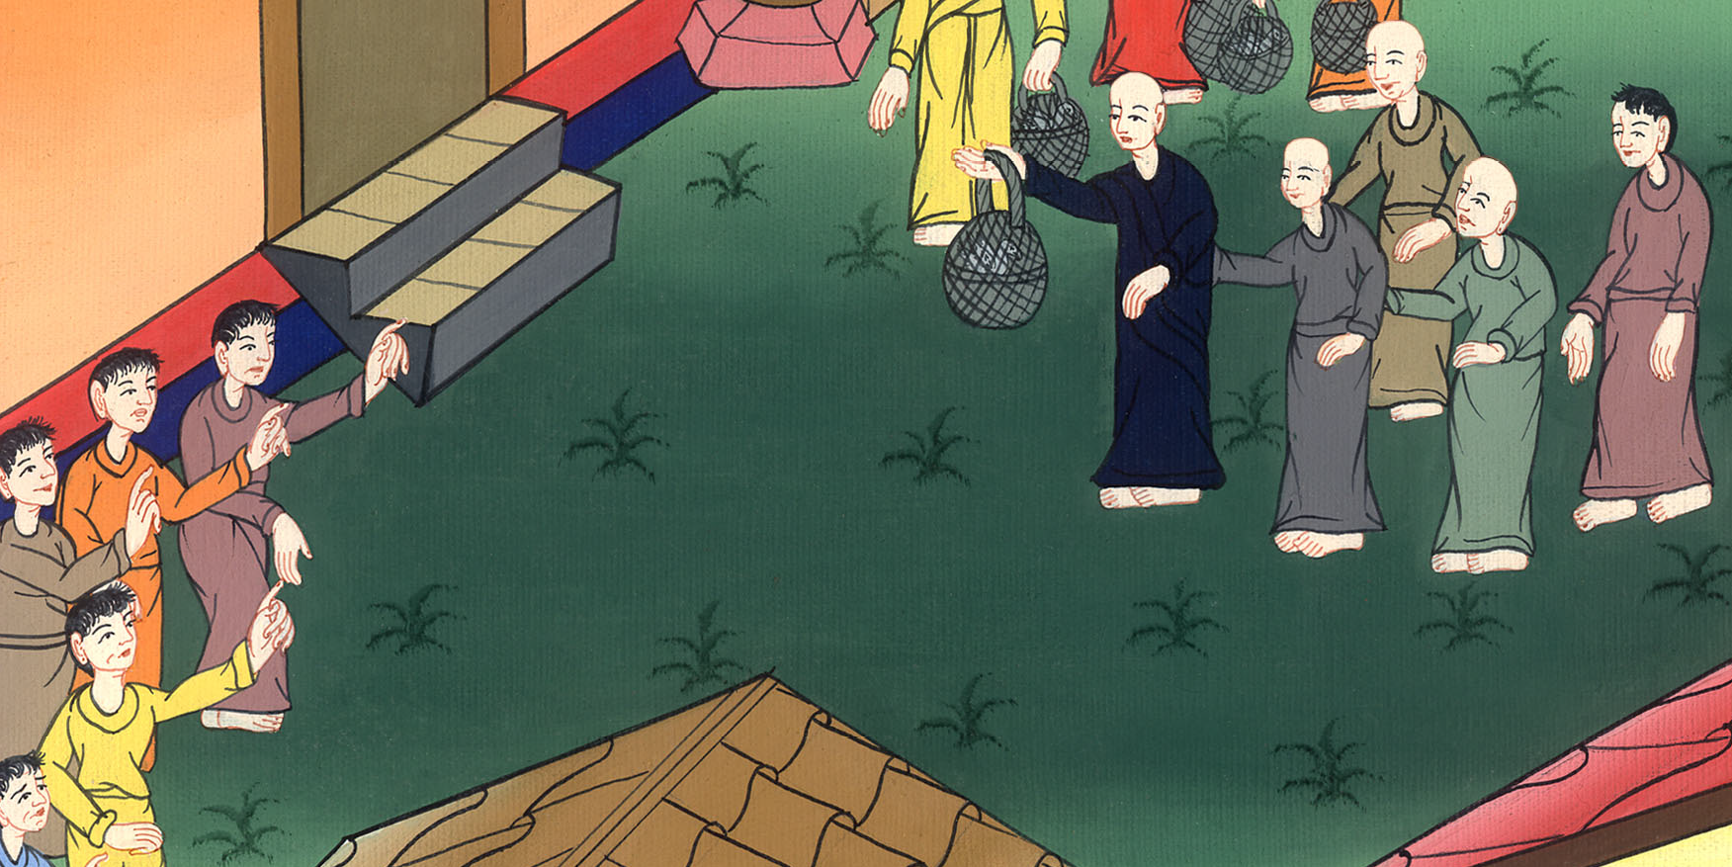
Acts 21:27

Slide 25
28They cried out, “Men of Israel, help! This is the man who teaches all men everywhere against the people, and the law, and this place.

Slide 26
Acts 21:28

Slide 27
Moreover, he also brought Greeks into the temple and has defiled this holy place!”

Slide 28
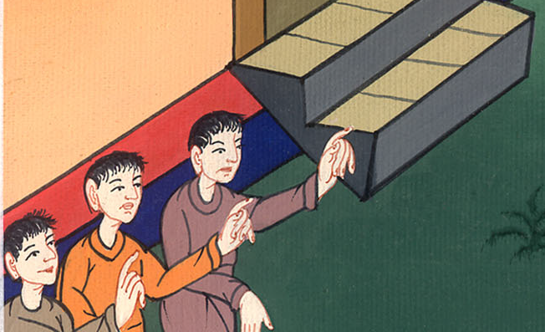
Acts 21:28

Slide 29
29For they had seen Trophimus the Ephesian, with him in the city, and they supposed that Paul had brought him into the temple.

Slide 30
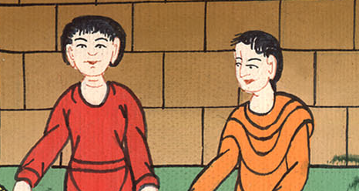
Acts 21:29

Slide 31
30All the city was moved and the people ran together. They seized Paul and dragged him out of the temple. Immediately the doors were shut.

Slide 32
Acts 21:30

