Slide 1
55-2
This work is licensed under a Creative Commons Attribution-ShareAlike 4.0 International License.
Please add this statement to all the videos you create.
English Bible quotes are from the World English Bible US, which is in the public domain.
Notes:
Ch
55 Paul’s Arrest and Trials
1. Paul purifies himself – Acts 21:17-30 (Left Top)
2. Paul captured – Acts 21:31 – 22:29 (Center Top)
3. Paul before the Jewish Council – Acts 22:30 – 23:10 (Right Top)
4. God encourages Paul – Acts 23:11 (Right 2nd)
5. Conspiracy to kill Paul – Acts 23:12-22 (Right 3rd)
6. Paul escorted out of Jerusalem – Acts 23:23-35 (Bottom)
7. Paul before Felix – Acts 24:1-27 (Left near Bottom)
8. Paul before Festus – Acts 25:1-12 (Left Center)
9. Paul before Agrippa and Bernice – Acts 25:13 – 26:32 (Center)

Slide 2
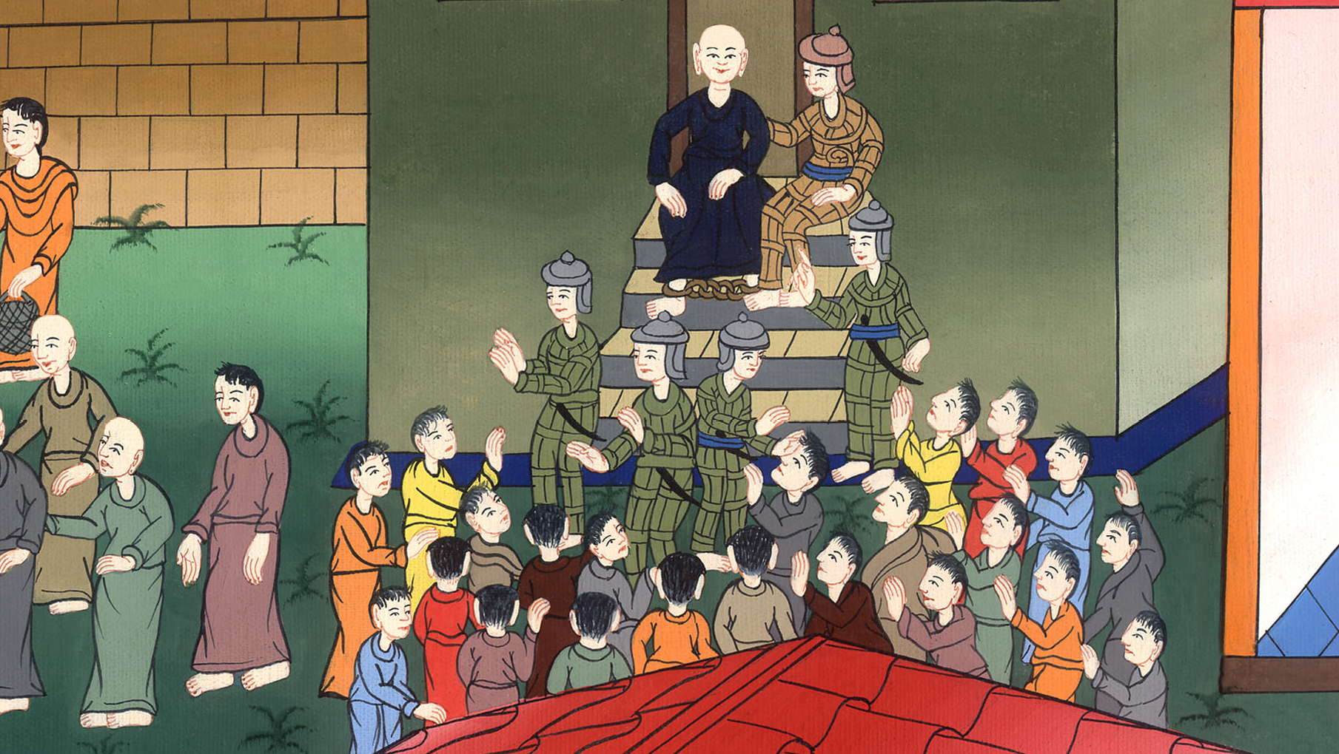
Paul captured – Acts 21:31-40

Slide 3
Paul captured – Acts 21:31-40

Slide 4
Paul captured – Acts 21:31-40

Slide 5
31As the people were trying to kill Paul, news came up to the commanding officer of the regiment that all Jerusalem was in an uproar.

Slide 6
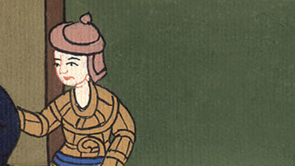
Acts 21:31

Slide 7
32Immediately he took soldiers and centurions and ran down to them. They, when they saw the chief captain and the soldiers, stopped beating Paul.

Slide 8
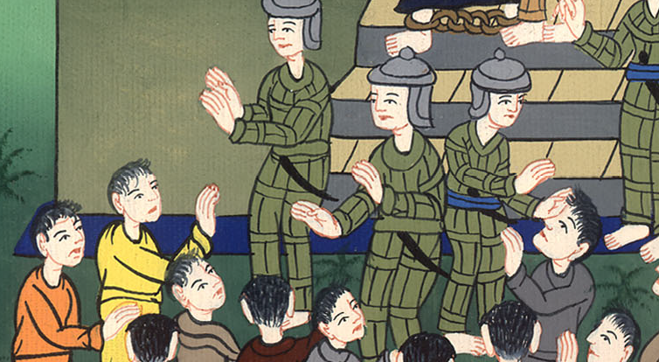
Acts 21:32

Slide 9
33Then the commanding officer came near, arrested him, commanded him to be bound with two chains, and inquired who he was and what he had done.

Slide 10
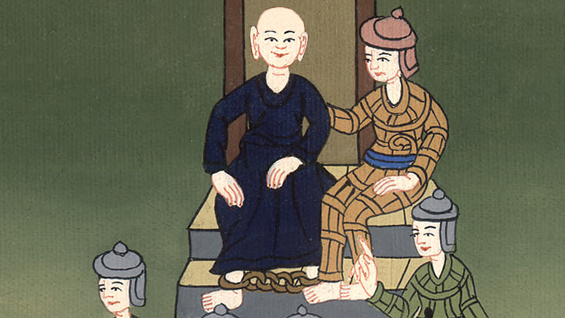
Acts 21:33

Slide 11
34Some shouted one thing and some another, among the crowd. When he couldn’t find out the truth because of the noise, he commanded him to be brought into the barracks.

Slide 12
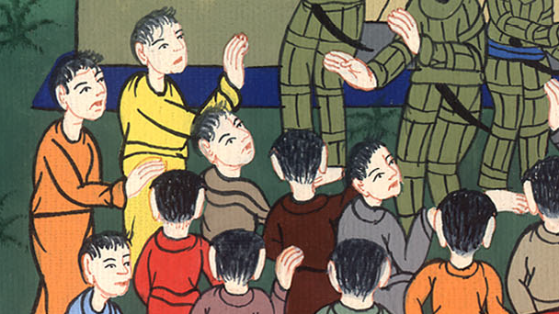
Acts 21:34

Slide 13
35When he came to the stairs, he was carried by the soldiers because of the violence of the crowd.

Slide 14
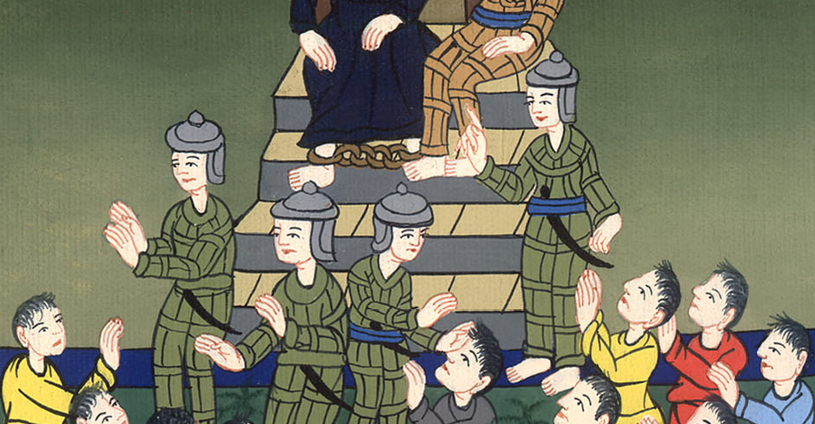
Acts 21:35

Slide 15
36The multitude of the people followed after, crying out, “Away with him!”

Slide 16
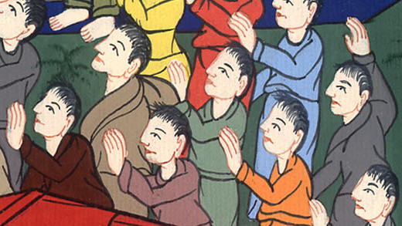
Acts 21:36

Slide 17
37As Paul was about to be brought into the barracks, he asked the commanding officer, “May I speak to you?”…

Slide 18
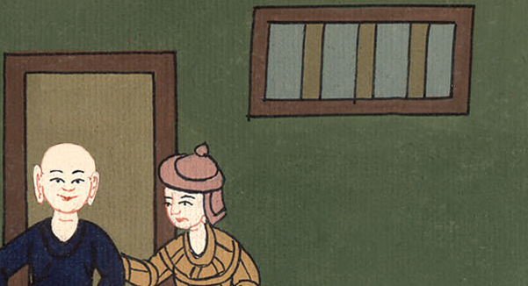
Acts 21:37

Slide 19
He said, “Do you know Greek? 38Aren’t you then the Egyptian who before these days stirred up to sedition and led out into the wilderness the four thousand men of the Assassins?”

Slide 20
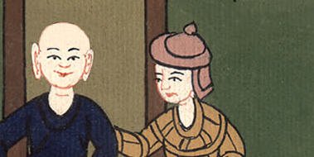
Acts 21:38

Slide 21
39But Paul said, “I am a Jew from Tarsus in Cilicia, a citizen of no insignificant city. I beg you, allow me to speak to the people.”

Slide 22
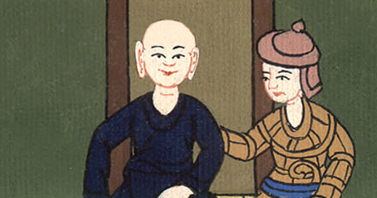
Acts 21:39

Slide 23
40When he had given him permission, Paul, standing on the stairs, beckoned with his hand to the people. When there was a great silence, he spoke to them in the Hebrew language.”

Slide 24
Acts 21:40

