Slide 1
55-3
This work is licensed under a Creative Commons Attribution-ShareAlike 4.0 International License.
Please add this statement to all the videos you create.
English Bible quotes are from the World English Bible US, which is in the public domain.
Notes:
ch

Slide 2
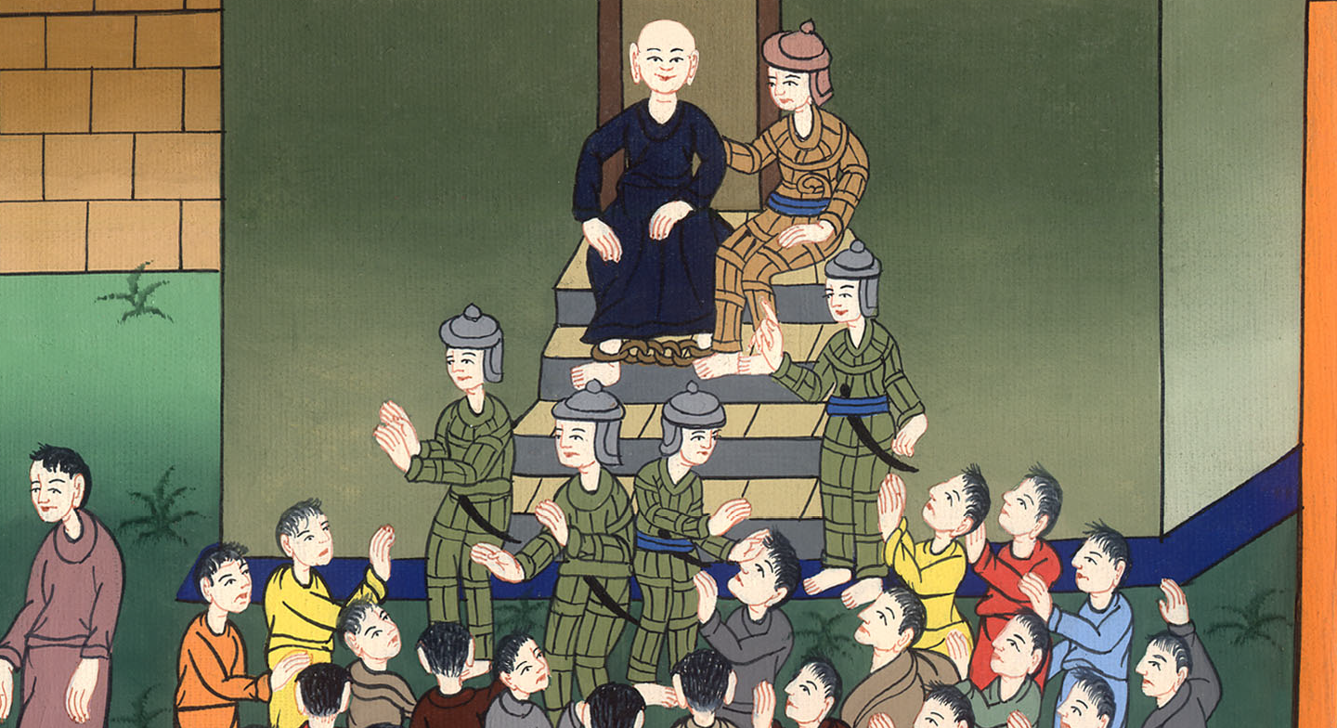
Paul Addresses the Crowd –
Acts 21:40 – 22:29

Slide 3
Paul Addresses the Crowd – Acts 21:40 – 22:29

Slide 4
Paul Addresses the Crowd –
Acts 21:40 – 22:29

Slide 5
40When the commander had given him permission to speak to the crowd, Paul, standing on the stairs, beckoned with his hand to the people. When there was a great silence, he spoke to them in the Hebrew language,

Slide 6
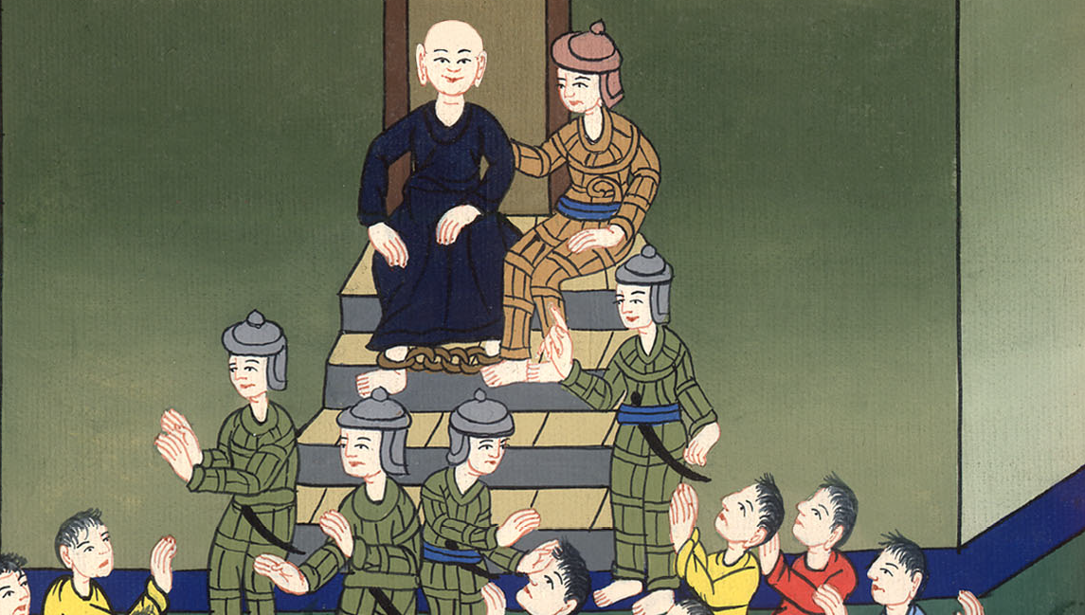
Acts 21:40

Slide 7
1“Brothers and fathers, listen to the defense which I now make to you.”
2When they heard that he spoke to them in the Hebrew language, they were even more quiet.

Slide 8
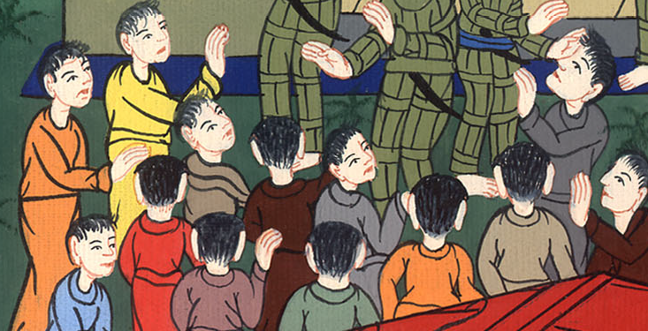
Acts 22:1,2

Slide 9
He said, 3“I am indeed a Jew, born in Tarsus of Cilicia, but brought up in this city at the feet of Gamaliel, instructed according to the strict tradition of the law of our fathers, being zealous for God, even as you all are today.

Slide 10
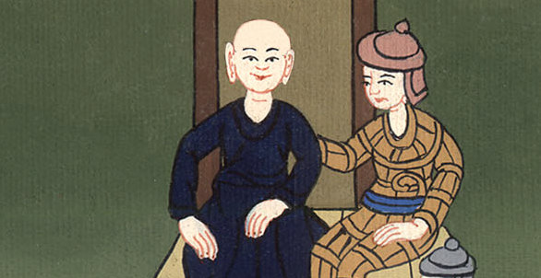
Acts 22:3

Slide 11
4I persecuted this Way to the death, binding and delivering into prisons both men and women,

Slide 12
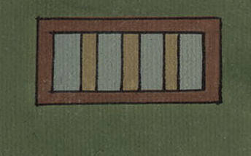
Acts 22:4

Slide 13
I traveled to Damascus to bring them also who were there to Jerusalem in bonds to be punished.6“As I made my journey and came close to Damascus, about noon suddenly a great light shone around me from the sky.

Slide 14
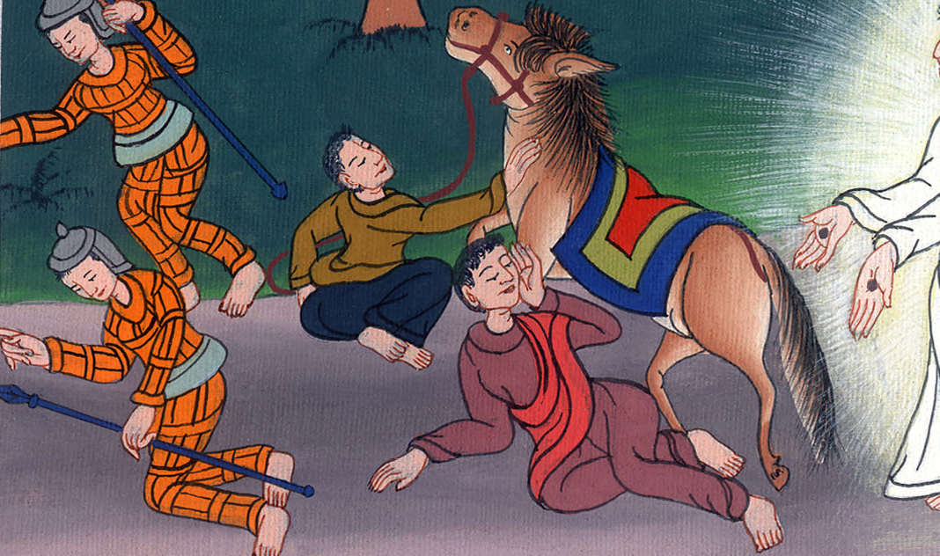
Acts 22:5,6

Slide 15
7I fell to the ground and heard a voice saying to me, ‘Saul, Saul, why are you persecuting me?’ 8I answered, ‘Who are you, Lord?’ He said to me, ‘I am Jesus of Nazareth, whom you persecute.’

Slide 16
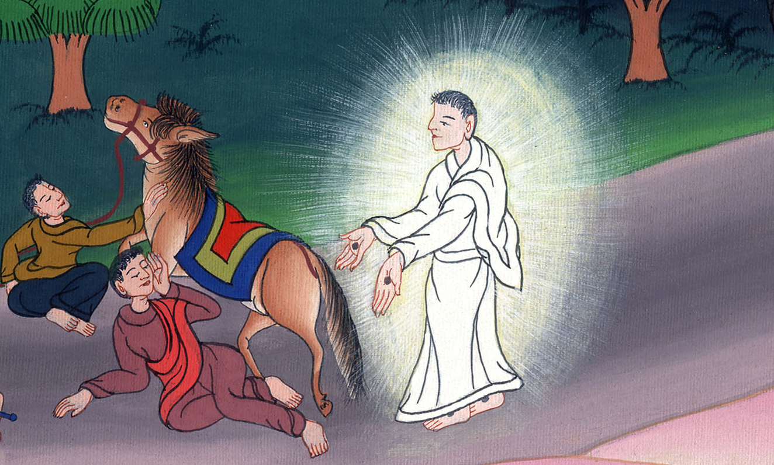
Acts 22:7,8

Slide 17
10I said, ‘What shall I do, Lord?’ The Lord said to me, ‘Arise, and go into Damascus. There you will be told about all things which are appointed for you to do.’ 11When I couldn’t see for the glory of that light, being led by the hand of those who were with me, I came into Damascus.

Slide 18
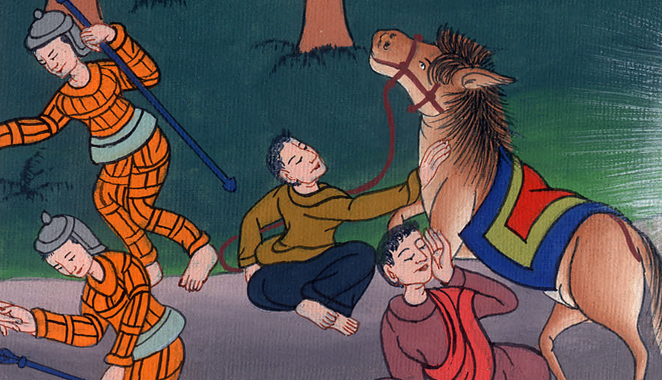
Acts 22:10,11
མཛད་པ། 22:

Slide 19
12“One Ananias, a devout man according to the law, well reported of by all the Jews who lived in Damascus, 13came to me.

Slide 20
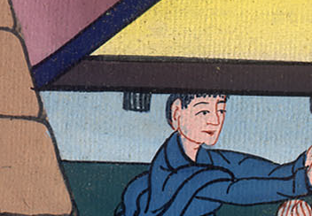
Acts 22:12

Slide 21
13He stood by me and said to me, ‘Brother Saul, receive your sight!’ In that very hour I looked up at him.

Slide 22
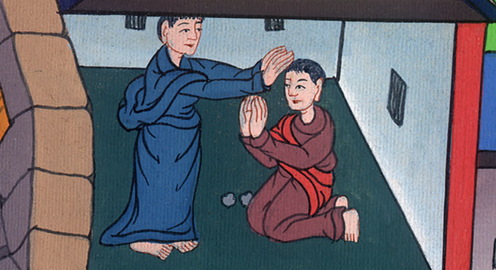
Acts 22:13

Slide 23
14He said, ‘The God of our fathers has appointed you to know his will, and to see the Righteous One, and to hear a voice from his mouth.

Slide 24
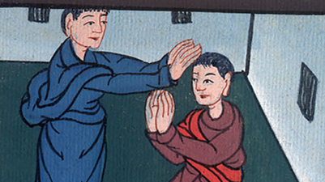
Acts 22:14

Slide 25
15For you will be a witness for him to all men of what you have seen and heard. 16Now why do you wait? Arise, be baptized, and wash away your sins, calling on the name of the Lord.’

Slide 26
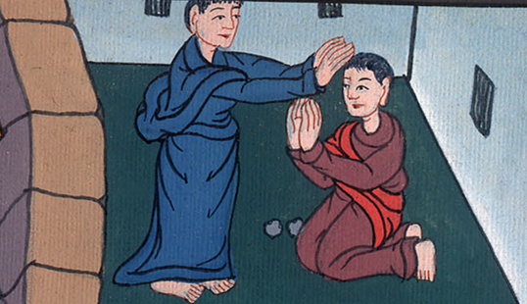
Acts 22:15,16

Slide 27
17“When I had returned to Jerusalem and while I prayed in the temple, I fell into a trance 18and saw him saying to me, ‘Hurry and get out of Jerusalem quickly, because they will not receive testimony concerning me from you.’

Slide 28
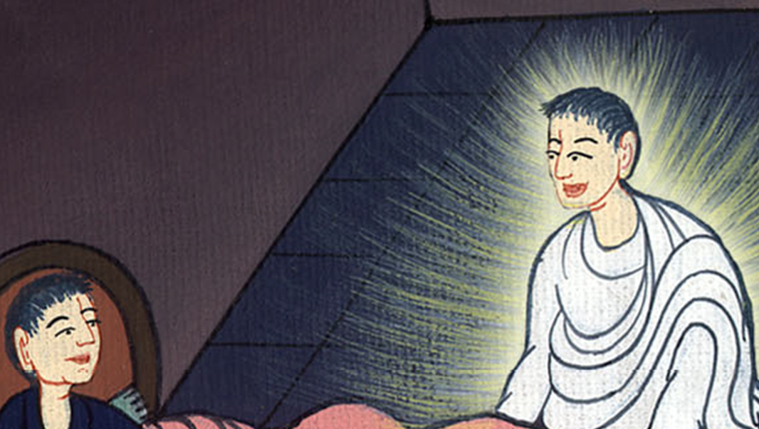
Acts 22:17,18

Slide 29
19I said, ‘Lord, they themselves know that I imprisoned and beat in every synagogue those who believed in you.

Slide 30
Acts 22:19

Slide 31
20When the blood of Stephen, your witness, was shed, I also was standing by, consenting to his death, and guarding the cloaks of those who killed him.’

Slide 32
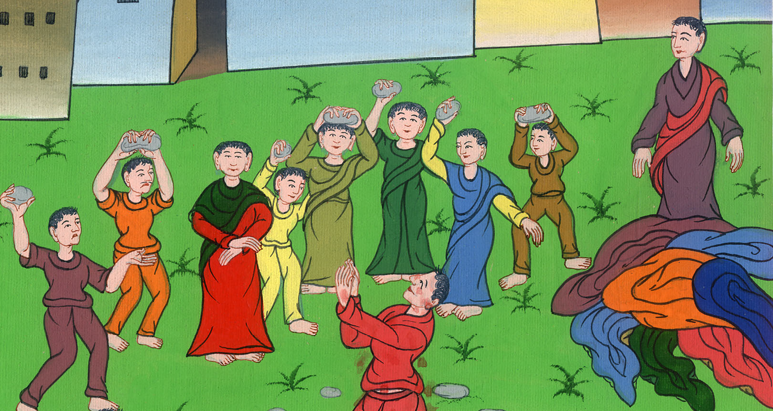
Acts 22:20

Slide 33
21“He said to me, ‘Depart, for I will send you out far from here to the Gentiles.’ ”
22They listened to him until he said that; then they lifted up their voice and said, “Rid the earth of this fellow, for he isn’t fit to live!”

Slide 34
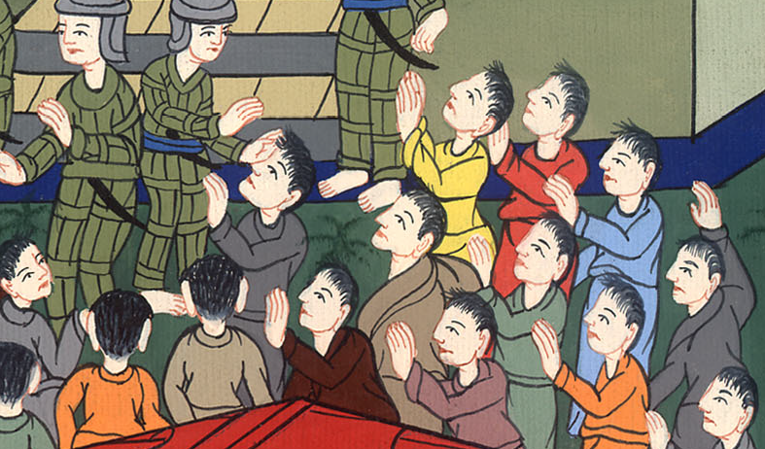
Acts 22:21,22

Slide 35
24The commanding officer commanded him to be brought into the barracks, ordering him to be examined by scourging, that he might know for what crime they shouted against him like that.

Slide 36
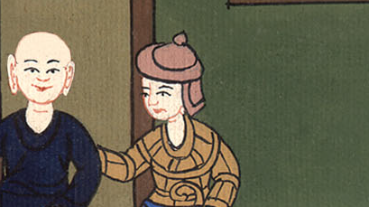
Acts 22:24

Slide 37
25When they had tied him up with thongs, Paul asked the centurion who stood by, “Is it lawful for you to scourge a man who is a Roman, and not found guilty?”

Slide 38
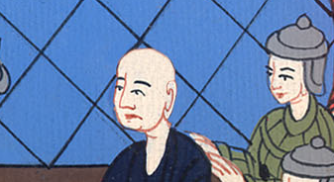
Acts 22:25

Slide 39
26When the centurion heard it, he went to the commanding officer and told him, “Watch what you are about to do, for this man is a Roman!”

Slide 40
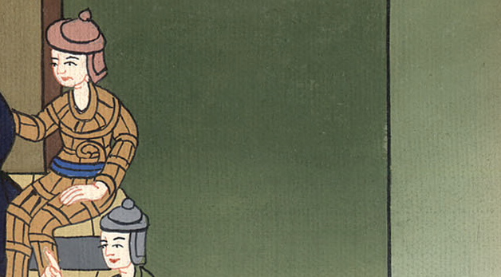
Acts 22:26

Slide 41
27The commanding officer came and asked him, “Tell me, are you a Roman?”
He said, “Yes.”

Slide 42
Acts 22:27

Slide 43
28The commanding officer answered, “I bought my citizenship for a great price.”
Paul said, “But I was born a Roman.”

Slide 44
Acts 22:28

Slide 45
29Immediately those who were about to examine him departed from him, and the commanding officer also was afraid when he realized that he was a Roman, because he had bound him.

Slide 46
Acts 22:29

