Slide 1
55-4
This work is licensed under a Creative Commons Attribution-ShareAlike 4.0 International License.
Please add this statement to all the videos you create.
English Bible quotes are from the World English Bible US, which is in the public domain.
Notes:
Ch
55 Paul’s Arrest and Trials
1. Paul purifies himself – Acts 21:17-30 (Left Top)
2. Paul captured – Acts 21:31 – 22:29 (Center Top)
3. Paul before the Jewish Council – Acts 22:30 – 23:10 (Right Top)
4. God encourages Paul – Acts 23:11 (Right 2nd)
5. Conspiracy to kill Paul – Acts 23:12-22 (Right 3rd)
6. Paul escorted out of Jerusalem – Acts 23:23-35 (Bottom)
7. Paul before Felix – Acts 24:1-27 (Left near Bottom)
8. Paul before Festus – Acts 25:1-12 (Left Center)
9. Paul before Agrippa and Bernice – Acts 25:13 – 26:32 (Center)

Slide 2
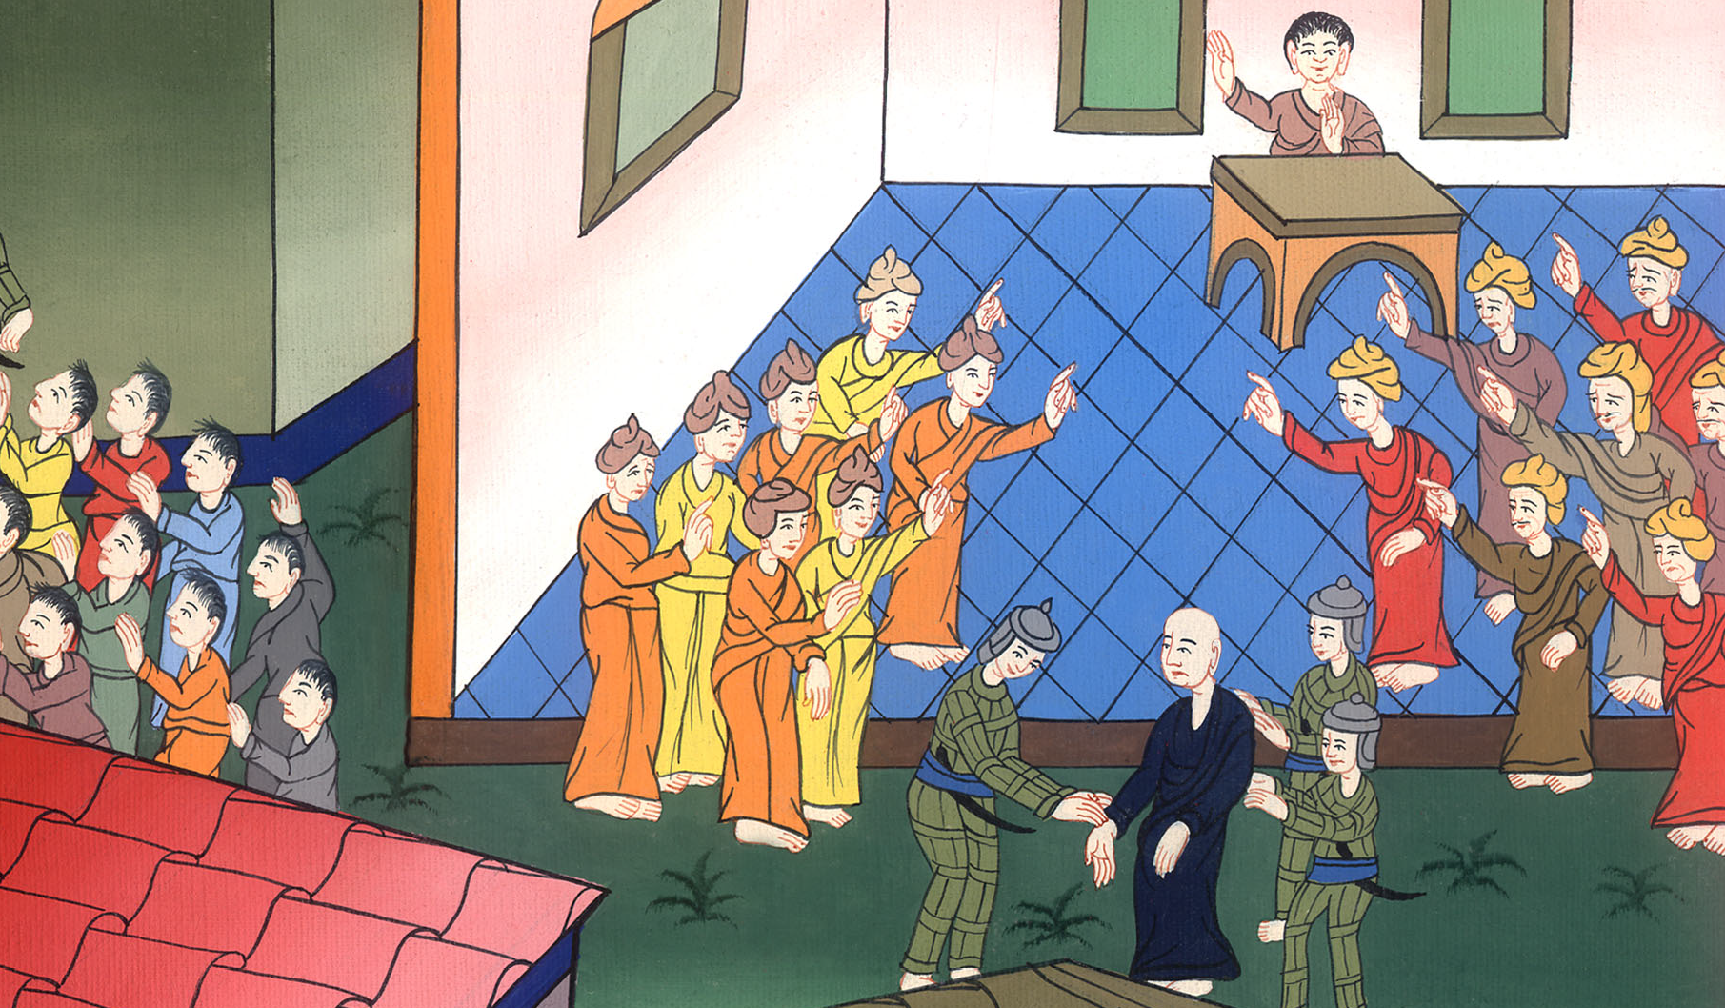
Paul before the Jewish Council – Acts 22:30 – 23:10

Slide 3
Paul before the Jewish Council – Acts 22:30 – 23:10

Slide 4
Paul before the Jewish Council – Acts 22:30 – 23:10

Slide 5
30But on the next day, desiring to know the truth about why he was accused by the Jews, he freed him from the bonds and commanded the chief priests and all the council to come together, and brought Paul down and set him before them.

Slide 6
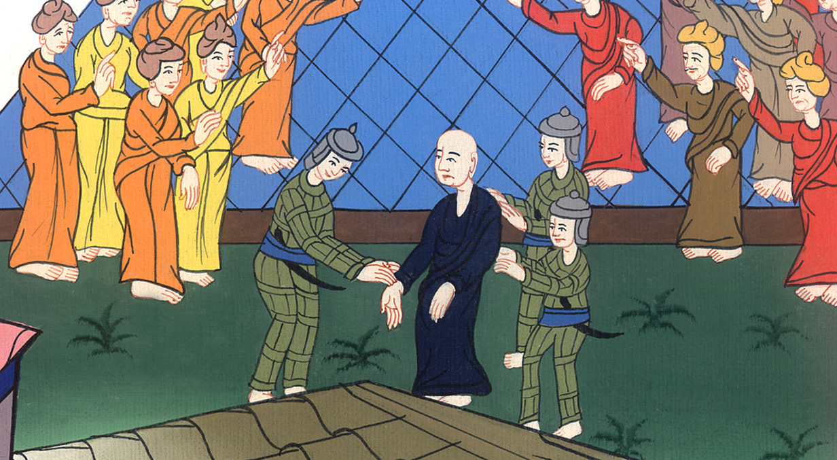
Acts 22:30

Slide 7
1Paul, looking steadfastly at the council, said, “Brothers, I have lived before God in all good conscience until today.”

Slide 8
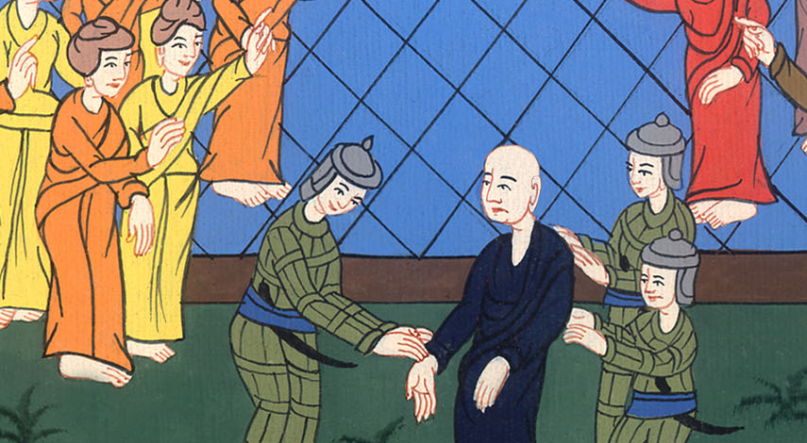
Acts 23:1

Slide 9
2The high priest, Ananias, commanded those who stood by him to strike him on the mouth.

Slide 10
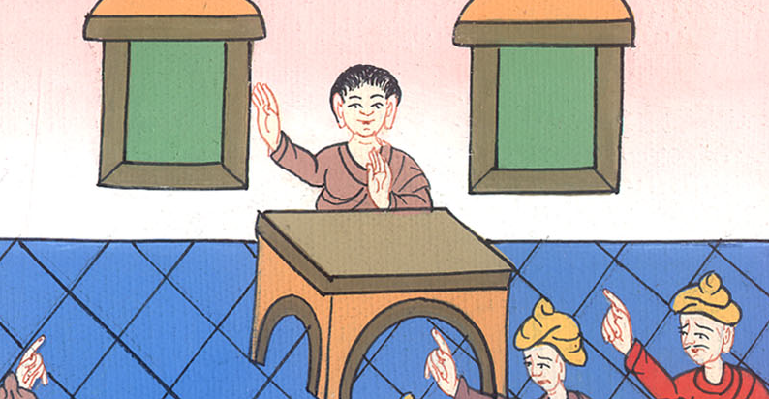
Acts 23:2

Slide 11
3Then Paul said to him, “God will strike you, you whitewashed wall! Do you sit to judge me according to the law, and command me to be struck contrary to the law?”

Slide 12
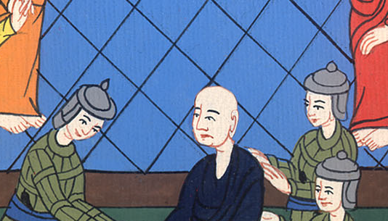
Acts 23:3

Slide 13
4Those who stood by said, “Do you malign God’s high priest?”

Slide 14
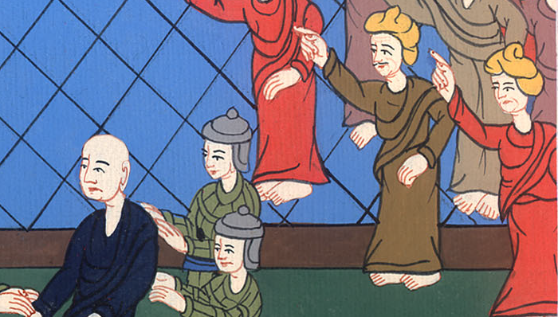
Acts 23:4

Slide 15
5Paul said, “I didn’t know, brothers, that he was high priest. For it is written, ‘You shall not speak evil of a ruler of your people.’”

Slide 16
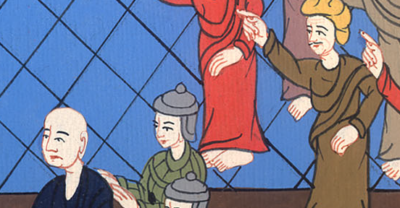
Acts 23:5

Slide 17
6But when Paul perceived that the one part were Sadducees and the other Pharisees, he cried out in the council, “Men and brothers, I am a Pharisee, a son of Pharisees. Concerning the hope and resurrection of the dead I am being judged!”

Slide 18
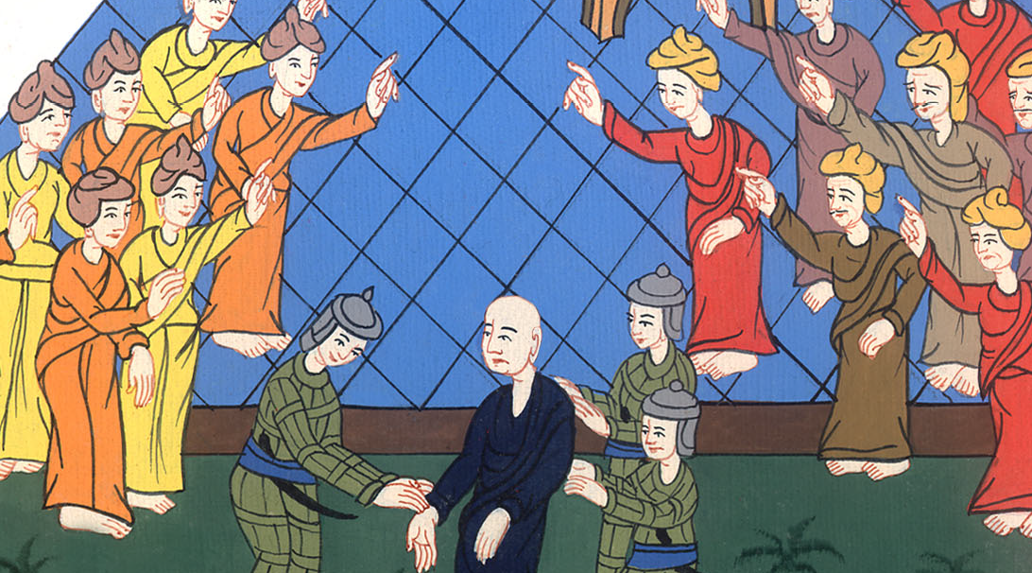
Acts 23:6

Slide 19
7When he had said this, an argument arose between the Pharisees and Sadducees, and the crowd was divided.

Slide 20
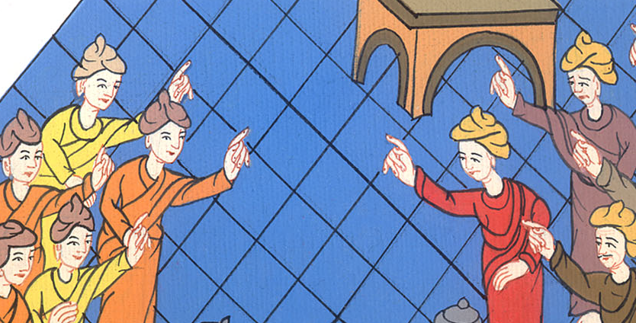
Acts 23:7

Slide 21
8For the Sadducees say that there is no resurrection, nor angel, nor spirit; but the Pharisees confess all of these.

Slide 22
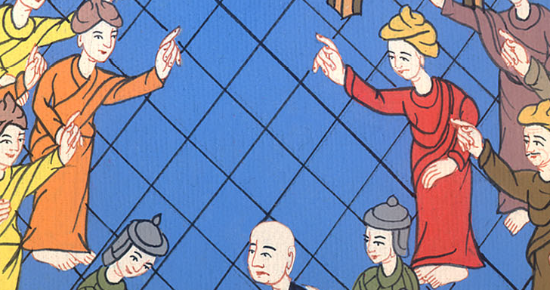
Acts 23:8

Slide 23
9A great clamor arose, and some of the scribes of the Pharisees’ part stood up, and contended, saying, “We find no evil in this man. But if a spirit or angel has spoken to him, let’s not fight against God!”

Slide 24
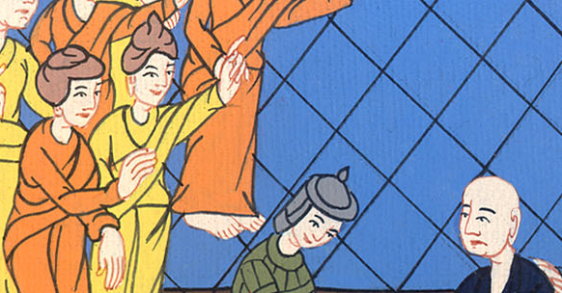
Acts 23:9

Slide 25
10When a great argument arose, the commanding officer, fearing that Paul would be torn in pieces by them, commanded the soldiers to go down and take him by force from among them and bring him into the barracks.

Slide 26
Acts 23:10

