Slide 1
55-5
This work is licensed under a Creative Commons Attribution-ShareAlike 4.0 International License.
Please add this statement to all the videos you create.
English Bible quotes are from the World English Bible US, which is in the public domain.

Slide 2
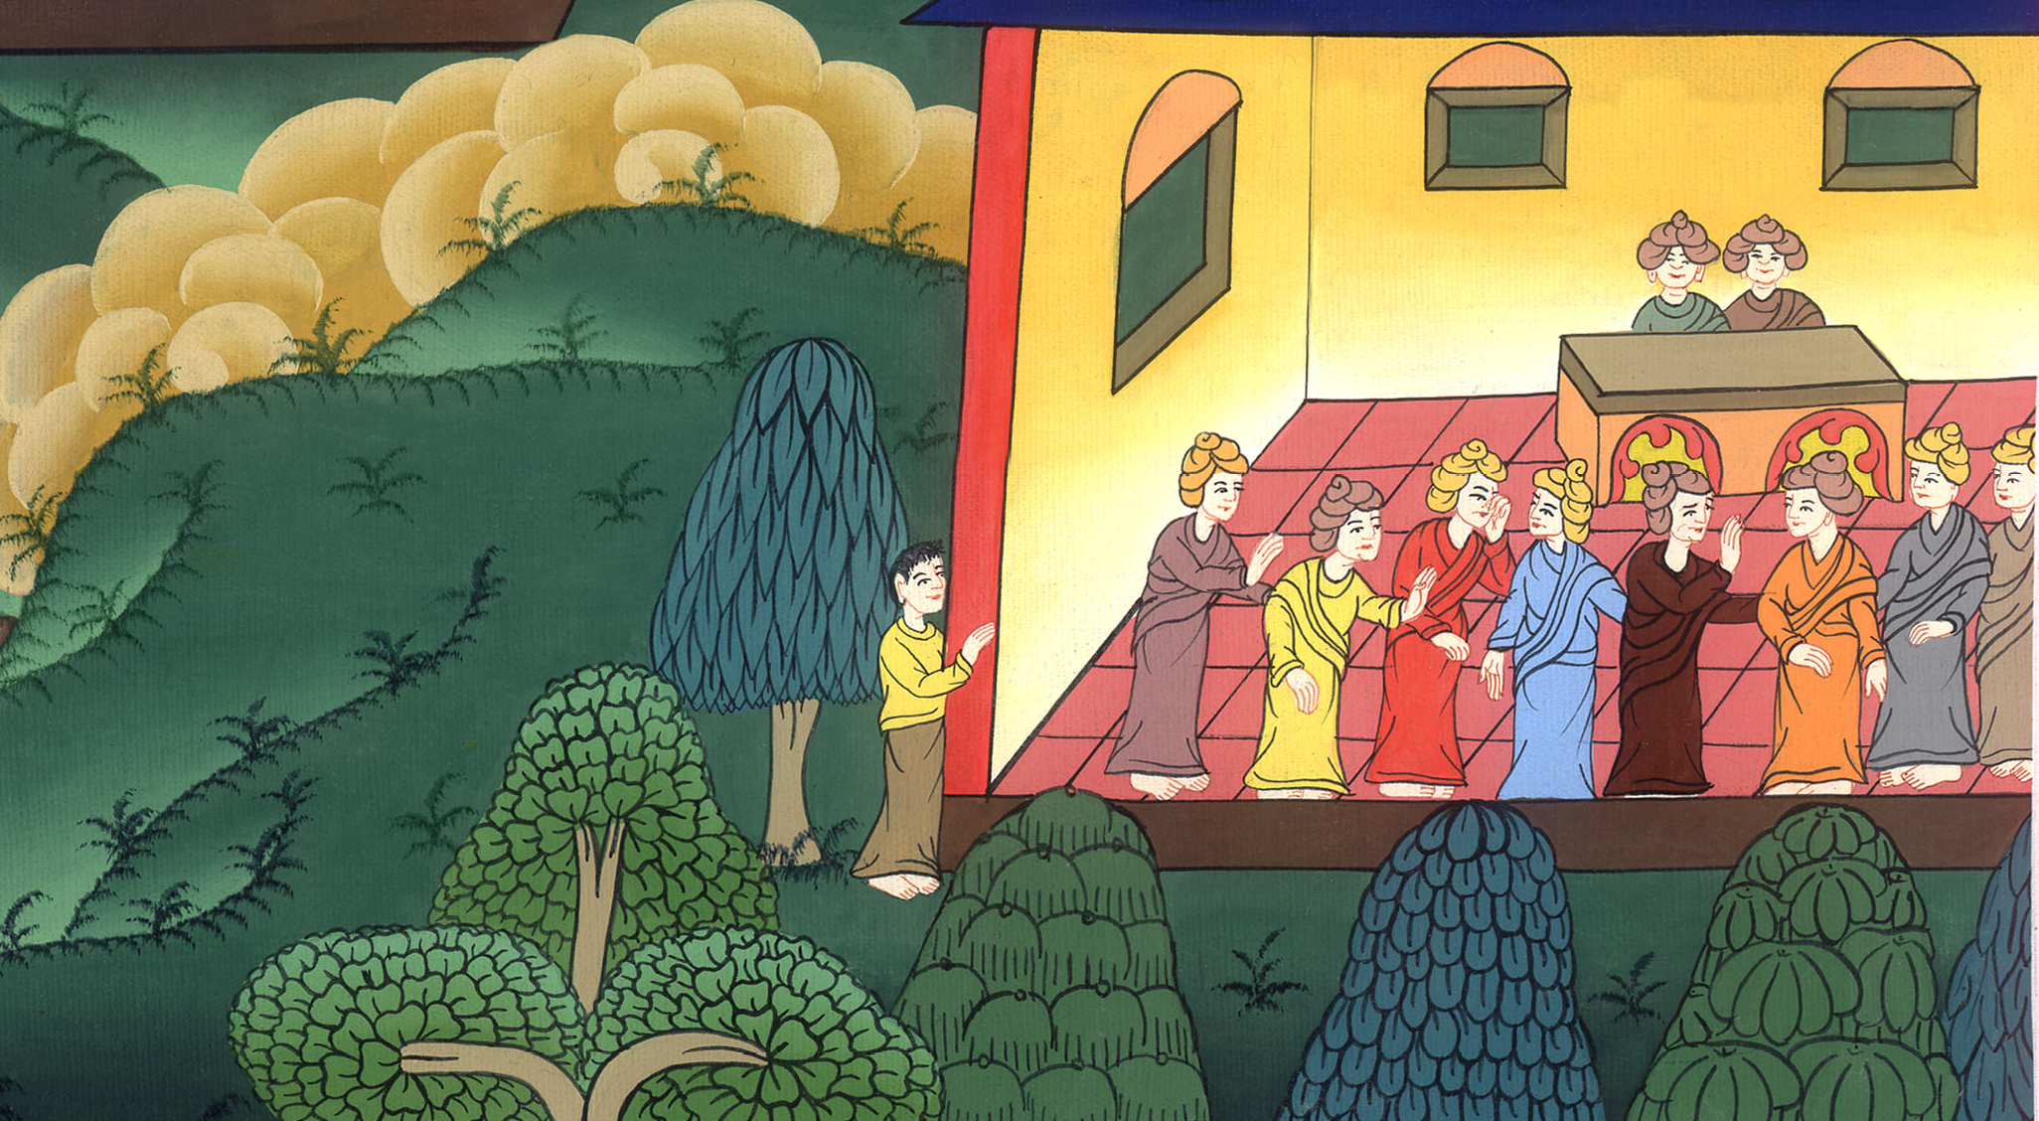
Conspiracy to kill Paul –
Acts 23:11-22

Slide 3
Conspiracy to kill Paul – Acts 23:11-22

Slide 4
Conspiracy to kill Paul –
Acts 23:11-22

Slide 5
11The following night, the Lord stood by him and said, “Cheer up, Paul, for as you have testified about me at Jerusalem, so you must testify also at Rome.”

Slide 6
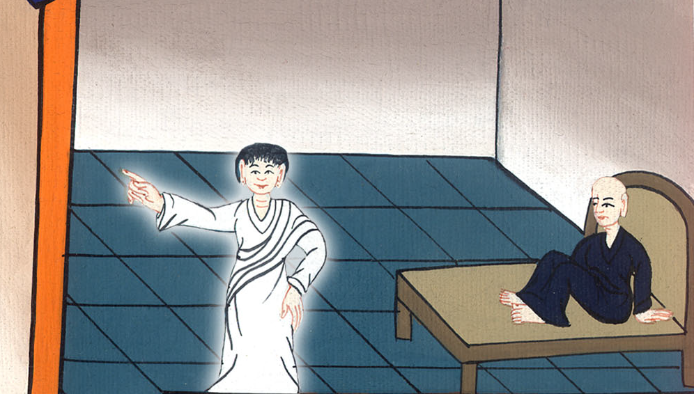
Acts 23:11

Slide 7
12When it was day, some of the Jews banded together and bound themselves under a curse, saying that they would neither eat nor drink until they had killed Paul.

Slide 8
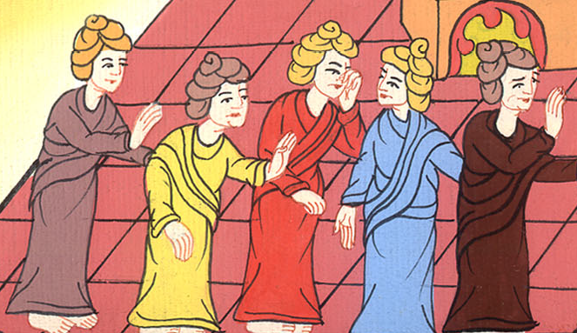
Acts 23:12

Slide 9
13There were more than forty people who had made this conspiracy. 14They came to the chief priests and the elders, and said, “We have bound ourselves under a great curse to taste nothing until we have killed Paul.

Slide 10
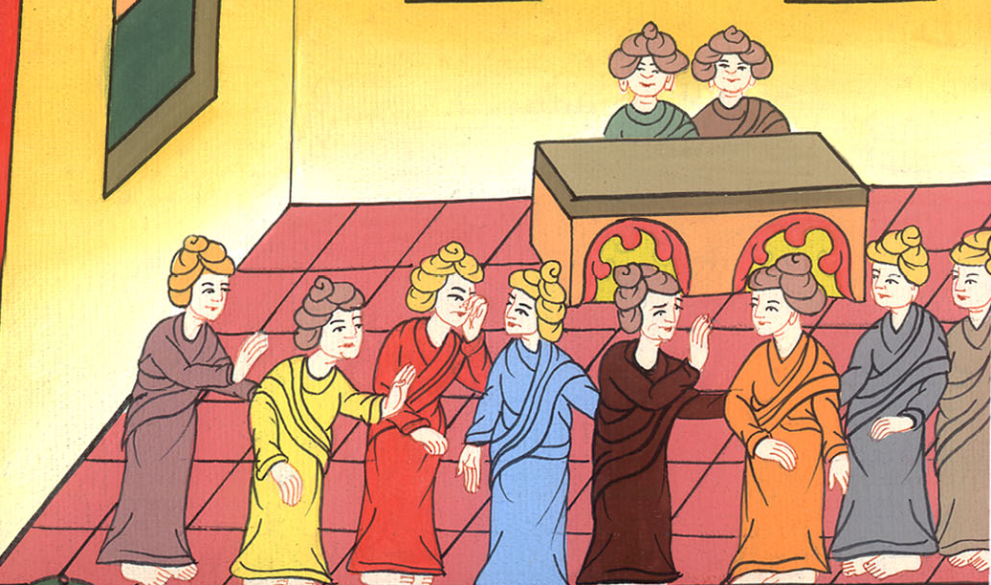
Acts 23:13,14

Slide 11
15Now therefore, you with the council inform the commanding officer that he should bring him down to you tomorrow, as though you were going to judge his case more exactly. We are ready to kill him before he comes near.”

Slide 12
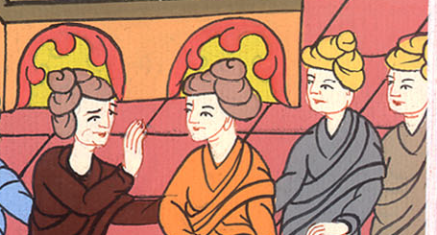
Acts 23:15

Slide 13
16But Paul’s sister’s son heard they were lying in wait, and he came and entered into the barracks and told Paul.

Slide 14
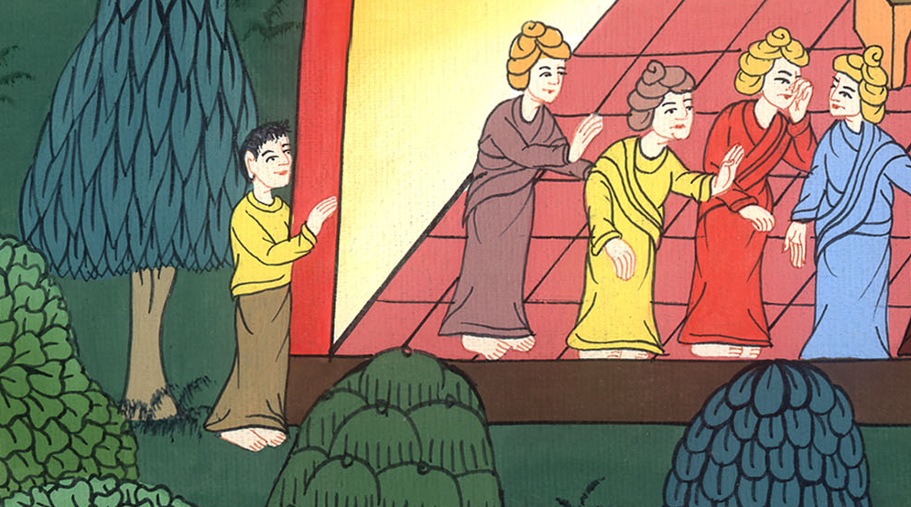
Acts 23:16

Slide 15
17Paul summoned one of the centurions and said, “Bring this young man to the commanding officer, for he has something to tell him.”

Slide 16
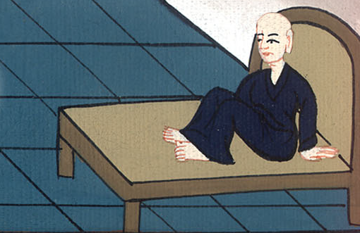
Acts 23:17

Slide 17
18So he took him and brought him to the commanding officer and said, “Paul, the prisoner, summoned me and asked me to bring this young man to you. He has something to tell you.”

Slide 18
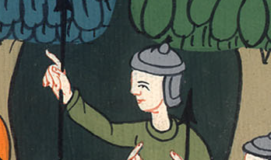
Acts 23:18

Slide 19
19The commanding officer took him by the hand, and going aside, asked him privately, “What is it that you have to tell me?”

Slide 20
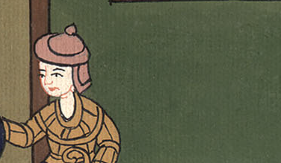
Acts 23:19

Slide 21
20He said, “The Jews have agreed to ask you to bring Paul down to the council tomorrow, as though intending to inquire somewhat more accurately concerning him.

Slide 22
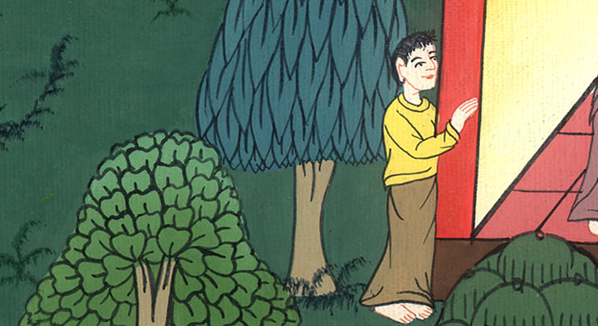
Acts 23:20

Slide 23
21Therefore don’t yield to them, for more than forty men lie in wait for him, who have bound themselves under a curse to neither eat nor drink until they have killed him. Now they are ready, looking for the promise from you.”

Slide 24
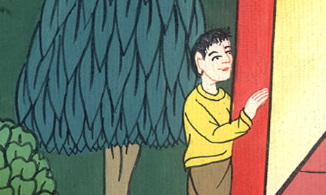
Acts 23:21

Slide 25
22So the commanding officer let the young man go, charging him, “Tell no one that you have revealed these things to me.”

Slide 26
Acts 23:22

