Slide 1
55-6
This work is licensed under a Creative Commons Attribution-ShareAlike 4.0 International License.
Please add this statement to all the videos you create.
English Bible quotes are from the World English Bible US, which is in the public domain.
Notes:
Ch
55 Paul’s Arrest and Trials
1. Paul purifies himself – Acts 21:17-30 (Left Top)
2. Paul captured – Acts 21:31 – 22:29 (Center Top)
3. Paul before the Jewish Council – Acts 22:30 – 23:10 (Right Top)
4. God encourages Paul – Acts 23:11 (Right 2nd)
5. Conspiracy to kill Paul – Acts 23:12-22 (Right 3rd)
6. Paul escorted out of Jerusalem – Acts 23:23-35 (Bottom)
7. Paul before Felix – Acts 24:1-27 (Left near Bottom)
8. Paul before Festus – Acts 25:1-12 (Left Center)
9. Paul before Agrippa and Bernice – Acts 25:13 – 26:32 (Center)

Slide 2
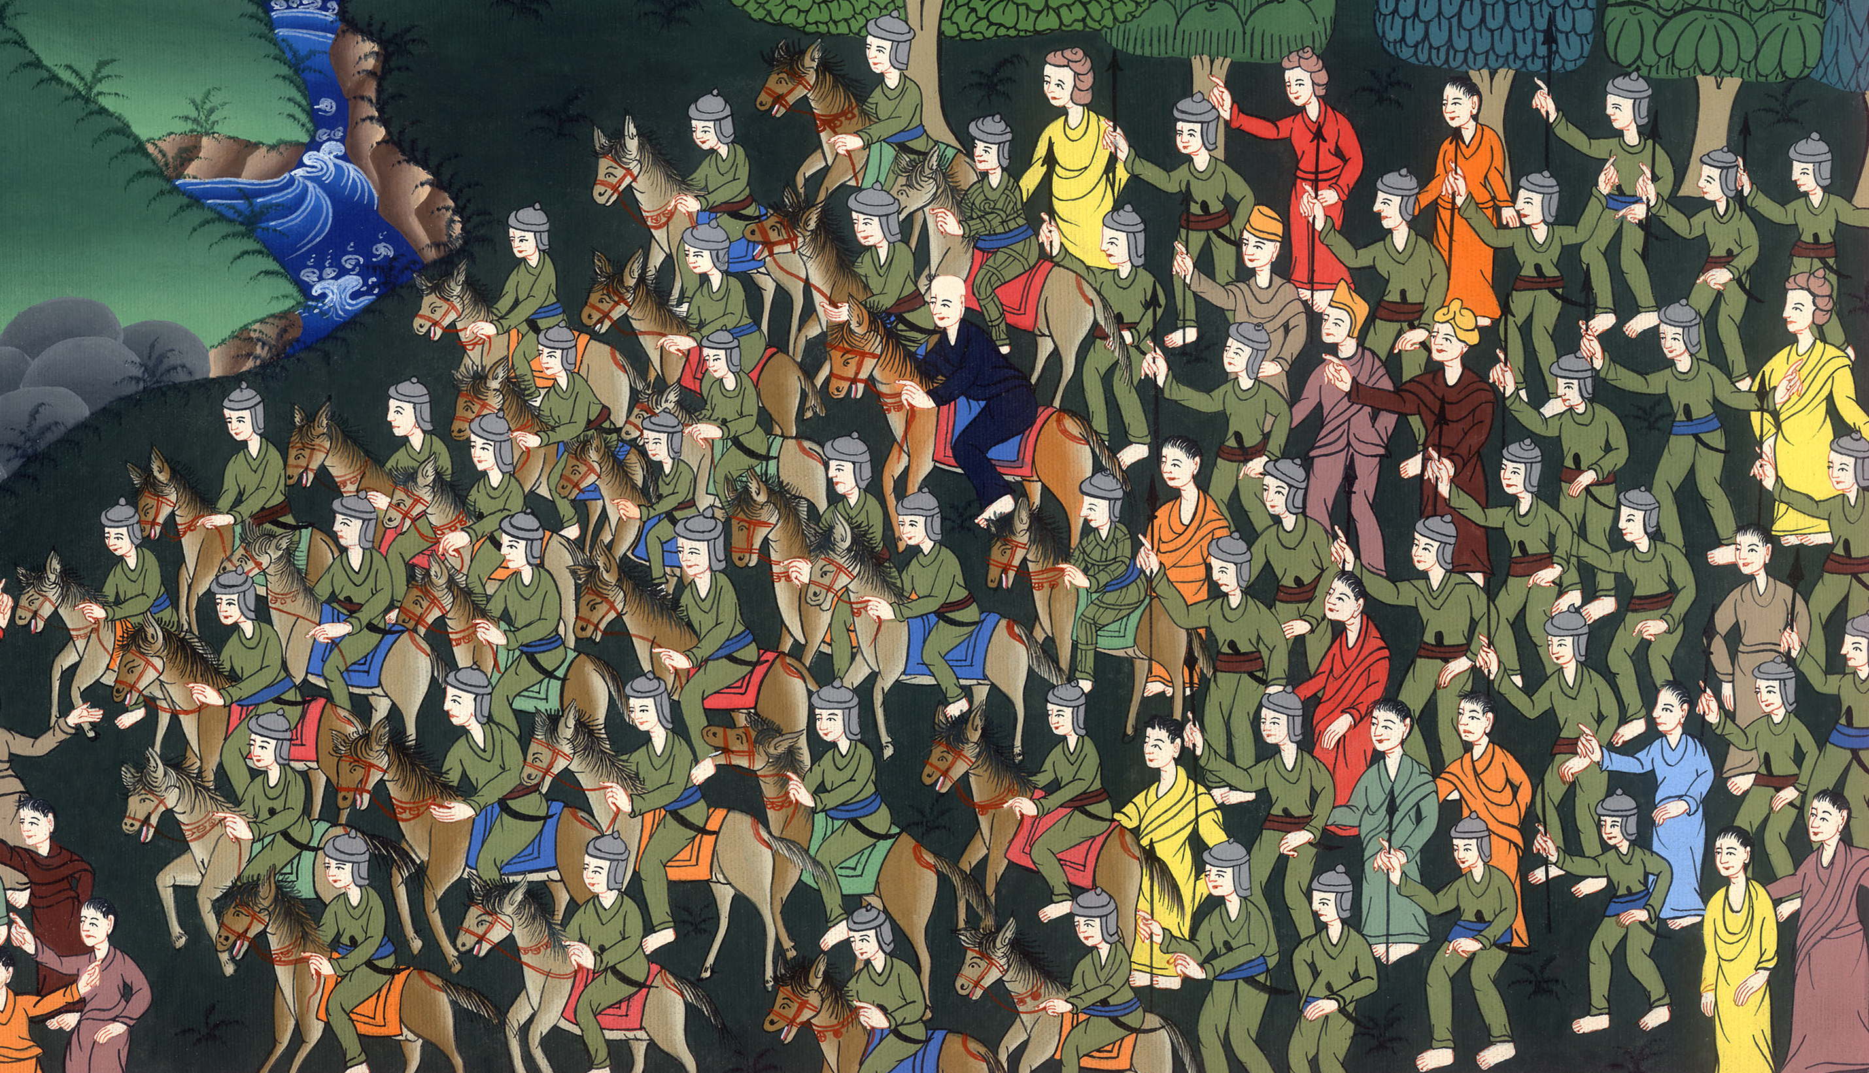
Paul escorted out of Jerusalem – Acts 23:23-35

Slide 3
Paul escorted out of Jerusalem – Acts 23:23-35

Slide 4
Paul escorted out of Jerusalem – Acts 23:23-35

Slide 5
Paul’s nephew had warned the commanding officer that there was a plan to kill Paul.

Slide 7
23The commanding officer called to himself two of the centurions, and said, “Prepare two hundred soldiers to go as far as Caesarea, with seventy horsemen and two hundred men armed with spears, at the third hour of the night.”

Slide 8
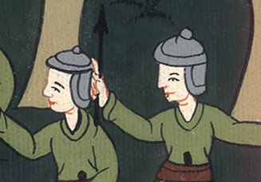
Acts 23:23

Slide 9
24He asked them to provide mounts, that they might set Paul on one, and bring him safely to Felix the governor.

Slide 10
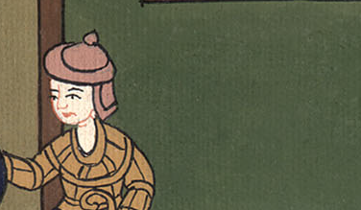
Acts 23:24

Slide 11
25He wrote a letter like this:
26“Claudius Lysias to the most excellent governor Felix: Greetings.

Slide 12
Acts 23:25,26

Slide 13
27“This man was seized by the Jews, and was about to be killed by them when I came with the soldiers and rescued him, having learned that he was a Roman.

Slide 14
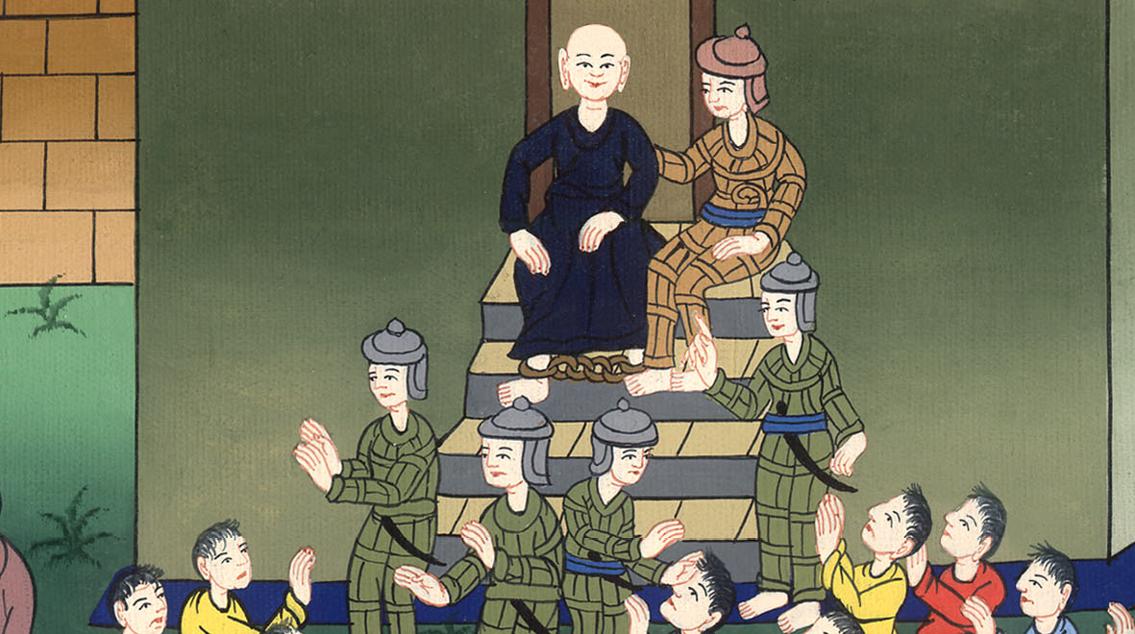
Acts 23:27

Slide 15
28Desiring to know the cause why they accused him, I brought him down to their council.

Slide 16
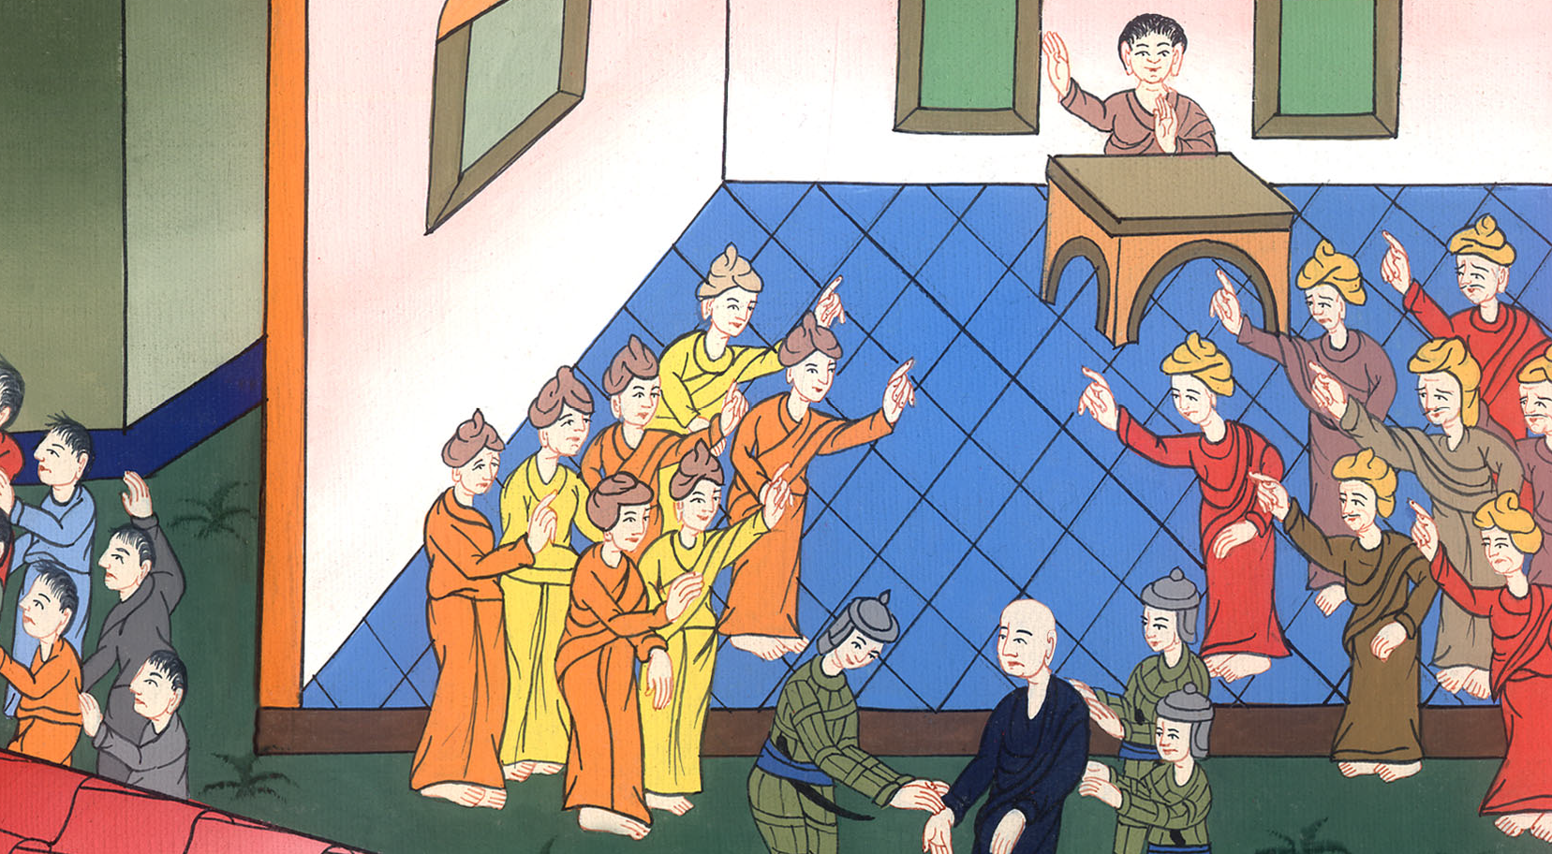
Acts 23:28

Slide 17
29I found him to be accused about questions of their law, but not to be charged with anything worthy of death or of imprisonment.

Slide 18
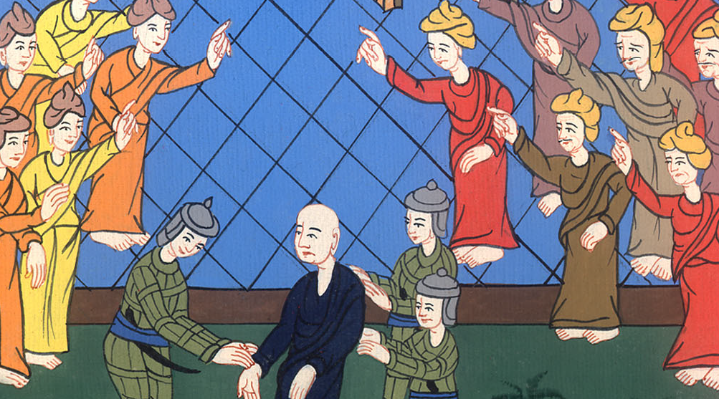
Acts 23:29

Slide 19
30When I was told that the Jews lay in wait for the man, I sent him to you immediately, charging his accusers also to bring their accusations against him before you. Farewell.”

Slide 20
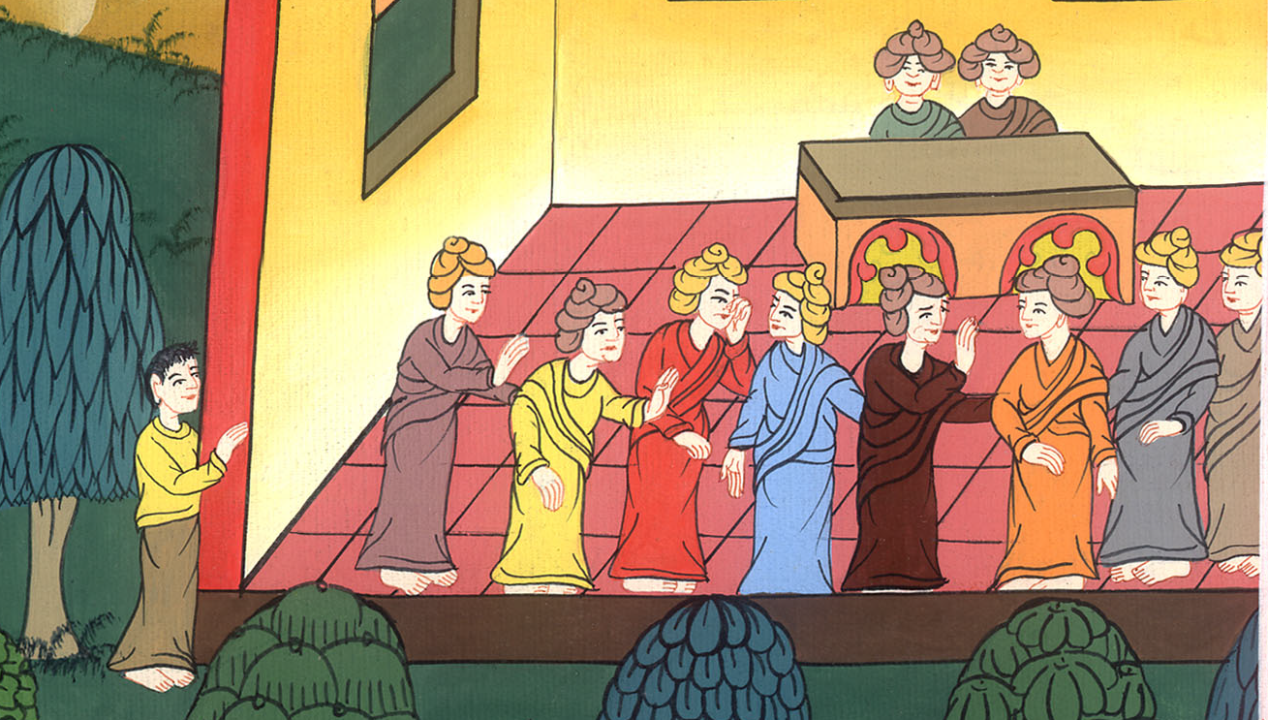
Acts 23:30

Slide 21
31So the soldiers, carrying out their orders, took Paul and brought him by night to Antipatris.

Slide 22
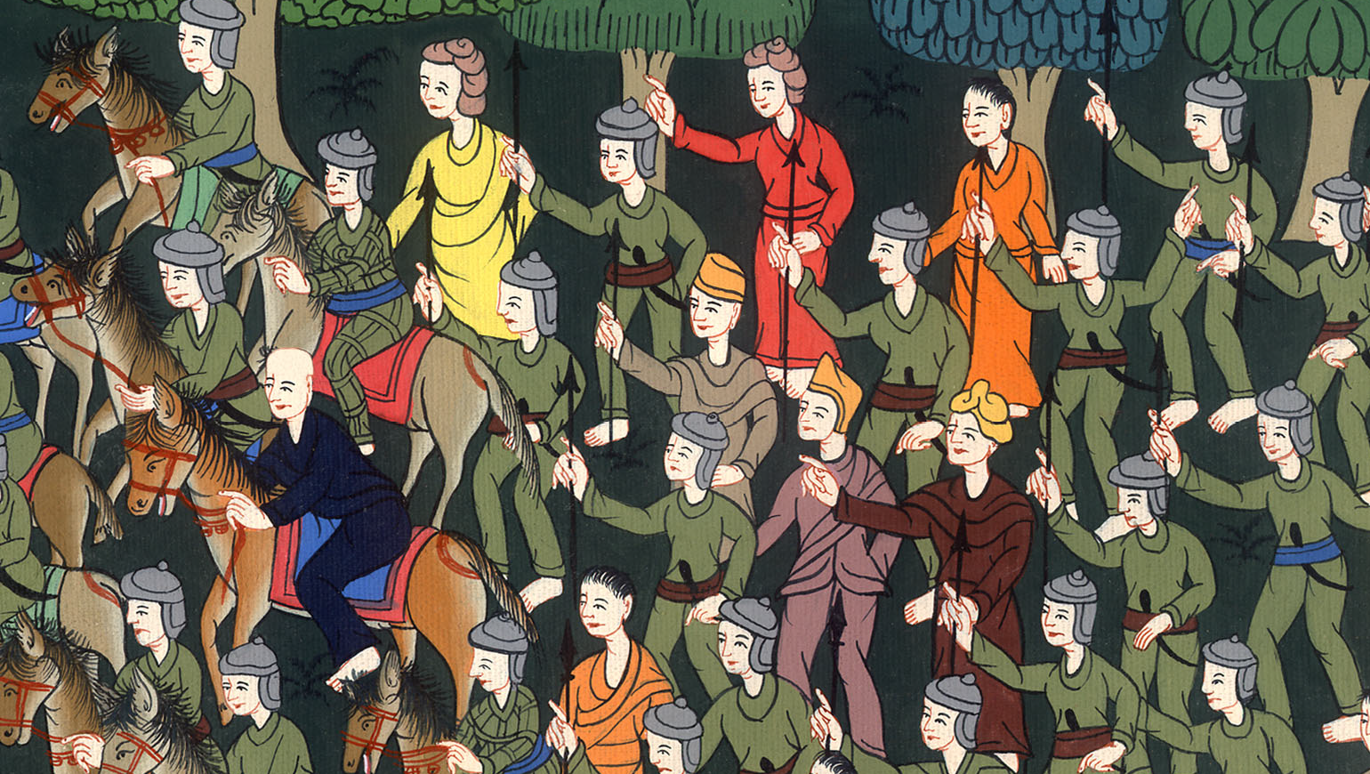
Acts 23:31

Slide 23
32But on the next day they left the horsemen to go with him, and returned to the barracks.

Slide 24
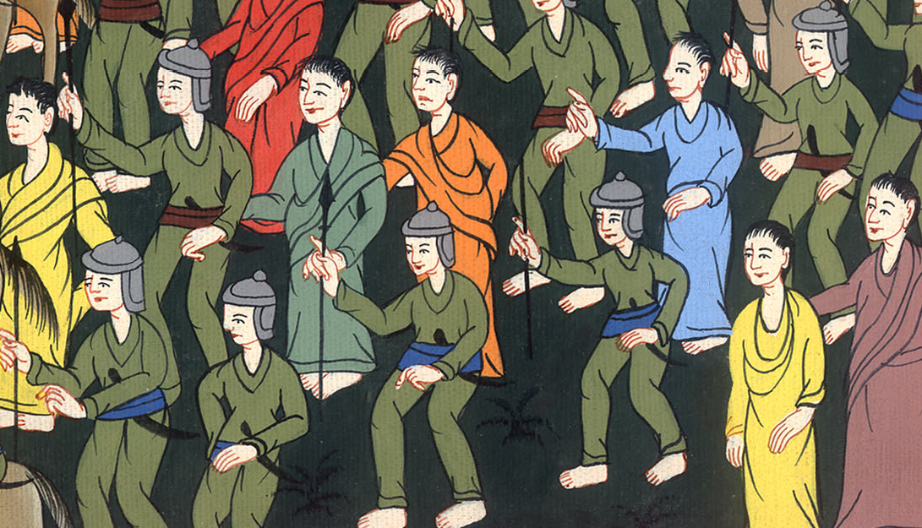
Acts 23:32

Slide 25
33When they came to Caesarea and delivered the letter to the governor, they also presented Paul to him.

Slide 26
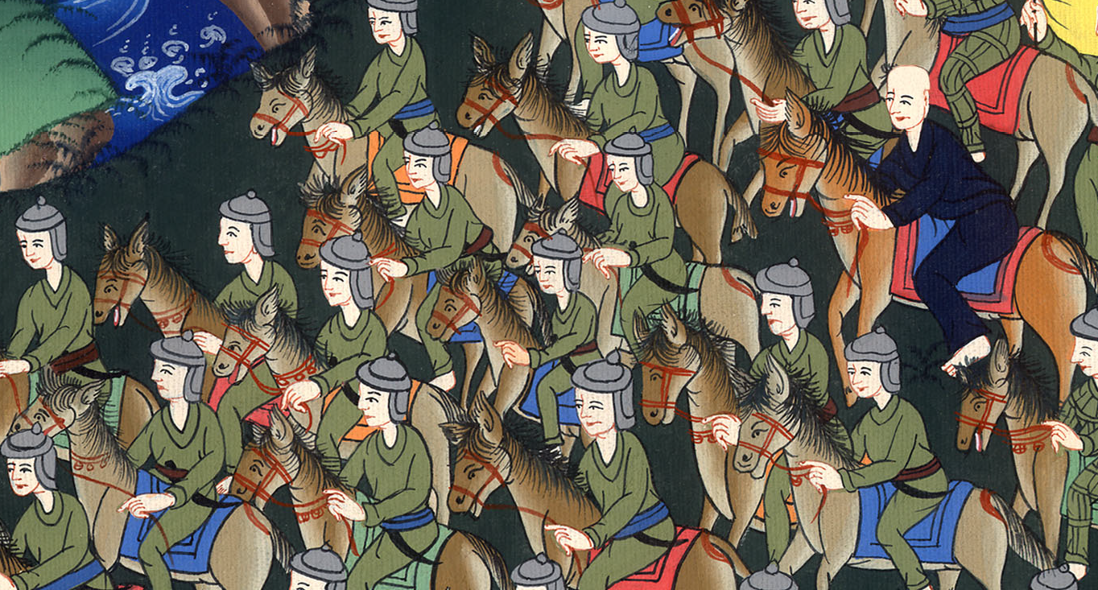
Acts 23:33

Slide 27
34When the governor had read it, he asked what province he was from. When he understood that he was from Cilicia.

Slide 28
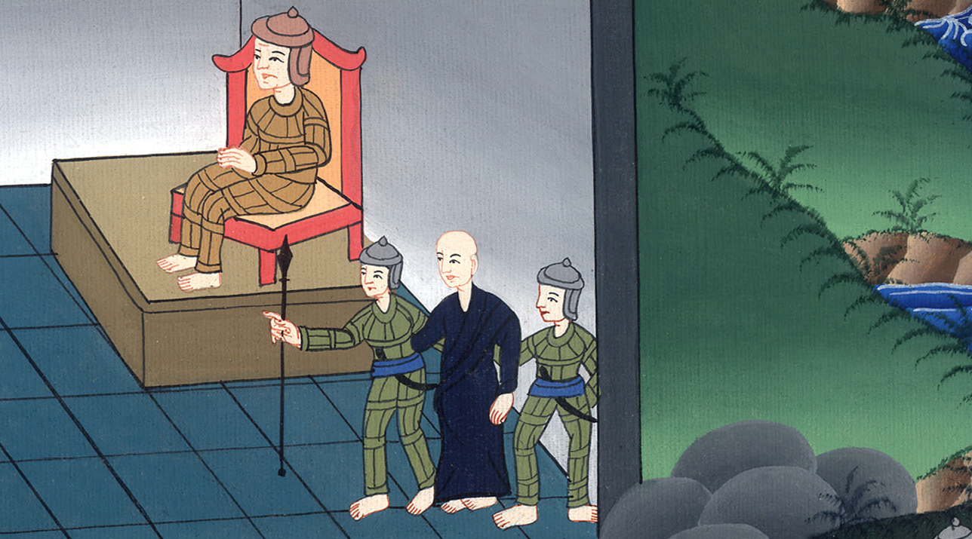
Acts 23:34

Slide 29
He said, 35“I will hear you fully when your accusers also arrive.” He commanded that he be kept in Herod’s palace.

Slide 30
Acts 23:35

