Slide 1
55-7
This work is licensed under a Creative Commons Attribution-ShareAlike 4.0 International License.
Please add this statement to all the videos you create.
English Bible quotes are from the World English Bible US, which is in the public domain.
Notes:
Ch
55 Paul’s Arrest and Trials
1. Paul purifies himself – Acts 21:17-30 (Left Top)
2. Paul captured – Acts 21:31 – 22:29 (Center Top)
3. Paul before the Jewish Council – Acts 22:30 – 23:10 (Right Top)
4. God encourages Paul – Acts 23:11 (Right 2nd)
5. Conspiracy to kill Paul – Acts 23:12-22 (Right 3rd)
6. Paul escorted out of Jerusalem – Acts 23:23-35 (Bottom)
7. Paul before Felix – Acts 24:1-27 (Left near Bottom)
8. Paul before Festus – Acts 25:1-12 (Left Center)
9. Paul before Agrippa and Bernice – Acts 25:13 – 26:32 (Center)

Slide 2
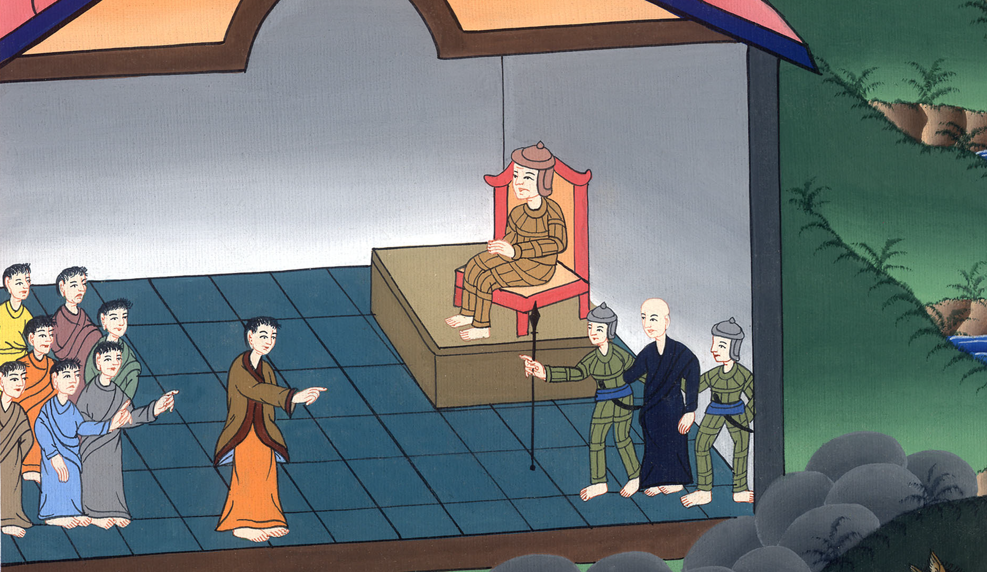
Paul before Felix –
Acts 24:1-27

Slide 3
Paul before Felix – Acts 24:1-27

Slide 4
Paul before Felix –
Acts 24:1-27

Slide 5
1After five days, the high priest, Ananias, came down with certain elders and an orator, one Tertullus. They informed the governor against Paul.

Slide 6
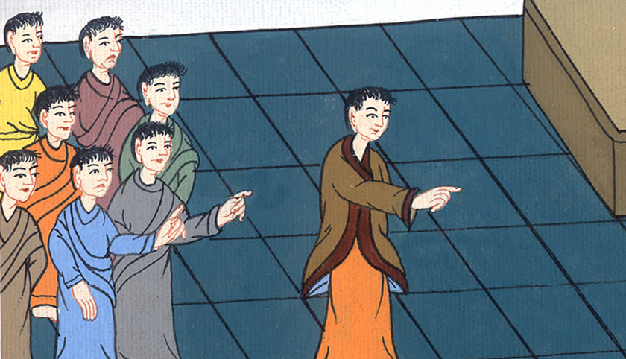
Acts 24:1

Slide 7
2When he was called, Tertullus began to accuse him, saying, “Seeing that by you we enjoy much peace, and that prosperity is coming to this nation by your foresight, 3we accept it in all ways and in all places, most excellent Felix, with all thankfulness. 4But that I don’t delay you, I entreat you to bear with us and hear a few words.

Slide 8
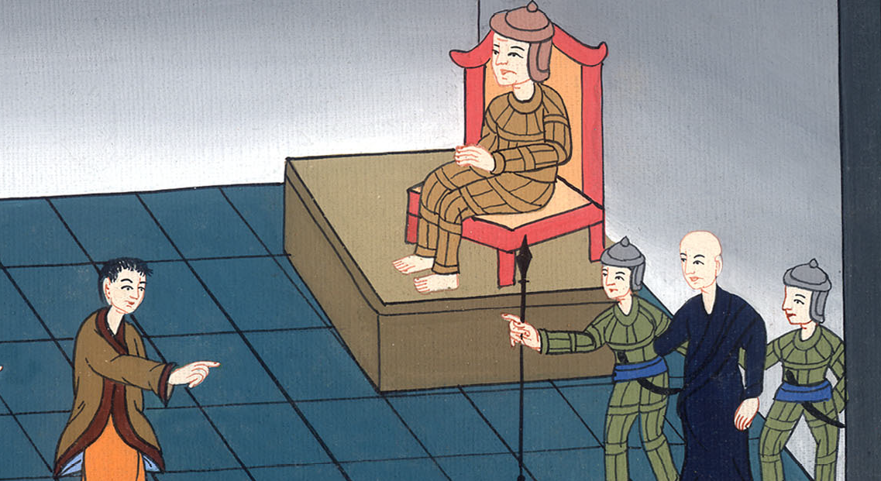
Acts 24:2-4

Slide 9
5For we have found this man to be a plague, an instigator of insurrections among all the Jews throughout the world, and a ringleader of the sect of the Nazarenes. 6-7He even tried to profane the temple, and we arrested him.

Slide 10
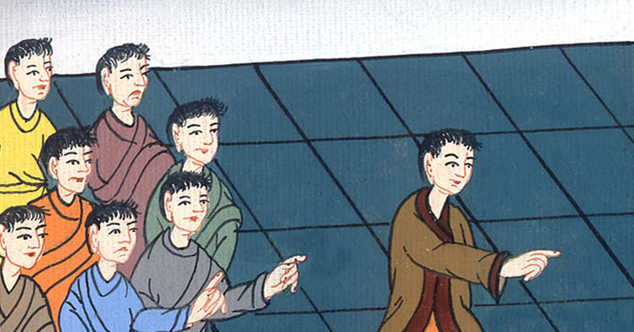
Acts 24:5-7

Slide 11
8By examining him yourself you may ascertain all these things of which we accuse him.”
9The Jews also joined in the attack, affirming that these things were so.

Slide 12
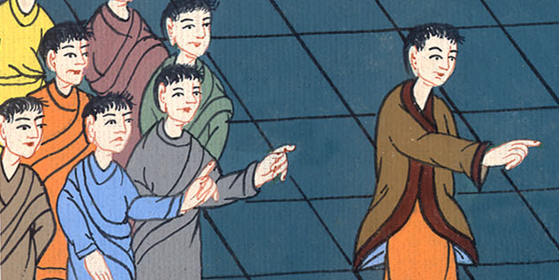
Acts 24:8,9

Slide 13
10When the governor had beckoned to him to speak, Paul answered, “Because I know that you have been a judge of this nation for many years, I cheerfully make my defense.

Slide 14
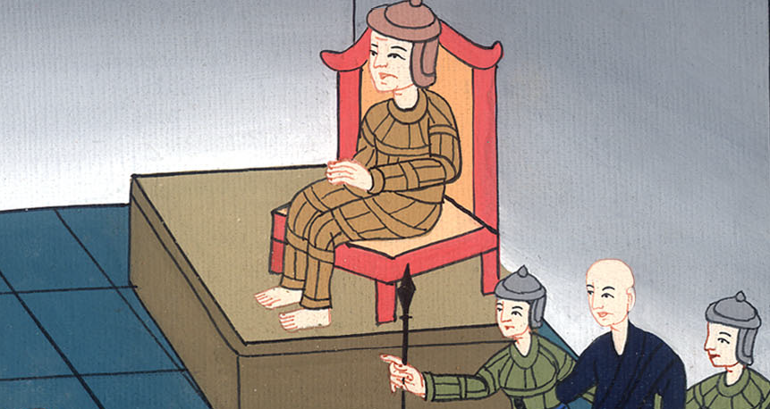
Acts 24:10

Slide 15
11You can verify that it is not more than twelve days since I went up to worship at Jerusalem.

Slide 16
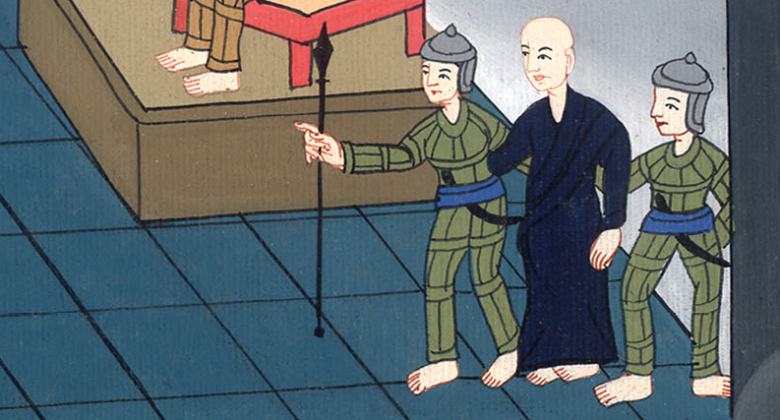
Acts 24:11

Slide 17
12In the temple they didn’t find me disputing with anyone or stirring up a crowd, either in the synagogues or in the city. 13Nor can they prove to you the things of which they now accuse me.

Slide 18
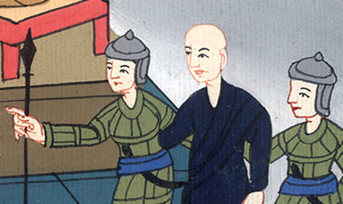
Acts 24:12,13

Slide 19
14But this I confess to you, that according to the Way, which they call a sect, so I serve the God of our fathers, believing all things which are according to the law, and which are written in the prophets.

Slide 20
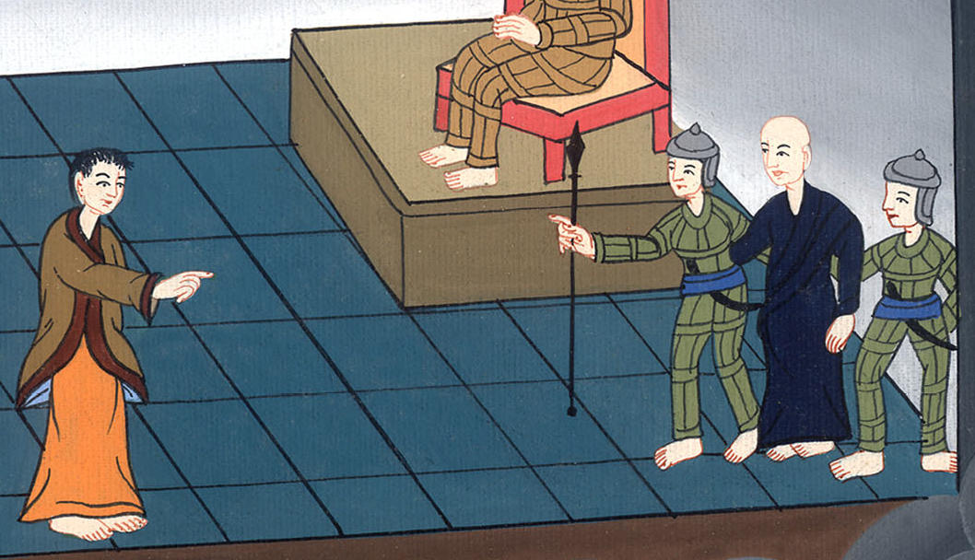
Acts 24:14

Slide 21
15I have hope toward God, which these also themselves look for, that there will be a resurrection of the dead, both of the just and unjust. 16In this I also practice always having a conscience void of offense toward God and men.

Slide 22
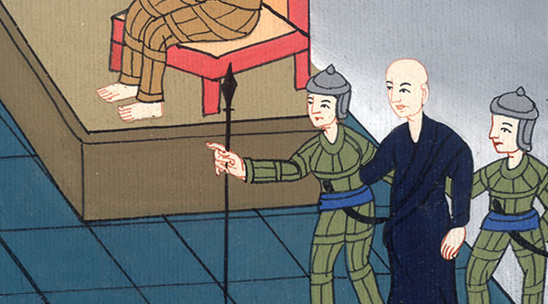
Acts 24:15,16

Slide 23
17Now after some years, I came to bring gifts for the needy to my nation, and offerings.

Slide 24
Acts 24:17

Slide 25
18amid which certain Jews from Asia found me purified in the temple, not with a mob, nor with turmoil.

Slide 26
Acts 24:18

Slide 27
20Or else let these men themselves say what injustice they found in me when I stood before the council, 21unless it is for this one thing that I cried standing among them, ‘Concerning the resurrection of the dead I am being judged before you today!’”

Slide 28
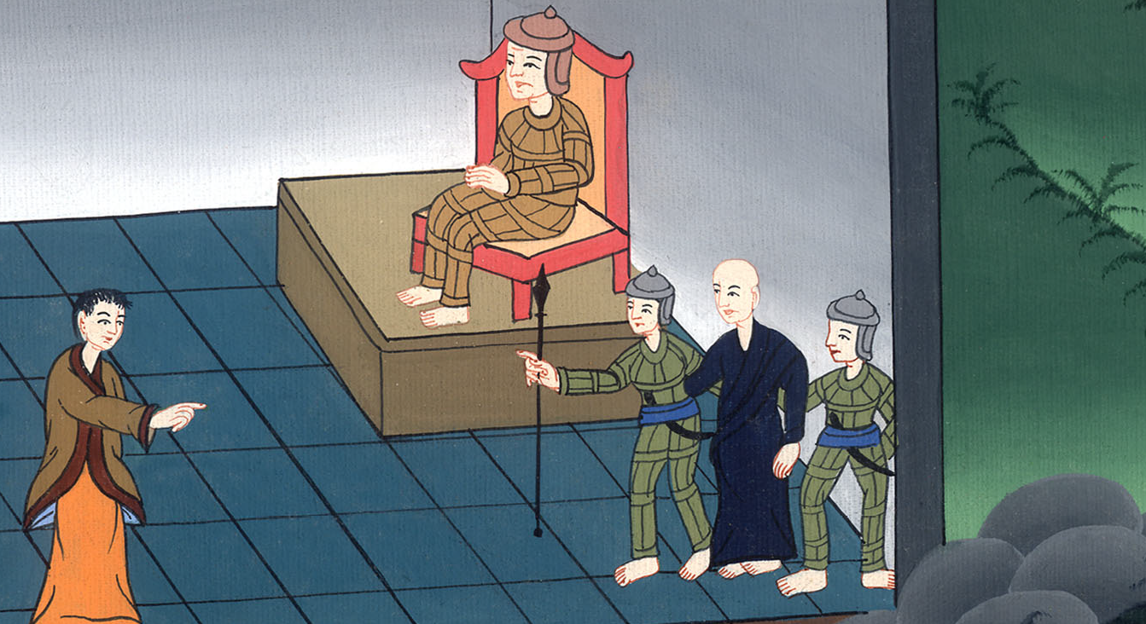
Acts 24:20,21

Slide 29
22But Felix, having more exact knowledge concerning the Way, deferred them, saying, “When Lysias, the commanding officer, comes down, I will decide your case.”

Slide 30
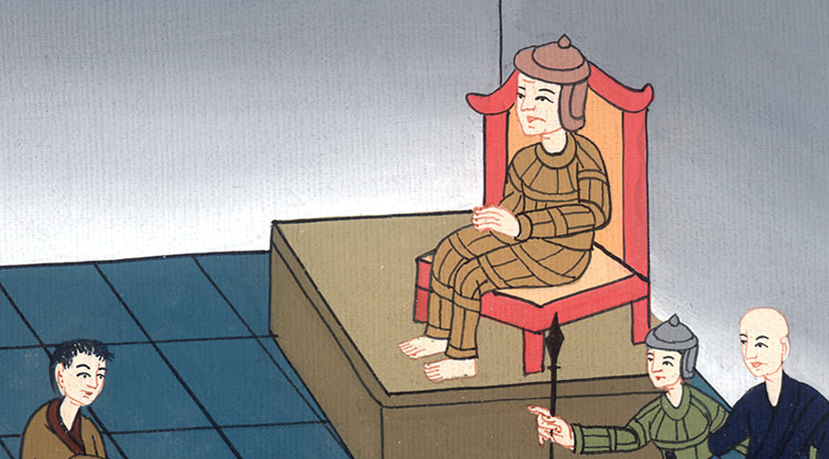
Acts 24:22

Slide 31
23He ordered the centurion that Paul should be kept in custody and should have some privileges, and not to forbid any of his friends to serve him or to visit him.

Slide 32
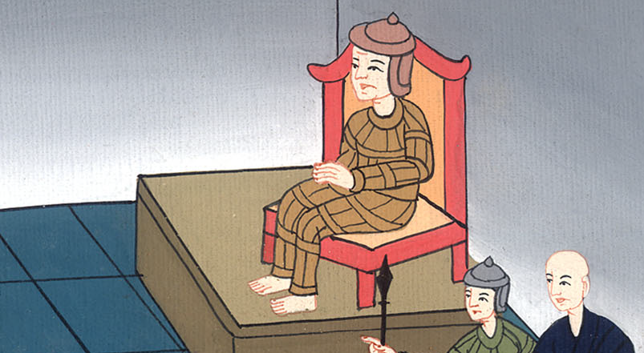
Acts 24:23

Slide 33
24After some days, Felix came with Drusilla his wife, who was a Jewess, and sent for Paul and heard him concerning the faith in Christ Jesus.

Slide 34
Acts 24:24

Slide 35
25As he reasoned about righteousness, self-control, and the judgment to come, Felix was terrified, and answered, “Go your way for this time, and when it is convenient for me, I will summon you.”

Slide 36
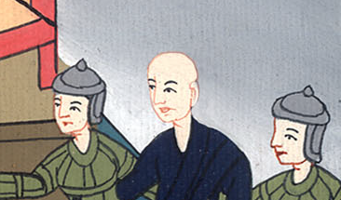
Acts 24:25

Slide 37
26Meanwhile, he also hoped that money would be given to him by Paul, that he might release him. Therefore also he sent for him more often and talked with him.

Slide 38
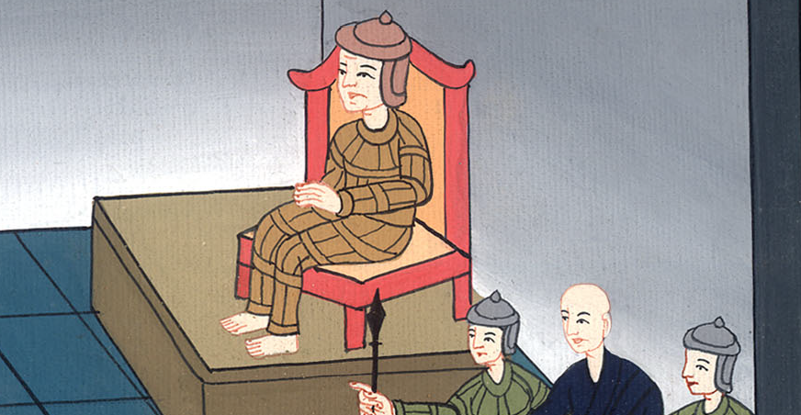
Acts 24:26

Slide 39
27But when two years were fulfilled, Felix was succeeded by Porcius Festus, and desiring to gain favor with the Jews, Felix left Paul in bonds.

Slide 40
Acts 24:27

