Slide 1
55-8
This work is licensed under a Creative Commons Attribution-ShareAlike 4.0 International License.
Please add this statement to all the videos you create.
English Bible quotes are from the World English Bible US, which is in the public domain.
Notes:
Ch
55 Paul’s Arrest and Trials
1. Paul purifies himself – Acts 21:17-30 (Left Top)
2. Paul captured – Acts 21:31 – 22:29 (Center Top)
3. Paul before the Jewish Council – Acts 22:30 – 23:10 (Right Top)
4. God encourages Paul – Acts 23:11 (Right 2nd)
5. Conspiracy to kill Paul – Acts 23:12-22 (Right 3rd)
6. Paul escorted out of Jerusalem – Acts 23:23-35 (Bottom)
7. Paul before Felix – Acts 24:1-27 (Left near Bottom)
8. Paul before Festus – Acts 25:1-12 (Left Center)
9. Paul before Agrippa and Bernice – Acts 25:13 – 26:32 (Center)

Slide 2
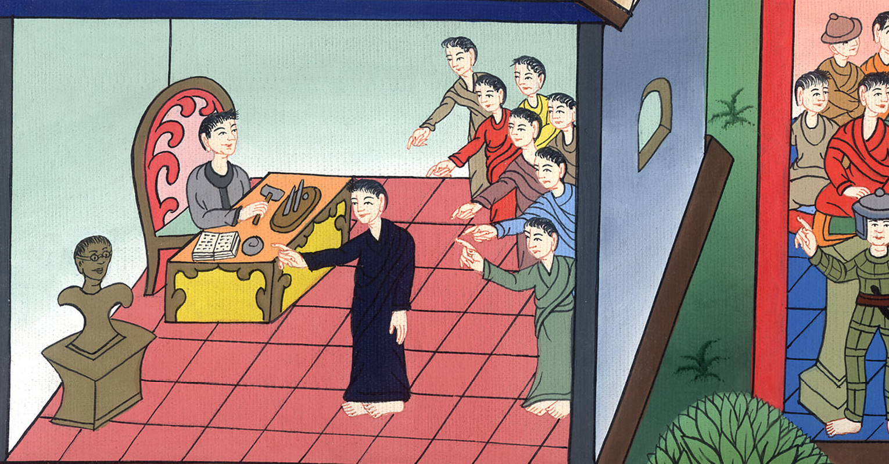
Paul before Festus –
Acts 25:1-12

Slide 3
Paul before Festus – Acts 25:1-12

Slide 4
Paul before Festus –
Acts 25:1-12

Slide 5
1Festus therefore, having come into the province, after three days went up to Jerusalem from Caesarea.

Slide 6
མཛད་པ། 25:1

Slide 7
2Then the high priest and the principal men of the Jews informed him against Paul.

Slide 8
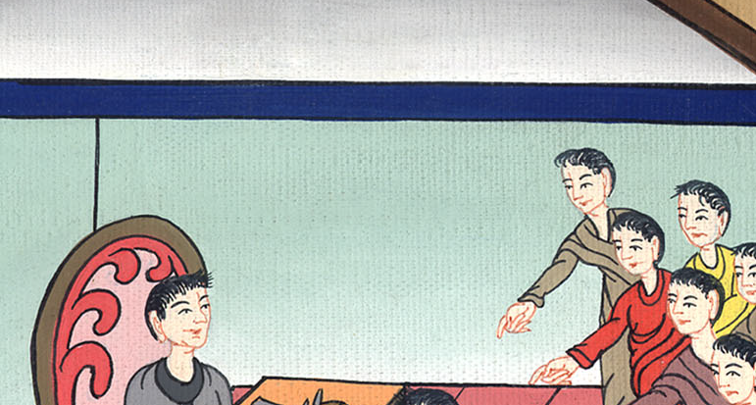
མཛད་པ། 25:2

Slide 9
they begged him, 3asking a favor against him, that he would summon him to Jerusalem, plotting to kill him on the way.

Slide 10
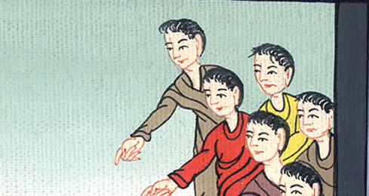
མཛད་པ། 25:3

Slide 11
4However Festus answered that Paul should be kept in custody at Caesarea, and that he himself was about to depart shortly.

Slide 12
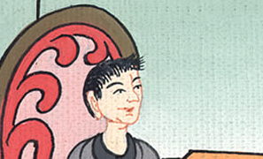
མཛད་པ། 25:4

Slide 13
5“Let them therefore”, he said, “that are in power among you go down with me, and if there is anything wrong in the man, let them accuse him.”

Slide 14
མཛད་པ། 25:5

Slide 15
6When he had stayed among them more than ten days, he went down to Caesarea, and on the next day he sat on the judgment seat, and commanded Paul to be brought.

Slide 16
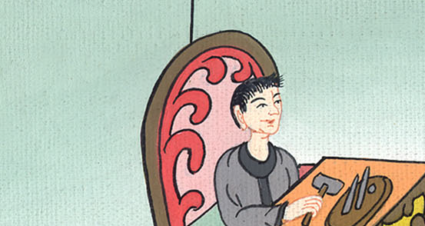
མཛད་པ། 25:6

Slide 17
7When Paul arrived, the Jews who had come down from Jerusalem stood around him. They brought many strong charges against him. But they couldn’t prove that these charges were true.

Slide 18
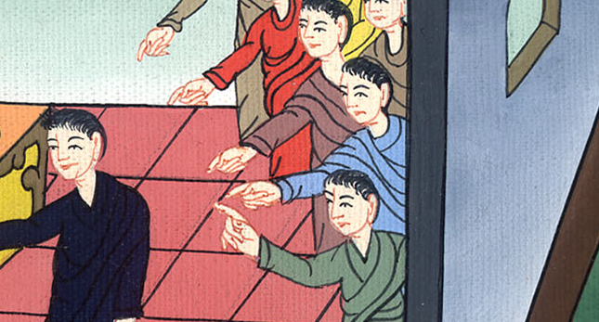
མཛད་པ། 25:7

Slide 19
8Then Paul spoke up for himself. He said, “I’ve done nothing wrong against the law of the Jews or against the temple. I’ve done nothing wrong against Caesar.”

Slide 20
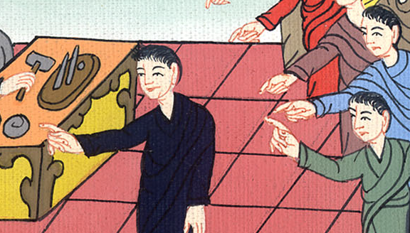
མཛད་པ། 25:8

Slide 21
9But Festus wanted to do the Jews a favor. So he said to Paul, “Are you willing to go up to Jerusalem? Are you willing to go on trial there? Are you willing to face these charges in my court?”

Slide 22
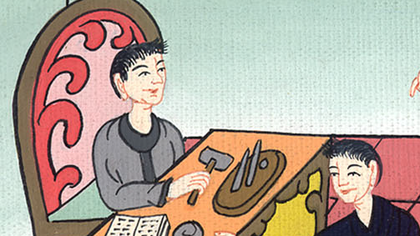
མཛད་པ། 25:9

Slide 23
10Paul answered, “I’m already standing in Caesar’s court. This is where I should go on trial. I haven’t done anything wrong to the Jews. You yourself know that very well.

Slide 24
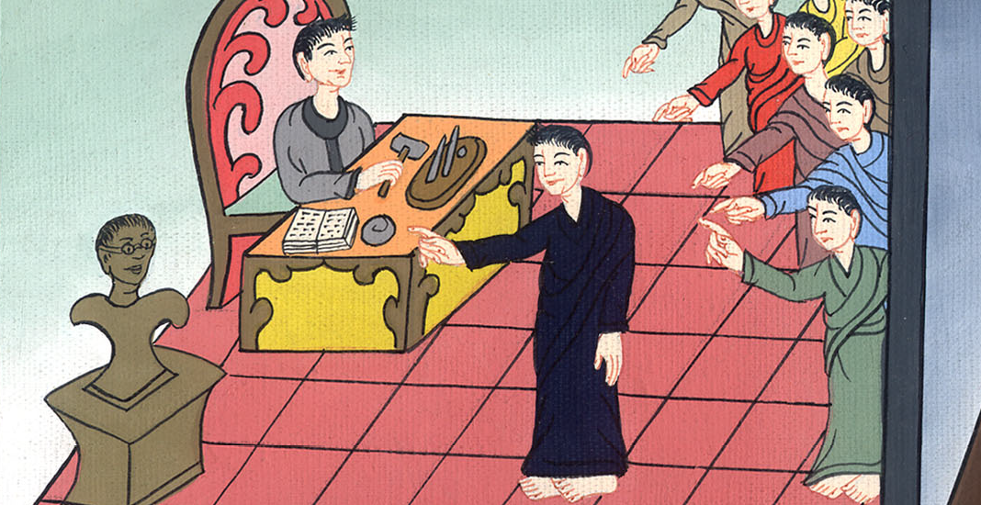
མཛད་པ། 25:10

Slide 25
11If I am guilty of anything worthy of death, I’m willing to die. But the charges brought against me by these Jews are not true. No one has the right to hand me over to them. I make my appeal to Caesar!”

Slide 26
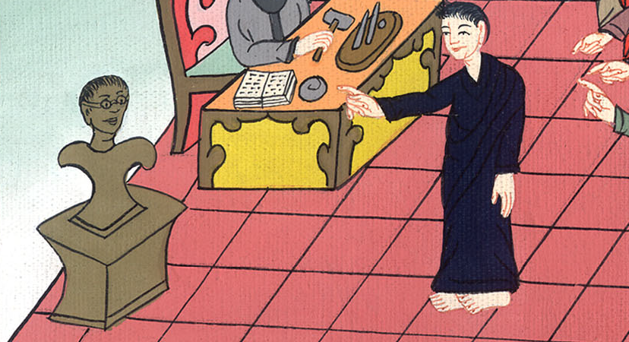
མཛད་པ། 25:11

Slide 27
12Festus talked it over with the members of his court. Then he said, “You have made an appeal to Caesar. To Caesar you will go!”

Slide 28
མཛད་པ། 25:12

