Slide 1
55-9
This work is licensed under a Creative Commons Attribution-ShareAlike 4.0 International License.
Please add this statement to all the videos you create.
English Bible quotes are from the World English Bible US, which is in the public domain.
Notes:
Ch
55 Paul’s Arrest and Trials
1. Paul purifies himself – Acts 21:17-30 (Left Top)
2. Paul captured – Acts 21:31 – 22:29 (Center Top)
3. Paul before the Jewish Council – Acts 22:30 – 23:10 (Right Top)
4. God encourages Paul – Acts 23:11 (Right 2nd)
5. Conspiracy to kill Paul – Acts 23:12-22 (Right 3rd)
6. Paul escorted out of Jerusalem – Acts 23:23-35 (Bottom)
7. Paul before Felix – Acts 24:1-27 (Left near Bottom)
8. Paul before Festus – Acts 25:1-12 (Left Center)
9. Paul before Agrippa and Bernice – Acts 25:13 – 26:32 (Center)

Slide 2
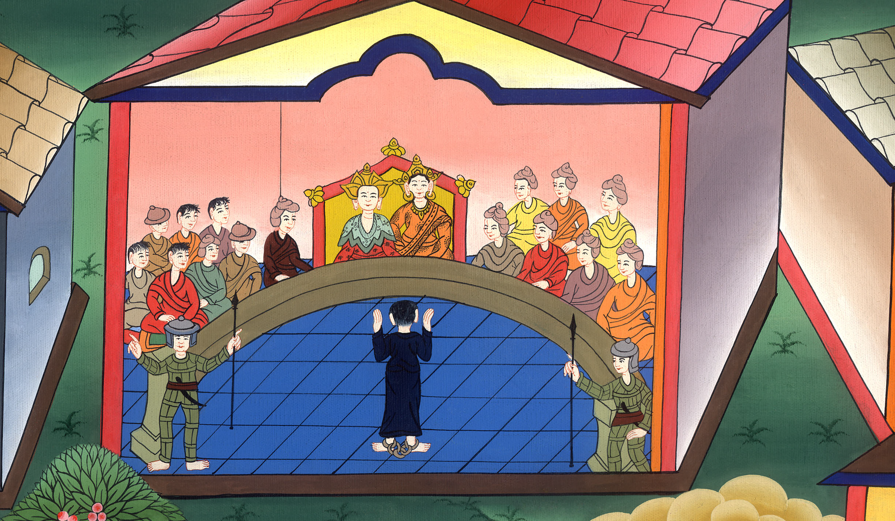
Paul before Agrippa –
Acts 25:13 – 26:32

Slide 3
Paul before Agrippa – Acts 25:13 – 26:32

Slide 4
Paul before Agrippa –
Acts 25:13 – 26:32

Slide 5
13Now when some days had passed, King Agrippa and Bernice arrived at Caesarea and greeted Festus.

Slide 6
Acts 25:13

Slide 7
14As he stayed there many days, Festus laid Paul’s case before the king, saying, “There is a certain man left a prisoner by Felix;

Slide 8
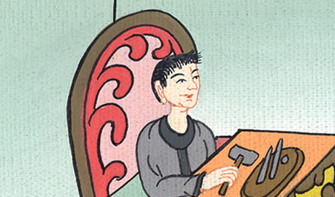
Acts 25:14

Slide 9
15about whom, when I was at Jerusalem, the chief priests and the elders of the Jews informed me, asking for a sentence against him.

Slide 10
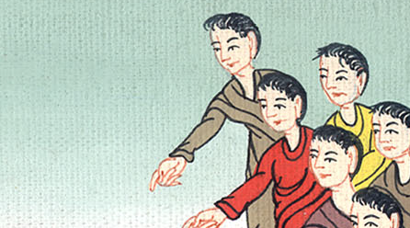
Acts 25:15

Slide 11
(I Brought them to the court)18When the accusers stood up, they brought no charges against him of such things as I supposed.

Slide 12
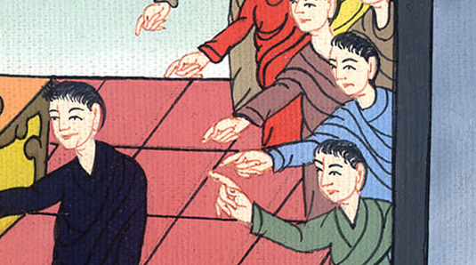
Acts 25:18

Slide 13
19but instead they had certain questions against him about their own religion and about one Jesus, who was dead, whom Paul affirmed to be alive.

Slide 14
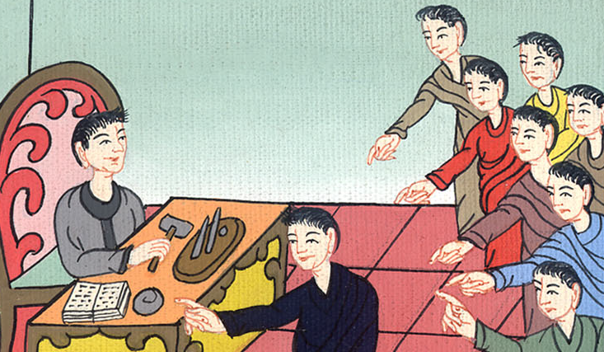
Acts 25:19

Slide 15
20Being perplexed how to inquire concerning these things, I asked whether he was willing to go to Jerusalem and there be judged concerning these matters.

Slide 16
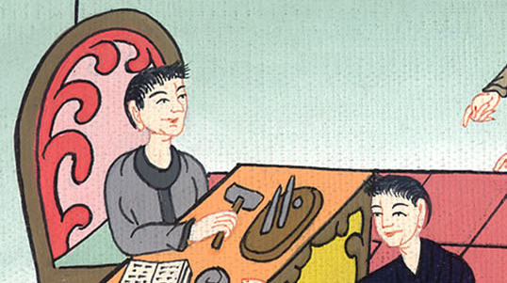
Acts 25:20

Slide 17
21But when Paul had appealed to be kept for the decision of the emperor, I commanded him to be kept until I could send him to Caesar.”

Slide 18
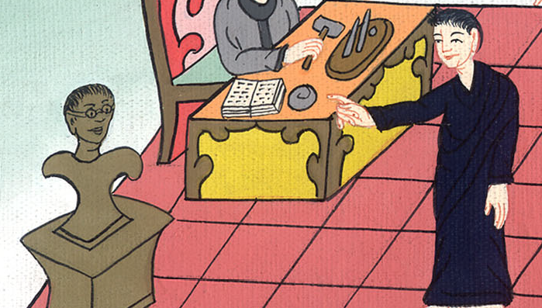
Acts 25:21

Slide 19
22Agrippa said to Festus, “I also would like to hear the man myself.”
“Tomorrow,” he said, “you shall hear him.”

Slide 20
Acts 25:22

Slide 21
23So on the next day, when Agrippa and Bernice had come with great pomp, and they had entered into the place of hearing with the commanding officers and the principal men of the city, at the command of Festus, Paul was brought in

Slide 22
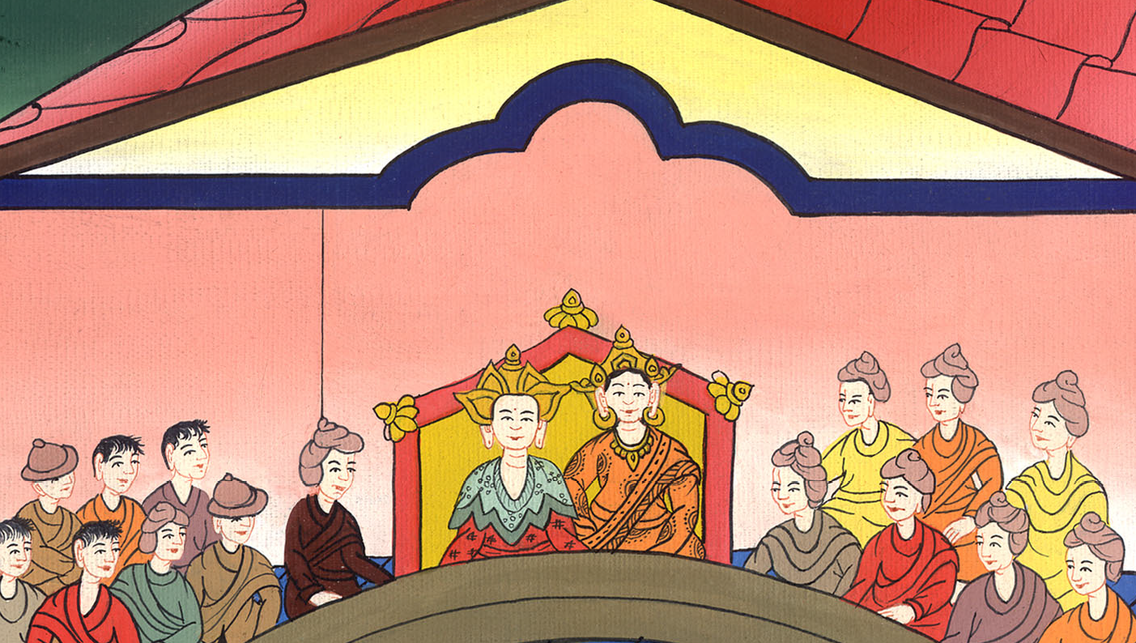
Acts 25:23

Slide 23
1Agrippa said to Paul, “You may speak for yourself.”
Then Paul stretched out his hand, and made his defense.

Slide 24
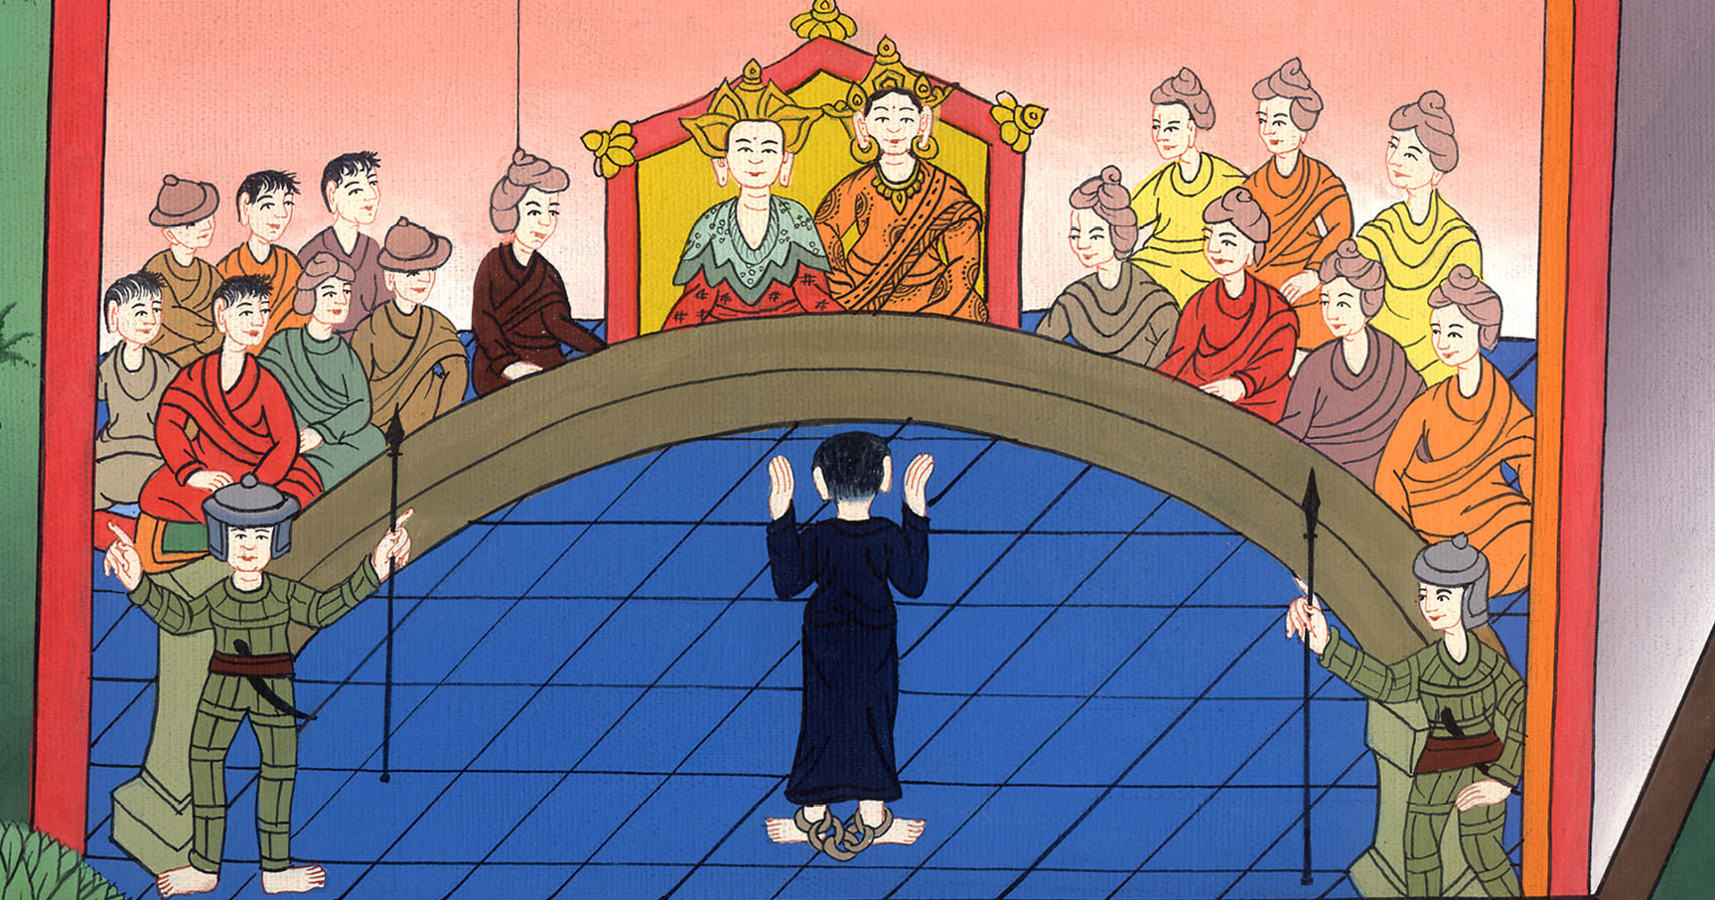
Acts 26:1

Slide 25
2“I think myself happy, King Agrippa, that I am to make my defense before you today concerning all the things that I am accused by the Jews. (The Jews know that I lived by the rules of the Pharisees)

Slide 26
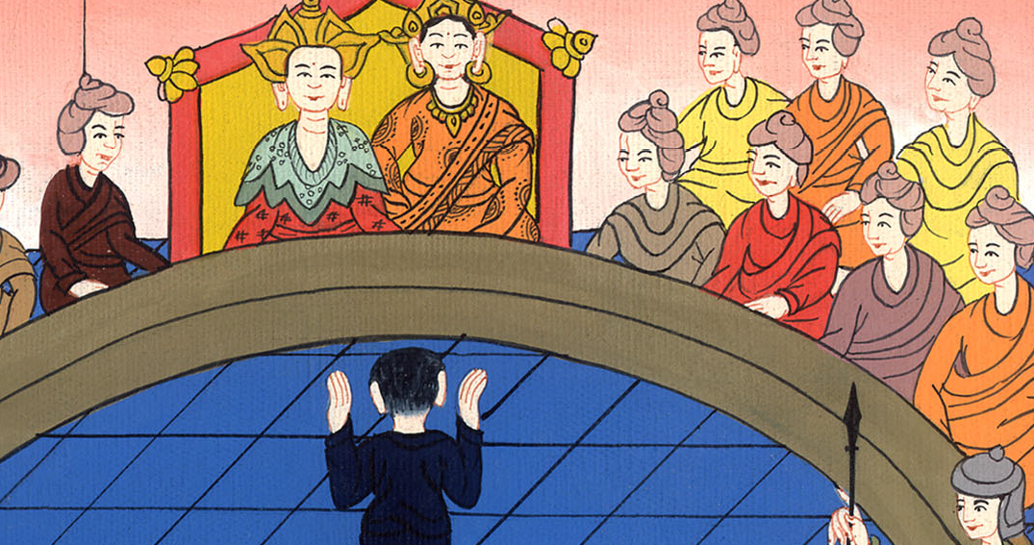
Acts 26:2

Slide 27
6Now I stand here to be judged for the hope of the promise made by God to our fathers.

Slide 28
Acts 26:6

Slide 29
8Why is it judged incredible with you if God does raise the dead?

Slide 30
Acts 26:8

Slide 31
9“I myself most certainly thought that I ought to do many things contrary to the name of Jesus of Nazareth. (I put many believers in prison and sentenced them to death)

Slide 32
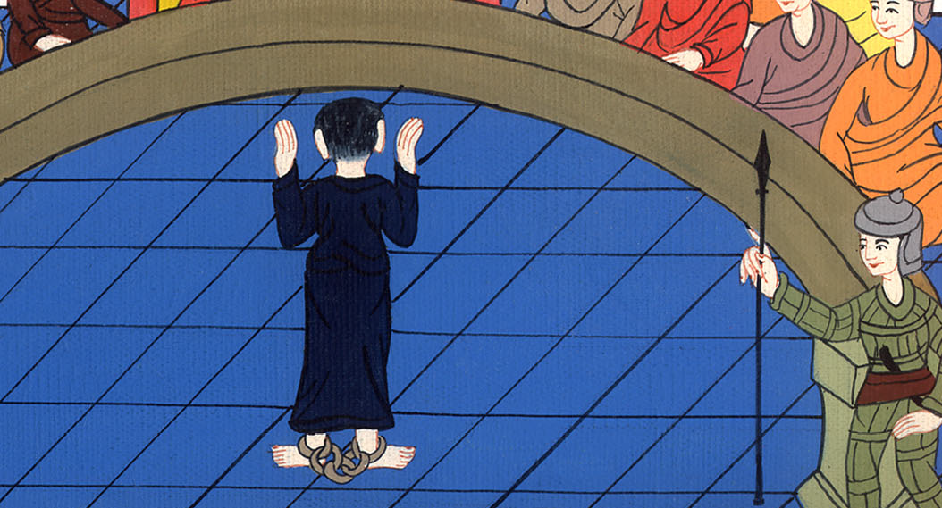
Acts 26:9

Slide 33
12“As I traveled to Damascus with the authority and commission from the chief priests, 13….(When I saw a light coming from heaven) 14…I heard a voice speak to me ... I heard a voice saying to me in the Hebrew language, ‘Saul, Saul, why are you persecuting me?…

Slide 34
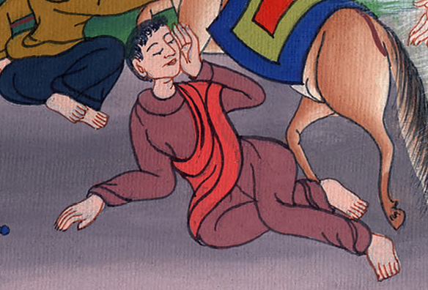
Acts 26:12-14

Slide 35
15“I said, ‘Who are you, Lord?’ He said, ‘I am Jesus, whom you are persecuting. 16But arise, and stand on your feet, for I have appeared to you for this purpose: to appoint you a servant and a witness both of the things which you have seen and of the things which I will reveal to you; …

Slide 36
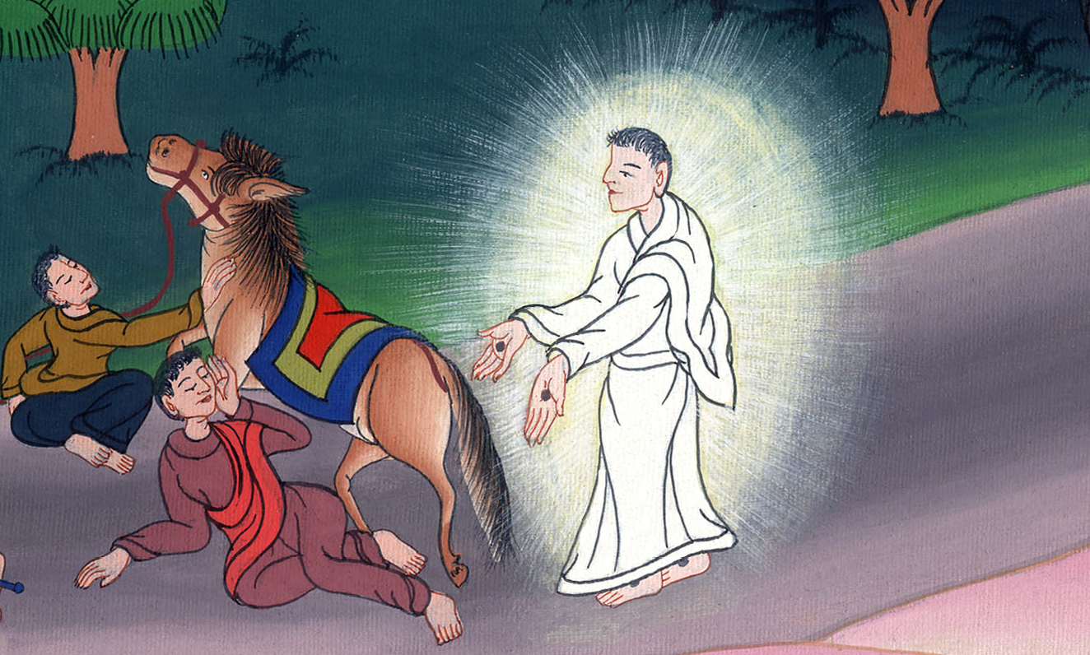
Acts 26:15,16

Slide 37
19“Therefore, King Agrippa, I was not disobedient to the heavenly vision, 20but declared first to them of Damascus, at Jerusalem, and throughout all the country of Judea, and also to the Gentiles, that they should repent and turn to God, doing works worthy of repentance.

Slide 38
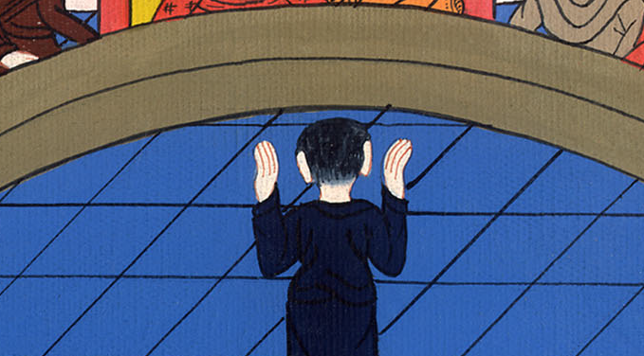
Acts 26:19-20

Slide 39
24As he thus made his defense, Festus said with a loud voice, “Paul, you are crazy! Your great learning is driving you insane!”
25But he said, “I am not crazy, most excellent Festus, but boldly declare words of truth and reasonableness.

Slide 40
Acts 26:24,25

Slide 41
26For the king knows of these things, to whom also I speak freely. For I am persuaded that none of these things is hidden from him, for this has not been done in a corner.

Slide 42
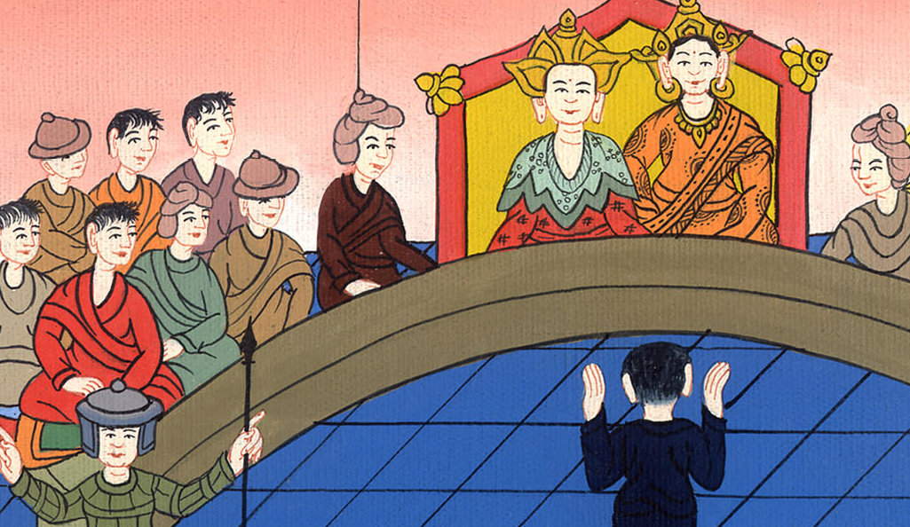
Acts 26:26

Slide 43
28Agrippa said to Paul, “With a little persuasion are you trying to make me a Christian?”

Slide 44
Acts 26:28

Slide 45
29Paul said, “I pray to God, that whether with little or with much, not only you, but also all that hear me today, might become such as I am, except for these bonds.”

Slide 46
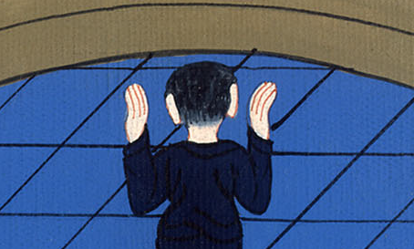
Acts 26:29

Slide 47
30The king rose up with the governor and Bernice, and those who sat with them. 31When they had withdrawn, they spoke to one another, saying, “This man does nothing worthy of death or of bonds.”

Slide 48
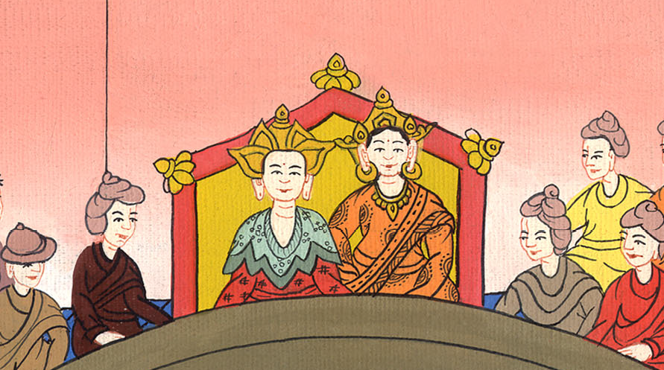
Acts 26:30,31

Slide 49
32Agrippa said to Festus, “This man might have been set free if he had not appealed to Caesar.”

Slide 50
Acts 26:32

