Slide 1
56-1
This work is licensed under a Creative Commons Attribution-ShareAlike 4.0 International License.
Please add this statement to all the videos you create.
English Bible quotes are from the World English Bible US, which is in the public domain.
Notes:
Ch
56 Paul goes to Rome
1. Paul on the ship – Acts 27:1-32 (Top)
2. The Shipwreck – Acts 27:33-44 (Center)
3. Snakebite – Acts 28:1-10 (Right Bottom)
4. Paul arrives in Rome – Acts 28:11-31 (Left Bottom)

Slide 2
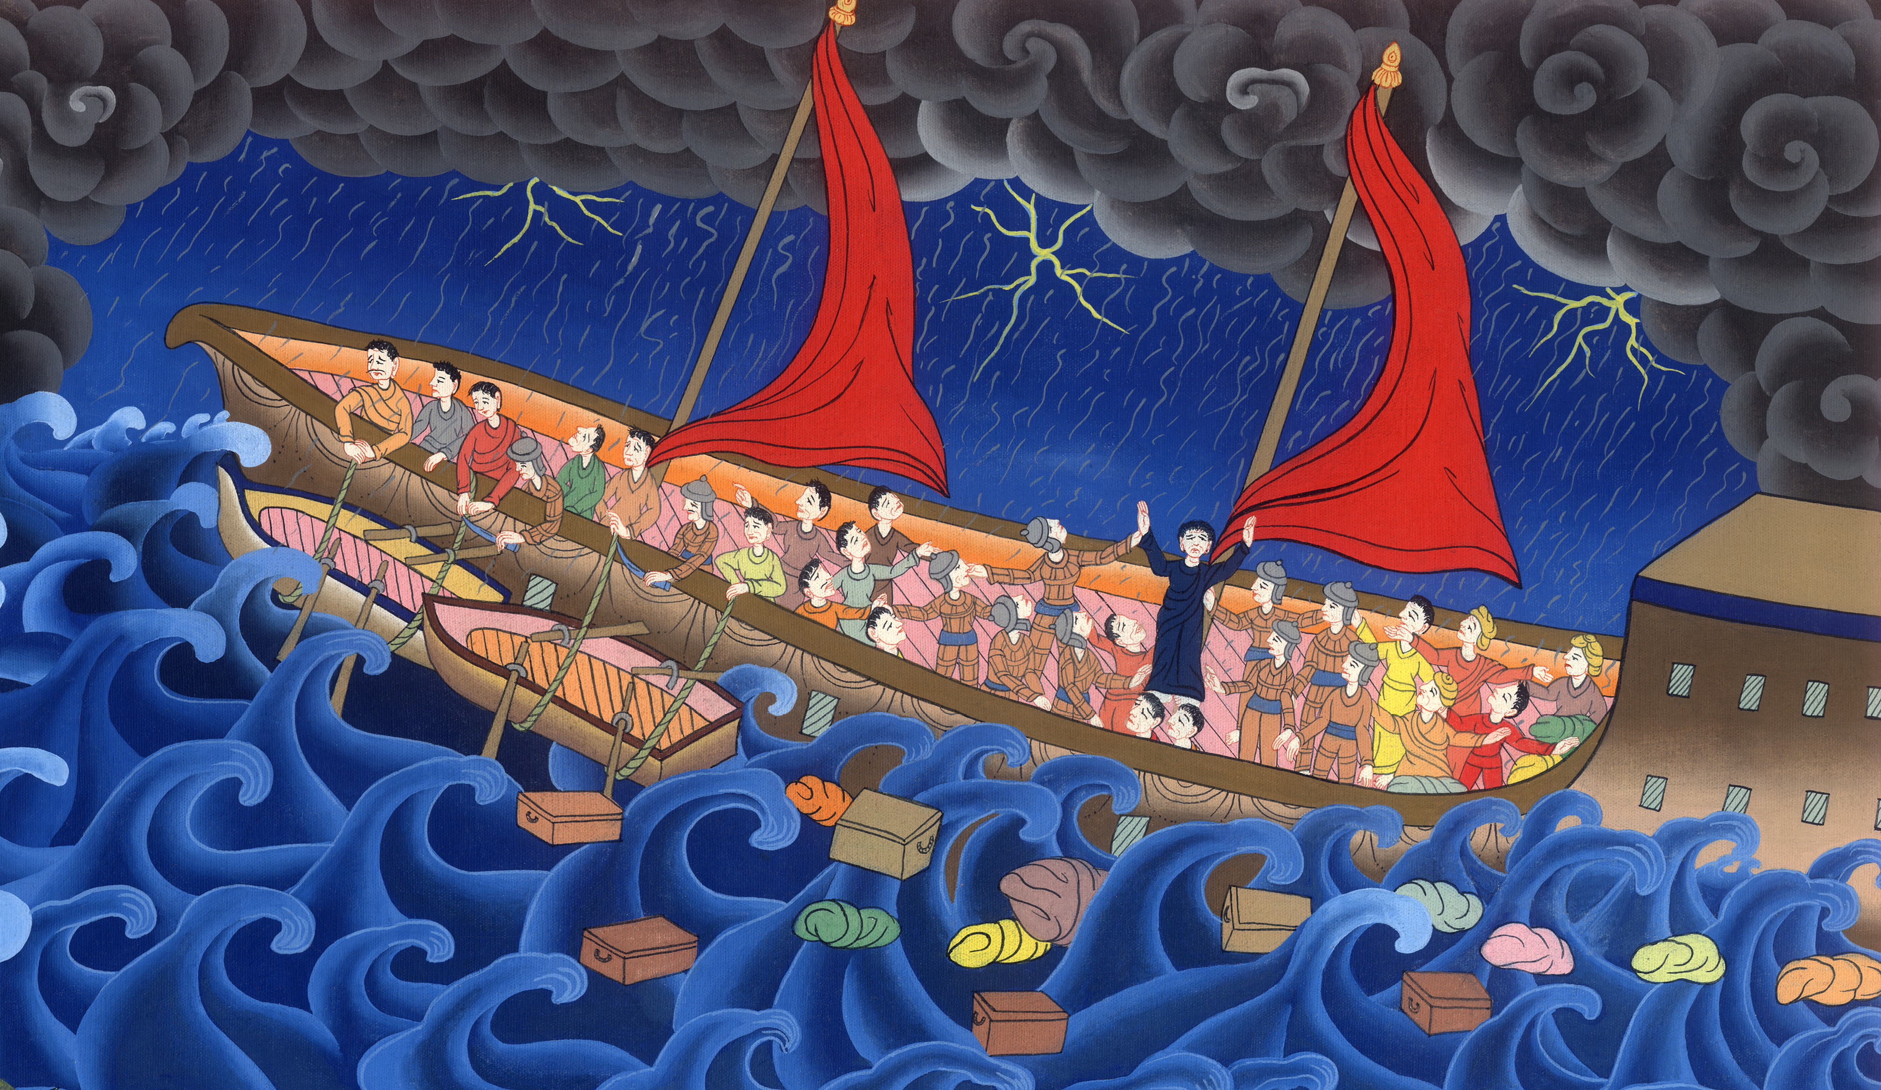
Paul on the ship to Rome – Acts 27:1-32

Slide 3
Paul goes to Rome
Paul on the ship to Rome – Acts 27:1-32

Slide 4
Paul on the ship to Rome – Acts 27:1-32

Slide 5
Luke writes 1When it was determined that we should sail for Italy, they delivered Paul and certain other prisoners to a centurion named Julius, of the Augustan band.

Slide 6
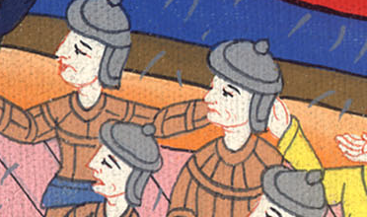
Acts 27:1

Slide 7
2Embarking in a ship of Adramyttium, which was about to sail to places on the coast of Asia, we put to sea…5We sailed across the sea…and …came to Myra, a city of Lycia.

Slide 8
Acts 27:2,5

Slide 9
7We sailed slowly many days….
9When much time had passed and the voyage was now dangerous, Paul admonished them.

Slide 10
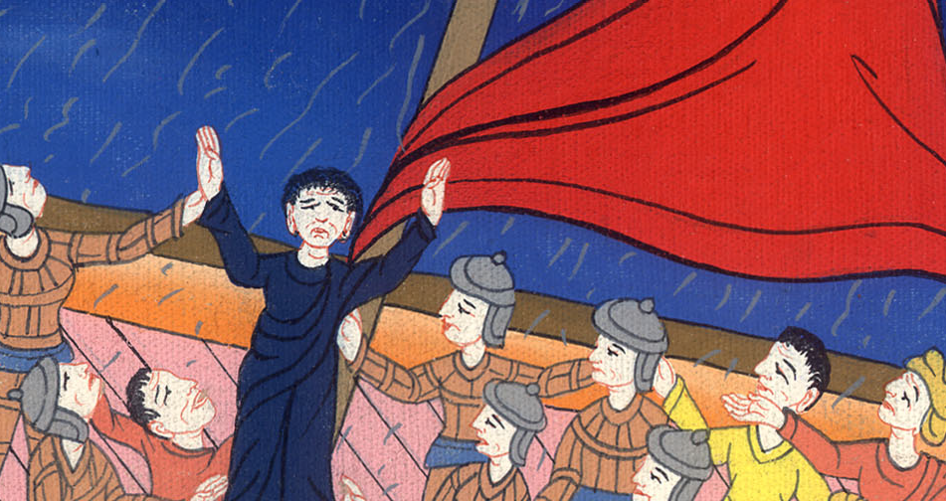
Acts 27:7,9

Slide 11
10Paul said to them, “Sirs, I perceive that the voyage will be with injury and much loss, not only of the cargo and the ship, but also of our lives.”

Slide 12
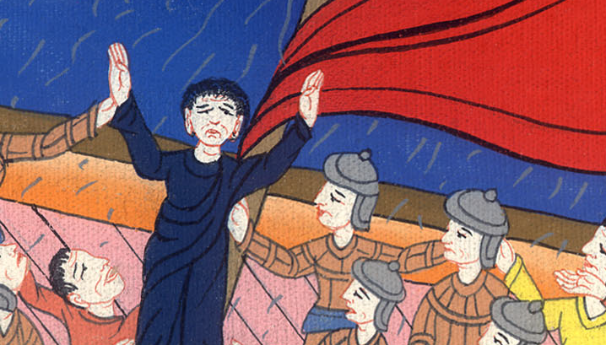
Acts 27:10

Slide 13
11But the centurion gave more heed to the master and to the owner of the ship than to those things which were spoken by Paul. 12Because the haven was not suitable to winter in, the majority advised going to sea from there….

Slide 14
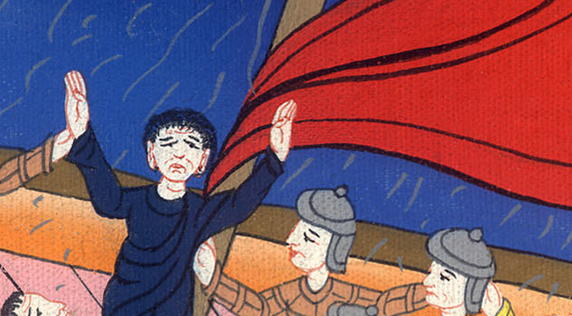
Acts 27:11,12

Slide 15
13When the south wind blew softly, supposing that they had obtained their purpose, they weighed anchor and sailed along Crete, close to shore.

Slide 16
Acts 27:13

Slide 17
14But before long, a stormy wind beat down from shore, which is called Euroclydon. 15When the ship was caught and couldn’t face the wind, we gave way to it and were driven along.

Slide 18
Acts 27:14,15

Slide 19
17… they used cables to help reinforce the ship. …
18As we labored exceedingly with the storm, the next day they began to throw things overboard.

Slide 20
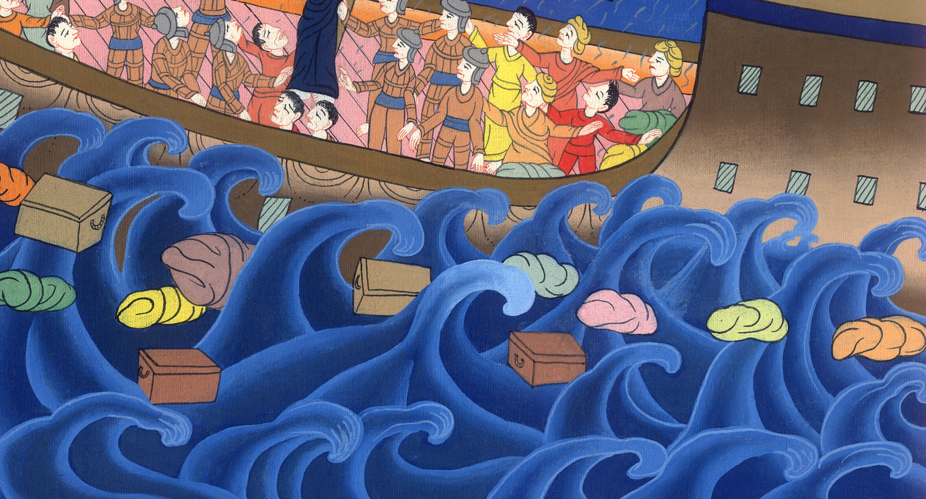
Acts 27:17,18

Slide 21
19On the third day, they threw out the ship’s tackle with their own hands. .

Slide 22
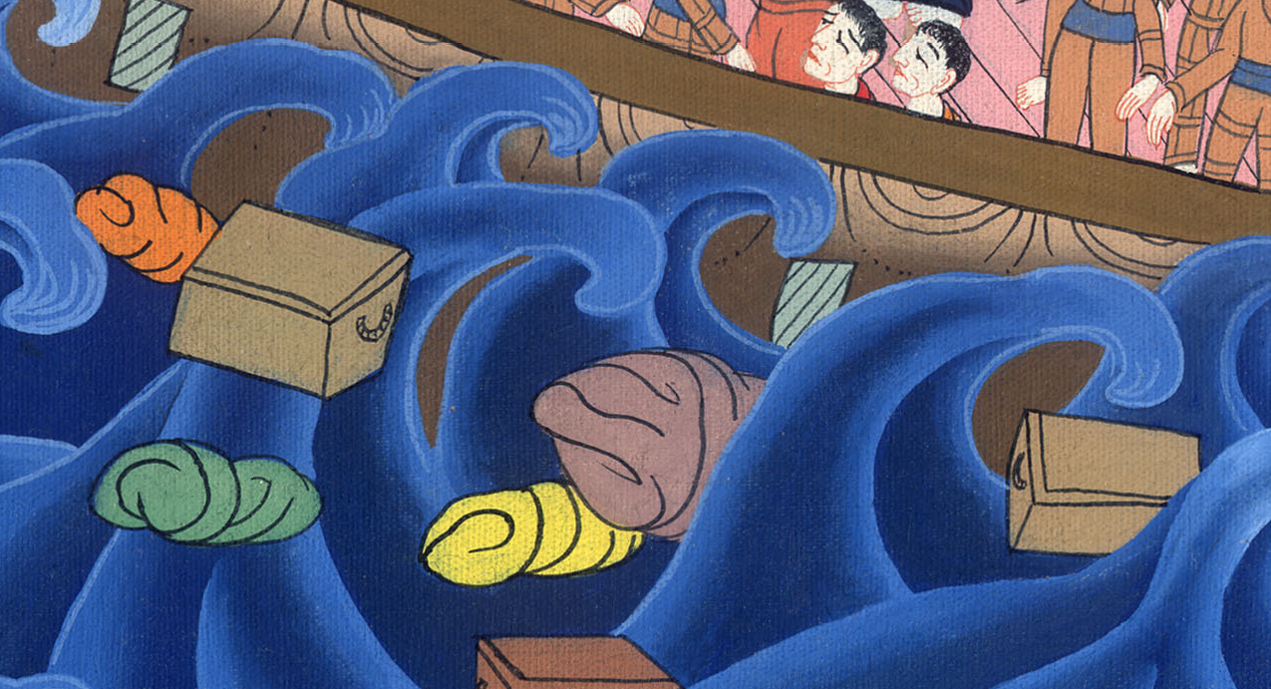
Acts 27:19

Slide 23
20When neither sun nor stars shone on us for many days, and no small storm pressed on us, all hope that we would be saved was now taken away.

Slide 24
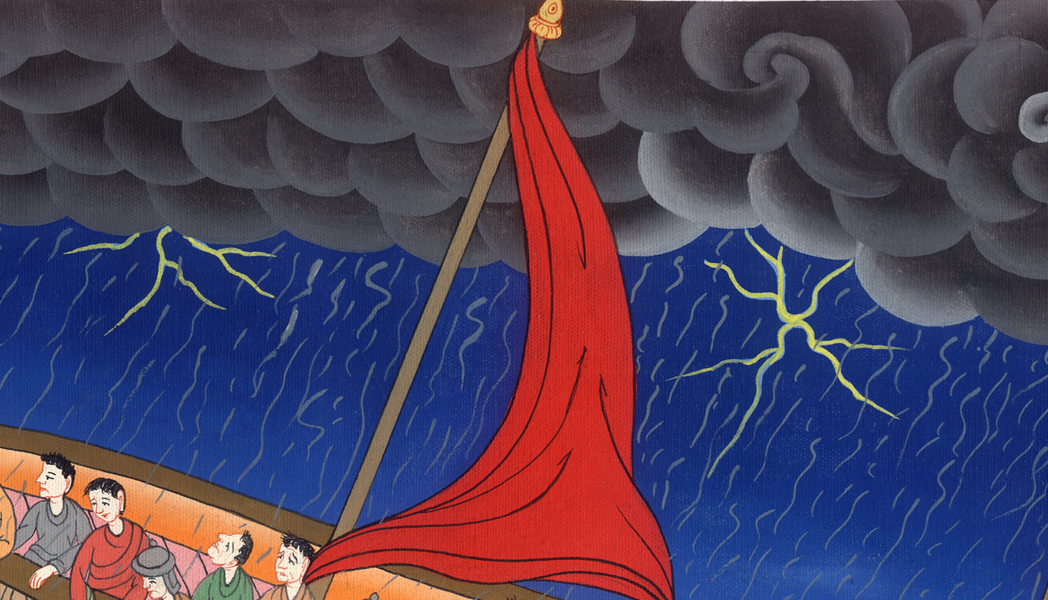
Acts 27:20

Slide 25
21When they had been long without food, Paul stood up in the middle of them and said, “Sirs, you should have listened to me, and not have set sail from Crete and have gotten this injury and loss.

Slide 26
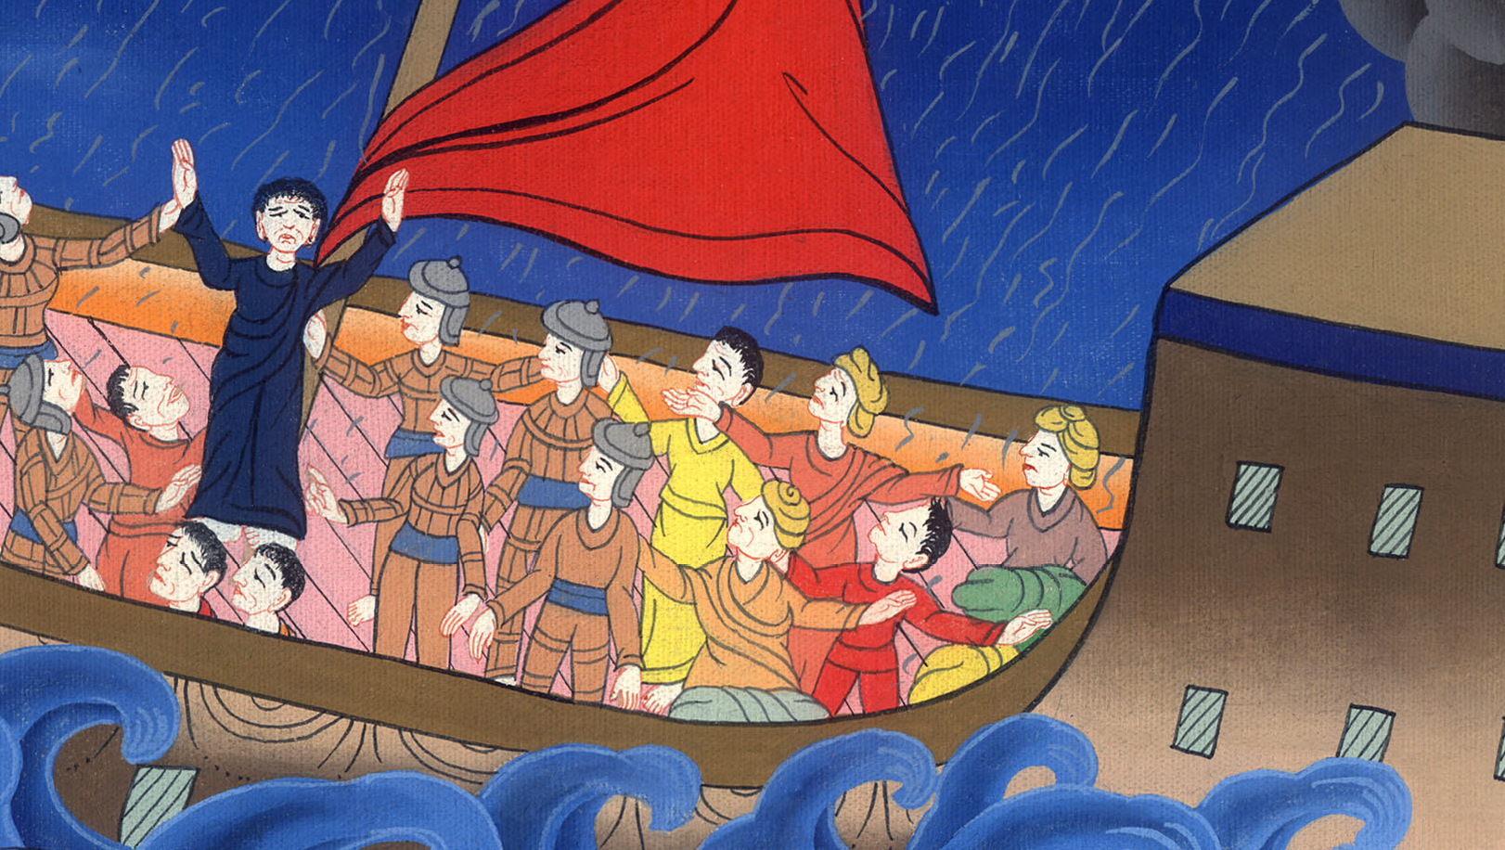
Acts 27:21

Slide 27
22Now I exhort you to cheer up, for there will be no loss of life among you, but only of the ship.

Slide 28
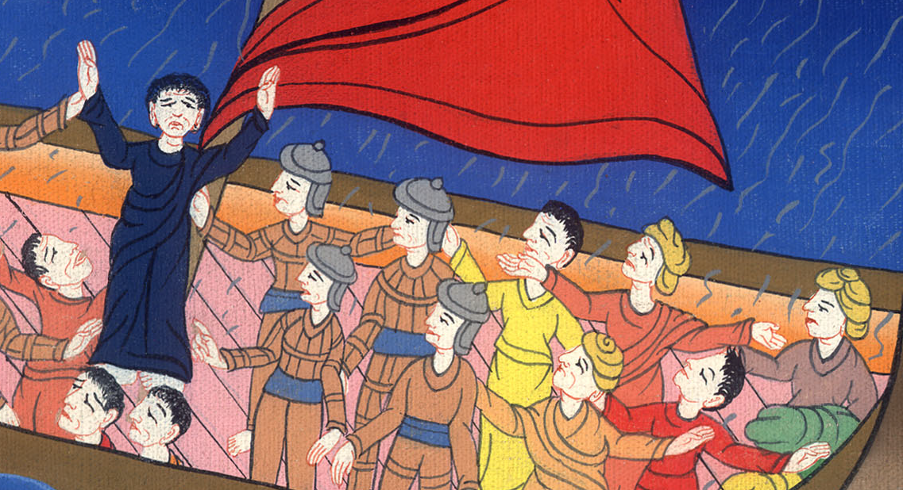
Acts 27:22

Slide 29
23For there stood by me this night an angel, belonging to the God whose I am and whom I serve, 24saying, ‘Don’t be afraid, Paul. You must stand before Caesar. Behold, God has granted you all those who sail with you.’

Slide 30
Acts 27:23,24

Slide 31
25Therefore, sirs, cheer up! For I believe God, that it will be just as it has been spoken to me. 26But we must run aground on a certain island.”

Slide 32
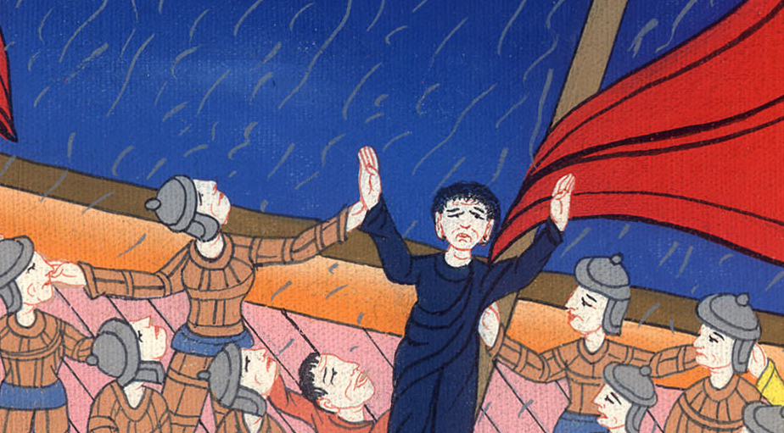
Acts 27:25,26

Slide 33
27But when the fourteenth night had come, as we were driven back and forth in the Adriatic Sea, about midnight the sailors surmised that they were drawing near to some land.

Slide 34
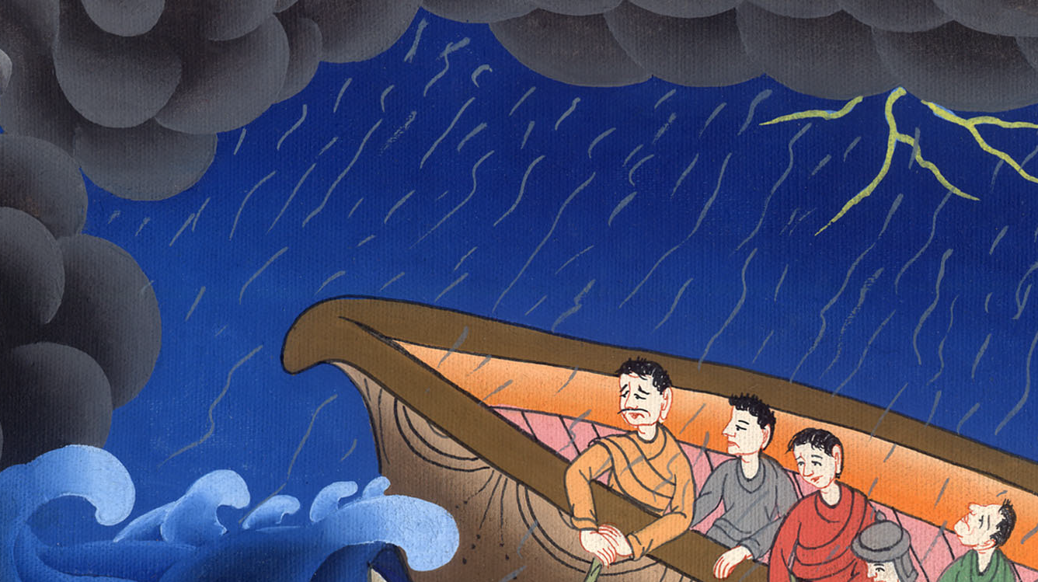
Acts 27:27

Slide 35
28They took soundings and found 36 metres. After a little while, they took soundings again, and found 27 metres.

Slide 36
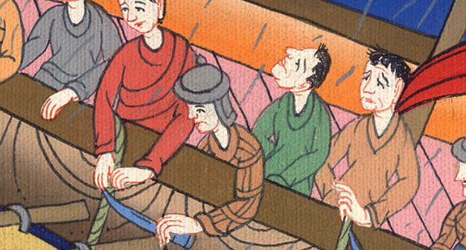
Acts 27:28

Slide 37
29Fearing that we would run aground on rocky ground, they let go four anchors from the stern, and wished for daylight.

Slide 38
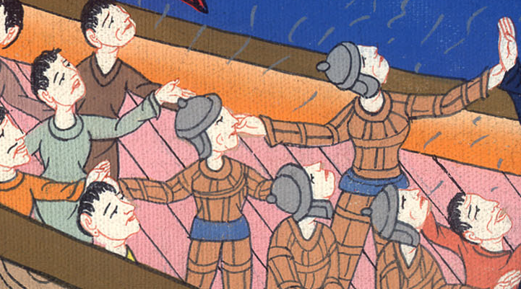
Acts 27:29

Slide 39
30As the sailors were trying to flee out of the ship and had lowered the boat into the sea, pretending that they would lay out anchors from the front of the ship.

Slide 40
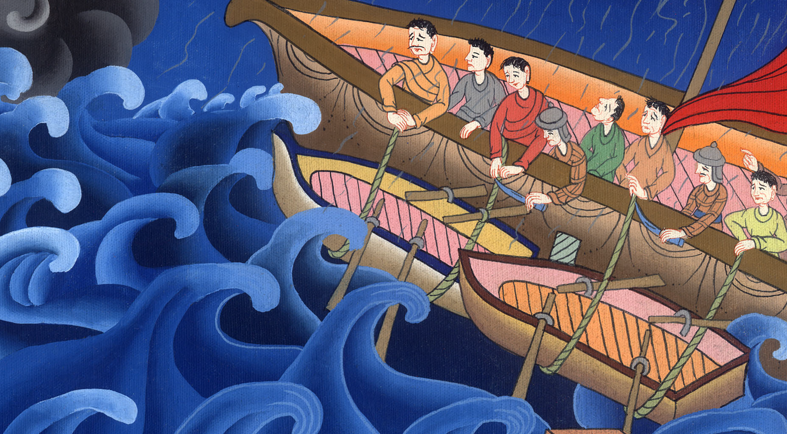
Acts 27:30

Slide 41
31Paul said to the centurion and to the soldiers, “Unless these stay in the ship, you can’t be saved.” 32Then the soldiers cut away the ropes of the boat and let it fall off.

Slide 42
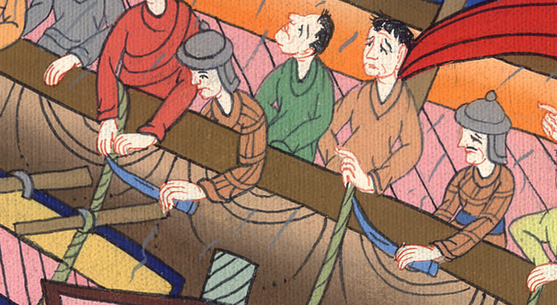
Acts 27:31,32

