Slide 1
56-2
This work is licensed under a Creative Commons Attribution-ShareAlike 4.0 International License.
Please add this statement to all the videos you create.
English Bible quotes are from the World English Bible US, which is in the public domain.
Notes:
Ch
56 Paul goes to Rome
1. Paul on the ship – Acts 27:1-32 (Top)
2. The Shipwreck – Acts 27:33-44 (Center)
3. Snakebite – Acts 28:1-10 (Right Bottom)
4. Paul arrives in Rome – Acts 28:11-31 (Left Bottom)

Slide 2
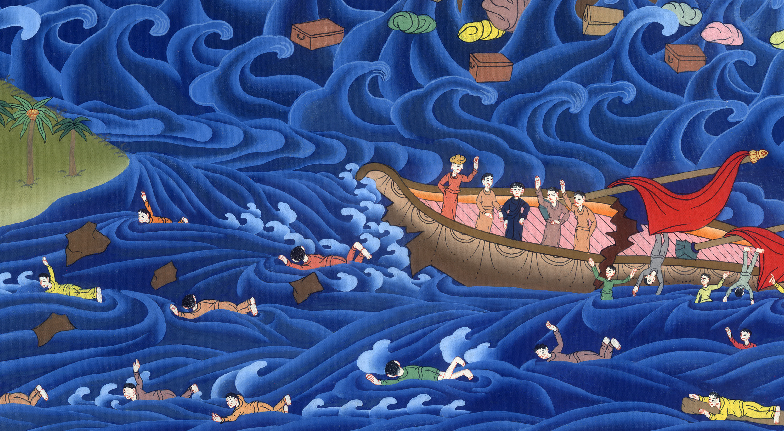
The Shipwreck – Acts 27:33-44

Slide 3
The Shipwreck – Acts 27:33-44

Slide 4
The Shipwreck – Acts 27:33-44

Slide 5
33While the day was coming on, Paul begged them all to take some food, saying, “Today is the fourteenth day that you wait and continue fasting, having taken nothing.

Slide 6
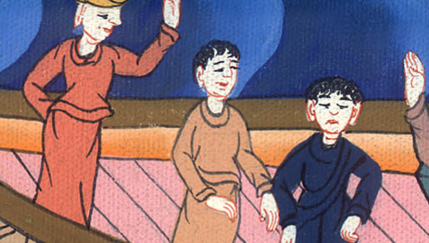
Acts 27:33

Slide 7
34Therefore I beg you to take some food, for this is for your safety; for not a hair will perish from any of your heads.”

Slide 8
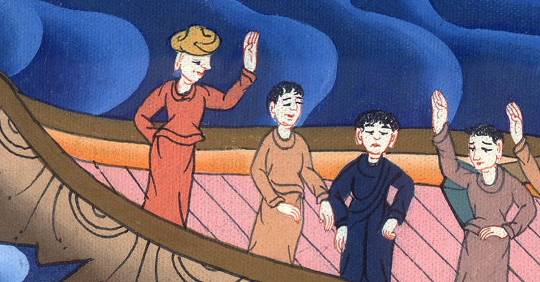
Acts 27:34

Slide 9
35When he had said this and had taken bread, he gave thanks to God in the presence of all; then he broke it and began to eat. 36Then they all cheered up, and they also took food.

Slide 10
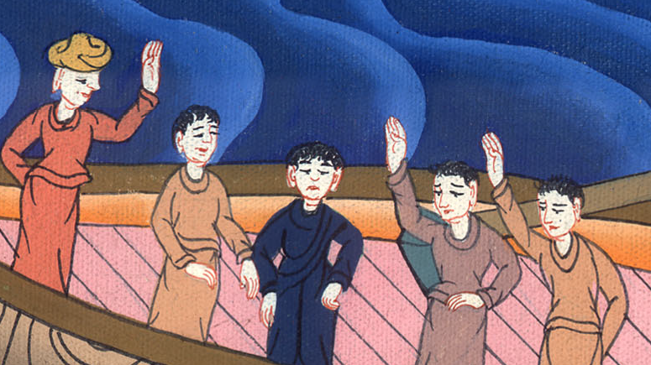
Acts 27:35,36

Slide 11
37In all, we were two hundred seventy-six souls on the ship. 38When they had eaten enough, they lightened the ship, throwing out the wheat into the sea.

Slide 12
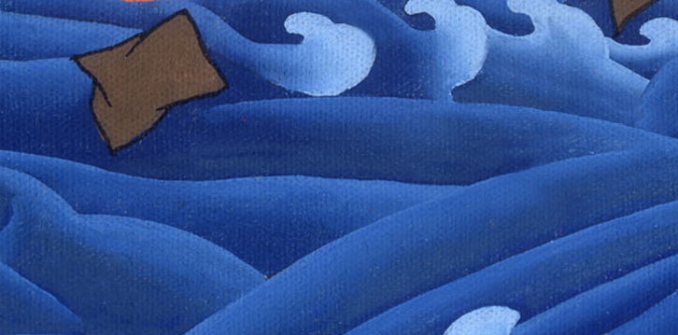
Acts 27:37,38

Slide 13
39When it was day, they didn’t recognize the land, but they noticed a certain bay with a beach, and they decided to try to drive the ship onto it.

Slide 14
Acts 27:39

Slide 15
40Casting off the anchors, they left them in the sea, at the same time untying the rudder ropes. Hoisting up the foresail to the wind, they made for the beach.

Slide 16
མཛད་པ། 27:40
Acts 27:40
Sails

Slide 17
41But coming to a place where two seas met, they ran the vessel aground. The front struck and remained immovable, but the back began to break up by the violence of the waves.

Slide 18
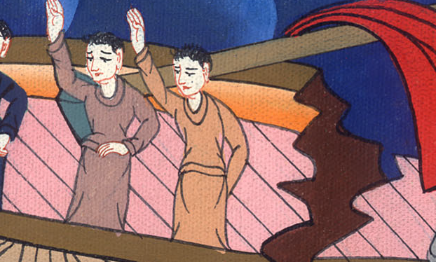
Acts 27:41

Slide 19
42The soldiers’ counsel was to kill the prisoners, so that none of them would swim out and escape.

Slide 20
Acts 27:42

Slide 21
43But the centurion, desiring to save Paul, stopped them from their purpose, and commanded that those who could swim should throw themselves overboard first to go toward the land;

Slide 22
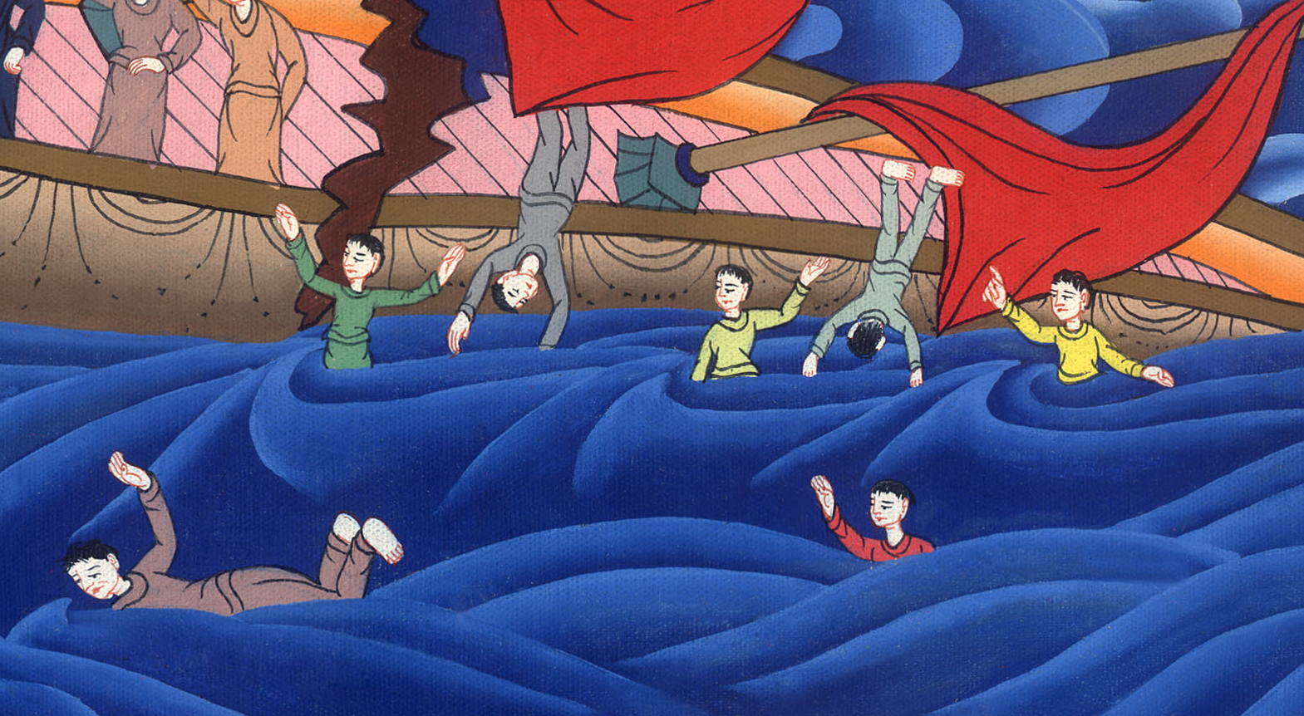
Acts 27:43

Slide 23
44and the rest should follow, some on planks and some on other things from the ship. So they all escaped safely to the land.

Slide 24
Acts 27:44

