Slide 1
56-3
This work is licensed under a Creative Commons Attribution-ShareAlike 4.0 International License.
Please add this statement to all the videos you create.
English Bible quotes are from the World English Bible US, which is in the public domain.
Notes:
Ch
56 Paul goes to Rome
1. Paul on the ship – Acts 27:1-32 (Top)
2. The Shipwreck – Acts 27:33-44 (Center)
3. Snakebite – Acts 28:1-10 (Right Bottom)
4. Paul arrives in Rome – Acts 28:11-31 (Left Bottom)

Slide 2
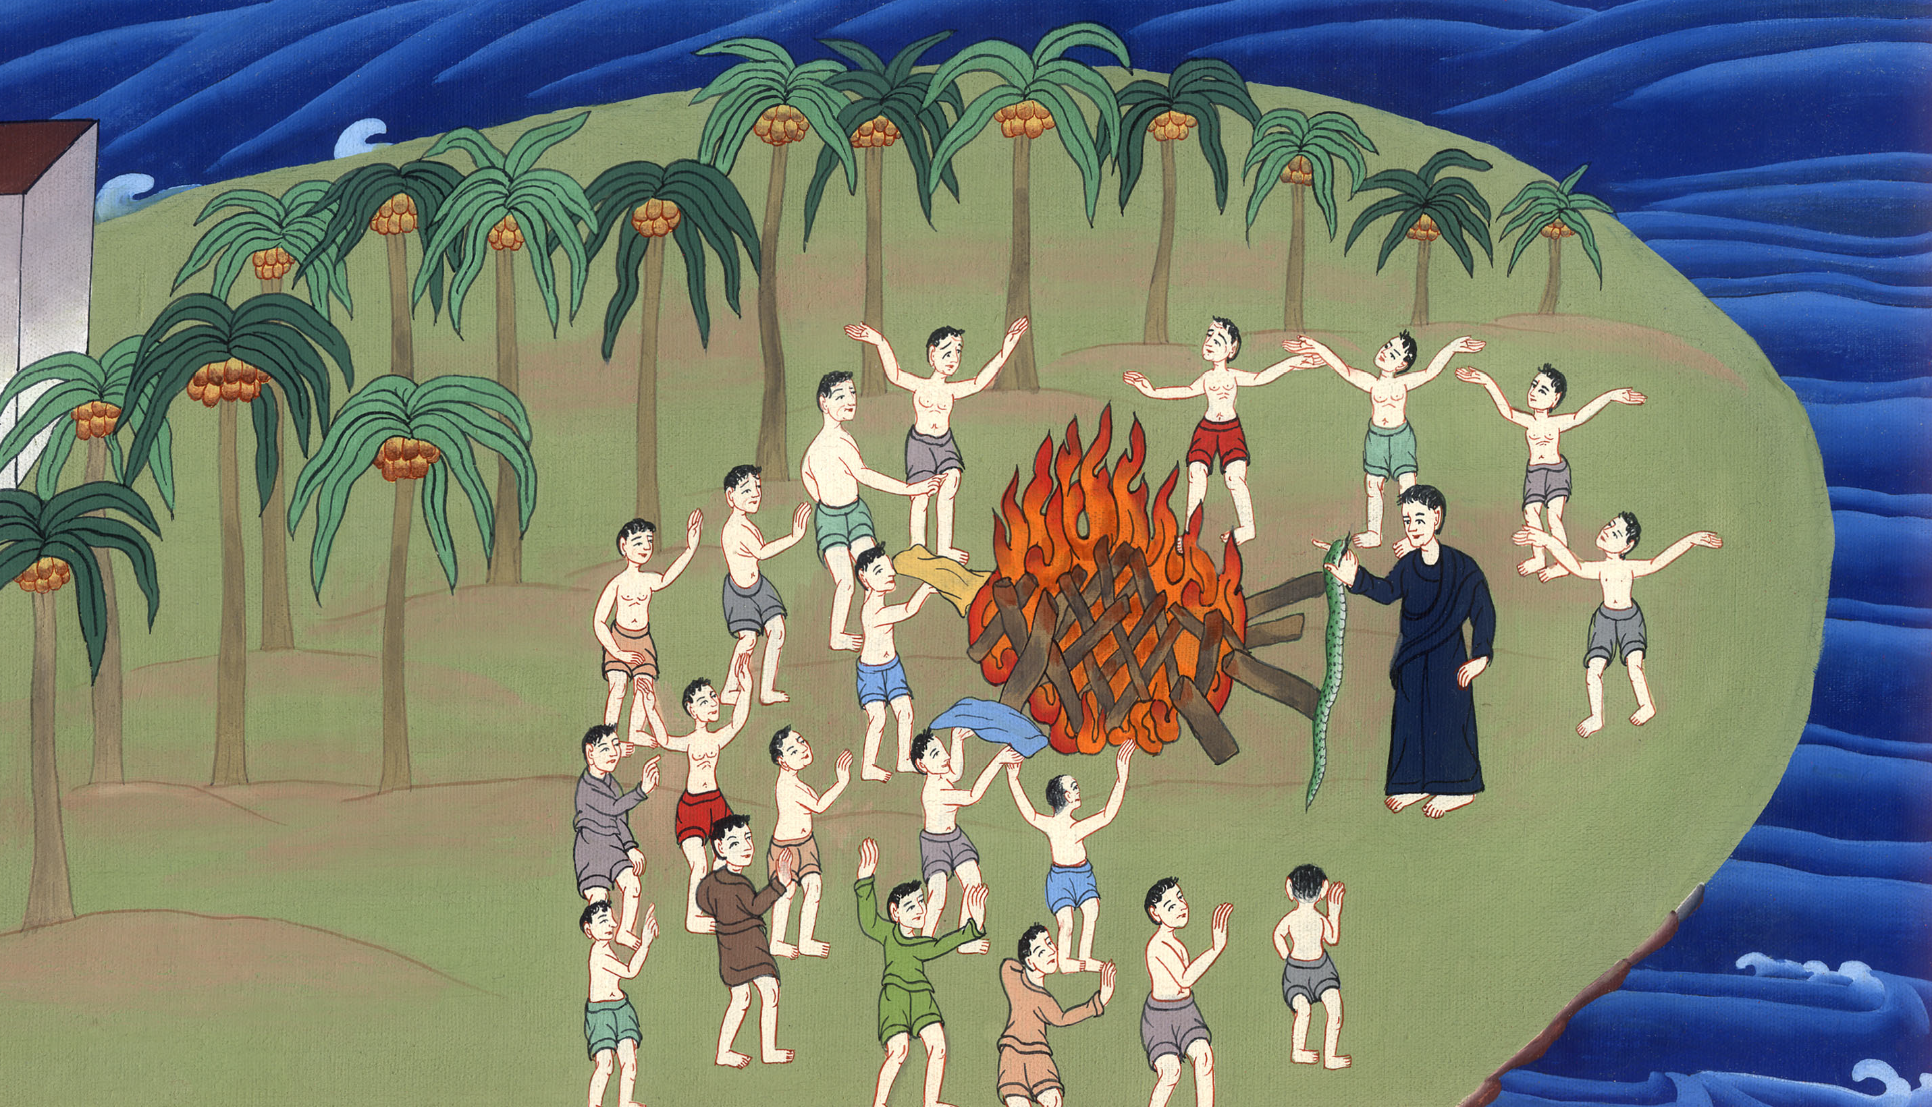
Snakebite – Acts 28:1-10

Slide 3
Snakebite – Acts 28:1-10

Slide 4
Snakebite – Acts 28:1-10

Slide 5
1When we had escaped, then they learned that the island was called Malta.

Slide 6
Acts 28:1

Slide 7
2The natives showed us uncommon kindness; for they kindled a fire and received us all, because of the present rain and because of the cold.

Slide 8
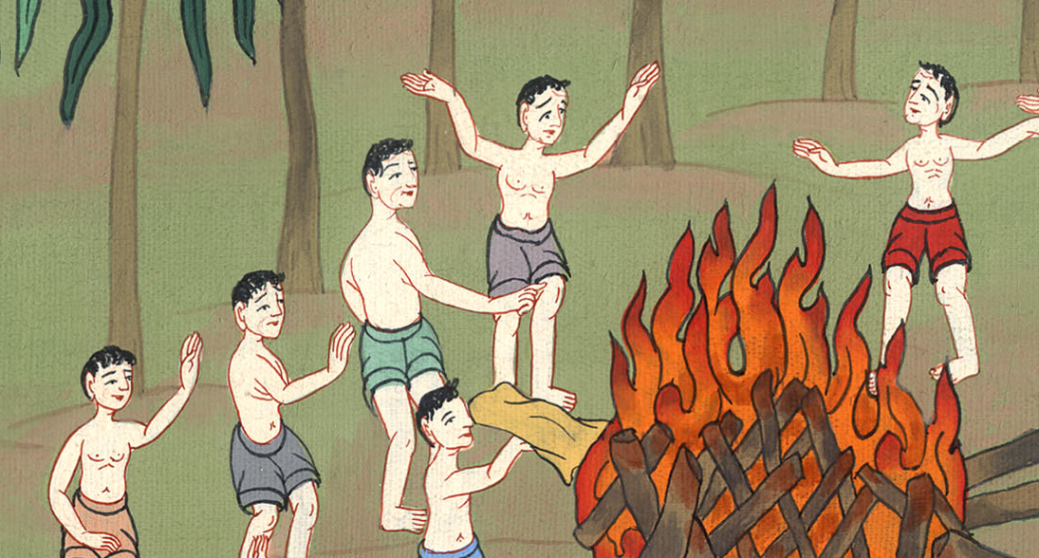
Acts 28:2

Slide 9
3But when Paul had gathered a bundle of sticks and laid them on the fire, a viper came out because of the heat and fastened on his hand.

Slide 10
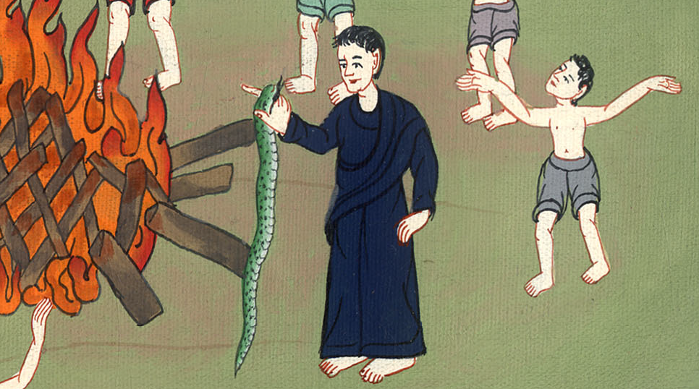
Acts 28:3

Slide 11
4When the natives saw the creature hanging from his hand, they said to one another, “No doubt this man is a murderer, whom, though he has escaped from the sea, yet Justice has not allowed to live.”

Slide 12
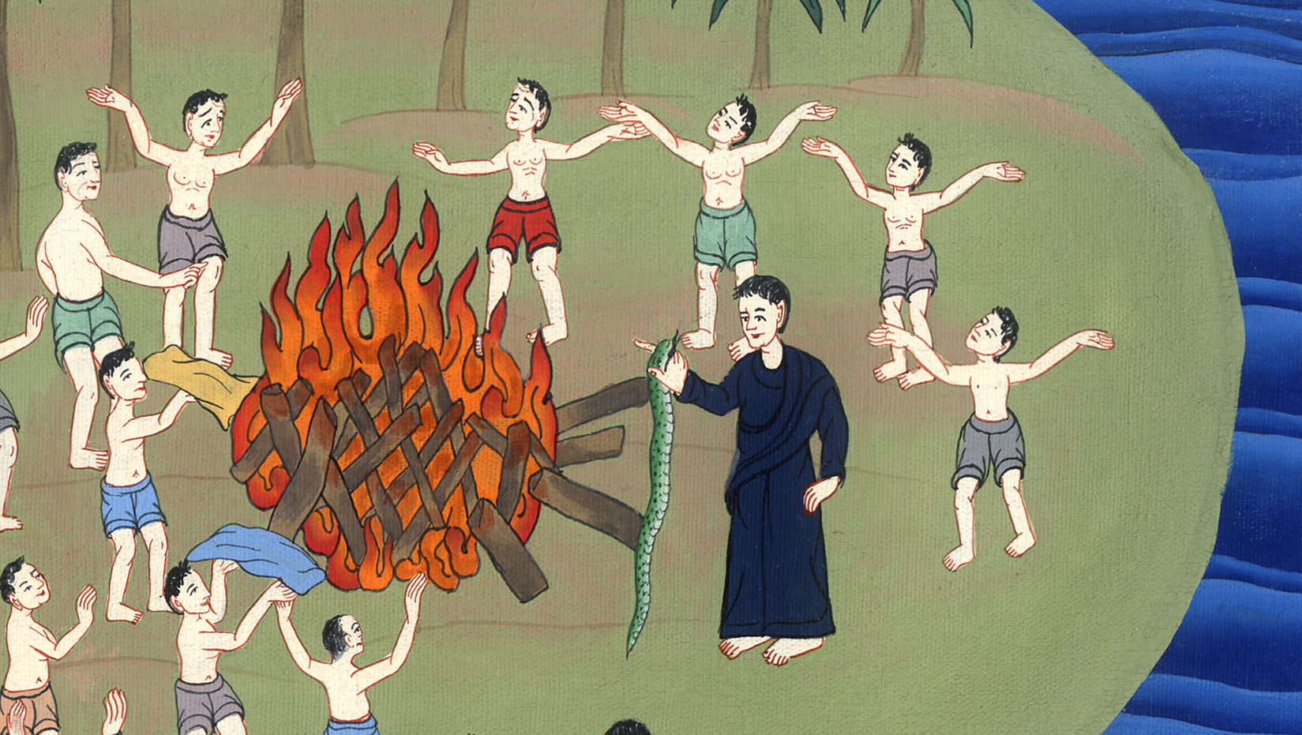
Acts 28:4

Slide 13
5However he shook off the creature into the fire, and wasn’t harmed.

Slide 14
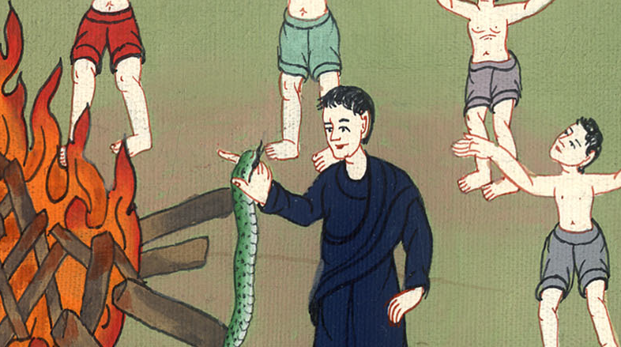
Acts 28:5

Slide 15
6But they expected that he would have swollen or fallen down dead suddenly, but when they watched for a long time and saw nothing bad happen to him, they changed their minds and said that he was a god.

Slide 16
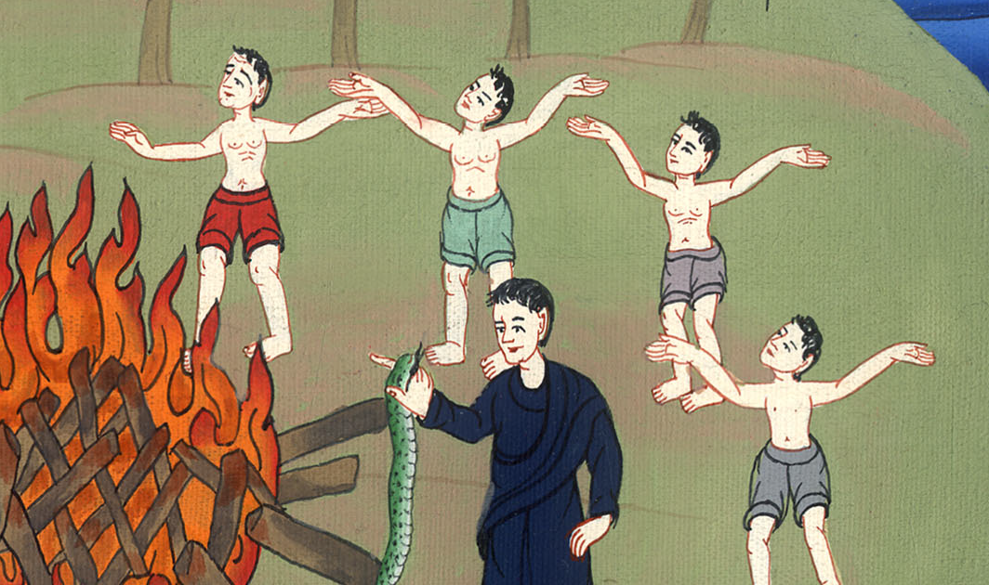
Acts 28:6

Slide 17
7Now in the neighborhood of that place were lands belonging to the chief man of the island, named Publius, who received us and courteously entertained us for three days.

Slide 18
Acts 28:7

Slide 19
8The father of Publius lay sick of fever and dysentery. Paul entered in to him, prayed, and laying his hands on him, healed him.

Slide 20
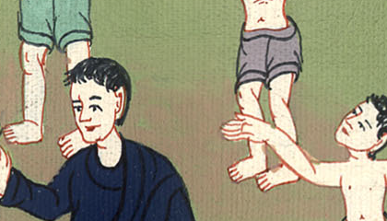
Acts 28:8

Slide 21
9Then when this was done, the rest also who had diseases in the island came and were cured.

Slide 22
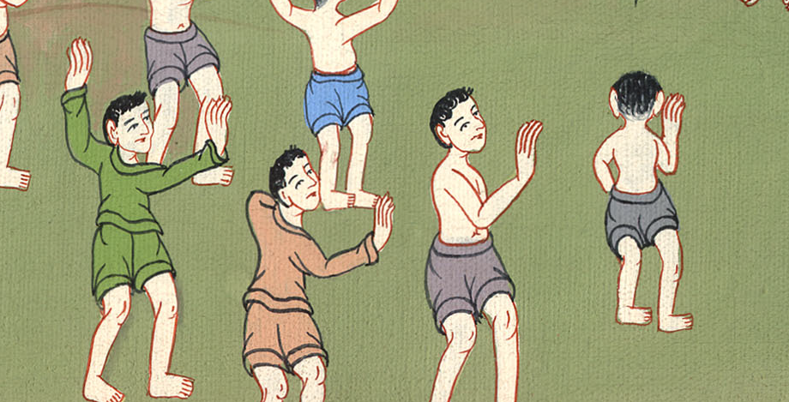
Acts 28:9

Slide 23
10They also honored us with many honors; and when we sailed, they put on board the things that we needed.

Slide 24
Acts 28:10

