Slide 1
56-4
This work is licensed under a Creative Commons Attribution-ShareAlike 4.0 International License.
Please add this statement to all the videos you create.
English Bible quotes are from the World English Bible US, which is in the public domain.
Notes:
Ch
56 Paul goes to Rome
1. Paul on the ship – Acts 27:1-32 (Top)
2. The Shipwreck – Acts 27:33-44 (Center)
3. Snakebite – Acts 28:1-10 (Right Bottom)
4. Paul arrives in Rome – Acts 28:11-31 (Left Bottom)

Slide 2
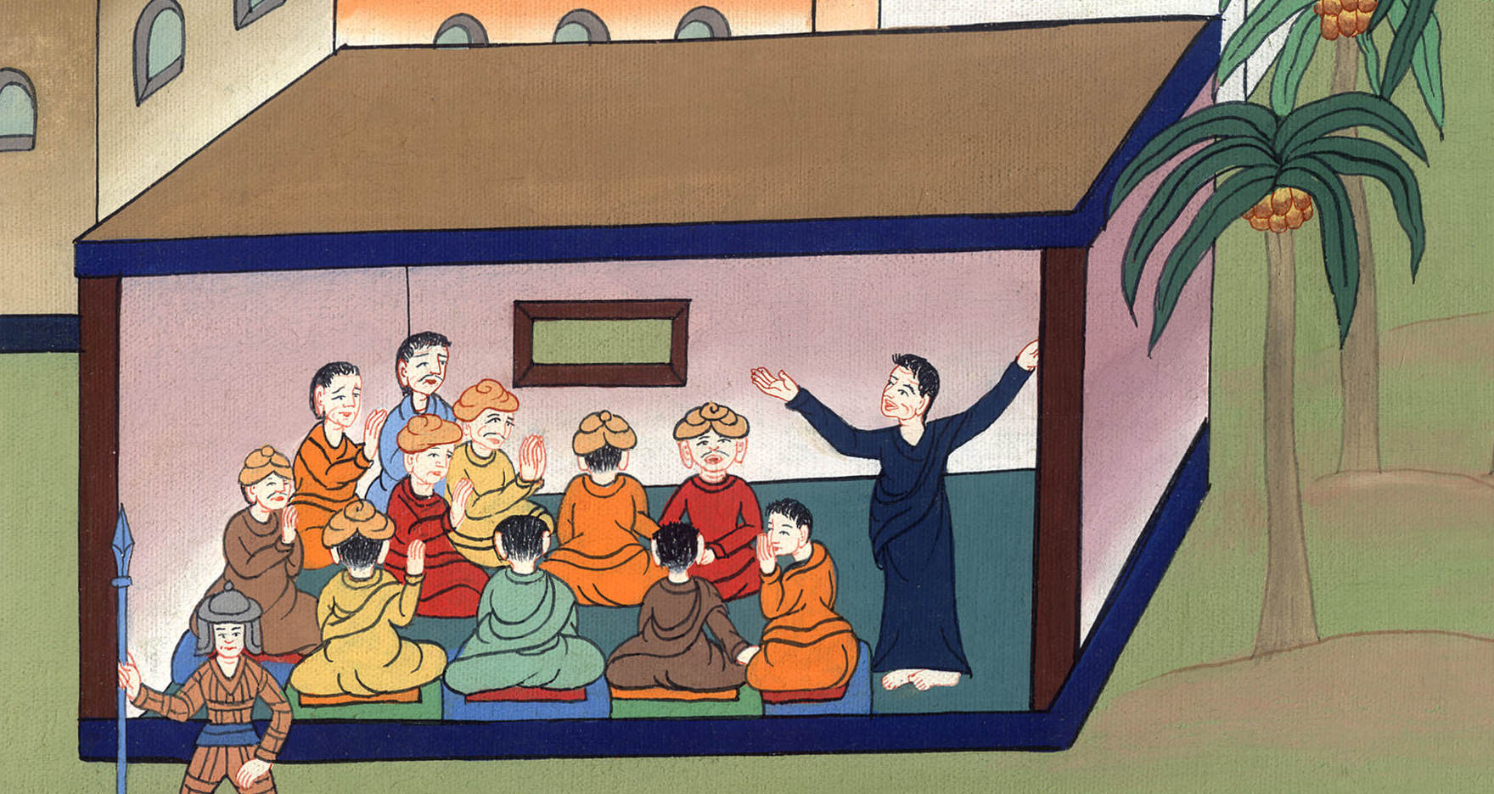
Paul arrives in Rome – Acts 28:15-31

Slide 3
Paul arrives in Rome – Acts 28:15-31
མཛད་པ། 28
རོ་མཱ་གྲོང་ཁྱེར་དུ་སླེབས་པ།

Slide 4
Paul arrives in Rome – Acts 28:15-31

Slide 5
After three months of winter were finished we sailed from island to Island. Finally we reached Rome

Slide 7
15From there the brothers, when they heard of us, came to meet us as far as The Market of Appius and The Three Taverns. When Paul saw them, he thanked God and took courage.

Slide 8
Acts 28:15

Slide 9
16When we entered into Rome, the centurion delivered the prisoners to the captain of the guard, but Paul was allowed to stay by himself with the soldier who guarded him.

Slide 10
Acts 28:16

Slide 11
17After three days Paul called together those who were the leaders of the Jews. When they had come together, he spoke to them.

Slide 12
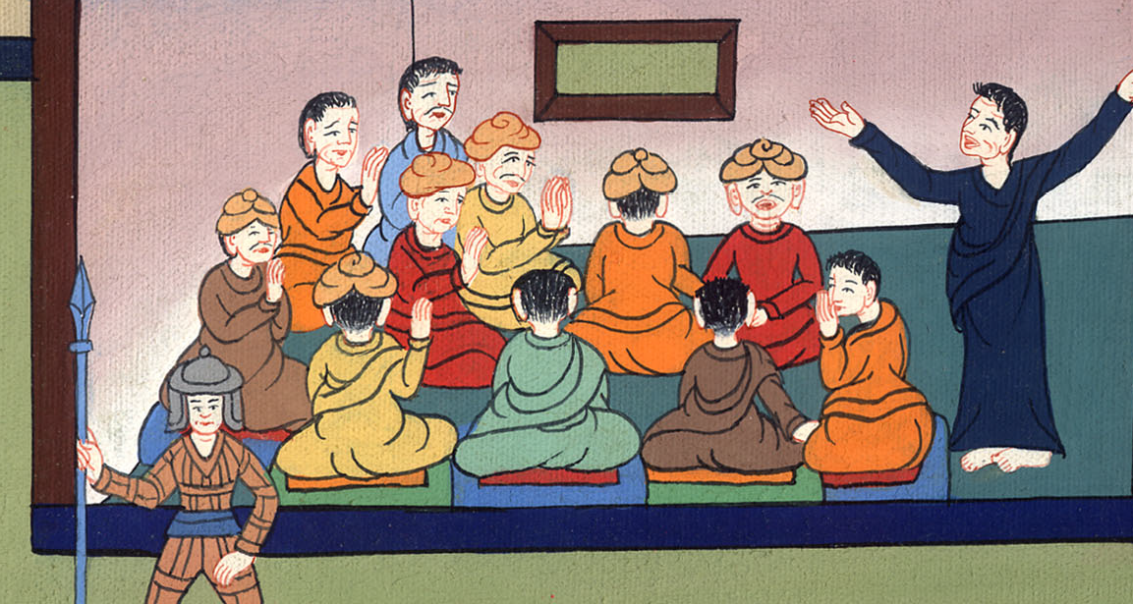
Acts 28:17

Slide 13
He said, “I, brothers, though I had done nothing against the people or the customs of our fathers, still was delivered prisoner from Jerusalem into the hands of the Romans.

Slide 14
Acts 28:17

Slide 15
18The Romans, when they had examined me, desired to set me free, because there was no cause of death in me.

Slide 16
Acts 28:18

Slide 17
19But when the Jews spoke against it, I was constrained to appeal to Caesar, not that I had anything about which to accuse my nation.

Slide 18
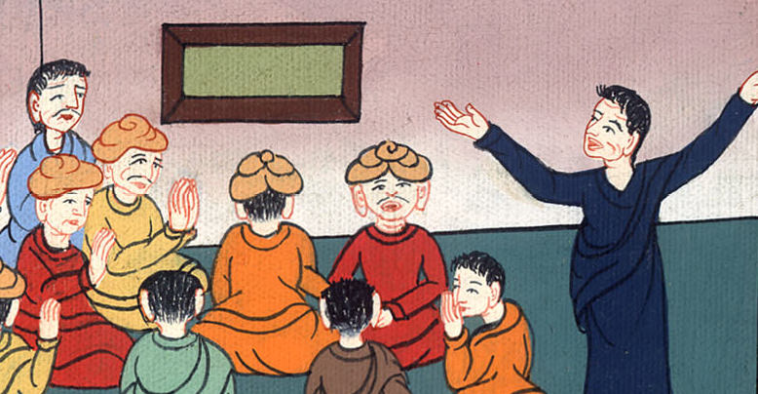
Acts 28:19

Slide 19
20For this cause therefore I asked to see you and to speak with you. For because of the hope of Israel I am bound with this chain.”

Slide 20
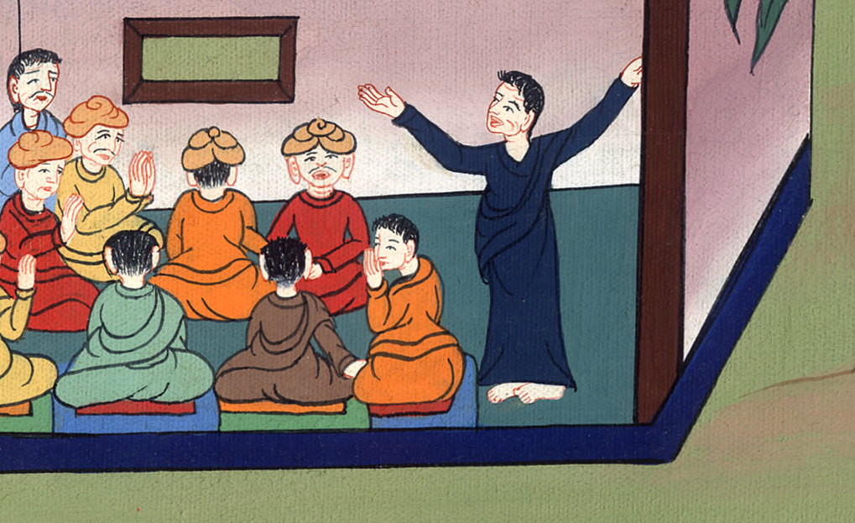
Acts 28:20

Slide 21
21They said to him, “We neither received letters from Judea concerning you, nor did any of the brothers come here and report or speak any evil of you.

Slide 22
Acts 28:21

Slide 23
22But we desire to hear from you what you think. For, as concerning this sect, it is known to us that everywhere it is spoken against.”

Slide 24
Acts 28:22

Slide 25
23When they had appointed him a day, many people came to him at his lodging. He explained to them, testifying about God’s Kingdom, and persuading them concerning Jesus, both from the law of Moses and from the prophets, from morning until evening.

Slide 26
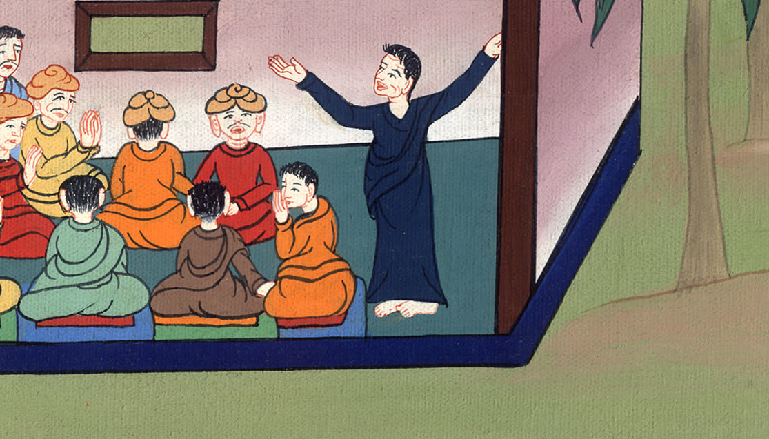
Acts 28:23

Slide 27
24Some believed the things which were spoken, and some disbelieved.

Slide 28
Acts 28:24

Slide 29
25When they didn’t agree among themselves, they departed after Paul had spoken one message: “The Holy Spirit spoke rightly through Isaiah the prophet to our fathers.

Slide 30
Acts 28:25

Slide 31
26The spirit said,
‘Go to this people and say,
in hearing, you will hear,
but will in no way understand.
In seeing, you will see,
but will in no way perceive.
,

Slide 32
Acts 28:26

Slide 33
27For this people’s heart has grown callous.
Their ears are dull of hearing.
Their eyes they have closed.
Lest they should see with their eyes,
hear with their ears,
understand with their heart,
and would turn again,
then I would heal them.’

Slide 34
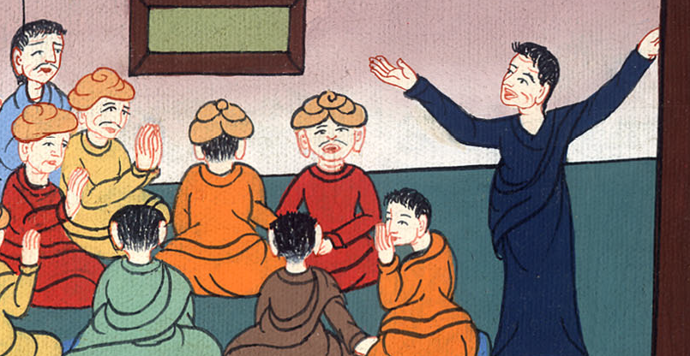
Acts 28:27

Slide 35
28“Be it known therefore to you that the salvation of God is sent to the nations, and they will listen.”

Slide 36
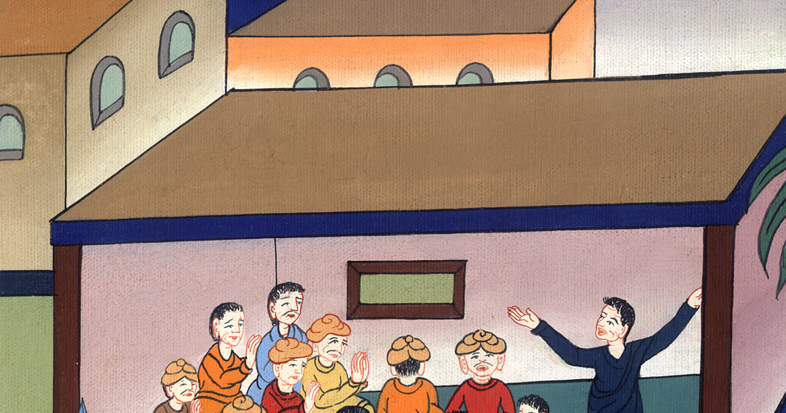
Acts 28:28

Slide 37
30Paul stayed two whole years in his own rented house and received all who were coming to him.

Slide 38
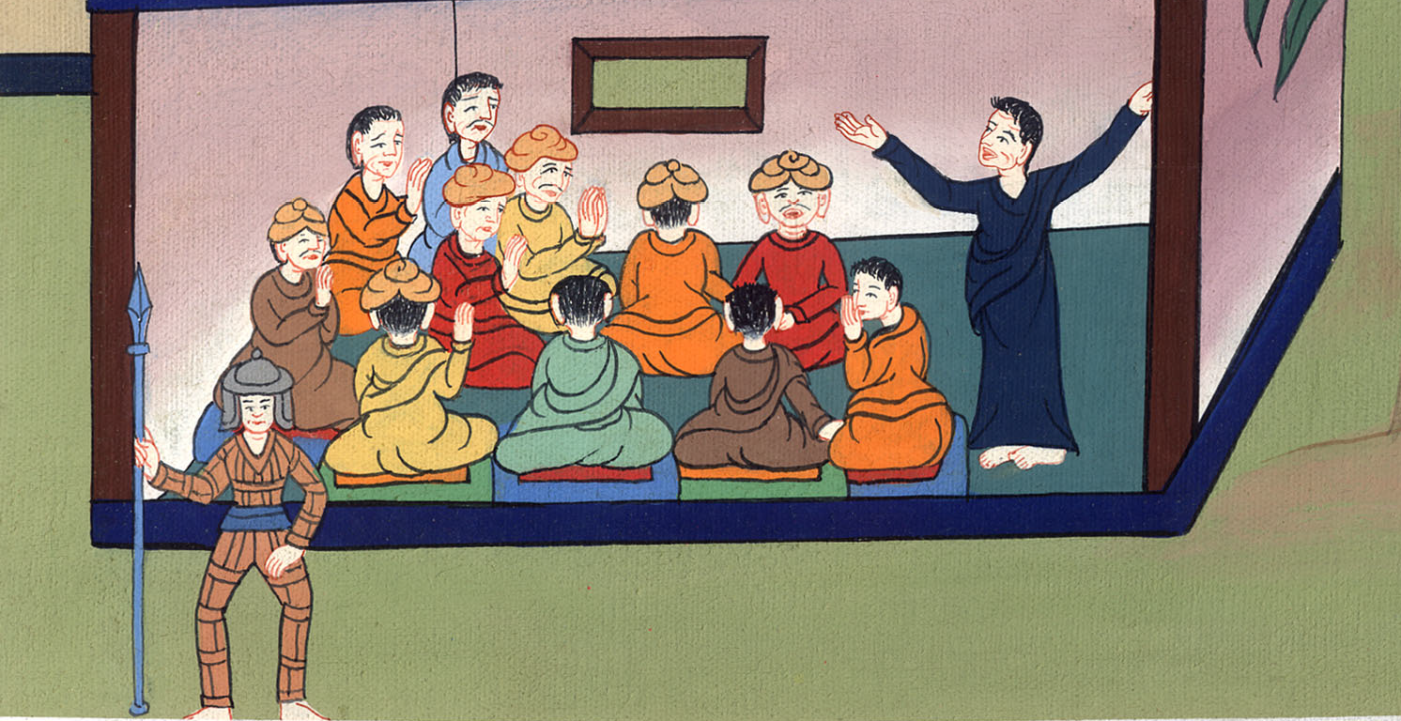
Acts 28:30

Slide 39
31He preached God’s Kingdom and teaching the things concerning the Lord Jesus Christ with all boldness, without hindrance.

Slide 40
Acts 28:31

