Slide 1
57-2
This work is licensed under a Creative Commons Attribution-ShareAlike 4.0 International License.
Please add this statement to all the videos you create.
English Bible quotes are from the World English Bible US, which is in the public domain.

Slide 2
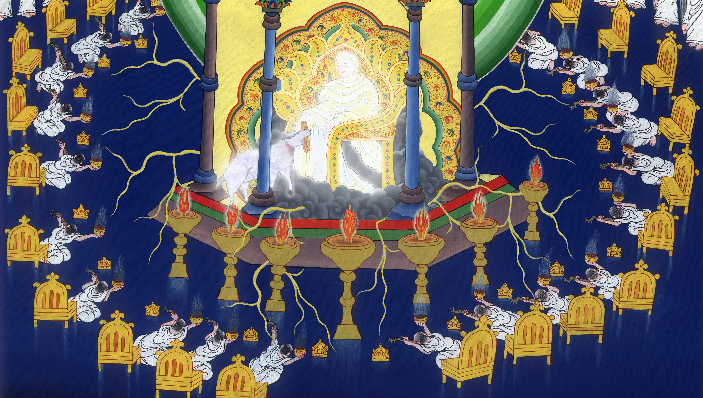
The Scroll and the Lamb - Revelation 5

Slide 3
The Scroll and the Lamb- Revelation 5

Slide 4
The Scroll and the Lamb - Revelation 5

Slide 5
1I saw, in the right hand of him who sat on the throne, a book written inside and outside, sealed shut with seven seals.

Slide 6
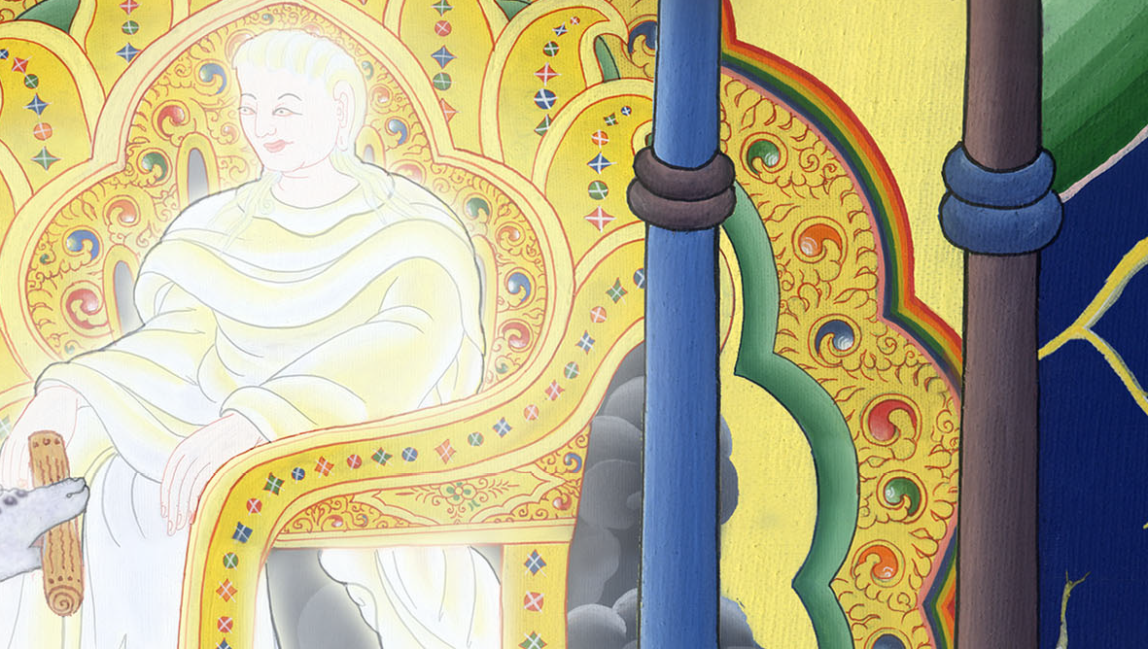
Revelation 5:1

Slide 7
2I saw a mighty angel proclaiming with a loud voice, “Who is worthy to open the book, and to break its seals?”

Slide 8
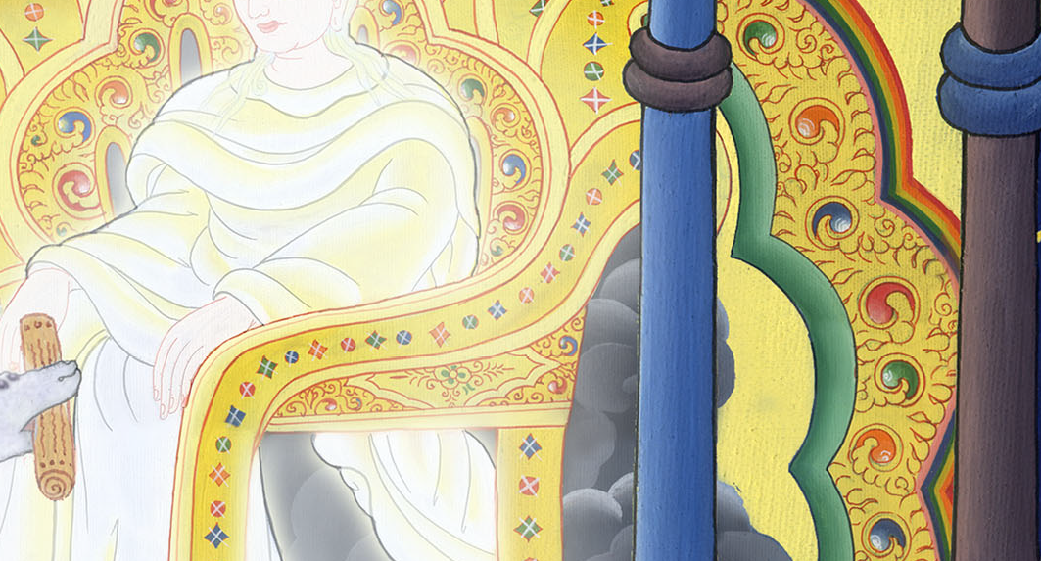
Revelation 5:2

Slide 9
3No one in heaven above, or on the earth, or under the earth, was able to open the book or to look in it.

Slide 10
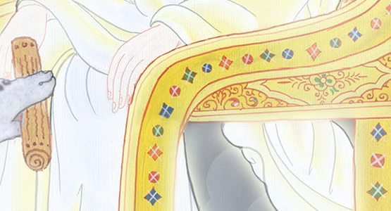
མངོན་པ། 5:3
Revelation 5:3

Slide 11
4Then I wept much, because no one was found worthy to open the book or to look in it.

Slide 12
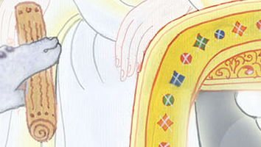
Revelation 5:4

Slide 13
5One of the elders said to me, “Don’t weep. Behold, the Lion who is of the tribe of Judah, the Root of David, has overcome: he who opens the book and its seven seals.”

Slide 14
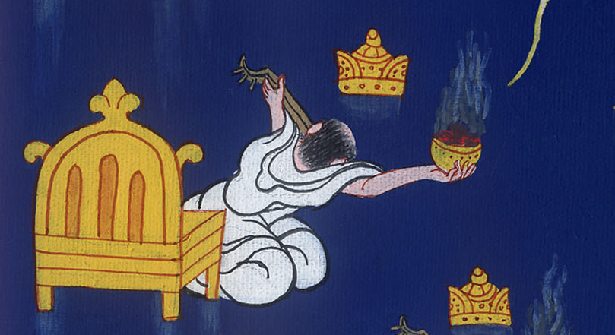
Revelation 5:5

Slide 15
6I saw in the middle of the throne and of the four living creatures, and in the middle of the elders, a Lamb standing, as though it had been slain, having seven horns and seven eyes, which are the seven Spirits of God, sent out into all the earth.

Slide 16
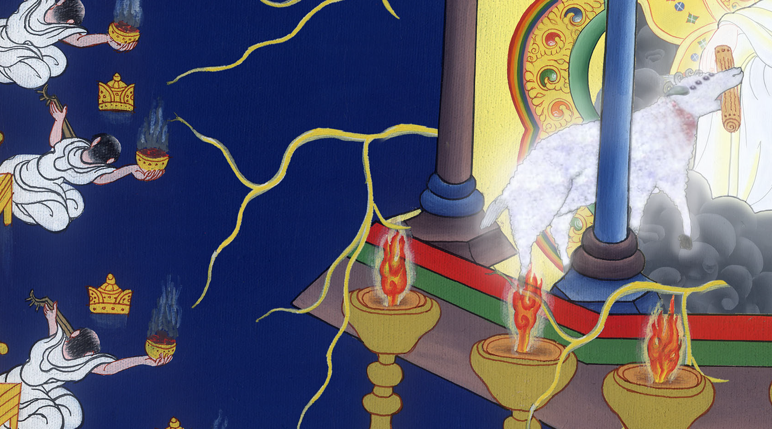
Revelation 5:6

Slide 17
7Then he came, and he took it out of the right hand of him who sat on the throne.

Slide 18
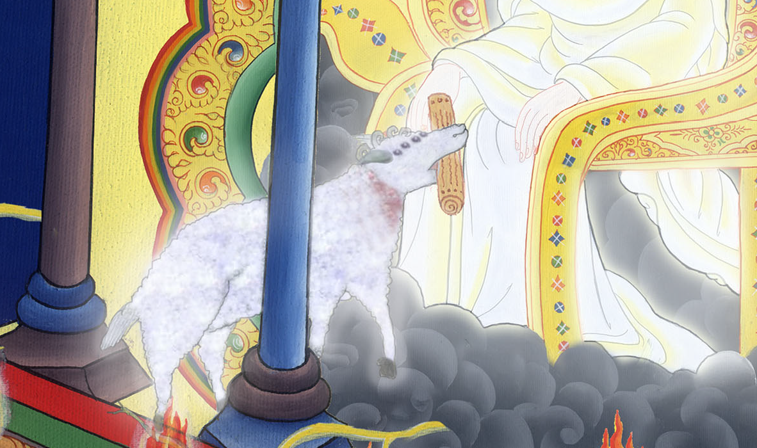
Revelation 5:7

Slide 19
8Now when he had taken the book, the four living creatures and the twenty-four elders fell down before the Lamb, each one having a harp, and golden bowls full of incense, which are the prayers of the saints.

Slide 20
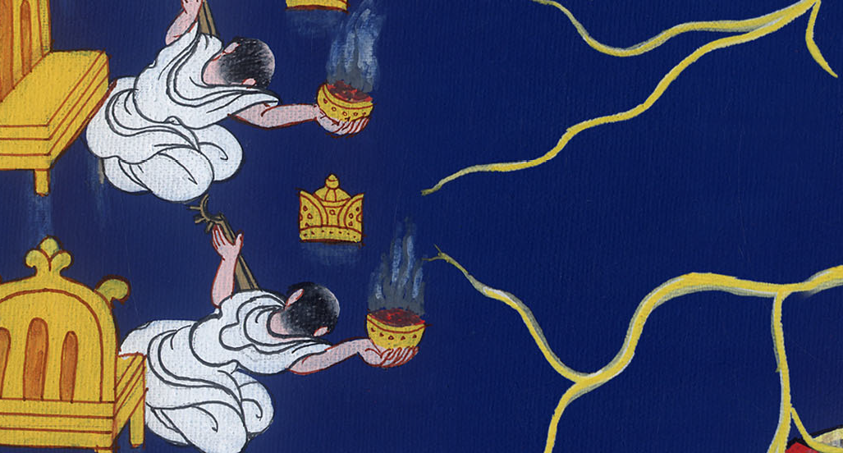
Revelation 5:8

Slide 21
9They sang a new song, saying,
“You are worthy to take the book
and to open its seals,
….

Slide 22
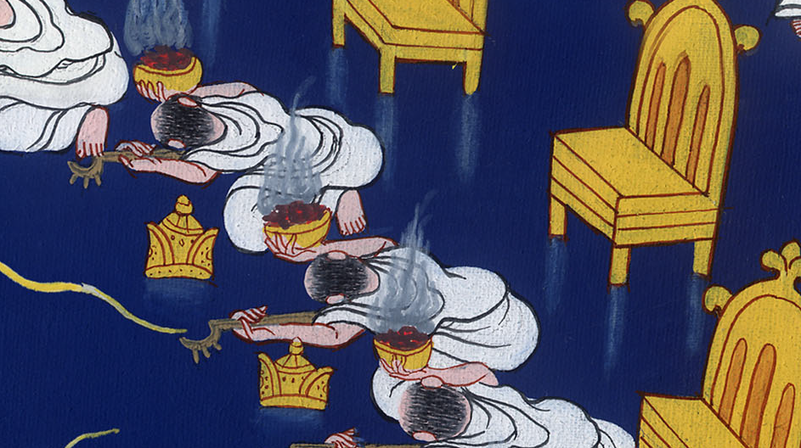
Revelation 5:9

Slide 23
for you were killed,
and bought us for God with your blood
out of every tribe, language, people, and nation,

Slide 24
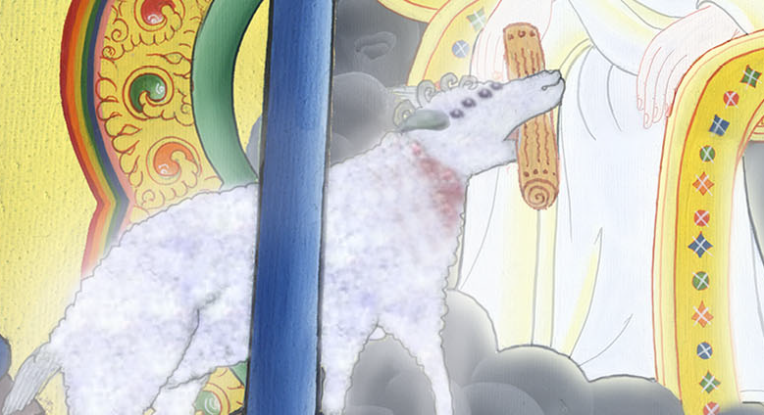
Revelation 5:9

Slide 25
10and made us kings and priests to our God;
and we will reign on the earth.”

Slide 26
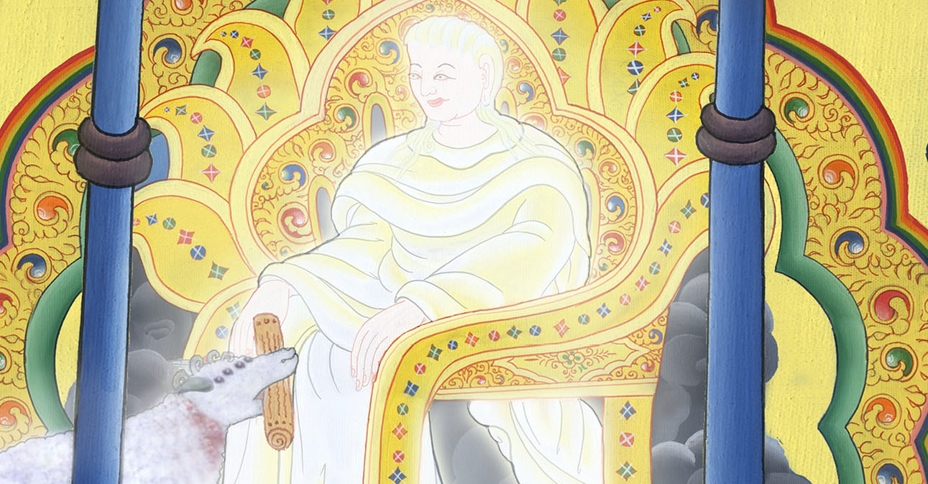
Revelation 5:10

Slide 27
11I looked, and I heard something like a voice of many angels around the throne, the living creatures, and the elders. The number of them was ten thousands of ten thousands, and thousands of thousands, 12saying with a loud voice,

Slide 28
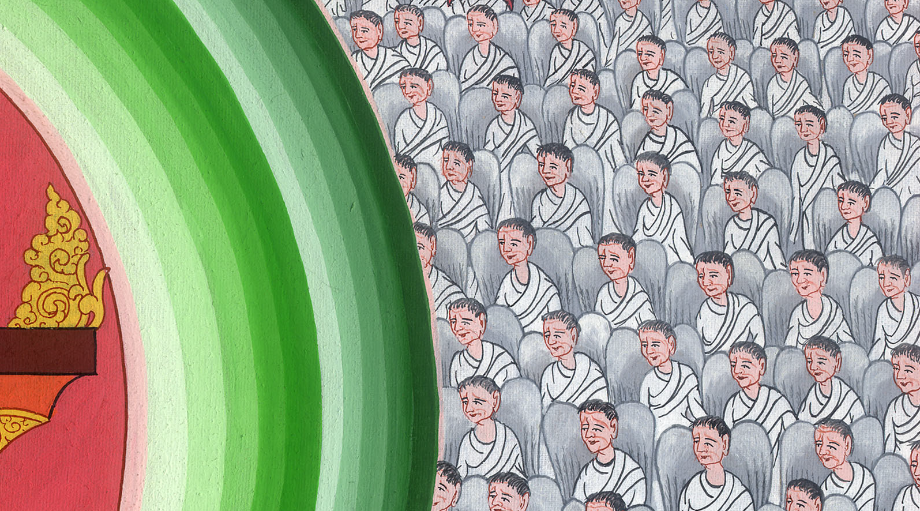
Revelation 5:11

Slide 29
“Worthy is the Lamb who has been killed to receive the power, wealth, wisdom, strength, honor, glory, and blessing!”

Slide 30
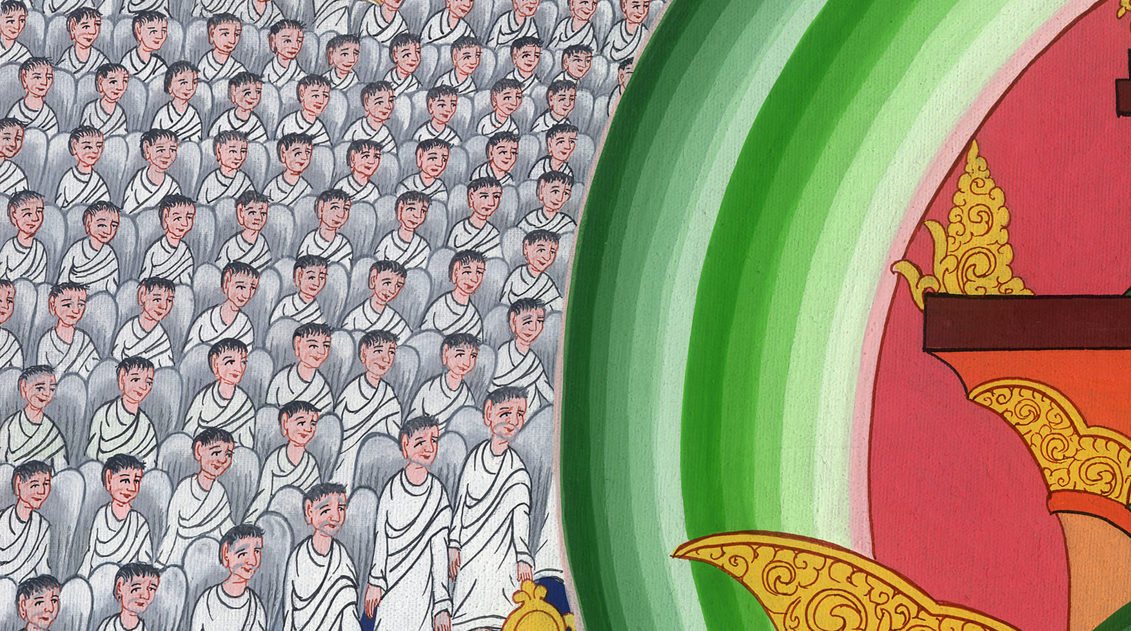
Revelation 5:12

Slide 31
13I heard every created thing which is in heaven, on the earth, under the earth, on the sea, and everything in them, saying,

Slide 32
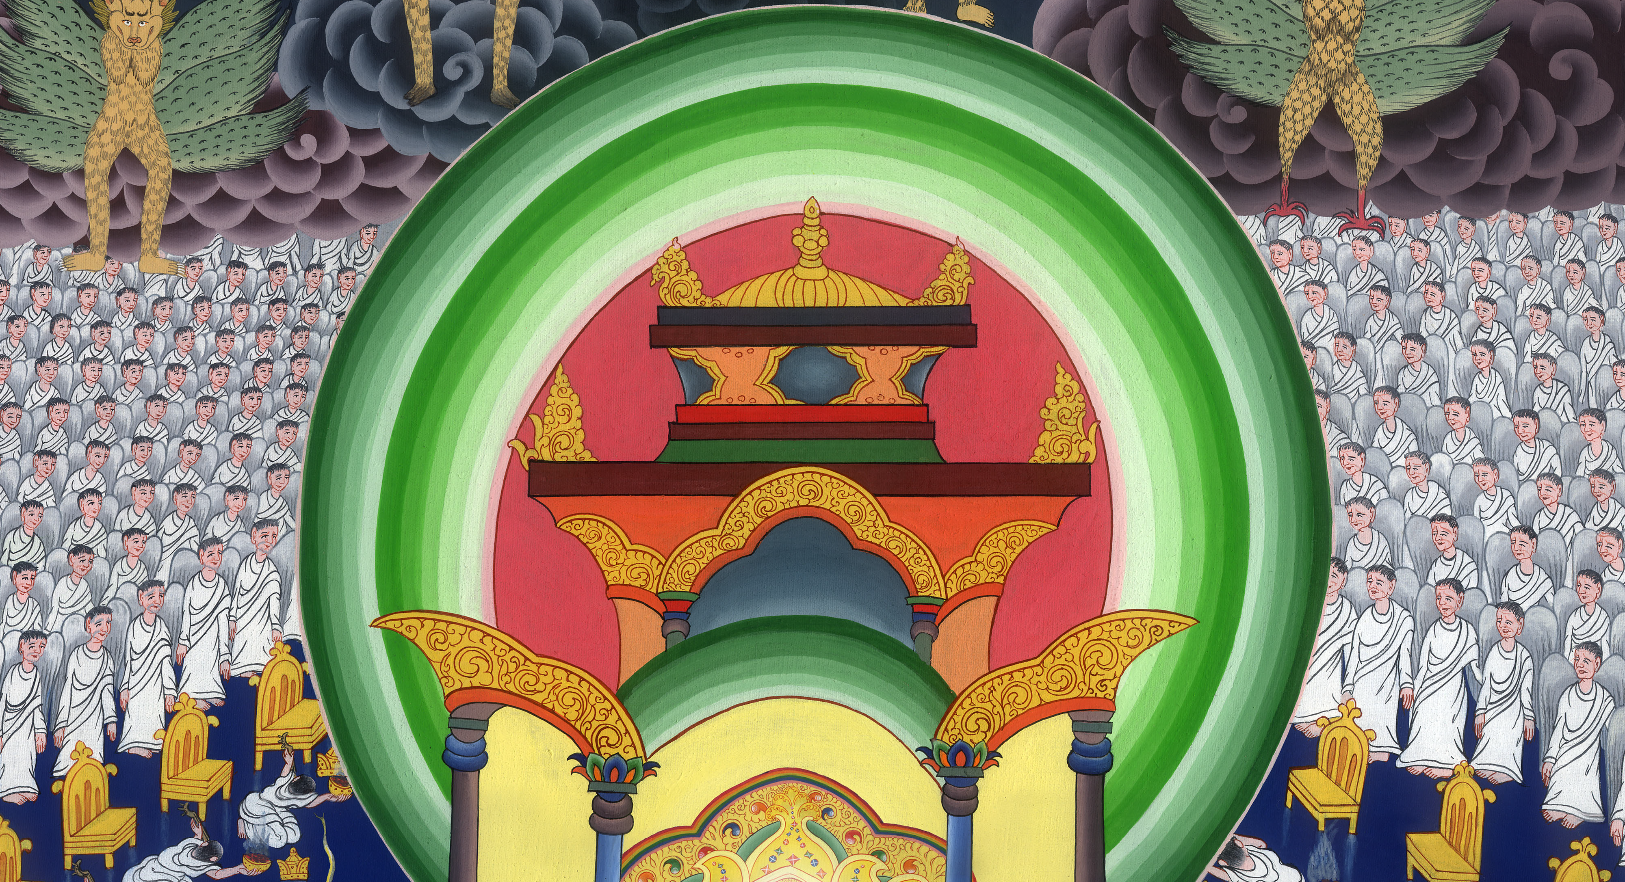
Revelation 5:13

Slide 33
“To him who sits on the throne and to the Lamb be the blessing, the honor, the glory, and the dominion, forever and ever! Amen!”

Slide 34
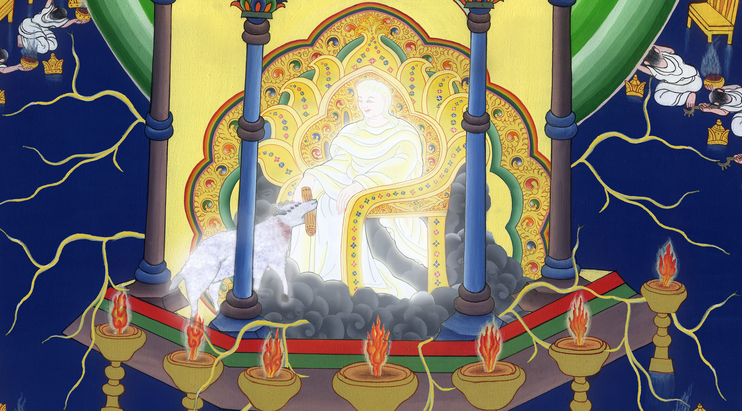
Revelation 5:13

Slide 35
14The four living creatures said, “Amen!” Then the elders fell down and worshiped.

Slide 36
Revelation 5:14

