Slide 1
58
This work is licensed under a Creative Commons Attribution-ShareAlike 4.0 International License.
Please add this statement to all the videos you create.
English Bible quotes are from the World English Bible US, which is in the public domain.
Notes:
Ch
P01 The Lost Son – Luke 15:11-32
1. The son asks his father for Inheritance - Luke 15:11-12 (Left Top)
2. The son goes away and waists the money – Luke 15:13 (Right Top)
3. The son gets a job feeding the pigs – Luke 15:14-16 (Right Center)
4. The son returns to his father – Luke 15:17-20 (Bottom)
5. The father restores the son – Luke 15:21-22 (Center)
6. The older son – Luke 15:23-32 (Left Center)

Slide 2
The Lost Son – Luke 15:11-32

Slide 3
The Lost Son – Luke 15:11-32

Slide 4
The Lost Son – Luke 15:11-32

Slide 5
11He said, “A certain man had two sons. 12The younger of them said to his father, ‘Father, give me my share of your property.’ So he divided his livelihood between them.

Slide 6
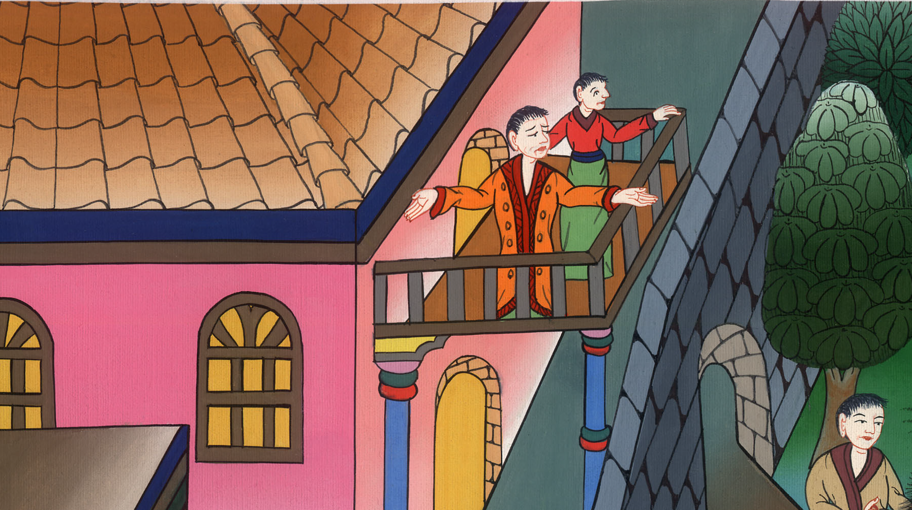
Luke 15:11,12

Slide 7
13Not many days after, the younger son gathered all of this together and traveled into a far country. There he wasted his property with riotous living.

Slide 8
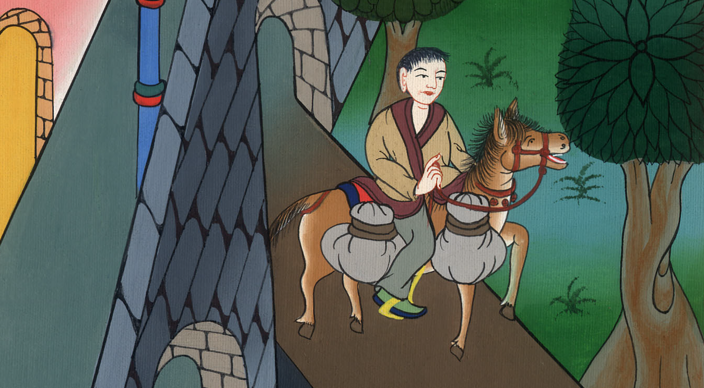
Luke 15:13

Slide 9
14When he had spent all of it, there arose a severe famine in that country, and he began to be in need.

Slide 10
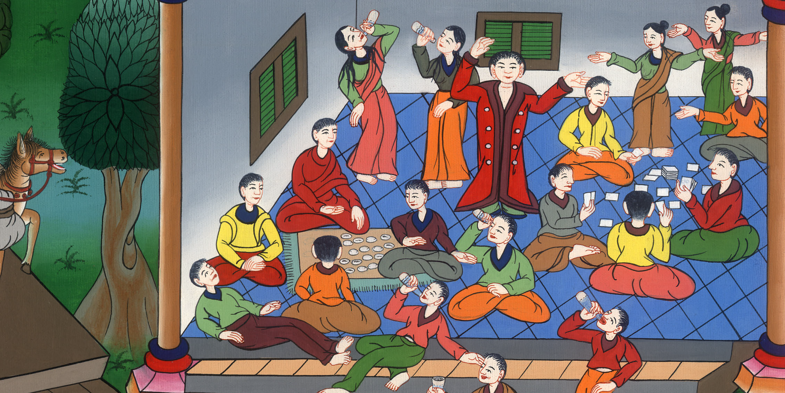
Luke 15:14

Slide 11
15He went and joined himself to one of the citizens of that country, and he sent him into his fields to feed pigs

Slide 12
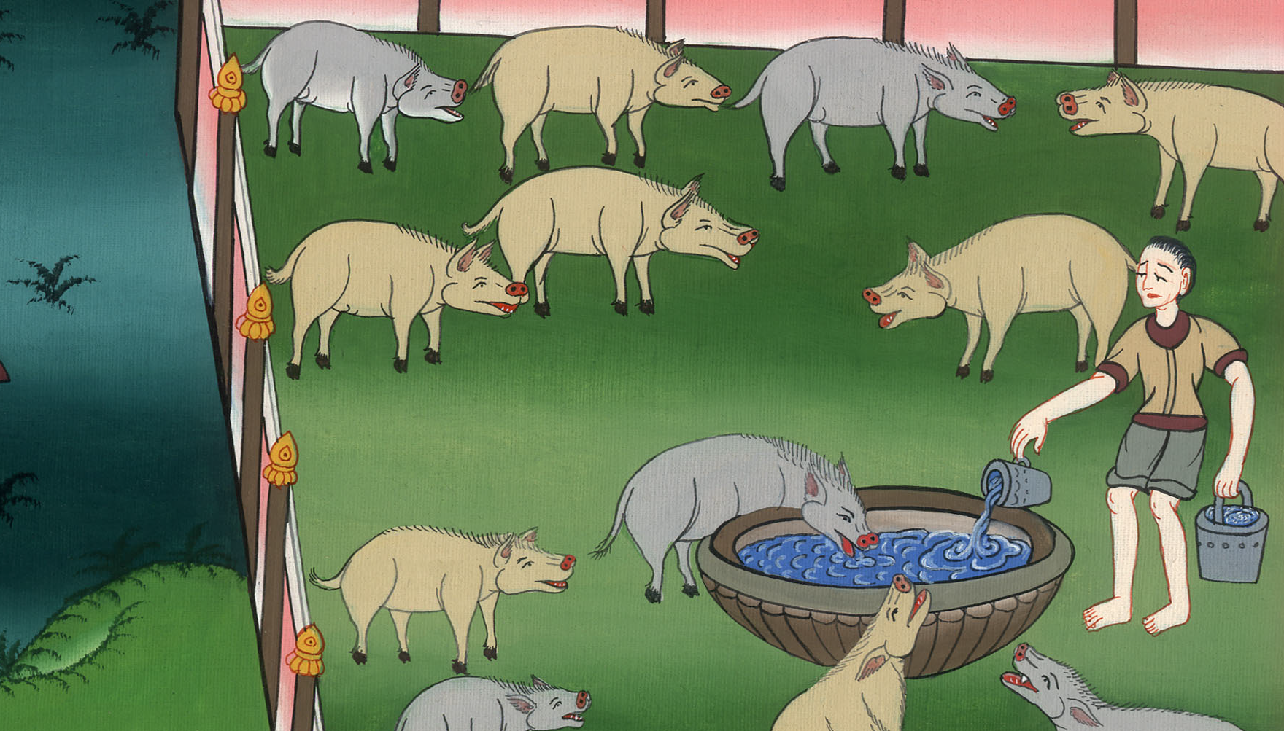
Luke 15:15

Slide 13
16He wanted to fill his belly with the pods that the pigs ate, but no one gave him any.

Slide 14
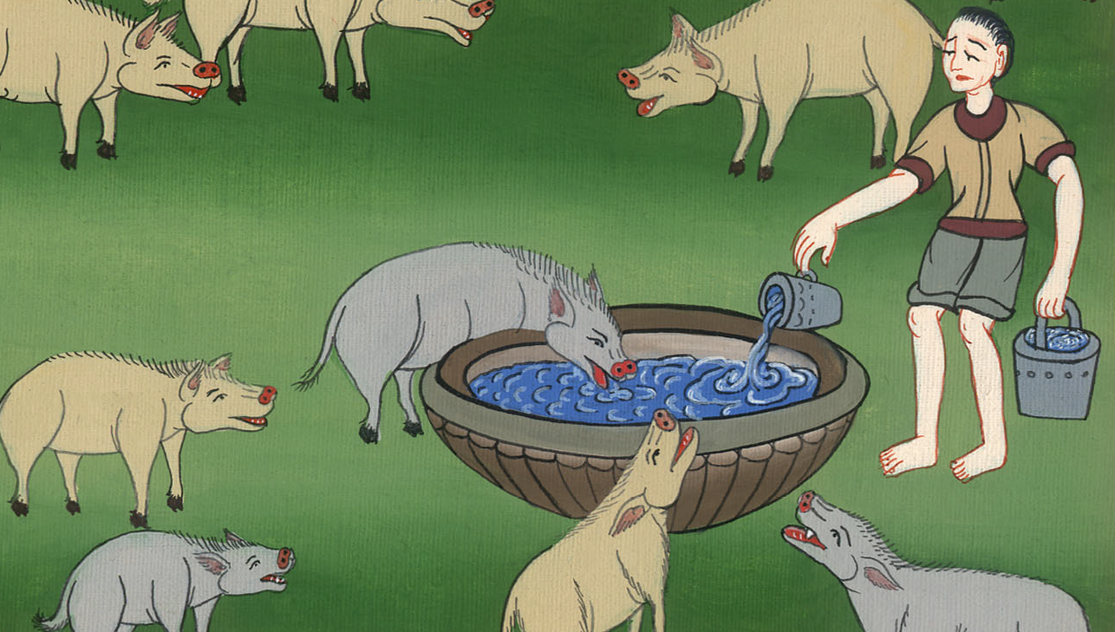
Luke 15:16

Slide 15
17But when he came to himself, he said, ‘How many hired servants of my father’s have bread enough to spare, and I’m dying with hunger!

Slide 16
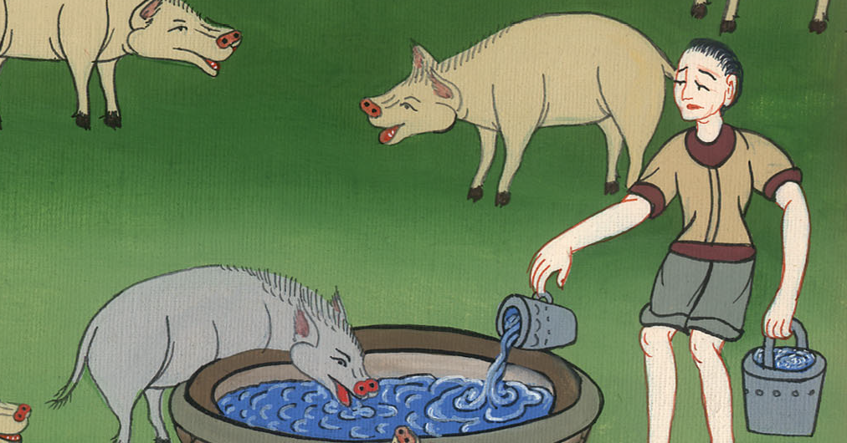
Luke 15:17

Slide 17
18I will get up and go to my father, and will tell him, “Father, I have sinned against heaven and in your sight.

Slide 18
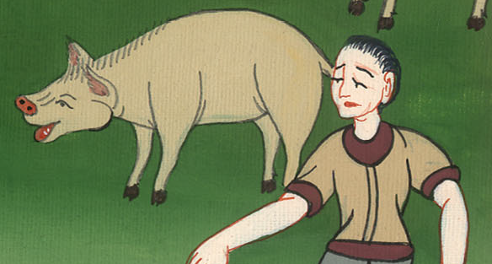
Luke 15:18

Slide 19
19I am no more worthy to be called your son. Make me as one of your hired servants.”’
20 “He arose and came to his father.

Slide 20
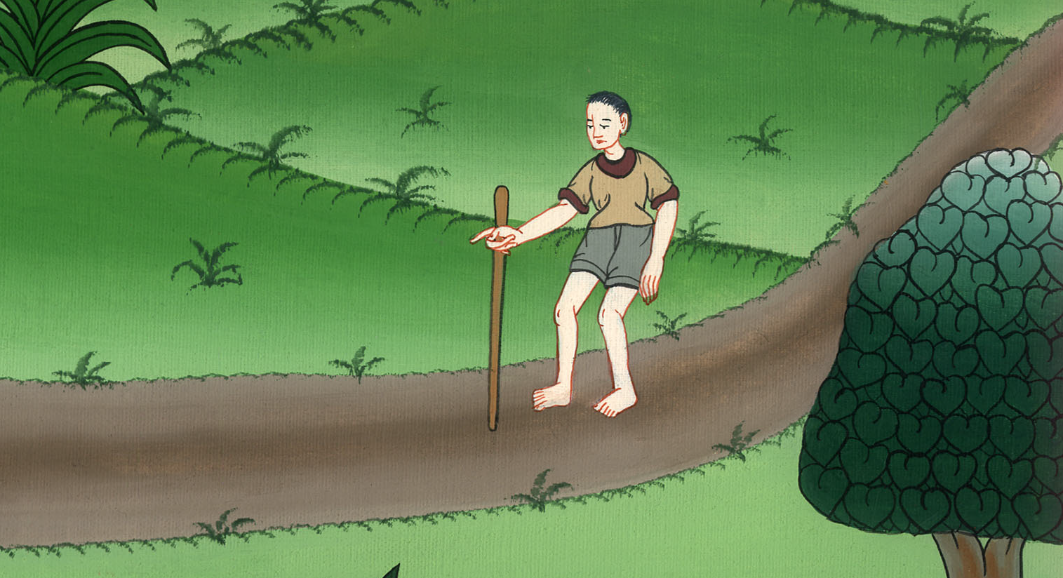
Luke 15:19

Slide 21
But while he was still far off, his father saw him and was moved with compassion, and ran, fell on his neck, and kissed him.

Slide 22
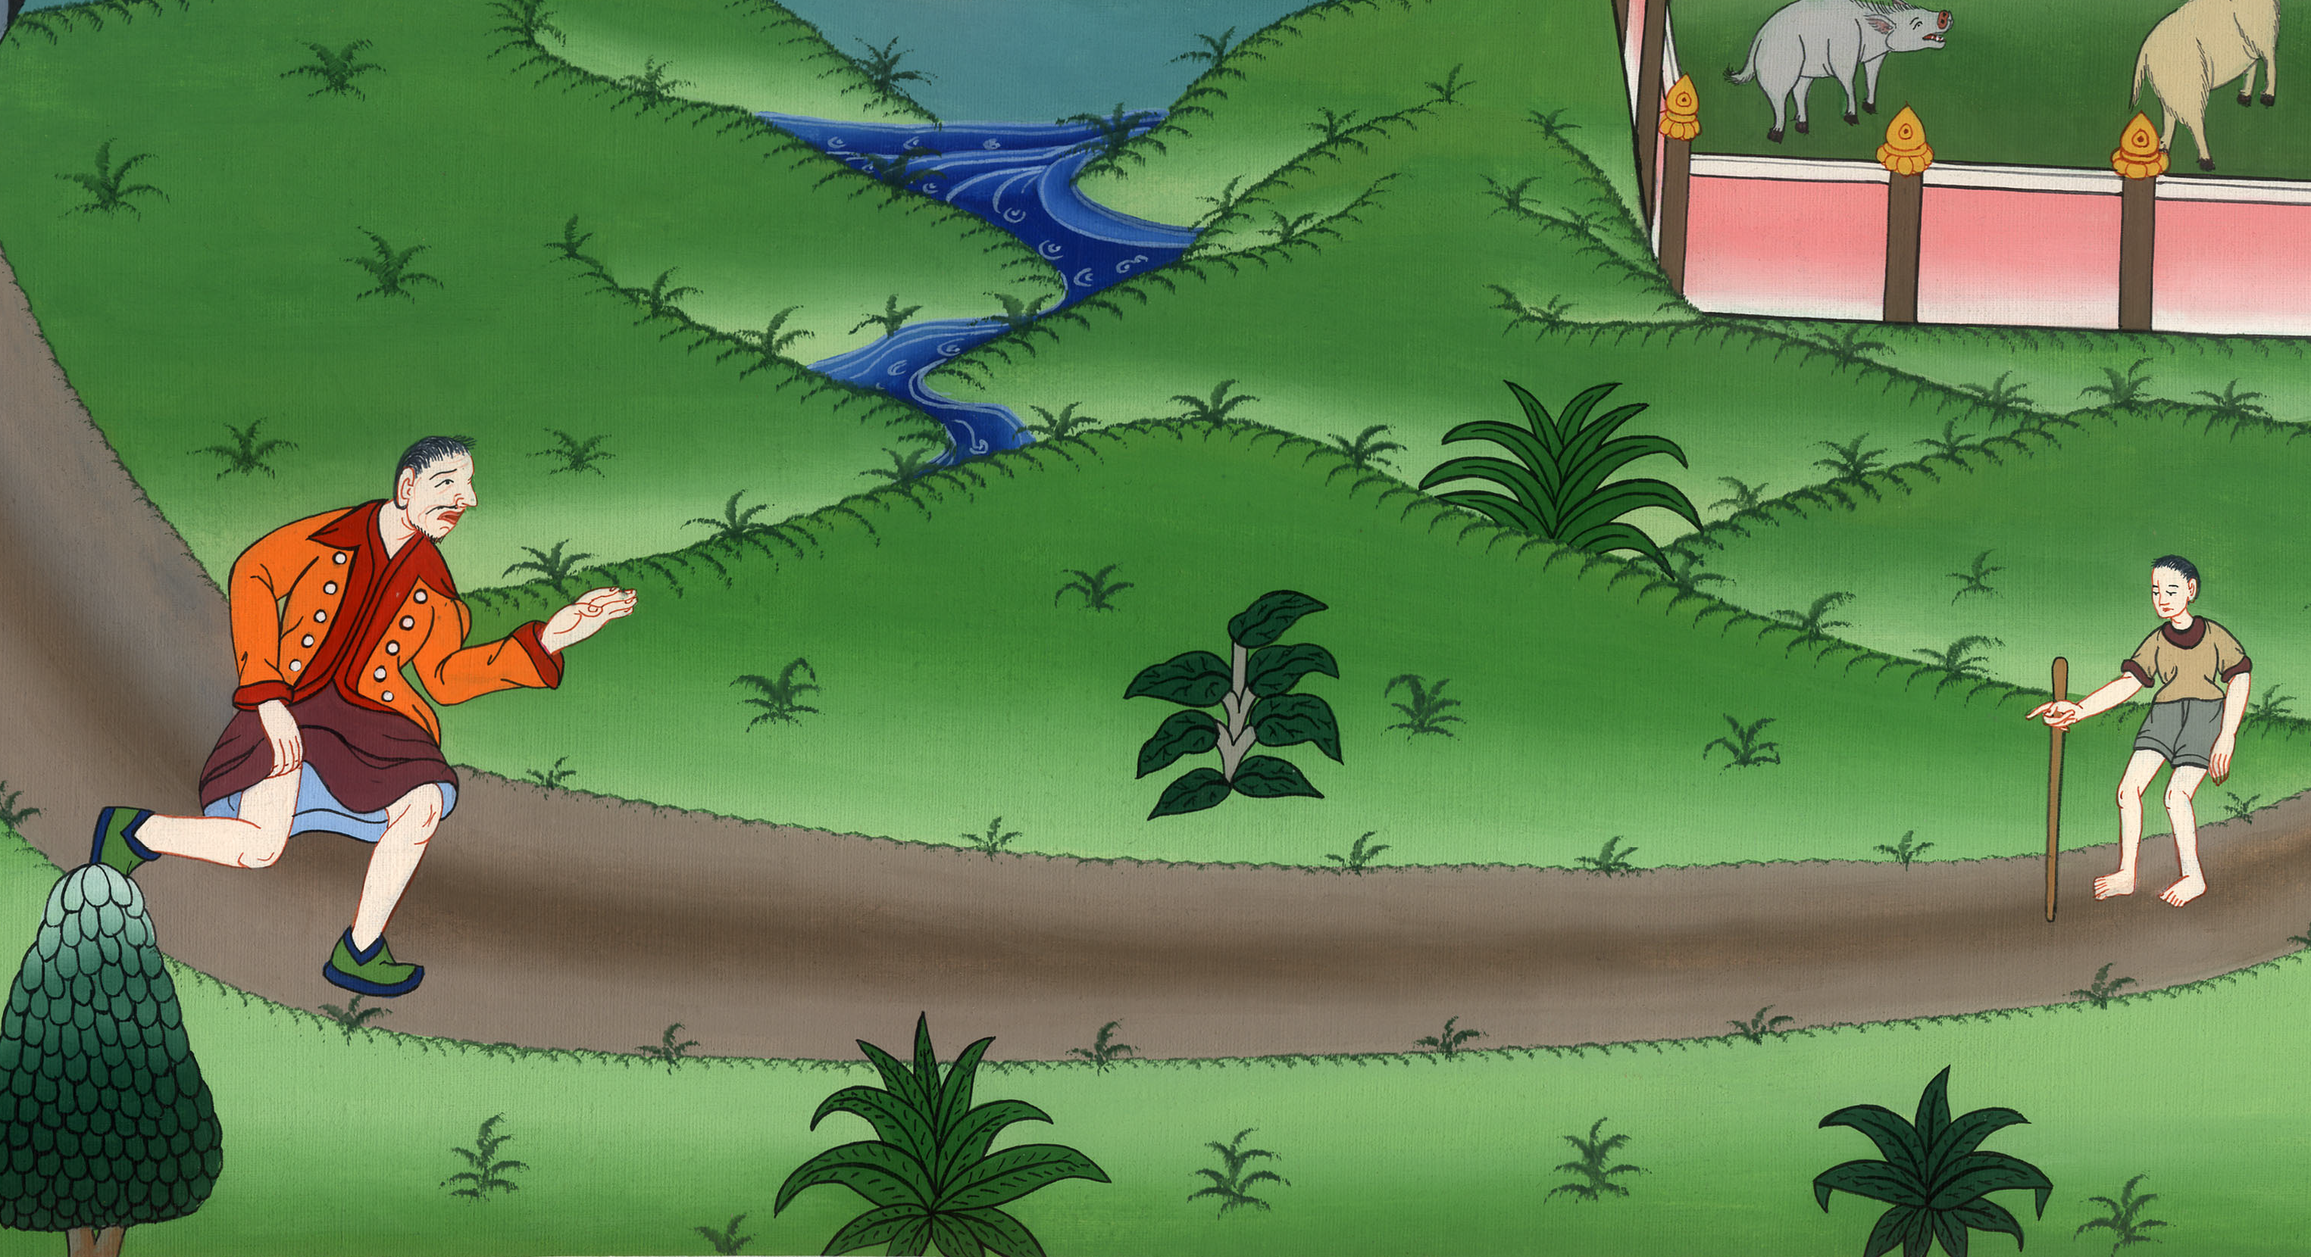
Luke 15:20

Slide 23
21The son said to him, ‘Father, I have sinned against heaven and in your sight. I am no longer worthy to be called your son.’

Slide 24
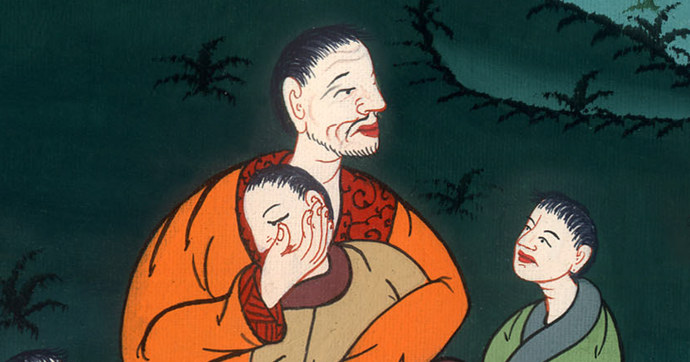
Luke 15:21

Slide 25
22“But the father said to his servants, ‘Bring out the best robe and put it on him. Put a ring on his hand and sandals on his feet. 23Bring the fattened calf, kill it, and let’s eat and celebrate;

Slide 26
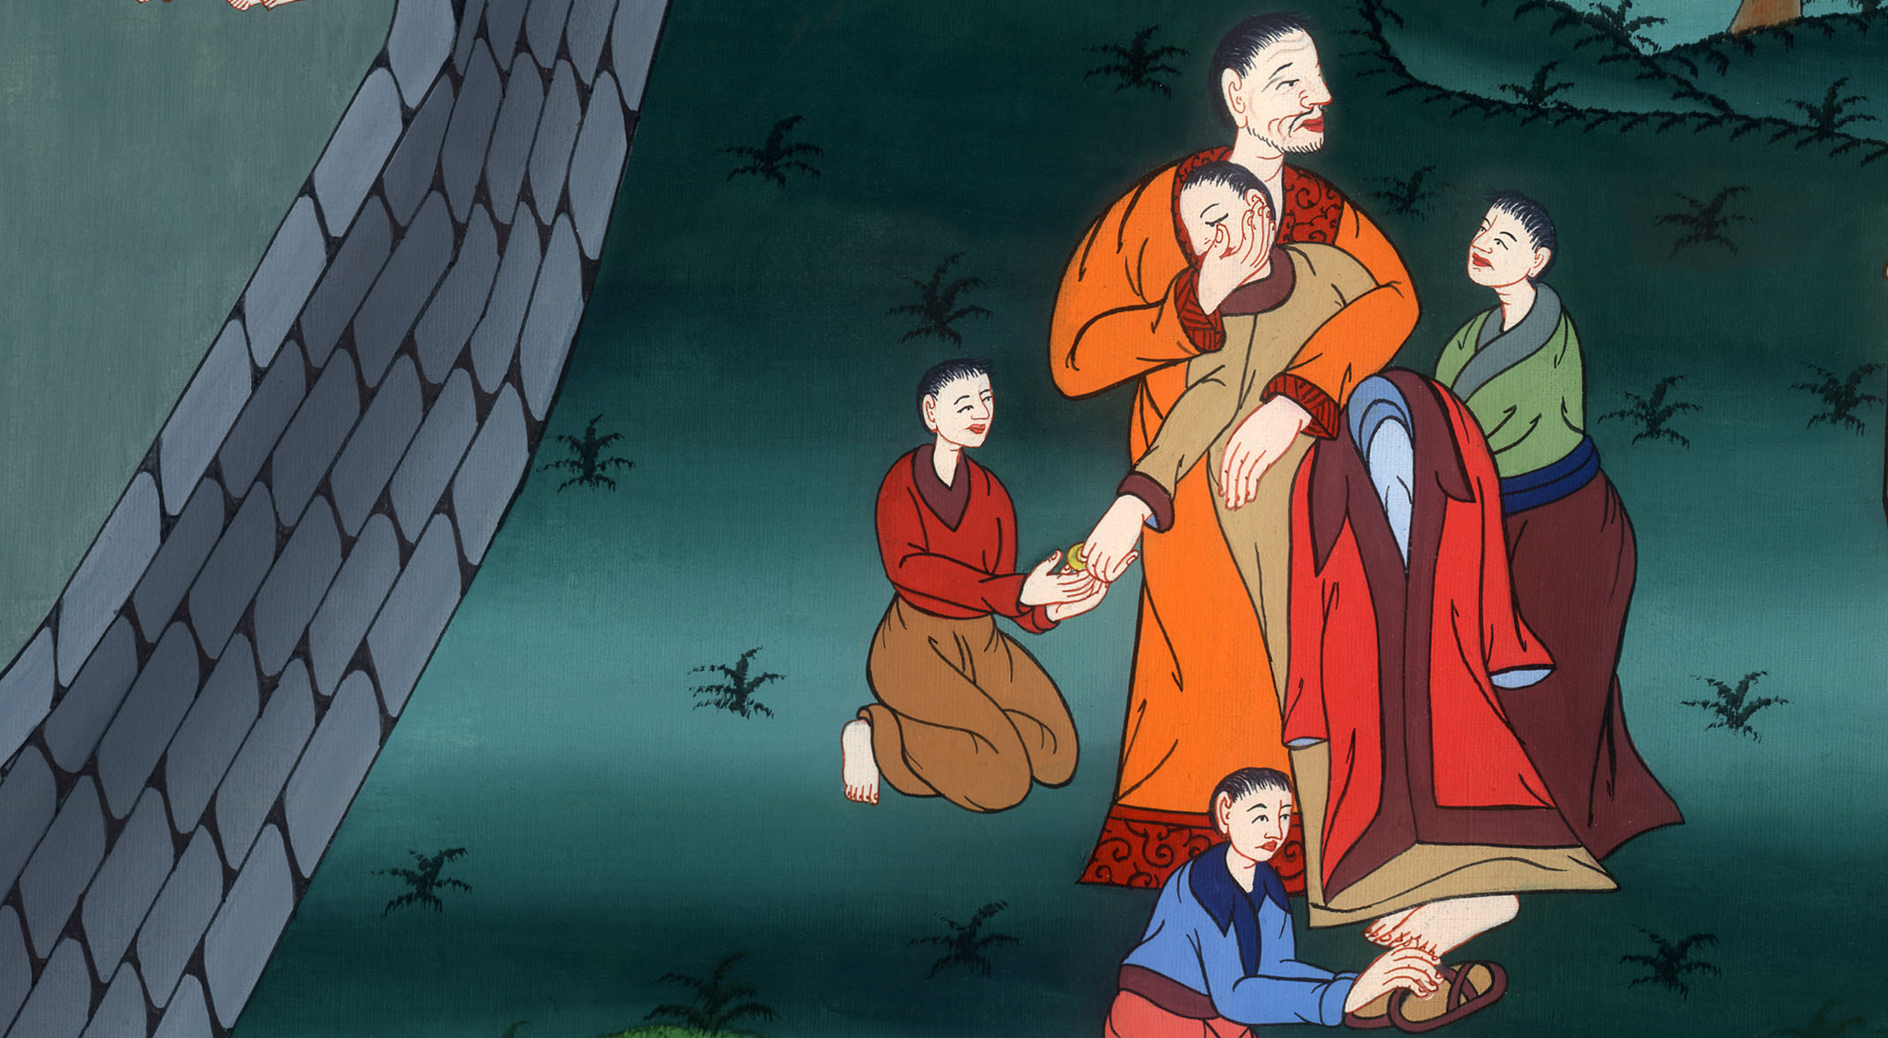
Luke 15:22,23

Slide 27
24for this, my son, was dead and is alive again. He was lost and is found.’ Then they began to celebrate.

Slide 28
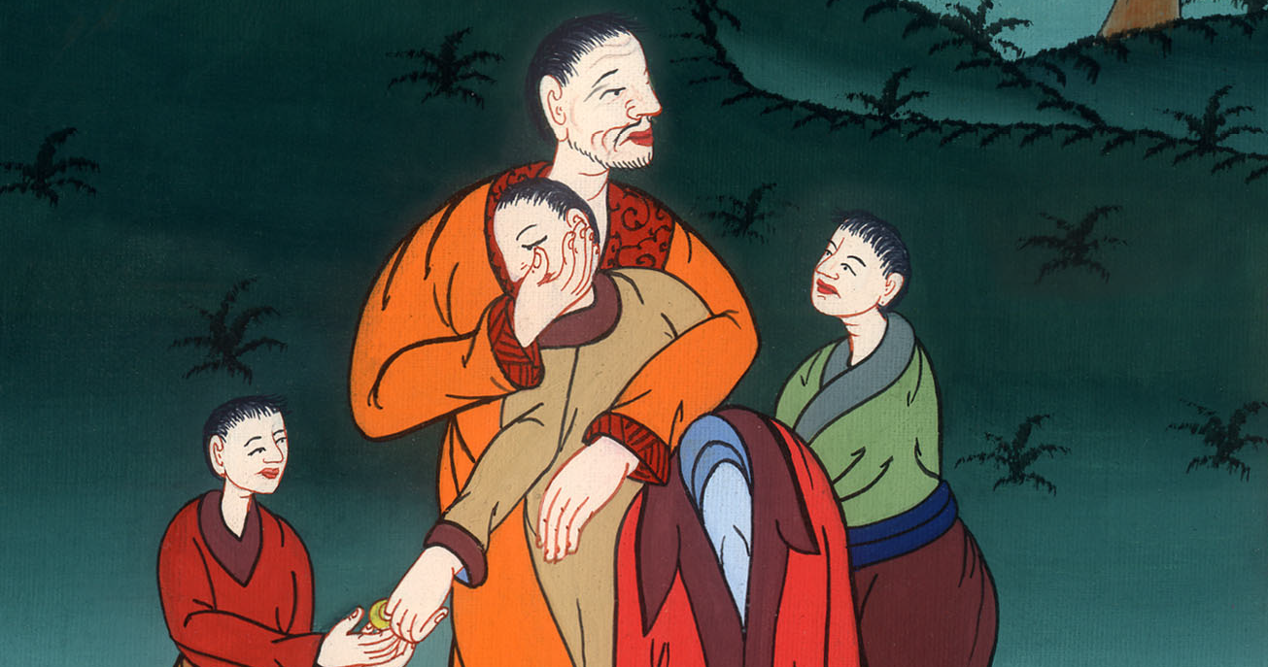
Luke 15:24

Slide 29
25 “Now his elder son was in the field. As he came near to the house, he heard music and dancing. 26He called one of the servants to him and asked what was going on.

Slide 30
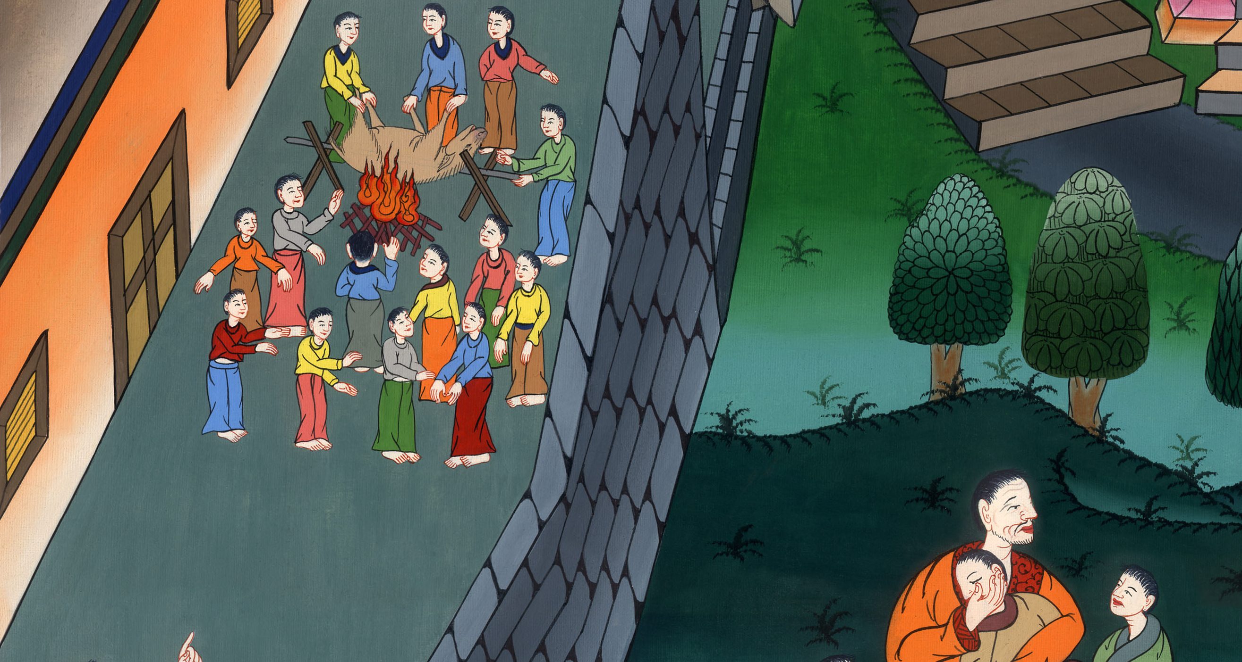
Luke 15:25,26

Slide 31
27He said to him, ‘Your brother has come, and your father has killed the fattened calf, because he has received him back safe and healthy.’

Slide 32
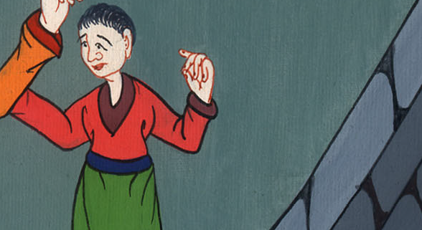
Luke 15:27

Slide 33
28But he was angry and would not go in. Therefore his father came out and begged him.

Slide 34
Luke 15:28

Slide 35
29But he answered his father, ‘Behold, these many years I have served you, and I never disobeyed a commandment of yours, but you never gave me a goat, that I might celebrate with my friends.

Slide 36
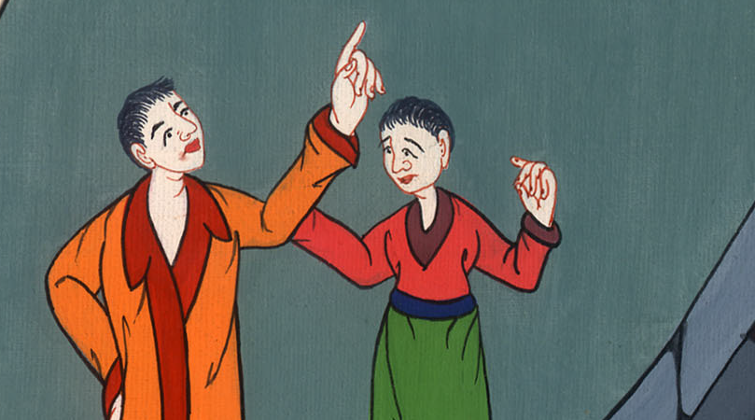
Luke 15:29

Slide 37
30But when this your son came, who has devoured your living with prostitutes, you killed the fattened calf for him.’

Slide 38
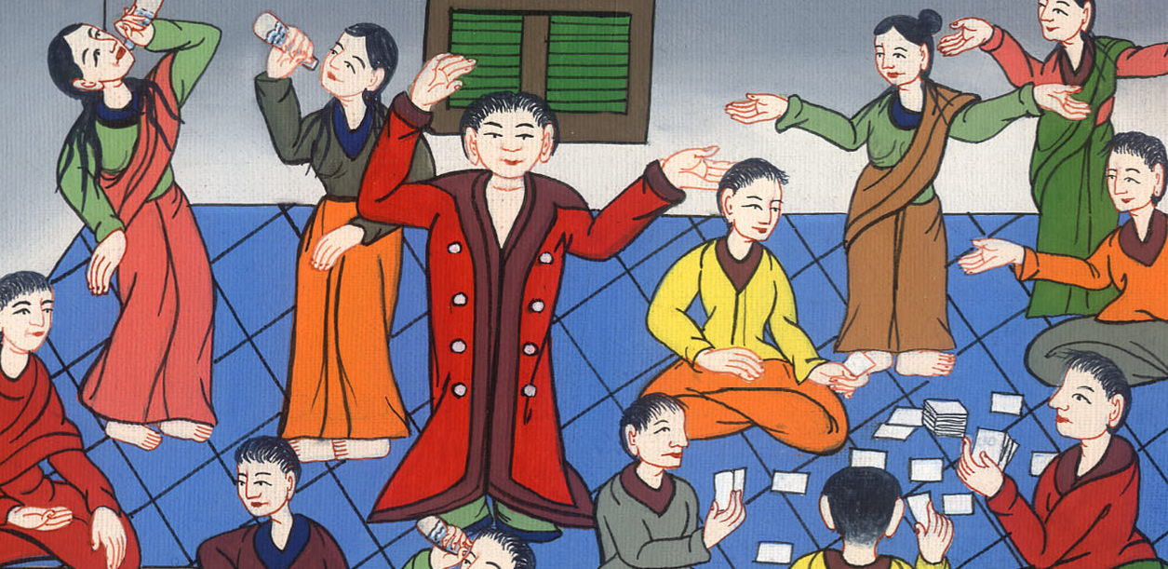
Luke 15:30

Slide 39
31“He said to him, ‘Son, you are always with me, and all that is mine is yours.

Slide 40
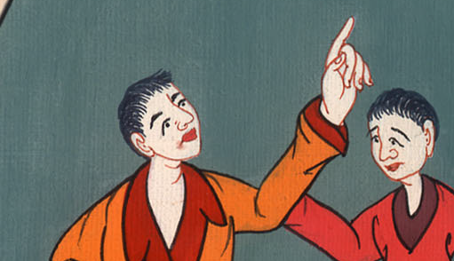
Luke 15:31

Slide 41
32But it was appropriate to celebrate and be glad, for this, your brother, was dead, and is alive again. He was lost, and is found.’”

Slide 42
Luke 15:32

