Slide 1
59
This work is licensed under a Creative Commons Attribution-ShareAlike 4.0 International License.
Please add this statement to all the videos you create.
English Bible quotes are from the World English Bible US, which is in the public domain.
Notes:
Ch
The Sower - Luke 8:4-15

Slide 2
The Sower - Luke 8:4-15

Slide 3
The Sower - Luke 8:4-15

Slide 4
The Sower - Luke 8:4-15

Slide 5
4When a great multitude came together and people from every city were coming to him, he spoke by a parable:

Slide 6
Luke 8:4

Slide 7
5“The farmer went out to sow his seed. As he sowed, some fell along the road, and it was trampled under foot, and the birds of the sky devoured it.

Slide 8
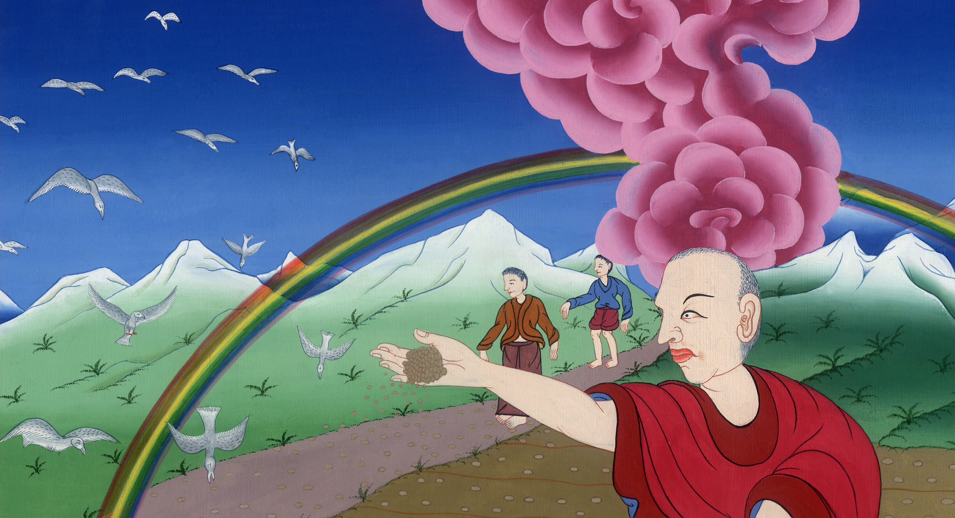
Luke 8:5

Slide 9
6Other seed fell on the rock, and as soon as it grew, it withered away, because it had no moisture.

Slide 10
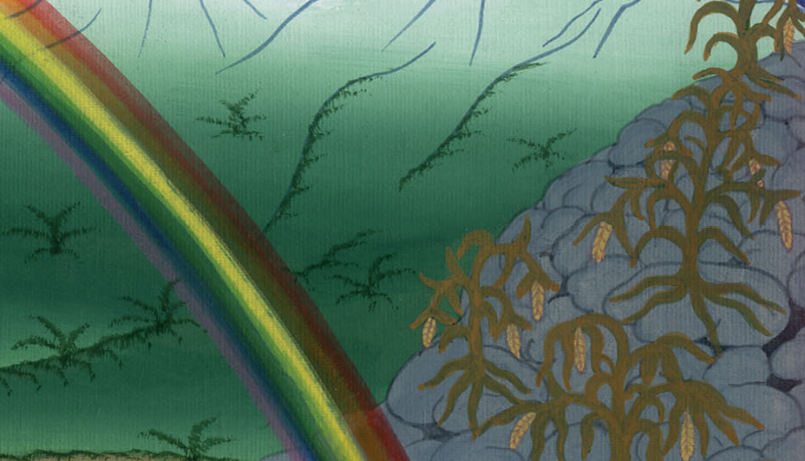
Luke 8:6

Slide 11
7Other fell amid the thorns, and the thorns grew with it and choked it.

Slide 12
Luke 8:7

Slide 13
8Other fell into the good ground and grew and produced one hundred times as much fruit.” As he said these things, he called out, “He who has ears to hear, let him hear!”

Slide 14
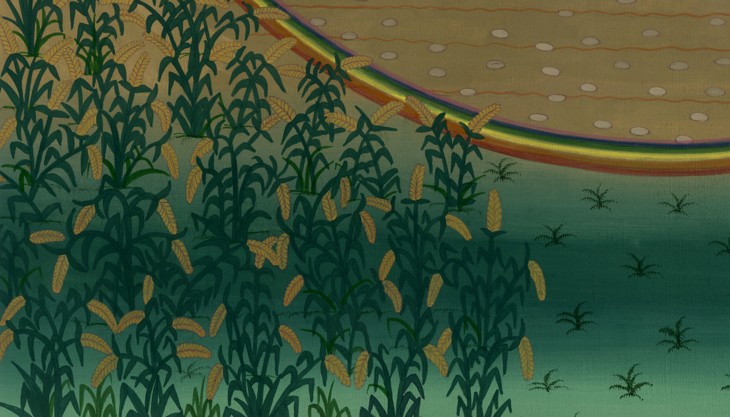
Luke 8:8

Slide 15
9Then his disciples asked him, “What does this parable mean?”

Slide 16
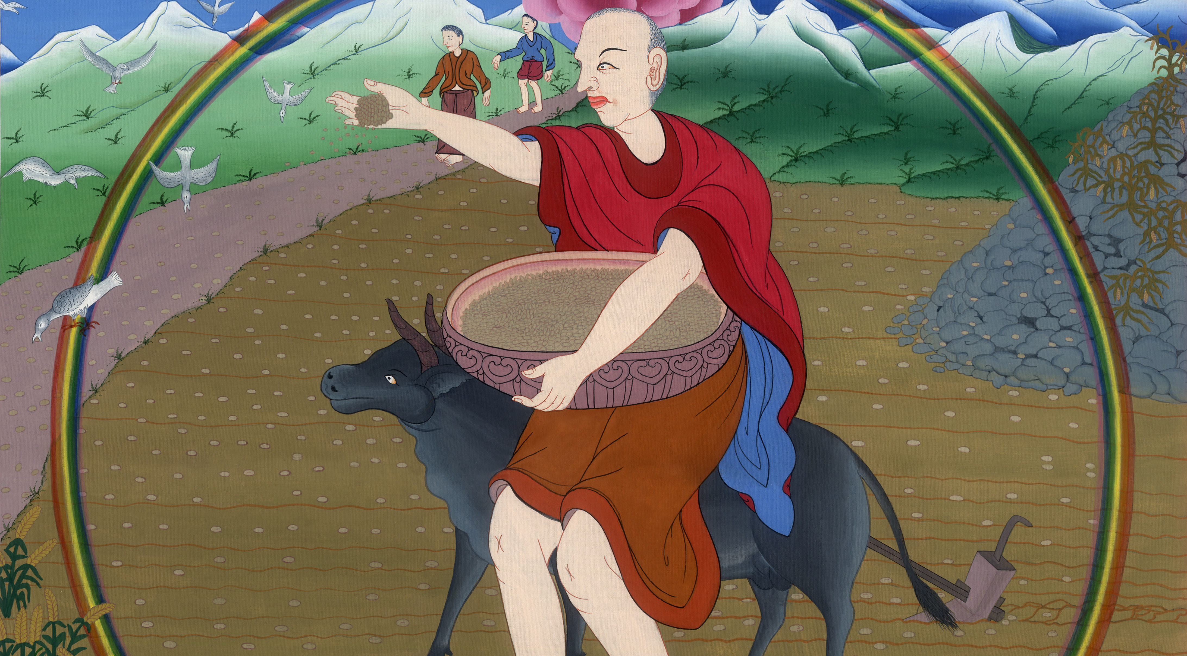
Luke 8:9

Slide 17
10He said, “To you it is given to know the mysteries of God’s Kingdom, but to the rest it is given in parables,

Slide 18
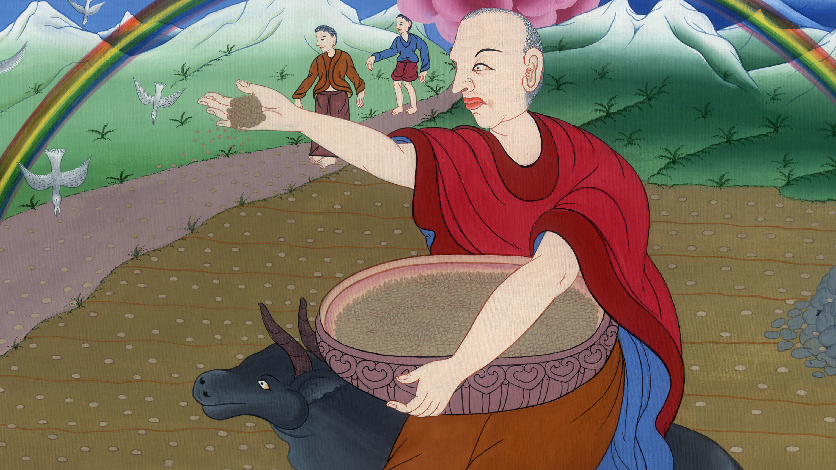
Luke 8:10

Slide 19
that ‘seeing they may not see, and hearing they may not understand.’ (Isaiah 6:9)

Slide 20
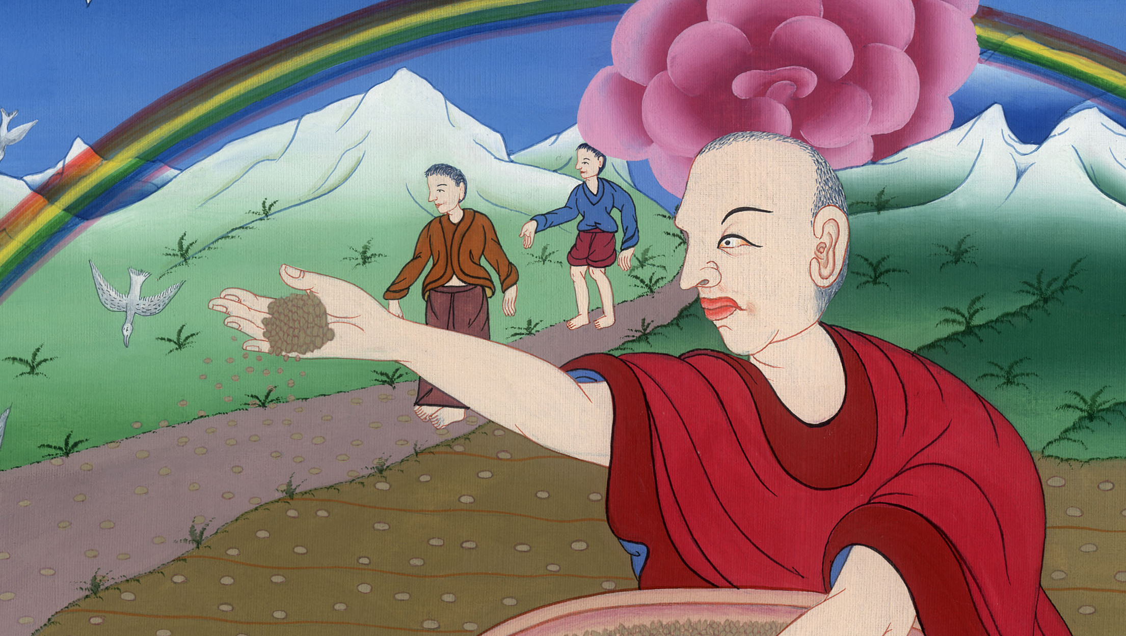
Luke 8:10

Slide 21
11“Now the parable is this: The seed is the word of God.

Slide 22
Luke 8:11

Slide 23
12Those along the road are those who hear; then the devil comes and takes away the word from their heart, that they may not believe and be saved.

Slide 24
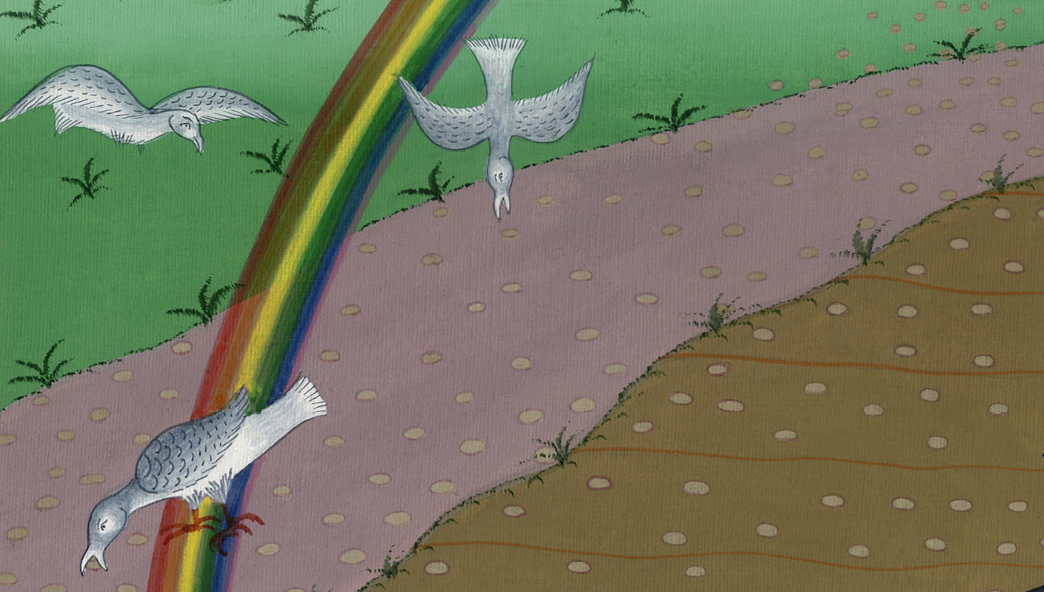
Luke 8:12

Slide 25
13Those on the rock are they who, when they hear, receive the word with joy; but these have no root. They believe for a while, then fall away in time of temptation.

Slide 26
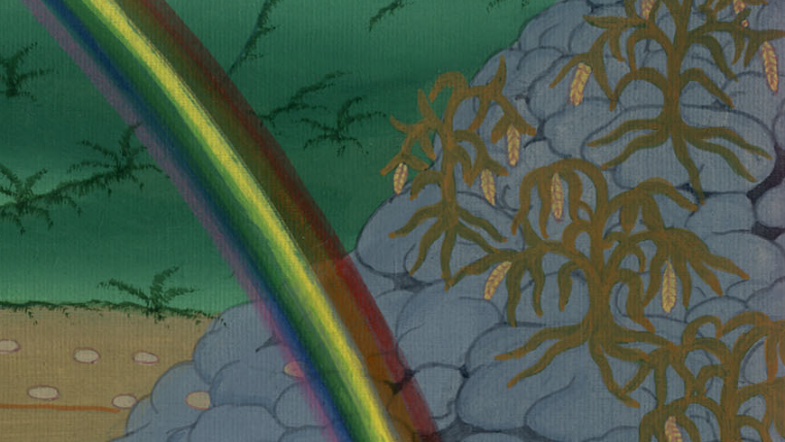
Luke 8:13

Slide 27
14What fell among the thorns, these are those who have heard, and as they go on their way they are choked with cares, riches, and pleasures of life; and they bring no fruit to maturity.

Slide 28
Luke 8:14

Slide 29
15Those in the good ground, these are those who with an honest and good heart, having heard the word, hold it tightly, and produce fruit with perseverance.

Slide 30
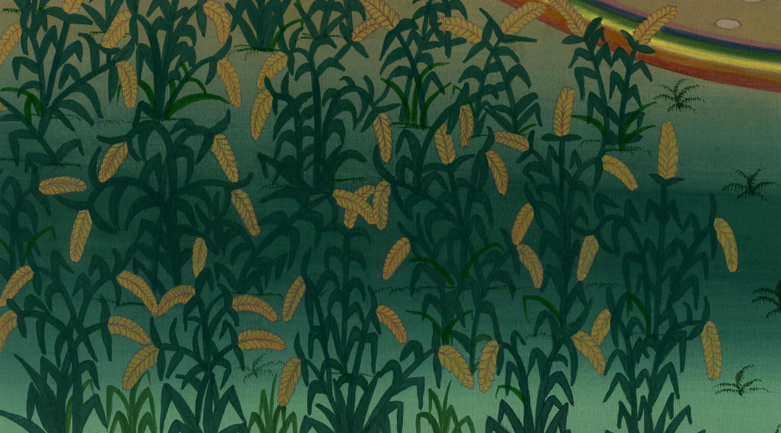
Luke 8:15

