Slide 1
61
This work is licensed under a Creative Commons Attribution-ShareAlike 4.0 International License.
Please add this statement to all the videos you create.
English Bible quotes are from the World English Bible US, which is in the public domain.
Notes:
ch

Slide 2
The Unforgiving Servant –
Matthew 18:21-35

Slide 3
The Unforgiving Servant - Matthew 18:21-35

Slide 4
The Unforgiving Servant –
Matthew 18:21-35

Slide 5
21Then Peter came and said to him, “Lord, how often shall my brother sin against me, and I forgive him? Until seven times?”

Slide 6
Matthew 18:21

Slide 7
22Jesus said to him, “I don’t tell you until seven times, but, until seventy times seven.

Slide 8
Matthew 18:22

Slide 9
23Therefore the Kingdom of Heaven is like a certain king who wanted to settle accounts with his servants.

Slide 10
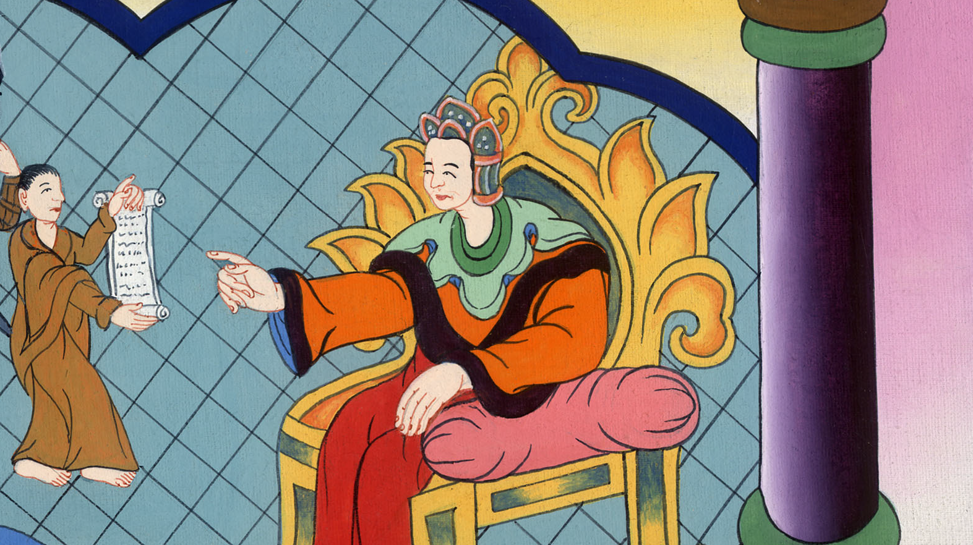
Matthew 18:23

Slide 11
24When he had begun to settle, one was brought to him who owed him ten thousand talents.

Slide 12
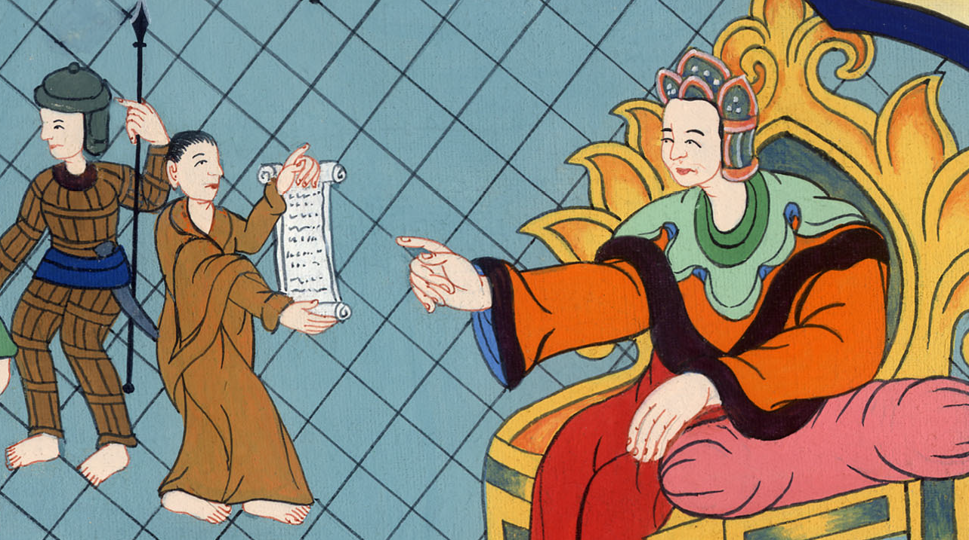
Matthew 18:24

Slide 13
25But because he couldn’t pay, his lord commanded him to be sold, with his wife, his children, and all that he had, and payment to be made.

Slide 14
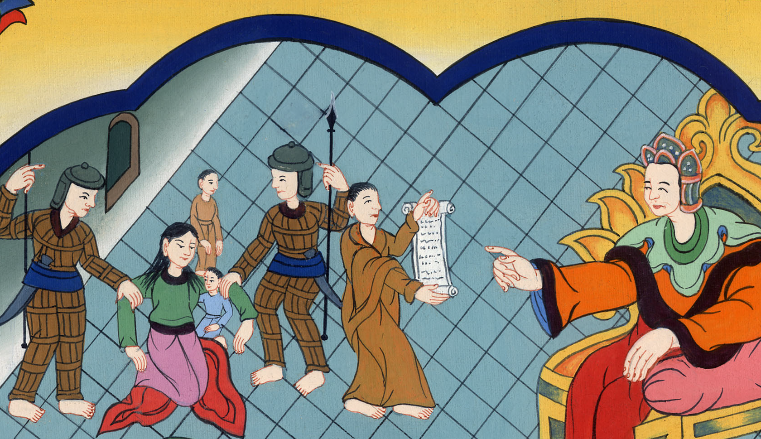
Matthew 18:25

Slide 15
26The servant therefore fell down and knelt before him, saying, ‘Lord, have patience with me, and I will repay you all!’

Slide 16
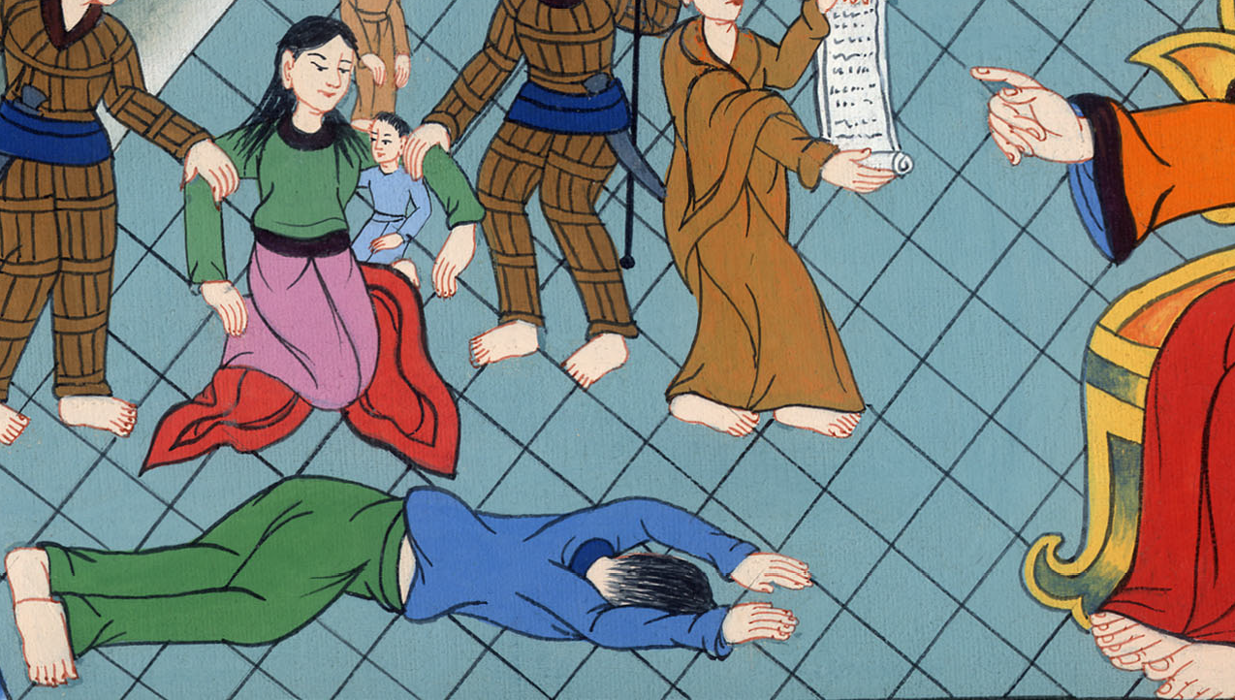
Matthew 18:26

Slide 17
27The lord of that servant, being moved with compassion, released him and forgave him the debt.

Slide 18
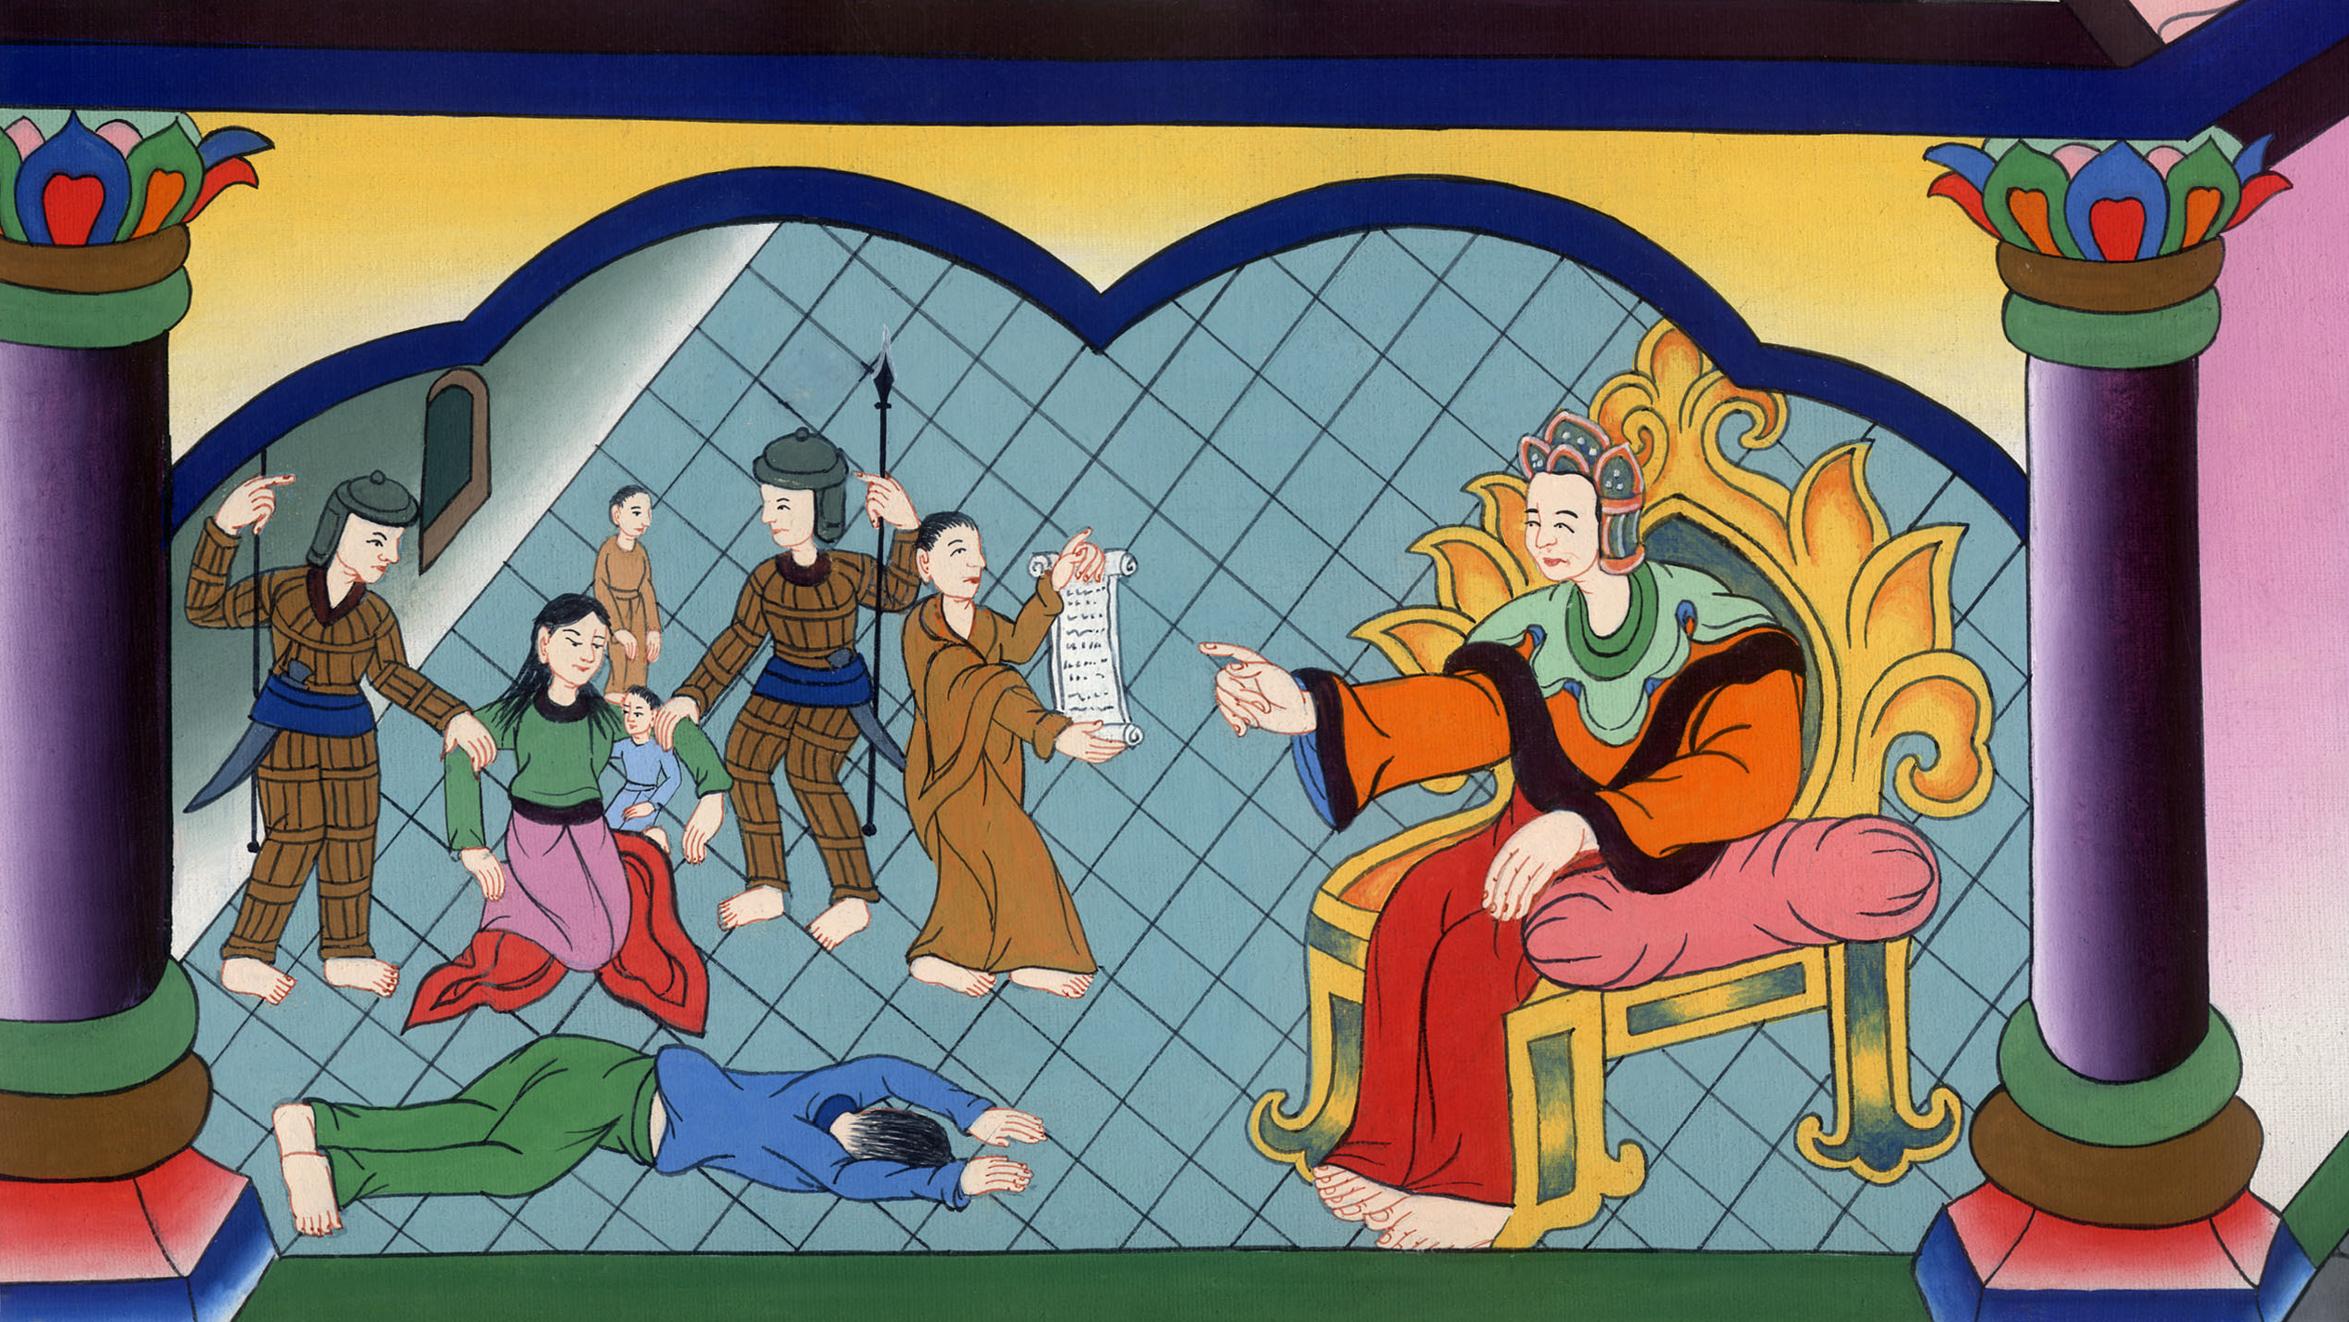
Matthew 18:27

Slide 19
28“But that servant went out and found one of his fellow servants who owed him one hundred denarii, and he grabbed him and took him by the throat, saying, ‘Pay me what you owe!’

Slide 20
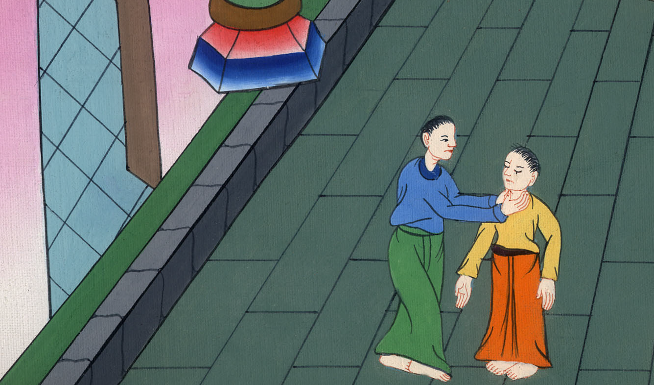
Matthew 18:28

Slide 21
29 “So his fellow servant fell down at his feet and begged him, saying, ‘Have patience with me, and I will repay you!’

Slide 22
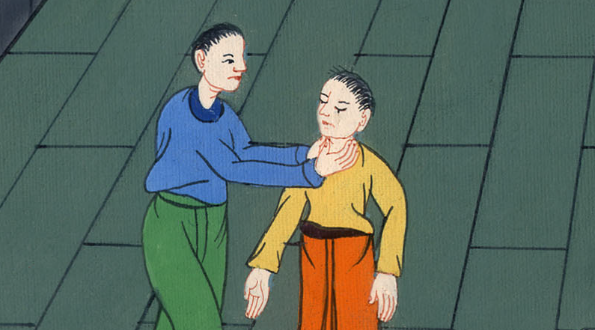
Matthew 18:29

Slide 23
30He would not, but went and cast him into prison until he should pay back that which was due.

Slide 24
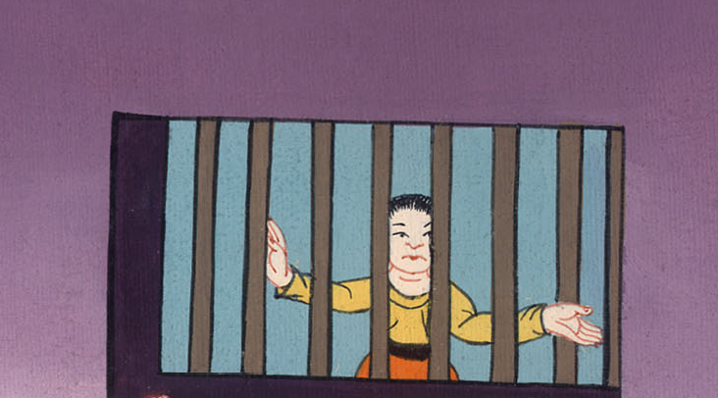
Matthew 18:30

Slide 25
31So when his fellow servants saw what was done, they were exceedingly sorry, and came and told their lord all that was done.

Slide 26
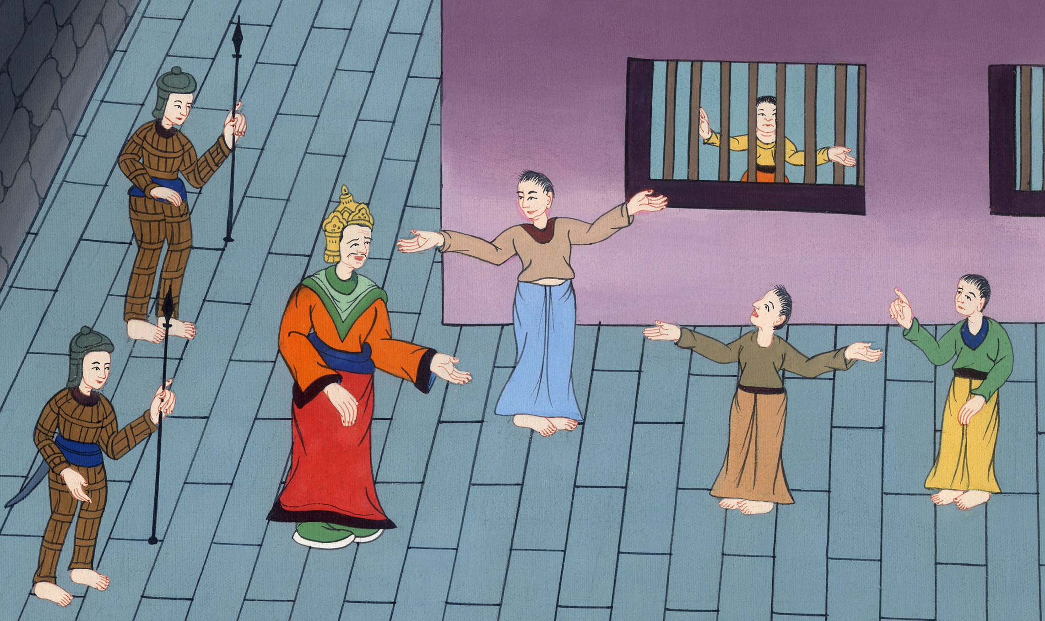
Matthew 18:31

Slide 27
32Then his lord called him in and said to him, ‘You wicked servant! I forgave you all that debt because you begged me.

Slide 28
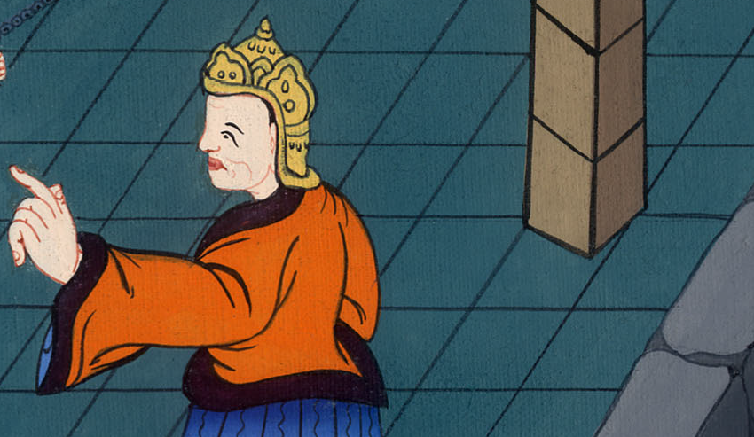
Matthew 18:32

Slide 29
33Shouldn’t you also have had mercy on your fellow servant, even as I had mercy on you?’

Slide 30
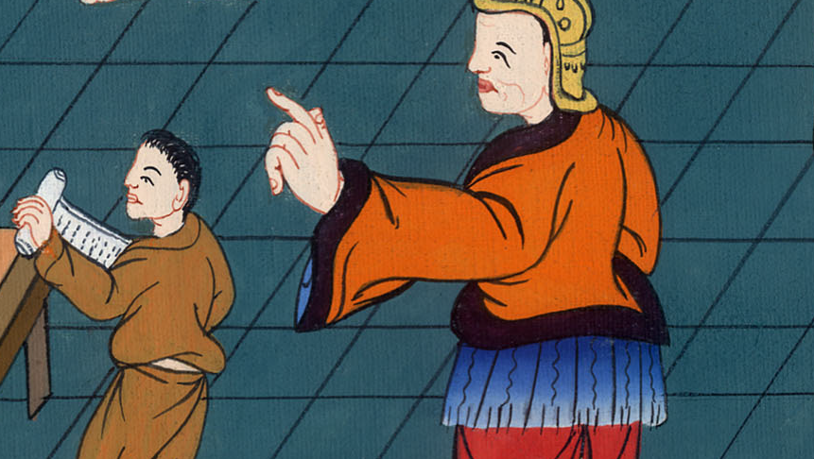
Matthew 18:33

Slide 31
34His lord was angry, and delivered him to the tormentors until he should pay all that was due to him.

Slide 32
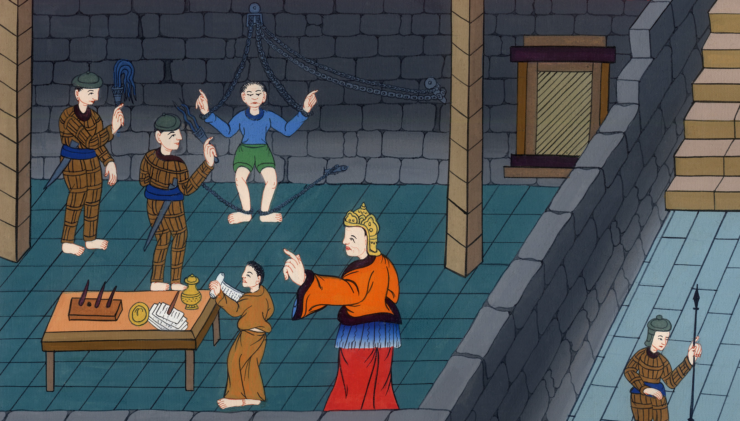
Matthew 18:34

Slide 33
35So my heavenly Father will also do to you, if you don’t each forgive your brother from your hearts for his misdeeds.”

Slide 34
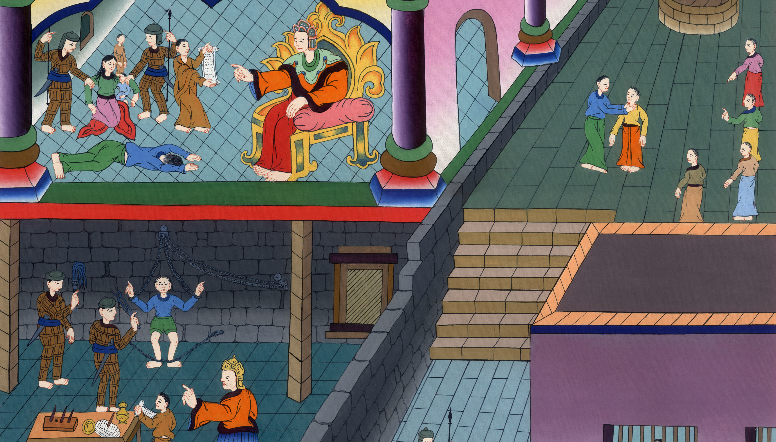
Matthew 18:35

