Slide 1
62-1
This work is licensed under a Creative Commons Attribution-ShareAlike 4.0 International License.
Please add this statement to all the videos you create.
English Bible quotes are from the World English Bible US, which is in the public domain.
Notes:
Ch
P05 Kingdom Parables
1. The Wise and Foolish Builders - Luke 6:46-49 (Left Top)
2. The Rich Man and Lazarus Luke 16:19-31 (Right Top)
3. The Weeds - Matthew 13:24-30; 36-43 (Right Center)
4. The Hidden Treasure - Matt 13:44 (Center)
5. The Rich Fool - Luke 12:13-34 (Right Bottom)
6. The Ten Virgins - Matthew 25:1-13 (Left Bottom)
7. The Talents - Matthew 25:14-30 (Left Center)

Slide 2
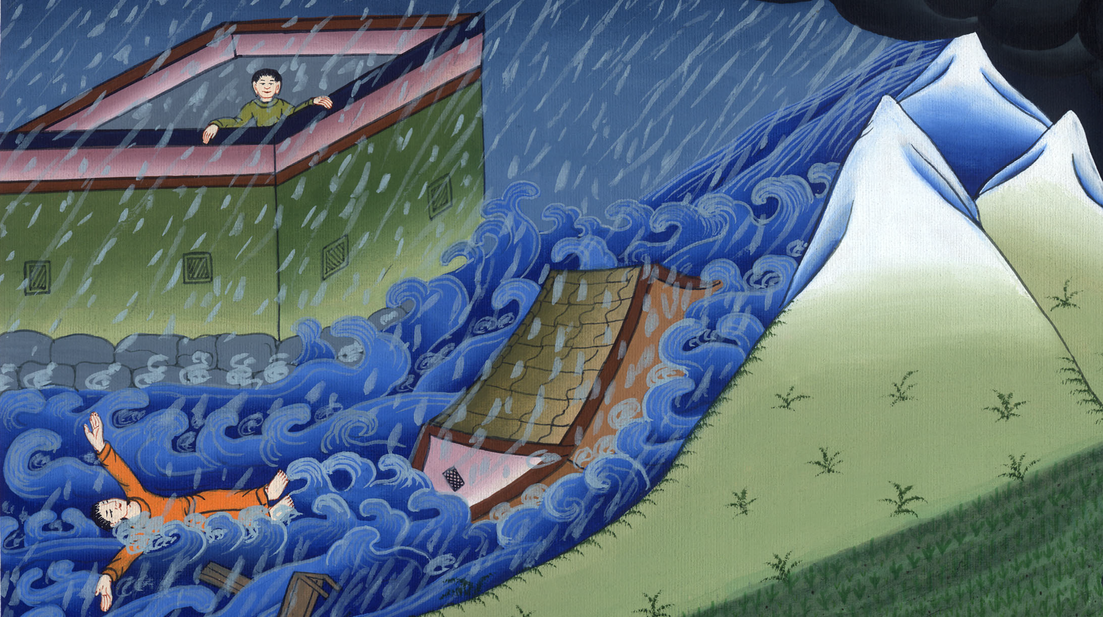
The Wise and Foolish Builders - Luke 6:46-49

Slide 3
Kingdom Parables
1. The Wise and Foolish Builders - Luke 6:46-49

Slide 4
The Wise and Foolish Builders - Luke 6:46-49

Slide 5
46“Why do you call me, ‘Lord, Lord,’ and don’t do the things which I say?

Slide 6
Luke 6:46

Slide 7
47Everyone who comes to me, and hears my words and does them, I will show you who he is like.

Slide 8
Luke 6:47

Slide 9
48He is like a man building a house, who dug and went deep and laid a foundation on the rock.

Slide 10
Luke 6:48

Slide 11
When a flood arose, the stream broke against that house, and could not shake it, because it was founded on the rock.

Slide 12
Luke 6:48

Slide 13
49But he who hears and doesn’t do, is like a man who built a house on the earth without a foundation

Slide 14
Luke 6:49

Slide 15
against which the stream broke, and immediately it fell

Slide 16
Luke 6:49

Slide 17
and the ruin of that house was great.”

Slide 18
Luke 6:49

