Slide 1
62-2
This work is licensed under a Creative Commons Attribution-ShareAlike 4.0 International License.
Please add this statement to all the videos you create.
English Bible quotes are from the World English Bible US, which is in the public domain.
Notes:
Ch
P05 Kingdom Parables
1. The Wise and Foolish Builders - Luke 6:46-49 (Left Top)
2. The Rich Man and Lazarus Luke 16:19-31 (Right Top)
3. The Weeds - Matthew 13:24-30; 36-43 (Right Center)
4. The Hidden Treasure - Matt 13:44 (Center)
5. The Rich Fool - Luke 12:13-34 (Right Bottom)
6. The Ten Virgins - Matthew 25:1-13 (Left Bottom)
7. The Talents - Matthew 25:14-30 (Left Center)

Slide 2
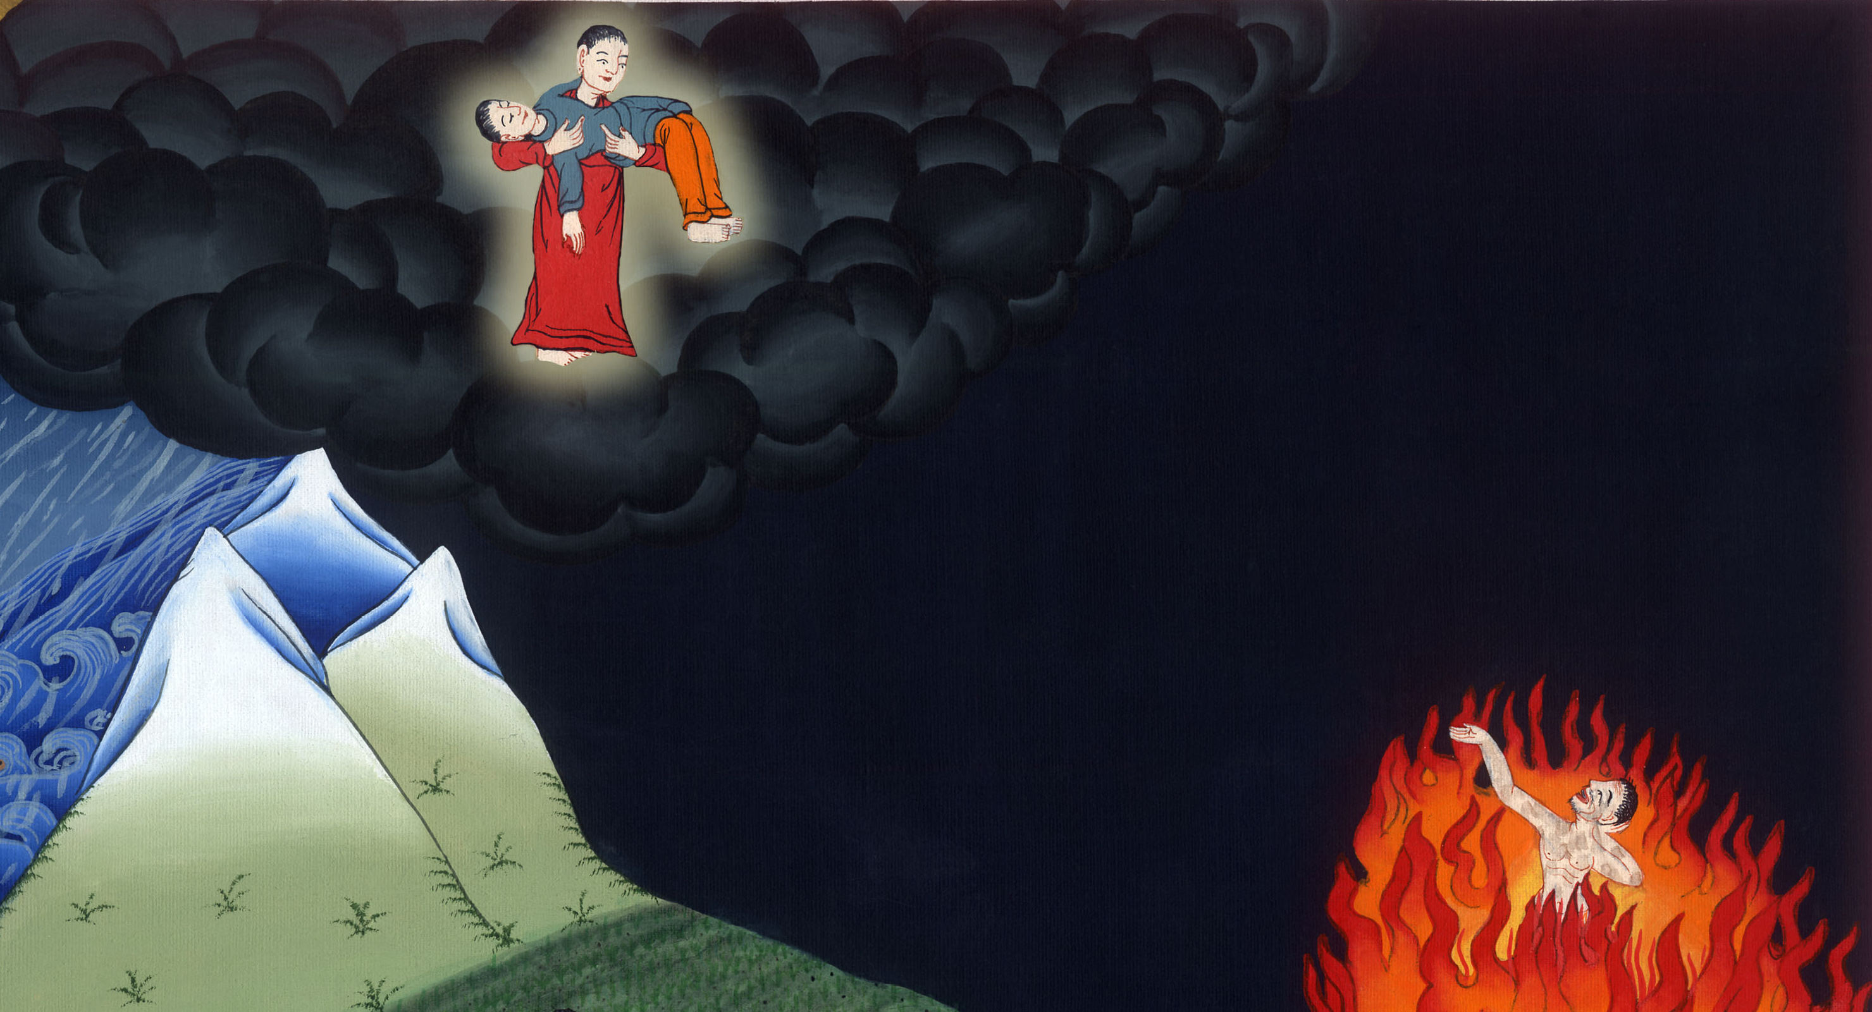
The Rich Man and Lazarus - Luke 16:19-31

Slide 3
The Rich Man and Lazarus - Luke 16:19-31

Slide 4
The Rich Man and Lazarus - Luke 16:19-31

Slide 5
19 “Now there was a certain rich man, and he was clothed in purple and fine linen, living in luxury every day.

Slide 6
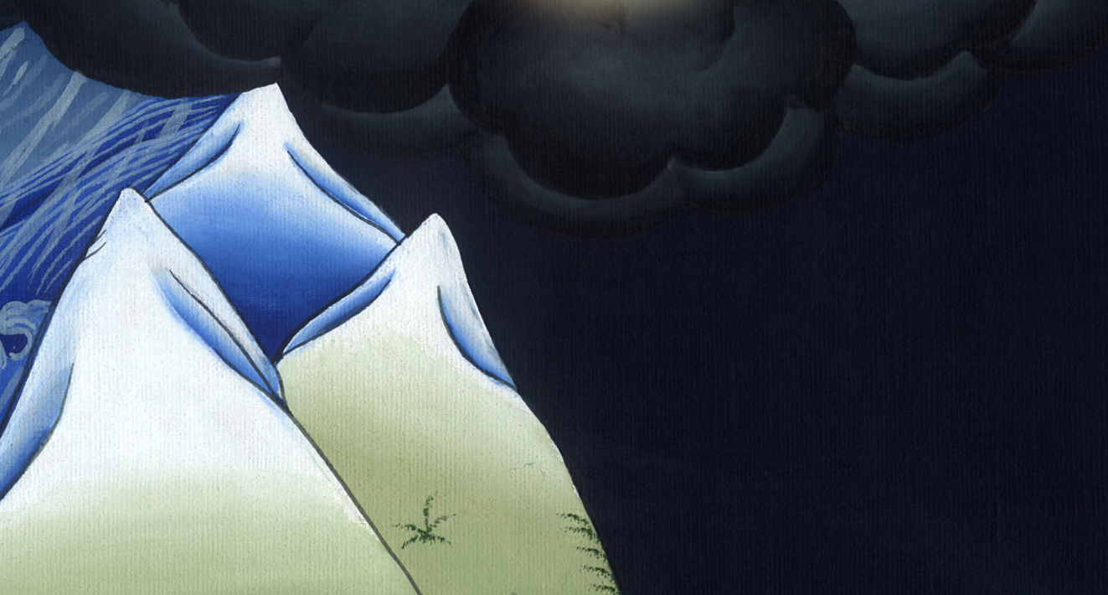
Luke 16:19

Slide 7
20A certain beggar, named Lazarus, was taken to his gate, full of sores,

Slide 8
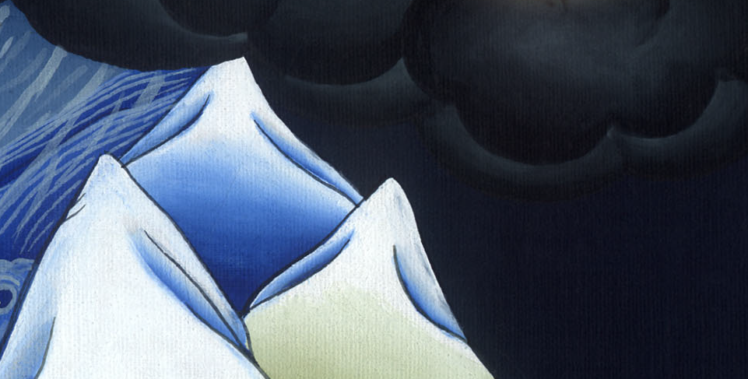
Luke 16:20

Slide 9
21and desiring to be fed with the crumbs that fell from the rich man’s table. Yes, even the dogs came and licked his sores.

Slide 10
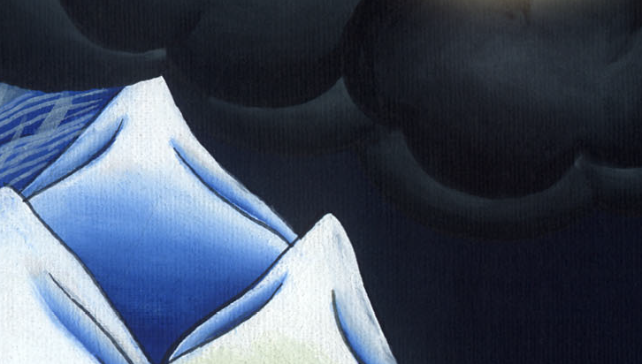
Luke 16:21

Slide 11
22 The beggar died, and he was carried away by the angels to Abraham’s bosom. The rich man also died and was buried.

Slide 12
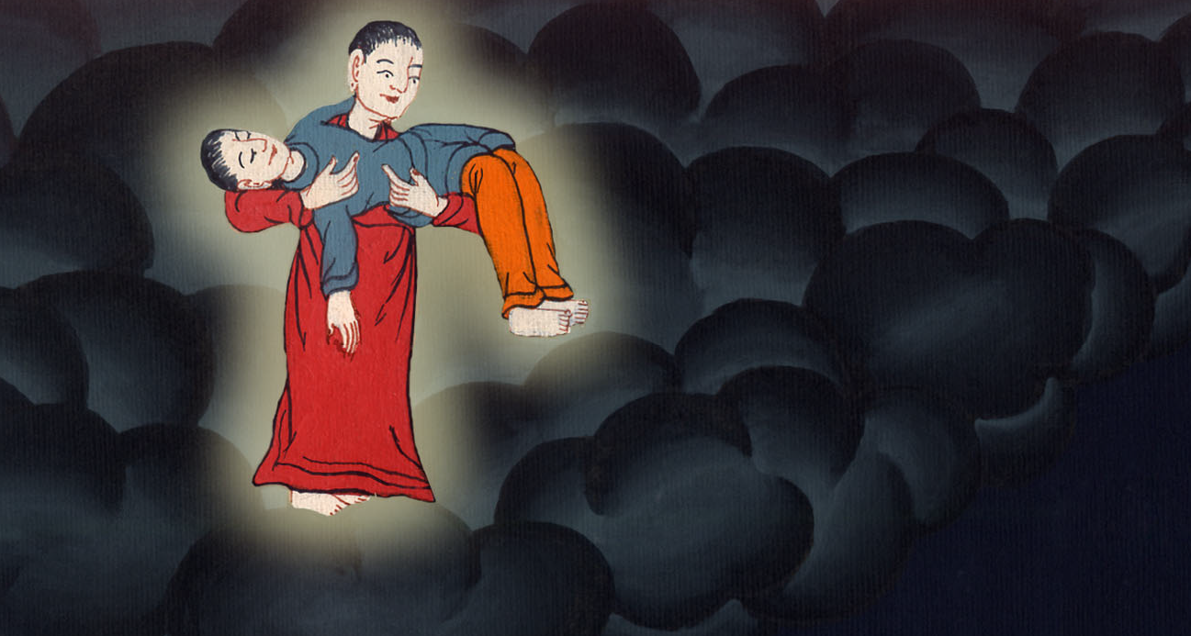
Luke 16:22

Slide 13
23 In Hades, he lifted up his eyes, being in torment, and saw Abraham far off, and Lazarus at his bosom.

Slide 14
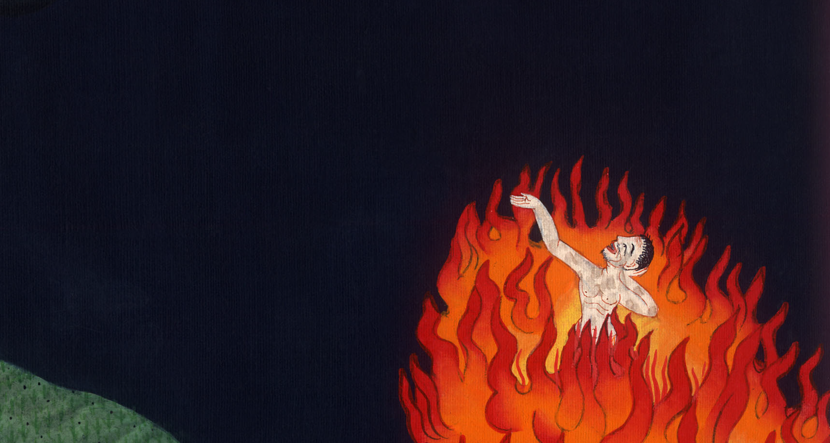
Luke 16:23

Slide 15
24He cried and said, ‘Father Abraham, have mercy on me, and send Lazarus, that he may dip the tip of his finger in water and cool my tongue! For I am in anguish in this flame.’

Slide 16
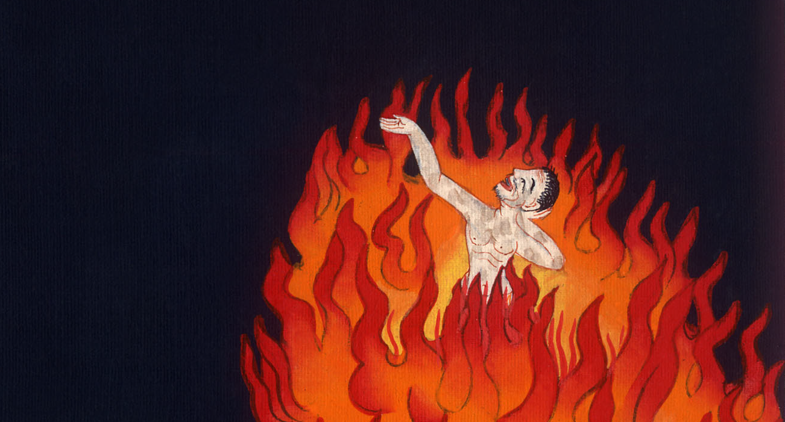
Luke 16:24

Slide 17
25“But Abraham said, ‘Son, remember that you, in your lifetime, received your good things, and Lazarus, in the same way, bad things. But here he is now comforted and you are in anguish.

Slide 18
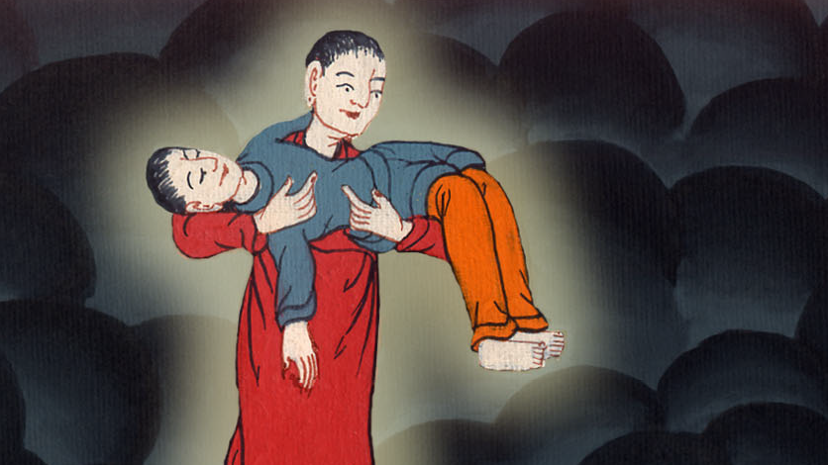
Luke 16:25

Slide 19
26 Besides all this, between us and you there is a great gulf fixed, that those who want to pass from here to you are not able, and that no one may cross over from there to us.’

Slide 20
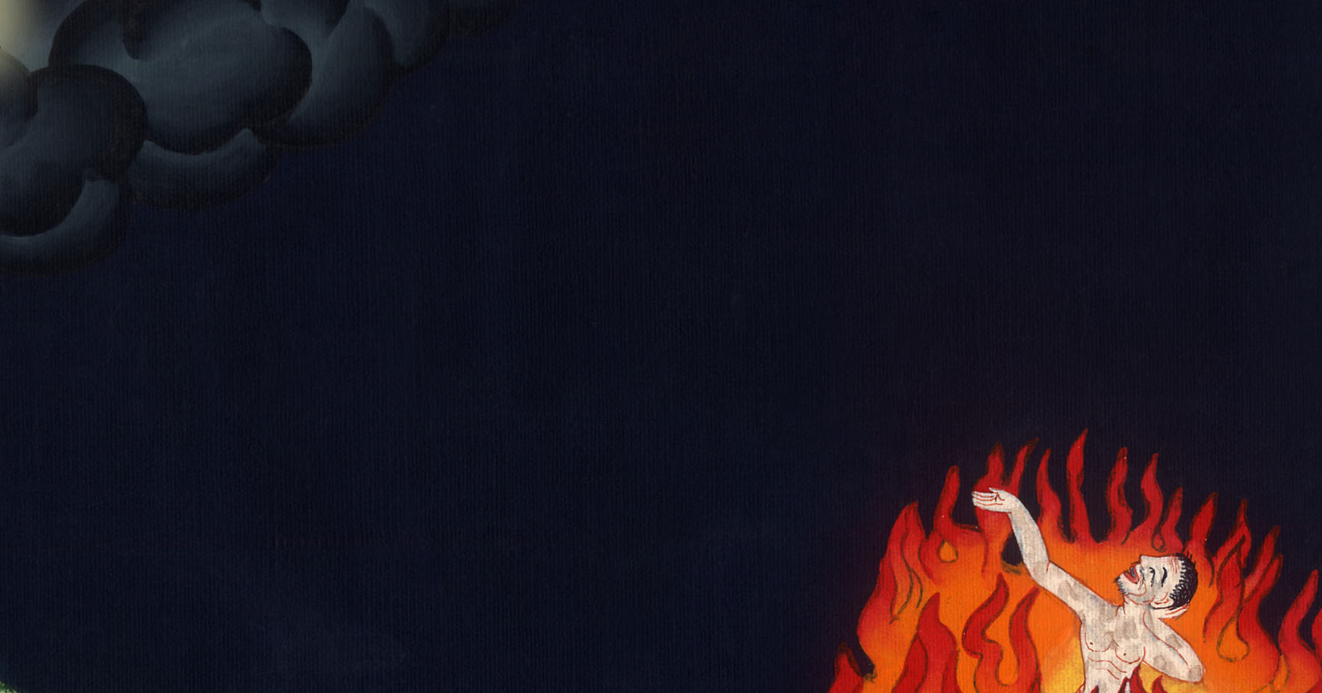
Luke 16:26

Slide 21
27 “He said, ‘I ask you therefore, father, that you would send him to my father’s house—

Slide 22
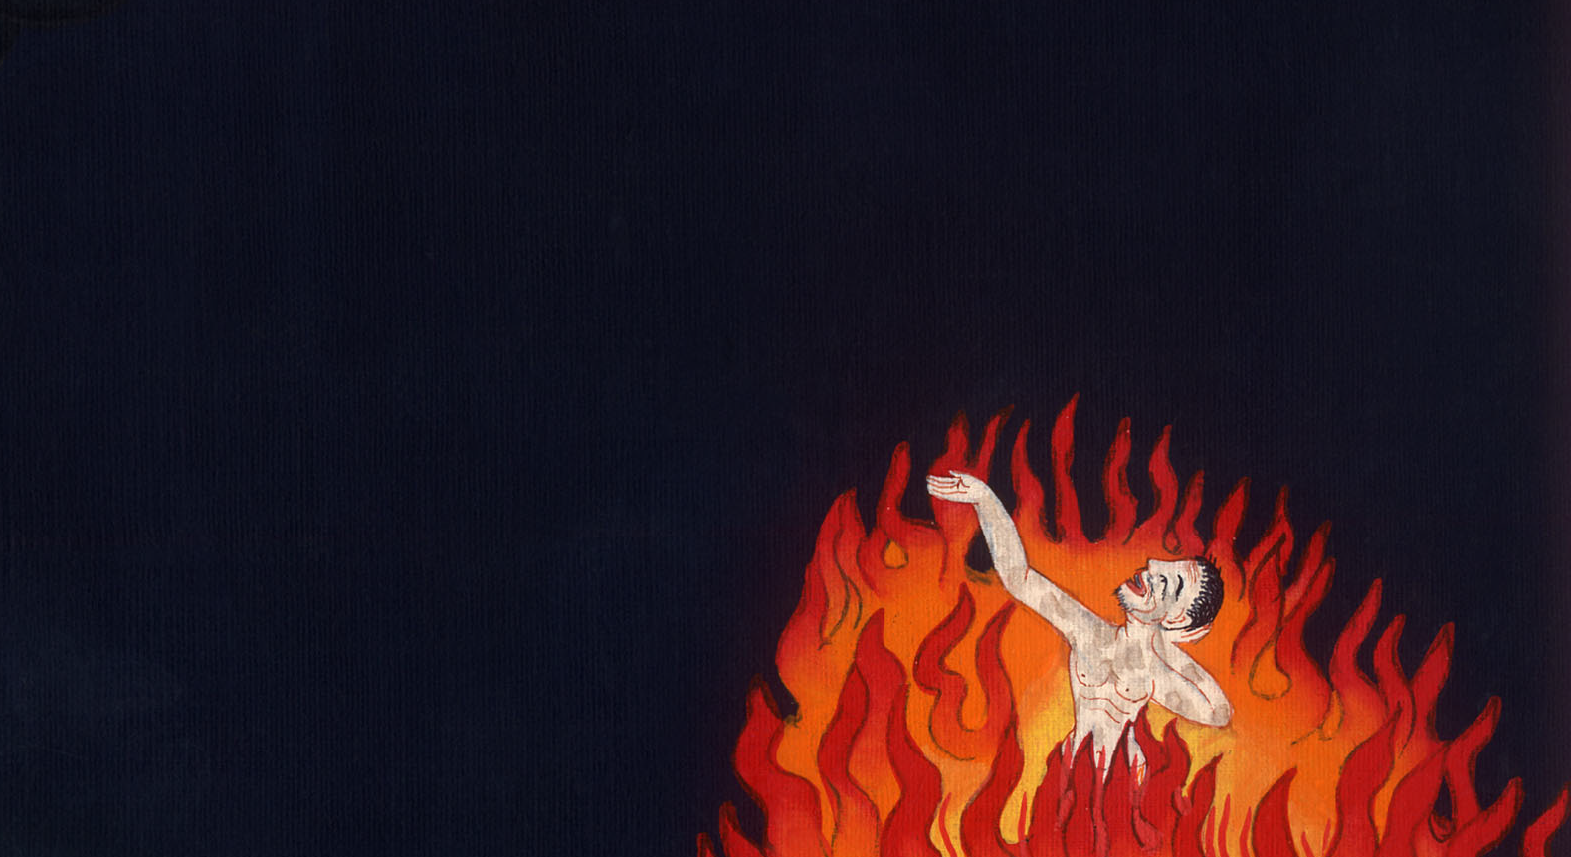
Luke 16:27

Slide 23
28 for I have five brothers—that he may testify to them, so they won’t also come into this place of torment.’

Slide 24
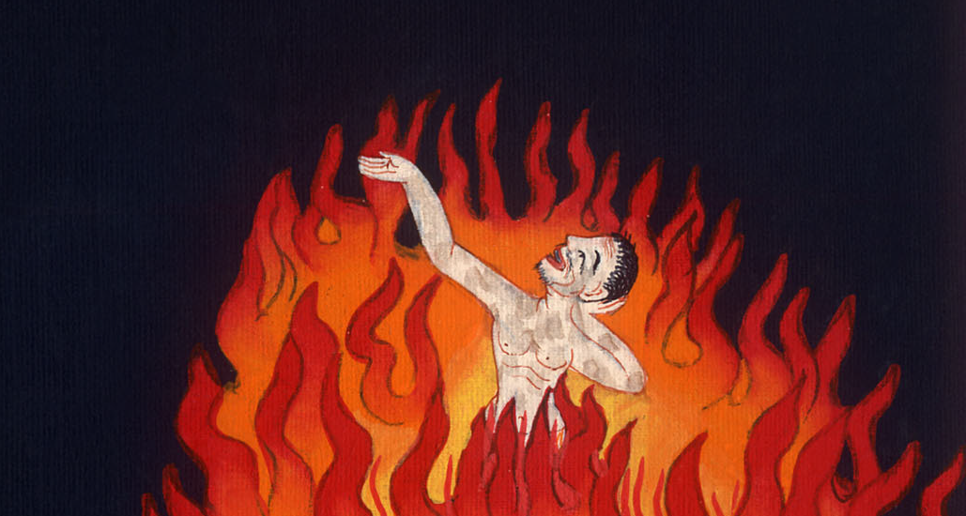
Luke 16:28

Slide 25
29 “But Abraham said to him, ‘They have Moses and the prophets. Let them listen to them.’

Slide 26
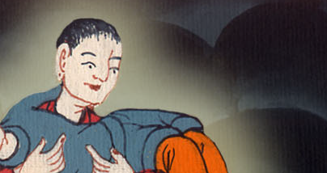
Luke 16:29

Slide 27
30 “He said, ‘No, father Abraham, but if one goes to them from the dead, they will repent.’

Slide 28
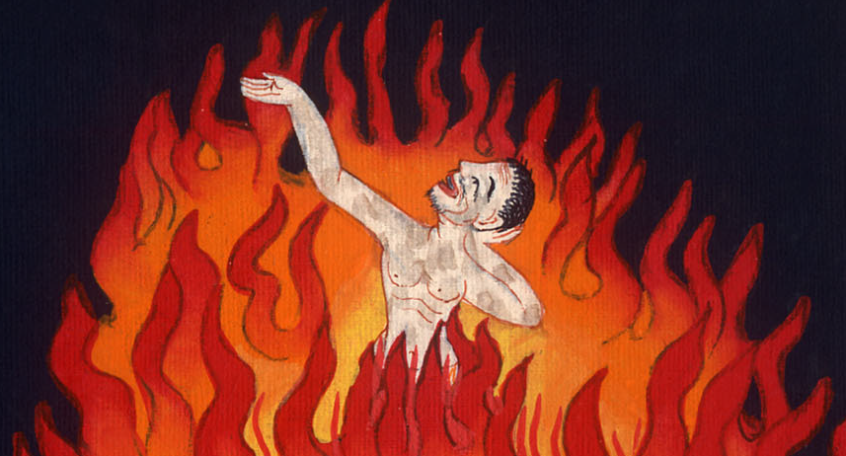
Luke 16:30

Slide 29
31 “He said to him, ‘If they don’t listen to Moses and the prophets, neither will they be persuaded if one rises from the dead.’”

Slide 30
Luke 16:31

