Slide 1
62-3
This work is licensed under a Creative Commons Attribution-ShareAlike 4.0 International License.
Please add this statement to all the videos you create.
English Bible quotes are from the World English Bible US, which is in the public domain.
Notes:
Ch
P05 Kingdom Parables
1. The Wise and Foolish Builders - Luke 6:46-49 (Left Top)
2. The Rich Man and Lazarus Luke 16:19-31 (Right Top)
3. The Weeds - Matthew 13:24-30; 36-43 (Right Center)
4. The Hidden Treasure - Matt 13:44 (Center)
5. The Rich Fool - Luke 12:13-34 (Right Bottom)
6. The Ten Virgins - Matthew 25:1-13 (Left Bottom)
7. The Talents - Matthew 25:14-30 (Left Center)

Slide 2
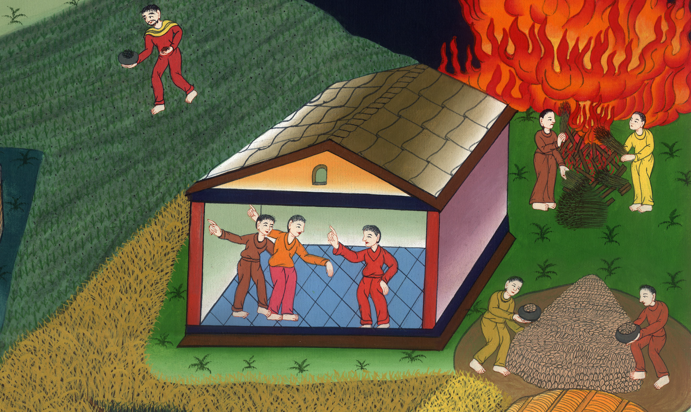
The Weeds –
Matthew 13:24-30; 36-43

Slide 3
The Weeds - Matthew 13:24-30; 36-43

Slide 4
The Weeds –
Matthew 13:24-30; 36-43

Slide 5
24He set another parable before them, saying, “The Kingdom of Heaven is like a man who sowed good seed in his field,

Slide 6
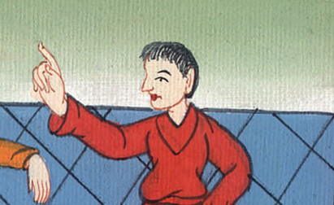
Matthew 13:24

Slide 7
25but while people slept, his enemy came and sowed darnel weeds also among the wheat, and went away.

Slide 8
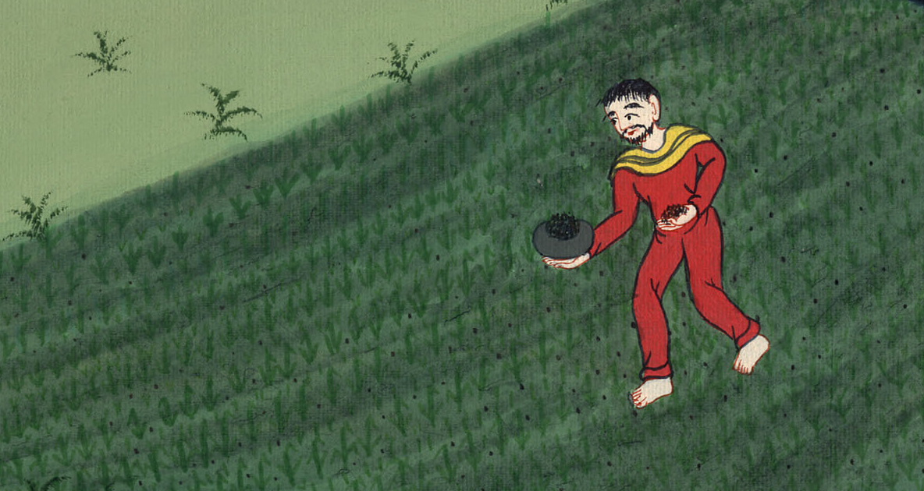
Matthew 13:25

Slide 9
26But when the blade sprang up and produced grain, then the darnel weeds appeared also.

Slide 10
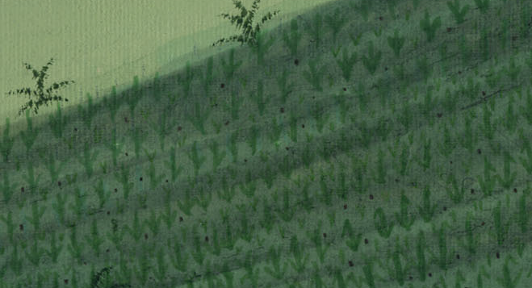
Matthew 13:26

Slide 11
27The servants of the householder came and said to him, ‘Sir, didn’t you sow good seed in your field? Where did these darnel weeds come from?’

Slide 12
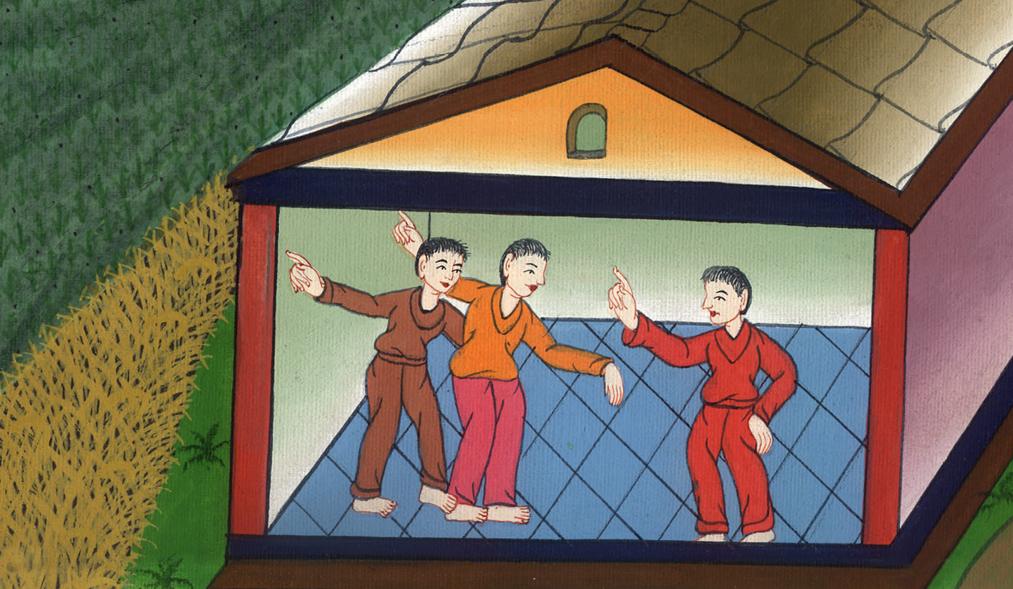
Matthew 13:27

Slide 13
28“He said to them, ‘An enemy has done this.’
“The servants asked him, ‘Do you want us to go and gather them up?’

Slide 14
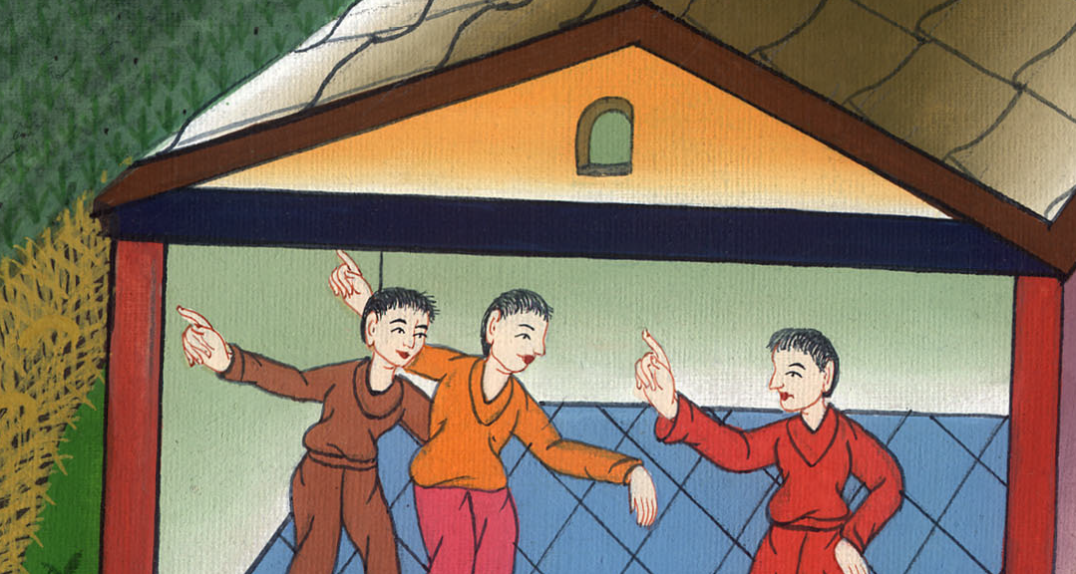
Matthew 13:28

Slide 15
29 “But he said, ‘No, lest perhaps while you gather up the darnel weeds, you root up the wheat with them.

Slide 16
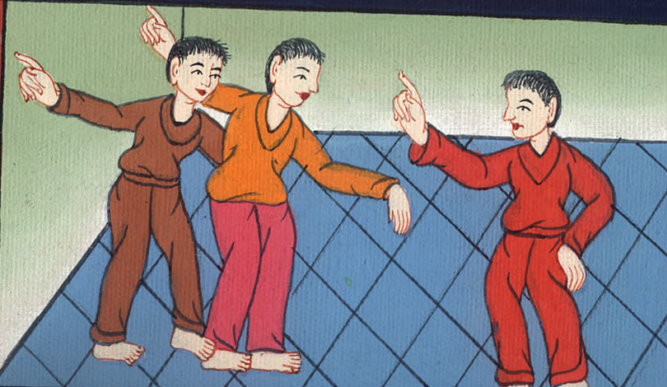
Matthew 13:29

Slide 17
30Let both grow together until the harvest, and in the harvest time I will tell the reapers, “First, gather up the darnel weeds, and bind them in bundles to burn them; but gather the wheat into my barn.”’”

Slide 18
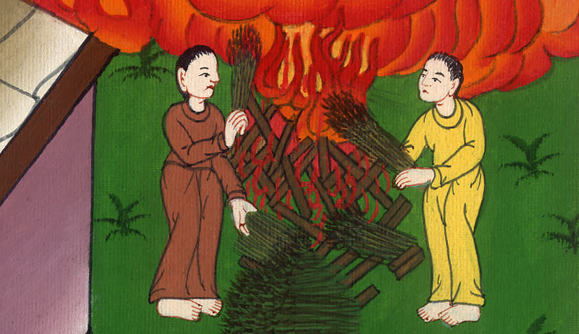
Matthew 13:30

Slide 19
36Then Jesus sent the multitudes away, and went into the house. His disciples came to him, saying, “Explain to us the parable of the darnel weeds of the field.”

Slide 20
Matthew 13:36

Slide 21
37He answered them, “He who sows the good seed is the Son of Man,

Slide 22
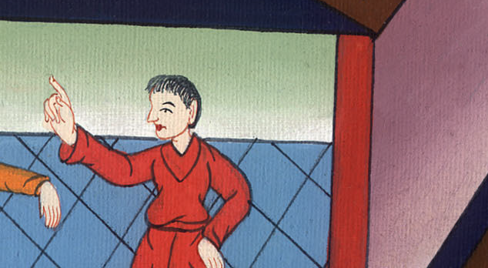
Matthew 13:37

Slide 23
38the field is the world, the good seeds are the children of the Kingdom, and the darnel weeds are the children of the evil one.

Slide 24
Matthew 13:38

Slide 25
39The enemy who sowed them is the devil. The harvest is the end of the age, and the reapers are angels.

Slide 26
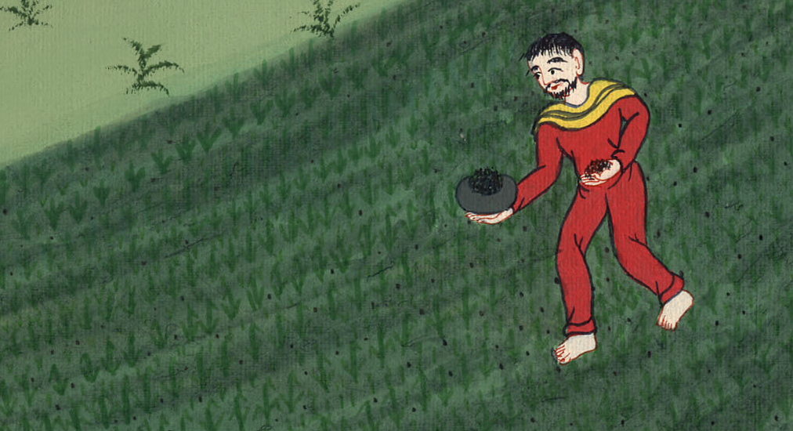
Matthew 13:39

Slide 27
40As therefore the darnel weeds are gathered up and burned with fire; so will it be at the end of this age.

Slide 28
Matthew 13:40

Slide 29
41The Son of Man will send out his angels, and they will gather out of his Kingdom all things that cause stumbling and those who do iniquity,

Slide 30
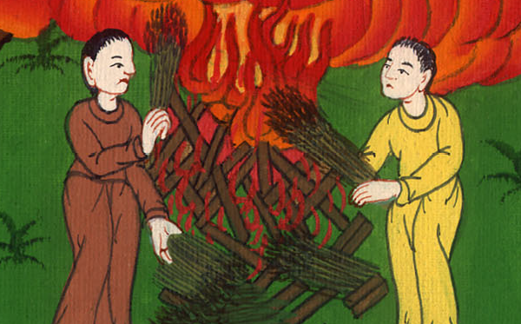
Matthew 13:41

Slide 31
42and will cast them into the furnace of fire. There will be weeping and gnashing of teeth.

Slide 32
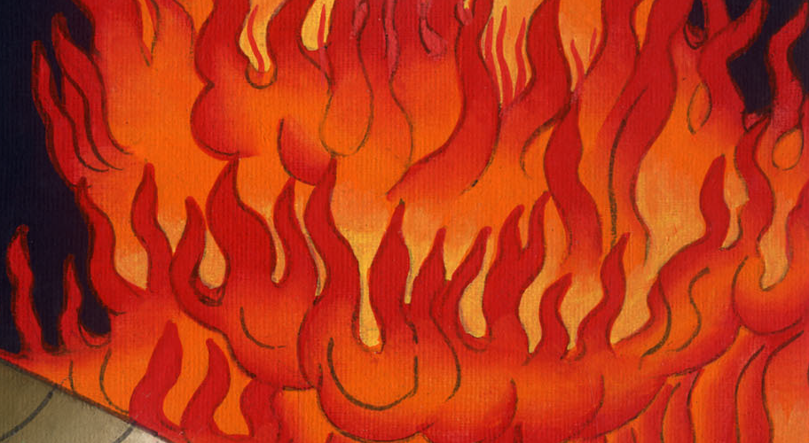
Matthew 13:42

Slide 33
43Then the righteous will shine like the sun in the Kingdom of their Father.

Slide 34
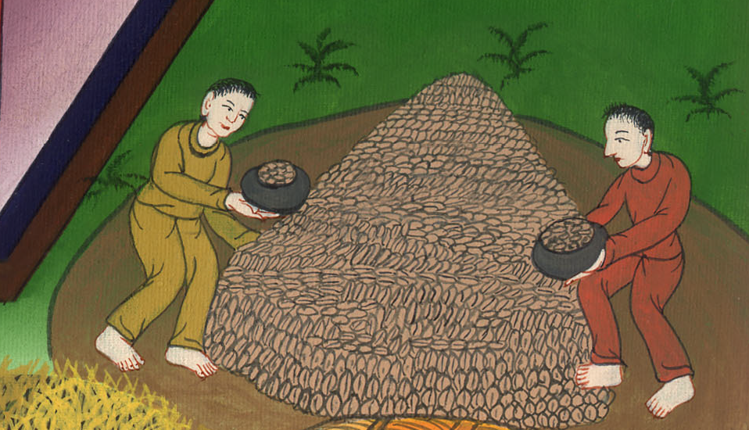
Matthew 13:43

Slide 35
He who has ears to hear, let him hear.

Slide 36
Matthew 13:43

