Slide 1
62-4
This work is licensed under a Creative Commons Attribution-ShareAlike 4.0 International License.
Please add this statement to all the videos you create.
English Bible quotes are from the World English Bible US, which is in the public domain.
Notes:
Ch
P05 Kingdom Parables
1. The Wise and Foolish Builders - Luke 6:46-49 (Left Top)
2. The Rich Man and Lazarus Luke 16:19-31 (Right Top)
3. The Weeds - Matthew 13:24-30; 36-43 (Right Center)
4. The Hidden Treasure - Matt 13:44 (Center)
5. The Rich Fool - Luke 12:13-34 (Right Bottom)
6. The Ten Virgins - Matthew 25:1-13 (Left Bottom)
7. The Talents - Matthew 25:14-30 (Left Center)

Slide 2
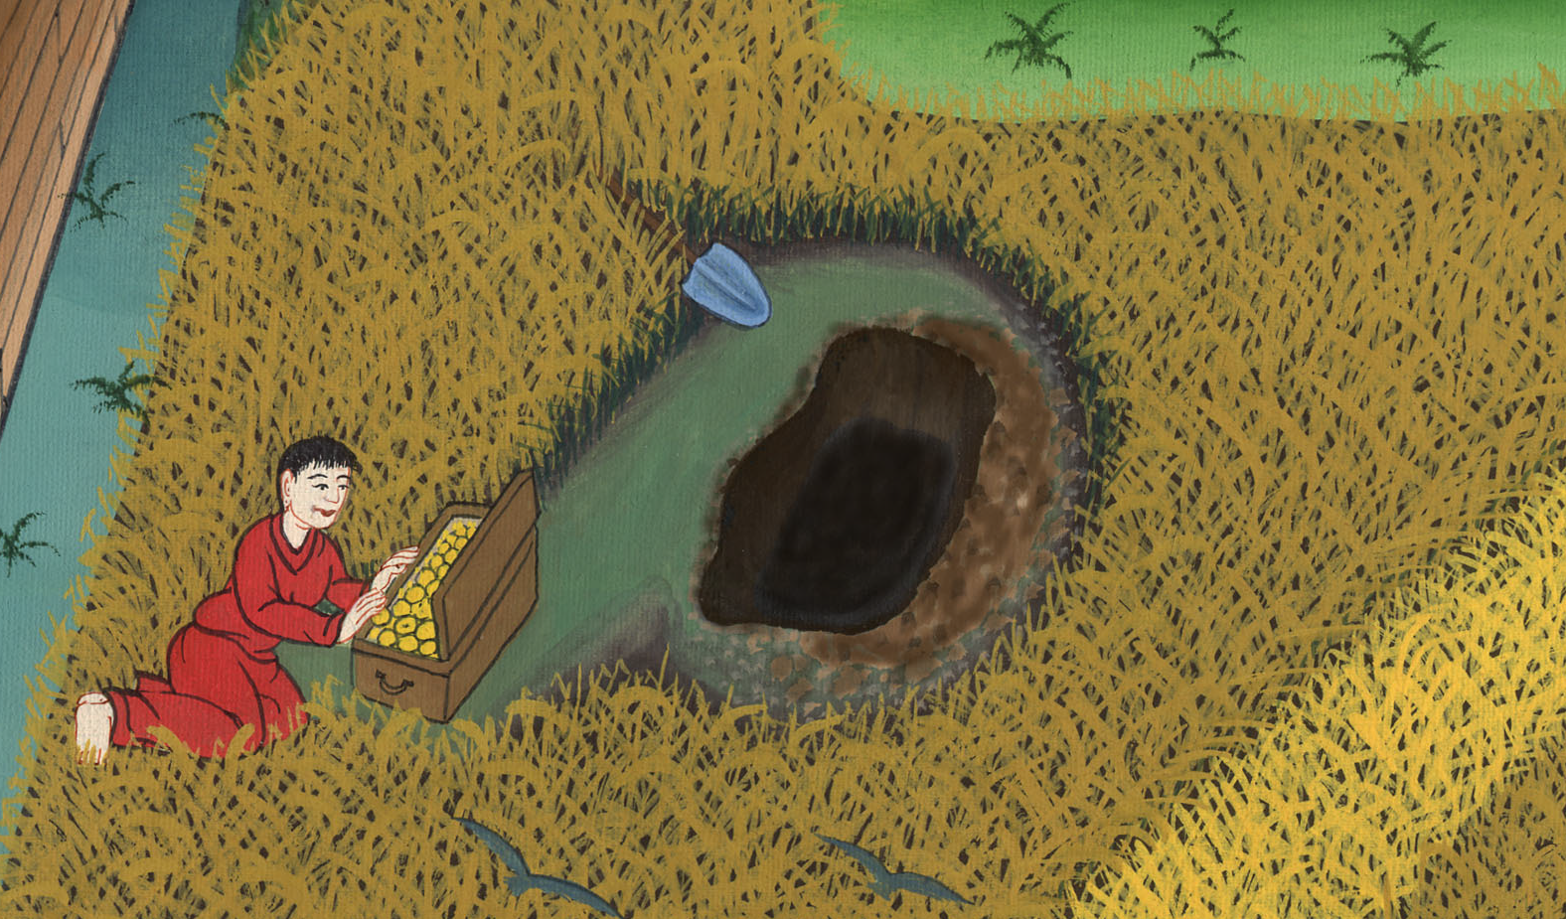
The Hidden Treasure - Matthew 13:44-46

Slide 3
The Hidden Treasure - Matthew 13:44-46

Slide 4
The Hidden Treasure - Matthew 13:44-46

Slide 5
44 “Again, the Kingdom of Heaven is like treasure hidden in the field,

Slide 6
Matthew 13:44

Slide 7
which a man found and hid.

Slide 8
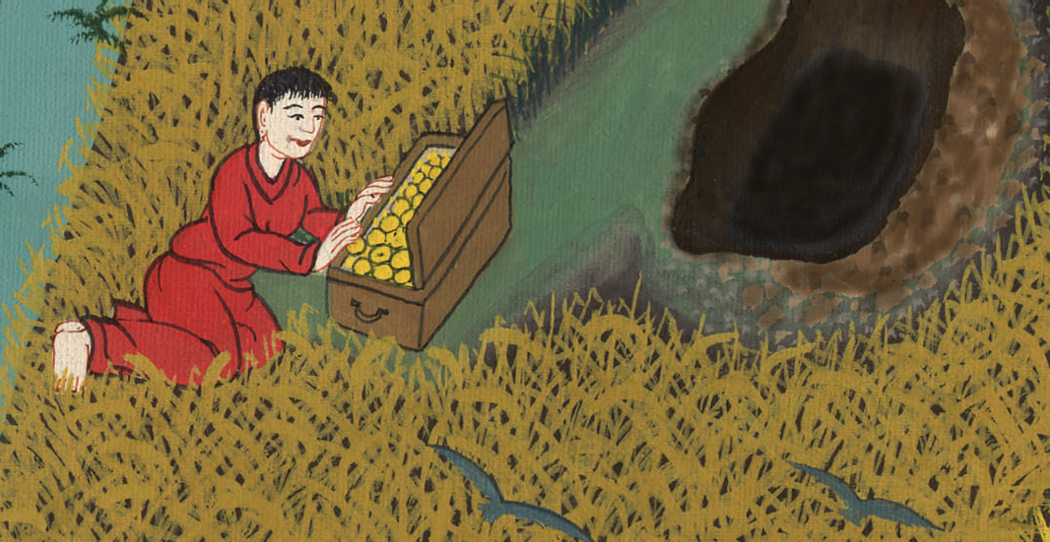
Matthew 13:44

Slide 9
In his joy, he goes and sells all that he has and buys that field.

Slide 10
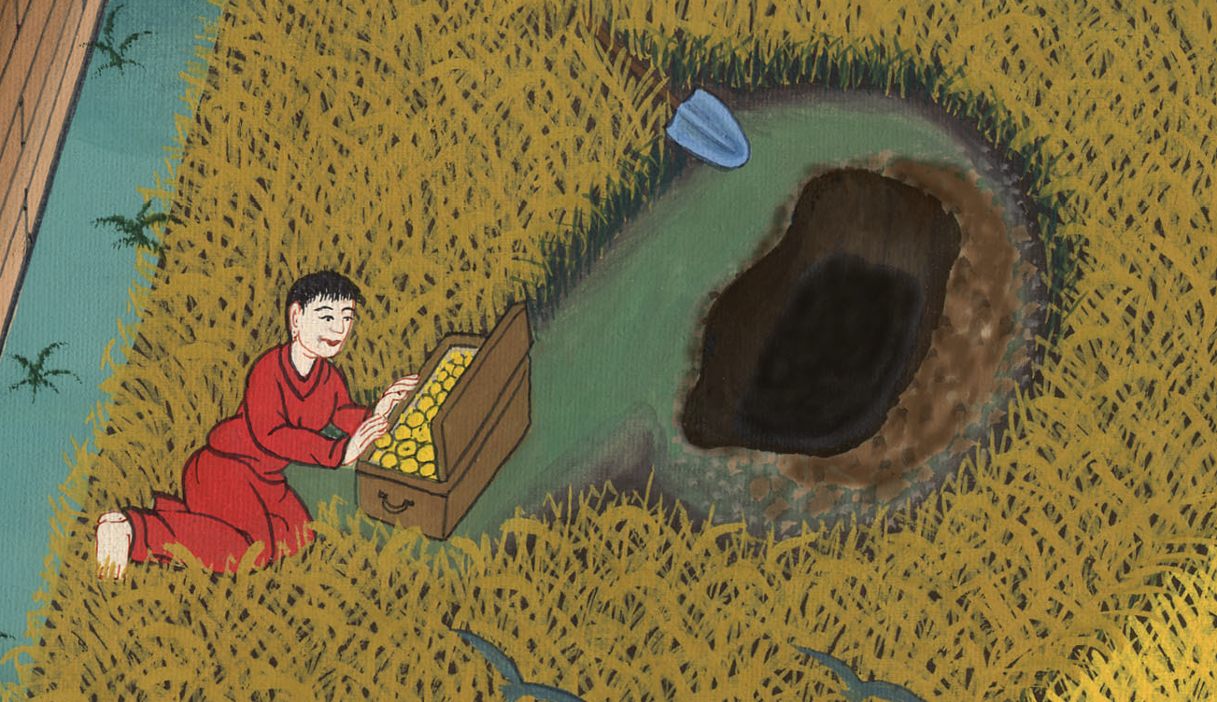
Matthew 13:44

Slide 11
45“Again, the Kingdom of Heaven is like a man who is a merchant seeking fine pearls,

Slide 12
Matthew 13:45

Slide 13
46who having found one pearl of great price, he went and sold all that he had and bought it.

Slide 14
Matthew 13:46

