Slide 1
62-5
This work is licensed under a Creative Commons Attribution-ShareAlike 4.0 International License.
Please add this statement to all the videos you create.
English Bible quotes are from the World English Bible US, which is in the public domain.
Notes:
Ch
P05 Kingdom Parables
1. The Wise and Foolish Builders - Luke 6:46-49 (Left Top)
2. The Rich Man and Lazarus Luke 16:19-31 (Right Top)
3. The Weeds - Matthew 13:24-30; 36-43 (Right Center)
4. The Hidden Treasure - Matt 13:44 (Center)
5. The Rich Fool - Luke 12:13-34 (Right Bottom)
6. The Ten Virgins - Matthew 25:1-13 (Left Bottom)
7. The Talents - Matthew 25:14-30 (Left Center)

Slide 2
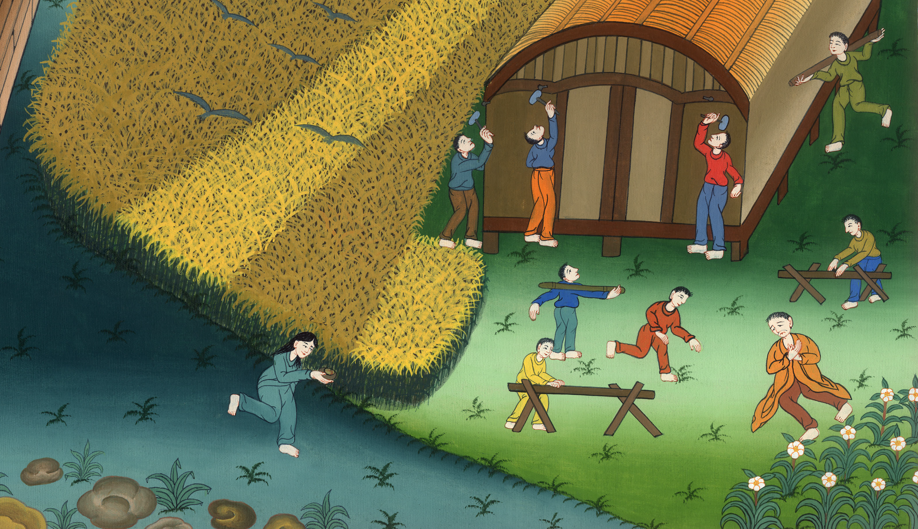
The Rich Fool - Luke 12:13-34

Slide 3
The Rich Fool - Luke 12:13-34

Slide 4
The Rich Fool - Luke 12:13-34

Slide 5
¹³ One of the multitude said to him, “Teacher, tell my brother to divide the inheritance with me.”

Slide 6
Luke 12:13

Slide 7
¹⁴ But he said to him, “Man, who made me a judge or an arbitrator over you?”

Slide 8
Luke 12:14

Slide 9
¹⁵ He said to them, “Beware! Keep yourselves from covetousness, for a man’s life doesn’t consist of the abundance of the things which he possesses.”

Slide 10
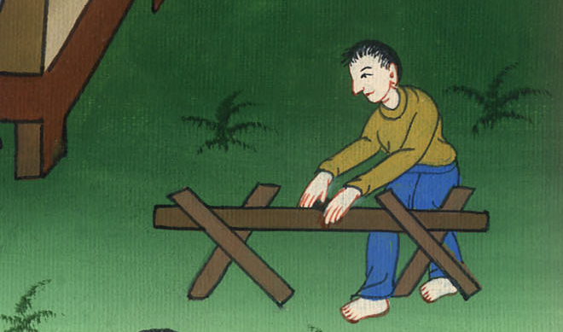
Luke 12:15

Slide 11
¹⁶ He spoke a parable to them, saying, “The ground of a certain rich man produced abundantly.

Slide 12
Luke 12:16

Slide 13
¹⁷ He reasoned within himself, saying, ‘What will I do, because I don’t have room to store my crops?’

Slide 14
Luke 12:17

Slide 15
¹⁸ He said, ‘This is what I will do. I will pull down my barns, build bigger ones, and there I will store all my grain and my goods.

Slide 16
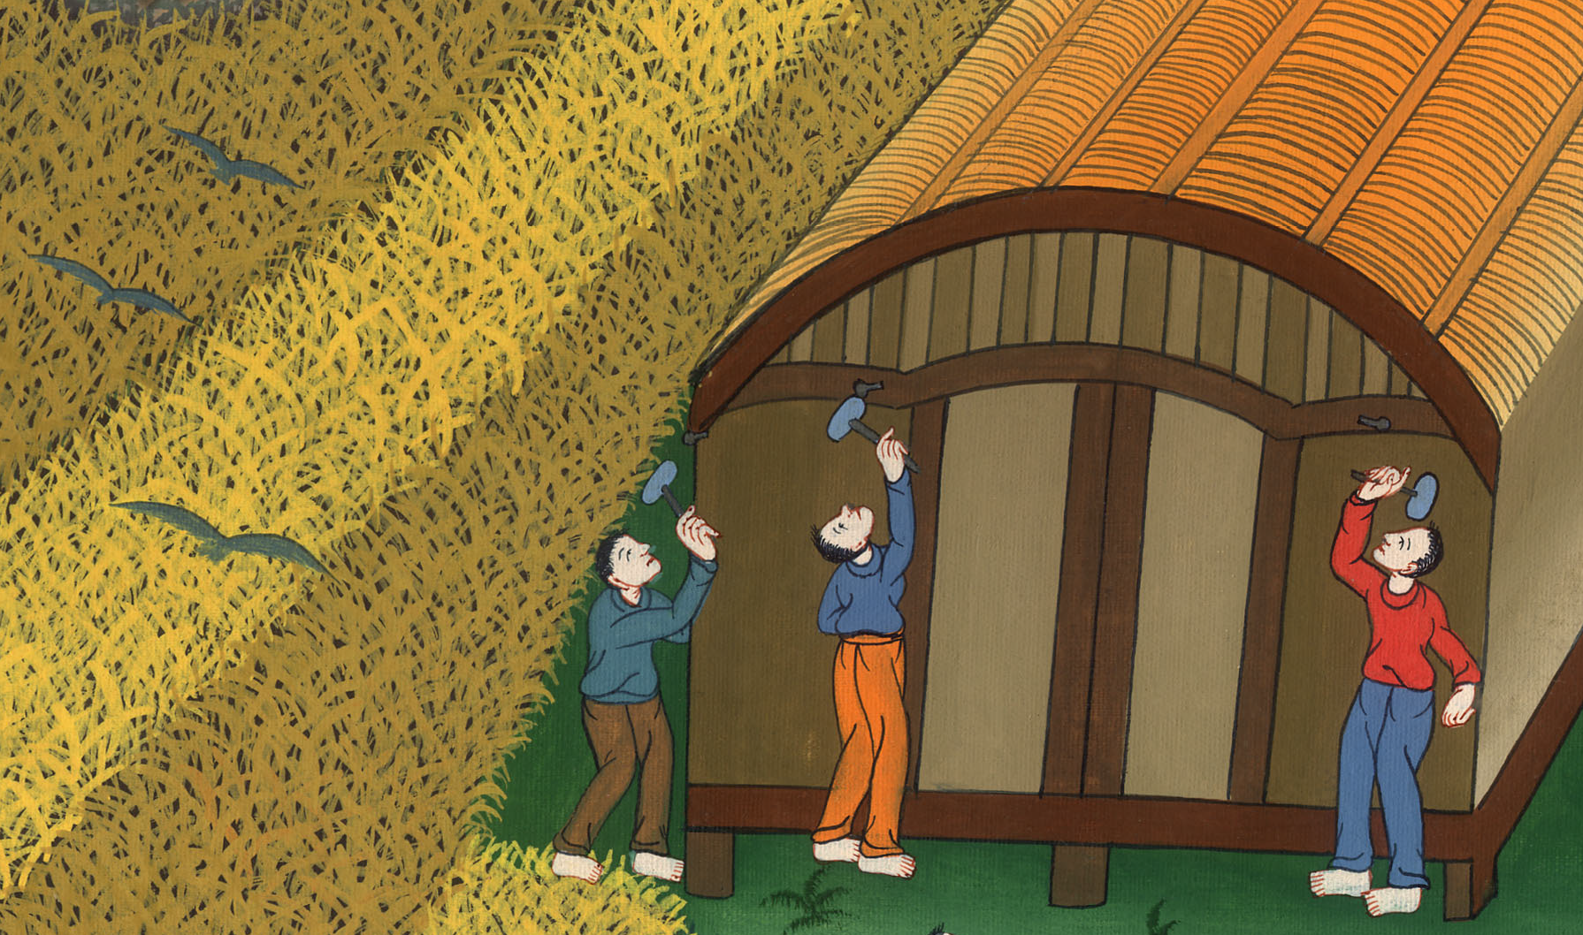
Luke 12:18

Slide 17
¹⁹ I will tell my soul, “Soul, you have many goods laid up for many years. Take your ease, eat, drink, and be merry.”’

Slide 18
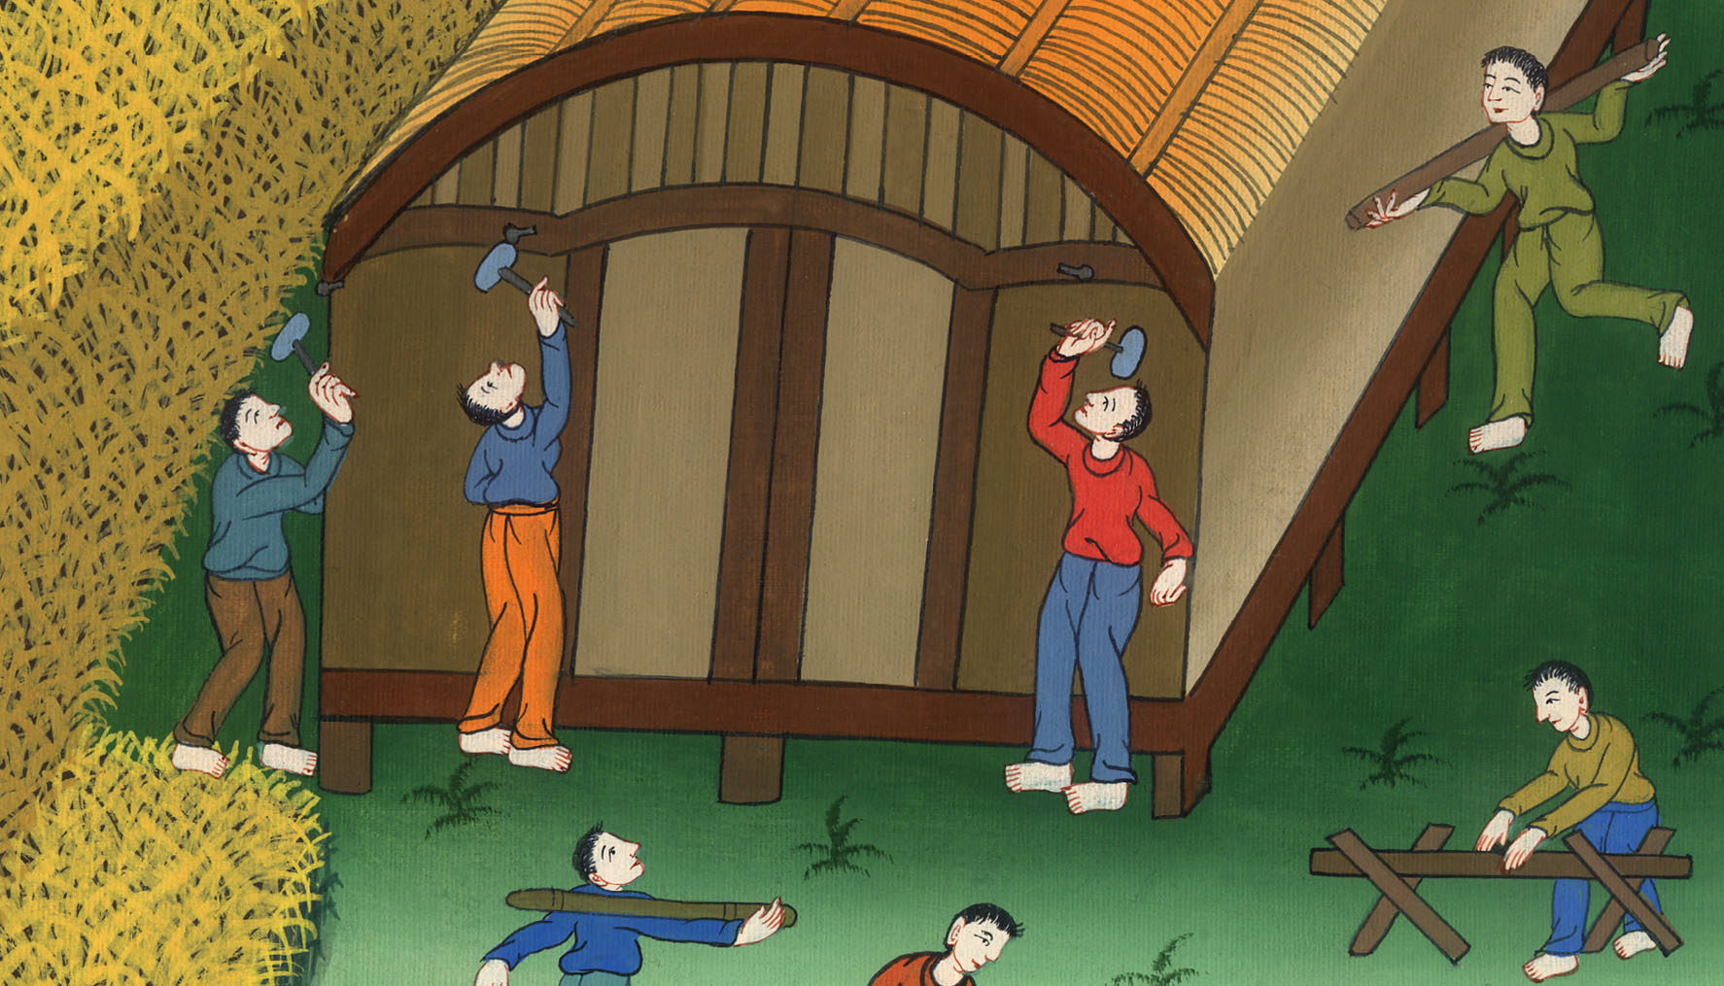
Luke 12:19

Slide 19
²⁰ “But God said to him, ‘You foolish one, tonight your soul is required of you. The things which you have prepared—whose will they be?’

Slide 20
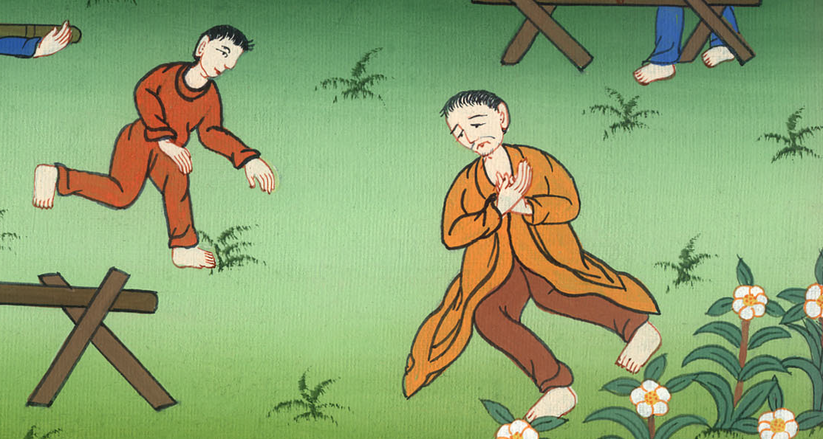
Luke 12:20

Slide 21
²¹ So is he who lays up treasure for himself, and is not rich toward God.”

Slide 22
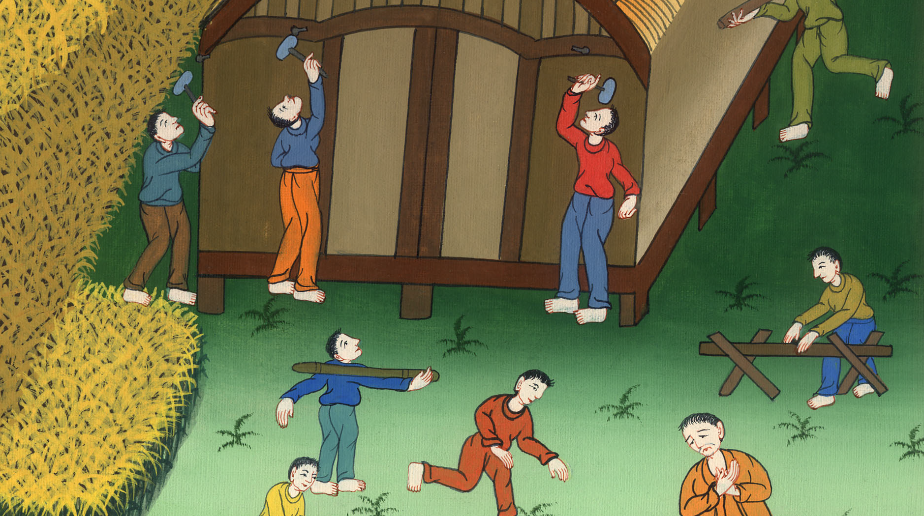
Luke 12:21

Slide 23
²² He said to his disciples, “Therefore I tell you, don’t be anxious for your life, what you will eat, nor yet for your body, what you will wear.

Slide 24
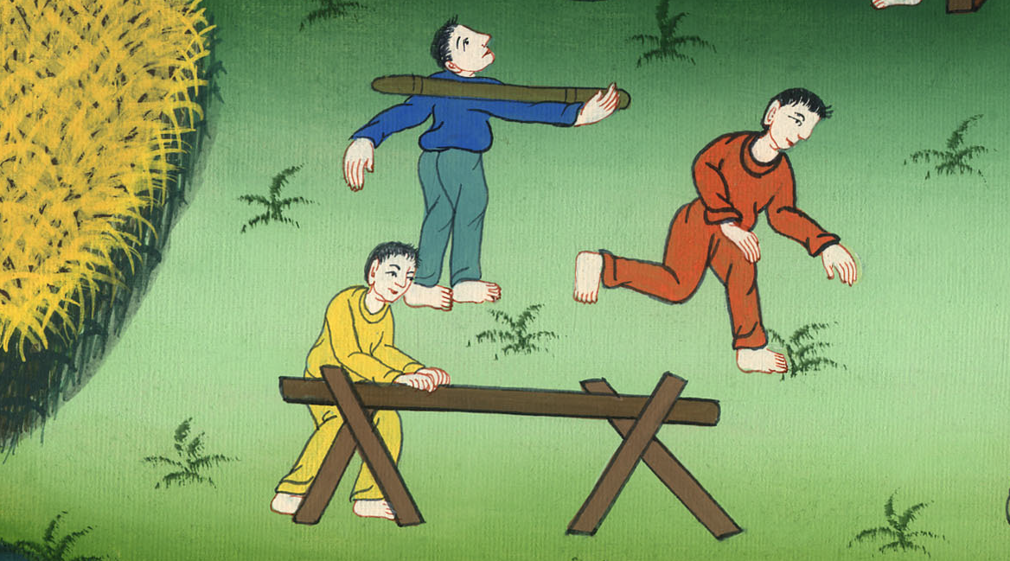
Luke 12:22

Slide 25
²³ Life is more than food, and the body is more than clothing.

Slide 26
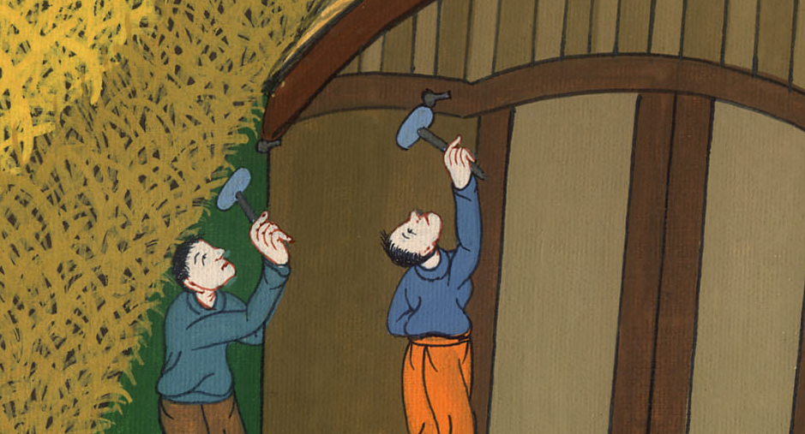
Luke 12:23

Slide 27
²⁴ Consider the ravens: they don’t sow, they don’t reap, they have no warehouse or barn, and God feeds them. How much more valuable are you than birds!

Slide 28
Luke 12:24

Slide 29
²⁵ Which of you by being anxious can add a cubit to his height?

Slide 30
Luke 12:25

Slide 31
²⁶ If then you aren’t able to do even the least things, why are you anxious about the rest?

Slide 32
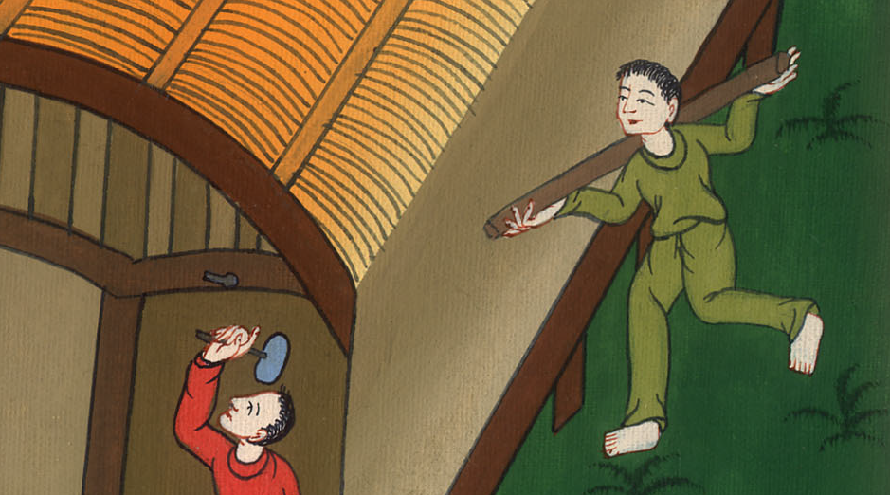
Luke 12:26

Slide 33
²⁷ Consider the lilies, how they grow. They don’t toil, neither do they spin;

Slide 34
Luke 12:27

Slide 35
yet I tell you, even Solomon in all his glory was not arrayed like one of these.

Slide 36
Luke 12:27

Slide 37
²⁸ But if this is how God clothes the grass in the field, which today exists and tomorrow is cast into the oven, how much more will he clothe you, O you of little faith?

Slide 38
Luke 12:28

Slide 39
²⁹ “Don’t seek what you will eat or what you will drink; neither be anxious.

Slide 40
Luke 12:29

Slide 41
³⁰ For the nations of the world seek after all of these things, but your Father knows that you need these things.

Slide 42
Luke 12:30

Slide 43
³¹ But seek God’s Kingdom, and all these things will be added to you.

Slide 44
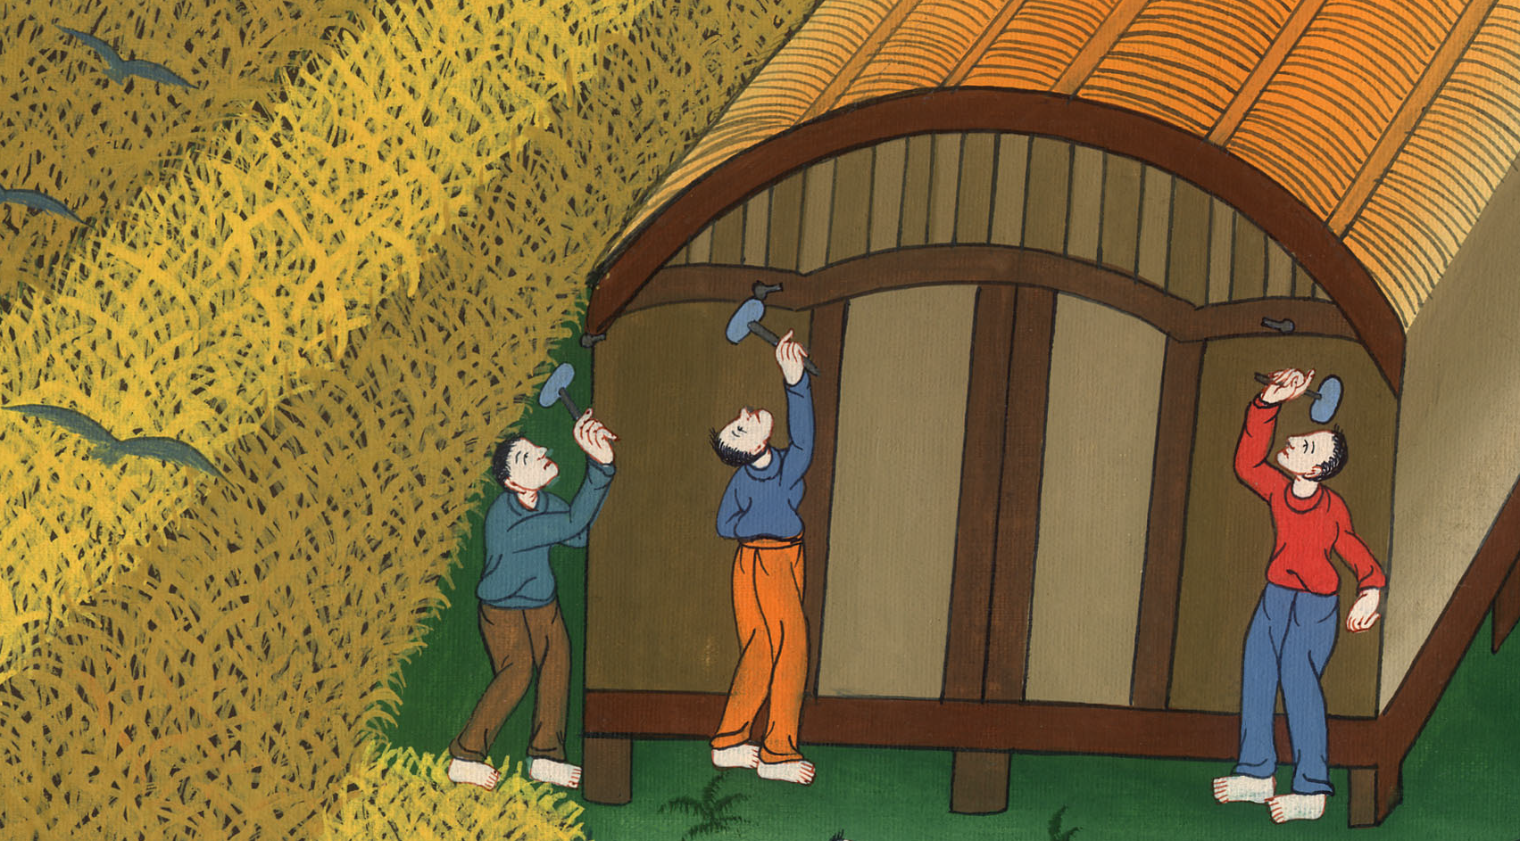
Luke 12:31

Slide 45
³² “Don’t be afraid, little flock, for it is your Father’s good pleasure to give you the Kingdom.

Slide 46
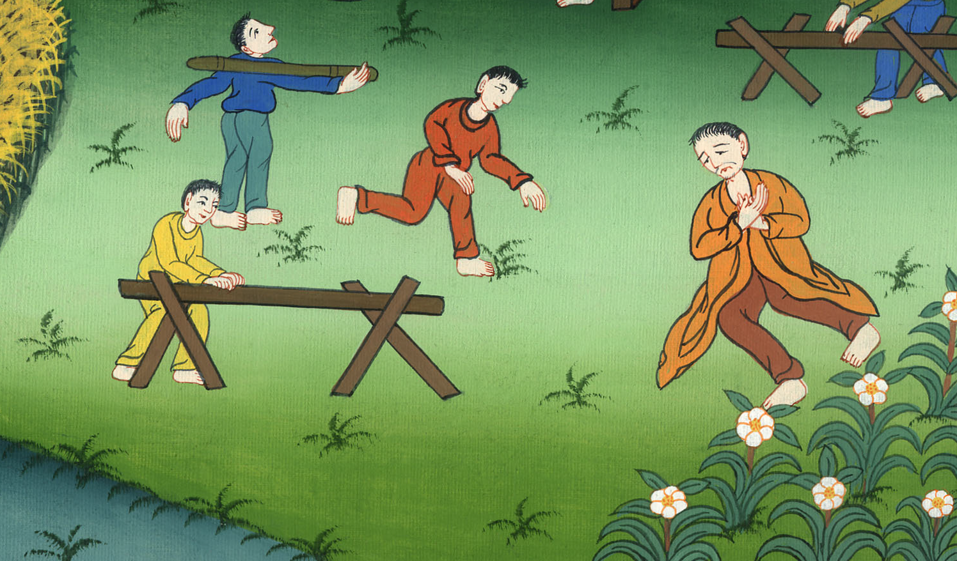
Luke 12:32

Slide 47
³³ Sell what you have and give gifts to the needy. Make for yourselves purses which don’t grow old

Slide 48
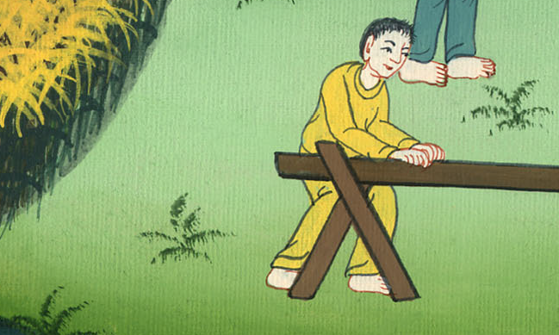
Luke 12:33

Slide 49
Make a treasure in the heavens that doesn’t fail, where no thief approaches and no moth destroys.

Slide 50
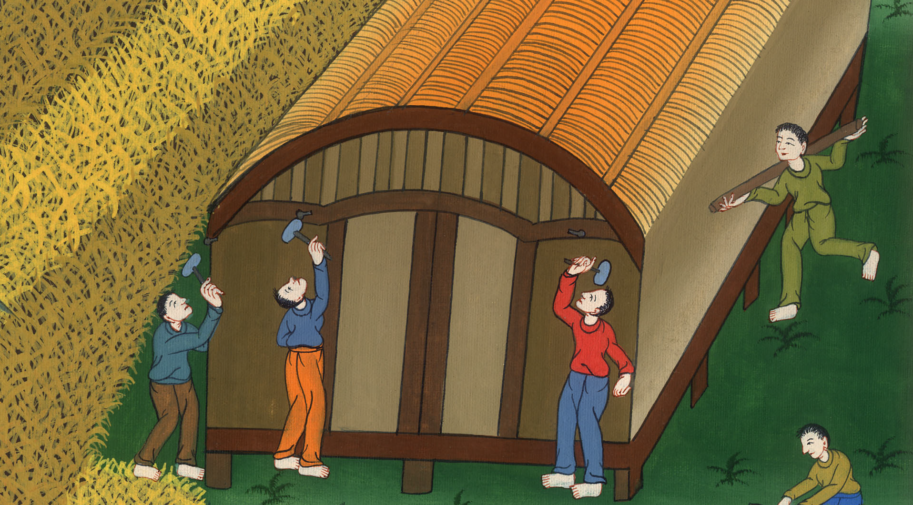
Luke 12:33

Slide 51
³⁴ For where your treasure is, there will your heart be also.

Slide 52
Luke 312:34

